Slide 1
kGEM: an EM Error Correction Algorithm for NGS Amplicon-based Data
ISBRA 2013
Alexander Artyomenko

Slide 2
Introduction
Reconstructing spectrum of viral population
Challenges:
Assembling short reads to span entire genome
Distinguishing sequencing errors from mutations
Avoid assembling:
ID sequences via high variability region
Notes:
Reconstructing spectrum of viral population is very reasonable task for epidemiology.
Limitations of sequencing technology do not allow to read the entire coding region and assembling short reads is a big challenge.
But sequencing errors cause another challenge for that problem.

Slide 3
Previous Work
KEC (k-mer Error Correction) [Skums et al.]
Incorporates counts (frequencies) of k-mers (substrings of length k)
QuasiRecomb (Quasispecies Recombination) [Töpfer et. al]
Hidden Markov Model-based approach
Incorporates possibility for recombinant progeny
Parameter: k generators (ancestor haplotypes)

Slide 4
Problem Formulation
Given: a set of reads R emitted by a set of unknown haplotypes H’
Find: a set of haplotypes H={H₁,…,H_{k}} maximizing Pr(R|H)

Slide 5
Fractional Haplotype
Fractional Haplotype: a string of 5-tuples of probabilities for each possible symbol: a, c, t, g, d=‘-’
a c - t c t g c
a | 0.71 | 0.06 | 0.0 | 0.13 | 0.0 | 0.27 | 0.10 | 0.03
c | 0.13 | 0.94 | 0.0 | 0.0 | 0.64 | 0.0 | 0.14 | 0.58
t | 0.16 | 0.0 | 0.01 | 0.87 | 0.11 | 0.73 | 0.0 | 0.09
g | 0.0 | 0.0 | 0.21 | 0.0 | 0.25 | 0.0 | 0.76 | 0.09
d | 0.0 | 0.0 | 0.78 | 0.0 | 0.0 | 0.0 | 0.0 | 0.21

Slide 6
kGEM
Initialize (fractional) Haplotypes
Repeat until Haplotypes are unchanged
Estimate Pr(r|H_{i}) probability of a read r being emitted by haplotype H_{i}
Estimate frequencies of Haplotypes
Update and Round Haplotypes
Collapse Identical and Drop Rare Haplotypes
Output Haplotypes

Slide 7
Initialization
Find set of reads representing haplotype population
Start with a random read
Each next read maximizes minimum distance to previously chosen
4
1
3
2

Slide 8
Initialization
Transform selected reads into fractional haplotypes using formula:
where s_{m} is i-th nucleotide of selected read s.
a c - t g - g a - c ε=0.01
$$f_{i,m}\left(e\right)=\left\{\begin{aligned}1−4ε ,if s_{m}=e \\ ε ,otherwise\end{aligned}\right.$$
a | 0.96 | 0.01 | 0.01 | 0.01 | 0.01 | 0.01 | 0.01 | 0.96 | 0.01 | 0.01
c | 0.01 | 0.96 | 0.01 | 0.01 | 0.01 | 0.01 | 0.01 | 0.01 | 0.01 | 0.96
t | 0.01 | 0.01 | 0.01 | 0.96 | 0.01 | 0.01 | 0.01 | 0.01 | 0.01 | 0.01
g | 0.01 | 0.01 | 0.01 | 0.01 | 0.96 | 0.01 | 0.96 | 0.01 | 0.01 | 0.01
d | 0.01 | 0.01 | 0.96 | 0.01 | 0.01 | 0.96 | 0.01 | 0.01 | 0.96 | 0.01

Slide 9
Read Emission Probability
Reads
Haplotypes
For each i=1, … , k and for each read r_{j} from R compute value:
1
h_{1,1}
h_{1,2}
1
h_{2,1}
${\operatorname{Pr}\left(r_{j} | H_{i}\right)=h}_{i,j}$ =
$$=\prod_{m=start(r)}^{end(r)}{\frac{f_{i,m}(r_{m})}{\sum_{e∈A}{f_{i,m}^{2}(e)}}}$$
2
h_{3,1}
h_{2,2}
2
3
h_{3,2}

Slide 10
Estimate Frequencies
Estimate haplotype frequencies via Expectation Maximization (EM) method
Repeat two steps until the change < σ
E-step: expected portion of r emitted by H_{i}
M-step: updated frequency of haplotype H_{i}
$$e_{i,r}=o_{r}∙\frac{f_{i}^{}∙h_{i,r}}{\sum_{i^{′}=1}^{k}{f_{i′}^{}}∙h_{i^{′},r}}$$
$$f_{i}^{next}=\frac{\sum_{r∈R}{e_{i,r}}}{\sum_{i^{′}=1}^{k}{\sum_{r∈R}{e_{i^{′},r}}}}$$

Slide 11
Update Haplotypes
Update allele frequencies for each haplotype according to read’s contribution:
$$f_{i,m}\left(e\right)=\frac{\sum_{r∈R:r_{m}=e}{p_{i,r}}}{\sum_{r∈R:begin\left(r\right)≤m≤end(r)}{p_{i,r}}}$$
a | 0.71 | 0.06 | 0.0 | 0.13 | 0.0 | 0.27 |  | … |  | 0.10 | 0.03
c | 0.13 | 0.94 | 0.0 | 0.0 | 0.64 | 0.0 |  |  |  | 0.14 | 0.58
t | 0.16 | 0.0 | 0.01 | 0.87 | 0.11 | 0.73 |  |  |  | 0.0 | 0.09
g | 0.0 | 0.0 | 0.21 | 0.0 | 0.25 | 0.0 |  |  |  | 0.76 | 0.09
d | 0.0 | 0.0 | 0.78 | 0.0 | 0.0 | 0.0 |  |  |  | 0.0 | 0.21

Slide 12
Round Haplotypes
Round each haplotype’s position to most probable allele
$$f_{i,m}\left(e\right)=\left\{\begin{aligned}1−4ε ,if e=\arg{\max_{e^{′}∈A}{f_{i,m}(e′)}} \\ ε ,otherwise \end{aligned}\right.$$
a | c | - | t | a | c | t |  |  |  | g | c
a | 0.76 | 0.0 | 0.01 | 0.06 | 0.77 | 0.0 | 0.29 |  | … |  | 0.14 | 0.09
c | 0.11 | 0.89 | 0.01 | 0.01 | 0.23 | 0.68 | 0.0 |  |  |  | 0.06 | 0.50
t | 0.13 | 0.0 | 0.11 | 0.93 | 0.0 | 0.14 | 0.71 |  |  |  | 0.0 | 0.04
g | 0.01 | 0.0 | 0.21 | 0.0 | 0.0 | 0.18 | 0.0 |  |  |  | 0.80 | 0.23
d | 0.01 | 0.11 | 0.68 | 0.0 | 0.0 | 0.0 | 0.0 |  |  |  | 0.0 | 0.14
a | 0.76 | 0.0 | 0.01 | 0.06 | 0.77 | 0.0 | 0.29 |  | … |  | 0.14 | 0.09
c | 0.11 | 0.89 | 0.01 | 0.01 | 0.23 | 0.68 | 0.0 |  |  |  | 0.06 | 0.50
t | 0.13 | 0.0 | 0.11 | 0.93 | 0.0 | 0.14 | 0.71 |  |  |  | 0.0 | 0.04
g | 0.01 | 0.0 | 0.21 | 0.0 | 0.0 | 0.18 | 0.0 |  |  |  | 0.80 | 0.23
d | 0.01 | 0.11 | 0.68 | 0.0 | 0.0 | 0.0 | 0.0 |  |  |  | 0.0 | 0.14
a | 0.76 | 0.0 | 0.01 | 0.06 | 0.77 | 0.0 | 0.29 |  | … |  | 0.14 | 0.09
c | 0.11 | 0.89 | 0.01 | 0.01 | 0.23 | 0.68 | 0.0 |  |  |  | 0.06 | 0.50
t | 0.13 | 0.0 | 0.11 | 0.93 | 0.0 | 0.14 | 0.71 |  |  |  | 0.0 | 0.04
g | 0.01 | 0.0 | 0.21 | 0.0 | 0.0 | 0.18 | 0.0 |  |  |  | 0.80 | 0.23
d | 0.01 | 0.11 | 0.68 | 0.0 | 0.0 | 0.0 | 0.0 |  |  |  | 0.0 | 0.14
a | 0.76 | 0.0 | 0.01 | 0.06 | 0.77 | 0.0 | 0.29 |  | … |  | 0.14 | 0.09
c | 0.11 | 0.89 | 0.01 | 0.01 | 0.23 | 0.68 | 0.0 |  |  |  | 0.06 | 0.50
t | 0.13 | 0.0 | 0.11 | 0.93 | 0.0 | 0.14 | 0.71 |  |  |  | 0.0 | 0.04
g | 0.01 | 0.0 | 0.21 | 0.0 | 0.0 | 0.18 | 0.0 |  |  |  | 0.80 | 0.23
d | 0.01 | 0.11 | 0.68 | 0.0 | 0.0 | 0.0 | 0.0 |  |  |  | 0.0 | 0.14
a | 0.96 | 0.01 | 0.01 | 0.01 | 0.96 | 0.01 | 0.01 |  | … |  | 0.01 | 0.01
c | 0.01 | 0.96 | 0.01 | 0.01 | 0.01 | 0.96 | 0.01 |  |  |  | 0.01 | 0.96
t | 0.01 | 0.01 | 0.01 | 0.96 | 0.01 | 0.01 | 0.96 |  |  |  | 0.01 | 0.01
g | 0.01 | 0.01 | 0.01 | 0.01 | 0.01 | 0.01 | 0.01 |  |  |  | 0.96 | 0.01
d | 0.01 | 0.01 | 0.96 | 0.01 | 0.01 | 0.01 | 0.01 |  |  |  | 0.01 | 0.01

Slide 13
Collapse and Drop Rare
Collapse haplotypes which have the same integral strings
Drop haplotypes with coverage ≤δ
Empirically, δ<5 implies drop in PPV without improving sensitivity

Slide 14
kGEM
Initialize (fractional) Haplotypes
Repeat until Haplotypes are unchanged
Estimate Pr(r|H_{i}) probability of a read r being emitted by haplotype H_{i}
Estimate frequencies of Haplotypes
Update and Round Haplotypes
Collapse Identical and Drop Rare Haplotypes
Output Haplotypes

Slide 15
Experimental Setup
HCV E1E2 sub-region (315bp)
20 simulated data sets of 10 variants
100,000 reads from Grinder 0.5
10 datasets with homo-polymer errors
Frequency distribution: uniform and power-law model with parameter α= 2.0

Slide 16
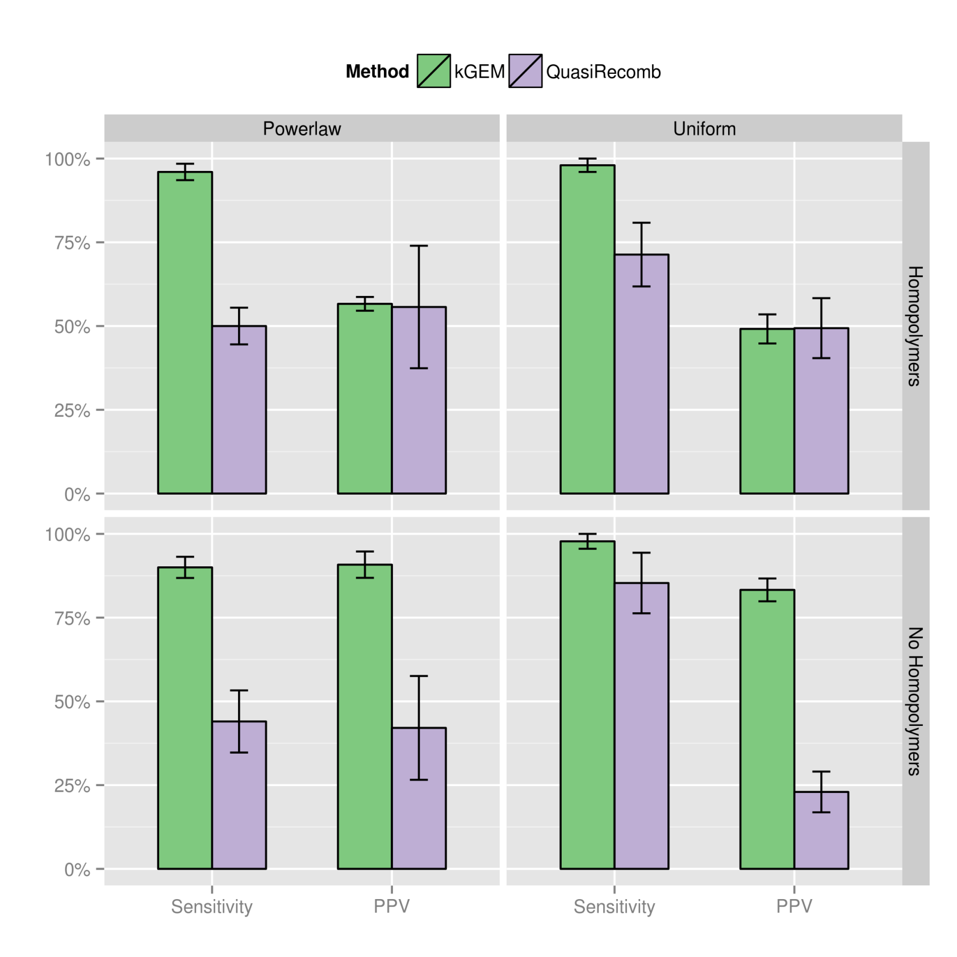

Slide 17
Acknowledgements
Nicholas Mancuso Alex Zelikovsky
Ion Măndoiu
Pavel Skums

Slide 18
Thank you!
Questions?

