Slide 1
StringBio 2018
Statistical Mitogenome Assembly with Repeats
Fahad Alqahtani & Ion Măndoiu
10-19-2018

Slide 2
Outline
Background and prior work
SMART pipeline
Results
Conclusions and future work

Slide 3
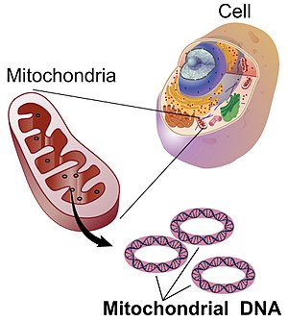
Mitochondria: the powerhouse of the cell
Cellular organelles within eukaryotic cells
Convert chemical energy from food into adenosine triphosphate (ATP)
The popular term "powerhouse of the cell" was coined by Philip Siekevitz in 1957

Slide 4
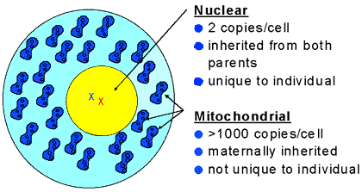
The second genome
Source:https://www.fbi.gov/about-us/lab/forensic-science-communications/fsc/july1999/dnalist.htm/dnaf1.htm

Slide 5
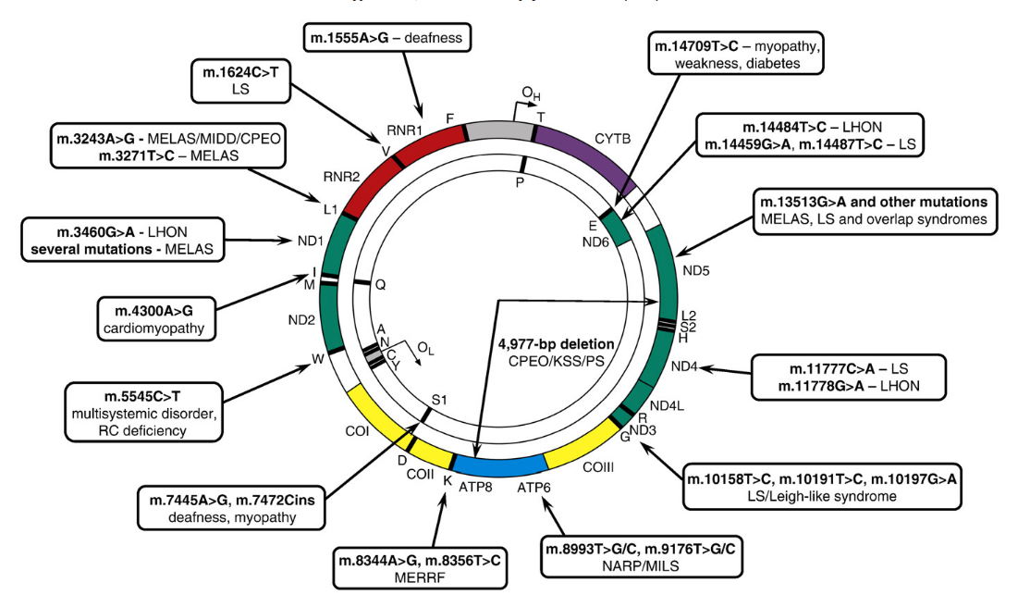
Why sequence the mitogenome?
Important role in disease
Tuppen, Helen AL, et al. "Mitochondrial DNA mutations and human disease." Biochimica et Biophysica Acta (BBA)-Bioenergetics 1797.2 (2010): 113-128.

Slide 6
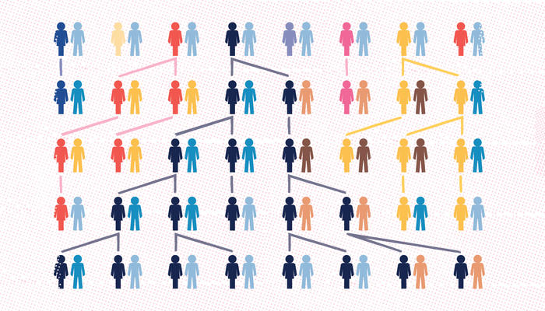
Why sequence the mitogenome?
Important role in disease
Tracing maternal ancestry
Source: http://www.norwaydna.no/mtdna_en/

Slide 7
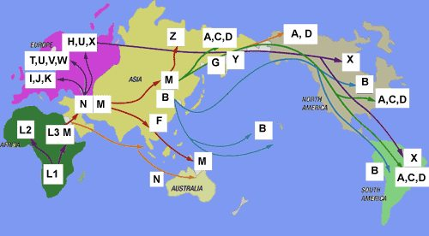
Why sequence the mitogenome?
Important role in disease
Tracing maternal ancestry
Inferring human population migrations
https://blog.23andme.com/ancestry/haplogroups-explained/

Slide 8
Why sequence the mitogenome?
Important role in disease
Tracing maternal ancestry
Inferring human population migrations
Species tree reconstruction
Kurabayashi, Atsushi, and Masayuki Sumida. "Afrobatrachian mitochondrial genomes: genome reorganization, gene rearrangement mechanisms,
and evolutionary trends of duplicated and rearranged genes." BMC genomics 14.1 (2013): 633.

Slide 9
Mitogenome assembly
Most existing pipelines rely on reference genome or mitogenome of related species
Off-the-shelf de novo assemblers poorly suited for assembling mtDNA from WGS reads
Mitochondrial reads often discarded due to much higher sequencing depth of mtDNA compared to gDNA
Do not handle well circular genomes & repeats

Slide 10
Prior work
Tool | Method | Input Requirements
MITOBim [Hahn at el 2013] | Reference-based assembly | Trimmed and interleaved reads, and a reference genome
 | De novo assembly | Trimmed and interleaved reads, and a seed sequence (coi gene)
NOVOPlasty [Dierckxsens at el 2017] | A seed-extend based assembler | Raw reads, insert size, read length, and a seed sequence (coi gene)
Norgal [Al-Nakeeb at el 2017] | De novo assembly | Raw reads

Slide 11
Outline
Background and prior work
SMART pipeline
Results
Conclusions and future work

Slide 12
SMART
Statistical Mitogenome Assembly with RepeaTs
Input:
Paired-end WGS reads
Seed sequence (COI gene)
Output:
Complete/circular mitogenome (or largest scaffold)

Slide 13
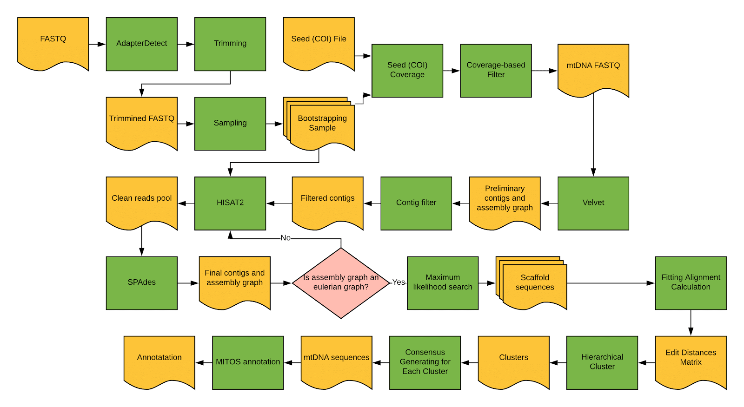
SMART workflow

Slide 14
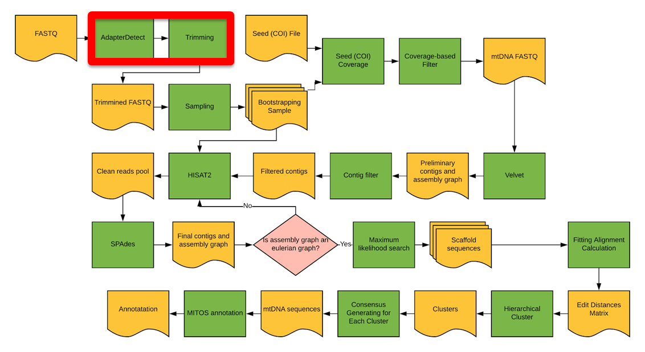
Adapter trimming
Automatic detection of adaptors and trimming using Perl/C++ modules from the IRFinder package
PE overlap allows very precise (single base resolution) adapter trimming
Middleton, Robert, et al. "IRFinder: assessing the impact of intron retention on mammalian gene expression." Genome biology 18.1 (2017): 51.

Slide 15
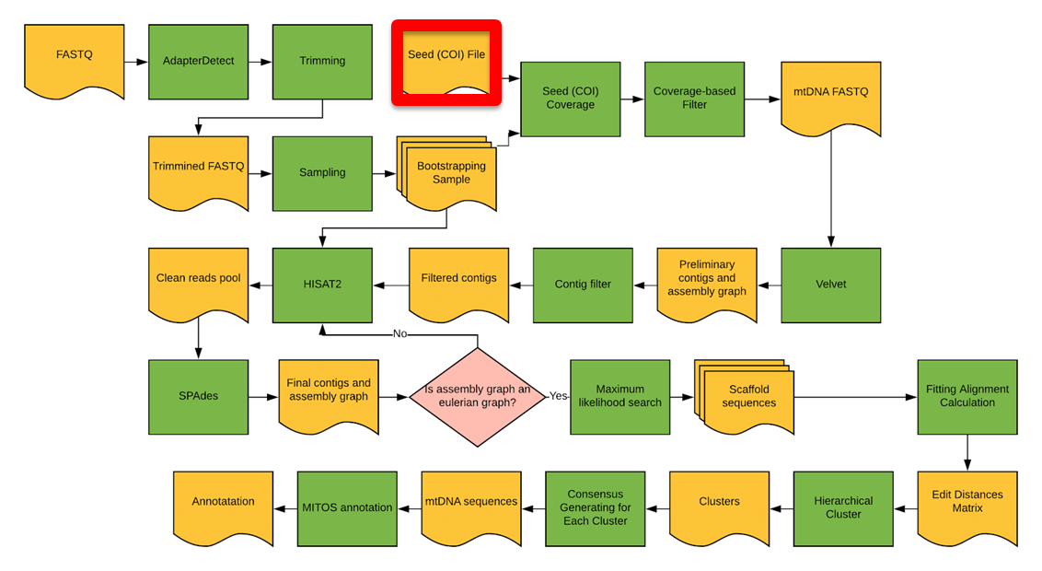
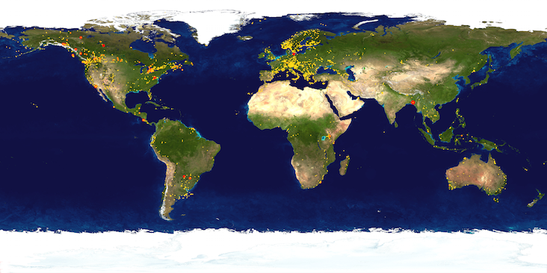
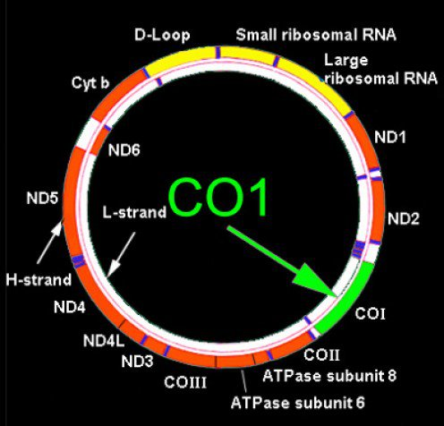
Seed (COI) sequences
A ~648bp region of Cytochrome c oxidase subunit 1 (COI) gene has been selected as a “DNA barcode” for taxonomic classification
Barcode of Life Datasystem (BOLD) has >6M barcodes from 194K animal species, 67K plant species, 21k fungi & other species
http://www.boldsystems.org/

Slide 16
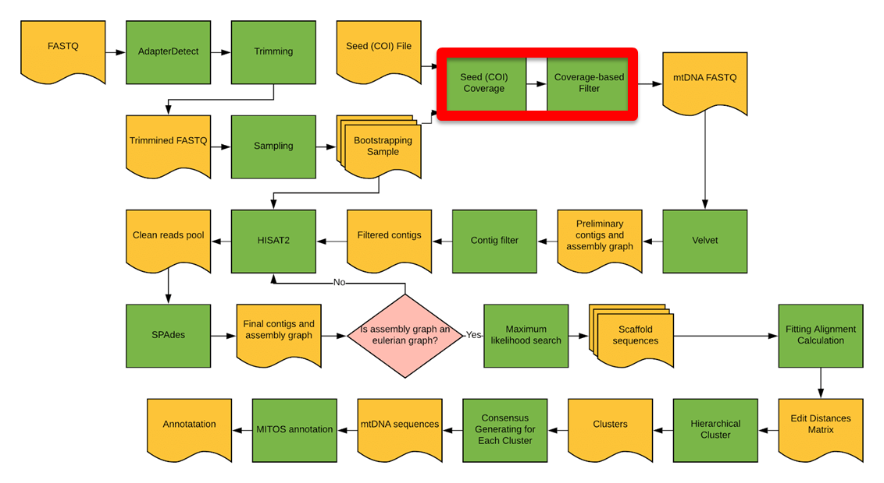
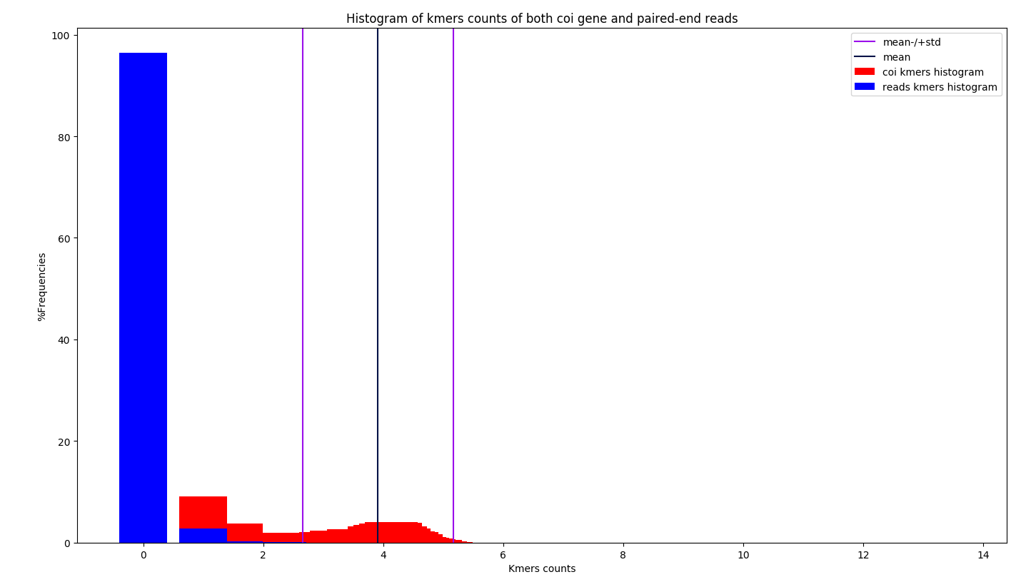
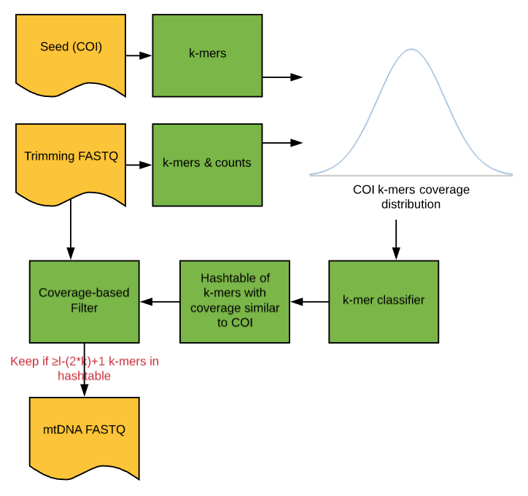
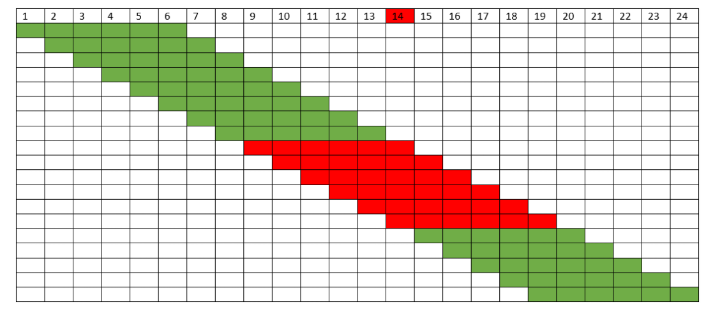
Coverage based filter
Reads with 1 error OK

Slide 17
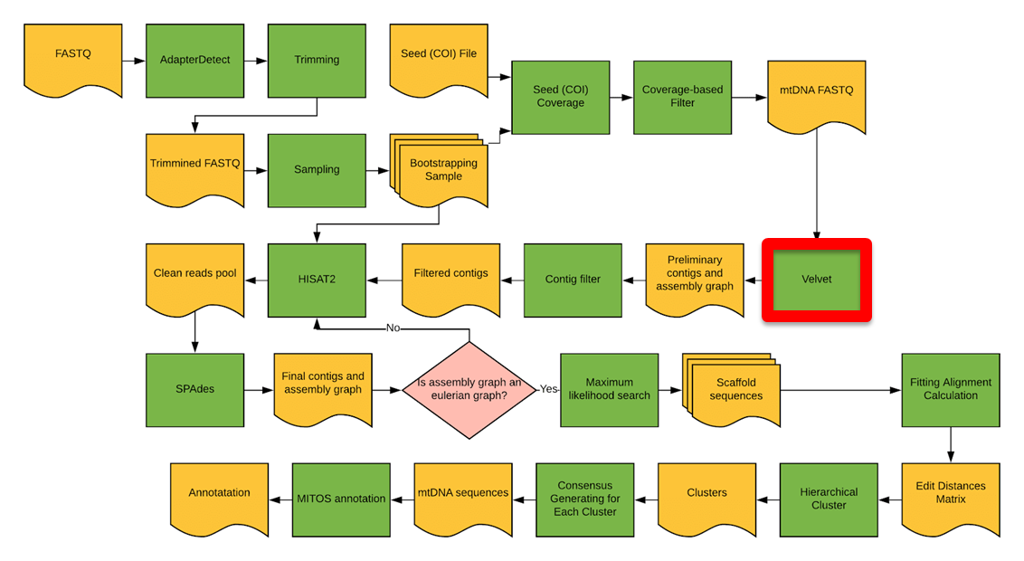
Preliminary assembly
Reads passing coverage filter assembled using Velvet
De Bruijn Graph assembler
https://en.wikipedia.org/wiki/Velvet_assembler

Slide 18
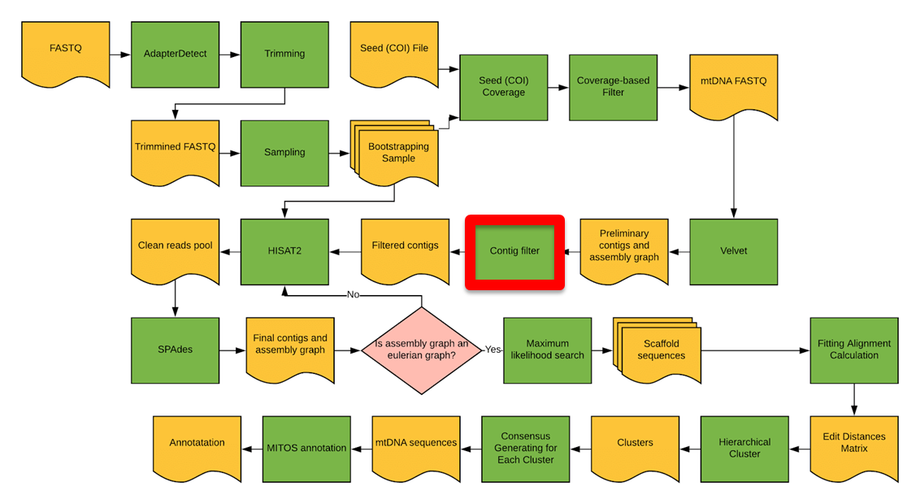
Preliminary contig filtering
Contigs aligned against eukaryotic mitogenomes using BLAST
Keep contigs with significant hits only

Slide 19
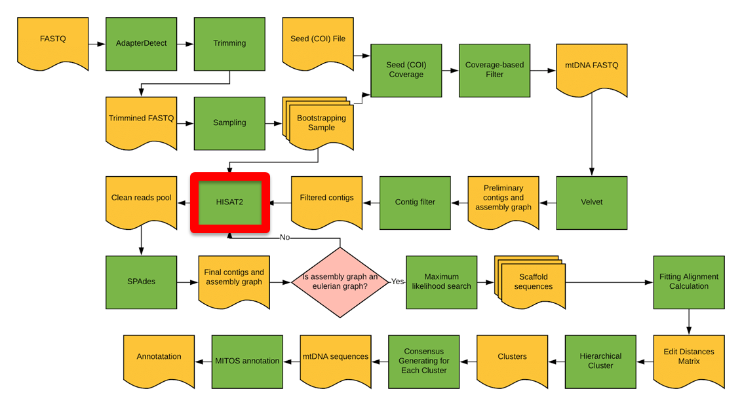
Read alignment
Using HISAT2
Fast and sensitive aligner for NGS reads
Pulls out additional mitochondrial reads missed by coverage filter

Slide 20
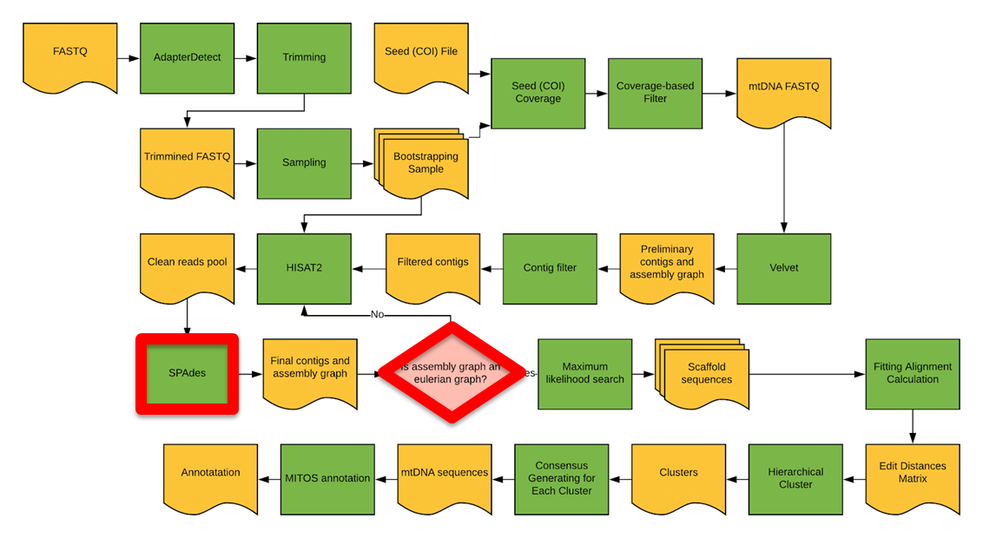
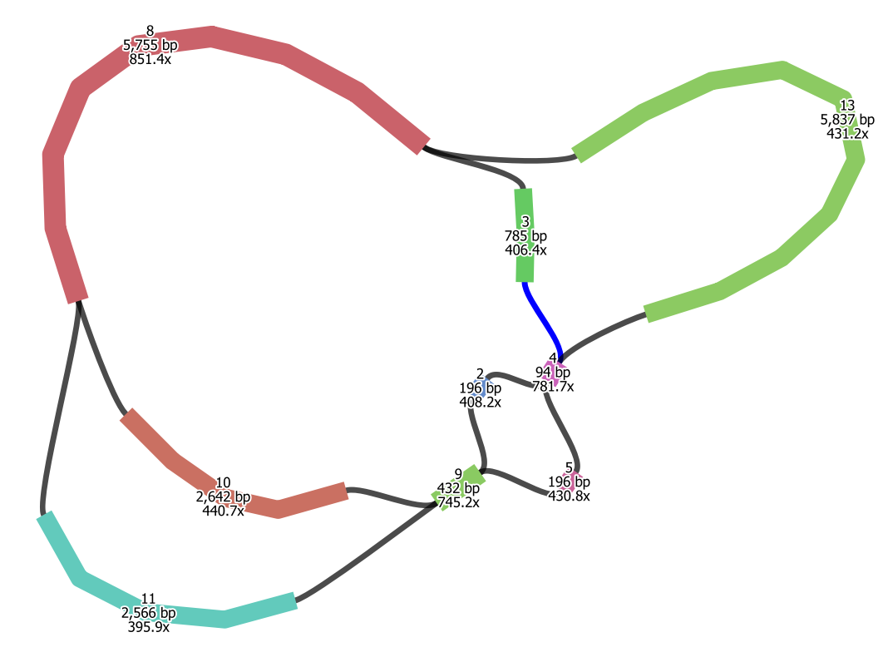
Secondary assembly
Using SPAdes
Based on multisized de Bruijn graph
Robust to non-uniformities in read coverage
Read alignment and SPAdes assembly repeated
Until simplified contig graph is Eulerian, or max iterations reached

Slide 21
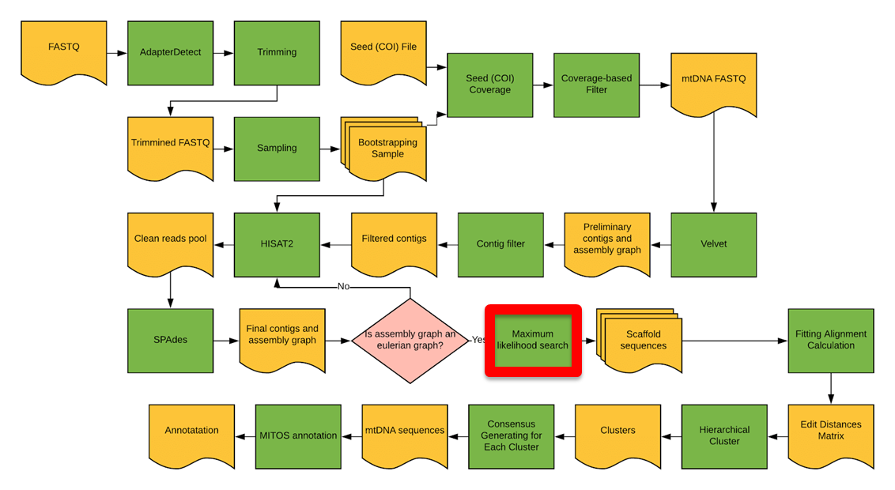
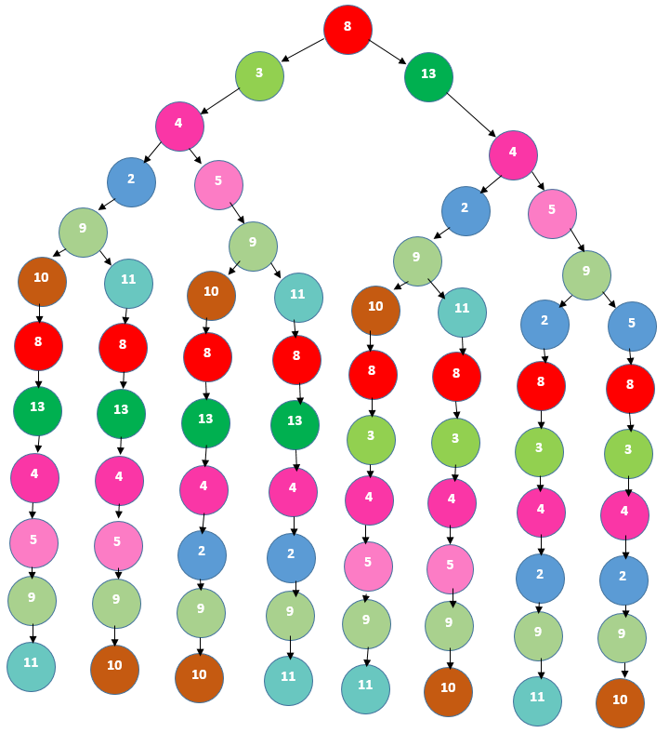
Max-likelihood search
Eulerian paths evaluated using likelihood model implemented in ALE [Clark et al 2013]

Slide 22
ALE likelihood
Placement scoring:
How well read sequences agree with the assembly
Insert scoring:
How well PE insert lengths match those we would expect
Depth scoring:
How well depth at each location agrees with depth expected after GC-bias correction
K-mer scoring:
How well k-mer counts of each contig match multinomial distribution estimated from entire assembly
https://academic.oup.com/bioinformatics/article/29/4/435/199222

Slide 23
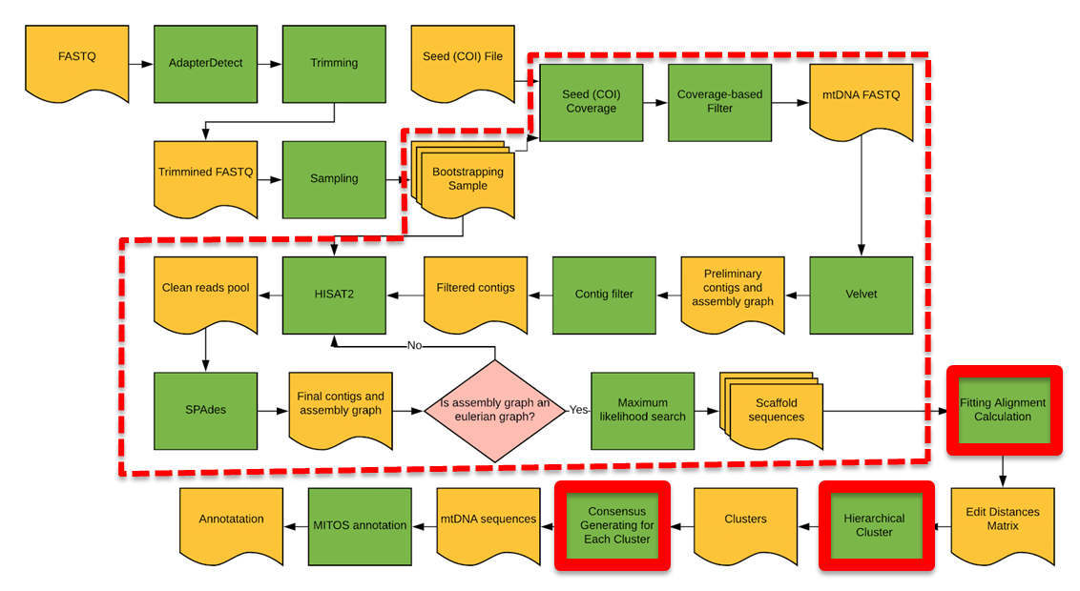
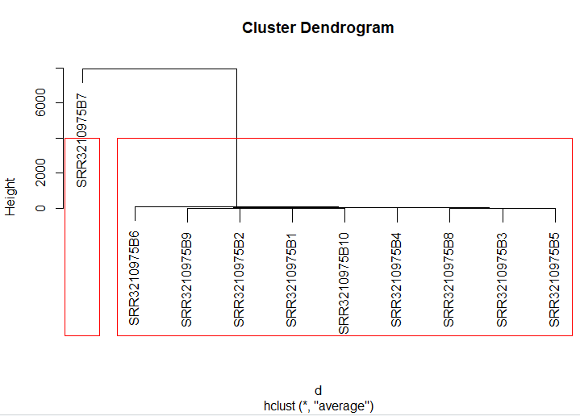
Bootstrapping & clustering
Process repeated for n=10 bootstrap samples
Rotation invariant pairwise distances computed using fitting alignment
ML sequences clustered using hierarchical clustering
Consensus computed for each cluster
A
A
B

Slide 24
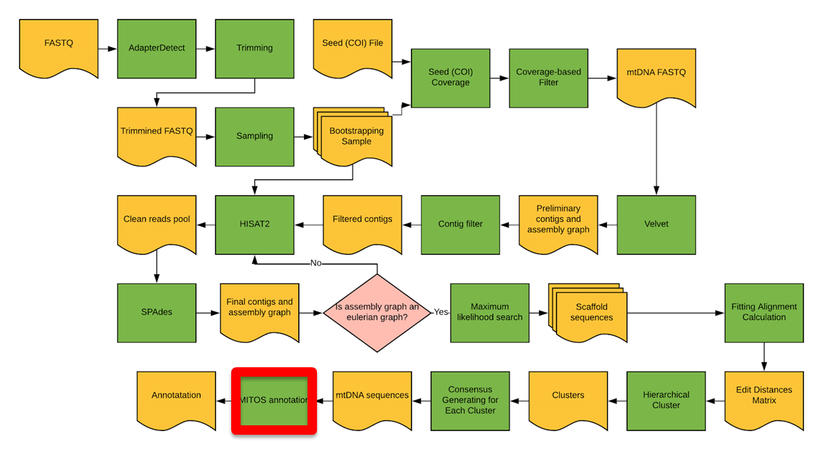
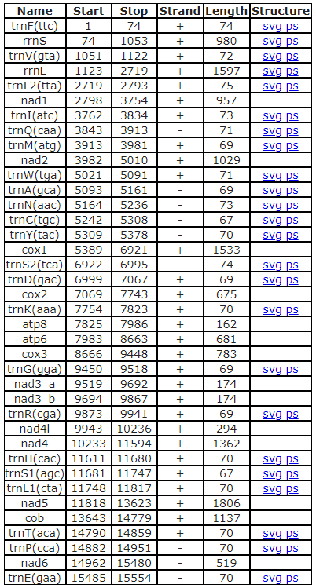
MITOS annotation

Slide 25
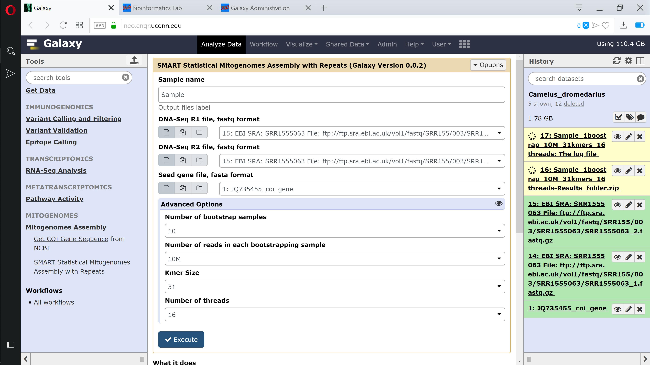
Galaxy interface @ neo.engr.uconn.edu/?toolid=SMART

Slide 26
Outline
Background and prior work
SMART pipeline
Results
Conclusions and future work

Slide 27
Coverage filter accuracy
2.5M reads
Ground truth determined by bowtie2 alignment to known reference
Species | Sample_ID | TPR | PPV | F-Score
Human | HG00501 | 0.750 | 0.443 | 0.557
Human | HG00524 | 0.454 | 0.147 | 0.222
Human | HG00581 | 0.779 | 0.516 | 0.620
Human | HG00635 | 0.771 | 0.240 | 0.366
Chimpanzee | SRR490082 | 0.715 | 0.207 | 0.321
Goat | ERR219544 | 0.875 | 0.220 | 0.352

Slide 28
1KGP human datasets

Slide 29
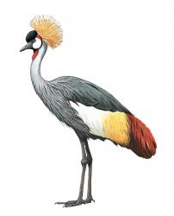
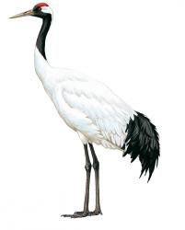
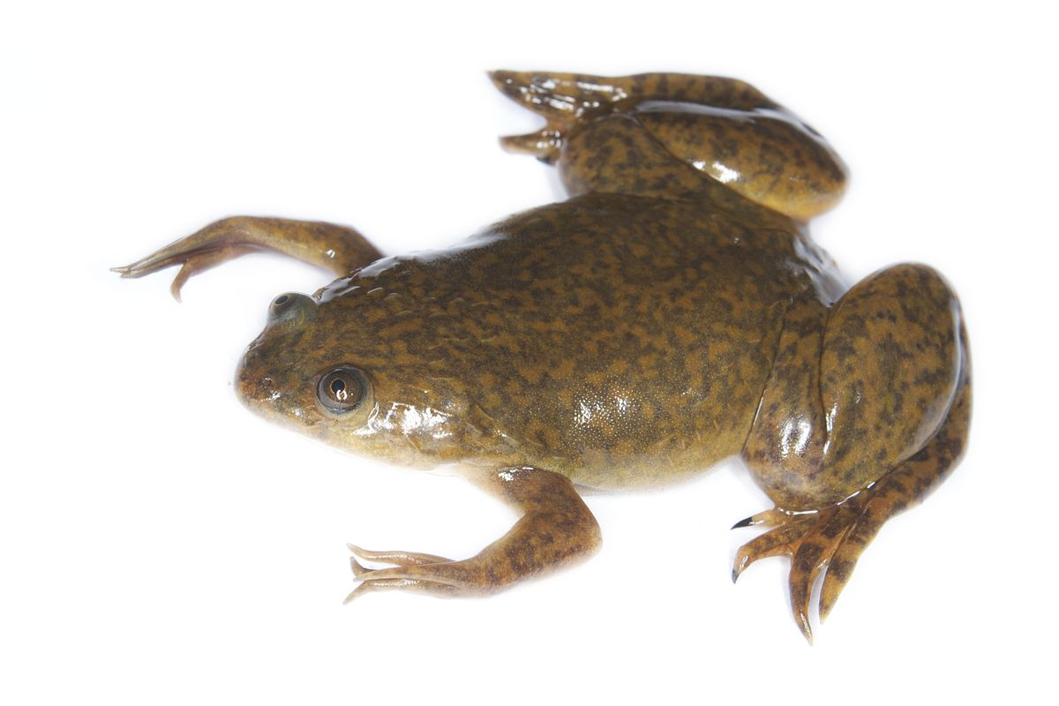
Other datasets
Sample |  | mtDNA sequence length (bp) | LASTZ pairwise % identity | MUSCLE pairwise % identity | ClustalW pairwise % identity | MAFFT pairwise % identity
Balearica regulorum |  | 16,742 | 98.0 | 98.3 | 98.3 | 98.3
Grus japonensis |  | 16,615 | 98.4 | 97.8 | 97.8 | 97.8
Xenopus laevis |  | 17,922 | 98.0 | 95.9 | 96.1 | 95.7

Slide 30
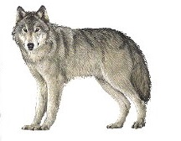
Other datasets
Sample |  | mtDNA sequence length (bp) | LASTZ pairwise % identity | MUSCLE pairwise % identity | ClustalW pairwise % identity | MAFFT pairwise % identity
Pan Troglodytes |  | 16,085 | 97.5 | 94.7 | 94.7 | 94.7
Mus Musculus |  | 15,802 | 99.97 | 96.9 | 96.7 | 96.9
Canis lupus |  | 16,580 | 97.1 | 96.7 | 96.7 | 96.7

Slide 31
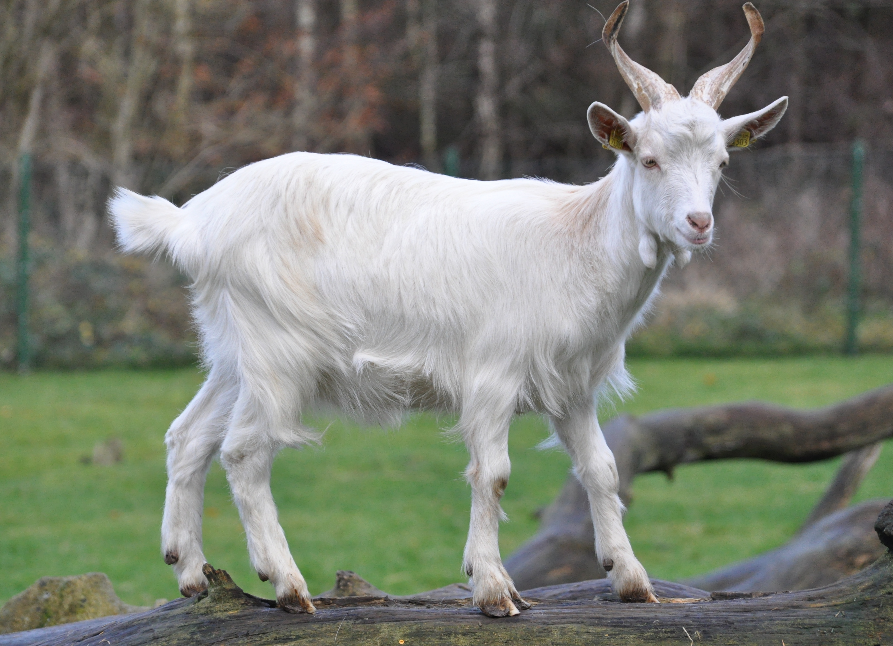
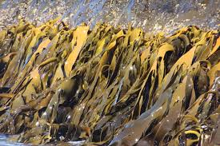
Other datasets
Sample |  | mtDNA sequence length (bp) | LASTZ pairwise % identity | MUSCLE pairwise % identity | ClustalW pairwise % identity | MAFFT pairwise % identity
Capra aegagrus hircus |  | 16,098 | 99.98 | 96.7 | 96.7 | 96.7
Saccharina japonica |  | 37,671 | 100 | 99.8 | 99.8 | 99.8

Slide 32
Outline
Background and prior work
SMART pipeline
Results
Conclusions and future work

Slide 33
Conclusions
SMART is an automated pipeline for de novo mitogenome assembly from WGS reads
Based on statistical framework
Probabilistic read classifier based on coverage
Likelihood maximization for resolving ambiguities in assembly graph
Assembly confidence estimated by bootstrapping
Produces complete/circular assemblies even in presence of repeats
Available via galaxy interface at neo.engr.uconn.edu/?toolid=SMART

Slide 34
Ongoing work
Large-scale pipeline validation
47 frog species from [Zhang et al 2013]
Comparison with other tools (MITOBim, NOVOPlasty, and Norgal)
Reconstruction of plant mitochondrial and chloroplast genomes
Extension to long read sequencing technologies (PacBio, Nanopore)

Slide 35
Thank you for you attention!
Any questions?

