Slide 1
Algorithms for Mitochondrial Genome Assembly and Haplogroup Assignment from Low-Coverage Whole-Genome Sequencing Data
Fahad Alqahtani
Supervisor: Dr. Ion Măndoiu
Associate Advisors: Dr. Mukul Bansal & Dr. Derek Aguiar
Computer Science & Engineering Department
University of Connecticut

Slide 2
Outline
Background
Mitochondrial Genome Assembly
  Related Work
  Statistical Mitogenome Assembly with Repeats (SMART)
    The pipeline
    Results
  Multi-Sample Statistical Mitogenome Assembly with Repeats (SMART2)
    The pipeline
    Results
Haplogroup Assignment
  Related Work
  Algorithms (single & mixture)
  Results
Future Work

Slide 3
Outline
Background
Mitochondrial Genome Assembly
  Related Work
  Statistical Mitogenome Assembly with Repeats (SMART)
    The pipeline
    Results
  Multi-Sample Statistical Mitogenome Assembly with Repeats (SMART2)
    The pipeline
    Results
Haplogroup Assignment
  Related Work
  Algorithms (single & mixture)
  Results
Future Work

Slide 4
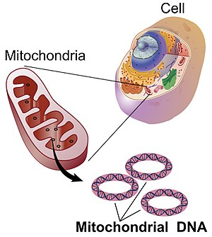
Mitochondria
Cellular organelles within eukaryotic cells
  Convert chemical energy from food into adenosine triphosphate (ATP)
  The popular term "powerhouse of the cell" was coined by Philip Siekevitz in 1957
Mitochondrial DNA - Wikipedia
Notes:
Best known organelle which are found in most of eukaryotic organisms

Slide 5
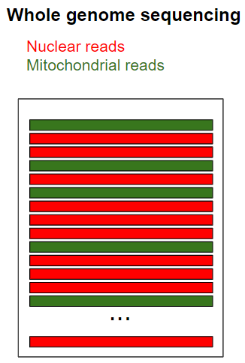
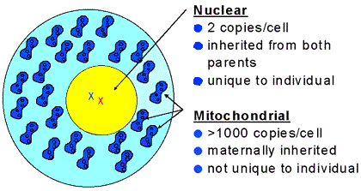
Nuclear Genome vs. Mitochondrial Genome
Source:https://www.fbi.gov/about-us/lab/forensic-science-communications/fsc/july1999/dnalist.htm/dnaf1.htm
Notes:
When DNA samples are sequencing using whole genome sequences, the data has both nuclear and mitochondrial reads.

Slide 6
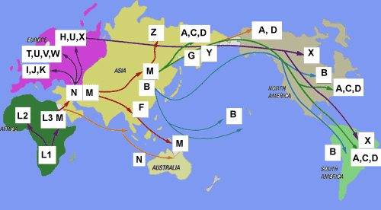
Why sequence the mitogenome?
Inferring human population migrations
  Single nucleotide polymorphisms in mitochondrial genome have long been used for tracking human migration
https://blog.23andme.com/ancestry/haplogroups-explained/
Notes:
Single nucleotide polymorphisms in mitochondrial genome have long been used for tracking human migration

Slide 7
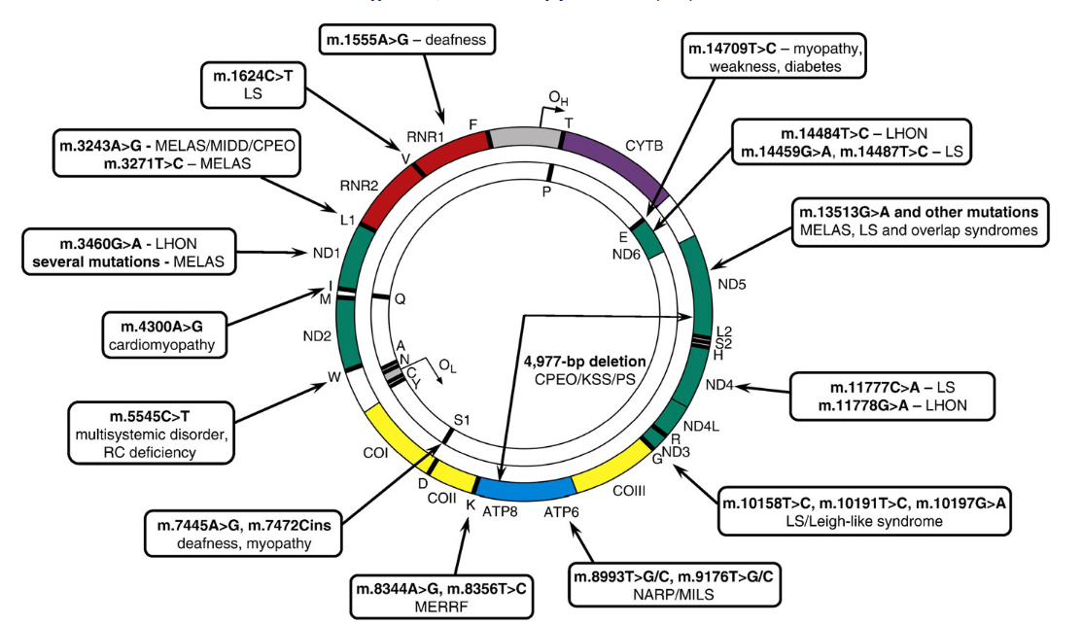
Why sequence the mitogenome?
Plays Important role in disease
  Mitochondrial DNA mutations have also been associated with human diseases
Tuppen, Helen AL, et al. "Mitochondrial DNA mutations and human disease." Biochimica et Biophysica Acta (BBA)-Bioenergetics 1797.2 (2010): 113-128.
Notes:
Mitochondrial DNA (mtDNA) mutations and heteroplasmy (simultaneous presence of multiple mitochondrial sequences in a cell) have also been associated with human diseases

Slide 8
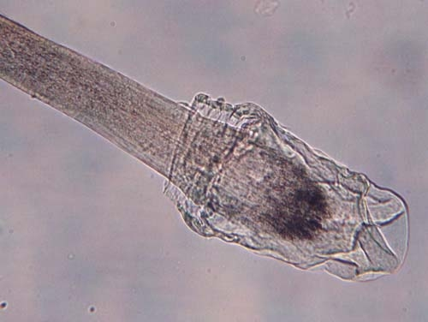
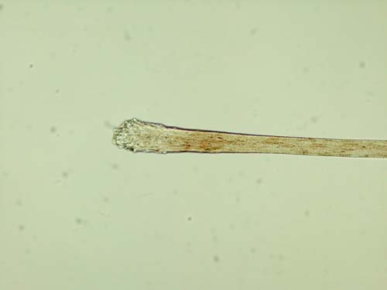
Why sequence the mitogenome?
Useful tool in forensic sciences
  Mitochondrial DNA analysis can be a useful tool in forensics, especially when a crime scene sample contains degraded DNA not suitable for nuclear DNA tests
https://dps.mn.gov/divisions/bca/bca-divisions/forensic-science/Pages/trace-hair.aspx
Notes:
mtDNA analysis can be a useful tool in forensics, especially when a crime scene sample contains degraded DNA not suitable for nuclear DNA tests

Slide 9
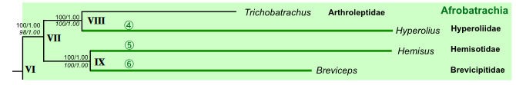
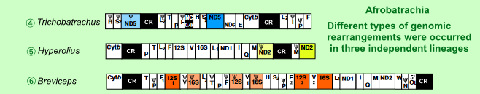
Why sequence the mitogenome?
Species tree reconstruction
  Mitochondrial genome sequences can be used for evolutionary studies of non-model species for which nuclear genomes are not yet available
Kurabayashi, Atsushi, and Masayuki Sumida. "Afrobatrachian mitochondrial genomes: genome reorganization, gene rearrangement mechanisms,
and evolutionary trends of duplicated and rearranged genes." BMC genomics 14.1 (2013): 633.
Notes:
mitochondrial genome sequences can be used for evolutionary studies of non-model species for which nuclear genomes are not yet available

Slide 10
Outline
Background
Mitochondrial Genome Assembly
  Related Work
  Statistical Mitogenome Assembly with Repeats (SMART)
    The pipeline
    Results
  Multi-Sample Statistical Mitogenome Assembly with Repeats (SMART2)
    The pipeline
    Results
Haplogroup Assignment
  Related Work
  Algorithms (single & mixture)
  Results
Future Work

Slide 11
Related Work
Mitochondrial DNA Isolation
  Mitochondrial DNA can be experimentally separated from the nuclear DNA and sequenced independently
    protocols are laborious.
Off-the-shelf de Novo Genome Assembly Tools
  Fail to generate high quality mitochondrial genome sequences
    A large difference in copy number (and hence sequencing depth) between the mitochondrial and nuclear genomes
Hahn, Christoph, Lutz Bachmann, and Bastien Chevreux. "Reconstructing mitochondrial genomes directly from genomic next-generation sequencing reads—a baiting and iterative mapping approach." Nucleic acids research 41, no. 13 (2013): e129-e129.

Slide 12
Long-read WGS Data
Organelle_PBA [Soorni et al 2017]
  High coverage required (> 50x) & relatively high cost of long-read sequencing make this approach uncommon

Slide 13
Most Existing Mitogenome Assembly Tools
Categories:
  Reference-based
    MToolBox [Calabrese, et al 2014]
  Seed-and-extend
    MITObim [Hahn at el 2013] and NOVOPlasty [Dierckxsens at el 2017]
  De Novo
    plasmidSPAdes [Antipov et al 2016] and Norgal [Al-Nakeeb et al 2017]

Slide 14
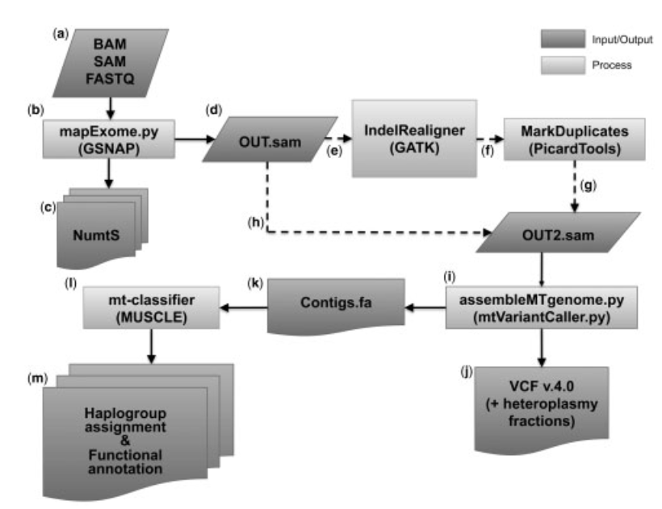
MToolBox
input:
Raw data or prealigned reads
A mitogenome reference genome
A nuclear reference genome
It cannot be used for non-model organisms

Slide 15
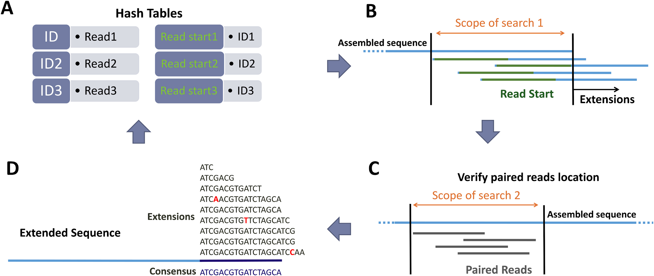
NOVOPlasty
Input: 1)Raw reads 2) insert size 3) read length 4) mitogenome size range
5) a seed sequence (COI gene)
It has difficult handling repetitive regions present in some mitochondrial genomes
Notes:
The difference between the MITOBim and NOVOPlast, in NOVOPlasty, they use library insert size to verify position of the paired reads. However, due to their inherently greedy approach, seed-and-extend methods have difficulty handling repetitive regions present in some mitochondrial genomes

Slide 16
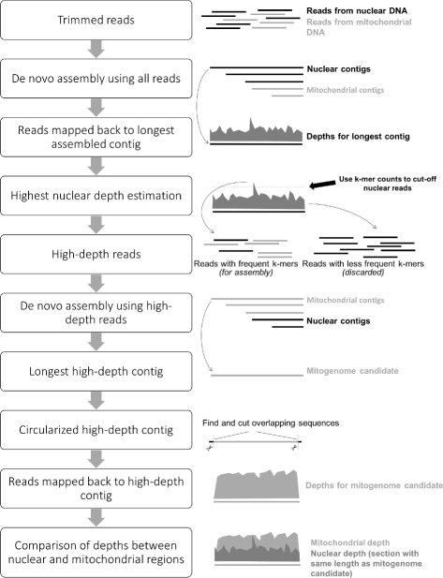
Norgal
Input:
Raw reads
It can have prohibitive running times and may still fail to reconstruct complete mitogenomes particularly in the presence of repeats shared between the nuclear and organelle genomes
Notes:
No need to reference and seed sequences in this approach. Although these tools are broadly applicable, they can have prohibitive running times and may still fail to reconstruct complete mitogenomes, particularly in the presence of repeats shared between the nuclear and organelle genomes. The differences between Norgal and plasmidSPAdes that they use different threshold to filter out nuclear and different assembler.

Slide 17
Outline
Background
Mitochondrial Genome Assembly
  Related Work
  Statistical Mitogenome Assembly with Repeats (SMART)
    The pipeline
    Results
  Multi-Sample Statistical Mitogenome Assembly with Repeats (SMART2)
    The pipeline
    Results
Haplogroup Assignment
  Related Work
  Algorithms (single & mixture)
  Results
Future Work

Slide 18

SMART
Statistical Mitogenome Assembly with RepeaTs
Input:
Paired-end WGS reads
Seed sequence (COI gene)
Output:
  Complete/circular mitogenome (or largest scaffold)

Slide 19
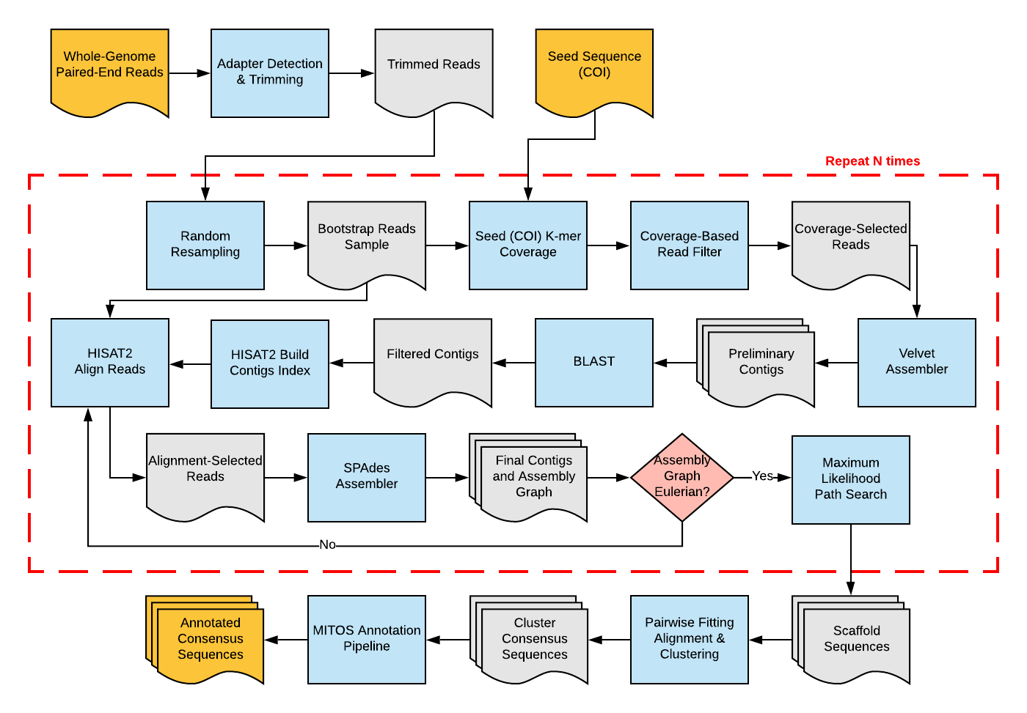
SMART Workflow

Slide 20

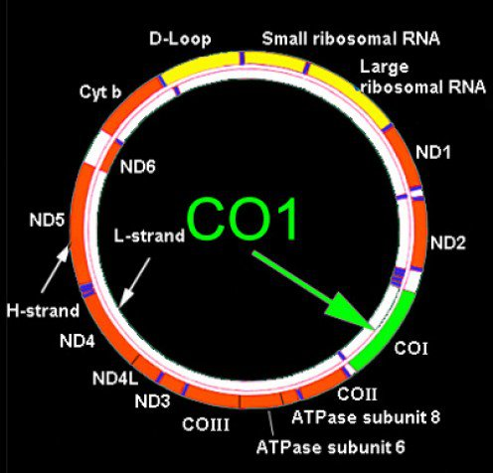
Seed Selection
Cytochrome c oxidase subunit 1 (COI) gene has been selected as a “DNA barcode” for taxonomic classification
Barcode of Life Datasystem (BOLD) has > 1.4M public barcodes from 118,358K animal species
http://www.boldsystems.org/
Notes:
Similar to seed-and-extend tools such as MITObim and NOVOPlasty, SMART requires as input a seed sequence.
However, unlike MITObim and NOVOPlasty, SMART uses the seed sequence only for estimating mtDNA k-mer coverage and implementing an efficient coverage-based read filter
Additionally, although seed sequences from the same species are preferable, assembly can succeed even with seeds from closely related species.

Slide 21
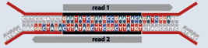
Adapter Detection and Trimming
Automatic detection of adaptors and trimming using Perl/C++ modules from the IRFinder package
Middleton, Robert, et al. "IRFinder: assessing the impact of intron retention on mammalian gene expression." Genome biology 18.1 (2017): 51.
Notes:
there are numerous tools that can be used for quality checking and filltering WGS data.
However, many of these tools require iterative user intervention.
To minimize user involvement, in SMART we have only incorporated automatic adapter detection and removal.
Specically, we detect and trim adapters using tools included in the IRFinder package.
These tools take advantage of the fact that for paired-end WGS data adapter sequences are included in both reads when the target DNA fragment is shorter than the read length.
This allows both highly accurate automatic detection of adaptor sequences from a small data sample and very precise (single base resolution) adapter trimming.

Slide 22
Random Read Re-sampling

Slide 23
Coverage-based Read Filtering
Notes:
The aim of this step is to filter out nuclear reads and keep mitochondrial ones by taking advantage of the difference in copy number between the nuclear and mitochondrial genomes.
Due to this difference, the counts of k-mers that originate from the mitocondrial genome are expected to be much higher than that of k-mers from the nuclear genome, with the possible exception of k-mers that originate from nuclear genome repeats with similar copy number.

Slide 24
Counting number of times unique kmers appear in Bootstrap sample
k-mers | Counts
Generating all kmers with Hamming distance one of the seed k-mers
Generating unique kmers that appear in the seed sequence
K-mers | Index
Look up
K-mers | Counts
Update counts
Update counts

Slide 25
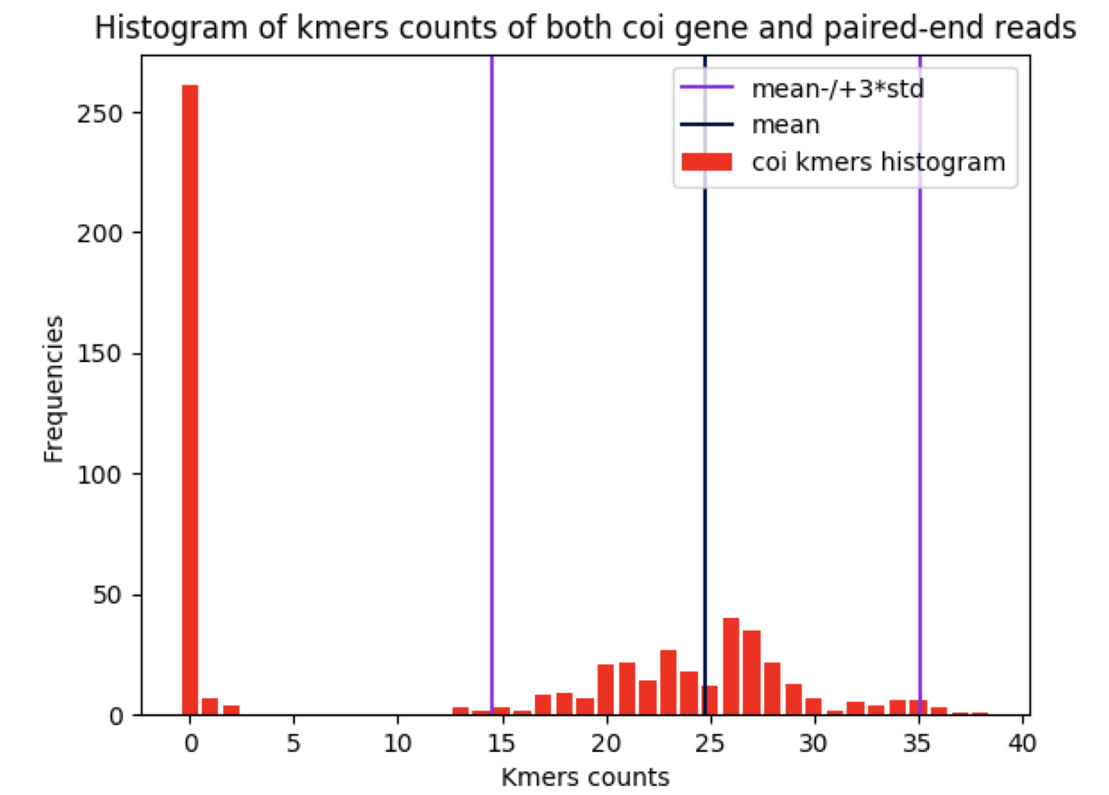
COI K-mers Counts Distribution
Two-component Gaussian mixture model to the one-dimensional distribution
Notes:
Although most seed sequence k-mers are expected to have high augmented counts, k-mers from regions of the seed sequence that have high dissimilarity to the homologous region of the sequenced mitogenome will still have zero or near-zero augmented counts.
Consequently, we use the MCLUST package to fit a two-component Gaussian mixture model to the one-dimensional distribution of augmented k-mer counts, and use the mean and standard deviation of the upper component as the estimate for the corresponding mtDNA k-mer count statistics.

Slide 26

Unique kmers appear in Bootstrap sample
k-mers | Counts
Good k-mers
Notes:
To eciently extract putative mitochondrial reads, a hash table is populated with all read k-mers (not just seed sequence k-mers) that have a count within 3 standard deviations of the estimated mtDNA k-mer count mean

Slide 27
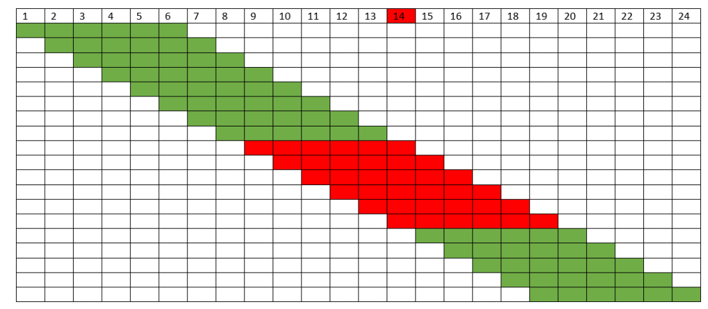
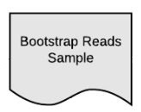
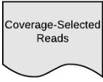

Reads with one sequencing error are kept
Good k-mers
Notes:
A read of length l in the bootstrap sample is then considered to be of mitochondrial origin if at least l - (2k - 1) of its k-mers are found in the hash table
Experimental results in the next section show that, albeit not perfect, the coverage-based filter typically leads to a substantial enrichment in mitochondrial reads, even when the coverage estimates are based on relatively few reads and short seed sequences.

Slide 28
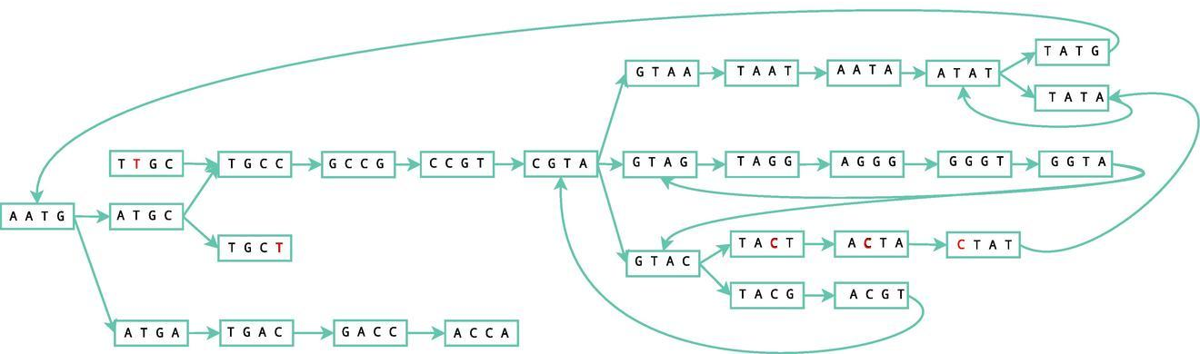
Preliminary Assembly
https://en.wikipedia.org/wiki/Velvet_assembler
Notes:
The goal of this step is to generate longer contigs from the enriched set of mitochondrial reads that pass the coverage-based filter. For eciency, we use Velvet, a fast short read assembler based on de Bruijn graphs.
Since some nuclear genome reads are expected to pass the coverage-based filter, the output of Velvet is typically a mixture of mitochondrial and nuclear genome contigs.

Slide 29
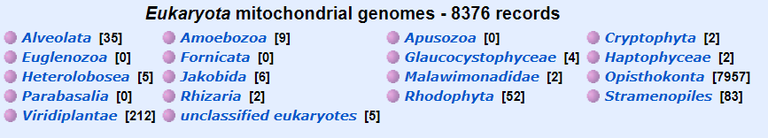
Preliminary Contig Filtering
Contigs aligned against a local database eukaryotic mitogenomes using nucleotide-nucleotide BLAST
  Keep contigs that have hits with E-value of 10⁻¹⁰ or less
Notes:
The aim of this step to filter out nuclear genome contigs.
This is accomplished by searching each contig against a local database of 8,376 complete eukaryotic mitogenomes downloaded from NCBI by using nucleotide-nucleotide BLAST 2.7.1+.
As result of this step we retain only contigs that have hits with an E-value of 10^-10 or less.

Slide 30
Alignment-based Read Filtering
Using HISAT2
  Fast and sensitive aligner for NGS reads
Pulls out the read pairs that have at least one of the reads aligned
Notes:
The aim of this step to pull out additional mitochondrial reads that are missed by coverage filter using an alignment-based approach reminiscent of the seed-and-extend approaches.
To implement this step eciently, we build an index for the contigs with significant BLAST matches, then align all bootstrap reads against the index by using HISAT2, a fast and sensitive aligner for NGS reads.
Since the set of preliminary contigs is likely incomplete, both reads in a pair are kept if one of them is aligned. Specifically, all reads in a bootstrap sample are aligned using HISAT2 as single reads, and the union of all read IDs is given to the seqtk tool to pull from the bootstrap sample the read pairs that have at least one of the reads aligned.

Slide 31
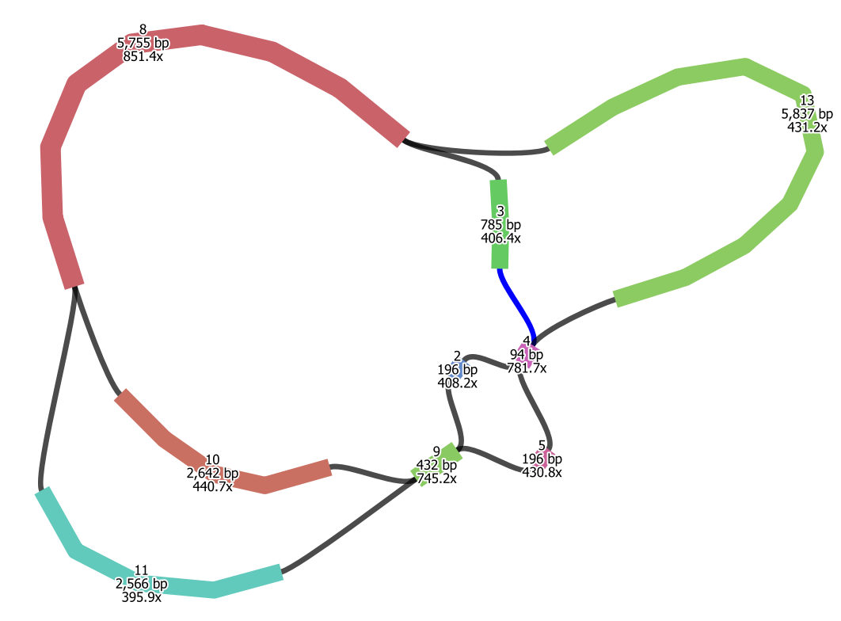
Secondary Assembly
Notes:
The goal of this step to assemble a high-quality mitochondrial sequence using the reads that pass the alignment-based filtering. SMART performs the secondary assembly using SPAdes, a multi-kmer de Bruijn graph assembler with robust performance even in the presence of non-uniformities in read coverage.
Since mitochondrial genomes are circular, SMART checks if the results of SPAdes assembly is an Eulearian graph using a custom python script.
If so, SMART moves to the scaffolding step, otherwise SMART repeats the alignment-based read filtering and secondary assembly using SPAdes for up to 5 iterations.
As a result of these iterations, the number of selected reads and the length of the assembled contigs typically increase.

Slide 32
Scaffolding

Slide 33
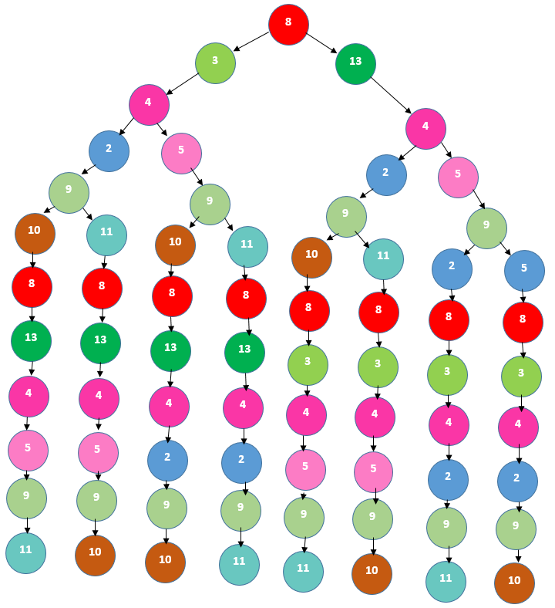
Scaffolding
Eulerian paths evaluated using likelihood model implemented in ALE [Clark et al 2013]
Notes:
When SPAdes produces an Eulerian assembly graph or the maximum number of iterations is reached, SMART begins the scaffolding step.
SMART generates all paths of the Eulerian graph using a depth-first approach.
For each explored path SMART generates a scaffold sequence by trying to overlap adjacent contigs or closing gaps between contigs using SSPACE.
To select the most likely assembly SMART uses the ALE tool to compute the likelihood of each scaffold sequence and outputs the sequence with maximum likelhood.

Slide 34
ALE likelihood
Placement scoring:
  How well read sequences agree with the assembly
Insert scoring:
  How well PE insert lengths match those we would expect
Depth scoring:
  How well depth at each location agrees with depth expected after GC-bias correction
K-mer scoring:
  How well k-mer counts of each contig match multinomial distribution estimated from entire assembly
https://academic.oup.com/bioinformatics/article/29/4/435/199222
Notes:
The ALE likelihood model is based on four sub-scores: placement scoring takes into account how well read sequences agree with the sca
old sequence, insert scoring assesses how well insert lengths implied by the alignments of paired reads match the expected insert length distribution, depth scoring re
ects how well the read depth at each location agrees with the depth expected after GC-bias correction, and k-mer scoring shows how well k-mer counts of each contig match the multinomial distribution estimated from the entire assembly.
The ALE likelihood assessment is particularly useful for selecting high-confidence assemblies when the Eulerian graph has duplicated contigs.

Slide 35
Clustering

Slide 36
Clustering
Process repeated for n bootstrap samples
  Pairwise distances computed using fitting alignment
    Rotation invariant
    Direction invariant
Bootstrap A
Bootstrap B

Slide 37
Clustering
If bootstrap A is longer than bootstrap B, we duplicate the longest sequence.
Use the both shortest sequence and its Watson-Crick complement
A
A
A
A
B
B

Slide 38
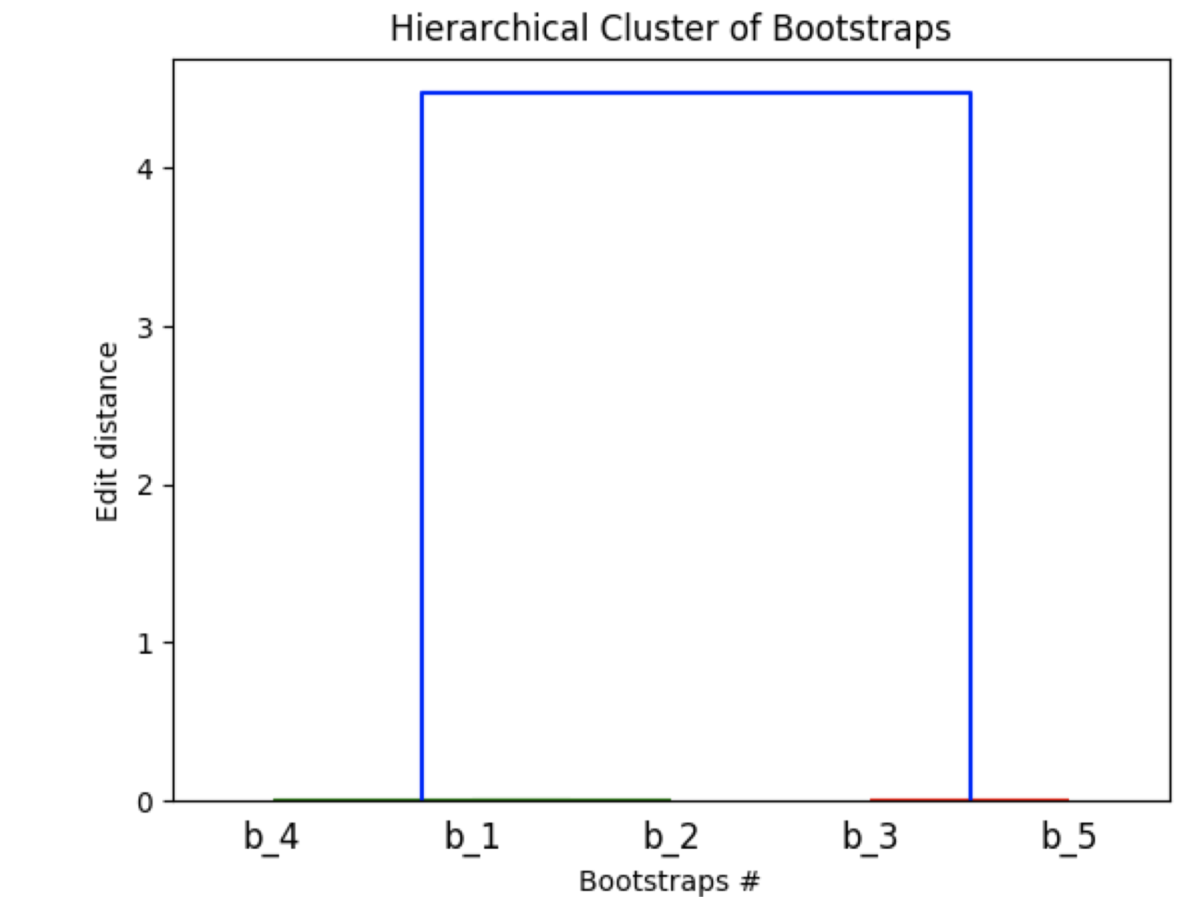
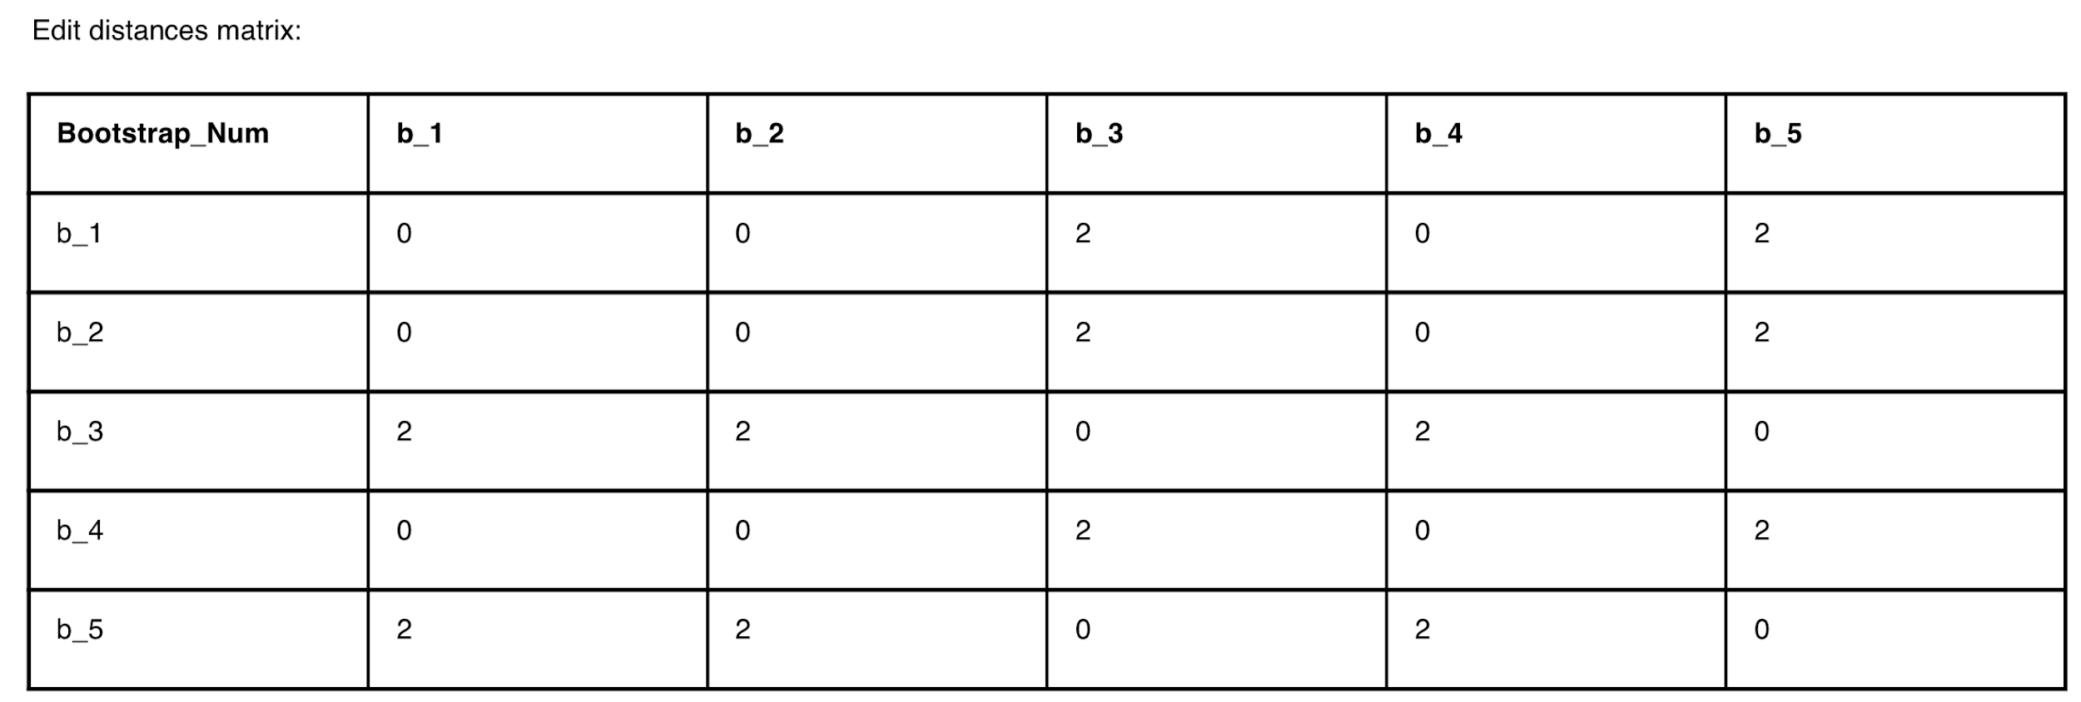
Clustering
Using hierarchical clustering on the edit distance matrix
A consensus sequences is generated for each cluster
Notes:
Once all pairwise distances are computed SMART runs the hierarchical clustering algorithm implemented by the hclust R package on the edit distance matrix and automatically cuts the resulting dendogram into clusters based on silhouette scores.
Sequences within each cluster are flipped to the same strand and rotated to a consistent linearization using MARS.
Finally, SMART runs the MAFFT multiple sequences alignment tool [31] to generate a consensus sequence for each cluster.

Slide 39
Annotation

Slide 40
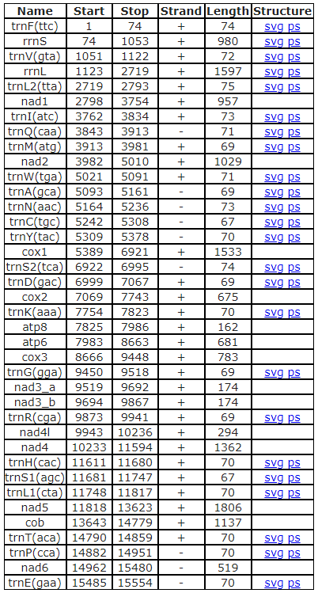

MITOS annotation
Notes:
Each cluster consensus sequence is annotated using the MITOS de novo mitochondrial genome annotation pipeline, which identifies protein coding genes based on BLAST searches against previously annotated protein sequences and annotates tRNA and rRNA genes based on manually curated covariance models capturing both sequence and secondary structure similarity to known sequences.

Slide 41
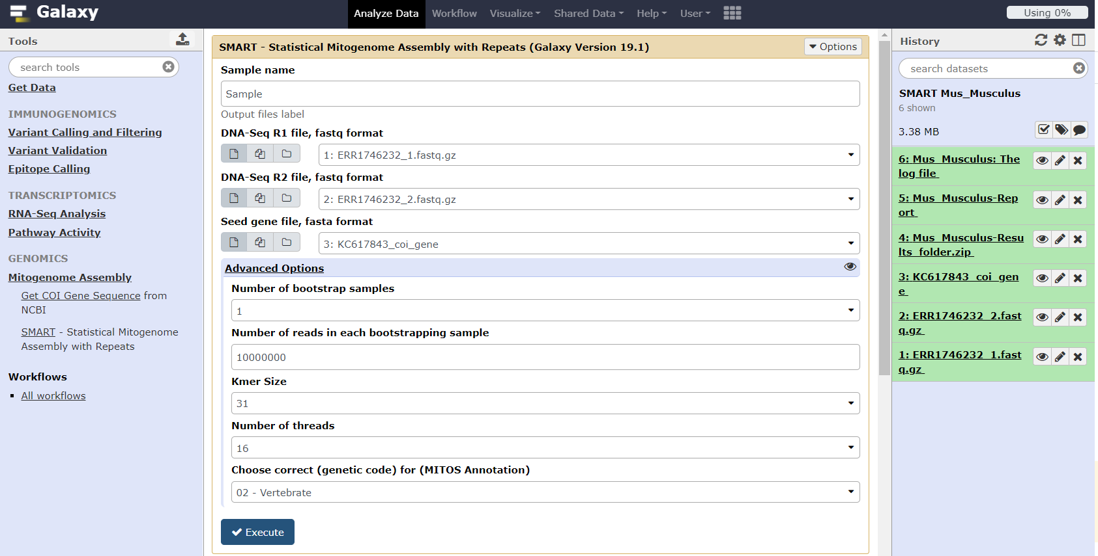
Galaxy Interface @ neo.engr.uconn.edu/?toolid=SMART

Slide 42
Outline
Background
Mitochondrial Genome Assembly
  Related Work
  Statistical Mitogenome Assembly with Repeats (SMART)
    The pipeline
    Results
  Multi-Sample Statistical Mitogenome Assembly with Repeats (SMART2)
    The pipeline
    Results
Haplogroup Assignment
  Related Work
  Algorithms (single & mixture)
  Results
Future Work

Slide 43
Datasets
Human datasets
Non-Human datasets
Notes:
To assess the effectiveness of SMART and compare it with prior methods we used two groups of datasets.

Slide 44
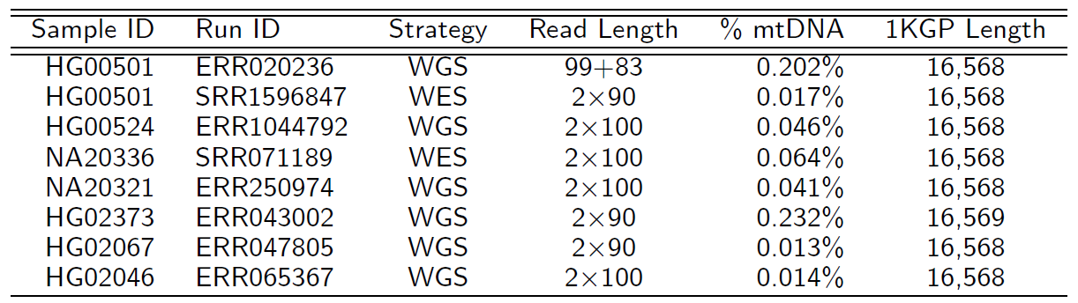
Human WGS and WES datasets
Notes:
Six of the human datasets were generated using the WGS strategy, while the other two datasets were generated using Whole Exome Sequencing (WES)

Slide 45
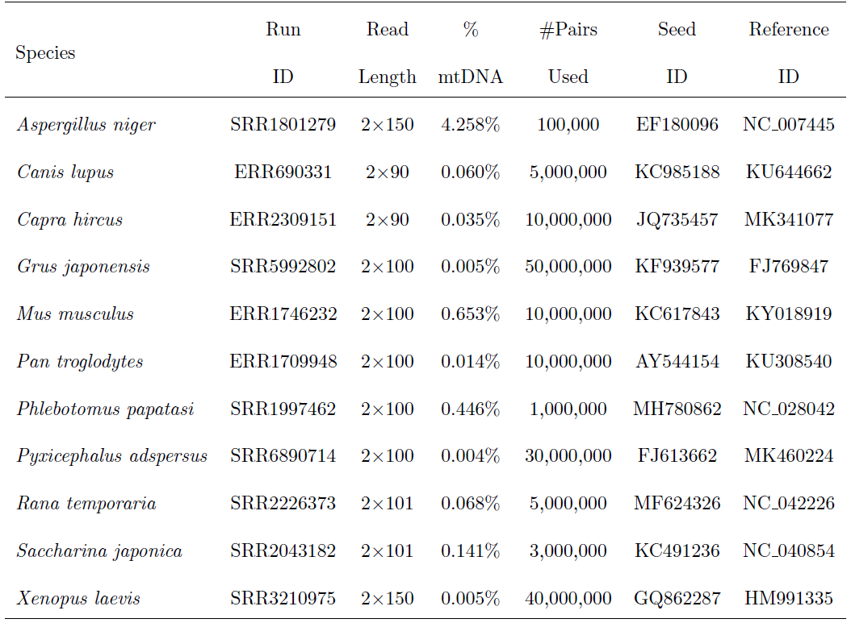
Non-Human WGS datasets
Notes:
A notable feature of the considered datasets is the highly variable percentage of reads of mitochondrial origin, ranging from 0.005% in Grus Japonensis to over 4% in Aspergillus niger. This percentage was estimated by aligning 25M read pairs (or the entire dataset if comprised of fewer than 25M read pairs) to the respective ground truth mtDNA sequence using bowtie2.
Most likely, other important contributing factors to this variability include DNA extraction and library preparation protocols, the tissue of origin, and the developmental stage of the sample.

Slide 46
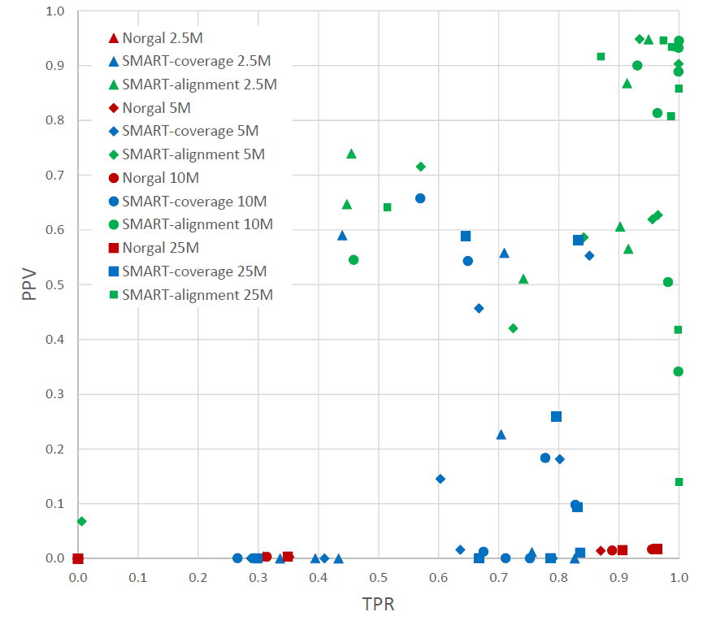
Assessment of read filtering accuracy for human datasets with 2.5-25M read pairs

Slide 47
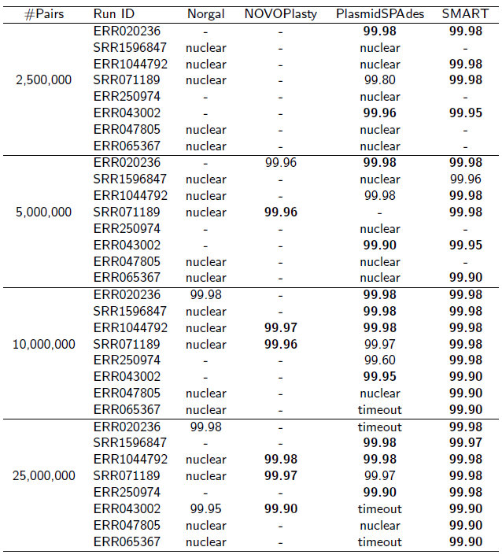
Assembly accuracy comparison on human datasets
The percentage identity is typeset in bold if the reconstructed sequence was a complete circular genome.

Slide 48
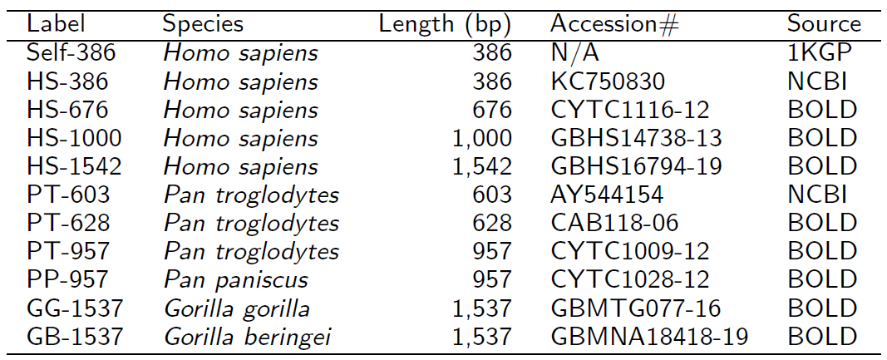
Effect of the seed Length and Similarity on Read Filtering Accuracy and Assembly

Slide 49
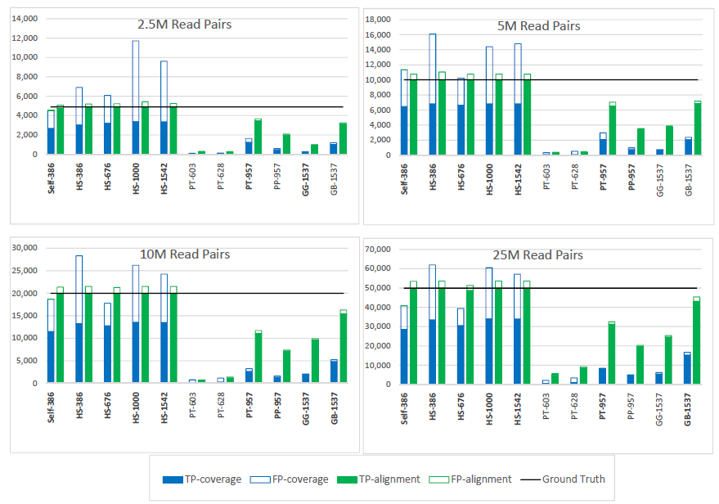
Effect of the seed Length and Similarity on Read Filtering Accuracy and Assembly
datasets with 2.5M-25M read pairs randomly selected from WGS run ERR020236
The percentage identity is typeset in bold if the reconstructed sequence was a complete circular genome.

Slide 50
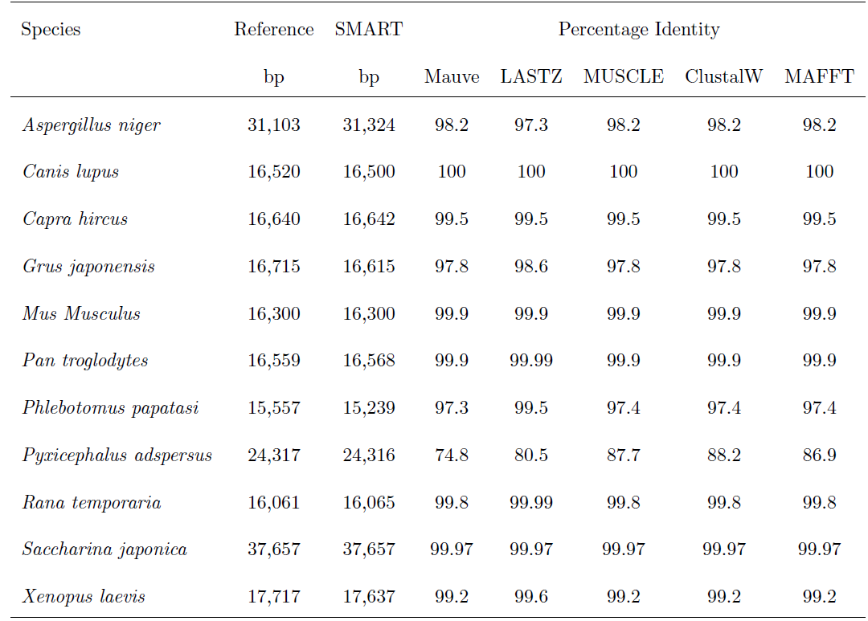
SMART assembly accuracy for non-human datasets
All are circular except Rana temporaria
Notes:
Although there are minor differences between the percentage identity reported by different tools, all values are very high, with the slightly lower identities observed for Aspergillus niger, Grus japonensis, and Phlebotomus papatasi possibly being explained by the higher intra-species variability within these species.

Slide 51
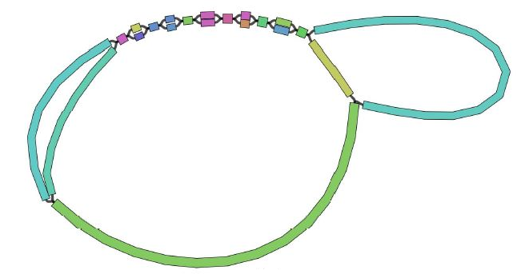
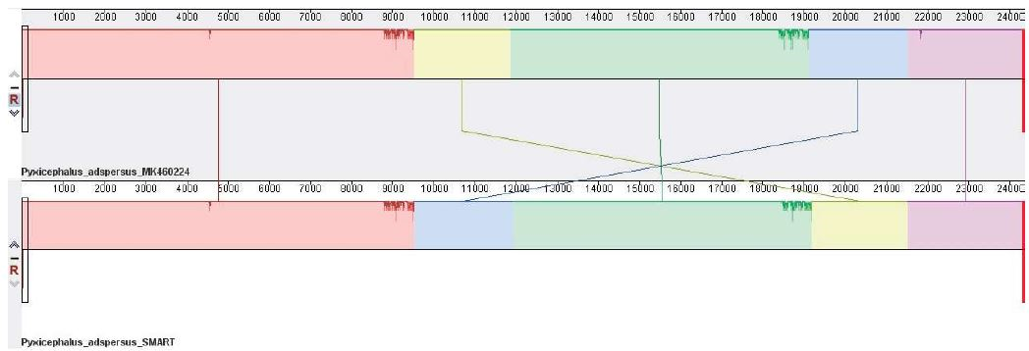
Pyxicephalus adspersus (African bullfrog)

Slide 52
Outline
Background
Mitochondrial Genome Assembly
  Related Work
  Statistical Mitogenome Assembly with Repeats (SMART)
    The pipeline
    Results
  Multi-Sample Statistical Mitogenome Assembly with Repeats (SMART2)
    The pipeline
    Results
Haplogroup Assignment
  Related Work
  Algorithms (single & mixture)
  Results
Future Work

Slide 53
SMART2
Multi-Sample Statistical Mitogenome Assembly with RepeaTs
Input:
  One/two paired-end WGS libraries
  Seed sequence (COI gene)
Output:
  Complete/circular mitogenome (or largest scaffold)

Slide 54
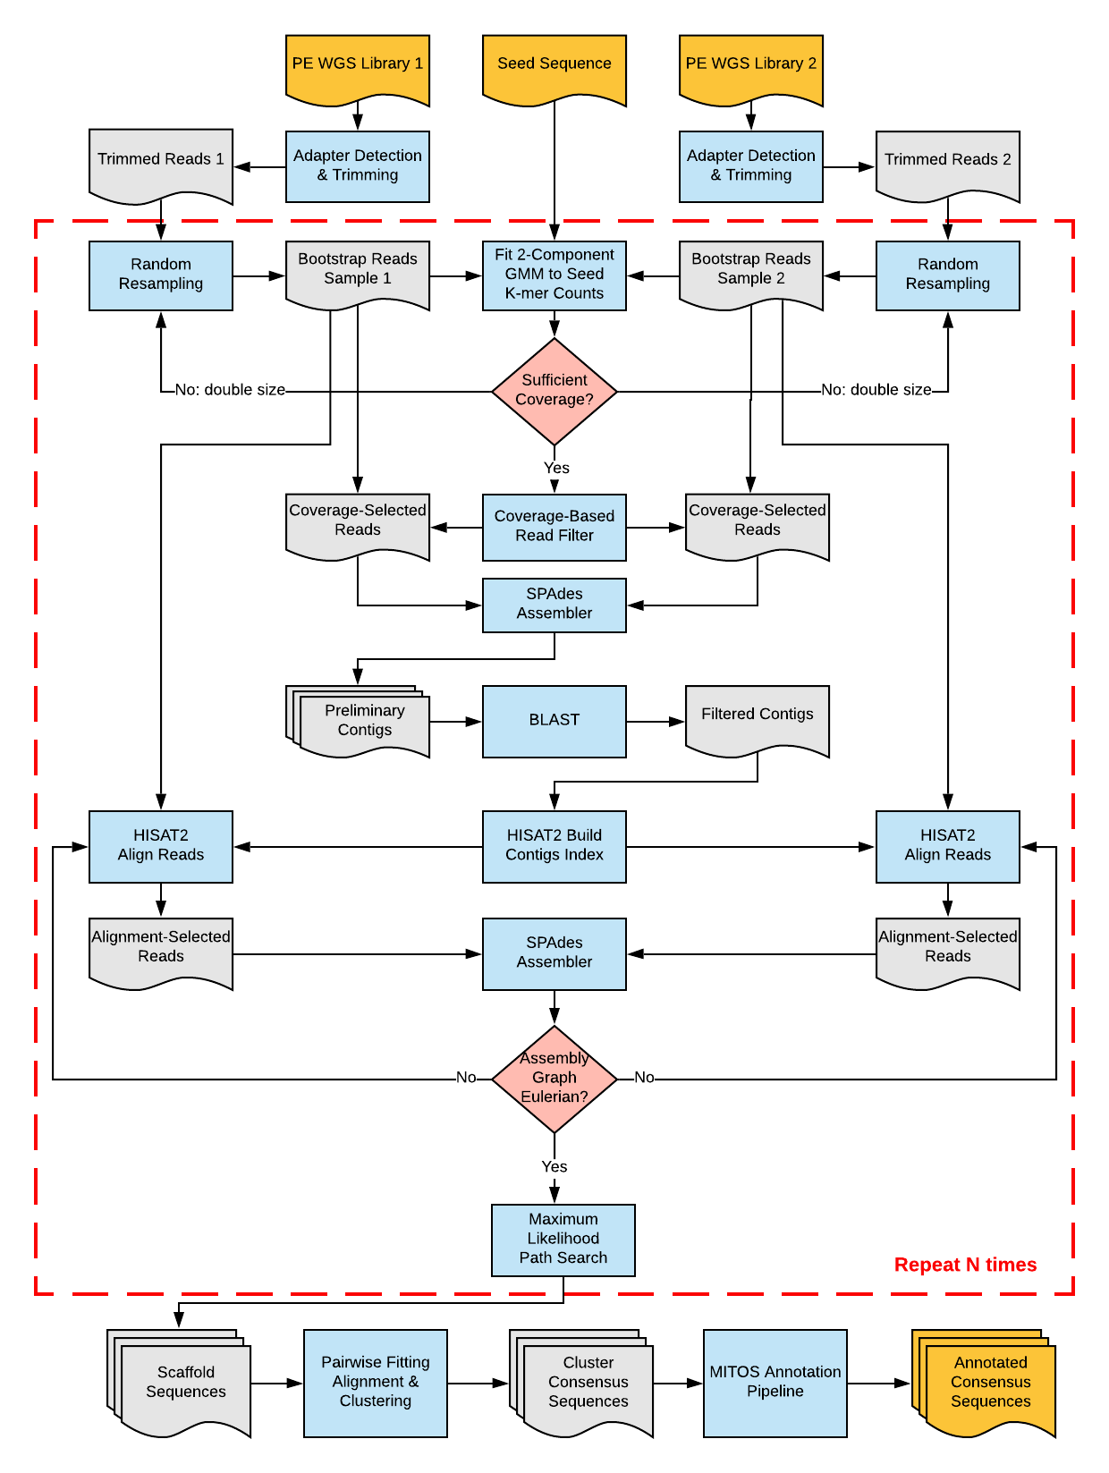
SMART2 Workflow

Slide 55
Automatic adapter detection and trimming, performed independently for each library.
Random resampling of a number of trimmed read pairs, either specified by the user or automatically determined using the doubling strategy.
Selection of mitochondrial reads based on coverage estimates of seed sequence k-mers – aggregated across libraries using one of the methods described below (2-dimensional Gaussian mixture modeling using MCLUST, Union, or Intersection).
Joint preliminary assembly of reads passing the coverage filter in the two libraries, performed using SPAdes.

Slide 56
Random Read Re-sampling
The number of read pairs in a bootstrap sample has a significant effect on the quality of resulting assembly.
  Too small a number of reads may produce fragmented assemblies due to lack of coverage for some regions.
  Too large a number may be detrimental by increasing the complexity of the assembly graph and making it more difficult to remove tangles generated by sequencing errors.
This can lead to many trial-and-error runs to find the optimal coverage.

Slide 57
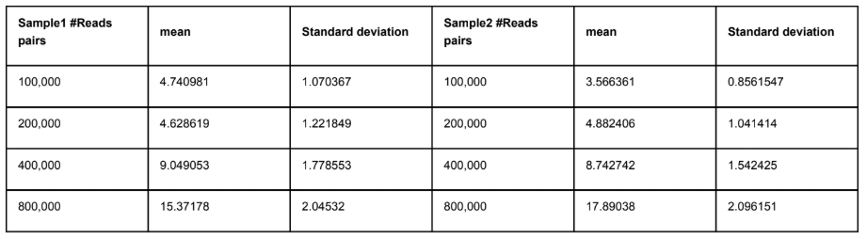
Doubling strategy
sum of the mean mitochondrial read coverages estimated from the two libraries >= 20

Slide 58
Automatic adapter detection and trimming, performed independently for each library.
Random resampling of a number of trimmed read pairs, either specified by the user or automatically determined using the doubling strategy.
Selection of mitochondrial reads based on coverage estimates of seed sequence k-mers – aggregated across libraries using one of the methods described below (2-dimensional Gaussian mixture modeling using MCLUST, Union, or Intersection).
Joint preliminary assembly of reads passing the coverage filter in the two libraries, performed using SPAdes.

Slide 59
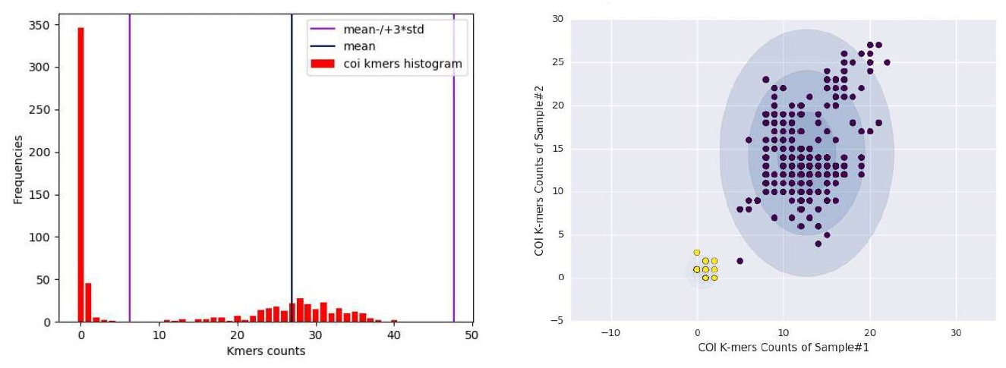
Coverage-based K-mer Classification
One WGS library:
  Two-component Gaussian mixture model to the one-dimensional distribution
Two WGS libraries:
  Two component Gaussian mixture model to the two-dimensional distribution
  Union
  Intersection

Slide 60
5. Filtering of preliminary contigs by BLAST searches against a local mitochondrial database.
6. Secondary read filtering by alignment to preliminary contigs that have significant BLAST matches, performed independently for each library.
7. Joint secondary assembly of selected reads, performed using SPAdes.
8. Iterative scaffolding and gap filling based on maximum likelihood.
9. Prediction and annotation of mitochondrial genes using MITOS.
As for SMART, steps 2-8 of SMART2 can be repeated a user-specified number of times to compute the bootstrap support for the assembled sequences.

Slide 61
Outline
Background
Mitochondrial Genome Assembly
  Related Work
  Statistical Mitogenome Assembly with Repeats (SMART)
    The pipeline
    Results
  Multi-Sample Statistical Mitogenome Assembly with Repeats (SMART2)
    The pipeline
    Results
Haplogroup Assignment
  Related Work
  Algorithms (single & mixture)
  Results
Future Work

Slide 62
Datasets
Two groups of data: published mitogenomes, and without published mitogenomes.

Slide 63
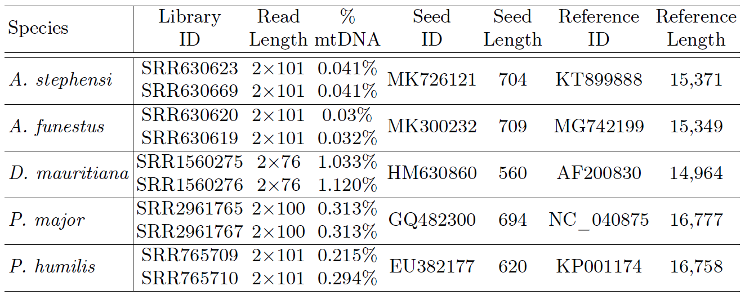
WGS Datasets from Species with Published Mitogenome

Slide 64
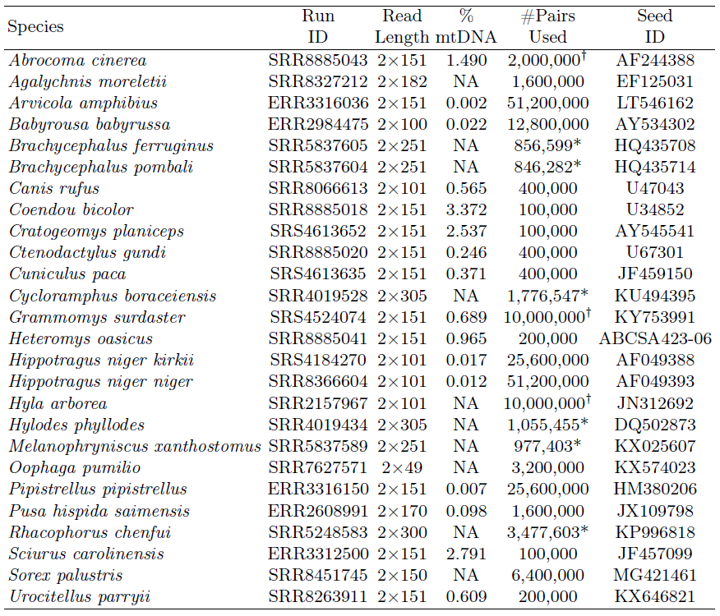
WGS Datasets from Species without Published Mitogenome

Slide 65
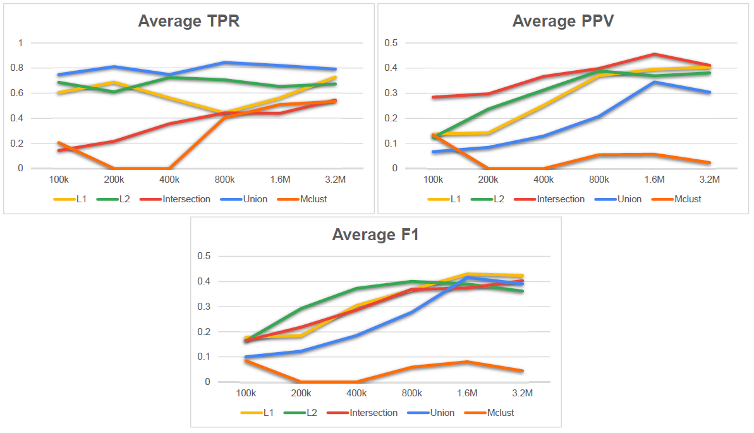
Accuracy of single and multi-library coverage-based filters on 100k-3.2M read pairs randomly selected

Slide 66
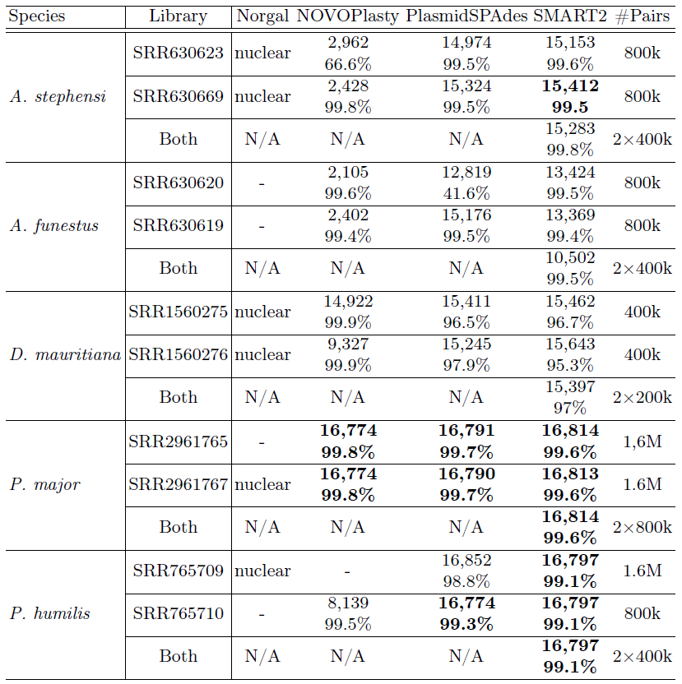
Assembled Sequence Length and Percentage Identity to the Published Reference

Slide 67
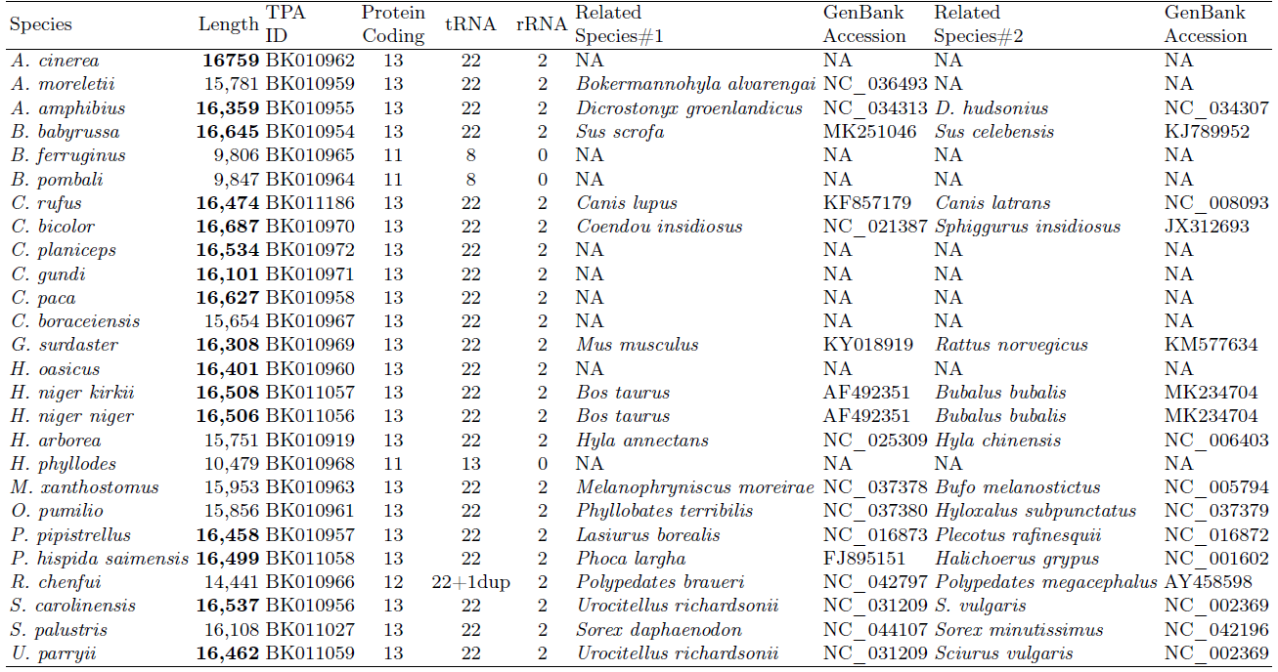
Mitochondrial Sequences Assembled by SMART2 for 26 Metazoans without Previously Published Mitogenomes

Slide 68
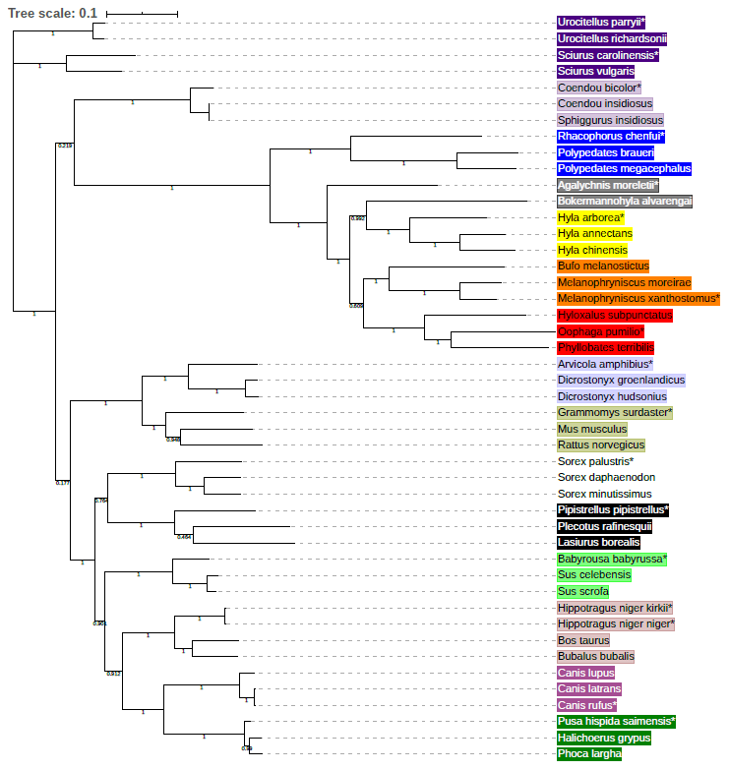
Phylogenetic Tree for Novel mtDNA Sequences with Related Species

Slide 69
Outline
Background
Mitochondrial Genome Assembly
  Related Work
  Statistical Mitogenome Assembly with Repeats (SMART)
    The pipeline
    Results
  Multi-Sample Statistical Mitogenome Assembly with Repeats (SMART2)
    The pipeline
    Results
Haplogroup Assignment
  Related Work
  Algorithms (single & mixture)
  Results
Future Work

Slide 70
Mitochondrial Haplotype and Haplogroup
Haplotype
  combination of variants is strongly associated
Haplogroups
  clustering of haplotypes is sharing common mutations

Slide 71
DNA Mixtures
Mixtures of DNA from more than one individual are commonly found in forensic samples
For example, a stain found at a crime scene may contain DNA from both a victim and an offender.

Slide 72
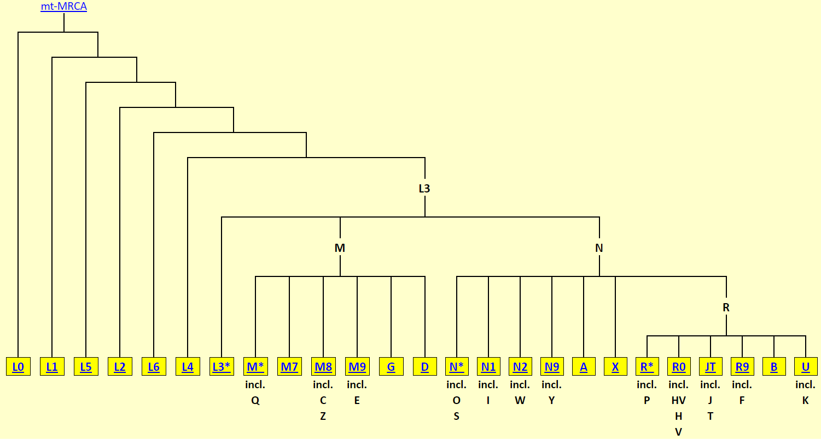
Phylotree

Slide 73
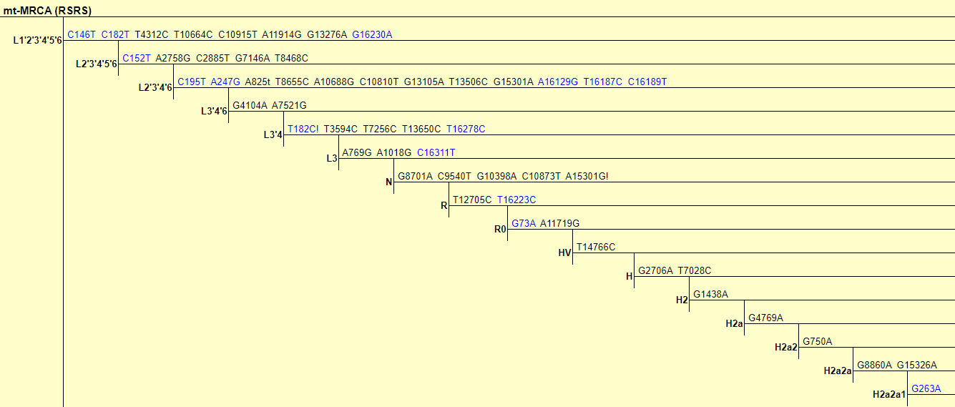
Phylotree

Slide 74
Related Work
MIXEMT Algorithm
  Input:
    The reference sequence
    Phylotree file
    Aligned sequences as a BAM file
  Output:
    #Contributors
    Proportion of each contributor
    Haplogroup of each contributor

Slide 75
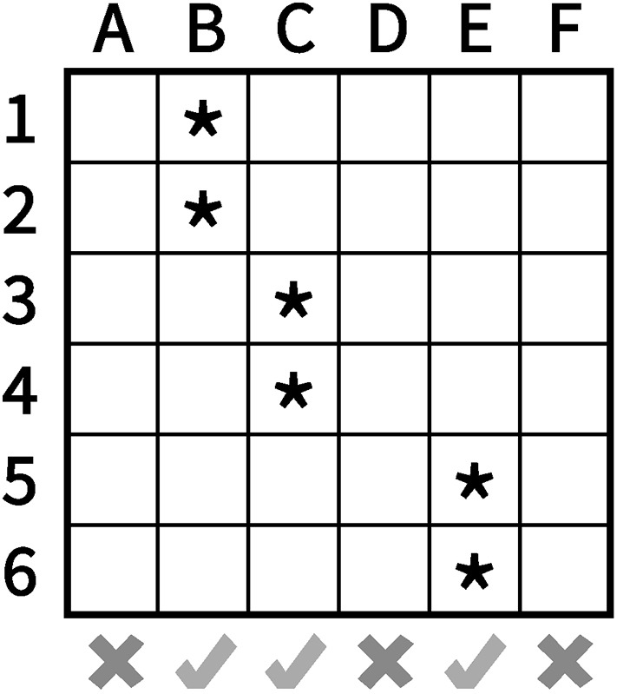
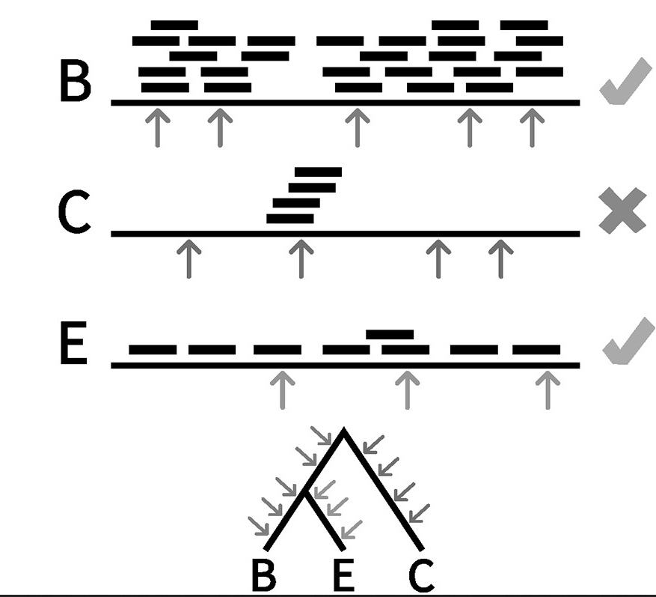
MIXEMT Workflow
Building A EM Matrix
First filter
Second filter
#Contributors
Proportion of each contributor
Haplogroup of each contributor

Slide 76
Outline
Background
Mitochondrial Genome Assembly
  Related Work
  Statistical Mitogenome Assembly with Repeats (SMART)
    The pipeline
    Results
  Multi-Sample Statistical Mitogenome Assembly with Repeats (SMART2)
    The pipeline
    Results
Haplogroup Assignment
  Related Work
  Algorithms (single & mixture)
  Results
Future Work

Slide 77
Single Individual Algorithms
Single Individual Algorithms:
  Frequencies
  Jaccard
  Hybrid

Slide 78
Frequencies
Building indexes for haplogroups sequences
IsoEM2
Top first haplogroups with highest frequencies

Slide 79
Jaccard
RSRS
Paired-end WGS data
HISAT2
SNVQ
Mutations
Haplogroups variations
Jaccard index
Top first haplogroup with highest Jaccard

Slide 80
Hybrid
RSRS
Paired-end WGS data
HISAT2
SNVQ
Mutations
Haplogroups variations
HISAT2
Building indexes
Top X haplogroup with highest Jaccard
Jaccard index
IsoEM2
Top first haplogroups with highest frequencies

Slide 81
Mixture Algorithms
Single Individual Algorithms:
  Frequencies
  Jaccard
  Jaccard-unions

Slide 82
Frequencies
Building indexes for haplogroups sequences
IsoEM2
Top two haplogroups with highest frequencies

Slide 83
Jaccard
RSRS
Paired-end WGS data
HISAT2
SNVQ
Mutations
Haplogroups variations
Jaccard index
Top two haplogroup with highest Jaccard

Slide 84
Jaccard-Unions
Preprocessing
  For all pairs of haplogroups
    compute union of mutations
RSRS
Paired-end WGS data
Pair haplogroups with union of variations
HISAT2
SNVQ
Mutations
Jaccard index
Top first pair haplogroup with highest Jaccard

Slide 85
Outline
Background
Mitochondrial Genome Assembly
  Related Work
  Statistical Mitogenome Assembly with Repeats (SMART)
    The pipeline
    Results
  Multi-Sample Statistical Mitogenome Assembly with Repeats (SMART2)
    The pipeline
    Results
Haplogroup Assignment
  Related Work
  Algorithms (single & mixture)
  Results
Future Work

Slide 86
Dataset
Single individual:
  Simulation data
  Real data
Mixture
  Simulation data

Slide 87
Simulation Data
We use just haplogroups that are leaves in Phylotree
The haplogroups are 2,897:
  423 haplogroups have one sequence
  2,454 haplogroups have two sequences
  20 haplogroups have three sequences.
We divide these sequences of the haplogroups into two groups.
  Each group has the only sequence from a haplogroup when it has just one sequence. If the haplogroup has more than one sequence, a different sequence is put in a different group.
A sequence is used for simulation is not used to be a reference to which map to it.

Slide 88
Simulation Data
We use wgsim tool to simulate data.
Single Individuals
  10,000 read pairs
  Read length: 250 bp
Mixture
  10,000 read pairs:
    5,000 read pairs for each haplogroup in pair.
    Read length: 250 bp

Slide 89
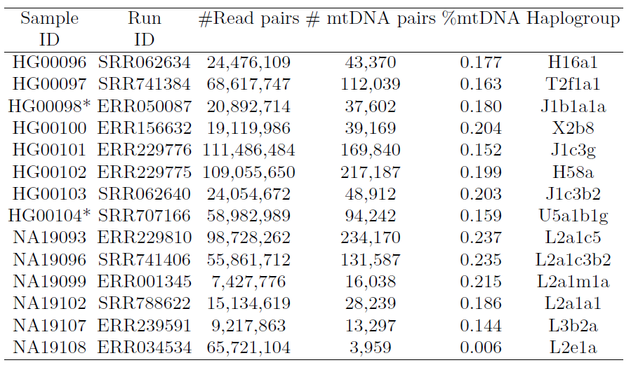
Single Individual (Real Data) Leaves Haplogroups

Slide 90

Single Individual (Real Data) Internal-Nodes Haplogroups

Slide 91


Single Individual (Simulation Data for 2,897 Haplogroups)
Group#1
Group#2

Slide 92


Single Individual (Simulation Data for 2,474 Haplogroups)
Group#1
Group#2

Slide 93

Single Individual (Real Data) Leaves Haplogroups

Slide 94

Single Individual (Real Data) Internal-Nodes Haplogroups

Slide 95

Mixture (Simulation Data) for 2,897 Pair Haplogroups

Slide 96
Outline
Background
Mitochondrial Genome Assembly
  Related Work
  Statistical Mitogenome Assembly with Repeats (SMART)
    The pipeline
    Results
  Multi-Sample Statistical Mitogenome Assembly with Repeats (SMART2)
    The pipeline
    Results
Haplogroup Assignment
  Related Work
  Algorithms (single & mixture)
  Results
Future Work

Slide 97
Future Work
Plants organelles Assembly
  Circular organelles in Plants:
    Mitochondria
    Chloroplasts
  Plants organelle genomes are much larger than in animals
  Mitochondrial genome sizes in plants are between 200,000 and 2,000,000 bp
  90% of these larger plants mitochondrial DNA sequences are introns and repeated sequences
  Chloroplasts genomes range size is between 120,000 and 170,000

Slide 98
Publications
M.S. Muyyarikkandy and F. Alqahtani and I.I. Mandoiu and M.A. Amalaradjou, Draft Genome Sequence of Lactobacillus rhamnosus NRRL B-442, a Potential Probiotic Strain, Genome Announcements 6, pp. e00046-18, 2018
M.S. Muyyarikkandy and F. Alqahtani and I.I. Mandoiu and M.A. Amalaradjou, Draft Genome Sequence of Lactobacillus paracasei DUP 13076, Which Exhibits Potent Antipathogenic Effects against Salmonella enterica Serovars Enteritidis, Typhimurium, and Heidelberg, Genome Announcements 6, pp. e00065-18, 2018
J. Duan and Z. Jiang and F. Alqahtani and I.I. Mandoiu and D. Hong and X. Zheng and S.L. Marjani and J. Chen and X. Tian, Methylome dynamics of bovine gametes and in vivo early embryos, Frontiers in Genetics 10:512, 2019
F. Alqahtani and I.I. Mandoiu, Statistical Mitogenome Assembly with Repeats, Journal of Computational Biology, 2020 (accepted)
F. Alqahtani and I.I. Mandoiu, SMART2: Multi-Library Statistical Mitogenome Assembly with Repeats, Post-proceedings of ICCABS’19, Springer Verlag LNBI, (under review)
F. Alqahtani, D. Duckett, S. Pirro, and I.I. Mandoiu, Complete mitochondrial genome of the Water vole, Microtus richardsoni, (in preparation)
F. Alqahtani and I.I. Mandoiu, Haplogroup Assignment of Mitochondrial DNA Sequence from Mixture Samples (in preparation)

Slide 99
Thank You for Your Attention
Any questions?

