Slide 1
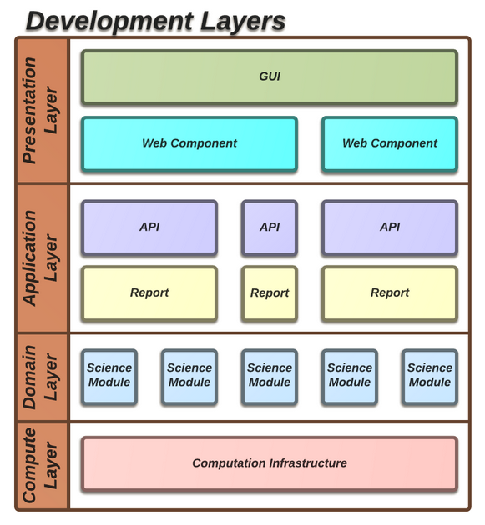
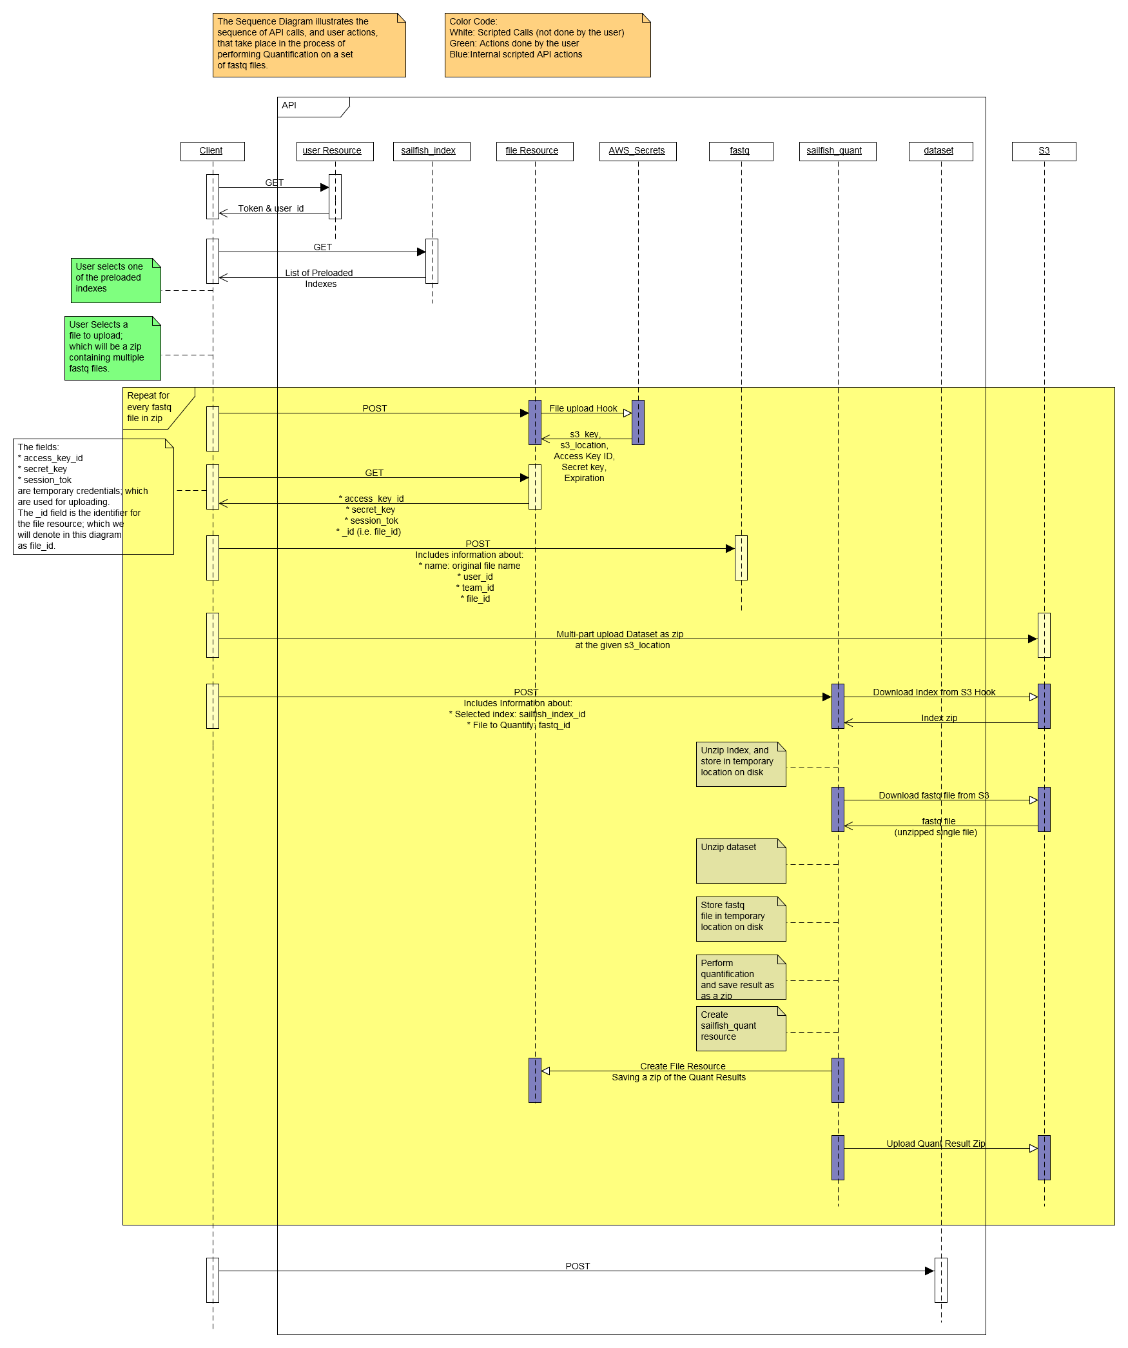
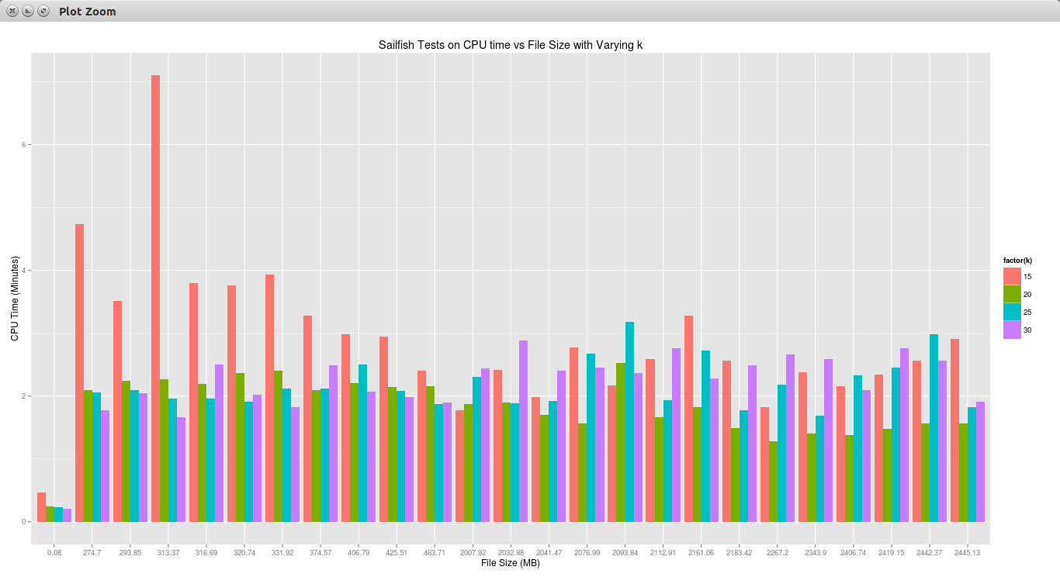
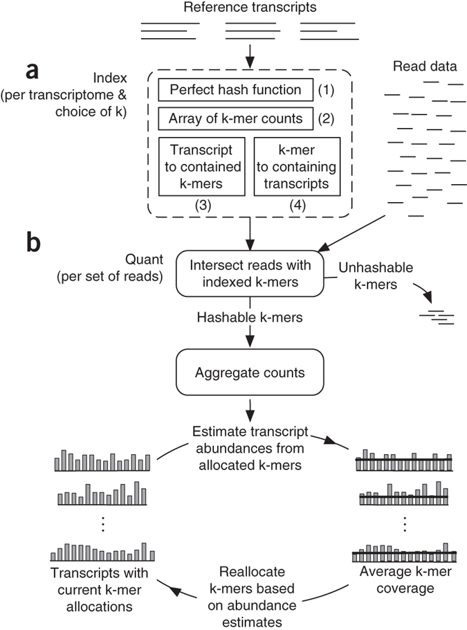
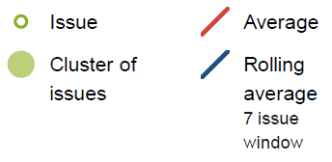
Cloud-Based Transcriptome Quantification from RNA-Sequencing Reads
Matthew Bemis¹, David Chen¹, Zachary Dicesare¹, Nicholas Kruczek¹, Reynaldo Morillo¹, James Lindsay², Mike Lydon², and Ion Mandoiu¹
¹Computer Science & Engineering Department University of Connecticut, Storrs, CT
²Smpl Bio LLC, One Technology Drive, Tolland, CT
Massively parallel whole transcriptome sequencing (RNA-Seq) has become the technology of choice for performing transcriptome analysis, rapidly replacing microarray-based technologies. Unlike microarrays, RNA-Seq has the ability to probe the complete transcriptome at single base resolution, providing a powerful tool for de novo transcriptome reconstruction, gene expression level estimation, studying trans- and cis-regulatory effects, calling expressed variants, etc. However, widespread adoption of RNA-Seq poses a significant challenge since most biology labs do not have the high-performance computational infrastructure and bioinformatics expertise needed to store and analyze large RNA-Seq datasets. The goal of this senior design project was to implement a prototype RNA-Seq analysis pipeline based on the scalable cloud-based software platform developed by Smpl Bio LLC.
Sequencer
AmazonS3
Instance 1
Instance 2
…
Instance n
Upload fastq files to
Amazon S3
Interactive visualization
using Polymer web-components & Plotly
Voice of the customer interviews
In the first phase of the project the team conducted interviews with RNA-Seq users across the UConn campus and distilled their feedback into a set of requirements.
User Interface
The user interface was built with web components implemented using Google’s Polymer library and the material design language, and integrates interactive visualizations implemented using the Plotly Python graphing library.
Preliminary evaluation
The team also performed a preliminary evaluation of existing RNA-Seq quantification tools, selecting for implementation the recently published Sailfish algorithm. The Sailfish algorithm operates on a set of reference transcript sequences and RNA-Seq reads given in fastq format. Reads are analyzed using a two-step process consisting of read and transcript indexing followed by quantification via Expectation-Maximization. The most salient feature of Sailfish is the replacement of the read mapping step used by other methods with very fast k-mer indexing and counting algorithms based on hashing. This allows Sailfish to quantify transcript abundances over 20 times faster than other tools.
Sequencing of API Calls
Science Module: Sailfish algorithm
About Smpl Bio
Smpl Bio LLC, a UConn spin-off based in Tolland, CT, is focused on delivering powerful yet easy to use bioinformatics solutions for targeted genomics, including best-in-class tools for biomarker selection, experimental design, and data analysis. These tools are delivered through a representational state transfer (REST) application program interface (API) server hosted on the Amazon Elastic Compute Cloud (EC2).

