Slide 1
TNet: Transmission Network Inference Using Within-Host Strain Diversity and its Application to Geographical Tracking of COVID-19 Spread
Saurav Dhar

Slide 2
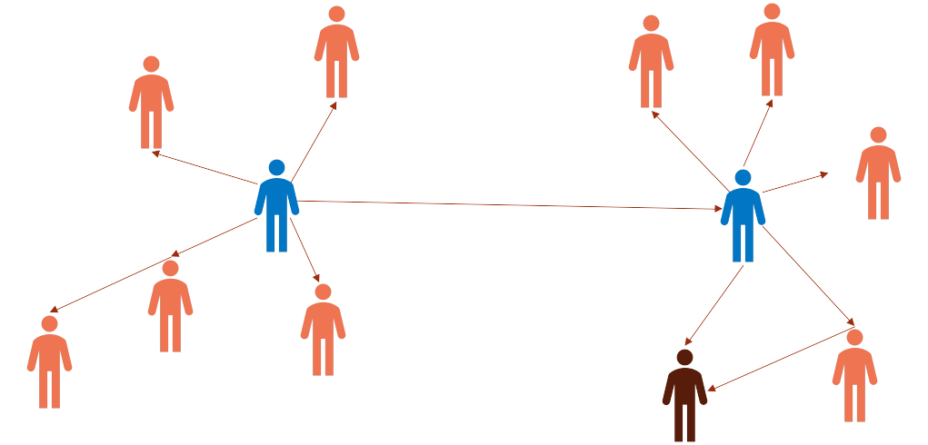
Transmission network
Who infected whom?
Who are the sources of infection?

Slide 3
Problem
Inputs
Viral sequences sampled from the hosts
Epidemiological data: sampling times, infection times
Other data: Contact network
Output
The Transmission Network

Slide 4
Approaches
Sequence Similarity or Relatedness Graph based
Ex: QUENTIN, HIV-TRACE
Lack of resolution, often unable to infer transmission directions
Phylogeny based
Ex: Phybreak, TransPhylo, BadTrIP, Phyloscanner, SharpTNI, TNet
Construct a phylogeny from the viral sequences (transmission phylogeny)
Infer transmission by computing a host assignment for each node

Slide 5
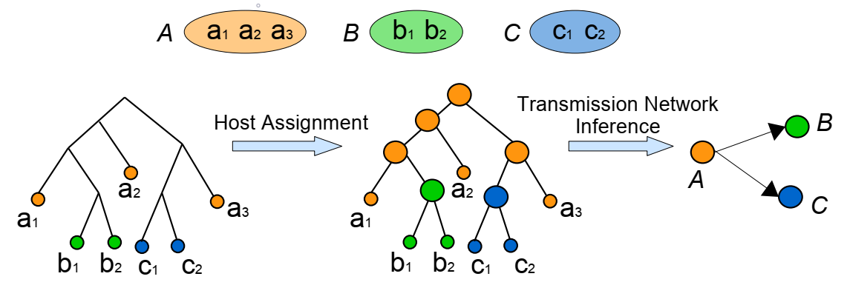
TNet workflow

Slide 6
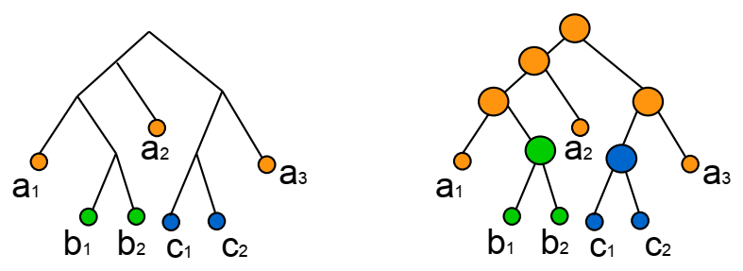
Host assignment for internal nodes
Assumption: Optimal assignment will have least number of host changes
Each host change will result in an edge in the transmission network
Small
Parsimony
Problem

Slide 7
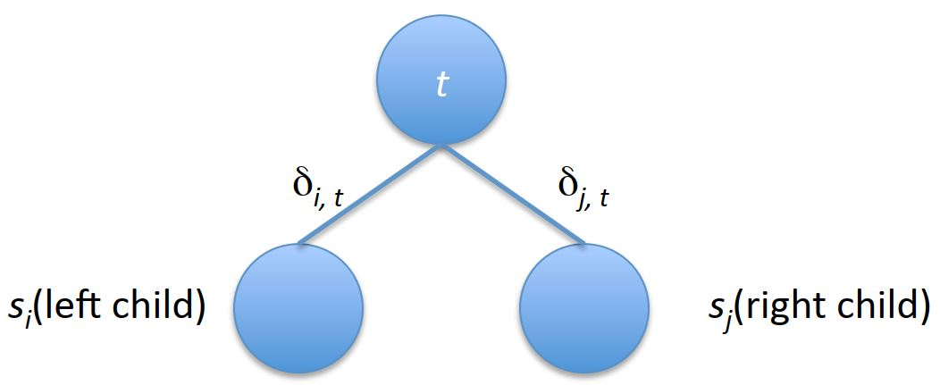

Sankoff’s Algorithm
$S_{t}\left(v\right)=minimum parsimony score of subtree rooted at node v if v has state t$
$S_{t}\left(v\right)=\left\{\begin{aligned}0 if node v has state t \\ ∞ if node v has any other state\end{aligned}\right.$
$S_{t}\left(parent\right)= \min_{i}{ \{S_{i}\left(left child\right)+}δ_{i,t}\}+\min_{j}{ \{S_{j}\left(right child\right)+}δ_{j,t}\}$

Slide 8
Step 1: Initialize leaf nodes
Hosts [H₁, H₂, H₃, H₄]
H₁
H₂
H₃
H₄
H₁
Score:
0 | ∞ | ∞ | ∞
∞ | 0 | ∞ | ∞
∞ | ∞ | 0 | ∞
∞ | ∞ | ∞ | 0
0 | ∞ | ∞ | ∞

Slide 9
Step 2: Calculate score for non-leaf nodes
3 | 4 | 4 | 4
Hosts [H₁, H₂, H₃, H₄]
Postorder traversal
2 | 2 | 2 | 3
1 | 1 | 2 | 2
1 | 2 | 2 | 1
H₁
H₂
H₃
H₄
H₁
Score:
0 | ∞ | ∞ | ∞
∞ | 0 | ∞ | ∞
∞ | ∞ | 0 | ∞
∞ | ∞ | ∞ | 0
0 | ∞ | ∞ | ∞

Slide 10
Step 3: Choose host at root
3 | 4 | 4 | 4
H₁
Hosts [H₁, H₂, H₃, H₄]
Parsimony score = 3
2 | 2 | 2 | 3
1 | 1 | 2 | 2
1 | 2 | 2 | 1
H₁
H₂
H₃
H₄
H₁
Score:
0 | ∞ | ∞ | ∞
∞ | 0 | ∞ | ∞
∞ | ∞ | 0 | ∞
∞ | ∞ | ∞ | 0
0 | ∞ | ∞ | ∞

Slide 11
Step 4: Choose hosts for all internal nodes
3 | 4 | 4 | 4
H₁
Hosts [H₁, H₂, H₃, H₄]
Preorder traversal
2 | 2 | 2 | 3
H₁
1 | 1 | 2 | 2
H₁
H₁
1 | 2 | 2 | 1
H₁
H₂
H₃
H₄
H₁
Score:
0 | ∞ | ∞ | ∞
∞ | 0 | ∞ | ∞
∞ | ∞ | 0 | ∞
∞ | ∞ | ∞ | 0
0 | ∞ | ∞ | ∞

Slide 12
Step 5: Identify transmission edges
H₁
Preorder traversal
Parsimony score = 3
H₁
H₁
H₁
H₁
H₂
H₃
H₄
H₁

Slide 13
Step 6: The Transmission Network
H₁ is the source
H₁
H₂
H₃
H₄

Slide 14
Is this enough?
Choices over maximum likelihood trees
Is the Maximum Likelihood tree the correct tree to model the outbreak?
Choices over multiple optimal host assignment
Which host to choose when multiple optimal score?

Slide 15
Dealing with multiple optimal host assignment
Root Score:
6 | 5 | 5 | 7
Assign H₂ or H₃ at root ?
Choose uniformly at random ?
Not a good idea
Count number of optimal solutions for each of these assignments
Use the counts to get the probability of choosing one host over another

Slide 16
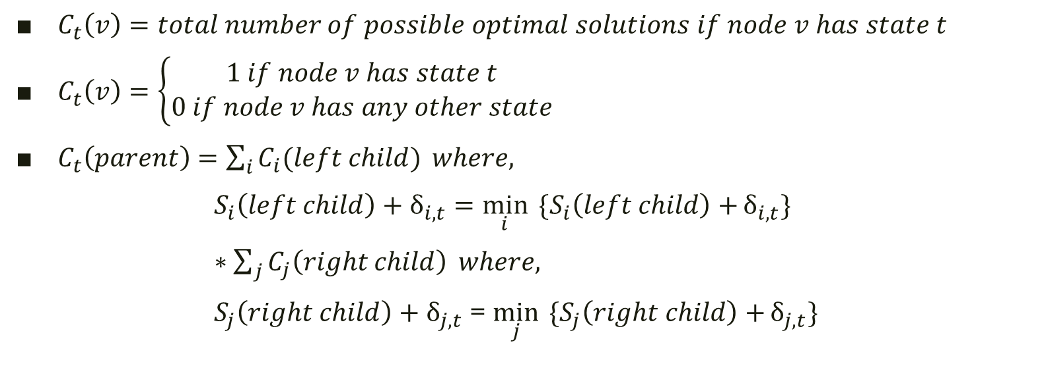
Counting number of optimal solutions
$C_{t}\left(v\right)=total number of possible optimal solutions if node v has state t$
$C_{t}\left(v\right)=\left\{\begin{aligned}1 if node v has state t \\ 0 if node v has any other state\end{aligned}\right.$
$C_{t}\left(parent\right)=\sum_{i}{C_{i}(left child)} where,$
$S_{i}\left(left child\right)+δ_{i,t}=\min_{i}{ \{S_{i}\left(left child\right)+}δ_{i,t}\}$
$∗\sum_{j}{C_{j}\left(right child\right)} where,$
$S_{j}\left(right child\right)+δ_{j,t}$ = $\min_{j}{ \{S_{j}\left(right child\right)+}δ_{j,t}\}$

Slide 17
Initialization of solution count
Score | 5 + 6
Count | 25 * 4
Score | 5 | 4 | 6 | 5
Count | 10 | 15 | 5 | 10
Score | 10 | 7 | 6 | 5
Count | 5 | 2 | 10 | 4
Now we can use both Score and Solution Count to make the choices

Slide 18
Extended Sankoff algorithm with scores and counts
3 | 4 | 4 | 4
1 | 3 | 3 | 8
H₁
2 | 2 | 2 | 3
1 | 1 | 3 | 3
H₁
1 | 1 | 2 | 2
1 | 2 | 2 | 1
1 | 1 | 1 | 1
H₁
H₁
1 | 1 | 1 | 1
H₁
H₂
H₃
H₄
H₁
Score:
0 | ∞ | ∞ | ∞
∞ | 0 | ∞ | ∞
∞ | ∞ | 0 | ∞
∞ | ∞ | ∞ | 0
0 | ∞ | ∞ | ∞
Count:
1 | 0 | 0 | 0
0 | 1 | 0 | 0
0 | 0 | 1 | 0
0 | 0 | 0 | 1
1 | 0 | 0 | 0

Slide 19
Dealing with multiple optimal host assignments with Random Sampling
Score | 6 | 5 | 5 | 10
Count | 20 | 10 | 30 | 5
H₂
H₃
P_{r}(H₂) = $\frac{10}{10+30}=\frac{1}{4}$
P_{r}(H₃) = $\frac{30}{10+30}=\frac{3}{4}$

Slide 20
Dealing with multiple optimal host assignments with Biased Sampling
Score | 5 + 6
H₁
Keep same host as parent
Random Sampling
H₁
Score | 5 | 4 | 6 | 5
Count | 10 | 15 | 5 | 10
Score | 10 | 7 | 5 | 5
Count | 5 | 2 | 10 | 5

Slide 21
Random Sampling vs. TNet
Parsimony score = 4
Parsimony score = 4
TNet minimizes the number of back-transmission by choosing the host in a greedy manner
Back-transmission means reinfection of the same host by a descendant strain
Changes are pushed further down the tree keeping the same parsimony score

Slide 22
Random Sampling vs. TNet:
Super spreader
Infector ratio ~ 2
Infector ratio ~ 7
From the simulated data we see that TNet with bias works better for networks with higher infector ratio

Slide 23
Inferring the final transmission network
Dealing with multiple optimal host assignment
Summarize over several runs of TNet (Sampling)
Pick the transmission edges based on a sampling threshold
Choices over maximum likelihood transmission phylogeny
Summarize over several bootstrap phylogeny
Pick the transmission edges based on a bootstrap threshold
Summarize both steps
First use a sampling threshold to get the edges over several runs on a single tree
Then use a bootstrap threshold to get the summary edges over all the bootstrap trees
These summary edges will inter the final transmission network

Slide 24
FAVITES Simulation Parameters
Contact Network: Barabasi-Albert
Total number of nodes: 1000
Seed nodes: 1
Seed Sequence: User defined
Sequence Evolution: GTR + Gamma
Transmission Time Sample: SEIR and SIR models
Sequence length: 250bp, 500bp and 1000bp
Mutation rate: 0.125, 0.25 and 0.5
Number of viral sequences per host: 5, 10 and 20
20 runs in each setting
Total 560 dataset

Slide 25
TNet on FAVITES dataset
Measure
Precision
Recall
F1 score
The true transmission network was known
Compare against
Phyloscanner
Random Sampling
sharpTNI
Handling topological uncertainty
Use 100 bootstrap trees
50% bootstrap threshold
Handling sampling uncertainty
Run 100 times on a single tree
Run for all 100 bootstrap trees

Slide 26
Accuracy of methods using single sample

Slide 27
Accuracy of methods using multiple samples and multiple phylogenies (50% sampling threshold)

Slide 28
Accuracy of methods using multiple samples and multiple phylogenies (100% sampling threshold)

Slide 29
TNet on CDC dataset
Dataset
10 HCV outbreaks with known sources
2 to 19 infected hosts per outbreak
49 to 209 sequences per outbreak
HVR-1 was sequenced
Measure
Precision
Recall
F1 score
Handling topological uncertainty
Use 100 bootstrap trees
50% bootstrap threshold
Handling sampling uncertainty
Run 100 times on a single tree
Run for all 100 bootstrap trees
Compare against
Phyloscanner
Random Sampling
sharpTNI

Slide 30
Accuracy of methods using multiple samples and multiple phylogenies (50% sampling threshold)

Slide 31
Accuracy of methods using multiple samples and multiple phylogenies (100% sampling threshold)

Slide 32
COVID-19 country level analysis
Dataset
59 countries
2123 total complete sequences
10 to 100 sequences per country
Up to June, 2020
Measure
Country of exposure
Top 5 spreaders and receivers in each month
Top 5 spreaders and receivers of USA
Handling topological uncertainty
Use 10 bootstrap trees
Handling sampling uncertainty
Run 100 times on a single tree
Run for all 100 bootstrap trees
Compared against Nextstrain (augur)
sharpTNI could not be applied because it did not scale to the size
We treated countries as hosts for this analysis

Slide 33
Accuracy percentage of known country of exposure for each sequence
TNet’s minimum back-transmission sampling assumption is violated by countries
Countries keep getting “reinfected” from other countries

Slide 34
Top 5 spreaders during each month

Slide 35
Top 5 receivers during each month

Slide 36
Top 5 spreaders to USA during each month

Slide 37
Top 5 receivers from USA during each month

Slide 38
COVID-19 USA state level analysis
Dataset
30 states
1801 total complete sequences
10 to 100 sequences per country
Up to July, 2020
Measure
State of exposure
Top 5 spreaders and receivers in each month
Top 5 spreaders and receivers of New York
Handling topological uncertainty
Use 10 bootstrap trees
Handling sampling uncertainty
Run 100 times on a single tree
Run for all 100 bootstrap trees
Compared against Nextstrain (augur)
sharpTNI could not be applied because it did not scale to the size
We treated states as hosts for this analysis

Slide 39
Accuracy percentage of known state of exposure for each sequence
TNet’s minimum back-transmission sampling assumption is violated by countries
Countries keep getting “reinfected” from other countries

Slide 40
Top 5 spreaders during each month

Slide 41
Top 5 receivers during each month

Slide 42
Top 5 spreaders to New York during each month

Slide 43
Top 5 receivers from New York during each month

Slide 44
Conclusion
TNet uses multiple strain sequences from each sampled host to infer transmissions and is simpler and more accurate than existing approaches.
TNet uses an extended version of the classical Sankoff algorithm for ancestral host assignment, where it is possible to efficiently compute support values for individual transmission edges based on a sampling of optimal host assignments minimizing the number of back-transmissions.
TNet is parameter-free and highly scalable and can be easily applied within seconds to datasets with hundreds of strain sequences and hosts.

