Slide 1
Bioinformatics Methods for Diagnosis and Treatment of Human Diseases
Jorge Duitama
Dissertation Defense for the Degree of Doctorate in Philosophy
Computer Science & Engineering Department
University of Connecticut

Slide 2
Outline
Introduction
Analysis pipeline for immunotherapy
  Strategies for mRNA reads mapping
  SNV detection and genotyping
  Single individual haplotyping
Results on detection of immunogenic cancer mutations
Conclusions
  Future work: RCCX sequencing

Slide 3
Introduction
Research efforts during the last two decades have provided a huge amount of genomic information for almost every form of life
Much effort is focused on refining methods for diagnosis and treatment of human diseases
The focus of this research is on developing computational methods and software tools for diagnosis and treatment of human diseases

Slide 4
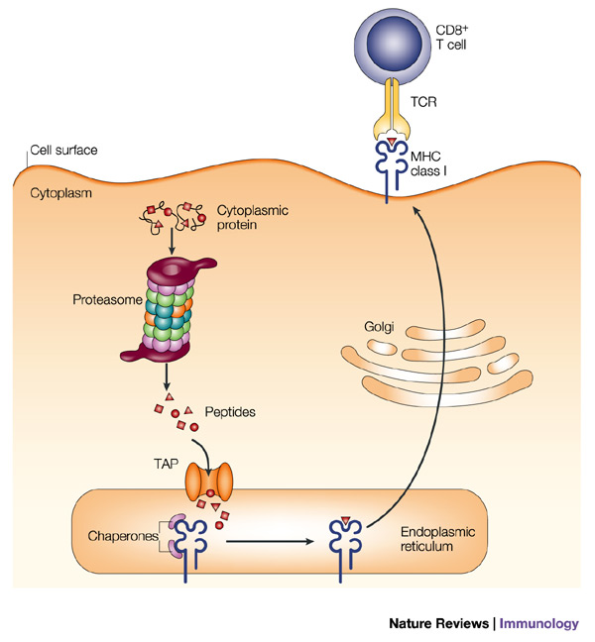
Immunology Background
J.W. Yedell, E Reits and J Neefjes. Making sense of mass destruction: quantitating MHC class I antigen presentation. Nature Reviews Immunology, 3:952-961, 2003

Slide 5

Cancer Immunotherapy
Peptides
Synthesis
Tumor mRNA
Sequencing
Tumor Specific
Epitopes Discovery
CTCAATTGATGAAATTGTTCTGAAACT
GCAGAGATAGCTAAAGGATACCGGGTT
SYFPEITHI
CCGGTATCCTTTAGCTATCTCTGCCTC
ISETDLSLL
CTGACACCATCTGTGTGGGCTACCATG
CALRRNESL
…
…
AGGCAAGCTCATGGCCAAATCATGAGA
Immune
System
Training
Tumor
Remission
Mouse Image Source: http://www.clker.com/clipart-simple-cartoon-mouse-2.html

Slide 6
Analysis Pipeline
CCDS mapped reads
CCDS
Mapping
Tumor mRNA reads
Mapped reads
Read Merging
Genome Mapping
Genome mapped reads
SNVs Detection
Tumor-specific SNVs
Close SNV Haplotypes
Epitopes Prediction
Haplotyping
Primers for Sanger Sequencing
Tumor specific epitopes
Primers Design

Slide 7
Analysis Pipeline
CCDS mapped reads
CCDS
Mapping
Tumor mRNA reads
Mapped reads
Read Merging
Genome Mapping
Genome mapped reads
SNVs Detection
Tumor-specific SNVs
Close SNV Haplotypes
Epitopes Prediction
Haplotyping
Primers for Sanger Sequencing
Tumor specific epitopes
Primers Design

Slide 8
SNP Calling from Genomic DNA Reads
Read sequences &
quality scores
Reference genome
sequence
@HWI-EAS299_2:2:1:1536:631
GGGATGTCAGGATTCACAATGACAGTGCTGGATGAG
+HWI-EAS299_2:2:1:1536:631
::::::::::::::::::::::::::::::222220
@HWI-EAS299_2:2:1:771:94
ATTACACCACCTTCAGCCCAGGTGGTTGGAGTACTC
+HWI-EAS299_2:2:1:771:94
:::::::::::::::::::::::::::2::222220
>ref|NT_082868.6|Mm19_82865_37:1-3688105 Mus musculus chromosome 19 genomic contig, strain C57BL/6J
GATCATACTCCTCATGCTGGACATTCTGGTTCCTAGTATATCTGGAGAGTTAAGATGGGGAATTATGTCA
ACTTTCCCTCTTCCTATGCCAGTTATGCATAATGCACAAATATTTCCACGCTTTTTCACTACAGATAAAG
AACTGGGACTTGCTTATTTACCTTTAGATGAACAGATTCAGGCTCTGCAAGAAAATAGAATTTTCTTCAT
ACAGGGAAGCCTGTGCTTTGTACTAATTTCTTCATTACAAGATAAGAGTCAATGCATATCCTTGTATAAT
Read Mapping
SNP calling
1 4764558 G T 2 1
1 4767621 C A 2 1
1 4767623 T A 2 1
1 4767633 T A 2 1
1 4767643 A C 4 2
1 4767656 T C 7 1
Notes:
8
NOTE: P(g|r) is NP-Hard…

Slide 9
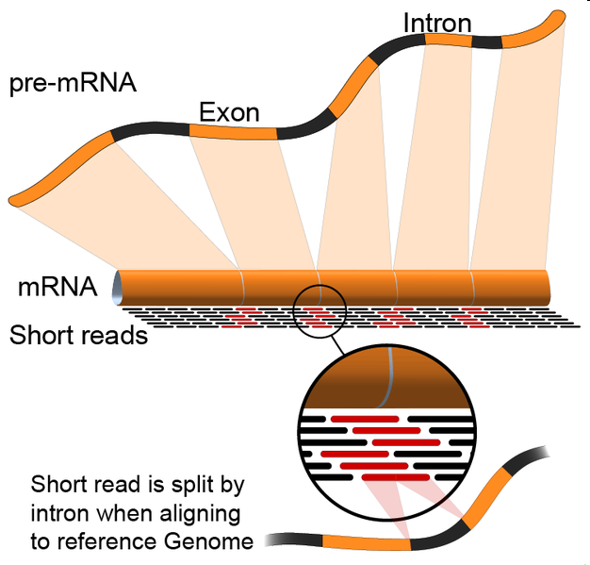
Mapping mRNA Reads
http://en.wikipedia.org/wiki/File:RNA-Seq-alignment.png
Notes:
9

Slide 10
Read Merging
Genome | CCDS | Agree? | Hard Merge | Soft Merge
Unique | Unique | Yes | Keep | Keep
Unique | Unique | No | Throw | Throw
Unique | Multiple | No | Throw | Keep
Unique | Not Mapped | No | Keep | Keep
Multiple | Unique | No | Throw | Keep
Multiple | Multiple | No | Throw | Throw
Multiple | Not Mapped | No | Throw | Throw
Not mapped | Unique | No | Keep | Keep
Not mapped | Multiple | No | Throw | Throw
Not mapped | Not Mapped | Yes | Throw | Throw

Slide 11
Analysis Pipeline
CCDS mapped reads
CCDS
Mapping
Tumor mRNA reads
Mapped reads
Read Merging
Genome Mapping
Genome mapped reads
SNVs Detection
Tumor-specific SNVs
Close SNV Haplotypes
Epitopes Prediction
Haplotyping
Primers for Sanger Sequencing
Tumor specific epitopes
Primers Design

Slide 12
SNV Detection and Genotyping
Locus i
Reference
AACGCGGCCAGCCGGCTTCTGTCGGCCAGCAGCCAGGAATCTGGAAACAATGGCTACAGCGTGC
AACGCGGCCAGCCGGCTTCTGTCGGCCAGCCGGCAG
CGCGGCCAGCCGGCTTCTGTCGGCCAGCAGCCCGGA
GCGGCCAGCCGGCTTCTGTCGGCCAGCCGGCAGGGA
GCCAGCCGGCTTCTGTCGGCCAGCAGCCAGGAATCT
GCCGGCTTCTGTCGGCCAGCAGCCAGGAATCTGGAA
CTTCTGTCGGCCAGCCGGCAGGAATCTGGAAACAAT
CGGCCAGCAGCCAGGAATCTGGAAACAATGGCTACA
CCAGCAGCCAGGAATCTGGAAACAATGGCTACAGCG
CAAGCAGCCAGGAATCTGGAAACAATGGCTACAGCG
GCAGCCAGGAATCTGGAAACAATGGCTACAGCGTGC
R_{i}
r(i) : Base call of read r at locus i
ε_{r(i)} : Probability of error reading base call r(i)
G_{i} : Genotype at locus i

Slide 13
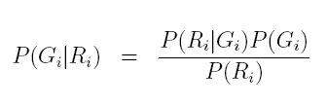
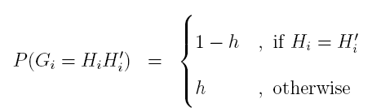
SNV Detection and Genotyping
Use Bayes rule to calculate posterior probabilities and pick the genotype with the largest one

Slide 14

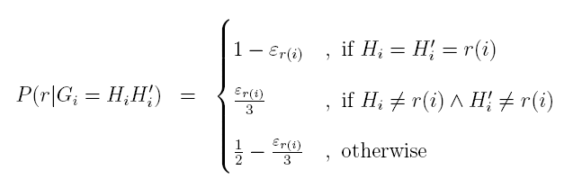
SNV Detection and Genotyping
Calculate conditional probabilities by multiplying contributions of individual reads

Slide 15
Accuracy Assessment of Variants Detection
113 million Illumina mRNA reads generated from blood cell tissue of Hapmap individual NA12878 (NCBI SRA database accession numbers SRX000565 and SRX000566)
  We tested genotype calling using as gold standard 3.4 million SNPs with known genotypes for NA12878 available in the database of the Hapmap project
  True positive: called variant for which Hapmap genotype coincides
  False positive: called variant for which Hapmap genotype does not coincide

Slide 16
Comparison of Mapping Strategies

Slide 17
Comparison of Variant Calling Strategies

Slide 18
Data Filtering

Slide 19
Data Filtering
Allow just x reads per start locus to eliminate PCR amplification artifacts
Chepelev et. al. algorithm:
  For each locus groups starting reads with 0, 1 and 2 mismatches
  Choose at random one read of each group

Slide 20
Comparison of Data Filtering Strategies

Slide 21
Accuracy per RPKM bins

Slide 22
Analysis Pipeline
CCDS mapped reads
CCDS
Mapping
Tumor mRNA reads
Mapped reads
Read Merging
Genome Mapping
Genome mapped reads
SNVs Detection
Tumor-specific SNVs
Close SNV Haplotypes
Epitopes Prediction
Haplotyping
Primers for Sanger Sequencing
Tumor specific epitopes
Primers Design

Slide 23
ReFHap: A Reliable and Fast Algorithm for Single Individual Haplotyping
Jorge Duitama^{1,2}, Thomas Huebsch², Gayle McEwen², Eun-Kyung Suk², Margret R. Hoehe²
1. Department of Computer Science and Engineering University of Connecticut, Storrs, CT, USA
2. Max Planck Institute for Molecular Genetics, Berlin, Germany

Slide 24
Haplotyping
Human somatic cells are diploid, containing two sets of nearly identical chromosomes, one set derived from each parent.
ACGTTACATTGCCACTCAATC--TGGA
ACGTCACATTG-CACTCGATCGCTGGA
Heterozygous variants

Slide 25
Haplotyping
Locus | Event | Alleles Hap 1 | Alleles Hap 2
1 | SNV | T | C
2 | Deletion | C | -
3 | SNV | A | G
4 | Insertion | - | GC
Locus | Event | Alleles
1 | SNV | C,T
2 | Deletion | C,-
3 | SNV | A,G
4 | Insertion | -,GC
The process of grouping alleles that are present together on the same chromosome copy of an individual is called haplotyping
Haplotyping enables improved predictions of changes in protein structure and increase power for genome-wide association studies

Slide 26
Current Approaches
Source Information | Approach
Populaton genotypes or haplotypes | Statistical Phasing
Parental genotypes | Trio Phasing
Evidence of coocurrance of alleles | Single Individual Haplotyping
New experimental approaches are now able to deliver input data for whole genome Single Individual Haplotyping
We propose a new formulation and an algorithm for this problem

Slide 27
Problem Formulation
Alleles for each locus are encoded with 0 and 1
Fragment: Segment showing coocurrance of two or more alleles in the same chromosome copy
Locus | 1 | 2 | 3 | 4 | 5 | 6 | 7 | 8 | 9 | ...
f | - | 0 | 1 | 1 | - | 1 | - | 0 | 0 | ...

Slide 28
Problem Formulation
Input: Matrix M of m fragments covering n loci
Locus | 1 | 2 | 3 | 4 | 5 | ... | n
f₁ | 1 | 1 | 0 | - | 1 |  | -
f₂ | - | 0 | 1 | 0 | 0 |  | 1
f₃ | - | 0 | 0 | 0 | 1 |  | -
...
f_{m} | - | - | - | - | 1 |  | 0

Slide 29
Problem Formulation
Input: Matrix M of m fragments covering n loci
Locus | 1 | 2 | 3 | 4 | 5 | ... | n
f₁ | 1 | 1 | 0 | - | 1 |  | -
f₂ | - | 0 | 1 | 0 | 0 |  | 1
f₃ | - | 0 | 0 | 0 | 1 |  | -
...
f_{m} | - | - | - | - | 1 |  | 0

Slide 30
Problem Formulation
Input: Matrix M of m fragments covering n loci
Locus | 1 | 2 | 3 | 4 | 5 | ... | n
f₁ | 1 | 1 | 0 | - | 1 |  | -
f₂ | - | 0 | 1 | 0 | 0 |  | 1
f₃ | - | 0 | 0 | 0 | 1 |  | -
...
f_{m} | - | - | - | - | 1 |  | 0

Slide 31
Problem Formulation
Input: Matrix M of m fragments covering n loci
Locus | 1 | 2 | 3 | 4 | 5 | ... | n
f₁ | 1 | 1 | 0 | - | 1 |  | -
f₂ | - | 0 | 1 | 0 | 0 |  | 1
f₃ | - | 0 | 0 | 0 | 1 |  | -
...
f_{m} | - | - | - | - | 1 |  | 0

Slide 32
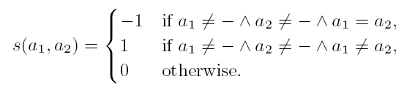
Problem Formulation
For two alleles a₁, a₂
For two rows i₁, i₂ of M
f₁ | - | 0 | 1 | 1 | 0
f₂ | 1 | 1 | 1 | - | 1
Score | 0 | 1 | -1 | 0 | 1
s(M,1,2) = 1

Slide 33

Problem Formulation
For a cut I of rows of M

Slide 34
Complexity
MFC is NP-Complete
0 | - | -
1 | 0 | -
- | 1 | 0
- | - | 1
2
4
1
3

Slide 35
Algorithm
Reduce the problem to Max-Cut.
Solve Max-Cut
Build haplotypes according with the cut
Locus | 1 | 2 | 3 | 4 | 5
f₁ | - | 0 | 1 | 1 | 0
f₂ | 1 | 1 | 0 | - | 1
f₃ | 1 | - | - | 0 | -
f₄ | - | 0 | 0 | - | 1
4
1
-1
3
1
2
1
-1
3
h₁ 00110
h₂ 11001

Slide 36
Heuristic for Max-Cut
Build G=(V,E,w) from M
Sort E from largest to smallest weight
Init I with a random subset of V
For each e in the first k edges
  I’ ← GreedyInit(G,e)
  I’ ← GreedyImprovement(G,I’)
  If s(M, I) < s(M, I’) then I ← I’
Total complexity: O(k(m²k₁k₂ + mk₁²k₂²))

Slide 37
Greedy Init
1
2
1
2
4
4
3
5
3
5
Complexity: O(m²k₁k₂)

Slide 38
Local Optimization
Classical greedy algorithm
1
1
4
4
2
3
2
3
Complexity: O(mk₁k₂)

Slide 39
Local Optimization
Edge flipping
1
2
2
1
3
4
3
4
Complexity: O(mk₁²k₂²)

Slide 40
Simulations Setup
We generated random instances varying:
  Number of loci n
  Number of fragments f
  Mean fragment length l
  Error rate e
  Gap rate g
For each experiment we fixed all parameters and generated 100 random instances

Slide 41
ReFHap vs HapCUT
Number of loci: 200
Mean fragment length: 6
Error rate: 0.05
Gap rate: 0.1
Number of Fragments between 222 and 370

Slide 42
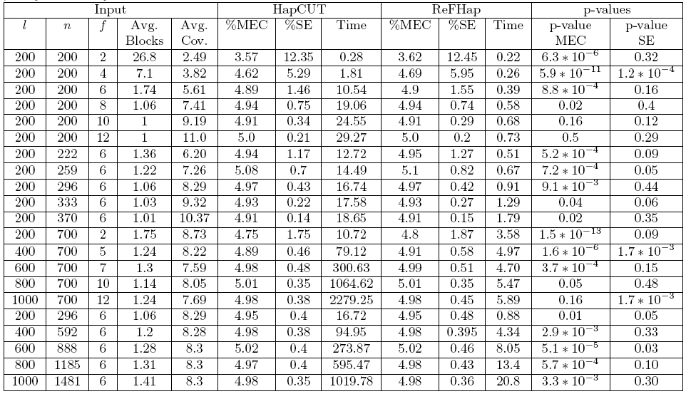
ReFHap vs HapCUT

Slide 43
Analysis Pipeline
CCDS mapped reads
CCDS
Mapping
Tumor mRNA reads
Mapped reads
Read Merging
Genome Mapping
Genome mapped reads
SNVs Detection
Tumor-specific SNVs
Close SNV Haplotypes
Epitopes Prediction
Haplotyping
Primers for Sanger Sequencing
Tumor specific epitopes
Primers Design

Slide 44
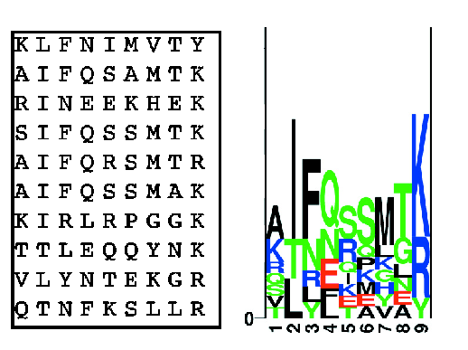
Epitopes Prediction
Predictions include MHC binding, TAP transport efficiency, and proteasomal cleavage
C. Lundegaard et al. MHC Class I Epitope Binding Prediction Trained on Small Data Sets. In Lecture Notes in Computer Science, 3239:217-225, 2004

Slide 45
NetMHC vs. SYFPEITHI

Slide 46
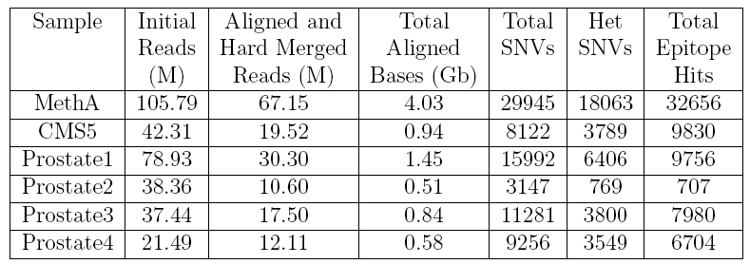
Results on Tumor Reads

Slide 47
Validation Results
Mutations reported by [Noguchi et al 94] were found by this pipeline
Confirmed with Sanger sequencing 18 out of 20 mutations for MethA and 26 out of 28 mutations for CMS5

Slide 48
NetMHC Scores Distribution of Mutated Peptides

Slide 49
Distribution of NetMHC Score Differences Between Mutated and Reference Peptides

Slide 50
Conclusions
We presented a bioinformatics pipeline for detection of immunogenic cancer mutations from high throughput mRNA sequencing data
We contributed new techniques and strategies for:
  Mapping of mRNA reads
  SNV detection and genotyping
  Single individual Haplotyping
We discovered hundreds of candidate epitopes for two cancer cell lines and four spontaneous tumors

Slide 51
Current Status
PrimerHunter paper published in NAR journal
  Jorge Duitama, Dipu M. Kumar, Edward Hemphill, Mazhar Khan, Ion I. Mandoiu and Craig E. Nelson. PrimerHunter: a primer design tool for PCR-based virus subtype identification. Nucleic Acids Research, 37(8):2483-2492,2009
ReFHap paper published in ACM BCB proceedings
  Jorge Duitama, Thomas Huebsch, Gayle McEwen, Eun-Kyung Suk, and Margret R. Hoehe. ReFHap: A reliable and fast algorithm for single individual haplotyping. In Proceedings of the First ACM international Conference on Bioinformatics and Computational Biology (Niagara Falls, New York, August 02 - 04, 2010). BCB '10. ACM, New York, NY, 160-169, 2010
GeneSeq paper to appear in BMC Bioinformatics
  Jorge Duitama, Justin Kennedy, Sanjiv Dinakar, Yozen Hernandez, Yufeng Wu and Ion I. Mandoiu. Linkage Disequilibrium Based Genotype Calling from Low-Coverage Shotgun Sequencing Reads. BMC Bioinformatics (to appear), 2011
Papers to be submitted
  SNV detection on mRNA reads to NAR
  Whole genome haplotyping from fosmid pools to Nature

Slide 52
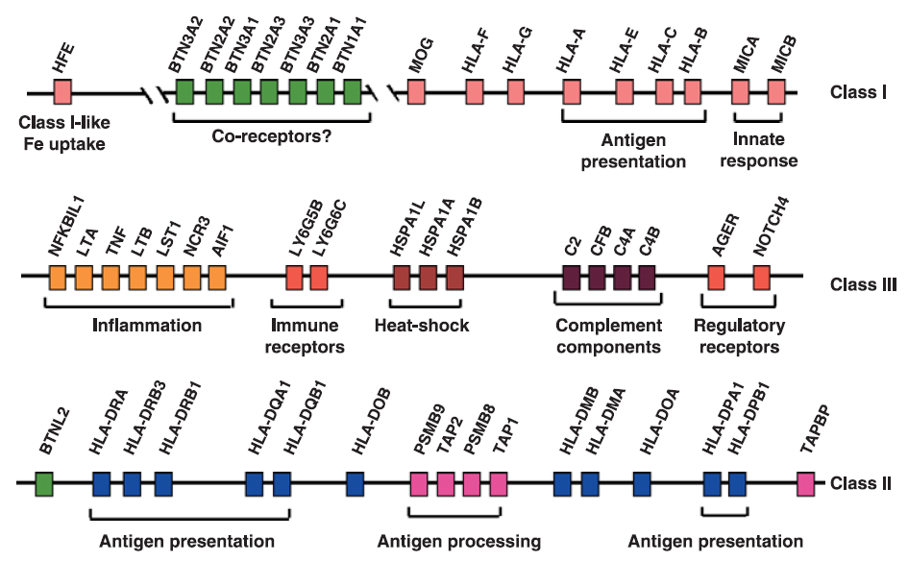
Major Histocompatibility Complex (MHC)
J. A. Traherne. Human MHC architecture and evolution: implications for disease association studies. International Journal of Immunogenetics, 35:179-192, 2008

Slide 53
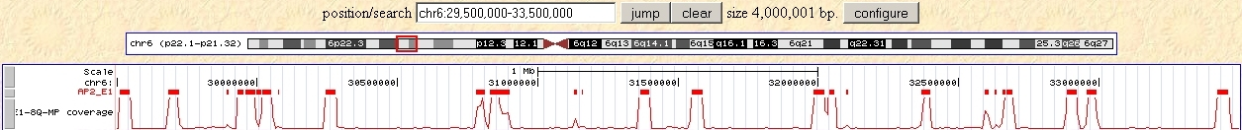
Fosmid Based Sequencing
Fosmid Detection Algorithm
Assign each read to a single 1kb long bin. Select bins with more than 5 reads
Perform allele calls for each heterozygous SNP. Mark bins with heterozygous calls
Cluster adjacent bins as belonging to the same fosmid if:
  The gap distance between them is less than 10kb and
  There are no bins with heterozygous SNPs between them
Keep fosmids with lengths between 3kb and 60kb

Slide 54
MHC Phasing: Preliminary Results
Number of blocks: 8
N50 block length: 793 kb
Maximum block length: 1.6 MB
Total extent of all blocks: 3.8 MB
Fraction of MHC phased into haplotype blocks: 95%
Number of heterozygous SNPs: 8030 SNPs
Fraction of SNPs phased: 86%

Slide 55
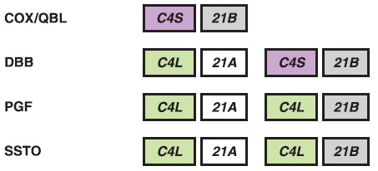
RCCX CNV Reconstruction
J. A. Traherne. Human MHC architecture and evolution: implications for disease association studies. International Journal of Immunogenetics, 35:179-192, 2008

Slide 56
Acknowledgments
Ion Mandoiu, Yufeng Wu and Sanguthevar Rajasekaran
Mazhar Khan, Dipu Kumar (Pathobiology & Vet. Science)
Craig Nelson and Edward Hemphill (MCB)
Pramod Srivastava, Brent Graveley and Duan Fei (UCHC)
Margret Hoehe, Thomas Huebsch, Gayle McEwen and Eun-Kyung Suk (MPIMG)
Fiona Hyland and Dumitru Brinza (Life Technologies)
NSF awards IIS-0546457, IIS-0916948, and DBI-0543365
UCONN Research Foundation UCIG grant

Slide 57
PrimerHunter: A Primer Design Tool for PCR-Based Virus Subtype Identification
Jorge Duitama¹, Dipu Kumar², Edward Hemphill³, Mazhar Khan², Ion Mandoiu¹, and Craig Nelson³
¹ Department of Computer Sciences & Engineering
² Department of Pathobiology & Veterinary Science
³ Department of Molecular & Cell Biology

Slide 58
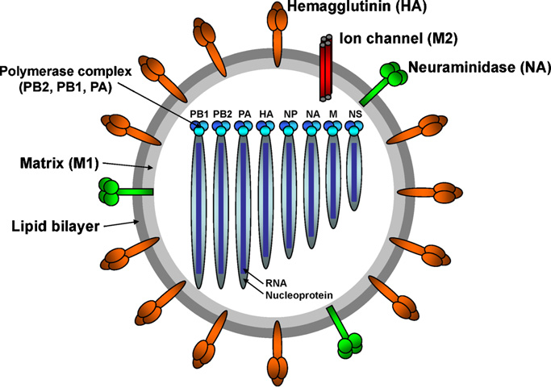
Avian Influenza
C.W.Lee and Y.M. Saif. Avian influenza virus. Comparative Immunology, Microbiology & Infectious Diseases, 32:301-310, 2009

Slide 59
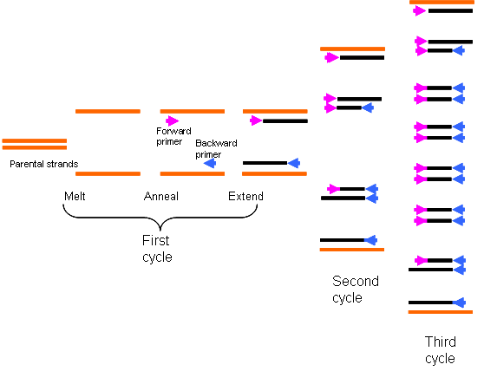
Polymerase Chain Reaction (PCR)
http://www.obgynacademy.com/basicsciences/fetology/genetics/

Slide 60
Primer3
PRIMER PICKING RESULTS FOR gi|13260565|gb|AF250358
No mispriming library specified
Using 1-based sequence positions
OLIGO start len tm gc% any 3' seq
LEFT PRIMER 484 25 59.94 56.00 5.00 3.00 CCTGTTGGTGAAGCTCCCTCTCCAT
RIGHT PRIMER 621 25 59.95 52.00 3.00 2.00 TTTCAATACAGCCACTGCCCCGTTG
SEQUENCE SIZE: 1410
INCLUDED REGION SIZE: 1410
PRODUCT SIZE: 138, PAIR ANY COMPL: 4.00, PAIR 3' COMPL: 1.00
…
481 TGTCCTGTTGGTGAAGCTCCCTCTCCATACAATTCAAGGTTTGAGTCGGTTGCTTGGTCA
>>>>>>>>>>>>>>>>>>>>>>>>>
541 GCAAGTGCTTGCCATGATGGCATTAGTTGGTTGACAATTGGTATTTCCGGGCCAGACAAC
<<<<
601 GGGGCAGTGGCTGTATTGAAATACAATGGTATAATAACAGACACTATCAAGAGTTGGAGA
<<<<<<<<<<<<<<<<<<<<<
…

Slide 61
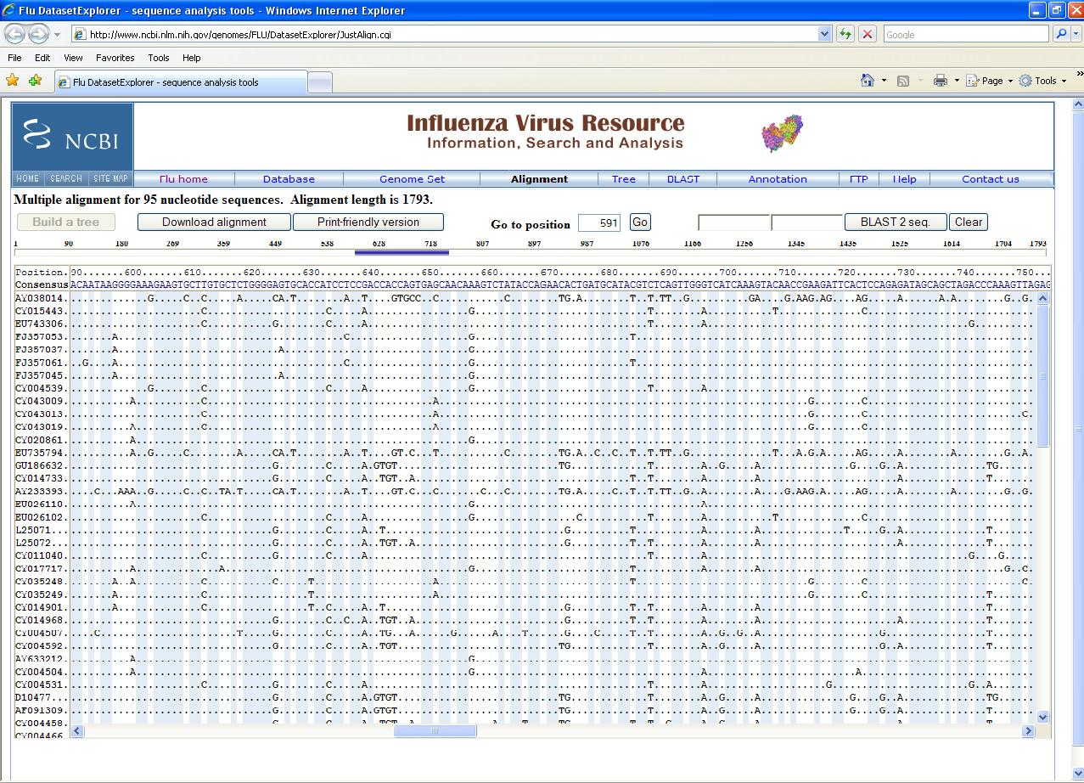

Slide 62
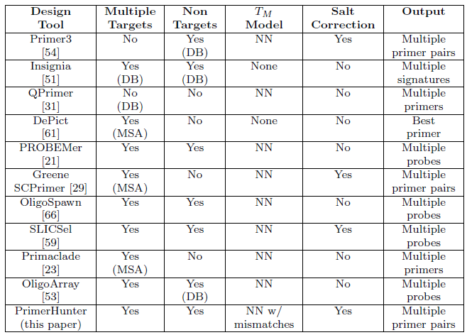
Tools Comparison

Slide 63
Notations
s(l,i): subsequence of length l ending at position i (i.e., s(i,l) = s_{i-l+1} … s_{i-1}s_{i})
Given a 5’ – 3’ sequence p and a 3’ – 5’ sequence s, |p| = |s|, the melting temperature T(p,s) is the temperature at which 50% of the possible p-s duplexes are in hybridized state
Given two 5’ – 3’ sequences p, t and a position i, T(p,t,i): Melting temperature T(p,t’(|p|,i))

Slide 64
Notations (Cont)
Given two 5’ – 3’ sequences p and s, |p| = |s|, and a 0-1 mask M, p matches s according to M if p_{i} = s_{i} for every i ∈ {1,…,|s|} for which M_{i} = 1
AATATAATCTCCATAT
CTTTAGCCCTTCAGAT
0000000000011011
I(p,t,M): Set of positions i for which p matches t(|p|, i) according to M

Slide 65
Discriminative Primer Selection Problem (DPSP)
Given
Sets TARGETS and NONTARGETS of target/non-target DNA sequences in 5’ – 3’ orientation, 0-1 mask M, temperature thresholds T_{min_target} and T_{max_nontarget}
Find
All primers p satisfying that
  for every t ∈ TARGETS, exists i ∈ I(p,t,M) s.t. T(p,t,i) ≥ T_{min_target}
  for every t ∈ NONTARGETS T(p,t,i) ≤ T_{max_nontarget} for every i ∈ {|p|… |t|}

Slide 66
Nearest Neighbor Model
Given an alignment x:
ΔH (x)
T_{m} (x) = ————————————————
ΔS (x) + 0.368*N/2*ln(Na⁺) + Rln(C)
where C is c₁-c₂/2 if c₁≠c₂ and (c₁+c₂)/4 if c₁=c₂
ΔH (x) and ΔS (x) are calculated by adding contributions of each pair of neighbor base pairs in x
Problem: Find the alignment x maximizing T_{m} (x)

Slide 67
Fractional Programming
Given a finite set S, and two functions f,g:S→R, if g>0, t*= max_{x∈S}(f(x) / g(x)) can be approximated by the Dinkelbach algorithm:
Choose t₁ ≤ t*; i ← 1
Find x_{i} ∈ S maximizing F(x) = f(x) – t_{i} g(x)
If F(x_{i}) ≤ ε for some tolerance output ε > 0, output t_{i}
Else, t_{i+1} ← (f(x_{i}) / g(x_{i})) and i ← i +1 and then go to step 2

Slide 68
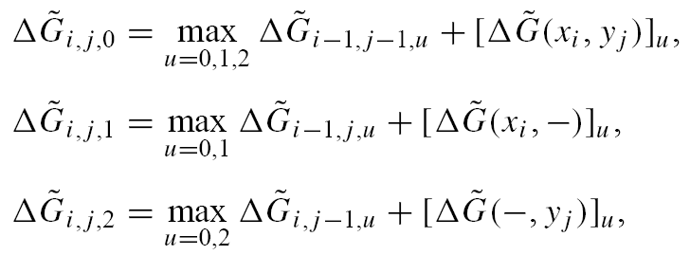
Fractional Programming Applied to T_{m} Calculation
Use dynamic programming to maximize:
t_{i}(ΔS (x) + 0.368*N/2*ln(Na⁺) + Rln(C)) - ΔH (x) = -ΔG (x)
ΔG (x) is the free energy of the alignment x at temperature t_{i}

Slide 69
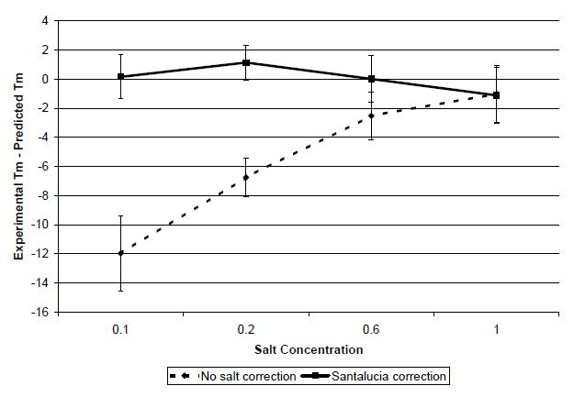
Melting Temperature Calculation Results

Slide 70
Design
forward
primers
Design
reverse
primers
Make pairs filtering
by product length,
cross dymerization
and ΔTm
Iterate over targets to build
a hash table of occurances
of seed patterns H
according with mask M
Test GC Content, GC
Clamp, single base repeat
and self complementarity
For each target t use H to
build I(p,t,M) and test if
T(p,t,i) ≥ T_{min_target}
Build candidates as suitable
length substrings of one or
more target sequences
For each non target t test
on every i if
T(p,t,i) < T_{max_nontarget}
Test each candidate p

Slide 71
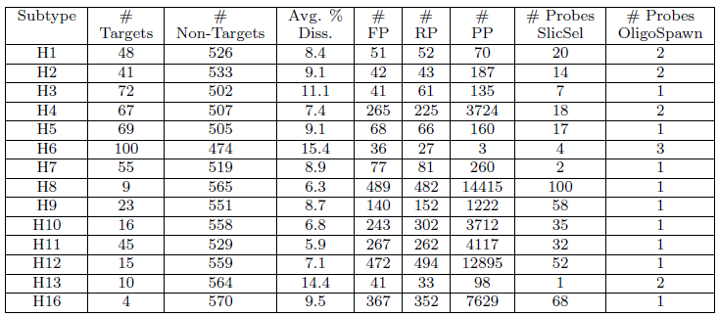
Design Success Rate
FP: Forward Primers; RP: Reverse Primers; PP: Primer Pairs

Slide 72
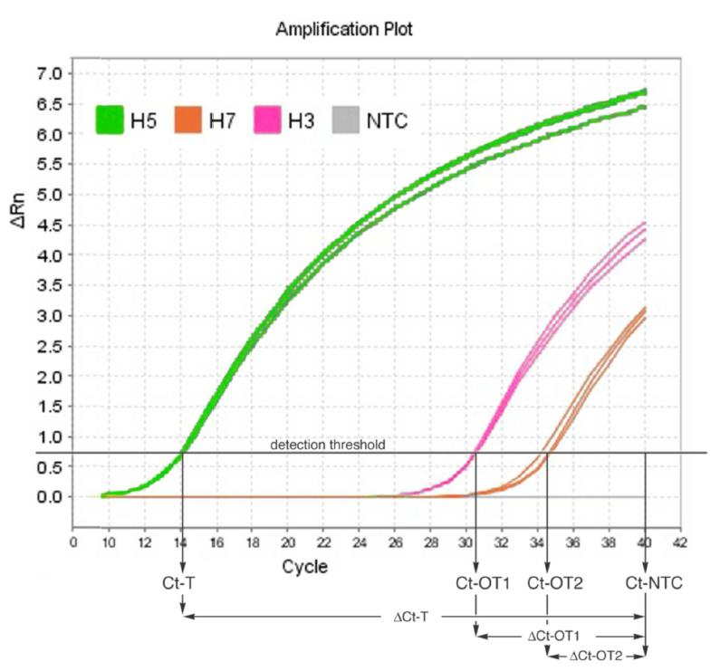
Primers Validation

Slide 73
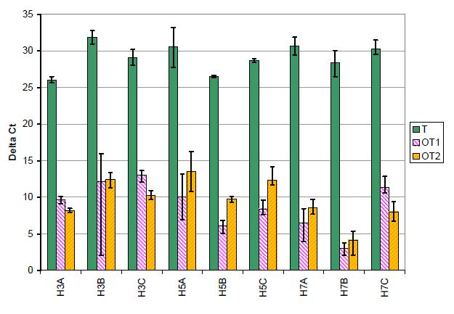
Primers Validation

Slide 74
Primers Design Parameters
Primer length between 20 and 25
Amplicon length between 75 and 200
GC content between 25% and 75%
Maximum mononucleotide repeat of 5
3’-end perfect match mask M = 11
No required 3’ GC clamp
Primer concentration of 0.8μM
Salt concentration of 50mM
T_{min_target} =T_{max_nontarget} = 40º C

Slide 75
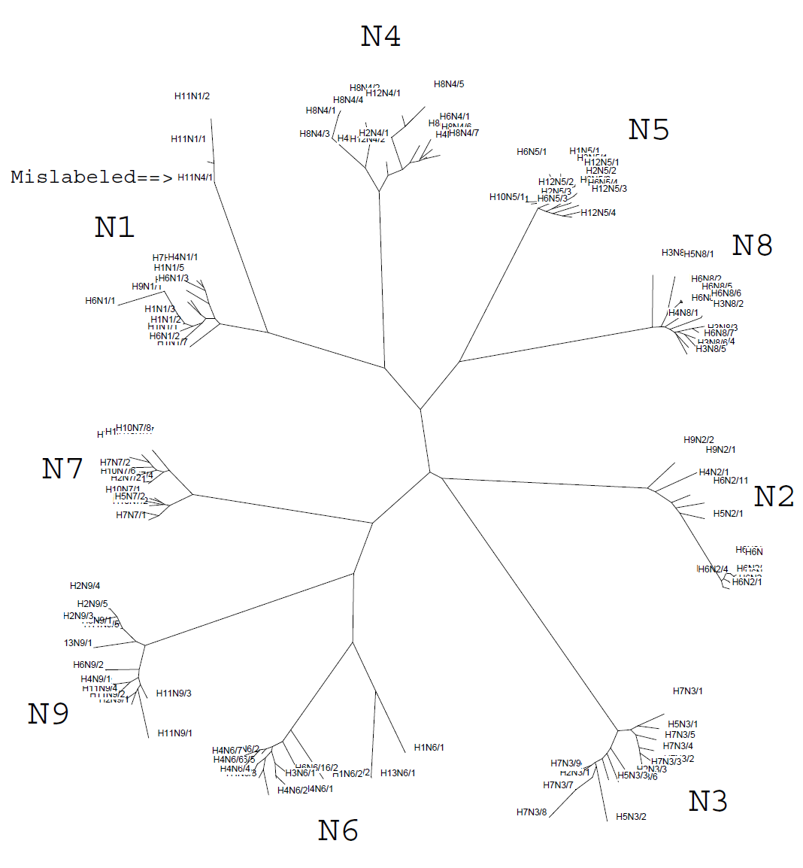
NA Phylogenetic Tree

Slide 76
Current Status
Paper published in Nucleic Acids Research in March 2009
Web server, and open source code available at http://dna.engr.uconn.edu/software/PrimerHunter/
Successful primers design for 287 submissions since publication

Slide 77
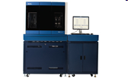
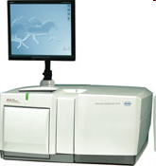
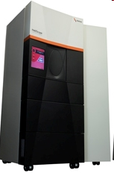
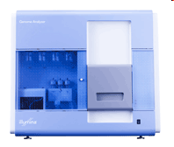
2nd Generation Sequencing Technologies
Massively parallel, orders of magnitude higher throughput compared to classic Sanger sequencing
Roche/454 FLX Titanium
~1M reads
400bp avg.
400-600Mb / run (10h)
ABI SOLiD 3 plus
~500M reads/pairs
35-50bp
25-60Gb / run (3.5-14 days)
Helicos HeliScope
25-55bp reads
>1Gb/day
Illumina Genome Analyzer IIx
~100-300M reads/pairs
35-100bp
4.5-33 Gb / run (2-10 days)
Notes:
77
-SBS: Sequencing by Synthesis
-SBL: Sequencing by Ligation
-Challenges in Genome Assembly: The short read lengths and absence of paired ends make it difficult for assembly software to disambiguate repeat regions, therefore resulting in fragmented assemblies.
-New Type of sequencing error: in 454 including incorrect estimates of homopolymer lengths,
‘transposition-like’ insertions (a base identical to a nearby homopolymer is inserted in a nearby nonadjacent location) and errors caused by multiple templates attached to the same bead

Slide 78
Current Status
Presented as a poster in ISBRA 2009 and as a talk at Genome Informatics in CSHL
Over a hundred of candidate epitopes are currently under experimental validation

Slide 79
Results with Real Data
Instance on chromosome 22 with 13,905 fragments spanning 32,347 SNPs
Number of blocks: 102
 | ReFHap | HapCUT (1 It) | HapCUT (50 It)
%MEC | 6.32% | 6.26% | 6.24%
Time | 73.04s | 0.99H | 50.4H
Predicted switch error rate: 1.86%

Slide 80
Results with Real Data

