Slide 1

Efficient Algorithms for SNP Genotype Data Analysis using Hidden
Markov Models of Haplotype Diversity
Justin Kennedy
Dissertation Defense for the Degree of Doctorate in Philosophy
Computer Science & Engineering Department
University of Connecticut
Notes:
“The title of my thesis is Efficient Algorithms for SNP Genotype Data Analysis using Hidden
Markov Models of Haplotype Diversity”.

Slide 2
Outline
Introduction
Hidden Markov Models of Haplotype Diversity
Genotype Error Detection using Hidden Markov Models of Haplotype Diversity
Imputation-based Local Ancestry Inference in Admixed Populations
Single Individual Genotyping from Low-Coverage Sequencing Data
Conclusion
Notes:
“I’ll begin with an introduction to the overall research area, followed by a description of “Hidden Markov Models of Haplotype Diversity”, a statistical model that is used in various ways in the the 3 specific goals my research has focused on. Then I’ll describe the 3 specific goals in more detail. The first goal is that of Genotype Error Detection, the second is Imputation-based Local Ancestry Inference In Admixed Populations, and the third being Single Individual Genotyping from Low-Coverage Sequencing Data. Finally I’ll conclude with a summarization of the contributions and describe areas for future work.”

Slide 3
Introduction-
Single Nucleotide Polymorphisms
Main form of variation between individual genomes: Single Nucleotide Polymorphisms (SNPs)
High density in the human genome: ≈ 1.3x10⁷ out of 3×10⁹ base pairs
Vast majority bi-allelic ➔ 0/1 encoding (major/minor resp.)
Haplotype: description of SNP alleles on a chromosome
  0/1 vector: 0 for major allele, 1 for minor
… ataggtccCtatttcgcgcCgtatacacgggActata …
… ataggtccGtatttcgcgcCgtatacacgggTctata …
… ataggtccCtatttcgcgcGgtatacacgggTctata …
Notes:
“My research is focused on improving data quality data related to Single Nucleotide Polymorphisms (or SNPs).”
“A SNP is a single base pair nucleotide variation between individuals of the same species at a specific locus along the genome”
“It is the main form of genomic variation, occurring in over 12 million out of the 3 billion base pair nucleotides in the human genome”
“The majority of SNPs are bi-allelic, meaning the variation is between only 2 nucleotides at a specific locus”
“We assume bi-allelic properties in my research, and notation will encode the major allele as a 0 and the minor allele as a 1”
“SNP are critical to the success of Disease-Gene Mapping, and SNP Genotypes are central to methods such as Genome-Wide Association Studies”

Slide 4
Genotype Error Detection-
SNP Genotypes
Diploid: two haplotypes for each chromosome
  One inherited from mother and one from father
Multilocus Genotype: description of alleles on both chromosomes
  0/1/2 vector: 0 (2) - both chromosomes contain the major (minor) allele; 1 - the chromosomes contain different alleles
SNP Genotypes are critical to Disease-Gene Mapping
011000110
001100010
012100120
two haplotypes per individual
+
genotype
Notes:
Pppppo8/.9/*:u/:”*j/ c appear in pairs in body cells but as single chromosomes in; spermatozoa

Slide 5
Introduction-
Why SNP Genotypes?
SNPs are the genetic marker of choice for genome wide association studies (GWASs)
  GWAS: Method for discovering disease associated genes by typing a dense set of markers in large numbers of cases and controls followed by a statistical test of association.
Ongoing GWASs generate a deluge of genotype data
  Genetic Association Information Network (GAIN): 6 studies totaling 19,000 individuals typed at 500,000 to 940,000 SNP loci
  Wellcome Trust Case-Control Consortium (WTCCC): 7 studies totaling 17,000 individuals typed at 500,000 SNPs
  WTCCC2: hundreds of thousands of individuals covering over a million SNPs!
Notes:
“With the sequencing of the human genome, the mapping of human haplotypes and rapid advances in SNP genotyping technologies, SNPs have become the genetic marker of choice for identification and mapping of disease-related genes via GWAS.”
“GWAS: Method for discovering disease associated genes by typing a dense set of markers in large numbers of cases and controls followed by a statistical test of association. Provides Higher statistical power compared to other gene mapping methods such as linkage for uncovering genetic basis of complex diseases.”
“There are numerous ongoing association studies, and this has resulted in huge amounts of SNP genotype data.”
“These 2 examples illustrate how large in scope some of these GWASs are. “
“With all of this ongoing analysis, there is major concern for the quality of genotype data.”

Slide 6
Introduction-
Computational Challenges to Disease Gene Mapping
  Genotype error detection: Genotyping errors can decrease statistical power and invalidate statistical tests for disease association based on haplotypes.
  Local ancestry Inference: Accurate estimates of local ancestry surrounding disease-associated loci are a critical step in admixture mapping.
Accurate SNP Genotyping from new sequencing technologies: Accurate determination of both alleles at variable loci is essential, and is limited by coverage depth due to random nature of shotgun sequencing.
Notes:
“We focus on three problems addressing computational challenges to Disease gene mapping when SNP Genotypes are used”
Genotype error detection: Low levels of genotyping errors can decrease statistical power and invalidate statistical tests for disease association based on haplotypes
Admixture Mapping: Accurate estimates of local ancestry surrounding disease-associated loci in admixed populations are a critical step in admixture mapping.

Slide 7
Outline
Introduction
Hidden Markov Models of Haplotype Diversity
Genotype Error Detection using Hidden Markov Models of Haplotype Diversity
Imputation-based Local Ancestry Inference in Admixed Populations
Single Individual Genotyping from Low-Coverage Sequencing Data
Conclusion

Slide 8
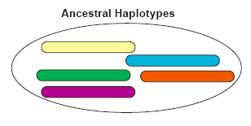
Haplotype structure in panmictic populations
Notes:
Panmictic: Random mating within a breeding population.
To help understand our HMM implementation, consider an extant population with a haplotype gene pool that arose from a small set of ancestral haplotypes. Through random mating and recombination, the extant haplotypes include segments that come directly from varying ancestors, and also there are mutations that have occurred over time.

Slide 9
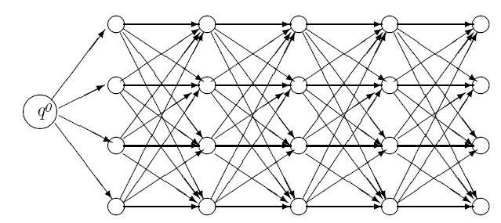
HMM of haplotype diversity
n = 5
(# SNPs)
k = 4
(# founders)
Similar models proposed in [Schwartz 04, Rastas et al. 08, Kennedy et al. 07, Kimmel&Shamir 05, Scheet&Stephens 06,…]
Captures Linkage Disequilibrium (LD)
Notes:
This type of recombination can be captured in a HMM of haplotype diversity, which we employ, and is similar to other models proposed in recent work. Specifically, our HMM is defined by nXK states, where n is the number of SNPs, and K is the number of founder haplotypes. Transitions are from left to right, occur only between adjacent SNPs, and they represent the probability of adherence to, or deviation from, these ancestral founder haplotypes. Emissions at each state represent the probability of observing a major or minor allele.

Slide 10
Graphical model representation
F₁
F₂
…
F_{n}
H₁
H₂
H_{n}
Random variables for each locus i (i=1..n)
  F_{i} = founder haplotype at locus i; values between 1 and k
  H_{i} = observed allele at locus i; values: 0 (major) or 1 (minor)
Model training, based on Baum-Welch algorithm, using:
  Reference haplotypes from population panel (e.g. Hapmap), or
  Haplotypes from phased genotype using ENT software
Given haplotype h, P(H=h|M) can be computed in O(nk²) using a forward algorithm.
Notes:
We can represent this HMM graphically as a founder haplotype and observed allele for each locus i (seen here as Fi & Hi respectively).
Under this model each haplotype in the current population can be viewed as a mosaic formed as a result of historical recombination among a set of these founder haplotypes.
Model training can come from reference haplotypes using Baum-Welch, assuming you have these, OR
You can take the unphased genotype data that you have which represents the population of interest, and implement EM to train the HMM.
Once you have a satisfactorily trained HMM, you can then compute the probability of observing a haplotype h given model M using a standard forward algorithm, which takes O(nK^2) time…again where n is the # of SNPs and K is the # of founders.
Increasing the number of founders allows more paths to describe a haplotype sequence, but at a cost of a longer run time.

Slide 11
Factorial HMM for genotype data
F₁
F₂
…
F_{n}
H₁
H₂
H_{n}
F'₁
F'₂
…
F'_{n}
H'₁
H'₂
H'_{n}
G₁
G₂
G_{n}
Random variable for each locus i (i=1..n)
  G_{i} = genotype at locus i; values: 0/1/2 (major hom./het./minor hom.)
  Given multilocus genotype g, P(g|M) can be computed in O(nk⁴) using a forward algorithm.
Notes:
11
So given that we have two distinct ancestral groups that have recently admixed and represent an individual or population of interest, we can define the Factorial HMM that we use to be, at the core, 2 regular HMMs that I just described.

Slide 12
HMM Based Genotype Imputation
Probability of observing genotype at locus i given the known multilocus genotype with missing data at i:
  ➔ G_{i} is imputed as:

Slide 13
Forward-backward computation
…
F_{i}
…
H_{i}
…
F’_{i}
…
H’_{i}
G_{i}
Notes:
13

Slide 14
Forward-backward computation
…
F_{i}
…
H_{i}
…
F’_{i}
…
H’_{i}
G_{i}
Notes:
14

Slide 15
Forward-backward computation
…
F_{i}
…
H_{i}
…
F’_{i}
…
H’_{i}
G_{i}
Notes:
15

Slide 16
Forward-backward computation
…
F_{i}
…
H_{i}
…
F’_{i}
…
H’_{i}
G_{i}
Notes:
16

Slide 17
Runtime
Direct recurrences for computing forward probabilities O(nk⁴) :
Runtime reduced to O(nk³) by reusing common terms:
where
Notes:
17

Slide 18
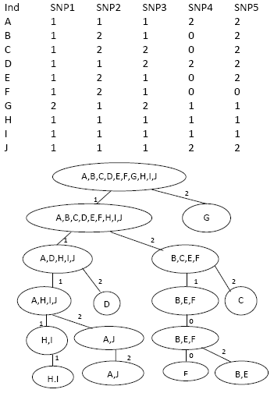
Speed-up: PopTree Trie

Slide 19
Outline
Introduction
Hidden Markov Models of Haplotype Diversity
Genotype Error Detection using Hidden Markov Models of Haplotype Diversity
  Motivation
  Likelihood Sensitivity Approach to Error Detection
  Hidden Markov Model of Haplotype Diversity
  Efficiently Computable Likelihood functions
  Experimental Results
Imputation-based Local Ancestry Inference in Admixed Populations
Single Individual Genotyping from Low-Coverage Sequencing Data
Conclusion

Slide 20
Genotype Errors- Motivation
A real problem despite advances in genotyping technology
  [Zaitlen et al. 2005] found 1.1% inconsistencies among the 20 million dbSNP genotypes typed multiple times
  1% errors decrease power by 10-50% for linkage, and by 5-20% for association
Error types
  Easily Detectable errors
    Systematic errors (e.g., assay failure) detected by HWE test [Hosking et al. 2004]
    For pedigree data some errors detected as Mendelian Inconsistencies (MIs)
      E.g. Only ~30% detectable as MIs for trios [Gordon et al. 1999]
  Undetected errors
Methods for handling undetected errors:
  Improved genotype calling algorithms
  Improved modeling in analysis methods
  Separate error detection step
    Detected errors can be retyped, imputed, or ignored in downstream analysis
Notes:
-Genotyping Errors present a real problem despite advances in technologies
-For example, Zaitlen et al found approximately 1% of all dbSNP genotypes that were typed multiple times showed to have inconsistencies. These inconsistencies indicate genotype errors
-dbSNP: public-domain archive for a broad collection of Single Nucleotide Polymorphisms (SNPs) as well as small insertion/deletions (indels) and is hosted at the National Center for Biotechnology Information.
-Linkage test: The linkage test is an approach to DNA testing that allows a prediction to be made about the presence of a mutated gene even if there is, at present, no clue at all about what the gene itself is, what changes have occurred in its DNA sequence, or what function the gene serves in the cells. Linkage tests can often be used in situations in which a direct DNA test cannot be done.
-Some errors are easy to detect, such as those cause by problematic assays, which can be detected by deviation from the Hardy-Weinberg equilibrium.
-In pedigree data, errors that results in Mendelian Inconsistencies can also be found easily.
However not all errors can be detected in this way-
-For example, in trio data, only approximately 30% of all genotyping errors are Mendelian inconsistent
-Even low error levels can have large effects for some study designs (e.g. rare alleles, haplotype-based)
-Errors as low as .1% can increase Type I error rates in haplotype sharing transmission disequilibrium test (HS-TDT) [Knapp&Becker04]
-1% errors decrease power by 10-50% for linkage, and by 5-20% for association [Douglas et al. 00, Abecasis et al. 01]
-In this work we propose methods to detect the remaining 70% which are Mendelian consistent.

Slide 21
Genotype Error Detection-
Likelihood Sensitivity Approach to Error Detection [Becker et al. 06]
Mother
Father
0 1 2 1 0 2
0 2 2 1 0 2
0 0 0 1 0 1 H₃
0 1 1 1 0 0 H₄
0 1 1 1 0 0 H₁
0 1 0 1 0 1 H₂
Child
0 2 2 1 0 2
0 1 1 1 0 0 H₁
0 0 0 1 0 1 H₃
Likelihood of best phasing for original trio T
Notes:
Becker et. al focused on error detection in trios consisting of mother, father & child genotypes, as in this example. However, this method can apply to other pedigree structures.
The approach starts by estimating haplotype frequencies in the population under study.
Haplotype frequencies are used to determine the likelihood of the best phasing for each trio-which is the maximum product of parent haplotype frequencies over all compatible phasings of the trio.

Slide 22
Genotype Error Detection-
Likelihood Sensitivity Approach to Error Detection [Becker et al. 06]
Mother
Father
0 1 2 1 0 2
0 2 2 1 0 2
0 0 0 1 0 0 H’ ₃
0 1 1 1 0 1 H’ ₄
0 1 0 1 0 1 H’₁
0 1 1 1 0 0 H’₂
Child
0 2 2 1 0 2
?
0 1 0 1 0 1 H’ ₁
0 0 0 1 0 0 H’ ₃
Likelihood of best phasing for original trio T
Likelihood of best phasing for modified trio T’
Notes:
We take this same trio and modify it by marking one SNP genotype as unknown and compute the likelihood of the best phasing for this modified trio.

Slide 23
Genotype Error Detection-
Likelihood Sensitivity Approach to Error Detection [Becker et al. 06]
Mother
Mother
Father
Father
0 1 2 1 0 2
0 1 2 1 0 2
0 2 2 1 0 2
0 2 2 1 0 2
Child
Child
0 2 2 1 0 2
0 2 2 1 0 2
?
Large change in likelihood suggests likely error
  Flag genotype as an error if L(T’)/L(T) > R, where R is the detection threshold (e.g., R=10⁴)
Notes:
In correct genotype data we don’t expect much of a change in likelihood due to altering a single genotype.
Becker et. al proposed to flag the original SNP genotype as a possible error if the ratio between the two likelihoods is greater than a given threshold parameter, such as 10,000.
Like the original likelihood in Becker et al, our functions are monotonic under data deletion, meaning that their value can only increase when a SNP genotype is marked as missing.

Slide 24
Genotype Error Detection-
Likelihood Sensitivity Approach to Error Detection
[Becker et al. 06] Implementation in FAMHAP Software
Window-based algorithm
  For each window including the SNP under test, generate list of H most frequent haplotypes (default H=50)
  Find most likely trio phasings by pruned search over the H⁴ quadruples of frequent haplotypes
  Flag genotype as an error if L(T’)/L(T) > R for at least one window
Mother …201012 1 02210...
Father …201202 2 10211...
Child …000120 2 21021...
Notes:
Becker et al implement the likelihood sensitivity approach in their FAMHAP software.
FAMHAP checks each SNP locus using several short overlapping windows.
To achieve a practical runtime, FAMHAP generates a short list of H most frequent haplotypes for each window.
The most likely phasing is found among the H^4 quadruples of frequent haplotypes by an essentially exhaustive search.
If the likelihood ratio from these phasings is greater than the R parameter threshold FOR ANY of the short windows, FAMHAP flags that genotype as a likely error.

Slide 25
Genotype Error Detection- Limitations of FAMHAP
Unbounded list of haplotypes (H=4^{n}) is hard to compute
Truncating H may lead to sub-optimal phasings and inaccurate L(T) values
False positives caused by nearby errors (due to the use of multiple short windows)
Our approach:
HMM of haplotype frequencies ➔ all haplotypes represented + no need for short windows
Alternate likelihood functions ➔ scalable runtime
Notes:
Due to Truncating the list of haplotypes, FAMHAP may produce sub-optimal phasings which result in inaccurate Likelihood values.
as observed by Becker et a.l., another drawback of the FAMHAP implementation is the large number of false positives caused by true errors within the same window.
Our approach overcomes these issues by using a Hidden Markov Model of haplotype diversity, in which ALL haplotypes are represented in the model, and removes the need for windows.
We also introduce alternate likelihood functions which allow us to achieve a scalable run time.

Slide 26
Trio-Based HMM of haplotype diversity
F₁
F₂
…
F_{n}
F₁
F₂
…
F_{n}
H₁
H₂
H_{n}
H₁
H₂
H_{n}
F‘₁
F‘₂
…
F'_{n}
F’₁
F’₂
…
F’_{n}
H'₁
H'₂
H'_{n}
H’₁
H’₂
H’_{n}
G_{M1}
G_{M2}
G_{Mn}
G_{F1}
G_{F2}
G_{Fn}
G_{C1}
G_{C2}
G_{Cn}

Slide 27
Genotype Error Detection-
Alternate Likelihood Functions
Viterbi probability (ViterbiProb): Maximum prob. of a set of 4 HMM paths that emit 4 haplotypes compatible with the trio.
Probability of Viterbi Haplotypes (ViterbiHaps): Obtain the path of the 4 Viterbi haplotypes, then then take product of these individual haplotype probabilities using forward (again).
Total Trio Probability (TotalProb): Total probability P(T) that the HMM emits four haplotypes that explain trio T along all possible 4-tuples of paths.
Notes:
These functions are linear to number of SNPs and individuals/trios
Viterbi probability:
-To avoid re-computing Viterbi probabilities from scratch for each of the 3N modified trios based on one original trio, we use a forward-backward algorithm.
-This allows computing ALL likelihood ratios in the same asymptotic time required to compute the likelihood of the unmodified genotypes, and this maintains a runtime of O(NK^5) per trio.
Probability of Viterbi haplotypes:
-For computing the probability of Viterbi haplotypes, the Viterbi probability algorithm to generate the 4 Viterbi haplotypes by traceback.
-The probability of each of the 4 haplotype under the HMM model can be computed using the forward algorithm in O(NK) time.
-However, since each the best 4 haplotypes in a modified trio might be different than the best 4 haplotypes generated from the original trio, an total added O(N^2K) term is needed per trio.
Total trio probability:
-The computation of total trio probability uses the same speed-up ideas used for Viterbi probability, resulting in the same runtime of O(NK^5) per trio.in our experimental results, the total trio propbability function performs slighly better than the other 2 function.
-We have focused on this function for our results, and have implemented a more accurate version, which involves taking the trio probability function, along with the same functions’ values where only one of the parents are computed, and the function that only calculates the likelihood of phasing for an unrelated individual. Taking the minimum of these 4 values shows this “Combined” version to be better in accuracy than other functions.

Slide 28
Genotype Error Detection- Speed Ups from reuse of common terms
Straight-forward approach run time:
  For a fixed trio, ViterbiProb/TotalProb paths can be found using a 4-path version of Viterbi’s/Forward algorithm in time
  For ViterbiHaps, additional traceback to compute probabilities:
K³ speed-up by reuse of common terms:
    per trio
  Likelihoods of all 3n modified trios computed using forward-backward algorithm,
  ViterbiProb/TotalProb for m trios:
  ViterbiHaps:
Notes:
For a fixed trio, the 4 Viterbi haplotype paths can be computed in O(NK^8) time using a 4-path extension of the classic Viterbi algorithm.
The K^8 factor in the running time comes Viterbi computing a probability for a 4-tuple of states locus j over all 4-tuples of states at locus j-1.
A significant speed-up is achieved by pre-computing common terms between each 4-tuples of states- this method is similar in design to a speed up implemented by Rastas et al. in the context of unrelated genotype phasing.
Our implementation involves precomputing common terms for each of the 4 paths at every locus, each taking K run time. After precomputing each in succession, the Viterbi probability of a 4-tuple of states can also be computed in O(K) time. Thus, the overall runtime for a fixed trio becomes O(NK^5), a K^3 speed-up.
Our experiments show that accuracy did not improve much by increasing the number of founders beyond 7. Therefore we used K=7 in our experiments.

Slide 29
Genotype Error Detection- Comparison of Likelihood Functions
  35 SNPs
  551 trios
  [Becker 06]
  1% err. rate
Sensitivity=TP/(TP+TN)
False Positive rate = 1 - TN/(FP+TN)
Notes:
Our results are shown mostly using Residual operating characteristic curves (or ROC curve for short). It describes the trade-off between sensitivity and false positive rate.
Our functions performing significantly better in children than in parents
(Motivation behind using ROC curves: we wanted to assess error detection accuracy of different methods in a threshold-independent manner)
(Sensitivity: Ratio between the number of mendelian consistent errors flagged by the algorithm and the total number of mendelian consistent errors inserted into the genotype population)
(False positive rate: Ratio between the number of false positives flagged by the algorithm and the total number of non-errors)

Slide 30
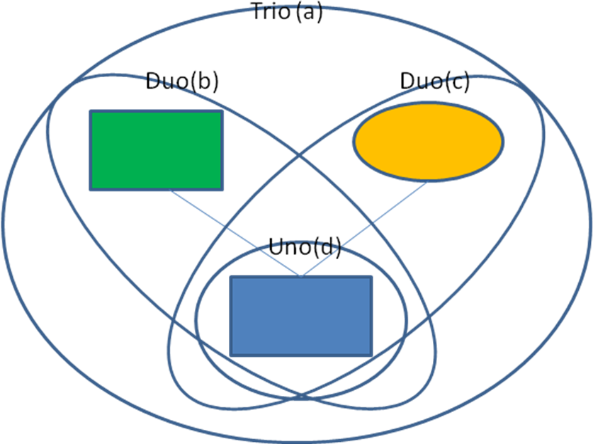
Genotype Error Detection-“Combined” Detection Method
Compute 4 likelihood ratios
  Trio
  Mother-child duo
  Father-child duo
  Child (unrelated)
Flag as error if all ratios are above detection threshold

Slide 31
Genotype Error Detection-
Comparison with FAMHAP
  35 SNPs
  551 trios
  [Becker 06]
  1% err. rate
Notes:
We use Receiver Operating Characteristic (ROC) curves, to compare the accuracy of our likelihood functions
This plot shows, for parents, our Combined method performing better than our other methods, and significantly better than similar functions in the FAMHAP software.

Slide 32
Outline
Introduction
Hidden Markov Models of Haplotype Diversity
Genotype Error Detection using Hidden Markov Models of Haplotype Diversity
Imputation-based Local Ancestry Inference in Admixed Populations
  Motivation
  Factorial HMM of genotype data
  Algorithms for genotype imputation and ancestry inference
  Experimental results
Single Individual Genotyping from Low-Coverage Sequencing Data
Conclusion

Slide 33
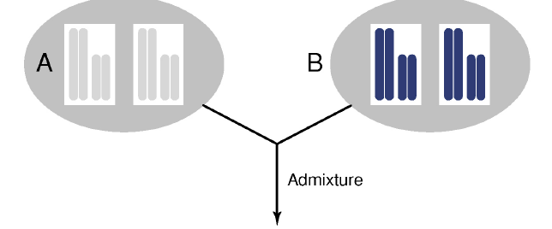
Introduction- Population admixture
http://www.garlandscience.co.uk/textbooks/0815341857.asp?type=resources
Notes:
“After several generations of random mating, Population admixture for a pair of ancestral populations result in producing individuals having 50% of their haplotype information coming from each ancestral group.”
33

Slide 34
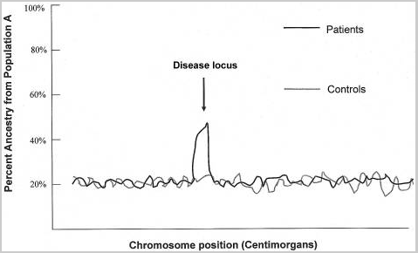
Introduction-
Motivation: Admixture mapping
Patterson et al, AJHG 74:979-1000, 2004
Notes:
Admixture mapping is a method for localizing disease causing genetic variants that differ in frequency across populations. It is most advantageous to apply this approach to populations that have descended from a recent mix of two ancestral groups that have been geographically isolated for many tens of thousands of years (e.g. African Europeans)
Assumption: near a disease-associated locus there will be an enhanced ancestry content from the
population with higher disease prevalence
34

Slide 35
Introduction-
Local ancestry inference problem
Given:
  Reference haplotypes for all ancestral populations to be studied
  Whole-genome SNP genotype data for extant individual
Find:
  Allele ancestries at each SNP locus
Reference haplotypes
1110001?0100110010011001111101110111?1111110111000
11100011010011001001100?100101?10111110111?0111000
11110010011001101001110010110101011111011110111000
1110001001000100111110001111011100111?111110111000
011101100110011011111100101101110111111111?0110000
11100010010001001111100010110111001111111110110000
011?001?011001101111110010?10111011111111110110000
11100110010001001111100011110111001111111110111000
1110001?0100110010011001111101110111?1111110111000
11100011010011001001100?100101?10111110111?0111000
11110010011001101001110010110101011111011110111000
1110001001000100111110001111011100111?111110111000
011101100110011011111100101101110111111111?0110000
11100010010001001111100010110111001111111110110000
011?001?011001101111110010?10111011111111110110000
11100110010001001111100011110111001111111110111000
1110001?0100110010011001111101110111?1111110111000
11100011010011001001100?100101?10111110111?0111000
11110010011001101001110010110101011111011110111000
1110001001000100111110001111011100111?111110111000
011101100110011011111100101101110111111111?0110000
11100010010001001111100010110111001111111110110000
011?001?011001101111110010?10111011111111110110000
11100110010001001111100011110111001111111110111000
Inferred local ancestry
rs11095710 P1 P1
rs11117179 P1 P1
rs11800791 P1 P1
rs11578310 P1 P2
rs1187611 P1 P2
rs11804808 P1 P2
rs17471518 P1 P2
...
SNP genotypes
rs11095710 T T
rs11117179 C T
rs11800791 G G
rs11578310 G G
rs1187611 G G
rs11804808 C C
rs17471518 A G
...
Notes:
Extant: still in existence; not extinct or destroyed or lost
35

Slide 36
Introduction- Previous work
Two main classes of methods for SNP Ancestry Inference
  HMM-based (exploit LD): SABER [Tang et al 06], SWITCH [Sankararaman et al 08a], HAPAA [Sundquist et al. 08], …
  Window-based (unlinked SNP Data): LAMP [Sankararaman et al 08b], WINPOP [Pasaniuc et al. 09]
Limitations
  Poor accuracy when ancestral populations are closely related (e.g. Japanese and Chinese)
  Methods based on unlinked SNPs outperform methods that model LD!
Notes:
The HMM-based classes differ in the exact structure of the model and the procedures used for estimating model parameters, but all of them exploit LD information.
The second class of methods considers each SNP without LD, and estimates the ancestry structure using a window-based framework and aggregates the results for each SNP using a majority vote.
These window based methods surprisingly do not perform as well as HMM based methods
Our method employs a Factorial HMM of genotype data, which DOES exploit LD, and we aim to improve over each of the previous methods.

Slide 37
Factorial HMM for genotype data in a window with known local ancestry
F₁
F₂
…
F_{n}
H₁
H₂
H_{n}
F'₁
F'₂
…
F'_{n}
H'₁
H'₂
H'_{n}
G₁
G₂
G_{n}
Notes:
37
So given that we have two distinct ancestral groups that have recently admixed and represent an individual or population of interest, we can define the Factorial HMM that we use to be, at the core, 2 regular HMMs that I just described.

Slide 38
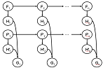
Imputation-based ancestry inference
Fixed-window version: pick ancestry that maximizes the average posterior probability of the SNP genotypes within a fixed-size window centered at the locus
Observations:
  The local ancestry of a SNP locus is typically shared with neighboring loci.
  Small Window sizes may not provide enough information
  Large Window sizes may violate local ancestry property for neighboring loci

Slide 39
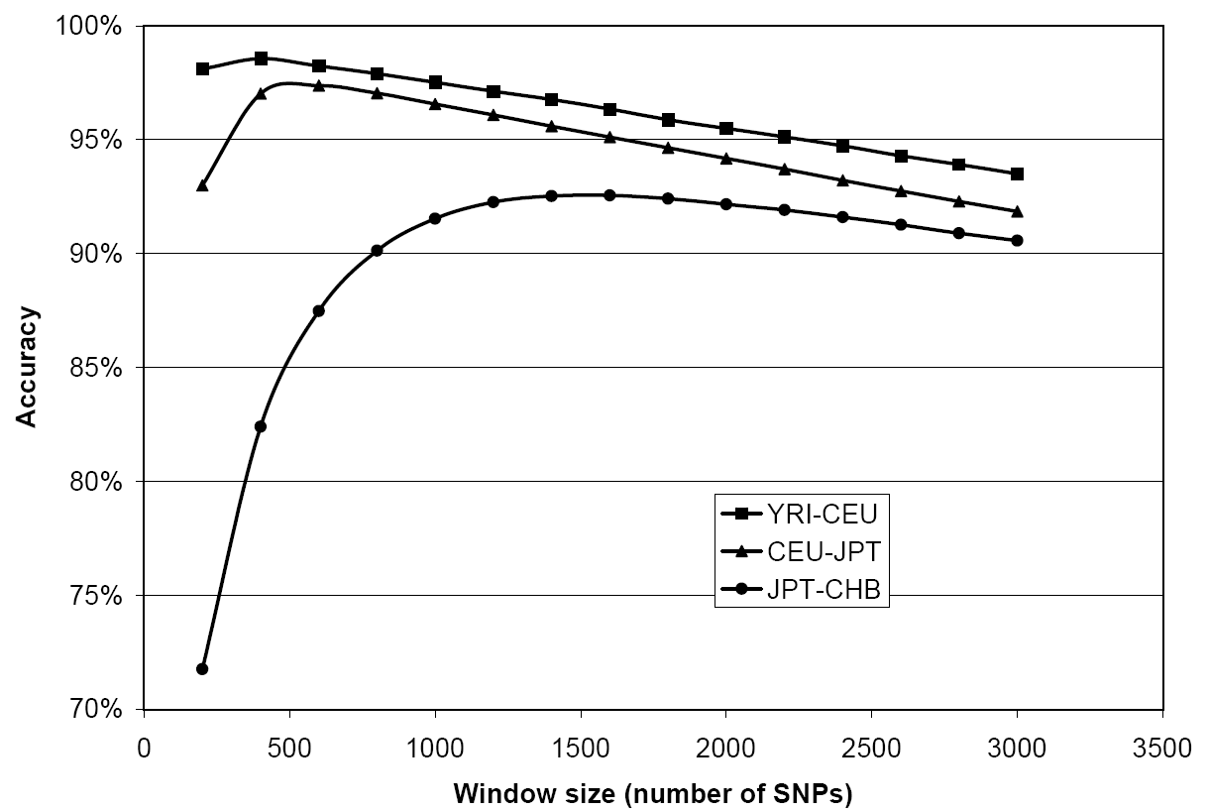
Window size effect
N=2,000
g=7
α=0.2
n=38,864
r=10⁻⁸
Notes:
As previously reported in other window-based methods we also notice that the best window size employed by our method for the three datasets is correlated with the genetic distance between ancestral populations, as closer ancestral populations benefit from longer window size for accurate predictions.
-Large windows are more likely to violate the local ancestry assumption when populations are diverse.
-Similar populations are likely to require larger windows in order to distinguish the ancestry better
Experimental setup:
-Alpha is the (X100) percentage of individuals coming from one population, with 1-alpha being the percentage of individuals coming from the second population.

Slide 40
Imputation-based ancestry inference
Multi-window version:
  Weighted voting over window sizes between 200-3000, with window weights proportional to average posterior probabilities
Notes:
Large window sizes are more violate the assumption that ancestry inference withing that window are uniform

Slide 41
Comparison with other methods
% of correctly recovered SNP ancestries
N=2,000
g=7
α=0.2
n=38,864
r=10⁻⁸
Notes:
YRI-CEU comparison:
-For distant populations, GEDI-ADMX achieves 97.5% accuracy in recovering the correct SNP ancestries, which is comparable to the best methods existing, but not as good as the theoretical upper bound of the methods that ignore LD
JPT-CHB comparison:
-For more closely related pouplations, not only is GEDI-ADMX better than all existing methods, but is better than the theoretical upper bound of the methods that ignore LD
Upper bound:
-Def: An estimate the best possible accuracy that can be achieved by any method that works on SNPs in LE (linkage equilibrium)
-We consider the case where the positions of the recent ancestral recombination events are known for each individual. Obviously, methods that are not provided with such information cannot do better than the optimal method that does exploit this information. Particularly, in this case, the optimal method for ancestry detection between any two recombination events is the maximum likelihood approach:
θ(i)= argmax AsAt∈{1,...,K}2 Prθ(i)=AsAt | f1,..., fK ,Gi
We thus applied the maximum likelihood model for every region defined by two recombination events to obtain an upper bound on the accuracy of both LAMP and WINPOP.
41

Slide 42
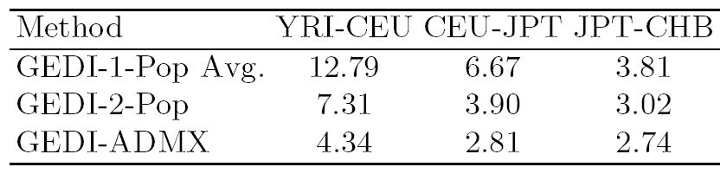
Untyped SNP imputation error rate in admixed individuals
N=2,000
g=7
α=0.5
n=38,864
r=10⁻⁸
Notes:
Alpha is the (X100) percentage of individuals coming from one population, with 1-alpha being the percentage of individuals coming from the second population.
42

Slide 43
Genotype Imputation-
Accuracy with number founders/runtime
  5835 SNPs
  2502 unrelated (CEU)
  [IMAGE]
  9% imputed (535 SNPs)
Notes:
We use Receiver Operating Characteristic (ROC) curves, to compare the accuracy of our likelihood functions
This plot shows, for parents, our Combined method performing better than our other methods, and significantly better than similar functions in the FAMHAP software.

Slide 44
Number of founders effect on Ancestry inference
CEU-JPT
N=2,000
g=7
α=0.2
n=38,864
r=10⁻⁸
Notes:
Ancestry inference depends much less on number of founders than it does on true values of the proper HMM model

Slide 45
Outline
Introduction
Hidden Markov Models of Haplotype Diversity
Genotype Error Detection using Hidden Markov Models of Haplotype Diversity
Imputation-based Local Ancestry Inference in Admixed Populations
Single Individual Genotyping from Low-Coverage Sequencing Data
  Motivation
  Single SNP Calling Algorithms
  HF-HMM Overview
  Multilocus HMM Calling Algorithm
  Experimental Results
Conclusion

Slide 46
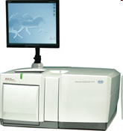
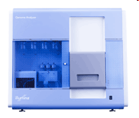
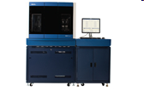
Low Coverage Genotyping-
Next Generation Sequencing (NGS)
By several orders of magnitude, NGS delivers higher throughput of sequencing reads compared to older technologies (e.g. Sanger sequencing)
Roche/454 FLX Titanium
~1M reads
400bp avg.
400-600Mb / run (10h)
Illumina Genome Analyzer IIx
~100-300M reads/pairs
35-100bp
4.5-33 Gb / run (2-10 days)
ABI SOLiD 3 plus
~500M reads/pairs
35-50bp
25-60Gb / run (3.5-14 days)
Notes:
46
-SBS: Sequencing by Synthesis
-SBL: Sequencing by Ligation
-Challenges in Genome Assembly: The short read lengths and absence of paired ends make it difficult for assembly software to disambiguate repeat regions, therefore resulting in fragmented assemblies.
-New Type of sequencing error: in 454 including incorrect estimates of homopolymer lengths,
‘transposition-like’ insertions (a base identical to a nearby homopolymer is inserted in a nearby nonadjacent location) and errors caused by multiple templates attached to the same bead

Slide 47
Low Coverage Genotyping-
NGS Applications and Challenges
NGS is enabling many applications, including personal genomics
  ~$100 million for the Sanger-sequenced Venter genome [Levy et al 07]
  ~$1 million for sequencing James Watson genome [Wheeler et al 08] using 454 technology.
  ~$50K human sequencing now available
  Thousands more individual genomes to be sequenced as part of 1000 Genomes Project
Challenges:
  Sequencing requires accurate determination of genetic variation (e.g. SNPs)
  Accuracy is limited by coverage depth due to random nature of shotgun sequencing
  For the Venter and Watson genomes (both sequenced at ~7.5x average coverage), only 75-80% accuracy achieved for sequencing based calls of heterozygous SNPs [Levy et al 07, Wheeler et al 08].
    [Wheeler et al 08] use hypothesis testing based on binomial distribution
Notes:
47

Slide 48
Low Coverage Genotyping-
Do Heuristic Inputs Help?
[Wendl&Wilson 08] predict that 21x coverage is required for sequencing of samples based on the assumption that “neglects any heuristic inputs”
We propose methods incorporating two additional sources of information:
  Quality scores reflecting uncertainty in sequencing data
  Linkage disequilibrium (LD) information and allele frequencies extracted from reference panels such as Hapmap
Notes:
48

Slide 49
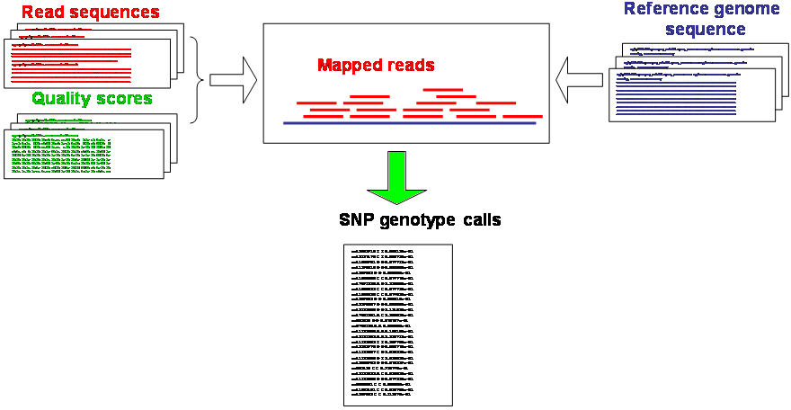
Low Coverage Genotyping-
Pipeline for Single Genotype Calling
Notes:
49

Slide 50
Single SNP Genotyping-
Basic Notations
Biallelic SNPs: 0 = major allele, 1 = minor allele (reads with non-reference alleles are discarded)
SNP genotypes: 0/2 = homozygous major/minor, 1=heterozygous
Read set r_{i} describes the mapped reads for each SNP i
Mapped reads with allele 0
012100120
Inferred genotypes
Mapped reads with allele 1
Sequencing errors
Notes:
Let me describe some basic notations before going into the Single SNP Genotype calling method
A read r(i) describes the set observed alleles from each read at SNP i, with coverage c_i. 0/1 values are used to describe each read, where 0 is the major allele and 1 is the minor allele, each allele represenenting one of the chromosomes in the genome
We assume SNPs are unlinked since the short reads typically do not make coverage of more than one SNP feasible.
To describe genotype sequences, we use additive notations for each SNP, with 0 and 2 values in the genotype sequence representing homozygotes, 1 being a heterozygote, where a sufficient amount of reads covering both alleles at the same SNP exist.

Slide 51
Single SNP Genotype Calling
Applying Bayes’ formula:
Where:
  is the conditional probability for the read set at locus i
  are genotype frequencies at inferred from a representative panel
Notes:
51
q_r(i_c_i) is the phred quality score for a read
e_r(i_c_i) is the probability a read is affected by a sequencing error
P(ri|Gi=1) can be simplified to this
Bayes’ Theorem shows how one conditional probability (such as the probability of a hypothesis given observed evidence) depends on its inverse (in this case, the probability of that evidence given the hypothesis). The theorem expresses the posterior probability (i.e. after evidence E is observed) of a hypothesis H in terms of the prior probabilities of H and E, and the probability of E given H. It implies that evidence has a stronger confirming effect if it was more unlikely before being observed

Slide 52
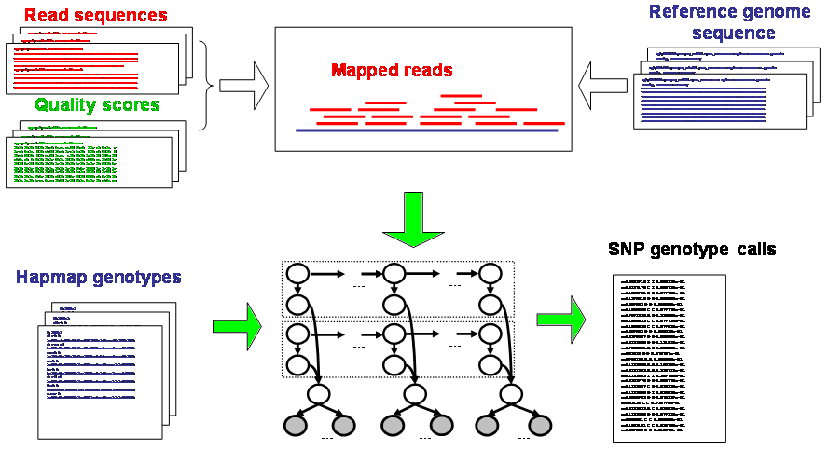
Low Coverage Genotyping-
Pipeline for Multilocus Genotyping
Reference haplotypes
Notes:
52

Slide 53
Multilocus Genotyping-
HF-HMM
F₁
F₂
…
F_{n}
HMMs representing LD in populations of origin for mother/father; similar to models used in [Scheet & Stephens 06, Rastas et al 08, Kennedy et al 08]
H₁
H₂
H_{n}
F'₁
F'₂
…
F'_{n}
H'₁
H'₂
H'_{n}
G₁
G₂
G_{n}
R_{1,1}
…
R_{1,c}
R_{2,1}
…
R_{2,c}
R_{n,1}
…
R_{n,c}
1
2
n
Notes:
The Hierarchical-Factorial HMM we used to describe haplotype sequences is similar to models recently proposed by others.
At the core of the model are 2 regular HMM representing haplotype frequencies in the populations of origin of the sequenced individual’s parents.
Under this model each haplotype in the population is viewed as a mosaic formed as a result of historical recombination among a set of K founder haplotypes.
Increasing the number of founders allows more paths to describe a haplotype sequence, but at a cost of a longer run time.
Training & the estimation of this HMM is done via a Baum-Welch algorithm based on haplotype inferred from a panel representing the population of origin of each parent.

Slide 54
Multilocus Genotyping-
HF-HMM Training
Training HMM based on Baum-Welch algorithm from haplotypes inferred from populations of origin for mother/father
  Use haplotype reference panel (e.g. HAPMAP) for training Haplotypes
Conditional probabilities for read sets are given by the formulas derived for the single SNP case:
Notes:
54
The Hierarchical-Factorial HMM we used to describe haplotype sequences is similar to models recently proposed by others.
At the core of the model are 2 regular HMM representing haplotype frequencies in the populations of origin of the sequenced individual’s parents.
Under this model each haplotype in the population is viewed as a mosaic formed as a result of historical recombination among a set of K founder haplotypes.
Increasing the number of founders allows more paths to describe a haplotype sequence, but at a cost of a longer run time.
Training & the estimation of this HMM is done via a Baum-Welch algorithm based on haplotype inferred from a panel representing the population of origin of each parent.

Slide 55
Multilocus Genotyping Problem
GIVEN:
  Shotgun read sets r=(r₁, r₂, … , r_{n})
  Quality scores
  Trained HMMs representing LD in populations of origin for mother/father
FIND:
  Multilocus genotype (G*₁,G*₂,…,G*_{n}) with maximum posterior probability, i.e., (G*₁,G*₂,…,G*_{n}) argmax_{G1..Gn} P(G₁…G_{n} | r)
Remark: max_{g}P((G*₁,G*₂,…,G*_{n})| r) is hard to approximate within unless ZPP=NP, and thus the multilocus genotyping problem is NP-hard
Notes:
NOTE: P(g|r) is NP-Hard…

Slide 56
Multilocus Genotyping-
HMM-Posterior Decoding Algorithm
For each i = 1..n, compute
Return
Notes:
56
To overcome this possible hardness, we propose 3 alternate algorithms that can be computed efficiently from the HMM.
The best likelihood function is the HMM-Posterior decoding algorithm …

Slide 57
Forward-Backward Computation of Posterior Probabilities
…
F_{i}
…
H_{i}
…
F’_{i}
…
H’_{i}
G_{i}
R_{1,1}
…
R_{1,c}
R_{i,1}
…
R_{i,c}
R_{n,1}
…
R_{n,c}
1
i
n
Notes:
57

Slide 58
Forward-Backward Computation of Posterior Probabilities
…
F_{i}
…
H_{i}
…
F’_{i}
…
H’_{i}
G_{i}
R_{1,1}
…
R_{1,c}
R_{i,1}
…
R_{i,c}
R_{n,1}
…
R_{n,c}
1
i
n
Notes:
58

Slide 59
Forward-Backward Computation of Posterior Probabilities
…
F_{i}
…
H_{i}
…
F’_{i}
…
H’_{i}
G_{i}
R_{1,1}
…
R_{1,c}
R_{i,1}
…
R_{i,c}
R_{n,1}
…
R_{n,c}
1
i
n
Notes:
59

Slide 60
Forward-Backward Computation of Posterior Probabilities
…
F_{i}
…
H_{i}
…
F’_{i}
…
H’_{i}
G_{i}
R_{1,1}
…
R_{1,c}
R_{i,1}
…
R_{i,c}
R_{n,1}
…
R_{n,c}
1
i
Notes:
60

Slide 61
Forward-Backward Computation of Posterior Probabilities
…
F_{i}
…
H_{i}
…
F’_{i}
…
H’_{i}
G_{i}
R_{1,1}
…
R_{1,c}
R_{i,1}
…
R_{i,c}
R_{n,1}
…
R_{n,c}
1
i
n
Notes:
61

Slide 62
Multilocus Genotyping-
Runtime
Direct implementation gives O(m+nk⁴) time:
  m = number of reads
  n = number of SNPs
  k = number of founder haplotypes in HMMs
Runtime reduced to O(m+nk³) by reusing common terms:
where
Notes:
62

Slide 63
Low Coverage Genotyping-
Experimental Results- Setup
Subset of James Watson’s 454 reads
  74.4M of 106.5M reads
    265 bp/read
    avg coverage: 5.64X
  Quality scores included
  Reads mapped on human genome build 36.3 using the nucmer tool of the MUMmer package [Kurtz et al 04]
  Estimated mapping error rates:
    FP rate: 0.37%
    FN rate: 21.16%
  Haplotype reference panel used to train HMM generated from Hapmap CEU genotypes (release 23a)

Slide 64
Accuracy Comparison (Heterozygous Genotypes)

Slide 65
Accuracy Comparison
(All Genotypes)

Slide 66
Accuracy at Varying Coverages (All Genotypes)

Slide 67
Outline
Introduction
Hidden Markov Models of Haplotype Diversity
Genotype Error Detection using Hidden Markov Models of Haplotype Diversity
Imputation-based Local Ancestry Inference in Admixed Populations
Single Individual Genotyping from Low-Coverage Sequencing Data
Conclusion

Slide 68
Conclusion
Genotype Error Detection
  Contributions:
    Proposed efficient methods for error detection in trio genotype data based on an HMM of haplotype diversity
    Can exploit available pedigree info
    Yield improved detection accuracy compared to FAMHAP
    Runtime grows linearly in #SNPs and #individuals
  Papers:
    J. Kennedy, I.I. Mandoiu, and B. Pasaniuc. Genotype Error Detection using Hidden Markov Models of Haplotype diversity. Journal of Computational Biology (to Appear).
    J. Kennedy, I.I. Mandoiu and B. Pasaniuc. Genotype Error Detection using Hidden Markov Models of Haplotype Diversity. Proc. WABI 2007, R. Giancarlo and S. Hannenhalli (eds.), LNBI 4645:73-84, 2007
  Software: GEDI (Genotype Error Detection and Imputation):
    J. Kennedy, I.I. Mandoiu and B. Pasaniuc. GEDI: Scalable Algorithms for Genotype Error Detection and Imputation. ARXIV Report, 2009
    Best poster award: J. Kennedy, I.I. Mandoiu and B. Pasaniuc. Genotype Error Detection and Imputation using Hidden Markov Models of Haplotype Diversity. ISBRA 2008.

Slide 69
Conclusion
Imputation-based local ancestry inference in admixed populations
  Contributions:
    Imputation-based local ancestry inference achieves significant improvement over previous methods for admixtures between close ancestral populations
  Future work:
    Evaluating accuracy under more realistic admixture scenarios (multiple ancestral populations/gene flow/drift in ancestral populations)
    Extension to pedigree data
    Extensions to sequencing data
    Exploiting inferred local ancestry for phasing of admixed individuals
    Inference of ancestral haplotypes from extant admixed populations
  Papers:
    B. Pasaniuc and J. Kennedy and I.I. Mandoiu, Imputation-based local ancestry inference in admixed populations, Proc. 5th International Symposium on Bioinformatics Research and Applications/2nd Workshop on Computational Issues in Genetic Epidemiology, pp. 221-233, 2009
  Software: GEDI-ADMX
    Unix and Windows version (geneAdmixViewer on Windows)

Slide 70
Conclusion
Genotyping from low coverage sequencing reads
  Contributions:
    Exploiting “heuristic inputs” such as quality scores and population allele frequency and LD information yields significant improvements in genotyping calling accuracy from low-coverage sequencing data
      LD information extracted from a reference panel gives highest benefit
      Relatively small gain from incorporating quality scores may be due in part to the poor calibration of 454 quality scores [Brockman et al 08, Quinlan et al 08]
    Although our evaluation is on 454 reads, the methods are well-suited for short read technologies
  Future Work: Population-based Genotyping from Low-Coverage Sequencing Data
    Extending the single individual genotyping methods to population sequencing data (removing the need for reference panels)
    Use Same HF-HMM as before, only training model based off of EM algorithm on population-level data provided.
  Papers:
    J. Duitama, S. Dinakar, Y. Hernandez, J. Kennedy, I. Mandoiu, and Y. Wu. Single individual genotyping from low-coverage sequencing data (In Preparation)
    Presentation: J.Kennedy. Linkage Disequilibrium Based Single Individual Genotyping from Low-Coverage Short Sequencing Reads. DIMACS workshop on Computational Issues in Genetic Epidemiology.
  Software: Gene-Seq
Notes:
Future Work: Population-based Genotyping from Low-Coverage Sequencing Data
Extending the single individual genotyping methods to population sequencing data (removing the need for reference panels)
Use Same HF-HMM as before, only training model based off of EM algorithm on population-level data provided.

Slide 71
Questions?

Slide 72
Acknowledgments
This work was supported in part by NSF (awards IIS-0546457, DBI-0543365, and CCF-0755373) and by the University of Connecticut Research Foundation

Slide 73
Click again for helper slides

Slide 74
HAPMAP:
The International HAPMAP Project is an organization whose goal is to develop a haplotype map of the human genome (the HapMap), which will describe the common patterns of human genetic variation.
HAPMAP is expected to be a key resource for researchers to find genetic variants affecting health, disease and responses to drugs and environmental factors. The information produced by the project is made freely available to researchers around the world.
The International HapMap Project is a collaboration among researchers at academic centers, non-profit biomedical research groups and private companies in Canada, China, Japan, Nigeria, the United Kingdom, and the United States.

Slide 75
Baum-Welch overview
The algorithm has two steps:
  Calculating the forward probability for each HMM state;
  Determining the frequency of the transition-emission pair values and dividing it by the probability of the entire sequence. This amounts to calculating the expected count of the particular transition-emission pair. Each time a particular transition is found, the value of the quotient of the transition divided by the probability of the entire sequence goes up, and this value can then be made the new value of the transition.

Slide 76
GEDI Speed-up: PopTree Trie
Due to limited genotype variation across individuals of the same population, additional re-use of forward and backward probability computations corresponding to genotype prefixes (respectively suffixes) shared by multiple genotypes is possible.
GEDI builds PopTree, which is a trie (prefix tree), from the given multilocus genotypes and then computes probabilities by performing a preorder traversal of the trie.
Specifically, the PopTree data structure for unrelated individuals in a population consists of:
  Up to n levels,
  Each node has up to 3 child edges one for each possible genotype value (0, 1, 2).

Slide 77
GEDI Speed-up: PopTree Speed-up

Slide 78
Genotype Imputation-
Accuracy with varying parameters
  5835 SNPs
  2502 unrelated
  [IMAGE]
  9% imputed (535 SNPs)
Notes:
We use Receiver Operating Characteristic (ROC) curves, to compare the accuracy of our likelihood functions
This plot shows, for parents, our Combined method performing better than our other methods, and significantly better than similar functions in the FAMHAP software.

Slide 79
Genotype Error Detection- Experimental Results (Setup)
Real dataset [Becker et al. 2006]
  35 SNP loci covering a region of 91kb
  551 trios
Synthetic datasets
  35 SNPs, 551 trios
  Preserved missing data pattern of real dataset
  Haplotypes assigned to trios based on frequencies inferred from real dataset
  1% error rate using random allele insertion model

Slide 80
Error Detection Accuracy on Unrelated Genotype Data
Genotype Error Detection-
Effect of Distance between SNPs
551 unrelated individuals
Recombination & mutation rates of 10⁻⁸ per generation per bp
35 SNPs within a region of 10kb-10Mb
Notes:
The effect of SNP density is shown here, where simulated data with higher recombination rates between adjacent SNPs (and hence lower linkage disequilibrium between adjacent SNPs) performs worse than denser sampling.

Slide 81
Genotype Error Detection-
TrioProb-Combined Results on Real Dataset
 | Total Signals |  |  | True Positives |  |  | False Positives |  |  | Unknown
FP Rate | 1% | .5% | .1% | 1% | .5% | .1% | 1% | .5% | .1% | 1% | .5% | .1%
Parents | 218 | 127 | 69 | 9 | 9 | 8 | 1 | 0 | 0 | 208 | 118 | 91
Children | 104 | 74 | 24 | 11 | 11 | 11 | 3 | 3 | 2 | 90 | 60 | 11
Total | 322 | 201 | 93 | 20 | 20 | 19 | 4 | 3 | 2 | 298 | 178 | 72
[Becker et al. 06] resequenced all trio members at 41 loci flagged by FAMHAP-3
  26 SNP genotypes in 23 trios were identified as true errors
  41*3-26=97 resequenced SNP genotypes agree with original calls (or are unknown)
Notes:
The results for the real datasets show similar improvements in accuracy over FAMHAP.
……………….
For the real dataset, not all true errors are known.
Becker et al. resequenced 123 genotypes flagged using their FAMHAP-3 algorithm with a threshold of 10,000.
Of these genotypes, 23 were found to be true errors, while the other 100 genotypes agreed with original calls.
Our method shows a much higher true positive-to-false positive ratio
Unknowns that we found were never re-sequenced, so we do not know if they are actual errors or not.

Slide 82
Genotype Error Detection-
Error Model Comparison
Notes:
82
Our method has a high detection accuracy for all four error models.
Of the four models, the random allele errors are slightly more difficult to detect.

Slide 83
Genotype Error Detection-
Distribution of LLR for Total Trio Prob.
  35 SNPs
  551 trios
  [Becker 06]
  1% err. rate
Same-locus errors in parents
Notes:
The histogram illustrates a problem of false positives caused by flagging the wrong individual as a genotyping error when a true error occurs at the same locus, but in a different individual in the same pedigree, mainly parents

Slide 84
Genotype Error Detection-
LLR for Combined Method
  35 SNPs
  551 trios
  [Becker 06]
  1% err. rate
Notes:
This combined method solves the problem of generating false positives due to errors in different individuals at the same marker.

Slide 85
Genotype Error Detection-
Effect of Population Size

Slide 86
Genotype Imputation-
Effect of flanking size

Slide 87
Genotype Imputation-
Effect of pedigree data/haplotypes

Slide 88
Introduction- Single Nucleotide Polymorphisms
Main form of variation between individual genomes: Single Nucleotide Polymorphisms (SNPs)
Human genome density: ≈ 1.2x10⁷ out of 3×10⁹ base pairs
Vast majority bi-allelic ➔ 0/1 encoding (major/minor resp.)
SNP Genotypes are critical to Disease-Gene Mapping
  One Method: Admixture Mapping
… ataggtccCtatttcgcgcCgtatacacgggActata …
… ataggtccGtatttcgcgcCgtatacacgggTctata …
… ataggtccCtatttcgcgcGgtatacacgggTctata …
012100120
011000110
001100010
genotype
+
two haplotypes per individual
Notes:
88

Slide 89
Helper Slide-Software Overview
Only Require information about ancestral allele frequencies:
  LAMP (No recombination assumption)
  WINPOP (a more refined model of recombination events coupled with an adaptive window size computation to achieve increased accuracy)
  SWITCH (HMM-Based)
Only require ancestral allele frequencies & genotypes
  SABER (HMM-Based)
Additionally use ancestral haplotype information:
  HAPAA (HMM-Based)
  GEDI-ADMX (HMM-Based)

Slide 90
Helper Slide- Probabilities
Random variable genotype at SNP i
Genotype variable taken at SNP i
Multilocus genotype without i
Multilocus genotype with I set to
HMM with ancestral pair k,l

Slide 91
Helper Slide- Emission Details

Slide 92
Window-based local ancestry inference
Input
  For every
  Window half-size w
Output (Single Window method)
  For every i=1..n:
  Where:
Notes:
92
A hat sub i: More precisely, the algorithm assigns to each SNP locus i the local ancestry that maximizes the average posterior probability for the true SNP genotypes over a window of up to 2w +1
SNPs centered at i (w SNPs downstream and w SNPs upstream of i

Slide 93
Window-based local ancestry inference
…….…………………………..……
…………………………………………………..….
???????????????????????????????????????????????????????????????????????????????????????
k
l
???????????????????????????????????????????????????????????????????????????????????????

Slide 94
Window-based local ancestry inference
…….…………………………..……
…………………………………………………..….
??????????????????????????????????????????????????????????????????????????????????????
k
1
l
??????????????????????????????????????????????????????????????????????????????????????
1

Slide 95
Window-based local ancestry inference
…….…………………………..……
…………………………………………………..….
????????????????????????????????????????????????????????????????????????????????????
k
1
1
l
????????????????????????????????????????????????????????????????????????????????????
1
1

Slide 96
Window-based local ancestry inference
…….…………………………..……
…………………………………………………..….
??????????????????????????????????????????????????????????????????????????????????
k
1
1
1
l
??????????????????????????????????????????????????????????????????????????????????
1
1
1

Slide 97
Window-based local ancestry inference
…….…………………………..……
…………………………………………………..….
????????????????????????????????????????????????????????????????????????????????
k
1
1
1
1
l
????????????????????????????????????????????????????????????????????????????????
1
1
1
2

Slide 98
Window-based local ancestry inference
…….…………………………..……
…………………………………………………..….
1111111112222222211111111111111112222 ???????????????????????????????????????????
1111111112222222211111111111111112222222222222222111111111111111111111111111
k
1
1112222222222222221111111111111122222222222222222222222221111111111111222222
l
1112222222222222221111111111111122222 ???????????????????????????????????????????
2

Slide 99
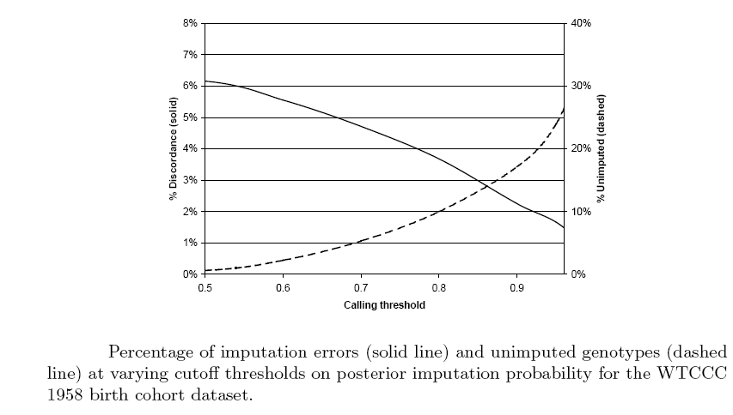
Experimental Results-
GEDI 1-pop Imputation
1,444 individuals trained on HAPMAP CEU haplotype reference panel
Imputed (after masking) 1% of SNPs on chromosome 22

Slide 100

Binomial Distribution
To call a heterozygous genotype, each allele must be covered by at least one read and the binomial probability for the observed number of 0 and 1 alleles must be at least 0.01
n: # of successive trials (reads)
p: the probability of a success (correct map)
1-p: =q , theprobability of a failure (incorrect map)
Notes:
100

Slide 101
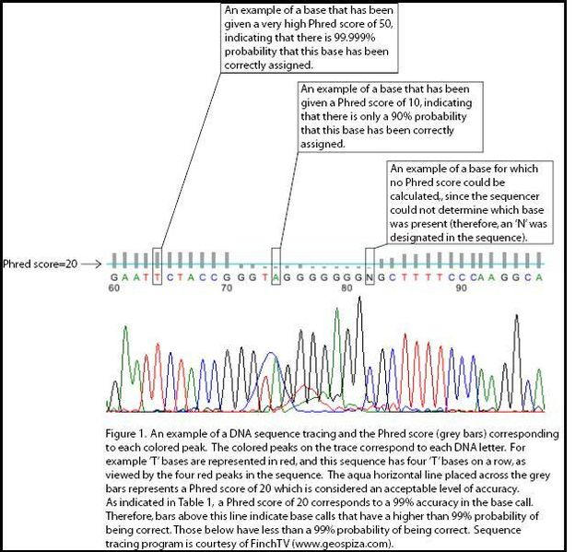
Phred Score
To determine quality scores, Phred first calculates several parameters related to peak shape and peak resolution at each base. Phred then uses these parameters to look up a corresponding quality score in huge lookup tables. These lookup tables were generated from sequence traces where the correct sequence was known, and are hard coded in Phred; different lookup tables are used for different sequencing chemistries and machines

Slide 102
Conditional Probability for Heterozygous Genotypes
Notes:
102
The Hierarchical-Factorial HMM we used to describe haplotype sequences is similar to models recently proposed by others.
At the core of the model are 2 regular HMM representing haplotype frequencies in the populations of origin of the sequenced individual’s parents.
Under this model each haplotype in the population is viewed as a mosaic formed as a result of historical recombination among a set of K founder haplotypes.
Increasing the number of founders allows more paths to describe a haplotype sequence, but at a cost of a longer run time.
Training & the estimation of this HMM is done via a Baum-Welch algorithm based on haplotype inferred from a panel representing the population of origin of each parent.

Slide 103
Baum-Welch overview
The algorithm has two steps:
  Calculating the forward probability for each HMM state;
  Determining the frequency of the transition-emission pair values and dividing it by the probability of the entire sequence. This amounts to calculating the expected count of the particular transition-emission pair. Each time a particular transition is found, the value of the quotient of the transition divided by the probability of the entire sequence goes up, and this value can then be made the new value of the transition.

Slide 104
Model Training- Details
Initial founder probabilities P(f₁), P(f’₁), transition probabilities P(f_{i+1}|f_{i}), P(f’_{i+1}|f’_{i}), and emission probabilities P(h_{i}|f_{i}), P(h’_{i}|f’_{i}) trained using the Baum-Welch algorithm from haplotypes inferred from the populations of origin for mother/father
P(g_{i}|h_{i},h’_{i}) set to 1 if h+h’_{i}=g_{i} and to 0 otherwise
  This implies that conditional probabilities for sets of reads are given by the formulas derived for the single SNP case:
Notes:
104
The Hierarchical-Factorial HMM we used to describe haplotype sequences is similar to models recently proposed by others.
At the core of the model are 2 regular HMM representing haplotype frequencies in the populations of origin of the sequenced individual’s parents.
Under this model each haplotype in the population is viewed as a mosaic formed as a result of historical recombination among a set of K founder haplotypes.
Increasing the number of founders allows more paths to describe a haplotype sequence, but at a cost of a longer run time.
Training & the estimation of this HMM is done via a Baum-Welch algorithm based on haplotype inferred from a panel representing the population of origin of each parent.

Slide 105
Implementation Details
Forward recurrences:
Backward recurrences are similar
Notes:
105

Slide 106
Allele coverage for heterozygous SNPs (Watson 454 @ 5.85x avg. coverage)

Slide 107
Allele coverage for heterozygous SNPs (Watson 454 @ 2.93x avg. coverage)

Slide 108
Allele coverage for heterozygous SNPs (Watson 454 @ 1.46x avg. coverage)

Slide 109
Allele coverage for heterozygous SNPs (Watson 454 @ 0.73x avg. coverage)

Slide 110
Allele coverage for heterozygous SNPs (Watson 454 @ 0.37x avg. coverage)

Slide 111
Single SNP Genotyping- Incorporating Base Call Uncertainty
Let r_{i} denote the set of mapped reads covering SNP locus i and c_{i}=| r_{i} |
  For a read r in r_{i} , r(i) denotes the allele observed at locus i
  If q_{r(i)} is the phred quality score of r(i), the probability that r(i) is incorrect is given by
The probability of observing read set r_{i} conditional on having genotype g_{i} is then given by:
Notes:
111
q_r(i_c_i) is the phred quality score for a read
e_r(i_c_i) is the probability a read is affected by a sequencing error
P(ri|Gi=1) can be simplified to this

Slide 112
Experimental Results-
Read Data
Subset of James Watson’s 454 reads
  74.4 million reads with quality scores (of 106.5 million reads used in [Wheeler et al 08]) downloaded from ftp://ftp.ncbi.nih.gov/pub/TraceDB/Personal_Genomics/Watson/
  Average read length ~265 bp
Notes:
112

Slide 113
Experimental Results-
Read Data
Reads mapped on human genome build 36.3 using the nucmer tool of the MUMmer package [Kurtz et al 04]
  Default nucmer parameters (MUM size 20, min cluster size 65, max gap between adjacent matches 90)
  Additional filtering: at least 90% of the read length matched to the genome, no more than 10 errors (mismatches or indels)
  Reads meeting above conditions at multiple genome positions (likely coming from genomic repeats) were discarded
Simulated 454 reads generated using ReadSim [Schmid et al 07] were used to estimate mapping error rates:
  FP rate: 0.37%
  FN rate: 21.16%
Notes:
113

Slide 114
Experimental Results-
Read Data
Average coverage by mapped reads of Hapmap SNPs was 5.64x
  Lower than [Wheeler et al 08] since we start with a subset of the reads and use more stringent mapping constraints
Notes:
114

Slide 115
Experimental Results-
Read Data
CEU genotypes from latest Hapmap release (23a) were dowloaded from http://ftp.hapmap.org/genotypes/latest_ncbi_build36/forward/non-redundant/
  Genotypes were phased using the ENT algorithm [Gusev et al 08] and inferred haplotypes were used to train the parent HMMs using Baum-Welch
Duplicate Affymetrix 500k SNP genotypes were downloaded from ftp://ftp.ncbi.nih.gov/pub/geo/DATA/SOFT/by_series/GSE10668/GSE10668_family.soft.gz
  We removed genotypes that were discordant in the two replicates and genotypes for which Hapmap and Affymetrix annotations had more than 5% in CEU same-strand allele frequency
Notes:
115

Slide 116
Accuracy Comparison (Homozygous Genotypes)

Slide 117
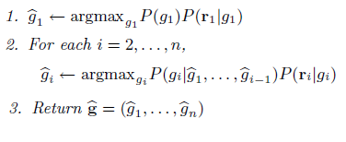
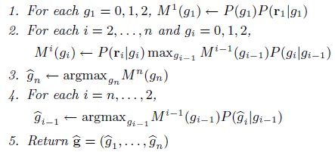
Gene-Seq Algorithms
Posterior Decoding (see presentation)
Greedy:
Markov Approximation:
Composite 2-SNP
Viterbi
Posterior Decoding, version 2

Slide 118
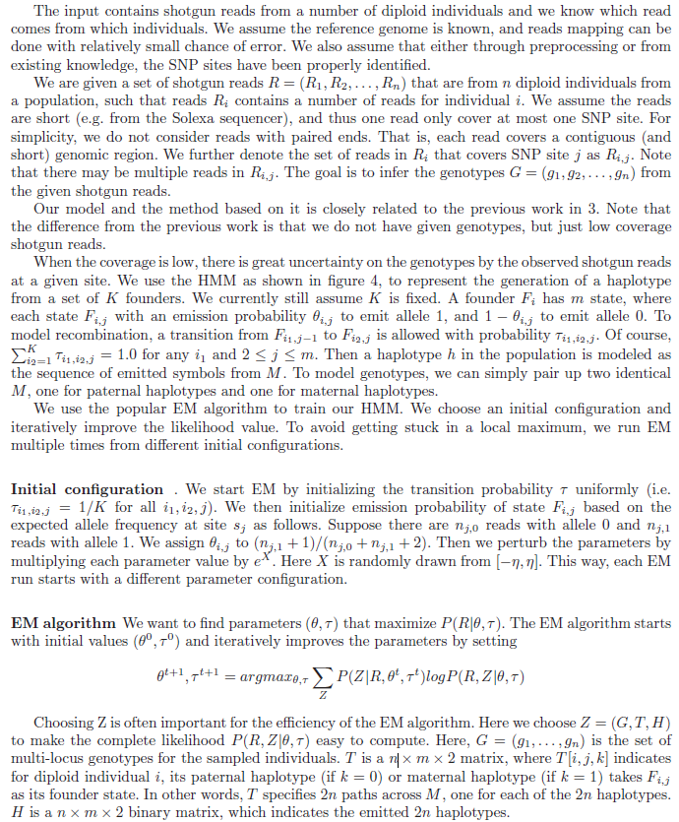

Slide 119
Introduction Helper
Linkage Analysis: Study aimed at establishing linkage between genes. Today linkage analysis serves as a way of gene-hunting and genetic testing.
  Genetic linkage is the tendency for genes and other genetic markers to be inherited together because of their location near one another on the same chromosome.
Relative Risk is the risk of an event (or of developing a disease) relative to exposure.
  Relative risk is a ratio of the probability of the event occurring in the exposed group versus a non-exposed group.
  For example, if the probability of developing lung cancer among smokers was 20% and among non-smokers 1%, then the relative risk of cancer associated with smoking would be 20. Smokers would be twenty times as likely as non-smokers to develop lung cancer.
Association Analysis: Test for association between a genetic variation (e.g. SNP) and one or more quantitative traits

Slide 120
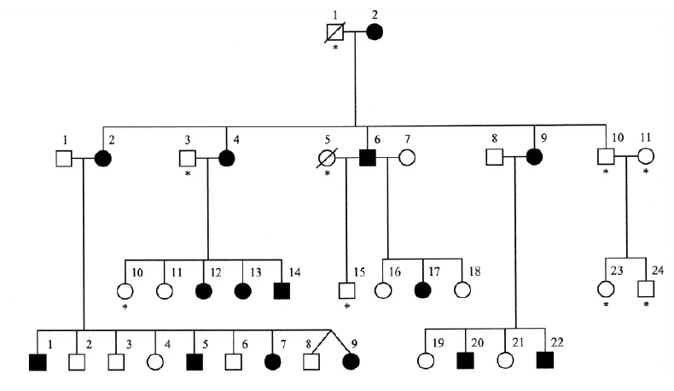
Introduction-
Disease Gene Mapping
Linkage analysis
  Very successful for Mendelian diseases (cystic fibrosis, Huntington’s,…)
  Low power to detect genes with small relative risk in complex diseases [RischMerikangas’96]
Association analysis
  Genome-wide scans made possible by recent progress in Single Nucleotide Polymorphism (SNP) genotyping technologies
Cases
Controls
Notes:
“The area of my research is focused on furthering successes in Disease Gene Mapping”
“Genes can be mapped by techniques such as Linkage Analysis or Association Analysis”
“Genome-wide association studies are

Slide 121
Genotype Error Detection-
Motivation
Even low error levels can have large effects for some study designs (e.g. rare alleles, haplotype-based)
Errors as low as .1% can increase Type I error rates in haplotype sharing transmission disequilibrium test (HS-TDT) [Knapp&Becker04]
  1% errors decrease power by 10-50% for linkage, and by 5-20% for association [Douglas et al. 00, Abecasis et al. 01]
Notes:
Effects of Undetected Errors

Slide 122
Genotype Error Detection-
Motivation
Improved genotype calling algorithms
  [Marchini et al. 07, Nicolae et al. 06, Rabbee&Speed 05, Xiao et al. 07]
Explicit modeling in analysis methods
  [Cheng 07, Hao & Wang 04, Liu et al. 07]
  Computationally complex
Separate error detection step
  Detected errors can be retyped, imputed, or ignored in downstream analyses
  Common approach in pedigree genotype data analysis [Abecasis et al. 02, Douglas et al. 00, Sobel et al. 02]
Notes:
122
Recent work addresses genotyping errors at several levels
First, there has been much work on improved genotype calling algorithms which attempt to produce more accurate genotypes from low level intensity data.
Second, there have been several attempts at explicitly modeling genotyping errors in linkage & association analyses mentioned previously. However, this approach is very computationally expensive.
Finally, Another option is to implement error detection as a separate step, following genotype calling and preceding downstream error analyses. Specifically this step produces a list of genotypes that are likely errors- These genotypes can be retyped, imputed or ignored altogether in further downstream analysis. Our work approaches error detection in this way.

Slide 123
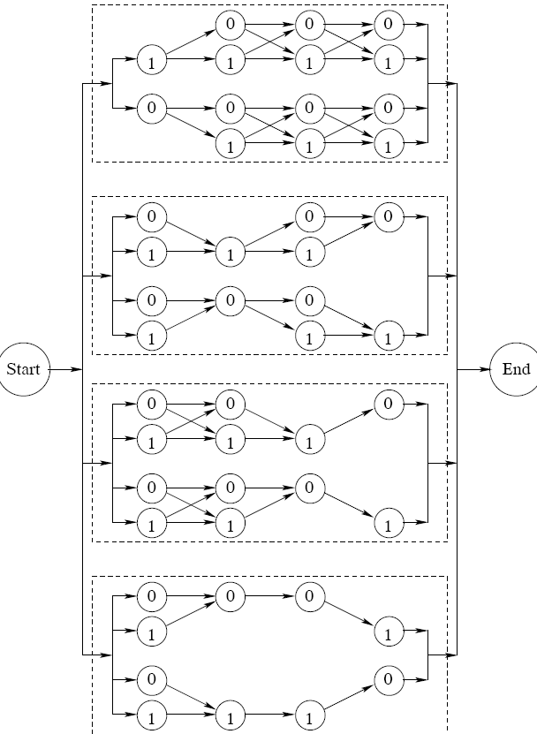
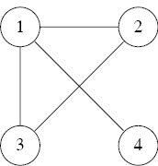
Complexity of Computing Maximum Phasing Probability
For unrelated genotypes, computing maximum phasing probability is hard to approximate within a factor of O(f^{½-ε}) unless ZPP=NP, where f is the number of founders
  For trios, hard to approx. within O(f^{1/4 -ε})
  Reductions from the clique problem

Slide 124
NGS Applications
Besides reducing costs of de novo genome sequencing, NGS has found many more apps:
  Resequencing, transcriptomics (RNA-Seq), gene regulation (non-coding RNAs, transcription factor binding sites using ChIP-Seq), epigenetics (methylation, nucleosome modifications), metagenomics, paleogenomics, …
NGS is enabling personal genomics
  James Watson genome [Wheeler et al 08] sequenced using 454 technology for ~$1 million compared to ~$100 million for the Sanger-sequenced Venter genome [Levy et al 07]
  Thousands more individual genomes to be sequenced as part of 1000 Genomes Project
Notes:
124
Sanger: long reads generally encounter fewer assembly problems on a per-read basis. However, the technology is much more expensive

Slide 125
Challenges in Medical Applications of Sequencing
Medical sequencing focuses on genetic variation (SNPs, CNVs, genome rearrangements)
  Requires accurate determination of both alleles at variable loci
  Accuracy is limited by coverage depth due to random nature of shotgun sequencing
  For the Venter and Watson genomes (both sequenced at ~7.5x average coverage), only 75-80% accuracy achieved for sequencing based calls of heterozygous SNPs [Levy et al 07, Wheeler et al 08].
  [Wheeler et al 08] use hypothesis testing based on binomial distribution
    To call a heterozygous genotype each allele must be covered by at least one read and the binomial probability for the observed number of 0 and 1 alleles must be at least 0.01
[Wendl&Wilson 08] predict that 21x coverage will be required for sequencing of normal tissue samples based on idealized theory that “neglects any heuristic inputs”
Notes:
125

Slide 126
Prior Methods for Calling SNP Genotypes from Read Data
Prior methods are all based on allele coverage
  [Levy et al 07] require that each allele be covered by at least 2 reads in order to be called
  [Wheeler et al 08] use hypothesis testing based on the binomial distribution
    To call a heterozygous genotype must have each allele covered by at least one read and the binomial probability for the observed number of 0 and 1 alleles must be at least 0.01
  [Wendl&Wilson 08] generalize these methods by allowing an arbitrary minimum allele coverage k
Notes:
Let me describe some basic notations before going into the Single SNP Genotype calling method
A read r(i) describes the set observed alleles from each read at SNP i, with coverage c_i. 0/1 values are used to describe each read, where 0 is the major allele and 1 is the minor allele, each allele represenenting one of the chromosomes in the genome
We assume SNPs are unlinked since the short reads typically do not make coverage of more than one SNP feasible.
To describe genotype sequences, we use additive notations for each SNP, with 0 and 2 values in the genotype sequence representing homozygotes, 1 being a heterozygote, where a sufficient amount of reads covering both alleles at the same SNP exist.

Slide 127
Linkage Disequilibrium-Based Single Individual Genotyping from
Low-Coverage Short Sequencing Reads
S. Dinakar¹, Y. Hernandez², J. Kennedy¹, I. Mandoiu¹, and Y. Wu¹
¹CSE Department, University of Connecticut ²Department of Computer Science, Hunter College

Slide 128
ORIGINAL PROPOSAL PRESENTATION NEXT

Slide 129
Efficient Algorithms for SNP Genotype Data Analysis using Hidden
Markov Models of Haplotype Diversity
Justin Kennedy
Dissertation Proposal for the Degree of Doctorate in Philosophy
Computer Science & Engineering Department
University of Connecticut

Slide 130
Outline
Introduction
Genotype Error Detection using Hidden Markov Models of Haplotype Diversity
Single Individual Genotyping from Low-Coverage Sequencing Data
Conclusion

Slide 131
Introduction-
Single Nucleotide Polymorphisms
Main form of variation between individual genomes: Single Nucleotide Polymorphisms (SNPs)
High density in the human genome: ≈ 1.2x10⁷ out of 3×10⁹ base pairs
Vast majority bi-allelic ➔ 0/1 encoding (major/minor resp.)
SNP Genotypes are critical to Disease-Gene Mapping
… ataggtccCtatttcgcgcCgtatacacgggActata …
… ataggtccGtatttcgcgcCgtatacacgggTctata …
… ataggtccCtatttcgcgcGgtatacacgggTctata …
Notes:
“My research is focused on improving data quality of Single Nucleotide Polymorphisms (or SNPs).”
“A SNP is a single base pair nucleotide variation between individuals of the same species at a specific locus along the genome”
“It is the main form of genomic variation, occurring in over 12 million out of the 3 billion base pair nucleotides in the human genome”
“The majority of SNPs are bi-allelic, meaning the variation is between only 2 nucleotides at a specific locus”
“We assume bi-allelic properties in my research, and notation will encode the major allele as a 0 and the minor allele as a 1”
“SNP are critical to the success of Disease-Gene Mapping, and SNP Genotypes are central to methods such as Genome-Wide Association Studies”

Slide 132
Introduction-
Why SNP Genotypes?
Single Nucleotide Polymorphisms (SNPs) have become the genetic marker of choice for genome wide association studies (GWASs)
  GWAS: Method for mapping disease associated genes by typing a dense set of markers in large numbers of cases and controls followed by a statistical test of association. Provides Higher statistical power compared to other gene mapping methods such as linkage for uncovering genetic basis of complex diseases
Ongoing GWASs generate a deluge of genotype data
  Genetic Association Information Network (GAIN): 6 studies totaling 18,000 individuals typed at 500,000 to 940,000 SNP loci
  Wellcome Trust Case-Control Consortium (WTCCC): 7 studies totaling 17,000 individuals typed at 500,000 SNP
Major concern: quality of genotype data
Notes:
“With the sequencing of the human genome, the mapping of human haplotypes by the HapMap project and rapid advances in SNP genotyping technologies, SNPs have become the genetic marker of choice for identification and mapping of disease-related genes via GWAS.”
“GWAS is a method…”
“There are numerous ongoing association studies, and this has resulted in huge amounts of SNP genotype data.”
“These 2 examples illustrate how large in scope some of these GWASs are. “
“With all of this ongoing analysis, there is major concern for the quality of genotype data.”

Slide 133
Introduction-
Computational Challenges to Disease Gene Mapping
  Genotype error detection: Low levels of genotyping errors can decrease statistical power and invalidate statistical tests for disease association based on haplotypes
Handling structural variation data provided by new sequencing technologies: Accurate determination of both alleles at variable loci is essential, and is limited by coverage depth due to random nature of shotgun sequencing
Notes:
“We focus on two problems addressing computational challenges to Disease gene mapping when SNP Genotypes are used”

Slide 134
Outline
Introduction
Genotype Error Detection using Hidden Markov Models of Haplotype Diversity
  Motivation
  Likelihood Sensitivity Approach to Error Detection
  Hidden Markov Model of Haplotype Diversity
  Efficiently Computable Likelihood functions
  Experimental Results
Single Individual Genotyping from Low-Coverage Sequencing Data
Conclusion

Slide 135
Genotype Error Detection-
Motivation
A real problem despite advances in genotyping technology
  [Zaitlen et al. 2005] found 1.1% inconsistencies among the 20 million dbSNP genotypes typed multiple times
  1% errors decrease power by 10-50% for linkage, and by 5-20% for association [Douglas et al. 00, Abecasis et al. 01]
Error types
  Systematic errors (e.g., assay failure) detected by HWE test [Hosking et al. 2004]
  For pedigree data some errors detected as Mendelian Inconsistencies (MIs)
    E.g. Only ~30% detectable as MIs for trios [Gordon et al. 1999]
  Undetected errors
Methods for Handling Undetected errors:
  Improved genotype calling algorithms [Marchini et al. 07,, Xiao et al. 07]
  Explicit modeling in analysis methods [Cheng 07, Hao & Wang 04, Liu et al. 07]
  Separate error detection step
    Detected errors can be retyped, imputed, or ignored in downstream analyses
Notes:
-Genotyping Errors present a real problem despite advances in technologies
-For example, Zaitlen et al found approximately 1% of all dnSNP genotypes that were typed multiple times showed to have inconsistencies. These inconsistencies indicate genotype errors
-Some errors are easy to detect, such as those cause by problematic assays, which can be detected by deviation from the Hardy-Weinberg equilibrium.
-In pedigree data, errors that results in Mendelian Inconsistencies can also be found easily.
However not all errors can be detected in this way-
-For example, in trio data, only approximately 30% of all genotyping errors are Mendelian inconsistent
-Even low error levels can have large effects for some study designs (e.g. rare alleles, haplotype-based)
-Errors as low as .1% can increase Type I error rates in haplotype sharing transmission disequilibrium test (HS-TDT) [Knapp&Becker04]
-1% errors decrease power by 10-50% for linkage, and by 5-20% for association [Douglas et al. 00, Abecasis et al. 01]
-In this work we propose methods to detect the remaining 70% which are Mendelian consistent.

Slide 136
Genotype Error Detection-
Haplotypes and Genotypes
Haplotype: description of SNP alleles on a chromosome
  0/1 vector: 0 for major allele, 1 for minor
Diploids: two homologous copies of each autosomal chromosome
  One inherited from mother and one from father
Genotype: description of alleles on both chromosomes
  0/1/2 vector: 0 (1) - both chromosomes contain the major (minor) allele; 2 - the chromosomes contain different alleles
011000110
001100010
021200210
two haplotypes per individual
+
genotype
Notes:
Major allele - allele most frequent in the population
Homozygous vs. heterozygous

Slide 137
Genotype Error Detection-
Likelihood Sensitivity Approach to Error Detection [Becker et al. 06]
Mother
Father
0 1 2 1 0 2
0 2 2 1 0 2
0 0 0 1 0 1 h₃
0 1 1 1 0 0 h₄
0 1 1 1 0 0 h₁
0 1 0 1 0 1 h₂
Child
0 2 2 1 0 2
0 1 1 1 0 0 h₁
0 0 0 1 0 1 h₃
Likelihood of best phasing for original trio T
Notes:
Becker et. al focused on error detection in trios consisting of mother, father & child genotypes, as in this example. However, this method can apply to other pedigree structures.
The approach starts by estimating haplotype frequencies in the population under study.
Haplotype frequencies are used to determine the likelihood of the best phasing for each trio-which is the maximum product of parent haplotype frequencies over all compatible phasings of the trio.

Slide 138
Genotype Error Detection-
Likelihood Sensitivity Approach to Error Detection [Becker et al. 06]
Mother
Father
0 1 2 1 0 2
0 2 2 1 0 2
0 0 0 1 0 0 h’ ₃
0 1 1 1 0 1 h’ ₄
0 1 0 1 0 1 h’₁
0 1 1 1 0 0 h’₂
Child
0 2 2 1 0 2
?
0 1 0 1 0 1 h’ ₁
0 0 0 1 0 0 h’ ₃
Likelihood of best phasing for original trio T
Likelihood of best phasing for modified trio T’
Notes:
We take this same trio and modify it by marking one SNP genotype as unknown and compute the likelihood of the best phasing for this modified trio.

Slide 139
Genotype Error Detection-
Likelihood Sensitivity Approach to Error Detection [Becker et al. 06]
Mother
Mother
Father
Father
0 1 2 1 0 2
0 1 2 1 0 2
0 2 2 1 0 2
0 2 2 1 0 2
Child
Child
0 2 2 1 0 2
0 2 2 1 0 2
?
Large change in likelihood suggests likely error
  Flag genotype as an error if L(T’)/L(T) > R, where R is the detection threshold (e.g., R=10⁴)
Notes:
In correct genotype data we don’t expect much of a change in likelihood due to altering a single genotype.
Becker et. al proposed to flag the original SNP genotype as a possible error if the ratio between the two likelihoods is greater than a given threshold parameter, such as 10,000.
Like the original likelihood in Becker et al, our functions are monotonic under data deletion, meaning that their value can only increase when a SNP genotype is marked as missing.

Slide 140
Genotype Error Detection-
Likelihood Sensitivity Approach to Error Detection
[Becker et al. 06] Implementation in FAMHAP Software
Window-based algorithm
  For each window including the SNP under test, generate list of H most frequent haplotypes (default H=50)
  Find most likely trio phasings by pruned search over the H⁴ quadruples of frequent haplotypes
  Flag genotype as an error if L(T’)/L(T) > R for at least one window
Mother …201012 1 02210...
Father …201202 2 10211...
Child …000120 2 21021...
Notes:
Becker et al implement the likelihood sensitivity approach in their FAMHAP software.
FAMHAP checks each SNP locus using several short overlapping windows.
To achieve a practical runtime, FAMHAP generates a short list of H most frequent haplotypes for each window.
The most likely phasing is found among the H^4 quadruples of frequent haplotypes by an essentially exhaustive search.
If the likelihood ratio from these phasings is greater than the R parameter threshold FOR ANY of the short windows, FAMHAP flags that genotype as a likely error.

Slide 141
Genotype Error Detection- Limitations of FAMHAP
Truncating the list of haplotypes to size H may lead to sub-optimal phasings and inaccurate L(T) values
False positives caused by nearby errors (due to the use of multiple short windows)
Our approach:
HMM of haplotype frequencies ➔ all haplotypes represented + no need for short windows
Alternate likelihood functions ➔ scalable runtime
Notes:
Due to Truncating the list of haplotypes, FAMHAP may produce sub-optimal phasings which result in inaccurate Likelihood values.
as observed by Becker et a.l., another drawback of the FAMHAP implementation is the large number of false positives caused by true errors within the same window.
Our approach overcomes these issues by using a Hidden Markov Model of haplotype diversity, in which ALL haplotypes are represented in the model, and removes the need for windows.
We also introduce alternate likelihood functions which allow us to achieve a scalable run time.

Slide 142
Genotype Error Detection-
Hidden Markov Model of Haplotype Diversity
K= #Founders(E.g. K=4)
N= #SNPs(E.g. N=5)
Emission Prob
Transition Prob
Similar HMMs proposed by [Kimmel &Shamir 05, Rastas et al. 05, Schwartz 04]
Paths with high transition probability correspond to “founder” haplotypes
Haplotype sequence/paths computed using Viterbi and forward algorithms
Notes:
The HMM we used to describe haplotype sequences is similar to models recently proposed by others.
This diagram shows the overall Model, which consists of 2 HMMs, each representing LD in population of origin for the parents (one for Mother, one for father)
The HMM is consists of a set of K states grouped by the N SNP loci, where K is the number of founders, and is a user specified parameter.
Increasing the number of founders allows more paths to describe a haplotype sequence, but at a cost of a longer run time.
Transition probabilities go from left to right, only exist between adjacent SNPs, and describe the likelihood of adherence to the founder haplotypes, or deviation from them via recombinations.
Each state can emit both alleles, but each state is usually biased towards one of them.
The probability a haplotype sequence H is emitted along a particular path in the given HMM is shown by this equation.

Slide 143
Genotype Error Detection-
Hidden Markov Model of Haplotype Diversity
K= #Founders(E.g. K=4)
N= #SNPs(E.g. N=5)
Emission Prob
Transition Prob
Training: 2- step algorithm that exploits pedigree info
  Step 1: Obtain haplotypes from using either:
    ENT: A pedigree-aware haplotype phasing algorithm based on entropy-minimization
    Haplotype reference panel (e.g. HAPMAP)
  Step 2: train HMM based on inferred haplotypes, using Baum-Welch
Notes:
The HMM we used to describe haplotype sequences is similar to models recently proposed by others.
This diagram shows the overall Model, which consists of 2 HMMs, each representing LD in population of origin for the parents (one for Mother, one for father)
The HMM is consists of a set of K states grouped by the N SNP loci, where K is the number of founders, and is a user specified parameter.
Increasing the number of founders allows more paths to describe a haplotype sequence, but at a cost of a longer run time.
Transition probabilities go from left to right, only exist between adjacent SNPs, and describe the likelihood of adherence to the founder haplotypes, or deviation from them via recombinations.
Each state can emit both alleles, but each state is usually biased towards one of them.
The probability a haplotype sequence H is emitted along a particular path in the given HMM is shown by this equation.

Slide 144
Genotype Error Detection- Alternate Likelihood Functions
Viterbi probability (ViterbiProb): Maximum probability of a set of 4 HMM paths that emit 4 haplotypes compatible with the trio
Probability of Viterbi Haplotypes (ViterbiHaps): Product of total probabilities of the 4 Viterbi haplotypes
Total Trio Probability (TotalProb): Total probability P(T) that the HMM emits four haplotypes that explain trio T along all possible 4-tuples of paths
Notes:
144
To overcome this hardness, we propose 3 alternate likelihood functions that can be computed efficiently from the HMM.
The first likelihood function is …

Slide 145
Genotype Error Detection- Speed Up of Viterbi Probability
For a fixed trio, Viterbi paths can be found using a 4-path version of Viterbi’s algorithm in time
K³ speed-up by reuse of common terms (similar to [Rastas et al. 05]):
Notes:
For a fixed trio, the 4 Viterbi haplotype paths can be computed in O(NK^8) time using a 4-path extension of the classic Viterbi algorithm.
The K^8 factor in the running time comes Viterbi computing a probability for a 4-tuple of states locus j over all 4-tuples of states at locus j-1.
A significant speed-up is achieved by pre-computing common terms between each 4-tuples of states- this method is similar in design to a speed up implemented by Rastas et al. in the context of unrelated genotype phasing.
Our implementation involves precomputing common terms for each of the 4 paths at every locus, each taking K run time. After precomputing each in succession, the Viterbi probability of a 4-tuple of states can also be computed in O(K) time. Thus, the overall runtime for a fixed trio becomes O(NK^5), a K^3 speed-up.
Our experiments show that accuracy did not improve much by increasing the number of founders beyond 7. Therefore we used K=7 in our experiments.

Slide 146
Genotype Error Detection-
Overall Function Runtimes
Viterbi probability
  Likelihoods of all 3N modified trios can be computed within time using forward-backward algorithm
  Overall runtime for M trios
Probability of Viterbi haplotypes
  Obtain haplotypes from standard traceback, then compute haplotype probabilities using forward algorithms
  Overall runtime
Total trio probability
  Similar pre-computation speed-up & forward-backward algorithm
  Overall runtime
Notes:
These functions are linear to number of SNPs and individuals/trios
Viterbi probability:
-To avoid re-computing Viterbi probabilities from scratch for each of the 3N modified trios based on one original trio, we use a forward-backward algorithm.
-This allows computing ALL likelihood ratios in the same asymptotic time required to compute the likelihood of the unmodified genotypes, and this maintains a runtime of O(NK^5) per trio.
Probability of Viterbi haplotypes:
-For computing the probability of Viterbi haplotypes, the Viterbi probability algorithm to generate the 4 Viterbi haplotypes by traceback.
-The probability of each of the 4 haplotype under the HMM model can be computed using the forward algorithm in O(NK) time.
-However, since each the best 4 haplotypes in a modified trio might be different than the best 4 haplotypes generated from the original trio, an total added O(N^2K) term is needed per trio.
Total trio probability:
-The computation of total trio probability uses the same speed-up ideas used for Viterbi probability, resulting in the same runtime of O(NK^5) per trio.in our experimental results, the total trio propbability function performs slighly better than the other 2 function.
-We have focused on this function for our results, and have implemented a more accurate version, which involves taking the trio probability function, along with the same functions’ values where only one of the parents are computed, and the function that only calculates the likelihood of phasing for an unrelated individual. Taking the minimum of these 4 values shows this “Combined” version to be better in accuracy than other functions.

Slide 147
Genotype Error Detection- Experimental Results (Setup)
Real dataset [Becker et al. 2006]
  35 SNP loci covering a region of 91kb
  551 trios
Synthetic datasets
  35 SNPs, 551 trios
  Preserved missing data pattern of real dataset
  Haplotypes assigned to trios based on frequencies inferred from real dataset
  1% error rate using random allele insertion model

Slide 148
Genotype Error Detection- Comparison of Likelihood Functions
Sensitivity=TP/(TP+TN)
False Positive rate = 1 - TN/(FP+TN)
Notes:
Our results are shown mostly using Residual operating characteristic curves (or ROC curve for short). It describes the trade-off between sensitivity and false positive rate.
Our functions performing significantly better in children than in parents
(Motivation behind using ROC curves: we wanted to assess error detection accuracy of different methods in a threshold-independent manner)
(Sensitivity: Ratio between the number of mendelian consistent errors flagged by the algorithm and the total number of mendelian consistent errors inserted into the genotype population)
(False positive rate: Ratio between the number of false positives flagged by the algorithm and the total number of non-errors)

Slide 149
Distribution of Log-Likelihood Ratios for TotalTrioProb
Same-locus errors in parents
Notes:
The histogram illustrates a problem of false positives caused by flagging the wrong individual as a genotyping error when a true error occurs at the same locus, but in a different individual in the same pedigree, mainly parents

Slide 150
Genotype Error Detection-“Combined” Detection Method
Compute 4 likelihood ratios
  Trio
  Mother-child duo
  Father-child duo
  Child (unrelated)
Flag as error if all ratios are above detection threshold

Slide 151
Distribution of Log-Likelihood Ratios for Combined Method
Notes:
This combined method solves the problem of generating false positives due to errors in different individuals at the same marker.

Slide 152
Comparison with FAMHAP (Children)
Notes:
The same goes for the children genotypes.

Slide 153
Comparison with FAMHAP (Parents)
Notes:
We use Receiver Operating Characteristic (ROC) curves, to compare the accuracy of our likelihood functions
This plot shows, for parents, our Combined method performing better than our other methods, and significantly better than similar functions in the FAMHAP software.

Slide 154
Outline
Introduction
Genotype Error Detection using Hidden Markov Models of Haplotype Diversity
Single Individual Genotyping from Low-Coverage Sequencing Data
  Motivation
  Single SNP Calling Algorithm
  Multilocus HMM Calling Algorithm
  Experimental Results
Conclusion

Slide 155

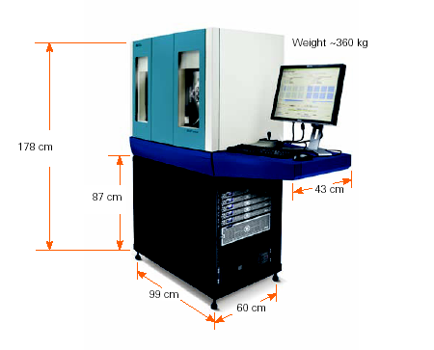
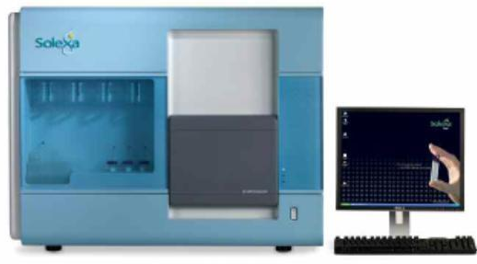
Low Coverage Genotyping-
Next Generation Sequencing (NGS)
By several orders of magnitude, NGS delivers higher throughput of sequencing reads compared to older technologies (e.g. Sanger sequencing)
  More improvements expected in quest for $1,000 genome
Roche / 454
Genome Sequencer FLX
100 Mb/run, 400bp reads
Illumina / Solexa
Genetic Analyzer 1G
1000 Mb/run, 35bp reads
Applied Biosystems
SOLiD
3000 Mb/run, 25-35bp reads
Notes:
155
-SBS: Sequencing by Synthesis
-SBL: Sequencing by Ligation
-Challenges in Genome Assembly: The short read lengths and absence of paired ends make it difficult for assembly software to disambiguate repeat regions, therefore resulting in fragmented assemblies.
-New Type of sequencing error: in 454 including incorrect estimates of homopolymer lengths,
‘transposition-like’ insertions (a base identical to a nearby homopolymer is inserted in a nearby nonadjacent location) and errors caused by multiple templates attached to the same bead

Slide 156
Low Coverage Genotyping-
NGS Applications and Challenges
NGS is enabling many applications, including personal genomics
  ~$1 million for sequencing James Watson genome [Wheeler et al 08] using 454 technology.
  ~$100 million for the Sanger-sequenced Venter genome [Levy et al 07]
  Thousands more individual genomes to be sequenced as part of 1000 Genomes Project
Challenges:
  Sequencing requires accurate determination of genetic variation (e.g. SNPs)
  Accuracy is limited by coverage depth due to random nature of shotgun sequencing
  For the Venter and Watson genomes (both sequenced at ~7.5x average coverage), only 75-80% accuracy achieved for sequencing based calls of heterozygous SNPs [Levy et al 07, Wheeler et al 08].
    [Wheeler et al 08] use hypothesis testing based on binomial distribution
  [Wendl&Wilson 08] predict that 21x coverage will be required for sequencing of normal tissue samples based on idealized theory that “neglects any heuristic inputs”
Notes:
156

Slide 157
Low Coverage Genotyping-
Do Heuristic Inputs Help?
We propose methods incorporating two additional sources of information:
  Quality scores reflecting uncertainty in sequencing data
  Linkage disequilibrium (LD) information and allele frequencies extracted from reference panels such as Hapmap
Experiments on a subset of the James Watson 454 reads show that our methods yield improved genotyping accuracy
  Improvement depends on the coverage depth (higher at lower coverage), e.g., accuracy achieved by the binomial test of [Wheeler et al. 08] for 5.6-fold mapped read coverage is achieved by our methods using less than 1/4 of the reads
Notes:
157

Slide 158
Low Coverage Genotyping-
Pipeline for Single Genotype Calling
Notes:
158

Slide 159
Single SNP Genotyping-
Basic Notations
Biallelic SNPs: 0 = major allele, 1 = minor allele (reads with non-reference alleles are discarded)
SNP genotypes: 0/2 = homozygous major/minor, 1=heterozygous
Mapped reads with allele 0
012100120
Inferred genotypes
Mapped reads with allele 1
Sequencing errors
Notes:
Let me describe some basic notations before going into the Single SNP Genotype calling method
A read r(i) describes the set observed alleles from each read at SNP i, with coverage c_i. 0/1 values are used to describe each read, where 0 is the major allele and 1 is the minor allele, each allele represenenting one of the chromosomes in the genome
We assume SNPs are unlinked since the short reads typically do not make coverage of more than one SNP feasible.
To describe genotype sequences, we use additive notations for each SNP, with 0 and 2 values in the genotype sequence representing homozygotes, 1 being a heterozygote, where a sufficient amount of reads covering both alleles at the same SNP exist.

Slide 160
Single SNP Genotyping- Incorporating Base Call Uncertainty
Let r_{i} denote the set of mapped reads covering SNP locus i and c_{i}=| r_{i} |
  For a read r in r_{i} , r(i) denotes the allele observed at locus i
  If q_{r(i)} is the phred quality score of r(i), the probability that r(i) is incorrect is given by
The probability of observing read set r_{i} conditional on having genotype G_{i} is then given by:
Notes:
160
q_r(i_c_i) is the phred quality score for a read
e_r(i_c_i) is the probability a read is affected by a sequencing error
P(ri|Gi=1) can be simplified to this

Slide 161
Single SNP Genotype Calling
Applying Bayes’ formula:
  Where are allele frequencies inferred from a representative panel
Notes:
161
q_r(i_c_i) is the phred quality score for a read
e_r(i_c_i) is the probability a read is affected by a sequencing error
P(ri|Gi=1) can be simplified to this

Slide 162
Low Coverage Genotyping-
Pipeline for Multilocus Genotyping
Notes:
162

Slide 163
Multilocus Genotyping-
HF-HMM
F₁
F₂
…
F_{n}
HMMs representing LD in populations of origin for mother/father; similar to models used in [Scheet & Stephens 06, Rastas et al 08, Kennedy et al 08]
H₁
H₂
H_{n}
F'₁
F'₂
…
F'_{n}
H'₁
H'₂
H'_{n}
G₁
G₂
G_{n}
R_{1,1}
…
R_{1,c}
R_{2,1}
…
R_{2,c}
R_{n,1}
…
R_{n,c}
1
2
n
Notes:
The Hierarchical-Factorial HMM we used to describe haplotype sequences is similar to models recently proposed by others.
At the core of the model are 2 regular HMM representing haplotype frequencies in the populations of origin of the sequenced individual’s parents.
Under this model each haplotype in the population is viewed as a mosaic formed as a result of historical recombination among a set of K founder haplotypes.
Increasing the number of founders allows more paths to describe a haplotype sequence, but at a cost of a longer run time.
Training & the estimation of this HMM is done via a Baum-Welch algorithm based on haplotype inferred from a panel representing the population of origin of each parent.

Slide 164
Multilocus Genotyping-
HF-HMM Training
Training HMM based on Baum-Welch algorithm from haplotypes inferred from populations of origin for mother/father
  Use haplotype reference panel (e.g. HAPMAP) for training Haplotypes
Conditional probabilities for read sets are given by the formulas derived for the single SNP case:
Notes:
164
The Hierarchical-Factorial HMM we used to describe haplotype sequences is similar to models recently proposed by others.
At the core of the model are 2 regular HMM representing haplotype frequencies in the populations of origin of the sequenced individual’s parents.
Under this model each haplotype in the population is viewed as a mosaic formed as a result of historical recombination among a set of K founder haplotypes.
Increasing the number of founders allows more paths to describe a haplotype sequence, but at a cost of a longer run time.
Training & the estimation of this HMM is done via a Baum-Welch algorithm based on haplotype inferred from a panel representing the population of origin of each parent.

Slide 165
Multilocus Genotyping Problem
GIVEN:
  Shotgun read sets r=(r₁, r₂, … , r_{n})
  Quality scores
  Trained HMMs representing LD in populations of origin for mother/father
FIND:
  Multilocus genotype g*=(g*₁,g*₂,…,g*_{n}) with maximum posterior probability, i.e., g*=argmax_{g} P(g | r)
Remark: max_{g}P(g | r) is hard to approximate within unless ZPP=NP, and thus the multilocus genotyping problem is NP-hard
Notes:
NOTE: P(g|r) is NP-Hard…

Slide 166
Multilocus Genotyping-
HMM-Posterior Decoding Algorithm
For each i = 1..n, compute
Return
Notes:
166
To overcome this possible hardness, we propose 3 alternate algorithms that can be computed efficiently from the HMM.
The best likelihood function is the HMM-Posterior decoding algorithm …

Slide 167
Forward-Backward Computation of Posterior Probabilities
…
f_{i}
…
h_{i}
…
f’_{i}
…
h’_{i}
g_{i}
r_{1,1}
…
r_{1,c}
r_{i,1}
…
r_{i,c}
R_{n,1}
…
R_{n,c}
1
i
n
Notes:
167

Slide 168
Forward-Backward Computation of Posterior Probabilities
…
f_{i}
…
h_{i}
…
f’_{i}
…
h’_{i}
g_{i}
r_{1,1}
…
r_{1,c}
r_{i,1}
…
r_{i,c}
R_{n,1}
…
R_{n,c}
1
i
n
Notes:
168

Slide 169
Forward-Backward Computation of Posterior Probabilities
…
f_{i}
…
h_{i}
…
f’_{i}
…
h’_{i}
g_{i}
r_{1,1}
…
r_{1,c}
r_{i,1}
…
r_{i,c}
R_{n,1}
…
R_{n,c}
1
i
n
Notes:
169

Slide 170
Forward-Backward Computation of Posterior Probabilities
…
f_{i}
…
h_{i}
…
f’_{i}
…
h’_{i}
g_{i}
r_{1,1}
…
r_{1,c}
r_{i,1}
…
r_{i,c}
R_{n,1}
…
R_{n,c}
1
i
n
Notes:
170

Slide 171
Forward-Backward Computation of Posterior Probabilities
…
f_{i}
…
h_{i}
…
f’_{i}
…
h’_{i}
g_{i}
r_{1,1}
…
r_{1,c}
r_{i,1}
…
r_{i,c}
R_{n,1}
…
R_{n,c}
1
i
n
Notes:
171

Slide 172
Multilocus Genotyping-
Runtime
Direct implementation gives O(m+nK⁴) time:
  m = number of reads
  n = number of SNPs
  K = number of founder haplotypes in HMMs
Runtime reduced to O(m+nK³) by reusing common terms:
where
Notes:
172

Slide 173
Low Coverage Genotyping-
Experimental Results- Setup
Subset of James Watson’s 454 reads
  74.4M of 106.5M reads
    265 bp/read
    avg coverage: 5.64X
  Quality scores included
  Reads mapped on human genome build 36.3 using the nucmer tool of the MUMmer package [Kurtz et al 04]
  Estimated mapping error rates:
    FP rate: 0.37%
    FN rate: 21.16%
  Haplotype reference panel used to train HMM generated from Hapmap CEU genotypes (release 23a)

Slide 174
Accuracy Comparison (Heterozygous Genotypes)

Slide 175
Accuracy Comparison
(All Genotypes)

Slide 176
Accuracy at Varying Coverages (All Genotypes)

Slide 177
Outline
Introduction
Genotype Error Detection using Hidden Markov Models of Haplotype Diversity
Single Individual Genotyping from Low-Coverage Sequencing Data
Conclusion

Slide 178
Conclusion
Genotype Error Detection
  Contributions:
    Proposed efficient methods for error detection in trio genotype data based on an HMM of haplotype diversity
    Can exploit available pedigree info
    Yield improved detection accuracy compared to FAMHAP
    Runtime grows linearly in #SNPs and #individuals
  Papers/Software:
    J. Kennedy, I.I. Mandoiu, and B. Pasaniuc. Genotype Error Detection using Hidden Markov Models of Haplotype diversity. Journal of Computational Biology (to Appear).
    J. Kennedy, I.I. Mandoiu and B. Pasaniuc. Genotype Error Detection using Hidden Markov Models of Haplotype Diversity. Proc. WABI 2007, R. Giancarlo and S. Hannenhalli (eds.), LNBI 4645:73-84, 2007
    J. Kennedy, I.I. Mandoiu and B. Pasaniuc. Genotype Error Detection using Hidden Markov Models of haplotype diversity. In 3rd RECOMB Satellie Workshop on: Computational Methods for SNPs and Haplotypes, 2007
    Software: GEDI (Genotype Error Detection and Imputation):
      Best poster award: J. Kennedy, I.I. Mandoiu and B. Pasaniuc. Genotype Error Detection and Imputation using Hidden Markov Models of Haplotype Diversity. ISBRA 2008.

Slide 179
Conclusion
Genotyping from low coverage sequencing reads
  Contributions:
    Exploiting “heuristic inputs” such as quality scores and population allele frequency and LD information yields significant improvements in genotyping calling accuracy from low-coverage sequencing data
      LD information extracted from a reference panel gives highest benefit
      Relatively small gain from incorporating quality scores may be due in part to the poor calibration of 454 quality scores [Brockman et al 08, Quinlan et al 08]
    Although our evaluation is on 454 reads, the methods are well-suited for short read technologies
  Papers/Software:
    S. Dinakar, Y. Hernandez, J. Kennedy, I. Mandoiu, and Y. Wu. Single individual genotyping from low-coverage sequencing data (In Preparation)
    Presentation: J.Kennedy. Linkage Disequilibrium Based Single Individual Genotyping from Low-Coverage Short Sequencing Reads. DIMACS workshop on Computational Issues in Genetic Epidemiology.
    Software: Gene-Seq

Slide 180
Conclusion
Future Work: Population-based Genotyping from Low-Coverage Sequencing Data
  Extending the single individual genotyping methods to population sequencing data (removing the need for reference panels)
  Use Same HF-HMM as before, only training model based off of EM algorithm on population-level data provided.

Slide 181
Questions?

Slide 182
Acknowledgments
This work was supported in part by NSF (awards IIS-0546457, DBI-0543365, and CCF-0755373) and by the University of Connecticut Research Foundation

Slide 183
Click again for helper slides

Slide 184
HAPMAP:
The International HAPMAP Project is an organization whose goal is to develop a haplotype map of the human genome (the HapMap), which will describe the common patterns of human genetic variation.
HAPMAP is expected to be a key resource for researchers to find genetic variants affecting health, disease and responses to drugs and environmental factors. The information produced by the project is made freely available to researchers around the world.
The International HapMap Project is a collaboration among researchers at academic centers, non-profit biomedical research groups and private companies in Canada, China, Japan, Nigeria, the United Kingdom, and the United States.

Slide 185
Baum-Welch overview
The algorithm has two steps:
  Calculating the forward probability and the backward probability for each HMM state;
  Determining the frequency of the transition-emission pair values and dividing it by the probability of the entire sequence. This amounts to calculating the expected count of the particular transition-emission pair. Each time a particular transition is found, the value of the quotient of the transition divided by the probability of the entire sequence goes up, and this value can then be made the new value of the transition.

Slide 186
Error Detection Accuracy on Unrelated Genotype Data
551 unrelated individuals
Recombination & mutation rates of 10⁻⁸ per generation per bp
35 SNPs within a region of 10kb-10Mb
Notes:
The effect of SNP density is shown here, where simulated data with higher recombination rates between adjacent SNPs (and hence lower linkage disequilibrium between adjacent SNPs) performs worse than denser sampling.

Slide 187
TrioProb-Combined Results on Real Dataset
 | Total Signals |  |  | True Positives |  |  | False Positives |  |  | Unknown
FP Rate | 1% | .5% | .1% | 1% | .5% | .1% | 1% | .5% | .1% | 1% | .5% | .1%
Parents | 218 | 127 | 69 | 9 | 9 | 8 | 1 | 0 | 0 | 208 | 118 | 91
Children | 104 | 74 | 24 | 11 | 11 | 11 | 3 | 3 | 2 | 90 | 60 | 11
Total | 322 | 201 | 93 | 20 | 20 | 19 | 4 | 3 | 2 | 298 | 178 | 72
[Becker et al. 06] resequenced all trio members at 41 loci flagged by FAMHAP-3
  26 SNP genotypes in 23 trios were identified as true errors
  41*3-26=97 resequenced SNP genotypes agree with original calls (or are unknown)
Notes:
The results for the real datasets show similar improvements in accuracy over FAMHAP.
……………….
For the real dataset, not all true errors are known.
Becker et al. resequenced 123 genotypes flagged using their FAMHAP-3 algorithm with a threshold of 10,000.
Of these genotypes, 23 were found to be true errors, while the other 100 genotypes agreed with original calls.
Our method shows a much higher true positive-to-false positive ratio
Unknowns that we found were never re-sequenced, so we do not know if they are actual errors or not.

Slide 188
Error Model Comparison
Notes:
188
Our method has a high detection accuracy for all four error models.
Of the four models, the random allele errors are slightly more difficult to detect.

Slide 189
Effect of Population Size

Slide 190
Binomial Distribution
To call a heterozygous genotype, each allele must be covered by at least one read and the binomial probability for the observed number of 0 and 1 alleles must be at least 0.01
n: # of successive trials (reads)
p: the probability of a success (correct map)
1-p: =q , theprobability of a failure (incorrect map)
Notes:
190

Slide 191
Conditional Probability for Heterozygous Genotypes
Notes:
191
The Hierarchical-Factorial HMM we used to describe haplotype sequences is similar to models recently proposed by others.
At the core of the model are 2 regular HMM representing haplotype frequencies in the populations of origin of the sequenced individual’s parents.
Under this model each haplotype in the population is viewed as a mosaic formed as a result of historical recombination among a set of K founder haplotypes.
Increasing the number of founders allows more paths to describe a haplotype sequence, but at a cost of a longer run time.
Training & the estimation of this HMM is done via a Baum-Welch algorithm based on haplotype inferred from a panel representing the population of origin of each parent.

Slide 192
Model Training- Details
Initial founder probabilities P(f₁), P(f’₁), transition probabilities P(f_{i+1}|f_{i}), P(f’_{i+1}|f’_{i}), and emission probabilities P(h_{i}|f_{i}), P(h’_{i}|f’_{i}) trained using the Baum-Welch algorithm from haplotypes inferred from the populations of origin for mother/father
P(g_{i}|h_{i},h’_{i}) set to 1 if h+h’_{i}=g_{i} and to 0 otherwise
  This implies that conditional probabilities for sets of reads are given by the formulas derived for the single SNP case:
Notes:
192
The Hierarchical-Factorial HMM we used to describe haplotype sequences is similar to models recently proposed by others.
At the core of the model are 2 regular HMM representing haplotype frequencies in the populations of origin of the sequenced individual’s parents.
Under this model each haplotype in the population is viewed as a mosaic formed as a result of historical recombination among a set of K founder haplotypes.
Increasing the number of founders allows more paths to describe a haplotype sequence, but at a cost of a longer run time.
Training & the estimation of this HMM is done via a Baum-Welch algorithm based on haplotype inferred from a panel representing the population of origin of each parent.

Slide 193
Implementation Details
Forward recurrences:
Backward recurrences are similar
Notes:
193

Slide 194
Experimental Results-
Read Data
Subset of James Watson’s 454 reads
  74.4 million reads with quality scores (of 106.5 million reads used in [Wheeler et al 08]) downloaded from ftp://ftp.ncbi.nih.gov/pub/TraceDB/Personal_Genomics/Watson/
  Average read length ~265 bp
Notes:
194

Slide 195
Experimental Results-
Read Data
Reads mapped on human genome build 36.3 using the nucmer tool of the MUMmer package [Kurtz et al 04]
  Default nucmer parameters (MUM size 20, min cluster size 65, max gap between adjacent matches 90)
  Additional filtering: at least 90% of the read length matched to the genome, no more than 10 errors (mismatches or indels)
  Reads meeting above conditions at multiple genome positions (likely coming from genomic repeats) were discarded
Simulated 454 reads generated using ReadSim [Schmid et al 07] were used to estimate mapping error rates:
  FP rate: 0.37%
  FN rate: 21.16%
Notes:
195

Slide 196
Experimental Results-
Read Data
Average coverage by mapped reads of Hapmap SNPs was 5.64x
  Lower than [Wheeler et al 08] since we start with a subset of the reads and use more stringent mapping constraints
Notes:
196

Slide 197
Experimental Results-
Read Data
CEU genotypes from latest Hapmap release (23a) were dowloaded from http://ftp.hapmap.org/genotypes/latest_ncbi_build36/forward/non-redundant/
  Genotypes were phased using the ENT algorithm [Gusev et al 08] and inferred haplotypes were used to train the parent HMMs using Baum-Welch
Duplicate Affymetrix 500k SNP genotypes were downloaded from ftp://ftp.ncbi.nih.gov/pub/geo/DATA/SOFT/by_series/GSE10668/GSE10668_family.soft.gz
  We removed genotypes that were discordant in the two replicates and genotypes for which Hapmap and Affymetrix annotations had more than 5% in CEU same-strand allele frequency
Notes:
197

Slide 198
Accuracy Comparison (Homozygous Genotypes)

Slide 199
Gene-Seq Algorithms
Posterior Decoding (see presentation)
Greedy:
Markov Approximation:
Composite 2-SNP
Viterbi
Posterior Decoding, version 2

Slide 201
Introduction Helper
Linkage Analysis: Study aimed at establishing linkage between genes. Today linkage analysis serves as a way of gene-hunting and genetic testing.
  Genetic linkage is the tendency for genes and other genetic markers to be inherited together because of their location near one another on the same chromosome.
Relative Risk is the risk of an event (or of developing a disease) relative to exposure.
  Relative risk is a ratio of the probability of the event occurring in the exposed group versus a non-exposed group.
  For example, if the probability of developing lung cancer among smokers was 20% and among non-smokers 1%, then the relative risk of cancer associated with smoking would be 20. Smokers would be twenty times as likely as non-smokers to develop lung cancer.
Association Analysis: Test for association between a genetic variation (e.g. SNP) and one or more quantitative traits

Slide 202
Introduction-
Disease Gene Mapping
Linkage analysis
  Very successful for Mendelian diseases (cystic fibrosis, Huntington’s,…)
  Low power to detect genes with small relative risk in complex diseases [RischMerikangas’96]
Association analysis
  Genome-wide scans made possible by recent progress in Single Nucleotide Polymorphism (SNP) genotyping technologies
Cases
Controls
Notes:
“The area of my research is focused on furthering successes in Disease Gene Mapping”
“Genes can be mapped by techniques such as Linkage Analysis or Association Analysis”
“Genome-wide association studies are

Slide 203
Genotype Error Detection-
Motivation
Even low error levels can have large effects for some study designs (e.g. rare alleles, haplotype-based)
Errors as low as .1% can increase Type I error rates in haplotype sharing transmission disequilibrium test (HS-TDT) [Knapp&Becker04]
  1% errors decrease power by 10-50% for linkage, and by 5-20% for association [Douglas et al. 00, Abecasis et al. 01]
Notes:
Effects of Undetected Errors

Slide 204
Genotype Error Detection-
Motivation
Improved genotype calling algorithms
  [Marchini et al. 07, Nicolae et al. 06, Rabbee&Speed 05, Xiao et al. 07]
Explicit modeling in analysis methods
  [Cheng 07, Hao & Wang 04, Liu et al. 07]
  Computationally complex
Separate error detection step
  Detected errors can be retyped, imputed, or ignored in downstream analyses
  Common approach in pedigree genotype data analysis [Abecasis et al. 02, Douglas et al. 00, Sobel et al. 02]
Notes:
204
Recent work addresses genotyping errors at several levels
First, there has been much work on improved genotype calling algorithms which attempt to produce more accurate genotypes from low level intensity data.
Second, there have been several attempts at explicitly modeling genotyping errors in linkage & association analyses mentioned previously. However, this approach is very computationally expensive.
Finally, Another option is to implement error detection as a separate step, following genotype calling and preceding downstream error analyses. Specifically this step produces a list of genotypes that are likely errors- These genotypes can be retyped, imputed or ignored altogether in further downstream analysis. Our work approaches error detection in this way.

Slide 205
Complexity of Computing Maximum Phasing Probability
For unrelated genotypes, computing maximum phasing probability is hard to approximate within a factor of O(f^{½-ε}) unless ZPP=NP, where f is the number of founders
  For trios, hard to approx. within O(f^{1/4 -ε})
  Reductions from the clique problem

Slide 206
NGS Applications
Besides reducing costs of de novo genome sequencing, NGS has found many more apps:
  Resequencing, transcriptomics (RNA-Seq), gene regulation (non-coding RNAs, transcription factor binding sites using ChIP-Seq), epigenetics (methylation, nucleosome modifications), metagenomics, paleogenomics, …
NGS is enabling personal genomics
  James Watson genome [Wheeler et al 08] sequenced using 454 technology for ~$1 million compared to ~$100 million for the Sanger-sequenced Venter genome [Levy et al 07]
  Thousands more individual genomes to be sequenced as part of 1000 Genomes Project
Notes:
206
Sanger: long reads generally encounter fewer assembly problems on a per-read basis. However, the technology is much more expensive

Slide 207
Challenges in Medical Applications of Sequencing
Medical sequencing focuses on genetic variation (SNPs, CNVs, genome rearrangements)
  Requires accurate determination of both alleles at variable loci
  Accuracy is limited by coverage depth due to random nature of shotgun sequencing
  For the Venter and Watson genomes (both sequenced at ~7.5x average coverage), only 75-80% accuracy achieved for sequencing based calls of heterozygous SNPs [Levy et al 07, Wheeler et al 08].
  [Wheeler et al 08] use hypothesis testing based on binomial distribution
    To call a heterozygous genotype each allele must be covered by at least one read and the binomial probability for the observed number of 0 and 1 alleles must be at least 0.01
[Wendl&Wilson 08] predict that 21x coverage will be required for sequencing of normal tissue samples based on idealized theory that “neglects any heuristic inputs”
Notes:
207

Slide 208
Prior Methods for Calling SNP Genotypes from Read Data
Prior methods are all based on allele coverage
  [Levy et al 07] require that each allele be covered by at least 2 reads in order to be called
  [Wheeler et al 08] use hypothesis testing based on the binomial distribution
    To call a heterozygous genotype must have each allele covered by at least one read and the binomial probability for the observed number of 0 and 1 alleles must be at least 0.01
  [Wendl&Wilson 08] generalize these methods by allowing an arbitrary minimum allele coverage k
Notes:
Let me describe some basic notations before going into the Single SNP Genotype calling method
A read r(i) describes the set observed alleles from each read at SNP i, with coverage c_i. 0/1 values are used to describe each read, where 0 is the major allele and 1 is the minor allele, each allele represenenting one of the chromosomes in the genome
We assume SNPs are unlinked since the short reads typically do not make coverage of more than one SNP feasible.
To describe genotype sequences, we use additive notations for each SNP, with 0 and 2 values in the genotype sequence representing homozygotes, 1 being a heterozygote, where a sufficient amount of reads covering both alleles at the same SNP exist.

Slide 209
Linkage Disequilibrium-Based Single Individual Genotyping from
Low-Coverage Short Sequencing Reads
S. Dinakar¹, Y. Hernandez², J. Kennedy¹, I. Mandoiu¹, and Y. Wu¹
¹CSE Department, University of Connecticut ²Department of Computer Science, Hunter College

Slide 210
GEDI-ADMX presentation from earlier this year (Ft lauderdale)

Slide 211
Imputation-based local ancestry inference in admixed populations
Justin Kennedy
Computer Science and Engineering Department
University of Connecticut
Joint work with I. Mandoiu and B. Pasaniuc

Slide 212
Outline
Introduction
Factorial HMM of genotype data
Algorithms for genotype imputation and ancestry inference
Preliminary experimental results
Conclusion
Notes:
I’ll begin with an introduction that gives an overview, motivation, and more formal definition of the ancestry inference problem
Then describe our approach to handling this problem, which will include a Factorial HMM of genotype data, and algorithms for genotype imputation and ancestry inference.
We have recently implemented our approach in a software package, and I will show some preliminary experimental results that have come from this package.
Finally I will conclude with a summary of our contribution and list some future work items.

Slide 213
Introduction-
Motivation: Admixture mapping
Patterson et al, AJHG 74:979-1000, 2004
Notes:
Admixture mapping is a method for localizing disease causing genetic variants that differ in frequency across populations. It is most advantageous to apply this approach to populations that have descended from a recent mix of two ancestral groups that have been geographically isolated for many tens of thousands of years (e.g. African Americans)
213

Slide 214
Introduction-
Local ancestry inference problem
Given:
  Reference haplotypes for ancestral populations P1,…,PN
  Whole-genome SNP genotype data for extant individual
Find:
  Allele ancestries at each SNP locus
Reference haplotypes
1110001?0100110010011001111101110111?1111110111000
11100011010011001001100?100101?10111110111?0111000
11110010011001101001110010110101011111011110111000
1110001001000100111110001111011100111?111110111000
011101100110011011111100101101110111111111?0110000
11100010010001001111100010110111001111111110110000
011?001?011001101111110010?10111011111111110110000
11100110010001001111100011110111001111111110111000
1110001?0100110010011001111101110111?1111110111000
11100011010011001001100?100101?10111110111?0111000
11110010011001101001110010110101011111011110111000
1110001001000100111110001111011100111?111110111000
011101100110011011111100101101110111111111?0110000
11100010010001001111100010110111001111111110110000
011?001?011001101111110010?10111011111111110110000
11100110010001001111100011110111001111111110111000
1110001?0100110010011001111101110111?1111110111000
11100011010011001001100?100101?10111110111?0111000
11110010011001101001110010110101011111011110111000
1110001001000100111110001111011100111?111110111000
011101100110011011111100101101110111111111?0110000
11100010010001001111100010110111001111111110110000
011?001?011001101111110010?10111011111111110110000
11100110010001001111100011110111001111111110111000
Inferred local ancestry
rs11095710 P1 P1
rs11117179 P1 P1
rs11800791 P1 P1
rs11578310 P1 P2
rs1187611 P1 P2
rs11804808 P1 P2
rs17471518 P1 P2
...
SNP genotypes
rs11095710 T T
rs11117179 C T
rs11800791 G G
rs11578310 G G
rs1187611 G G
rs11804808 C C
rs17471518 A G
...
Notes:
Extant: still in existence; not extinct or destroyed or lost
214

Slide 215
Introduction- Previous work
MANY methods
  Ancestry inference at different granularities, assuming different kinds/amounts of info about genetic makeup of ancestral populations
Two main classes of methods
  HMM-based (exploit LD): SABER [Tang et al 06], SWITCH [Sankararaman et al 08a], HAPAA [Sundquist et al. 08], …
  Window-based (unlinked SNP Data): LAMP [Sankararaman et al 08b], WINPOP [Pasaniuc et al. 09]
Poor accuracy when ancestral populations are closely related (e.g. Japanese and Chinese)
  Methods based on unlinked SNPs outperform methods that model LD!
Notes:
The HMM-based classes differ in the exact structure of the model and the procedures used for estimating model parameters, but all of them exploit LD information.
The second class of methods considers each SNP without LD, and estimates the ancestry structure using a window-based framework and aggregates the results for each SNP using a majority vote.
These window based methods surprisingly do not perform as well as HMM based methods

Slide 216
Outline
Introduction
Factorial HMM of genotype data
Algorithms for genotype imputation and ancestry inference
Preliminary experimental results
Conclusion
Notes:
Our method employs a Factorial HMM of genotype data, which DOES exploit LD, and we aim to improve over each of the previous methods.

Slide 217
Haplotype structure in panmictic populations
Notes:
Panmictic: Random mating within a breeding population.
To help understand our HMM implementation, consider an extant population with a haplotype gene pool that arose from a small set of ancestral haplotypes. Through random mating and recombination, the extant haplotypes include segments that come directly from varying ancestors, and also there are mutations that have occurred over time.

Slide 218
HMM of haplotype frequencies
n = 5
(# SNPs)
K = 4
(# founders)
Similar models proposed in [Schwartz 04, Rastas et al. 05, Kennedy et al. 07, Kimmel&Shamir 05, Scheet&Stephens 06,…]
Notes:
This type of recombination can be captured in a HMM of haplotype diversity, which we employ, and is similar to other models proposed in recent work. Specifically, our HMM is defined by nXK states, where n is the number of SNPs, and K is the number of founder haplotypes. Transitions are from left to right, occur only between adjacent SNPs, and they represent the probability of adherence to, or deviation from, these ancestral founder haplotypes. Emissions at each state represent the probability of observing a major or minor allele.

Slide 219
Graphical model representation
F₁
F₂
…
F_{n}
H₁
H₂
H_{n}
Random variables for each locus i (i=1..n)
  F_{i} = founder haplotype at locus i; values between 1 and K
  H_{i} = observed allele at locus i; values: 0 (major) or 1 (minor)
Model training
  Based on reference haplotypes using Baum-Welch alg, or
  Based on unphased genotypes using EM [Rastas et al. 05]
Given haplotype h, P(H=h|M) can be computed in O(nK²) using a forward algorithm, where n=#SNPs, K=#founders
Notes:
We can represent this HMM graphically as a founder haplotype and observed allele for each locus i (seen here as Fi & Hi respectively).
Under this model each haplotype in the current population can be viewed as a mosaic formed as a result of historical recombination among a set of these founder haplotypes.
Model training can come from reference haplotypes using Baum-Welch, assuming you have these, OR
You can take the unphased genotype data that you have which represents the population of interest, and implement EM to train the HMM.
Once you have a satisfactorily trained HMM, you can then compute the probability of observing a haplotype h given model M using a standard forward algorithm, which takes O(nK^2) time…again where n is the # of SNPs and K is the # of founders.
Increasing the number of founders allows more paths to describe a haplotype sequence, but at a cost of a longer run time.

Slide 220
Factorial HMM for genotype data in a window with known local ancestry
F₁
F₂
…
F_{n}
H₁
H₂
H_{n}
F'₁
F'₂
…
F'_{n}
H'₁
H'₂
H'_{n}
G₁
G₂
G_{n}
Random variable for each locus i (i=1..n)
  G_{i} = genotype at locus i; values: 0/1/2 (major hom./het./minor hom.)
Notes:
220
So given that we have two distinct ancestral groups that have recently admixed and represent an individual or population of interest, we can define the Factorial HMM that we use to be, at the core, 2 regular HMMs that I just described.

Slide 221
Outline
Introduction
Factorial HMM of genotype data
Algorithms for genotype imputation and ancestry inference
Preliminary experimental results
Conclusion

Slide 222
HMM Based Genotype Imputation
Probability of observing genotype at locus i given the known multilocus genotype with missing data at i:
  ➔ g_{i} is imputed as

Slide 223
Forward-backward computation
…
f_{i}
…
h_{i}
…
f’_{i}
…
h’_{i}
g_{i}
Notes:
223

Slide 224
Forward-backward computation
…
f_{i}
…
h_{i}
…
f’_{i}
…
h’_{i}
g_{i}
Notes:
224

Slide 225
Forward-backward computation
…
f_{i}
…
h_{i}
…
f’_{i}
…
h’_{i}
g_{i}
Notes:
225

Slide 226
Forward-backward computation
…
f_{i}
…
h_{i}
…
f’_{i}
…
h’_{i}
g_{i}
Notes:
226

Slide 227
Runtime
Direct recurrences for computing forward probabilities O(nK⁴) :
Runtime reduced to O(nK³) by reusing common terms:
where
Notes:
227

Slide 228
Imputation-based ancestry inference
View local ancestry inference as a model selection problem
  Each possible local ancestry defines a factorial HMM
  compute for all possible k,l,i,x values
  Pick model that re-imputes SNPs most accurately around the locus i.
    Fixed-window version: pick ancestry that maximizes the average posterior probability of the SNP genotypes within a fixed-size window centered at the locus
    Multi-window version: weighted voting over window sizes between 200-3000, with window weights proportional to average posterior probabilities

Slide 229
Imputation-based ancestry inference
Local Ancestry at a locus is an unordered pair of (not necessarily distinct) ancestral populations.
Observations:
  The local ancestry of a SNP locus is typically shared with neighboring loci.
  Small Window sizes may not provide enough information
  Large Window sizes may violate local ancestry property for neighboring loci
  When using the true values of in ,the accuracy of SNP genotype imputation within such a neighborhood is typically higher than when using a mis-specified model.
Notes:
Longer terms for observations:
For individual from recently admixed populations the local ancestry of a SNP locus is typically shared with a large number of neighboring loci.
The accuracy of SNP genotype imputation within such a neighborhood is typically higher when using the factorial HMMs corresponding to the correct local ancestry compared to a mis-specified model.

Slide 230
Outline
Introduction
Factorial HMM of genotype data
Algorithms for genotype imputation and ancestry inference
Preliminary experimental results
Conclusion

Slide 231
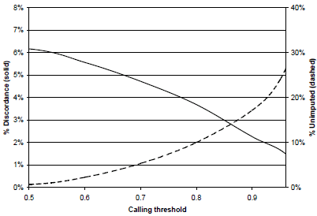
HMM imputation accuracy
Missing data rate and accuracy for imputed genotypes at different thresholds (WTCCC 58BC/Hapmap CEU)
Notes:
We measured the error rate as the percentage of erroneously recovered genotypes from the total number of masked genotypes. Since the model provides the posterior probability for each imputed SNP genotype, one can get different tradeoffs between the error rate and the percentage of imputed genotypes by varying the cutoff threshold on posterior imputation probability.
This figure plots the achievable tradeoffs. For example, using a cutoff threshold
of 0.95, HMM-based imputation has an error rate of 1.7%, with 24% of the
genotypes left un-imputed.

Slide 232
Window size effect
N=2,000
g=7
α=0.2
n=38,864
r=10⁻⁸
Notes:
As previously reported in other window-based methods we also notice that the best window size employed by our method for the three datasets is correlated with the genetic distance between ancestral populations as closer ancestral populations benefit from longer window size for accurate predictions.

Slide 233
Number of founders effect
CEU-JPT
N=2,000
g=7
α=0.2
n=38,864
r=10⁻⁸

Slide 234
Comparison with other methods
% of correctly recovered SNP ancestries
N=2,000
g=7
α=0.2
n=38,864
r=10⁻⁸
Notes:
Alpha is the (X100) percentage of individuals coming from one population, with 1-alpha being the percentage of individuals coming from the second population.
234

Slide 235
Untyped SNP imputation error rate in admixed individuals
N=2,000
g=7
α=0.5
n=38,864
r=10⁻⁸
Notes:
Alpha is the (X100) percentage of individuals coming from one population, with 1-alpha being the percentage of individuals coming from the second population.
235

Slide 236
Outline
Introduction
Factorial HMM of genotype data
Algorithms for genotype imputation and ancestry inference
Preliminary experimental results
Conclusion

Slide 237
Conclusion-
Summary and ongoing work
Imputation-based local ancestry inference achieves significant improvement over previous methods for admixtures between close ancestral populations
  Code at http://dna.engr.uconn.edu/software/
Ongoing work
  Evaluating accuracy under more realistic admixture scenarios (multiple ancestral populations/gene flow/drift in ancestral populations)
  Extension to pedigree data
  Exploiting inferred local ancestry for more accurate untyped SNP imputation and phasing of admixed individuals
  Extensions to sequencing data
  Inference of ancestral haplotypes from extant admixed populations

Slide 238
Questions?

Slide 239
1. L.E. Baum, T. Petrie, G. Soules, and N.Weiss. A maximization technique occurring in the statistical analysis of probabilistic functions of Markov chains. Ann. Math. Statist., 41:164{171, 1970.
2. The Wellcome Trust Consortium. Genome-wide association study of 14,000 cases of seven common diseases and 3,000 shared controls. Nature, 447:661{678, 2007.3. Z. Ghahramani and M.I. Jordan. Factorial hidden Markov models. Mach. Learn., 29(2-3):245{273, 1997.
4. J. Kennedy, I.I. Mandoiu, and B. Pasaniuc. Genotype error detection using hidden markov models of haplotype diversity. Journal of Computational Biology, 15(9):1155{1171, 2008.
5. J. Kennedy, B. Pasaniuc, and I.I. Mandoiu. GEDI: Genotype error detection and imputation using hidden markov models of haplotype diversity, manuscript in preparation. software available at at http://dna.engr.uconn.edu/software/gedi/ .
6. G. Kimmel and R. Shamir. A block-free hidden Markov model for genotypes and its application to disease association. Journal of Computational Biology, 12:1243{1260, 2005.
7. Y. Li and G. R. Abecasis. Mach 1.0: Rapid haplotype reconstruction and missing genotype inference. American Journal of Human Genetics, 79:2290, 2006.
8. J. Marchini, C. Spencer, Y.Y. Teo, and P. Donnelly. A bayesian hierarchical mix ture model for genotype calling in a multi-cohort study. in preparation, 2007.
9. B. Pasaniuc, S. Sankararaman, G. Kimmel, and E. Halperin. Inference of locus-specic ancestry in closely related populations (under review).
10. E. J. Parra, A. Marcini, J. Akey, J. Martinson, M. A. Batzer, R. Cooper, T. For-rester, D. B. Allison, R. Deka, R. E. Ferrell, et al. Estimating african american admixture proportions by use of population-specic alleles. Am J Hum Genet, 63(6):1839{1851, December 1998.
11. P. Rastas, M. Koivisto, H. Mannila, and E. Ukkonen. Phasing genotypes using a hidden Markov model. In I.I. Mandoiu and A. Zelikovsky, editors, Bioinformatics Algorithms: Techniques and Applications, pages 355{372. Wiley, 2008.
12. D. Reich and Patterson N. Will admixture mapping work to nd disease genes? Philos Trans R Soc Lond B Biol Sci, 360:1605{1607, 2005.
13. S. Sankararaman, G. Kimmel, E. Halperin, and M.I. Jordan. On the inference of ancestries in admixed populations. Genome Research, (18):668{675, 2008.
14. S. Sankararaman, S. Sridhar, G. Kimmel, and E. Halperin. Estimating local ancestry in admixed populations. American Journal of Human Genetics, 8(2):290{303,2008.
15. P. Scheet and M. Stephens. A fast and exible statistical model for large-scale population genotype data: applications to inferring missing genotypes and haplotypicphase. American Journal of Human Genetics, 78:629{644, 2006.16. R. Schwartz. Algorithms for association study design using a generalized model of haplotype conservation. In Proc. CSB, pages 90{97, 2004.
17. M. W. Smith, N. Patterson, J. A. Lautenberger, A. L. Truelove, G. J. McDonald, A.Waliszewska, B. D. Kessing, M. J. Malasky, C. Scafe, E. Le, et al. A high-density admixture map for disease gene discovery in african americans. Am J Hum Genet,74(5):1001{1013, May 2004.
18. A. Sundquist, E. Fratkin, C.B. Do, and S. Batzoglou. Eect of genetic divergence in identifying ancestral origin using HAPAA. Genome Research, 18(4):676{682,2008.
19. H. Tang, M. Coram, P. Wang, X. Zhu, and N. Risch. Reconstructing genetic ancestry blocks in admixed individuals. Am J Hum Genet, 79:1{12, 2006.
20. H. Tang, Peng J., and Pei Wang P.and Risch N.J. Estimation of individual admixture: Analytical and study design considerations. Genetic Epidemiology, 28:289{
301, 2005.
21. C. Tian, D. A. Hinds, R. Shigeta, R. Kittles, D. G. Ballinger, and M. F. Seldin. A
genomewide single-nucleotide-polymorphism panel with high ancestry information
for African American admixture mapping. Am J Hum Genet, 79:640{649, 2006.
22. http://www.hapmap.org/.

Slide 240
Acknowledgments
Work supported in part by NSF awards IIS-0546457 and DBI-0543365.

Slide 241
HELPER SLIDES-STARTS NEXT PAGE

Slide 242
Introduction- Single Nucleotide Polymorphisms
Main form of variation between individual genomes: Single Nucleotide Polymorphisms (SNPs)
Human genome density: ≈ 1.2x10⁷ out of 3×10⁹ base pairs
Vast majority bi-allelic ➔ 0/1 encoding (major/minor resp.)
SNP Genotypes are critical to Disease-Gene Mapping
  One Method: Admixture Mapping
… ataggtccCtatttcgcgcCgtatacacgggActata …
… ataggtccGtatttcgcgcCgtatacacgggTctata …
… ataggtccCtatttcgcgcGgtatacacgggTctata …
012100120
011000110
001100010
genotype
+
two haplotypes per individual
Notes:
242

Slide 243
Helper Slide- Other Software
HMM-based methods:
  SABER
  SWITCH
  HAPAA
Window based Majority vote:
  LAMP (no recombination assumption)
  WINPOP (a more refined model of recombination events coupled with an adaptive window size computation to achieve increased accuracy.

Slide 244
Helper Slide- Probabilities
Random variable genotype at SNP i
Genotype variable taken at SNP i
Multilocus genotype without i
Multilocus genotype with I set to
HMM with ancestral pair k,l

Slide 245
Helper Slide- Emission Details

Slide 246
Window-based local ancestry inference
Input
  For every
  Window half-size w
Output (Single Window method)
  For every i=1..n:
  Where:
Notes:
246
A hat sub i: More precisely, the algorithm assigns to each SNP locus i the local ancestry that maximizes the average posterior probability for the true SNP genotypes over a window of up to 2w +1
SNPs centered at i (w SNPs downstream and w SNPs upstream of i

Slide 247
Window-based local ancestry inference
…….…………………………..……
…………………………………………………..….
???????????????????????????????????????????????????????????????????????????????????????
k
l
???????????????????????????????????????????????????????????????????????????????????????

Slide 248
Window-based local ancestry inference
…….…………………………..……
…………………………………………………..….
??????????????????????????????????????????????????????????????????????????????????????
k
1
l
??????????????????????????????????????????????????????????????????????????????????????
1

Slide 249
Window-based local ancestry inference
…….…………………………..……
…………………………………………………..….
????????????????????????????????????????????????????????????????????????????????????
k
1
1
l
????????????????????????????????????????????????????????????????????????????????????
1
1

Slide 250
Window-based local ancestry inference
…….…………………………..……
…………………………………………………..….
??????????????????????????????????????????????????????????????????????????????????
k
1
1
1
l
??????????????????????????????????????????????????????????????????????????????????
1
1
1

Slide 251
Window-based local ancestry inference
…….…………………………..……
…………………………………………………..….
????????????????????????????????????????????????????????????????????????????????
k
1
1
1
1
l
????????????????????????????????????????????????????????????????????????????????
1
1
1
2

Slide 252
Window-based local ancestry inference
…….…………………………..……
…………………………………………………..….
1111111112222222211111111111111112222 ???????????????????????????????????????????
1111111112222222211111111111111112222222222222222111111111111111111111111111
k
1
1112222222222222221111111111111122222222222222222222222221111111111111222222
l
1112222222222222221111111111111122222 ???????????????????????????????????????????
2

Slide 253
Experimental Results-
GEDI 1-pop Imputation
1,444 individuals trained on HAPMAP CEU haplotype reference panel
Imputed (after masking) 1% of SNPs on chromosome 22

Slide 254
Helper Slide-Software Overview
Only Require information about ancestral allele frequencies:
  LAMP
  WINPOP
  SWITCH (HMM-Based)
Only require ancestral allele frequencies & genotypes
  SABER (HMM-Based)
Additionally use ancestral haplotype information:
  HAPAA (HMM-Based)
  GEDI-ADMX (HMM-Based)

Slide 255
Genotype Error Detection-
Hidden Markov Model of Haplotype Diversity
F₁
F₂
F_{i}
F_{n}
Transition Prob
n= #SNPs
Emission Prob
H₁
H₂
H_{i}
H_{n}
K= #Founders(E.g. K=4)
(Graphical model representation)
n= #SNPs(E.g. n=5)
Similar HMMs proposed by [Kimmel &Shamir 05, Rastas et al. 05, Schwartz 04]
Paths with high transition probability correspond to “founder” haplotypes
Haplotype sequence/paths computed using Viterbi and forward algorithms
Notes:
The HMM we used to describe haplotype sequences is similar to models recently proposed by others.
This diagram shows the overall Model, which consists of 2 HMMs, each representing LD in population of origin for the parents (one for Mother, one for father)
The HMM is consists of a set of K states grouped by the N SNP loci, where K is the number of founders, and is a user specified parameter.
Increasing the number of founders allows more paths to describe a haplotype sequence, but at a cost of a longer run time.
Transition probabilities go from left to right, only exist between adjacent SNPs, and describe the likelihood of adherence to the founder haplotypes, or deviation from them via recombinations.
Each state can emit both alleles, but each state is usually biased towards one of them.
The probability a haplotype sequence H is emitted along a particular path in the given HMM is shown by this equation.

Slide 256
Genotype Error Detection-
Hidden Markov Model of Haplotype Diversity
F₁
F₂
F_{i}
F_{n}
n= #SNPs
H₁
H₂
H_{i}
H_{n}
(Graphical model representation)
Random variables for each locus i (i=1..n)
  Fi = founder haplotype at locus i; values between 1 and K
  Hi = observed allele at locus i; values: 0 (major) or 1 (minor)
Given haplotype h, P(H=h|M) can be computed in O(nK²) using a forward algorithm, where n=#SNPs, K=#founders
Notes:
The HMM we used to describe haplotype sequences is similar to models recently proposed by others.
This diagram shows the overall Model, which consists of 2 HMMs, each representing LD in population of origin for the parents (one for Mother, one for father)
The HMM is consists of a set of K states grouped by the N SNP loci, where K is the number of founders, and is a user specified parameter.
Increasing the number of founders allows more paths to describe a haplotype sequence, but at a cost of a longer run time.
Transition probabilities go from left to right, only exist between adjacent SNPs, and describe the likelihood of adherence to the founder haplotypes, or deviation from them via recombinations.
Each state can emit both alleles, but each state is usually biased towards one of them.
The probability a haplotype sequence H is emitted along a particular path in the given HMM is shown by this equation.

Slide 257
Genotype Error Detection-
Hidden Markov Model of Haplotype Diversity
F₁
F₂
F_{i}
F_{n}
n= #SNPs
H₁
H₂
H_{i}
H_{n}
(Graphical model representation)
Training: 2- step algorithm that exploits pedigree info
  Step 1: Obtain haplotypes from using either:
    ENT: A pedigree-aware haplotype phasing algorithm based on entropy-minimization
    Haplotype reference panel (e.g. HAPMAP)
  Step 2: train HMM based on inferred haplotypes, using Baum-Welch
Notes:
The HMM we used to describe haplotype sequences is similar to models recently proposed by others.
This diagram shows the overall Model, which consists of 2 HMMs, each representing LD in population of origin for the parents (one for Mother, one for father)
The HMM is consists of a set of K states grouped by the N SNP loci, where K is the number of founders, and is a user specified parameter.
Increasing the number of founders allows more paths to describe a haplotype sequence, but at a cost of a longer run time.
Transition probabilities go from left to right, only exist between adjacent SNPs, and describe the likelihood of adherence to the founder haplotypes, or deviation from them via recombinations.
Each state can emit both alleles, but each state is usually biased towards one of them.
The probability a haplotype sequence H is emitted along a particular path in the given HMM is shown by this equation.

Slide 258
Genotype Error Detection-
Factorial HMM for multilocus genotype data
F₁
F₂
F_{i}
F_{n}
n= #SNPs
H₁
H₂
H_{i}
H_{n}
F₁
F₂
F_{i}
F_{n}
H₁
H₂
H_{i}
H_{n}
G₁
G₂
G_{i}
G_{n}
Notes:
The HMM we used to describe haplotype sequences is similar to models recently proposed by others.
This diagram shows the overall Model, which consists of 2 HMMs, each representing LD in population of origin for the parents (one for Mother, one for father)
The HMM is consists of a set of K states grouped by the N SNP loci, where K is the number of founders, and is a user specified parameter.
Increasing the number of founders allows more paths to describe a haplotype sequence, but at a cost of a longer run time.
Transition probabilities go from left to right, only exist between adjacent SNPs, and describe the likelihood of adherence to the founder haplotypes, or deviation from them via recombinations.
Each state can emit both alleles, but each state is usually biased towards one of them.
The probability a haplotype sequence H is emitted along a particular path in the given HMM is shown by this equation.

Slide 259
Genotype Error Detection-
Factorial HMM for multilocus trio data
n= #SNPs
F₁
F_{i}
F_{n}
F₁
F_{i}
F_{n}
H₁
H_{i}
H_{n}
H₁
H_{i}
H_{n}
F₁
F_{i}
F_{n}
F₁
F_{i}
F_{n}
H₁
H_{i}
H_{n}
H_{i}
H_{n}
H₁
M₁
M_{i}
M_{n}
F₁
F_{i}
F_{n}
G₁
G_{i}
G_{n}
Notes:
The HMM we used to describe haplotype sequences is similar to models recently proposed by others.
This diagram shows the overall Model, which consists of 2 HMMs, each representing LD in population of origin for the parents (one for Mother, one for father)
The HMM is consists of a set of K states grouped by the N SNP loci, where K is the number of founders, and is a user specified parameter.
Increasing the number of founders allows more paths to describe a haplotype sequence, but at a cost of a longer run time.
Transition probabilities go from left to right, only exist between adjacent SNPs, and describe the likelihood of adherence to the founder haplotypes, or deviation from them via recombinations.
Each state can emit both alleles, but each state is usually biased towards one of them.
The probability a haplotype sequence H is emitted along a particular path in the given HMM is shown by this equation.

Slide 260
(Graphical model representation)
F₁
F₂
F₃
F₄
F₅
H₁
H₂
H₃
H₄
H₅
Random variables for each locus i (i=1..n)
  F_{i} = founder haplotype at locus i; values between 1 and K
  H_{i} = observed allele at locus i; values: 0 (major) or 1 (minor)
Model training
  Based on reference haplotypes using Baum-Welch alg, or
  Based on unphased genotypes using EM [Rastas et al. 05]
Given haplotype h, P(H=h|M) can be computed in O(nK²) using a forward algorithm, where n=#SNPs, K=#founders
Notes:
We can represent this HMM graphically as a founder haplotype and observed allele for each locus i (seen here as Fi & Hi respectively).
Under this model each haplotype in the current population can be viewed as a mosaic formed as a result of historical recombination among a set of these founder haplotypes.
Model training can come from reference haplotypes using Baum-Welch, assuming you have these, OR
You can take the unphased genotype data that you have which represents the population of interest, and implement EM to train the HMM.
Once you have a satisfactorily trained HMM, you can then compute the probability of observing a haplotype h given model M using a standard forward algorithm, which takes O(nK^2) time…again where n is the # of SNPs and K is the # of founders.
Increasing the number of founders allows more paths to describe a haplotype sequence, but at a cost of a longer run time.

Slide 261
Factorial HMM for genotype data in a window with known local ancestry
F₁
F₂
…
F_{n}
H₁
H₂
H_{n}
F'₁
F'₂
…
F'_{n}
H'₁
H'₂
H'_{n}
G₁
G₂
G_{n}
Random variable for each locus i (i=1..n)
  G_{i} = genotype at locus i; values: 0/1/2 (major hom./het./minor hom.)
Notes:
261
So given that we have two distinct ancestral groups that have recently admixed and represent an individual or population of interest, we can define the Factorial HMM that we use to be, at the core, 2 regular HMMs that I just described.

