Slide 1
Scaffolding Large Genomes Using Integer Linear Programming
James Lindsay*, Hamed Salooti, Alex Zelikovski, Ion Mandoiu*
ACM-BCB 2012
University of Connecticut*
Georgia State University

Slide 2
De-novo Assembly Paradigm
short reads
shotgun sequencing
the genome
denovo
assembly
the scaffolds
scaffolding
short contigs

Slide 3
Why Scaffolding?
Annotation
Comparative biology
Re-sequencing and gap filling
Structural variation!
No scaffold
gene XYZ
Scaffold
5’ UTR
gene XYZ
3’ UTR

Slide 4
Why Scaffolding?
Annotation
Comparative biology
Re-sequencing and gap filling
Structural variation!
Biologist: There are holes in my genes!
5’ UTR
gene XYZ
3’ UTR
Sanger Sequencing
5’ UTR
gene XYZ
3’ UTR

Slide 5
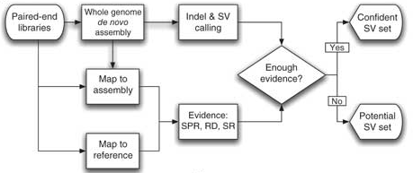
Why Scaffolding?
Annotation
Comparative biology
Re-sequencing and gap Filling
Structural variation!

Slide 6
Fragmented Genomes
Massive Sequencing Projects
Effects of Read Length
I5k
5000 insect and arthropod species
G10k
10,000 vertebrate species
Dog Genome
7.5x Sanger
N50: 180Kb
Chicken Genome
6x Illumina
N50: 12Kb
Human Genome
100x Illumina
N50: 24Kb

Slide 7
The Scaffolding Problem
Given
Contigs, Paired reads
Find
Orientation, Ordering, Relative distance
Goal
Recreate true scaffolds

Slide 8
Paired Reads
Paired Read Construction
Paired Read Styles
Mate Pair
Paired End
same strand and orientation
2kb
R1
R2
2kb
different strand and orientation
R1
R2
100b
100b
10kb

Slide 9
Linkage Information
Possible States (mate pair)
Two contigs are adjacent if:
A read pair spans the contigs
State (A, B, C, D)
Depends on orientation of the read
Order of contigs is arbitrary
Each read pair can be “consistent” with one of the four states
5’
3’
R1
R2
A
B
C
D
contig i
contig j

Slide 10
Scaffolding Graph
Nodes
Edges
Nodes are contigs
Adjacent contigs have 4 edges (one for each state)
Weighted by overlap with repetitive region
State A
contig i
contig j
$$W_{ij}^{A}=\sum_{read pairs}{1−\frac{\#bp in repeat region}{\#bp in read}}$$

Slide 11
Integer Linear Program Formulation
Variables
Contig orientation:
$$S_{i}∈\left\{0,1\right\}$$
Adjacent contig
consistency:
$$S_{ij}∈\left\{0,1\right\}$$
Contig pair state:
$A_{ij},B_{ij}$, $C_{ij}$, $D_{ij}∈\left\{0,1\right\}$
Objective
Maximize weight of consistent pairs
$$z=max{\sum_{\left(i,j\right)∈E}{{(W}_{ij}^{A}A_{ij})+{(W}_{ij}^{B}B_{ij})+{(W}_{ij}^{C}C_{ij})+{(W}_{ij}^{D}D_{ij})}}$$

Slide 12
Constraints
Variables
Contig orientation:
$$S_{i}∈\left\{0,1\right\}$$
Adjacent contig
consistency:
$$S_{ij}∈\left\{0,1\right\}$$
Contig pair state:
$A_{ij},B_{ij}$, $C_{ij}$, $D_{ij}∈\left\{0,1\right\}$
Pairwise Orientation
$$S_{ij}≤S_{j}+S_{i}$$
$$S_{ij}≥S_{j}−S_{i}$$
$${ S}_{ij} ≤2−S_{i}−S_{j}$$
$$S_{ij}≥S_{i}−S_{j}$$

Slide 13
Constraints
Variables
Contig orientation:
$$S_{i}∈\left\{0,1\right\}$$
Adjacent contig
consistency:
$$S_{ij}∈\left\{0,1\right\}$$
Contig pair state:
$A_{ij},B_{ij}$, $C_{ij}$, $D_{ij}∈\left\{0,1\right\}$
State Variables
$${2A}_{ij}≤{(1−S}_{i})+(1−S_{j})$$
$${2B}_{ij}≤{(1−S}_{i})+S_{j})$$
$${2C}_{ij}≤S_{i}+(1−S_{j})$$
$${2D}_{ij}≤S_{i}+S_{j}$$

Slide 14
Constraints
Variables
Contig orientation:
$$S_{i}∈\left\{0,1\right\}$$
Adjacent contig
consistency:
$$S_{ij}∈\left\{0,1\right\}$$
Contig pair state:
$A_{ij},B_{ij}$, $C_{ij}$, $D_{ij}∈\left\{0,1\right\}$
Mutual Exclusivity
$$A_{ij}+D_{ij}≤1−S_{ij}$$
$$B_{ij}+C_{ij}≤S_{ij}$$

Slide 15
Constraints
Forbid 2 Cycles
$$B_{ij}+C_{ij}≤S_{ij}$$
$$A_{ij}+D_{ij}≤1−S_{ij}$$
Forbid 3 Cycles
$A_{ij}+A_{jk}+A_{ki}≤$2
$A_{ij}+B_{jk}+C_{ki}≤$2
$B_{ij}+C_{jk}+A_{ki}≤$2
$B_{ij}+D_{jk}+C_{ki}≤$2
$C_{ij}+A_{jk}+B_{ki}≤$2
$C_{ij}+B_{jk}+D_{ki}≤$2
$D_{ij}+C_{jk}+B_{ki}≤$2
$D_{ij}+D_{jk}+D_{ki}≤$2
*larger cycles are broken at the end

Slide 16
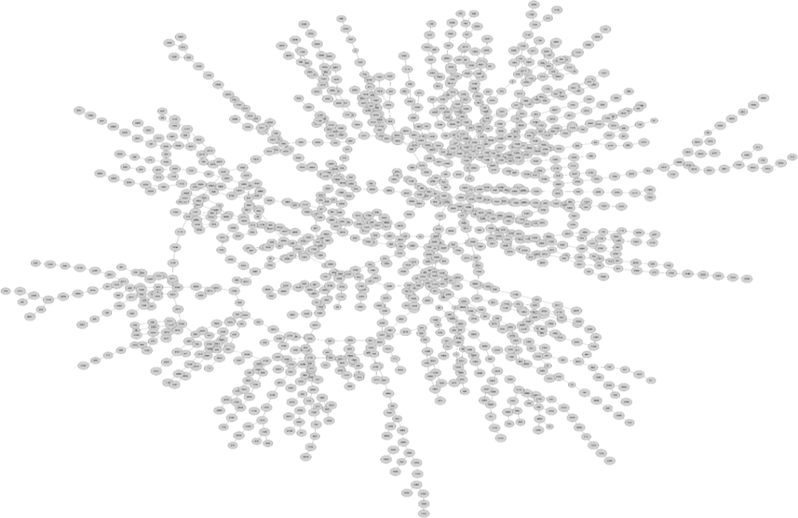
Largest Connected Component

Slide 17
Graph Decomposition: Articulation Points
solve
Articulation point
MIP, Salmela 2011

Slide 18
Largest Biconnected Component

Slide 19
Non-Serial Dynamic Programming
A technique which exploits the sparsity of the scaffolding graph by computing the
solution in stages, incorporating the results from previous stages ~inspired by (Neumaier, 06)

Slide 20
Non-Serial Dynamic Programming
$$z^{A}$$
$$z^{B}$$
+
+
2-cut
+
-
$$z^{C}$$
-
$$z^{D}$$
-
+
-

Slide 21
Non-Serial Dynamic Programming
$$z^{A}$$
$$z^{B}$$
+
+
+
-
$$z^{A}$$
$$z^{B}$$
$$z^{C}$$
-
$$z^{D}$$
-
$$z^{C}$$
$$z^{D}$$
+
-
Objective Modification:
$z^{A}+\frac{z^{D}+z^{C}−z^{B}−z^{A}}{2}S_{i}+\frac{z^{D}+z^{C}+z^{B}−z^{A}}{2}S_{j}$+$\frac{{−z}^{D}+z^{C}+z^{B}−z^{A}}{2}S_{ij}$

Slide 22
SPQR-tree Based Implementation
SPQR-tree efficiently finds 2 cuts (Tarjan, 73)
DFS of SPQR-tree is used to schedule elimination order for NSDP

Slide 23
Post Processing ILP Solution
outgoing
incoming
ILP Solution
A
A
B
B
B
D
A
F
C
C
E
D
D
C
E
E
May have cycles
Not a total ordering for each connected components
F
F
Bipartite matching
Objectives:
Max weight
Max cardinality
Max cardinality / Max weight

Slide 24
GAGE Framework
Genome | Size (Mb) | # reads
Staphlococcus Aureus | 2.9 | 3,494,070
Rhodobacter sphaeorides | 4.6 | 2,050,868
Human Chr14 | 107 | 22,669,408
Assembled using:
ABySS, Allpaths-LG, Bambus2, CABOG, MSR-CA, SGA, SOAPdenovo, Velvet
Scaffolded using:
SILP (our method), Opera, MIP, Bambus2

Slide 25
Testing Metrics
TPN50
Break scaffold at incorrect edges, then find N50
Size of contig where 50% of the contigs are $≥$ this size
Binary Classification
Given n contigs in a scaffold
How many of n-1 adjacencies can you predict
PPV
Sensitivity
MCC

Slide 26
Results

Slide 27
Results

Slide 28
Results

Slide 29
Results

Slide 30
Conclusions
Success
ILP solves scaffolding problem!
NSDP works
Improvements
Include SOAPdenovo, Allpaths-LG scaffolds in comparison
Look at parameter effects
Practical considerations (read style, multi-libraries, merge ctgs)
Future Work
Where else can I apply NSDP?
Scaffold before assembly … promising
Structural Variation??

Slide 31
Questions?

