Slide 1

Locality Sensitive Imputation for Single-Cell RNA-Seq Data
Marmar Moussa
& Ion Măndoiu
Computer Science & Engineering Department
University of Connecticut
ISBRA 2018, June 11th

Slide 2
Outline
Motivation & Background
Novel Algorithm - LSImpute: Locality Sensitive Imputation for Single Cell RNA-Seq Data
Results
Future Work & Application Demo

Slide 3
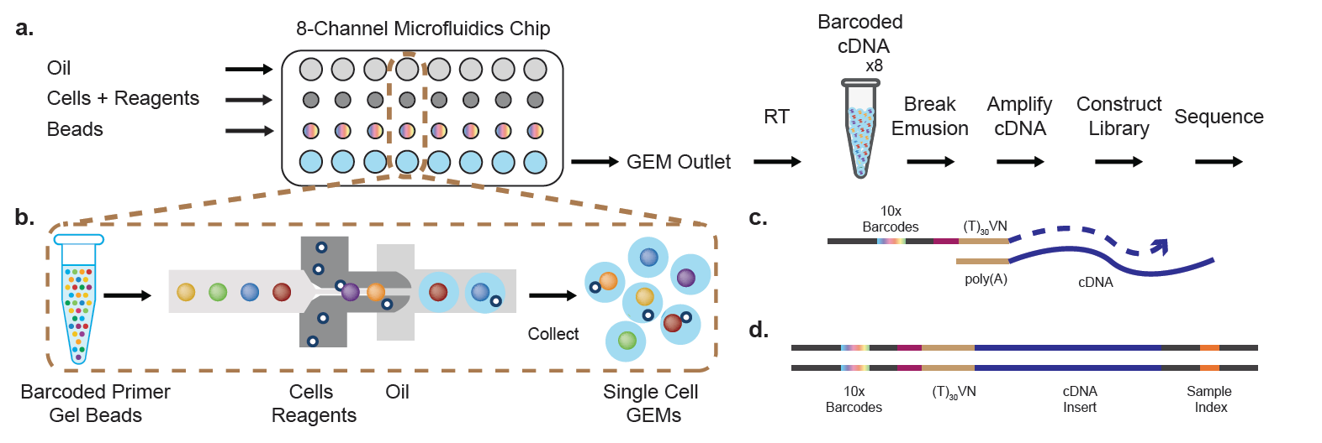
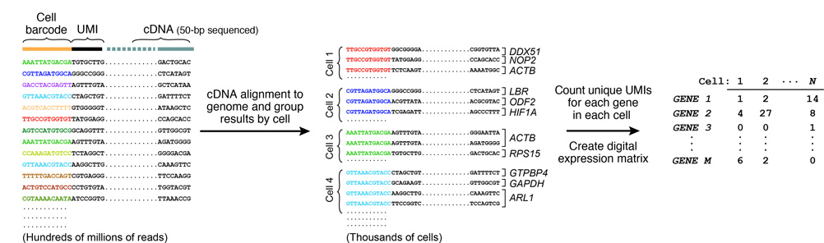
The Gene Expression Matrix
3’-end Sequencing w/ UMIs* (10X Genomics):

Slide 4
Drop-outs
Drop-outs occurring because of
  inefficient RT (Reverse Transcription) & mRNA capture leading to uniformly random dropout in reads,
  low number of RNA transcripts and the stochastic nature of gene expression
  …
Result : capturing only a fraction of the transcriptome of each cell
zero inflated data.
difficult to distinguish technical dropout of transcripts from true biological variation between cells.
→correcting dropouts needed for applications like cell count/detection fractions (e.g. % TILs in Tumors) etc.
Notes:
drop-outs typically do not affect the highly expressed genes as severely but may affect biologically interesting genes expressed at low levels such as transcription factors.

Slide 5
Existing single cell RNA-Seq imputation methods - DrImpute
DRImpute (clustering cells)
scImpute
KNNImpute (K nearest neighbour genes)
Notes:
DrImpute: imputing zero values multiple times based on the resulting clusters, and
finally averaging the imputation results
scImpute: assumption that most genes have a bimodal expression pattern that can be described by a mixture model with two components
KNN: for microarray data, imputes genes to their nearest neighbor

Slide 6
Proposed method: Locality Sensitive Imputation for scRNA-Seq Data (LSImpute)
High level summary of the novel imputation algorithm (LSImpute):
Step 1. Given a set (S) of (n) cells , start by selecting a small number (m) of cells with highest similarity level, based on their locality sensitive hashing values.
Step 2. Group the highly similar cells from Step 1 into clusters (“tight” ).
Step 3. For each cluster, replace zeros for each gene j with values imputed based on the expression levels of gene j in all cells within the cluster.
Step 4. The selected cells now have imputed values and the clusters they form are collapsed into their respective centroids.
The centroids are pooled together with remaining cells to form a (S’) and the process is repeated starting again at Step 1.
Notes:
unlike KNN, which uses similarity between genes, LSImpute uses similarity between cells. Also, the number of nearest cells used for imputation is not fixed but depends on the minimum similarity threshold

Slide 7
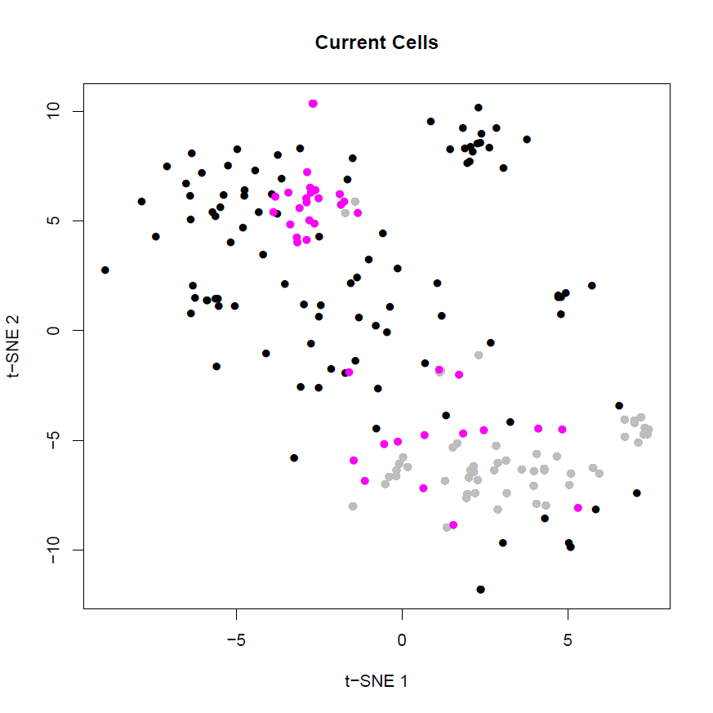
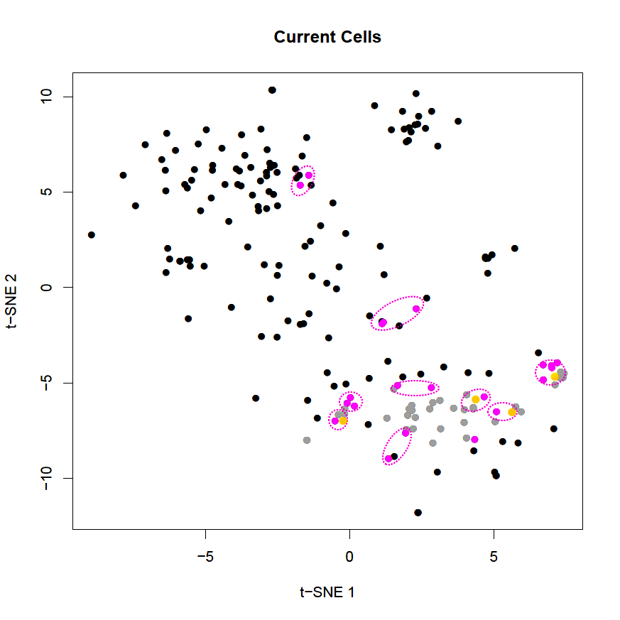
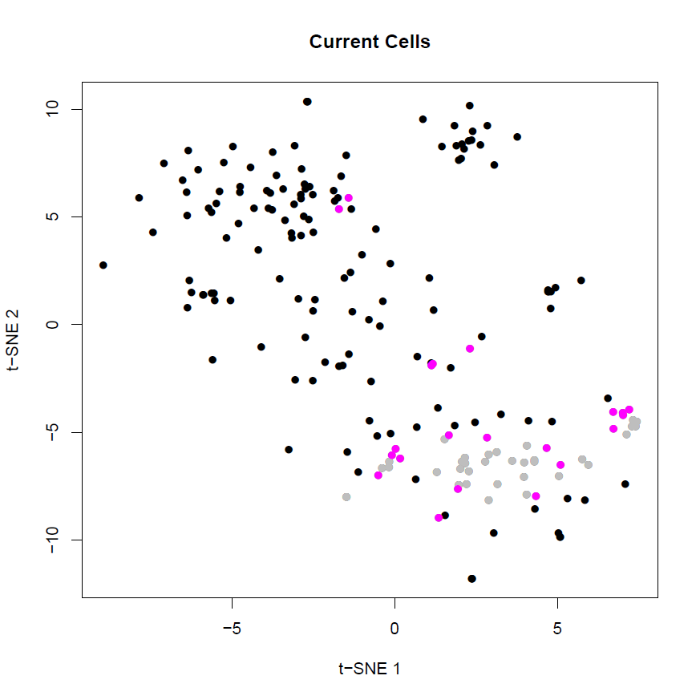
Toy Example:

Slide 8
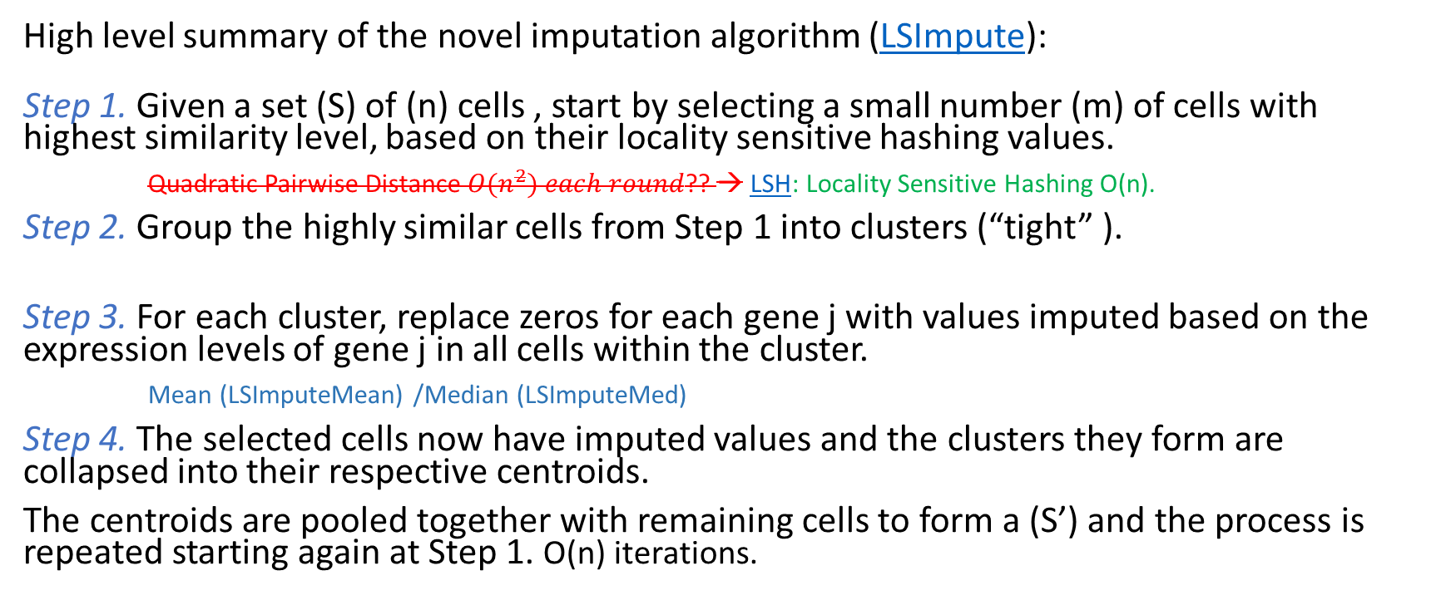
Proposed method: Locality Sensitive Imputation for scRNA-Seq Data (LSImpute)
High level summary of the novel imputation algorithm (LSImpute):
Step 1. Given a set (S) of (n) cells , start by selecting a small number (m) of cells with highest similarity level, based on their locality sensitive hashing values.
Quadratic Pairwise Distance ${O(n}^{2}) each round$?? → LSH: Locality Sensitive Hashing O(n).
Step 2. Group the highly similar cells from Step 1 into clusters (“tight” ).
Step 3. For each cluster, replace zeros for each gene j with values imputed based on the expression levels of gene j in all cells within the cluster.
Mean (LSImputeMean) /Median (LSImputeMed)
Step 4. The selected cells now have imputed values and the clusters they form are collapsed into their respective centroids.
The centroids are pooled together with remaining cells to form a (S’) and the process is repeated starting again at Step 1. O(n) iterations.
Notes:
unlike KNN, which uses similarity between genes, LSImpute uses similarity between cells. Also, the number of nearest cells used for imputation is not fixed but depends on the minimum similarity threshold.
Using the median of both zero and non-zero values, first, decides implicitly whether a zero is a drop-out event or a true biological effect, and prevents large but isolated expression values from driving imputation of nearby zeros, while collapsing into centroids in each iteration limits the propagation of potential imputation errors.

Slide 9
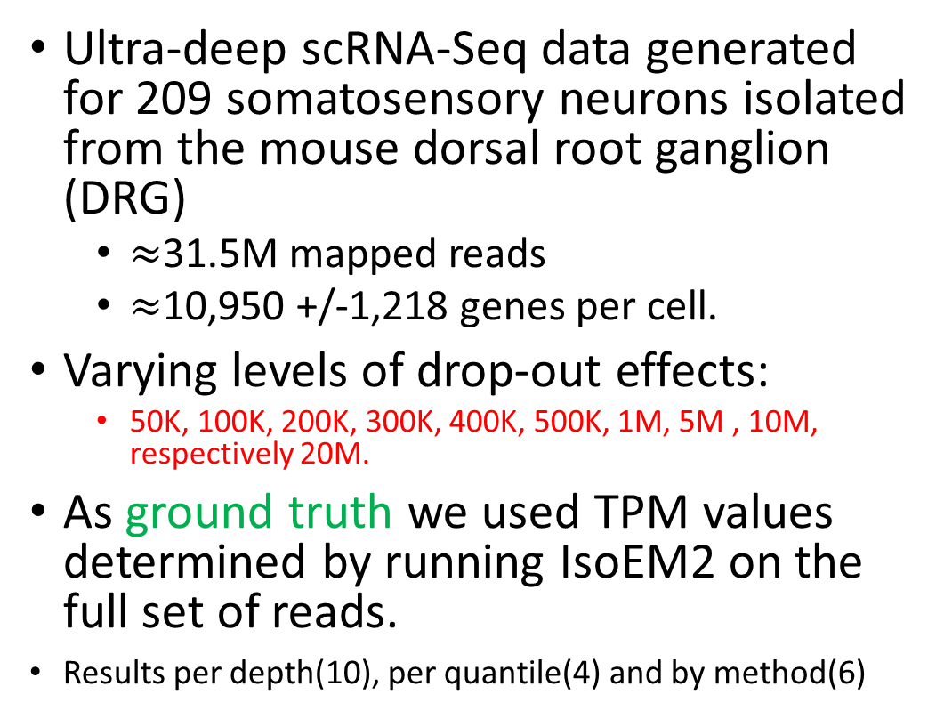
Experimental Setup – DRG neurons Data Set
Ultra-deep scRNA-Seq data generated for 209 somatosensory neurons isolated from the mouse dorsal root ganglion (DRG)
  $≈$31.5M mapped reads
  $≈$10,950 +/-1,218 genes per cell.
Varying levels of drop-out effects:
  50K, 100K, 200K, 300K, 400K, 500K, 1M, 5M , 10M, respectively 20M.
As ground truth we used TPM values determined by running IsoEM2 on the full set of reads.
Results per depth(10), per quantile(4) and by method(6)

Slide 10
Evaluation metrics
Detection fraction :
  Number of cells in which the gene is detected divided by the total number of cells .
  Compared to the `true' detection ratio in scatter plot.
Median percent error (MPE):
  Median of the set of relative errors for the gene detection fraction.
  Relative Error: |y -x| / y.
  (For each gene, y = predicted detection fraction, x = ground truth detection fraction)
Gene detection accuracy:
  Gene detection as a binary classification problem:
  TP+TN / (N*M) where N and M are the # genes and # cells respectively.
  TP are the (gene,cell) pairs for which both imputed and ground truth TPM values are positive. TN are (gene,cell) pairs for which both TPM values are zero.
Clustering micro-accuracy.

Slide 11
Detection Fraction
True (x-axis) Detection of each gene (dot) vs. Raw (y-axis) Detection Fraction.
Dot color shades are based on four quartiles of genes non-zero mean expression.
For an ideal imputation method all dots would lie on the diagonal

Slide 12
For 200K Raw Rounded TPMs
DrImpute
scImpute
KNNImpute
LSImpute-Med
LSImpute-Mean

Slide 13
100K, 1M, 10M
Rounded True vs. imputed detection fractions:
Raw Data,
DrImpute,
scImpute,
KNNImpute,
LSImputeMed,
LSImputeMean
<

Slide 14
Error curves for
100K data set.
The error curve plots, for every threshold x between 0 and 1 (or larger):
% of genes with relative error > x.
The abscissa of dashed vertical lines correspond to MPE of raw data.

Slide 15
Median Percent Error values in log scale (y-axis) for each depth (x-axis) in each quantile (z-axis) for each method:
Raw data,
DrImpute,
scImpute,
KNNImpute,
LSImputeMed, and
LSImputeMean
<

Slide 16
Gene Detection Accuracy

Slide 17
<

Slide 18
Raw Data 100K
DrImpute
scImpute
KNNImpute
LSImputeMed
LSImputeMean

Slide 19
MethA 10x Data
638 cells: 494,275 Reads/Cell, down-sampled to 52,180 Reads/Cell (Fraction of Reads Kept 11.8%)
Detection Accuracy : Raw 0.97; DrImpute 0.95; LSImpute 0.974
True vs. down-sampled
DrImpute
LSImpute

Slide 20
Conclusion
To impute or not to impute – that is the question!
  Two-edged sword in several methods (over-imputation)
  Sequencing Depth is one of the main factors to consider, also application.
LSImpute, especially the variant based on median imputation, tends to impute more conservatively than existing methods resulting in better performance and more accurate imputation.
LSImpute is more likely to reduce drop-out effects and reduce sparsity of the data without introducing false expression patterns or over-imputation.

Slide 21
References
Kwak, I.Y., Gong, W., Koyano-Nakagawa, N., Garry, D.: Drimpute: Imputing dropout events in single cell rna sequencing data. bioRxiv p. 181479 (2017)
Leskovec, J., Rajaraman, A., Ullman, J.D.: Mining of massive datasets. Cambridge University Press (2014) 20.
Li, C.L., Li, K.C., Wu, D., Chen, Y., Luo, H., Zhao, J.R., Wang, S.S., Sun, M.M., Lu, Y.J., Zhong, Y.Q.,et al.: Somatosensory neuron types identied by high-coverage single-cell rna-sequencing and functional heterogeneity. Cell research 26(1), 83 (2016)
21. Li, W.V., Li, J.J.: scimpute: accurate and robust imputation for single cell rna-seq data. bioRxiv p. 141598 (2017)
Moussa, M., Mandoiu, I.: Locality sensitive imputation for single-cell rna-seq data. ISBRA2018 Proceedings (to appear in ISBRA 2018 proceedings) . bioRxiv preprint available at doi: https://doi.org/10.1101/291807.
http://cnv1.engr.uconn.edu:3838/SC1/
http://cnv1.engr.uconn.edu:3838/LSImpute/

Slide 22
Thank You.
Questions?
Acknowledgements : This work was partially supported by NSF Award 1564936, NIH grants 1R01MH112739-01 and 2R01NS073425-06A1, and a UConn Academic Vision Program Grant.

Slide 23
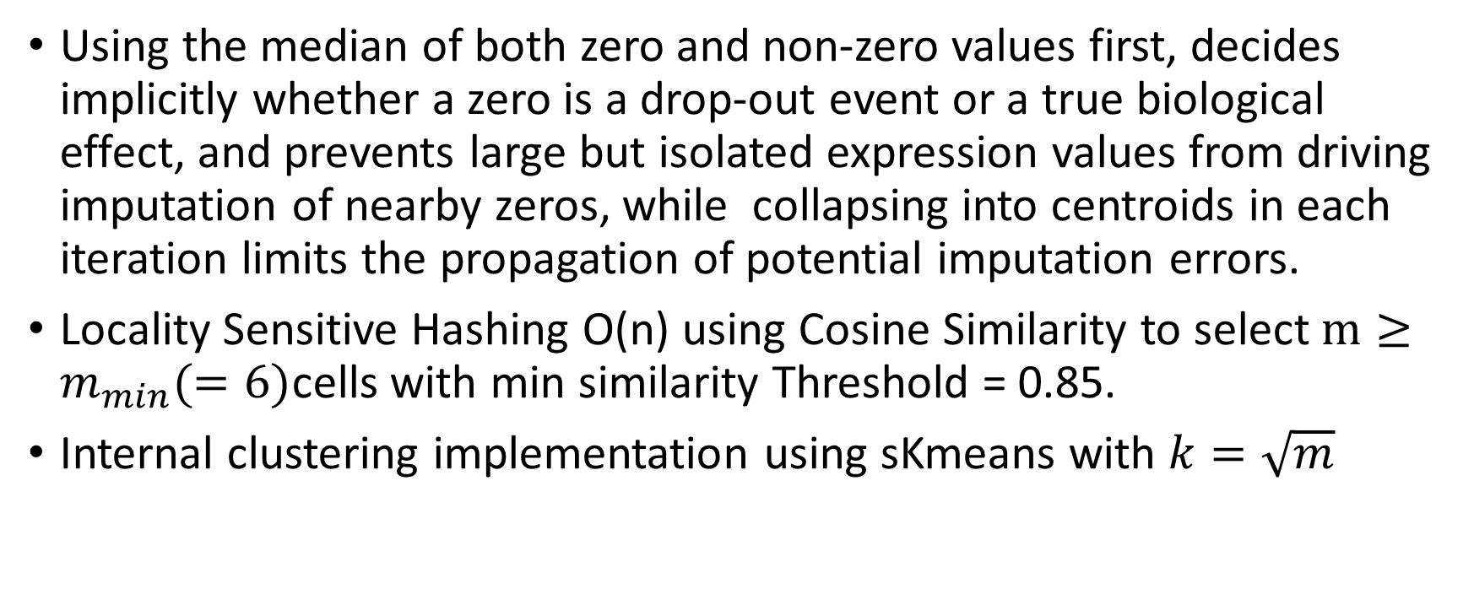
Notes on LSImpute
Using the median of both zero and non-zero values first, decides implicitly whether a zero is a drop-out event or a true biological effect, and prevents large but isolated expression values from driving imputation of nearby zeros, while collapsing into centroids in each iteration limits the propagation of potential imputation errors.
Locality Sensitive Hashing O(n) using Cosine Similarity to select $m≥m_{min}(=6)$cells with min similarity Threshold = 0.85.
Internal clustering implementation using sKmeans with $k=\sqrt{m}$
<

Slide 24
Notes on LSImpute
 | Candidate Cell 1 | Candidate Cell 2 | N-Bands/Similarity Level
1 | 25 | 27 | 40
2 | 205 | 209 | 27
3 | 207 | 209 | 27
4 | 205 | 207 | 26
5 | 208 | 209 | 24
6 | 137 | 165 | 22
7 | 206 | 208 | 22
8 | 206 | 209 | 22
9 | 207 | 208 | 22
10 | 33 | 69 | 21
11 | 62 | 68 | 21
12 | 111 | 113 | 21
13 | 132 | 170 | 21
14 | 137 | 192 | 21
15 | 153 | 171 | 21
16 | 153 | 177 | 21
17 | 18 | 20 | 20
18 | 56 | 62 | 20
19 | 56 | 68 | 20
20 | 62 | 63 | 20
21 | 68 | 79 | 20
if m_min = 6 → 6 unique cells
if m_min = 10, overshoot, >10 unique cells → resolve with a Threshold Step over normalized similarity
<

Slide 25
Existing single cell RNA-Seq imputation methods - DrImpute
The DrImpute R package implements imputation for scRNA-Seq based on clustering the data.
  distance between cells using Spearman and Pearson correlations,
  cell clustering based on each distance matrix,
  followed by imputing zero values multiple times based on the resulting clusters, and
  finally averaging the imputation results to produce a value for the drop-outs.
<

Slide 26
Existing single cell RNA-Seq imputation methods - scImpute
The scImpute R package makes the assumption that most genes have a bimodal expression pattern that can be described by a mixture model with two components.
The parameters in the mixture model are estimated using Expectation-Maximization (EM) results to produce a value for the drop-outs.
<

Slide 27
Existing single cell RNA-Seq imputation methods - KNNimpute
Weighted K-nearest neighbors (KNNimpute), a method originally developed for microarray data, selects genes with expression profiles similar to the gene of interest to impute missing values.
For instance, consider a gene A that has a missing value in cell 1, KNN will find K other genes which have a value present in cell 1, with expression most similar to A in cells 2 to N, where N is the total number of cells.
A weighted average of values in cell 1 for the K genes closest in Euclidean distance is then used as an estimate for the missing value for gene A.
<

Slide 28
Imputation effect on Clustering
sKmeans, top TF-IDF,
100K DRG

