Slide 1
A Maximum Likelihood Method for Quasispecies Reconstruction
Nicholas Mancuso, Georgia State University
Bassam Tork, Georgia State University
Pavel Skums, Centers for Disease Control
Lilia Ganova-Raeva, Centers for Disease Control
Ion Mandoiu, University of Connecticut
Alex Zelikovsky, Georgia State University

Slide 2
Outline
Background
Quasispecies spectrum reconstruction from amplicon NGS reads
Ongoing and future work

Slide 3
Cost of DNA Sequencing
http://www.economist.com/node/16349358

Slide 4
Cost/Performance Comparison [Glenn 2011]

Slide 5
Viral Quasispecies and NGS
RNA Viruses
HIV, HCV, SARS, Influenza
Higher (than DNA) mutation rates
➔ quasispecies
set of closely related variants rather than a single species
Knowing quasispecies can help
Interferon HCV therapy effectiveness (Skums et al 2011)
NGS allows to find individual quasispecies sequences
454 Life Sciences : 400-600 Mb with reads 300-800 bp long
Sequencing is challenging
multiple quasispecies
qsps sequences are very similar
different qsps may be indistinguishable for > 1kb (longer than reads)

Slide 6
Shotgun vs. Amplicon Reads
Shotgun reads
starting positions
distributed ~uniformly
Amplicon reads
reads have
predefined start/end positions
covering fixed overlapping
windows

Slide 7
Quasispecies Spectrum Reconstruction (QSR) Problem
Given
Shotgun/amplicon pyrosequencing reads from a quasispecies population of unknown size and distribution
Reconstruct the quasispecies spectrum
Sequences
Frequencies

Slide 8
Prior Work
Eriksson et al 2008
maximum parsimony using Dilworth’s theorem, clustering, EM
Westbrooks et al. 2008
min-cost network flow
Zagordi et al 2010-11 (ShoRAH)
probabilistic clustering based on a Dirichlet process mixture
Prosperi et al 2011 (amplicon based)
based on measure of population diversity
Huang et al 2011 (QColors)
Parsimonious reconstruction of quasispecies subsequences using constraint programming within regions with sufficient variability

Slide 9
Outline
Background
Quasispecies spectrum reconstruction from amplicon NGS reads
Ongoing and future work

Slide 10
Amplicon Sequencing Challenges
Distinct quasispecies may be indistinguishable in an amplicon interval
Multiple reads from consecutive amplicons may match over their overlap

Slide 11
Prosperi et al. 2011
First published approach for amplicons
Based on the idea of guide distribution
choose most variable amplicon
extend to right/left with matching reads, breaking ties by rank
220 | 200 | 140 | 160 | 150
200 | 140 | 130 | 150 | 140
70 | 130 | 120 | 140 | 130
10 | 20 | 110 | 130 | 120
0 | 10 | 100 | 20 | 60

Slide 12
Read Graph for Amplicons
K amplicons → K-staged read graph
vertices → distinct reads
edges → reads with consistent overlap
vertices, edges have a count function

Slide 13
Read Graph
May transform bi-cliques into 'fork' subgraphs
common overlap is represented by fork vertex

Slide 14
Observed vs Ideal Read Frequencies
Ideal frequency
consistent frequency across forks
Observed frequency (count)
inconsistent frequency across forks

Slide 15
Fork Balancing Problem
Given
Set of reads and respective frequencies
Find
Minimal frequency offsets balancing all forks
Simplest approach is to scale frequencies from left to right

Slide 16
Least Squares Balancing
Quadratic Program for read offsets
q – fork, o_{i} – observed frequency, x_{i} – frequency offset

Slide 17
Fork Resolution: Parsimony
6
8
4
2
8
6
6
12
6
8
6
4
4
8
2
4
8
4
2
4
4
2
2
4
2
4
2
4
2
2
(a)
(b)

Slide 18
Fork Resolution: Max Likelihood
Observation
Potential quasispecies has extra bases in overlap
Must be at least two instances of this quasispecies to produce both of these reads
Assumption
Solution is a forest

Slide 19
Fork Resolution: Max Likelihood
Given a forest, ML = # of ways to produce observed reads / 2^(#qsp):
Can be computed efficiently for trees: multiply by binomial coefficient of a leaf and its parent edge, prune the edge, and iterate
Solution (b) has a larger likelihood than (a) although both have 3 qsp’s
(a) (4 choose 2) * (8 choose 4) * (8 choose 4)/2^20 = 29400/2^20 ~ 2.8%
(b) (12 choose 6) * (4 choose 2)*(4 choose 2)/2^20 = 33264/2^20 ~ 3.3%
6
8
8
6
6
12
6
8
4
4
2
4
8
4
2
4
4
2
2
4
2
4
2
4
2
2
(a)
(b)

Slide 20
Fork Resolution: Min Entropy
12
6
4
8
4
8
6
6
6
8
2
4
8
4
2
4
4
2
2
4
2
4
2
4
2
2
(a)
(b)
Solution (b) also has a lower entropy than (a)
(a) -[ (8/20)log(8/20) + (8/20)log(8/20) + (4/20)log(4/20) ] ~ 1.522
(b) -[ (12/20)log(4/20) + (4/20)log(4/20) + (4/20)log(4/20) ] ~ 1.37

Slide 21
Fork Resolution: Min Entropy
Local Resolution
Greedily match maximum count reads in overlap
Repeat for all forks until graph is fully resolved
Global Resolution
Maximum bandwidth paths
Find s-t path, reduce counts by minimum edge, repeat until exhausted

Slide 22
Local Optimization: Greedy Method

Slide 23
Greedy Method

Slide 24
Greedy Method

Slide 25
Greedy Method

Slide 26
Greedy Method

Slide 27
Greedy Method

Slide 28
Greedy Method

Slide 29
Greedy Method

Slide 30
Greedy Method

Slide 31
Global Optimization: Maximum Bandwidth

Slide 32
Maximum Bandwidth Method

Slide 33
Maximum Bandwidth Method

Slide 34
Maximum Bandwidth Method

Slide 35
Maximum Bandwidth Method

Slide 36
Maximum Bandwidth Method

Slide 37
Maximum Bandwidth Method

Slide 38
Maximum Bandwidth Method

Slide 39
Experimental Setup
Error free reads simulated from 1739bp long fragments of HCV quasispecies
- Frequency distributions: uniform, geometric, …
5k-100k reads
- Amplicon width = 300bp
- Shift (= width – overlap, i.e., how much to slide the next amplicon) between 50 and 250
Quality measures
- Sensitivity
- PPV
- Jensen-Shannon divergence

Slide 40
Sensitivity for 100k Reads
(Uniform Qsps)

Slide 41
PPV for 100k Reads (Uniform Qsps)

Slide 42
JS Divergence for 100k Reads (Uniform Qsps)

Slide 43
Amplicon vs. Shotgun Reads
(avg. sensitivity/PPV over 10 runs)

Slide 44
Real HBV Data
Real HBV data from two patients
Sequenced using GS FLX LR25
Twenty-five amplicons were generated
Error correction with KEC (Skums 2011)
Aligned with MosiakAligner tool

Slide 45
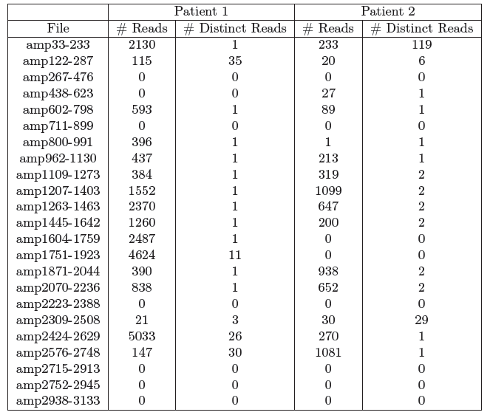
Real HBV Data

Slide 46
Real HBV Data
Method | Patient One | Patient Two
Greedy Method | 17 qsps | 3 qsps
Maximum Bandwidth | 3 qsps | 3 qsps

Slide 47
Outline
Background
Quasispecies spectrum reconstruction from amplicon NGS reads
Ongoing and future work

Slide 48
Ongoing and Future Work
Correction for coverage bias
Comparison of shotgun and amplicon based reconstruction methods on real data
Quasispecies reconstruction from Ion Torrent reads
Combining long and short read technologies
Optimization of vaccination strategies

Slide 49
Acknowledgements
University of Connecticut
Rachel O’Neill, PhD.
Mazhar Kahn, Ph.D.
Hongjun Wang, Ph.D.
Craig Obergfell
Andrew Bligh
Georgia State University
Alex Zelikovsky, Ph.D.
Bassam Tork
Nicholas Mancuso
Serghei Mangul
Centers for Disease Control
and Prevention
Pavel Skums, Ph.D.
University of Maryland
Irina Astrovskaya, Ph.D.

