Slide 1
Estimation of alternative splicing isoform frequencies from RNA-Seq data
Ion Mandoiu
Computer Science and Engineering Department
University of Connecticut
Joint work with Marius Nicolae, Serghei Mangul, and Alex Zelikovsky

Slide 2
Outline
Introduction
EM Algorithm
Experimental results
Conclusions and future work

Slide 3
Alternative Splicing
[Griffith and Marra 07]

Slide 4
RNA-Seq
Make cDNA & shatter into fragments
Sequence fragment ends
Map reads
A
B
C
D
E
Gene Expression (GE)
Isoform Discovery (ID)
Isoform Expression (IE)
A
B
C
A
C
D
E

Slide 5
Gene Expression Challenges
Read ambiguity (multireads)
What is the gene length?
A
B
C
D
E

Slide 6
Previous approaches to GE
Ignore multireads
[Mortazavi et al. 08]
Fractionally allocate multireads based on unique read estimates
[Pasaniuc et al. 10]
EM algorithm for solving ambiguities
Gene length: sum of lengths of exons that appear in at least one isoform
➔ Underestimates expression levels for genes with 2 or more isoforms [Trapnell et al. 10]

Slide 7
Read Ambiguity in IE
A
B
C
D
E
A
C

Slide 8
Previous approaches to IE
[Jiang&Wong 09]
Poisson model + importance sampling, single reads
[Richard et al. 10]
EM Algorithm based on Poisson model, single reads in exons
[Li et al. 10]
EM Algorithm, single reads
[Feng et al. 10]
Convex quadratic program, pairs used only for ID
[Trapnell et al. 10]
Extends Jiang’s model to paired reads
Fragment length distribution

Slide 9
Our contribution
EM Algorithm for IE
Single and/or paired reads
Fragment length distribution
Strand information
Base quality scores

Slide 10
Read-Isoform Compatibility

Slide 11
Fragment length distribution
Paired reads
Single reads
A
A
A
B
B
B
C
C
C
A
A
A
C
C
C
A
A
A
B
B
B
C
C
C
A
A
A
C
C
C

Slide 12
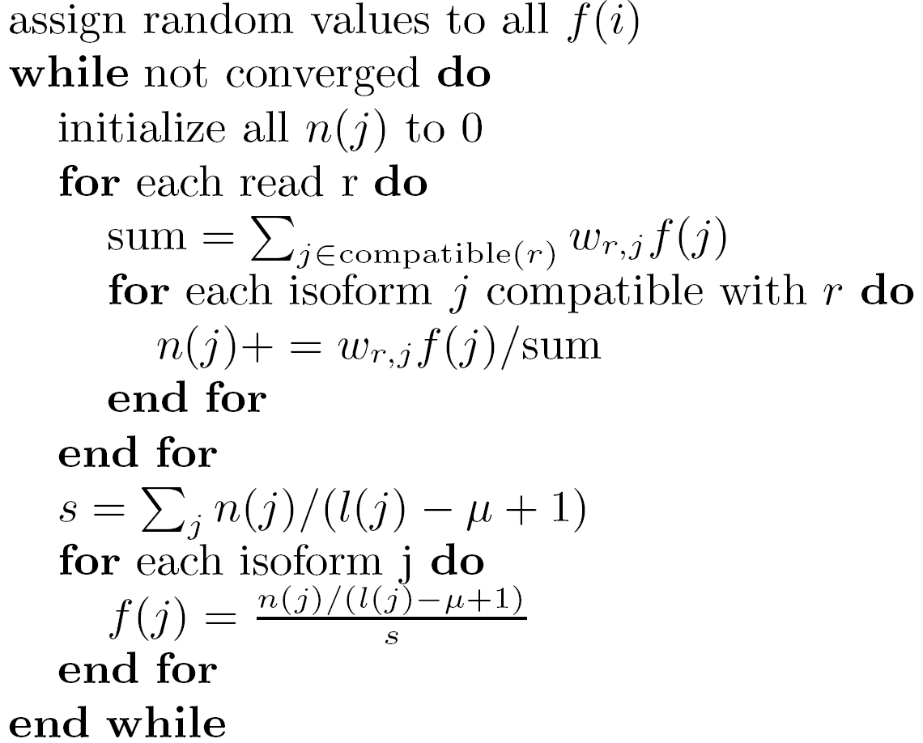
IsoEM algorithm
E-step
M-step

Slide 13
Simulation setup
Human genome UCSC known isoforms
GNFAtlas2 gene expression levels
Uniform/geometric expression of gene isoforms
Normally distributed fragment lengths
Mean 250, std. dev. 25

Slide 14
Accuracy measures
Error Fraction (EF_{t})
Percentage of isoforms (or genes) with relative error larger than given threshold t
Median Percent Error (MPE)
Threshold t for which EF is 50%
r²

Slide 15
Error Fraction Curves - Isoforms
30M single reads of length 25

Slide 16
Error Fraction Curves - Genes
30M single reads of length 25

Slide 17
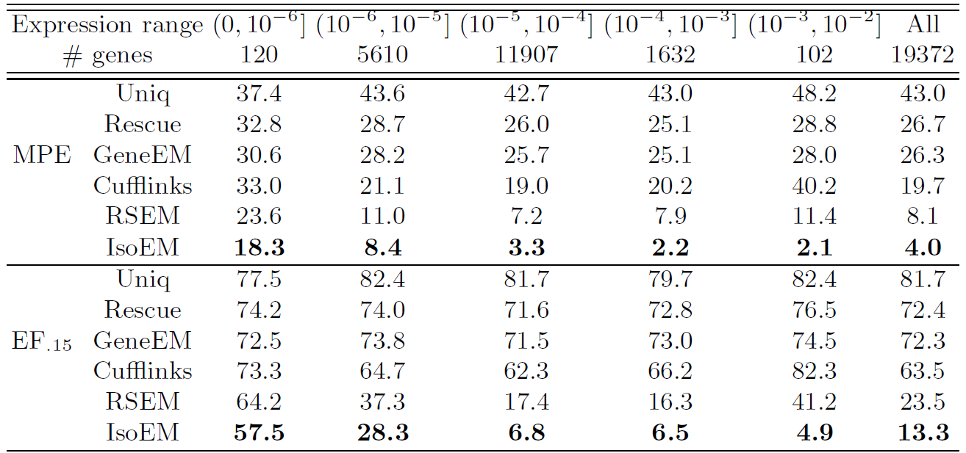
MPE and EF₁₅ by Gene Frequency
30M single reads of length 25

Slide 18
Read Length Effect
Fixed sequencing throughput (750Mb)

Slide 19
Effect of Pairs & Strand Information
1-60M 75bp reads

Slide 20
Validation on Human RNA-Seq Data
≈8 million 27bp reads from two cell lines [Sultan et al. 10]
47 AEEs measured by qPCR [Richard et al. 10]

Slide 21
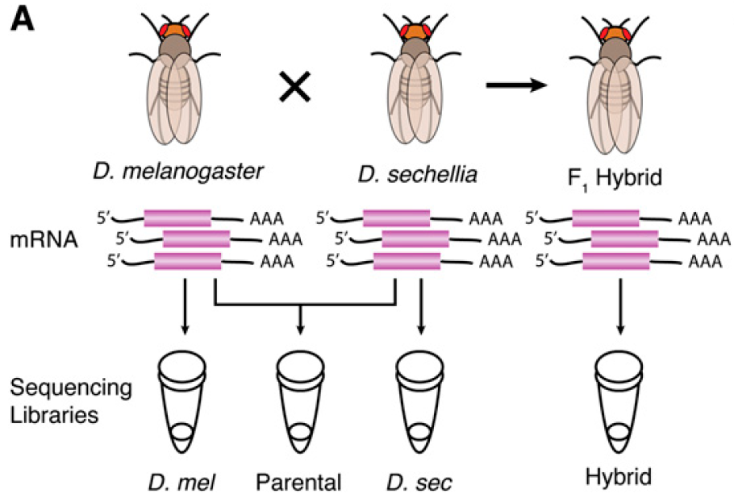
Validation on Drosophila RNA-Seq Data
[McManus et al. 10]
26M 42M 31M 78M
Paired-end reads (37bp)

Slide 22
Allele Specific Expression in Parental Pool

Slide 23
Comparison to Pyrosequencing

Slide 24
Runtime scalability
Scalability experiments conducted on a Dell PowerEdge R900
Four 6-core E7450Xeon processors at 2.4Ghz, 128Gb of internal memory

Slide 25
Conclusions & Future Work
Presented EM algorithm for estimating isoform/gene expression levels
Integrates fragment length distribution, base qualities, pair and strand info
Java implementation available at
http://dna.engr.uconn.edu/software/IsoEM/
Ongoing work
Correction for library preparation and sequencing biases
E.g., random hexamer priming bias [Hansen et al. 10]
Comparison of RNA-Seq with DGE
Isoform discovery
Reconstruction & frequency estimation for virus quasispecies

Slide 26
Acknowledgments
NSF awards 0546457 & 0916948 to IM and 0916401 to AZ

