Slide 1
Bioinformatics Tools for Personalized Cancer Immunotherapy
Ion Mandoiu
Department of Computer Science & Engineering

Slide 2
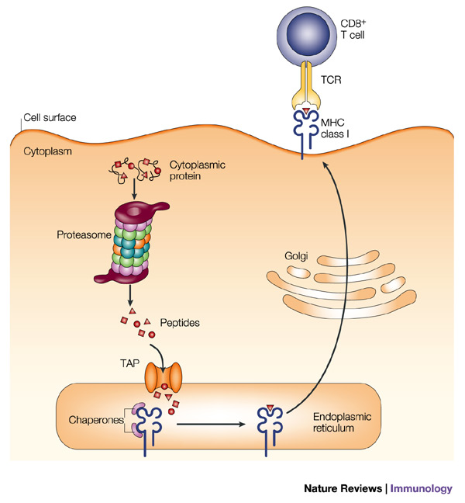
Immunology Background
J.W. Yedell, E Reits and J Neefjes. Making sense of mass destruction: quantitating MHC class I antigen presentation. Nature Reviews Immunology, 3:952-961, 2003

Slide 3

Genomics-Guided Cancer Immunotherapy
Peptide
Synthesis
Tumor mRNA
Sequencing
Tumor Specific Epitopes
CTCAATTGATGAAATTGTTCTGAAACT
GCAGAGATAGCTAAAGGATACCGGGTT
SYFPEITHI
CCGGTATCCTTTAGCTATCTCTGCCTC
ISETDLSLL
CTGACACCATCTGTGTGGGCTACCATG
CALRRNESL
…
…
AGGCAAGCTCATGGCCAAATCATGAGA
Immune
System
Stimulation
Tumor
Remission
Mouse Image Source: http://www.clker.com/clipart-simple-cartoon-mouse-2.html

Slide 4
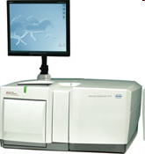
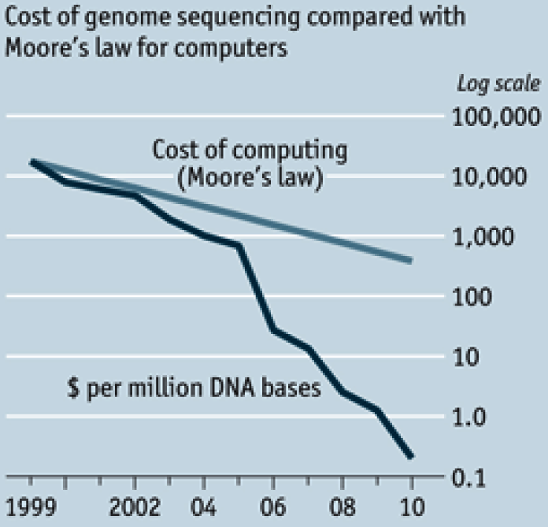
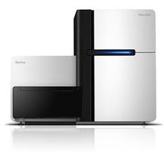
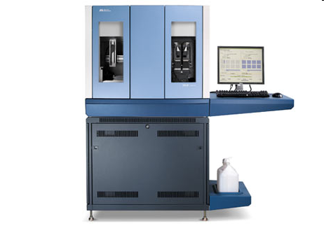
Advances in High-Throughput Sequencing
http://www.economist.com/node/16349358
Notes:
4

Slide 5
Bioinformatics Pipeline
CCDS mapped reads
CCDS
Mapping
Tumor mRNA reads
Mapped reads
Read Merging
Genome Mapping
Genome mapped reads
SNVs Detection
Tumor-specific SNVs
Close SNV Haplotypes
Epitope Prediction
Haplotyping
Primers for Sanger Sequencing
Tumor specific epitopes
Primers Design

Slide 6
Bioinformatics Pipeline
CCDS mapped reads
CCDS
Mapping
Tumor mRNA reads
Mapped reads
Read Merging
Genome Mapping
Genome mapped reads
SNVs Detection
Tumor-specific SNVs
Close SNV Haplotypes
Epitope Prediction
Haplotyping
Primers for Sanger Sequencing
Tumor specific epitopes
Primers Design

Slide 7
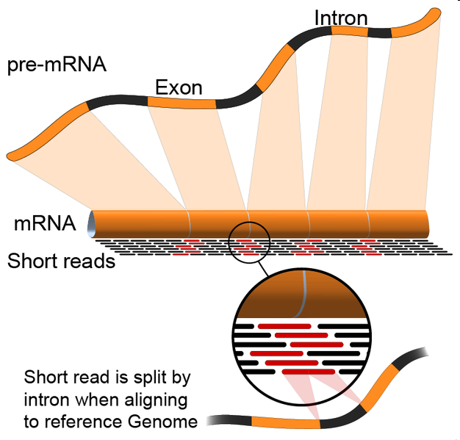
Mapping mRNA Reads
http://en.wikipedia.org/wiki/File:RNA-Seq-alignment.png
Notes:
7

Slide 8
Read Merging
Genome | CCDS | Agree? | Hard Merge | Soft Merge
Unique | Unique | Yes | Keep | Keep
Unique | Unique | No | Throw | Throw
Unique | Multiple | No | Throw | Keep
Unique | Not Mapped | No | Keep | Keep
Multiple | Unique | No | Throw | Keep
Multiple | Multiple | No | Throw | Throw
Multiple | Not Mapped | No | Throw | Throw
Not mapped | Unique | No | Keep | Keep
Not mapped | Multiple | No | Throw | Throw
Not mapped | Not Mapped | Yes | Throw | Throw

Slide 9
SNV Detection and Genotyping
Locus i
Reference
AACGCGGCCAGCCGGCTTCTGTCGGCCAGCAGCCAGGAATCTGGAAACAATGGCTACAGCGTGC
AACGCGGCCAGCCGGCTTCTGTCGGCCAGCCGGCAG
CGCGGCCAGCCGGCTTCTGTCGGCCAGCAGCCCGGA
GCGGCCAGCCGGCTTCTGTCGGCCAGCCGGCAGGGA
GCCAGCCGGCTTCTGTCGGCCAGCAGCCAGGAATCT
GCCGGCTTCTGTCGGCCAGCAGCCAGGAATCTGGAA
CTTCTGTCGGCCAGCCGGCAGGAATCTGGAAACAAT
CGGCCAGCAGCCAGGAATCTGGAAACAATGGCTACA
CCAGCAGCCAGGAATCTGGAAACAATGGCTACAGCG
CAAGCAGCCAGGAATCTGGAAACAATGGCTACAGCG
GCAGCCAGGAATCTGGAAACAATGGCTACAGCGTGC
R_{i}
r(i) : Base call of read r at locus i
ε_{r(i)} : Probability of error reading base call r(i)
G_{i} : Genotype at locus i

Slide 10
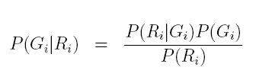

SNV Detection and Genotyping
Use Bayes rule to calculate posterior probabilities and pick the genotype with the largest one

Slide 11

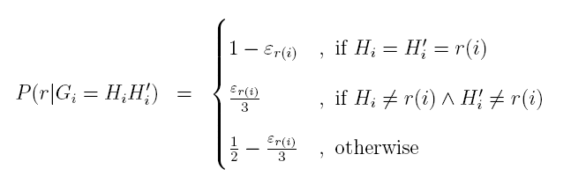
SNV Detection and Genotyping
Calculate conditional probabilities by multiplying contributions of individual reads

Slide 12
Data Filtering

Slide 13
Accuracy per RPKM bins

Slide 14
Bioinformatics Pipeline
CCDS mapped reads
CCDS
Mapping
Tumor mRNA reads
Mapped reads
Read Merging
Genome Mapping
Genome mapped reads
SNVs Detection
Tumor-specific SNVs
Close SNV Haplotypes
Epitope Prediction
Haplotyping
Primers for Sanger Sequencing
Tumor specific epitopes
Primers Design

Slide 15
Haplotyping
Human somatic cells are diploid, containing two sets of nearly identical chromosomes, one set derived from each parent.
ACGTTACATTGCCACTCAATC--TGGA
ACGTCACATTG-CACTCGATCGCTGGA
Heterozygous variants

Slide 16
Haplotyping
Locus | Event | Alleles Hap 1 | Alleles Hap 2
1 | SNV | T | C
2 | Deletion | C | -
3 | SNV | A | G
4 | Insertion | - | GC
Locus | Event | Alleles
1 | SNV | C,T
2 | Deletion | C,-
3 | SNV | A,G
4 | Insertion | -,GC

Slide 17
RefHap Algorithm
Reduce the problem to Max-Cut.
Solve Max-Cut
Build haplotypes according with the cut
Locus | 1 | 2 | 3 | 4 | 5
f₁ | - | 0 | 1 | 1 | 0
f₂ | 1 | 1 | 0 | - | 1
f₃ | 1 | - | - | 0 | -
f₄ | - | 0 | 0 | - | 1
4
1
-1
3
1
2
1
-1
3
h₁ 00110
h₂ 11001

Slide 18
Bioinformatics Pipeline
CCDS mapped reads
CCDS
Mapping
Tumor mRNA reads
Mapped reads
Read Merging
Genome Mapping
Genome mapped reads
SNVs Detection
Tumor-specific SNVs
Close SNV Haplotypes
Epitope Prediction
Haplotyping
Primers for Sanger Sequencing
Tumor specific epitopes
Primers Design

Slide 19
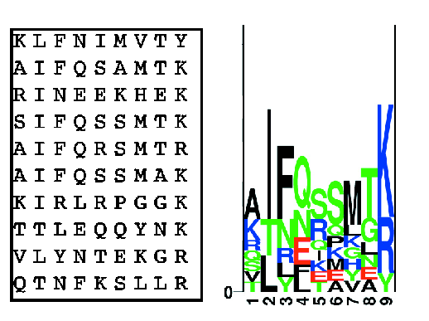
Epitope Prediction
C. Lundegaard et al. MHC Class I Epitope Binding Prediction Trained on Small Data Sets. In Lecture Notes in Computer Science, 3239:217-225, 2004

Slide 20
NetMHC vs. SYFPEITHI

Slide 21
NetMHC vs. SYFPEITHI

Slide 22
Results on Tumor Data
Mouse strain |  | BALB/C |  | B10.D2 TRAMP
Tumor |  | Meth-A | CMS5 | prostate1 | prostate2 | prostate3 | prostate4
#lanes |  | 1 | 3 | 4 | 3 | 3 | 3
HQ Het SNPs |  | 465 | 77 | 86 | 17 | 292 | 193
Dd | Weak | 119 | 17 | 14 | 12 | 63 | 70
 | Strong | 20 | 2 | 2 | 0 | 7 | 12
Kd | Weak | 111 | 21 | 10 | 0 | 19 | 54
 | Strong | 3 | 1 | 1 | 0 | 1 | 3
Ld | Weak | 99 | 12 | 25 | 4 | 47 | 75
 | Strong | 8 | 0 | 0 | 0 | 2 | 9
Total | Weak | 329 | 50 | 49 | 16 | 129 | 199
 | Strong | 31 | 3 | 3 | 0 | 10 | 24

Slide 23
Validation Results
Mutations reported by [Noguchi et al 94] were found by this pipeline
Confirmed with Sanger sequencing 18 out of 20 mutations for MethA and 26 out of 28 mutations for CMS5

Slide 24
Ongoing Work
Tumor rejection potential of identified epitopes is being evaluated experimentally in the Srivastava lab
Detecting other forms of variation: indels, gene fusions, novel transcripts
Computational deconvolution of heterogeneous tumor RNA-Seq data
Incorporating predictions of TAP transport efficiency and proteasomal cleavage in epitope prediction
Integration of mass-spectrometry data
Monitoring immune response by TCR sequencing

Slide 25
Acknowledgments
Jorge Duitama (KU Leuven)
Pramod K. Srivastava, Adam Adler, Brent Graveley, Duan Fei (UCHC)
Matt Alessandri and Kelly Gonzalez (Ambry Genetics)
NSF awards IIS-0546457, IIS-0916948, and DBI-0543365
UCONN Research Foundation UCIG grant

