Slide 1
Scalable Algorithms for
Next-Generation Sequencing Data Analysis
Ion Mandoiu
UTC Associate Professor in Engineering Innovation
Department of Computer Science & Engineering

Slide 2
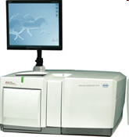
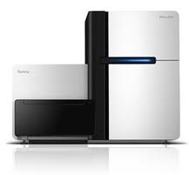
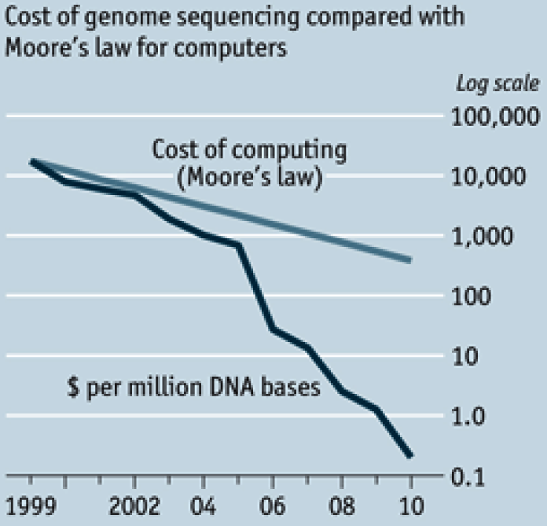
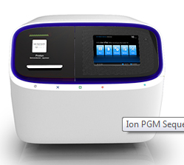
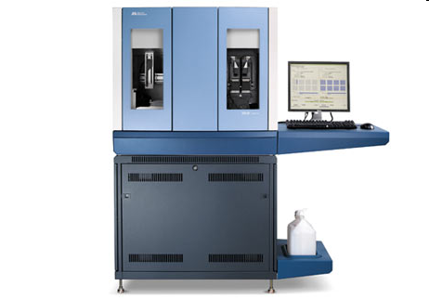
Next Generation Sequencing
Illumina HiSeq 2000
Roche/454 FLX Titanium
Ion Proton Sequencer
SOLiD 4/5500
http://www.economist.com/node/16349358

Slide 3
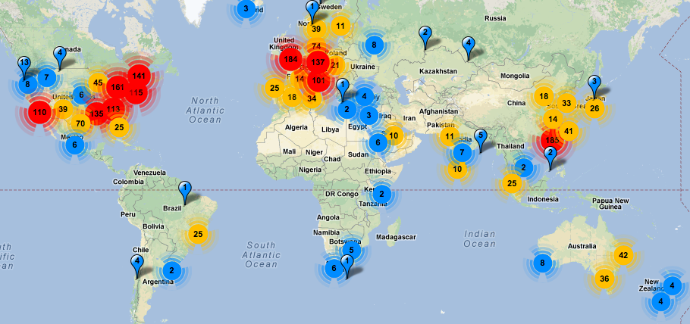
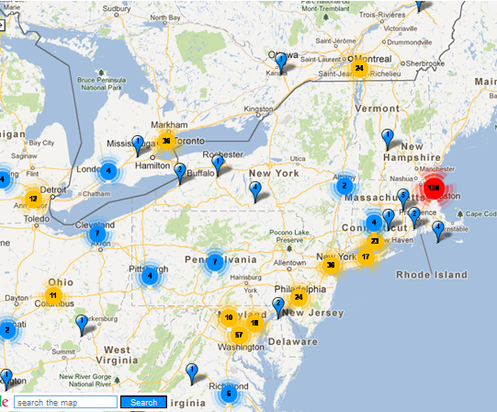
Next Generation Sequencing
http://omicsmaps.com/

Slide 4
A transformative technology
Re-sequencing
De novo sequencing
RNA-Seq
Non-coding RNAs
Structural variation
ChIP-Seq
Methyl-Seq
Shape-Seq
Chromosome conformation
Viral quasispecies
… many more biological measurements “reduced” to NGS sequencing
Notes:
4

Slide 5

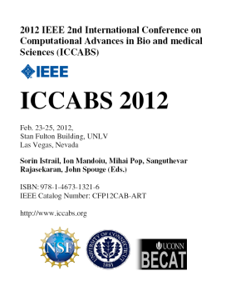
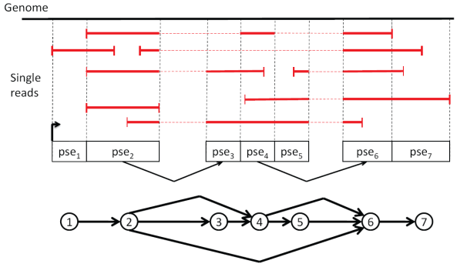
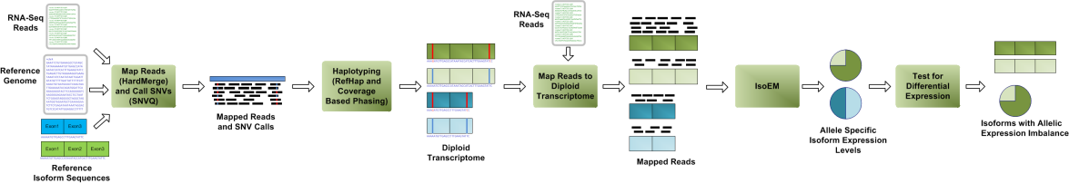
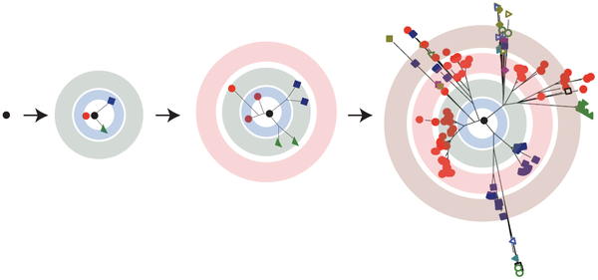
Mandoiu Lab
Main Research Areas:
Bioinformatics Algorithms
Development of Computational Methods for Next-Gen Sequencing Data Analysis
Ongoing Projects
RNA-Seq Analysis (NSF, NIH, Life Technologies)
  Novel transcript reconstruction
  Allele-specific isoform expression
  Computational deconvolution of heterogeneous samples
Viral quasispecies reconstruction (USDA)
  IBV evolution and vaccine optimization
Sequencing error correction, genome assembly and scaffolding, metabolomics, biomarker selection, …
  More info & software at http://dna.engr.uconn.edu

Slide 6
Epi-Seq Bioinformatics Pipeline
Bayesian model based on quality scores (SNVQ)
Haplotyping
PWM and ANN algorithms (NetMHC)
Epitope Prediction
Max-Cut algorithm (RefHap)
Variant Detection
Read Alignment
Hybrid alignment strategy (HardMerge)
Data Cleaning
Clipping alignments & removal of PCR artifacts
Source code & binaries available at http://dna.engr.uconn.edu/software/Epi-Seq/

Slide 7
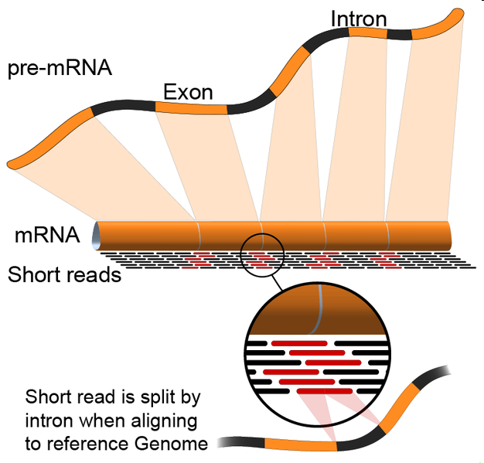
Hybrid Read Alignment Approach
Transcript Library
Mapping
Transcript mapped reads
mRNA reads
Read Merging
Mapped reads
Genome Mapping
Genome mapped reads
More efficient compared to spliced alignment onto genome
Stringent filtering: reads with multiple alignments are discarded
http://en.wikipedia.org/wiki/File:RNA-Seq-alignment.png
Notes:
7

Slide 8
Clipping Alignments

Slide 9
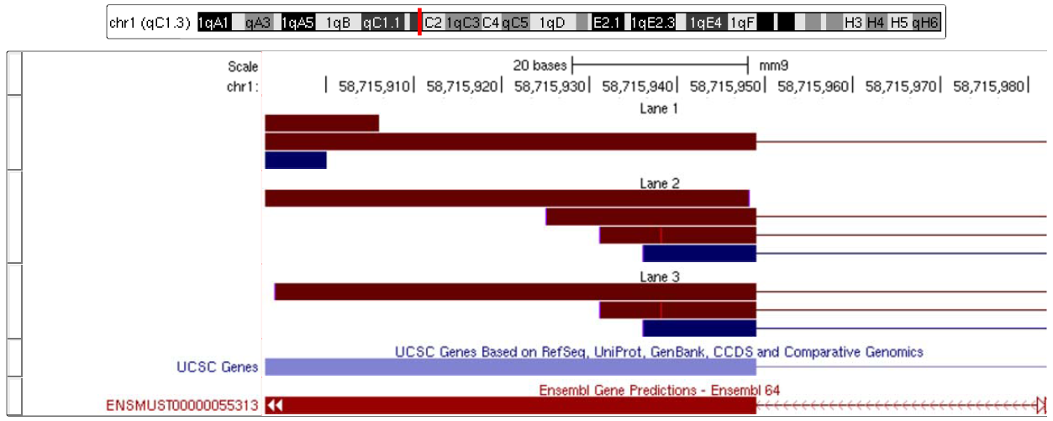
Removal of PCR Artifacts

Slide 10
Variant Detection and Genotyping
Locus i
Reference
genome
AACGCGGCCAGCCGGCTTCTGTCGGCCAGCAGCCAGGAATCTGGAAACAATGGCTACAGCGTGC
AACGCGGCCAGCCGGCTTCTGTCGGCCAGCCGGCAG
CGCGGCCAGCCGGCTTCTGTCGGCCAGCAGCCCGGA
GCGGCCAGCCGGCTTCTGTCGGCCAGCCGGCAGGGA
GCCAGCCGGCTTCTGTCGGCCAGCAGCCAGGAATCT
GCCGGCTTCTGTCGGCCAGCAGCCAGGAATCTGGAA
CTTCTGTCGGCCAGCCGGCAGGAATCTGGAAACAAT
CGGCCAGCAGCCAGGAATCTGGAAACAATGGCTACA
CCAGCAGCCAGGAATCTGGAAACAATGGCTACAGCG
CAAGCAGCCAGGAATCTGGAAACAATGGCTACAGCG
GCAGCCAGGAATCTGGAAACAATGGCTACAGCGTGC
R_{i}

Slide 11
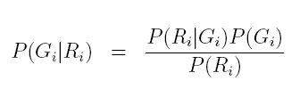


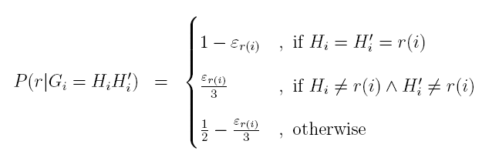
Variant Detection and Genotyping
Pick genotype with the largest posterior probability

Slide 12
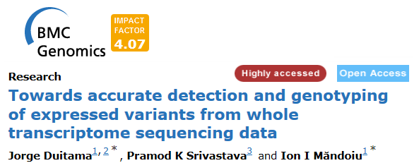
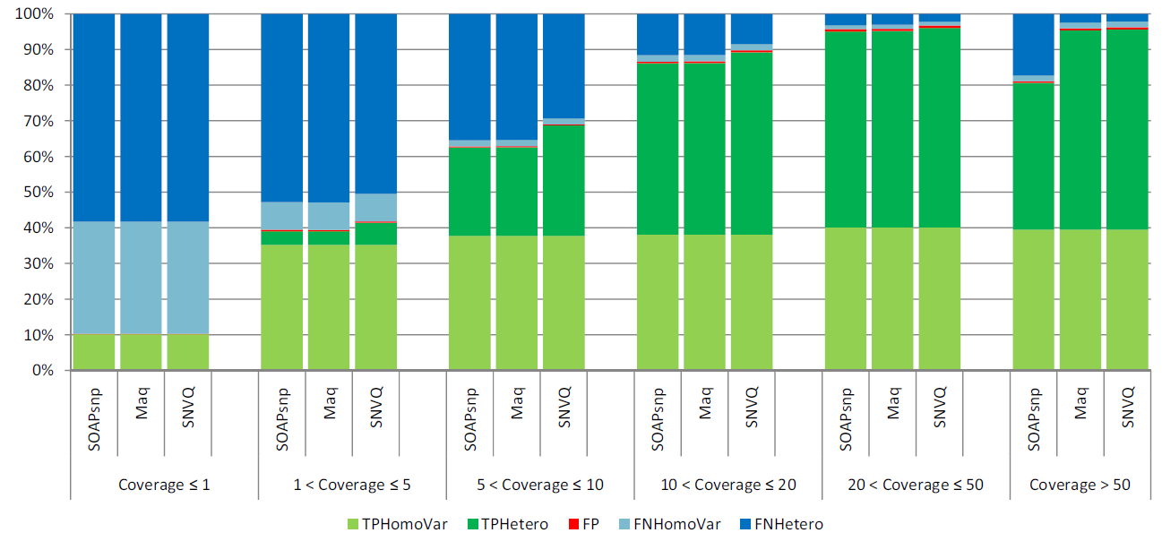
Accuracy as Function of Coverage

Slide 13
Haplotyping
Somatic cells are diploid, containing two nearly identical copies of each autosomal chromosome
  Novel mutations are present on only one chromosome copy
  For epitope prediction we need to know if nearby mutations appear in phase
Locus | Mutation | Alleles
1 | SNV | C,T
2 | Deletion | C,-
3 | SNV | A,G
4 | Insertion | -,GC
Locus | Mutation | Haplotype 1 | Haplotype 2
1 | SNV | T | C
2 | Deletion | C | -
3 | SNV | A | G
4 | Insertion | - | GC

Slide 14
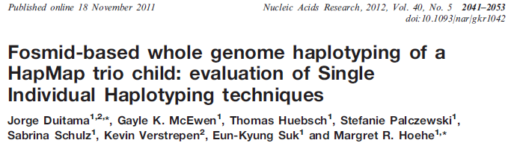
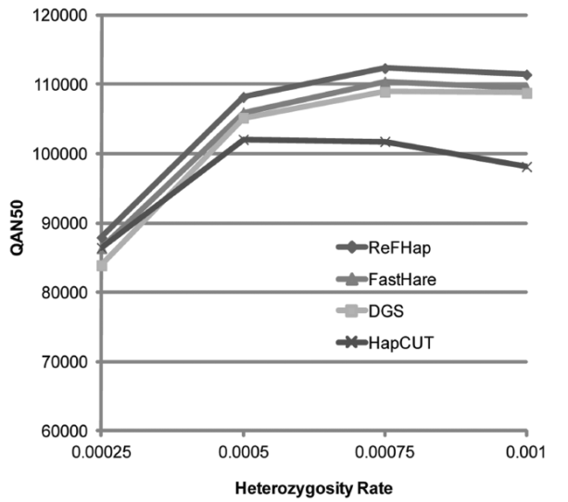
RefHap Algorithm
Reduce the problem to Max-Cut
Solve Max-Cut
Build haplotypes according with the cut
Locus | 1 | 2 | 3 | 4 | 5
f₁ | * | 0 | 1 | 1 | 0
f₂ | 1 | 1 | 0 | * | 1
f₃ | 1 | * | * | 0 | *
f₄ | * | 0 | 0 | * | 1
f₄
1
-1
3
f₁
f₂
1
-1
f₃
h₁ 00110
h₂ 11001

Slide 15
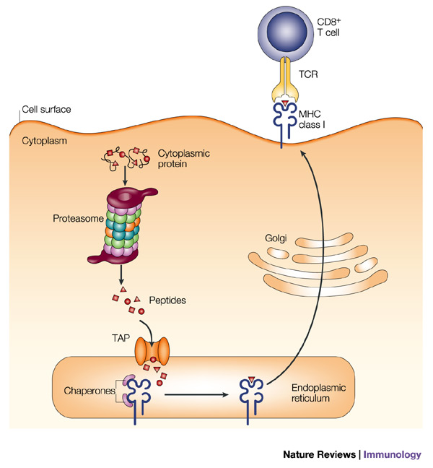
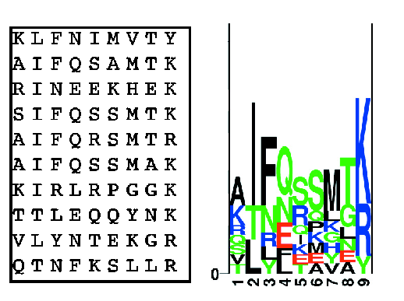
Epitope Prediction
Profile weight matrix (PWM) model
C. Lundegaard et al. MHC Class I Epitope Binding Prediction Trained on Small Data Sets. In Lecture Notes in Computer Science, 3239:217-225, 2004
J.W. Yedell, E Reits and J Neefjes. Making sense of mass destruction: quantitating MHC class I antigen presentation. Nature Reviews Immunology, 3:952-961, 2003

Slide 16
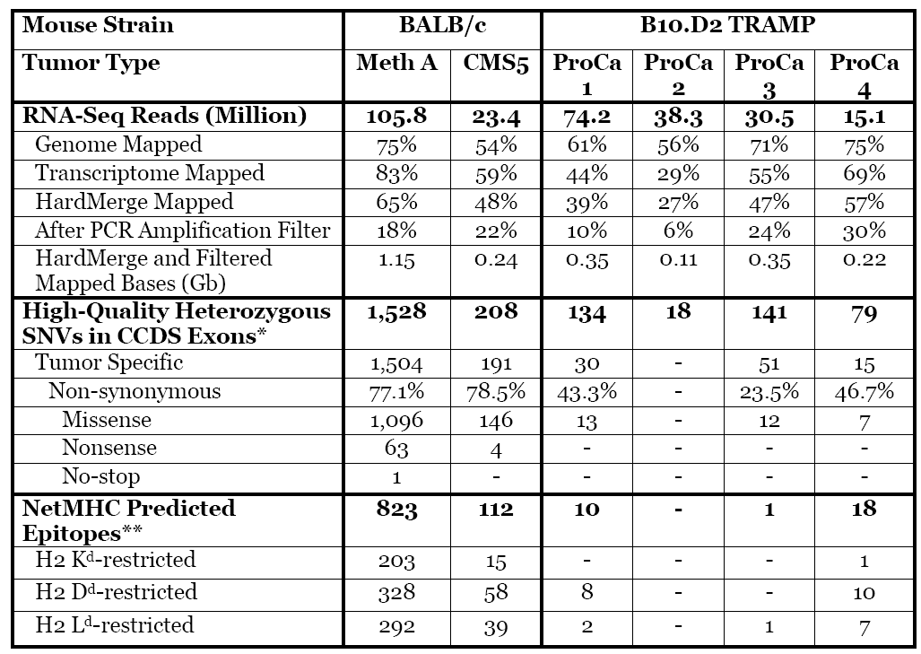
Results on Tumor Data

Slide 17
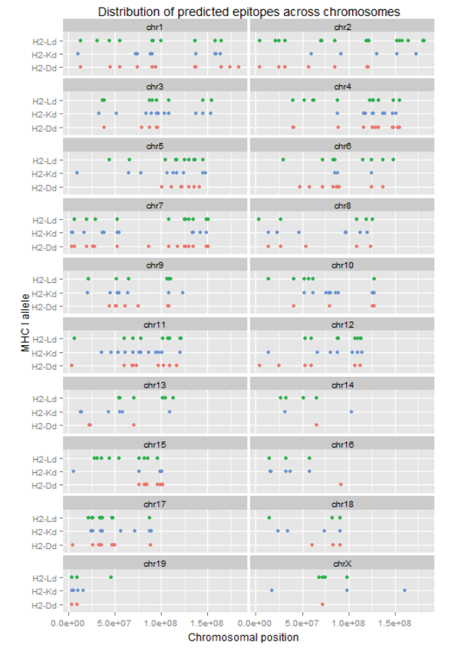
Results on Tumor Data

Slide 18
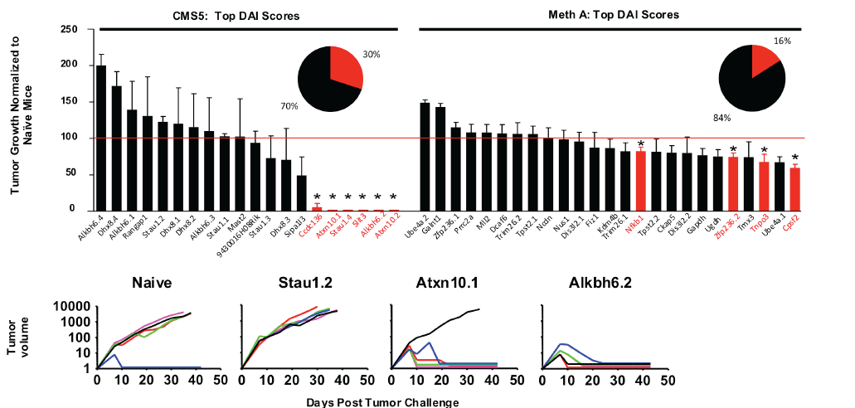
Results on Tumor Data

Slide 19
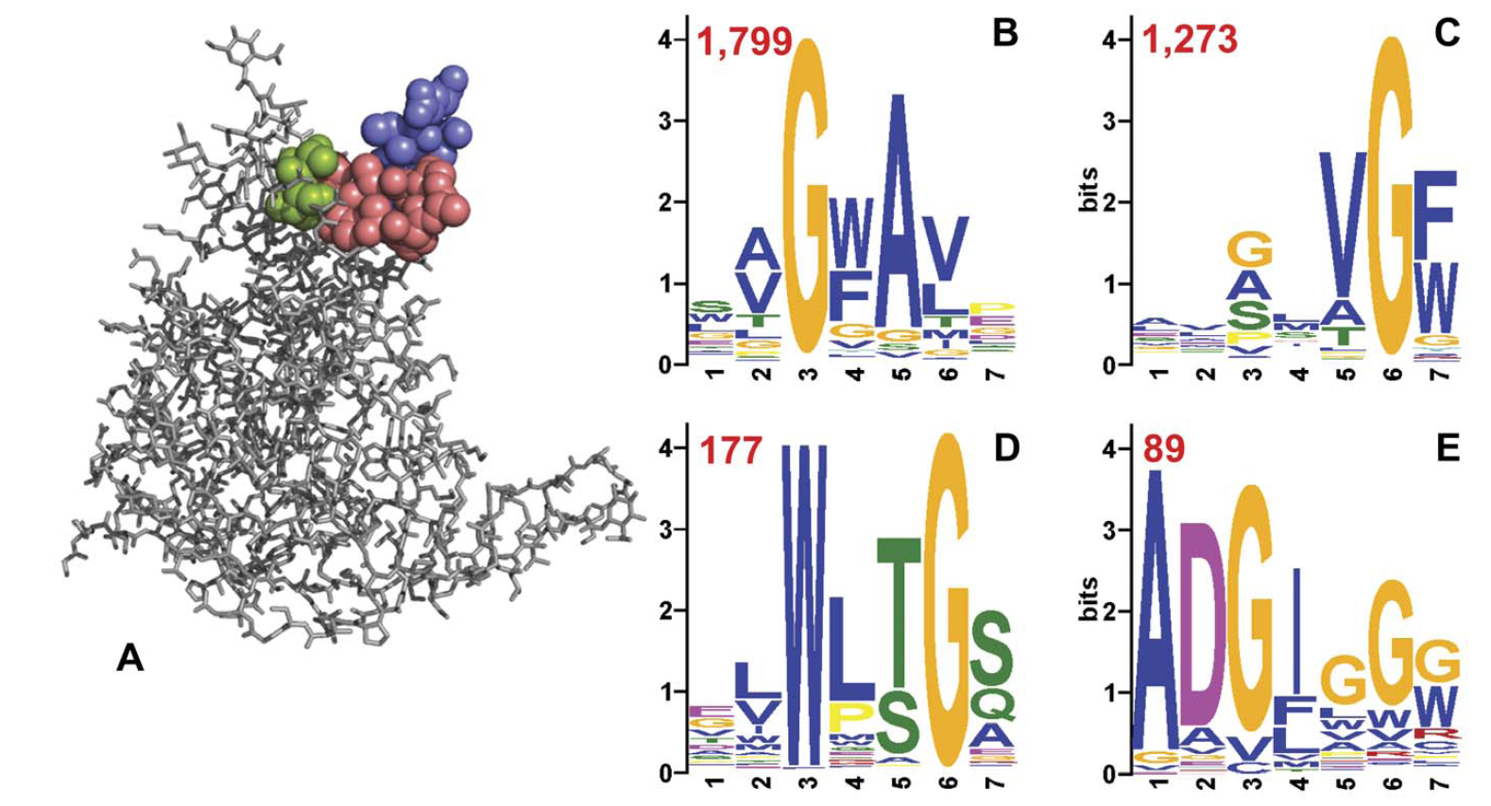
Deep Panning for Early Cancer Detection
http://www.plosone.org/article/info%3Adoi%2F10.1371%2Fjournal.pone.0041469

Slide 20
Deep Panning for Early Cancer Detection
c
N
E
Peptide
E
P
F
K
V
C
D
Q
A
R
D
L
Phage
envelop
F
A
Y
P
R
W
Peptide
coding
sequence
Phage
DNA

Slide 21
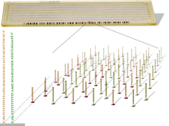
Deep Panning for Early Cancer Detection
Incubation
NextGen Sequencing
Elution of antibody
bound phage
Making DNA library
from phage DNA
Phage library
Amplification
in E.coli
Another round of selection
Generating peptide mimotope
profile of serum antibodies
Serum antibodies

Slide 22
Preliminary Results
Overlap for 5-mer |  | Overlap for 6-mer |  | Overlap for 7-mer
Two different sera | The same serum | Two different sera | The same serum | Two different sera | The same serum
8.3% | 27.6% | 2.9% | 20.7% | 2.6% | 18.8%

Slide 23
Preliminary Results
binomial p=0.03125 |  | Control |  |  |  |  | Cancer
 | peptide | A | B | C | E | H | D | F | G | I | J
7-mer | NAVQTMT | 0 | 0 | 0 | 0 | 0 | 1 | 52 | 1 | 2 | 1
 | GPLYSSL | 0 | 0 | 0 | 0 | 0 | 7 | 1 | 1 | 1 | 1
6-mer | PIYRSE | 0 | 0 | 0 | 0 | 4 | 6 | 625 | 5 | 10 | 13
 | GVEDRL | 0 | 0 | 0 | 0 | 0 | 595 | 11 | 29 | 1 | 4
 | NPLERN | 0 | 0 | 0 | 0 | 0 | 3 | 24 | 1 | 20 | 29
5-mer | GELMT | 0 | 0 | 0 | 1 | 1 | 6 | 56 | 6 | 14 | 23
 | PVEWY | 0 | 0 | 0 | 0 | 0 | 101 | 7 | 5 | 2266 | 11
 | GPVEW | 0 | 0 | 0 | 0 | 0 | 270 | 5 | 5 | 2282 | 11
 | IVHLQ | 0 | 0 | 0 | 0 | 0 | 15 | 5 | 6 | 6 | 4
 | NAIEL | 1 | 0 | 2 | 0 | 9 | 43 | 535 | 14 | 17 | 47

Slide 24
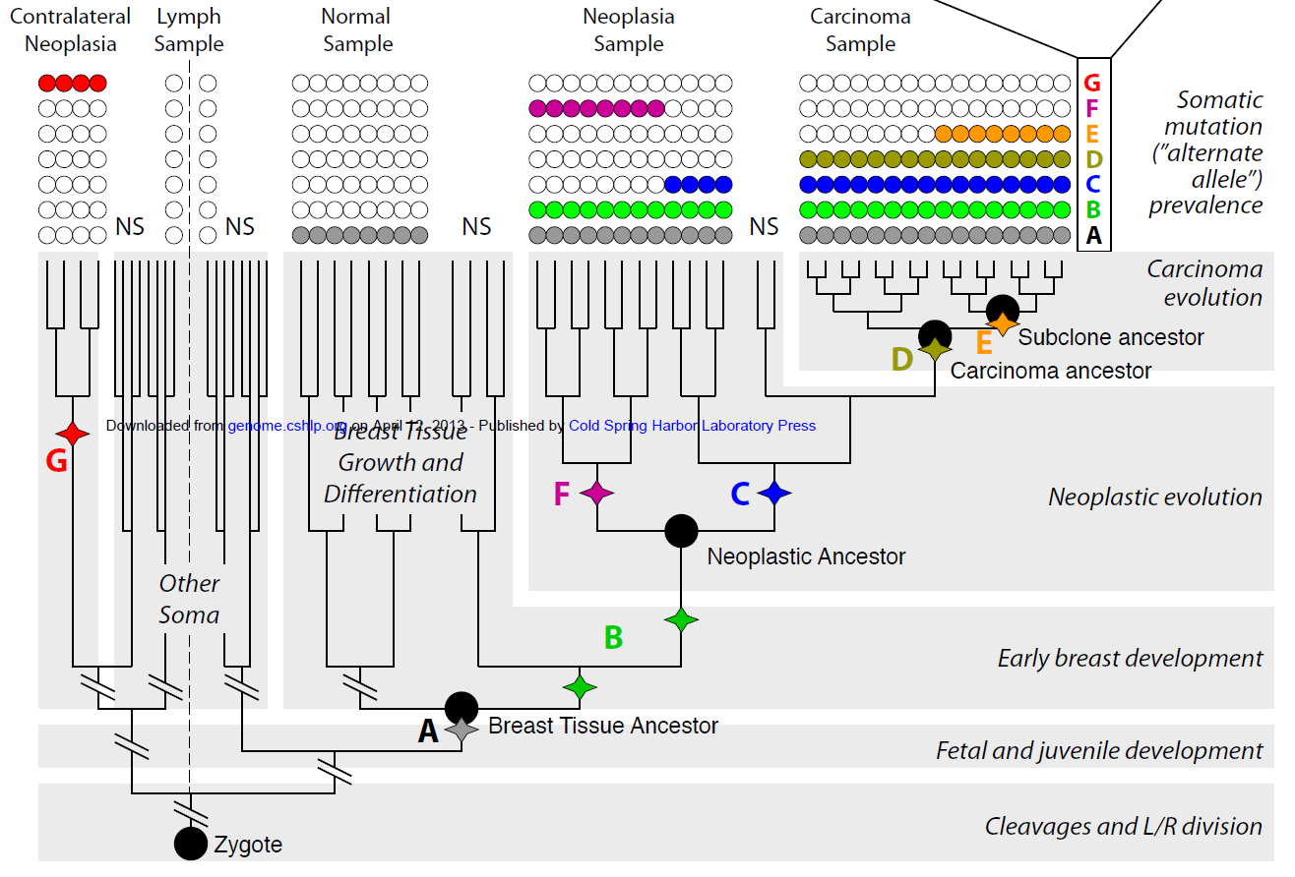
Ongoing Work: Understanding Cancer Evolution
http://genome.cshlp.org/content/early/2013/04/08/gr.151670.112

Slide 25




Acknowledgments
Pramod Srivastava
Duan Fei
Sahar Al Seesi
Jorge Duitama
Ekaterina Nenastyeva
Alexander Zelikovsky
Yurij Ionov

Slide 26





Acknowledgements

Slide 27

Questions?

