Slide 1
Cancer Vaccine Design
Ion Mandoiu
UTC Associate Professor in Engineering Innovation
Department of Computer Science & Engineering

Slide 2
Vaccine Design Criteria
Which Epitopes go into the vaccine?
  High Differential Agretopic Index (DAI)
  High expression
  Diversity across the individual’s HLA alleles
  High cancer clone coverage

Slide 3
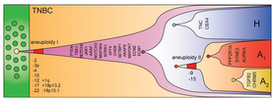
Rational vaccine design requires info on the clonal structure of the tumor
  Not all cells harbor all candidate epitopes
Approaches to clonality analysis
  Computational inference from sequencing depth
  Targeted amplicon sequencing of selected mutations at single cell level

Slide 4
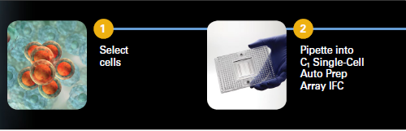
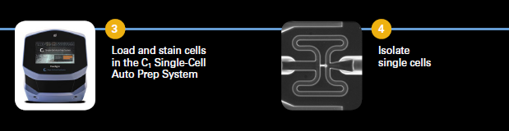
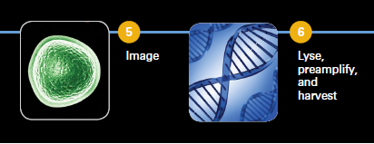
Single-cell capture

Slide 5
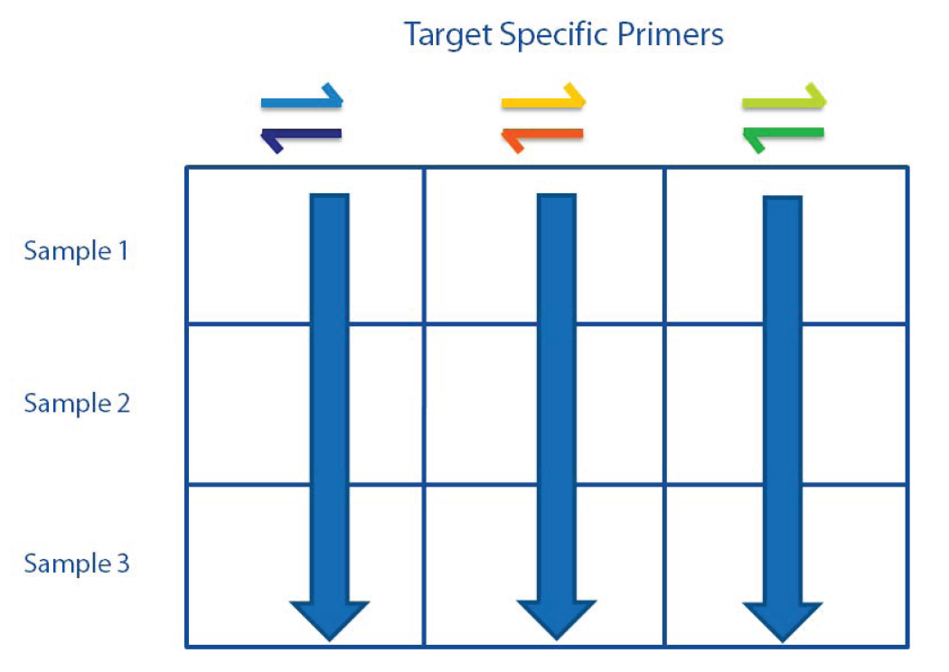
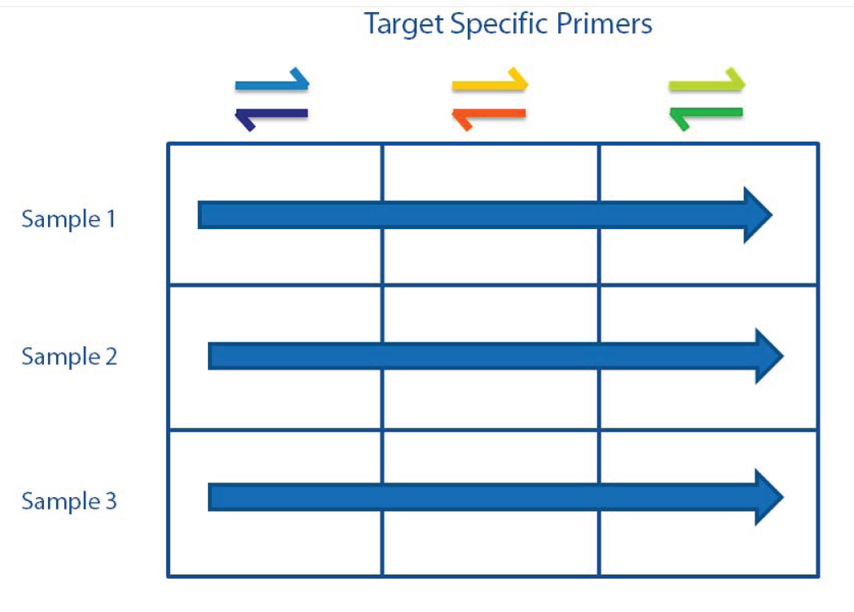
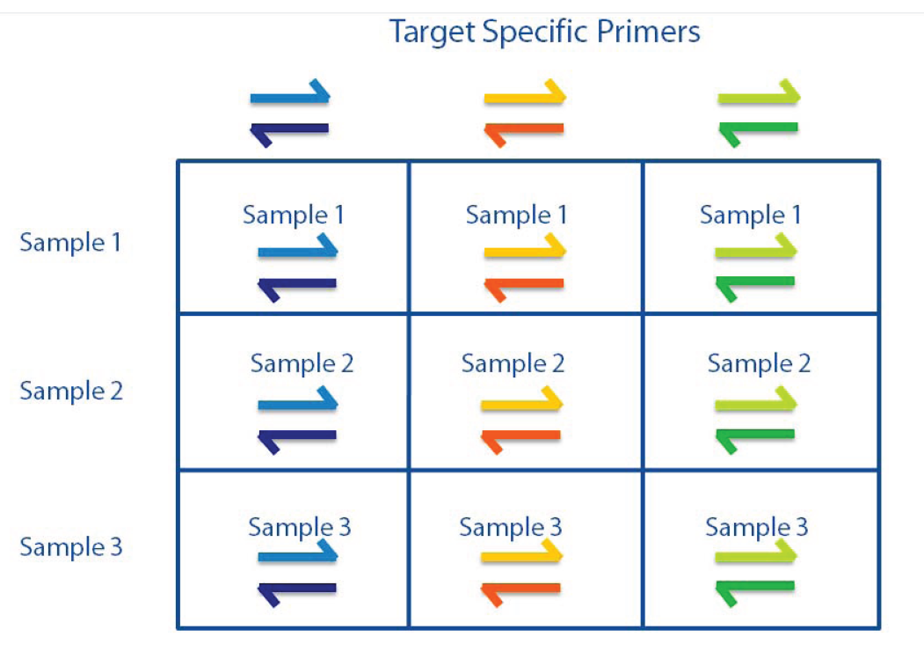
PCR on Access Array

Slide 6
SNV Support Matrix
Cells
SNVs
Low High

Slide 7
Vaccine Design Criteria
Which Epitopes go into the vaccine?
  High Differential Agretopic Index (DAI)
  High expression
  Diversity across the individual’s HLA alleles
  High cancer clone coverage
  Highly immunogenic
    How to monitor immune response?
    How to predict?

Slide 8
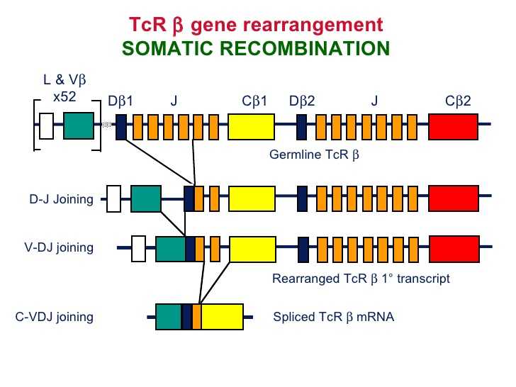
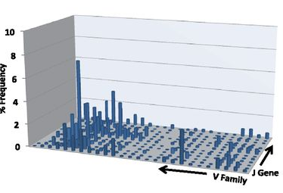
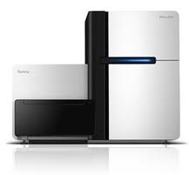
TCR sequencing

Slide 9




Acknowledgements

