Slide 1
Computational methods for genomics-guided immunotherapy
Ion Mandoiu
Computer Science & Engineering Department
University of Connecticut

Slide 2
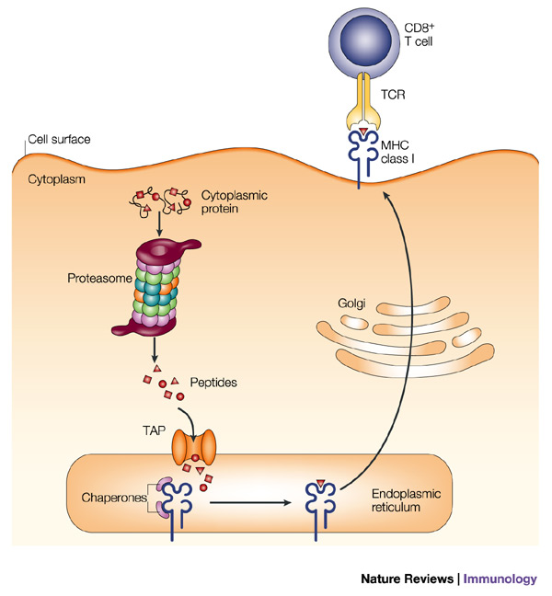
Class I endogenous antigen presentation

Slide 3
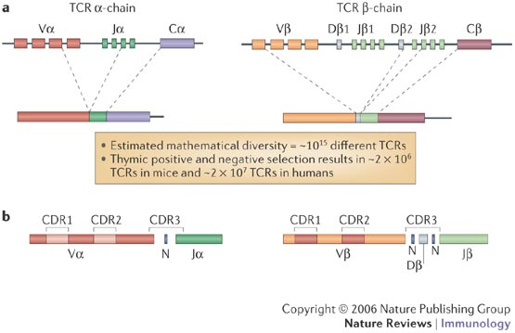
Somatic rearrangement of T-cell receptor genes
Potential TCR repertoire diversity: 10¹⁵

Slide 4
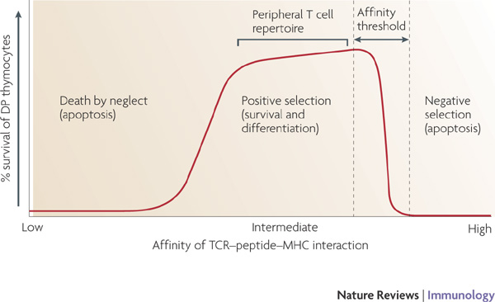
T-cell selection in thymus
Estimated TCR repertoire diversity after selection: ~2x10⁷

Slide 5
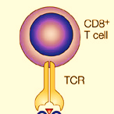
T-cell activation and proliferation

Slide 6
T-cell activation and proliferation

Slide 7
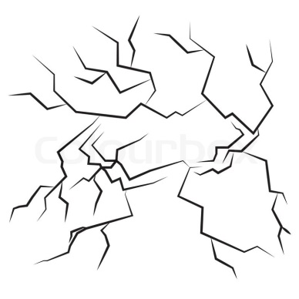
T-cell activation and proliferation

Slide 8
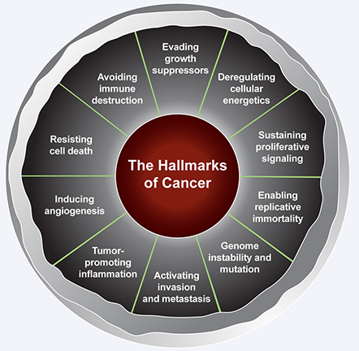
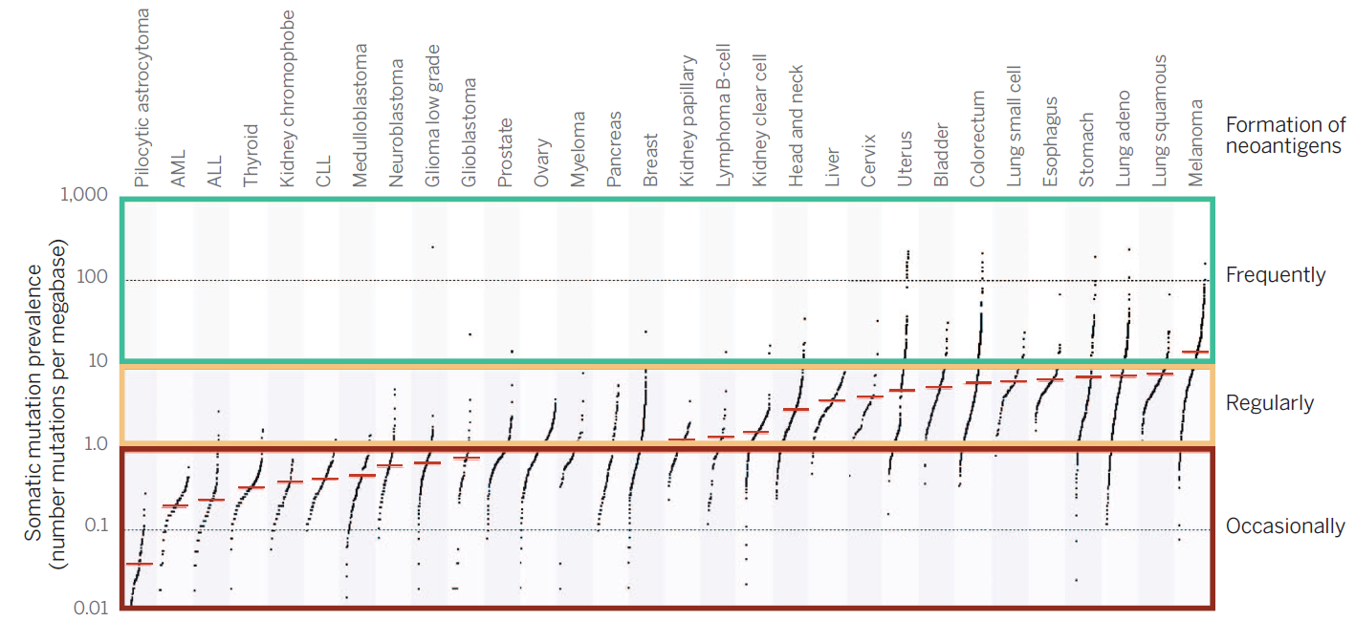
The immune system and cancer

Slide 9

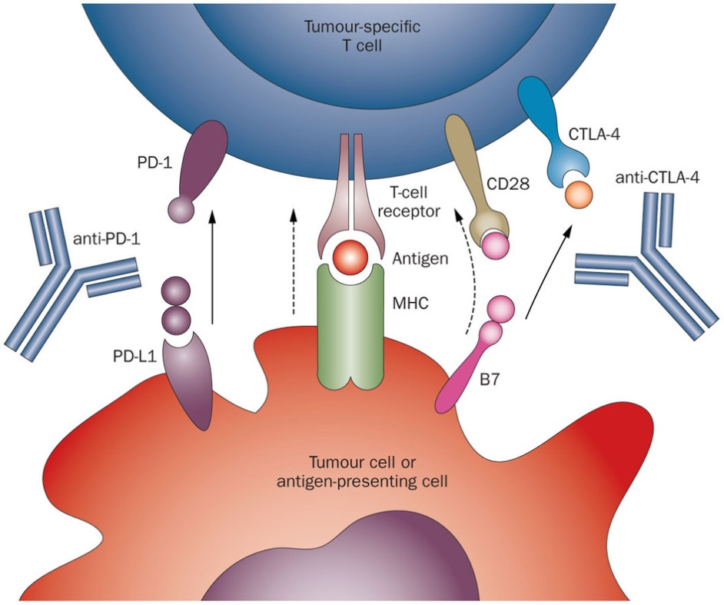
Cutting the brakes: PD1 and CTLA-4 blockade

Slide 10
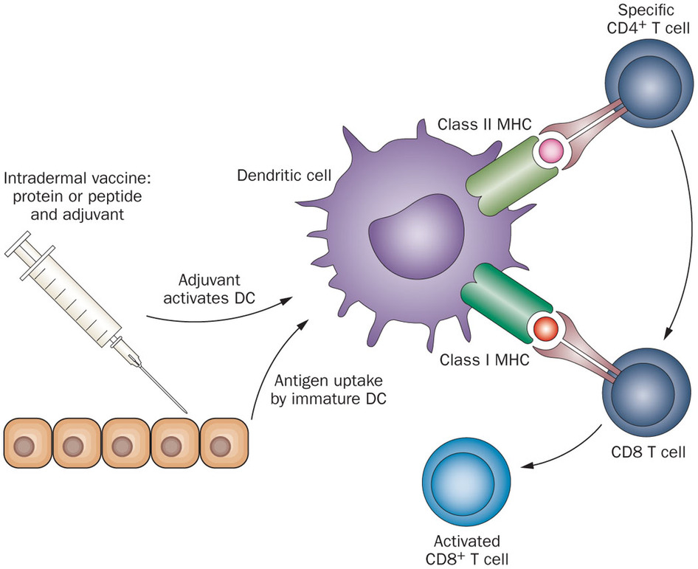
Stepping on the gas: vaccination with neoepitopes

Slide 11
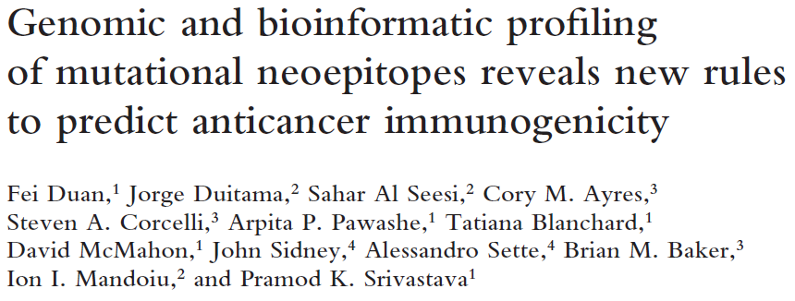
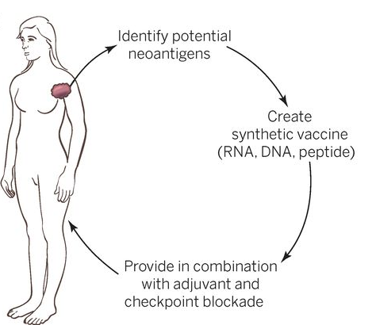
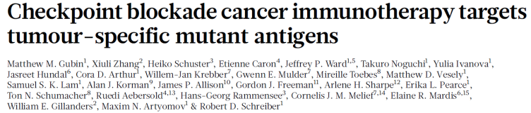
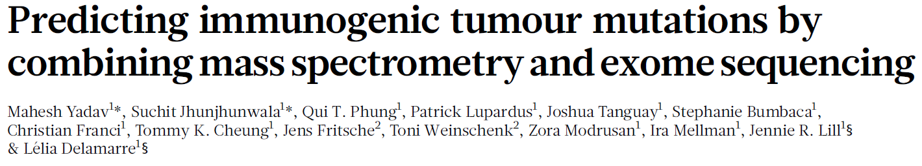
Combined approach
Ton N. Schumacher, and Robert D. Schreiber Science 2015;348:69-74

Slide 12
Sequencing
QC and Mapping
SNV Calling & Phasing
Epitope
Prediction
Vaccine Design
Clonality Analysis
TCR Sequencing

Slide 13

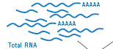
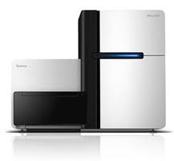

Sequencing
QC and Mapping
SNV Calling & Phasing
Epitope Prediction
Vaccine Design
Clonality Analysis
TCR Sequencing
Tumor DNA
Normal DNA
Tumor RNA
Whole Genome
Library prep
or
Nextera Rapid
Capture Exome
Whole Transcriptome
Library prep
Illumina HiSeq
Sequencing

Slide 14
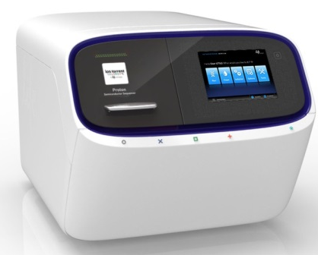
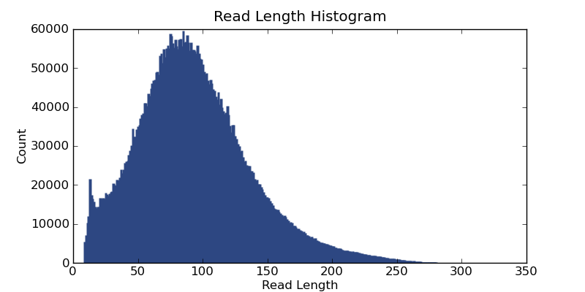
Sequencing
QC and Mapping
SNV Calling & Phasing
Epitope Prediction
Vaccine Design
Clonality Analysis
TCR Sequencing
Tumor DNA
Normal DNA
Tumor RNA
Whole Genome
Library prep
or
Exome
AmpliSeq
Whole Transcriptome
Library prep
Ion Proton
Sequencing

Slide 15
Sequencing
QC and Mapping
SNV Calling & Phasing
Epitope Prediction
Vaccine Design
Clonality Analysis
TCR Sequencing
ION-Torrent Proton Runs: read statistics
 |  | # of reads | # of bases | Mean of reads lengths | std of reads lengths
Melanoma Patient | PB | 25,031,340 | 3,272,787,408 | 130.74 | 66.88
 | 1T | 19,252,932 | 2,589,624,915 | 134.5 | 68.67
 | 2T | 28,400,728 | 4,147,914,801 | 146.04 | 66.91
 | 3T | 26,039,006 | 3,800,446,471 | 145.95 | 67.02
Synthetic Tumor | Normal | 20,726,352 | 3,353,732,704 | 161.81 | 63.35
 | TumorAF10 | 20,726,352 | 3,360,840,809 | 162.15 | 63.14
 | TumorAF20 | 20,726,352 | 3,367,827,877 | 162.49 | 62.92

Slide 16


Sequencing
QC and Mapping
SNV Calling & Phasing
Epitope Prediction
Vaccine Design
Clonality Analysis
TCR Sequencing
Tumor Exome Reads
Human reference
Normal Exome Reads
Human reference
Tumor RNA-Seq Reads

Slide 17
Sequencing
QC and Mapping
SNV Calling & Phasing
Epitope Prediction
Vaccine Design
Clonality Analysis
TCR Sequencing
fastq QC Tools
  Tools to analyze and preprocess fastq files
  FASTX (http://hannonlab.cshl.edu/fastx_toolkit/)
    Charts quality statistics
    Filters sequences based on quality
    Trims sequences based on quality
    Collapses identical sequences into a single sequence

Slide 18
Sequencing
QC and Mapping
SNV Calling & Phasing
Epitope Prediction
Vaccine Design
Clonality Analysis
TCR Sequencing
fastq QC Tools
  Tools to analyze and preprocess fastq files
  PRINSEQ (http://prinseq.sourceforge.net/)
    Generates read length and quality statistics
    Filters reads based on length, quality, GC content and other criteria
    Trims reads based on length/position or quality scores

Slide 19
Sequencing
QC and Mapping
SNV Calling & Phasing
Epitope Prediction
Vaccine Design
Clonality Analysis
TCR Sequencing
Pre-alignment QC
  Trim reads based on base quality scores
  Filter reads below min. length

Slide 20
Sequencing
QC and Mapping
SNV Calling & Phasing
Epitope Prediction
Vaccine Design
Clonality Analysis
TCR Sequencing
Read mapping decisions
  What is the best mapper for your data?
  End-to-end vs. spliced vs local alignments
  Unique vs. non-unique alignments

Slide 21
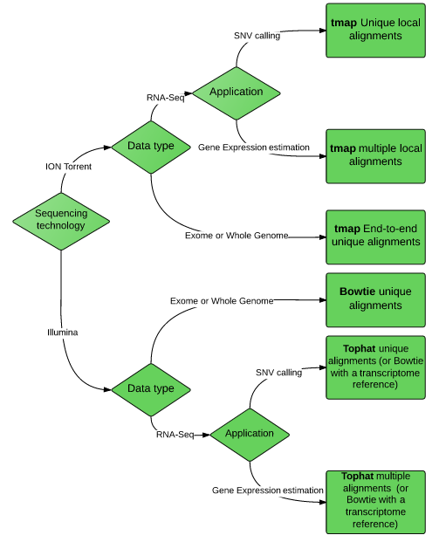
Tumor Exome Reads
Human reference
Normal Exome Reads
Human reference
Tumor RNA-Seq Reads

Slide 22
Sequencing
QC and Mapping
SNV Calling & Phasing
Epitope Prediction
Vaccine Design
Clonality Analysis
TCR Sequencing
ION-Torrent Proton read mapping comparison
 |  | Bowtie2 |  | TMAP |  | Segemehl
 |  | % of aligned bases | Aligned reads length mean | % of aligned bases | Aligned reads length mean | % of aligned bases 2 | Aligned reads length mean2
Melanoma Patient | PB | 89% | 138.8 | 100% | 130.7 | 99% | 135.4
 | 1T | 90% | 143.3 | 100% | 134.5 | 99% | 140.4
 | 2T | 90% | 153.3 | 100% | 146 | 99% | 150.3
 | 3T | 91% | 153.4 | 100% | 146 | 99% | 150.4
Synthetic Tumor | Normal | 89% | 172.89 | 100% | 161.81 | 98% | 167.66
 | Tumor_AF10 | 89% | 173.03 | 100% | 162.15 | 99% | 167.87
 | Tumor_AF20 | 89% | 173.17 | 100% | 162.49 | 99% | 168.08

Slide 23
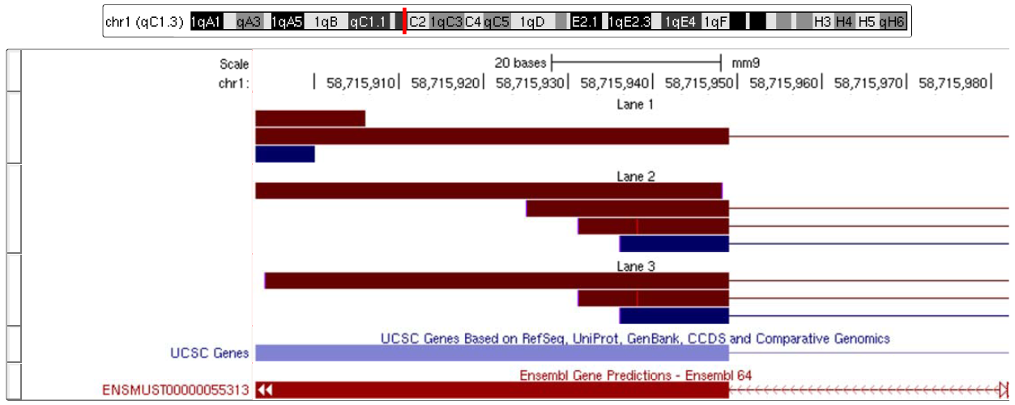
Sequencing
QC and Mapping
SNV Calling & Phasing
Epitope Prediction
Vaccine Design
Clonality Analysis
TCR Sequencing
Post-alignment QC
  Remove duplicate read sequences (likely PCR artifacts)

Slide 24
Sequencing
QC and Mapping
SNV Calling & Phasing
Epitope Prediction
Vaccine Design
Clonality Analysis
TCR Sequencing
Post-alignment QC
  Remove duplicate read sequences (likely PCR artifacts)
  Trimming based on mismatch statistics

Slide 25
Sequencing
QC and Mapping
SNV Calling & Phasing
Epitope Prediction
Vaccine Design
Clonality Analysis
TCR Sequencing
Tumor Exome Reads
*
*
*
*
*
*
Human Reference
*
*
Normal Exome Reads

Slide 26
Sequencing
QC and Mapping
SNV Calling & Phasing
Epitope Prediction
Vaccine Design
Clonality Analysis
TCR Sequencing
Somatic Variant Callers
Mutect (Broad Inst.)
VarScan2 (Wash. U.)
SomaticSniper (Wash. U)
Strelka (Illumina)
SNVQ w/ subtraction (UConn)

Slide 27
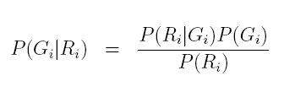


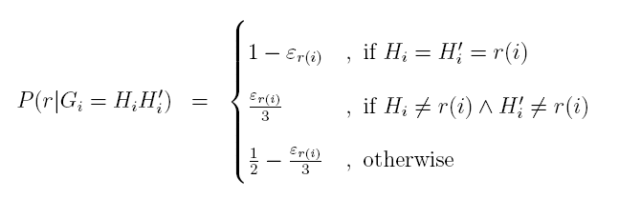
Sequencing
QC and Mapping
SNV Calling & Phasing
Epitope Prediction
Vaccine Design
Clonality Analysis
TCR Sequencing
SNVQ model [Duitama et al. 2012]

Slide 28
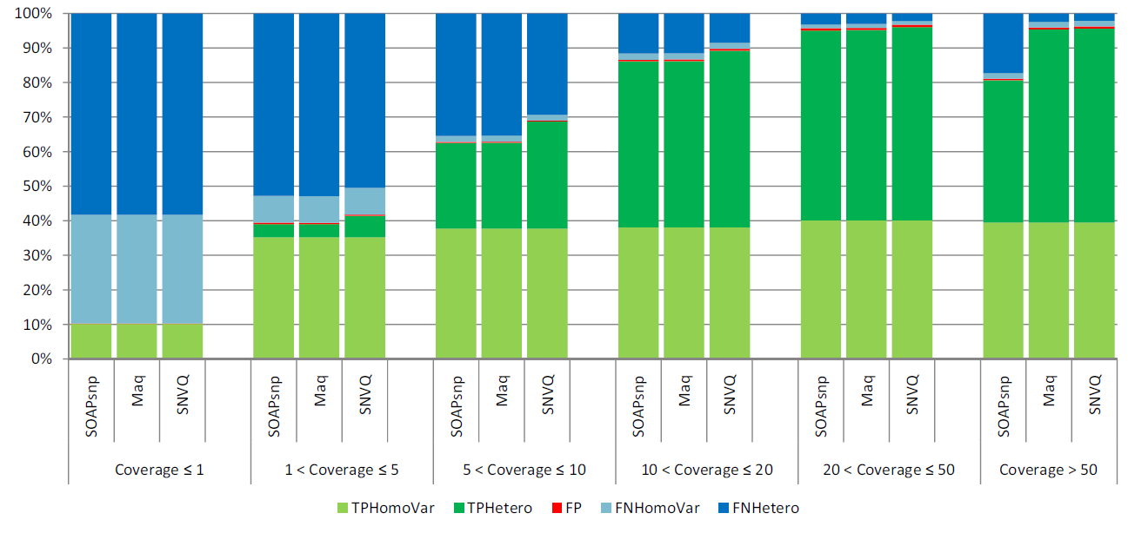
Sequencing
QC and Mapping
SNV Calling & Phasing
Epitope Prediction
Vaccine Design
Clonality Analysis
TCR Sequencing
Accuracy as Function of Coverage

Slide 29
Sequencing
QC and Mapping
SNV Calling & Phasing
Epitope Prediction
Vaccine Design
Clonality Analysis
TCR Sequencing
Coverage distribution of exome vs. SNV calls

Slide 30
Sequencing
QC and Mapping
SNV Calling & Phasing
Epitope Prediction
Vaccine Design
Clonality Analysis
TCR Sequencing
Comparing Somatic Variant Callers
Synthetic Tumors
  ION Torrent Proton exome sequencing of two 1K Genomes individual (mutations known)
  Downloaded from the public Torrent server
  Both exomes were sequenced on the same Proton chip
  Subset of the NA19240 sample was used as the normal sample
  Mixtures of NA19240 and NA12878 samples were used as the tumor samples
  Reads were mixed in different proportions to simulate allelic fractions, 0.1, 0.2, 0.3, 0.4 and 0.5.

Slide 31
Sequencing
QC and Mapping
SNV Calling & Phasing
Epitope Prediction
Vaccine Design
Clonality Analysis
TCR Sequencing
Comparing Somatic Variant Callers

Slide 32
Sequencing
QC and Mapping
SNV Calling & Phasing
Epitope Prediction
Vaccine Design
Clonality Analysis
TCR Sequencing
Comparing Somatic Variant Callers

Slide 33


Sequencing
QC and Mapping
SNV Calling & Phasing
Epitope Prediction
Vaccine Design
Clonality Analysis
TCR Sequencing
The ICGC-TCGA DREAM Somatic Mutation Calling Challenge
Challenge 1: 10 Real Tumor/Normal pairs
  5 from pancreatic tumors and 5 from prostate tumors
  Sequenced to avg. depth 50x/30x
Up to 10K candidate SNVs will be validated by targeted resequencing

Slide 34
Sequencing
QC and Mapping
SNV Calling & Phasing
Epitope Prediction
Vaccine Design
Clonality Analysis
TCR Sequencing
  For epitope prediction we need phase of nearby SNVs
    RefHap algorithm [Duitama et al. 2010]
Reduce the problem to Max-Cut
Solve Max-Cut
Build haplotypes according with the cut
Locus | 1 | 2 | 3 | 4 | 5
f₁ | * | 0 | 1 | 1 | 0
f₂ | 1 | 1 | 0 | * | 1
f₃ | 1 | * | * | 0 | *
f₄ | * | 0 | 0 | * | 1
f₄
1
-1
3
f₁
f₂
1
-1
f₃
h₁ 00110
h₂ 11001

Slide 35
Sequencing
QC and Mapping
SNV Calling & Phasing
Epitope Prediction
Vaccine Design
Clonality Analysis
TCR Sequencing
Selection criteria:
  Gene harboring the SNV must be expressed (IsoEM)
  Mutated peptides must cleaved by the proteasome (NetChop)
  Mutated peptides must bind to MHC (NetMHC)
Notes:
>example
KYMDQLHRYTKLSYlVVFPLELRLFNTSG

Slide 36
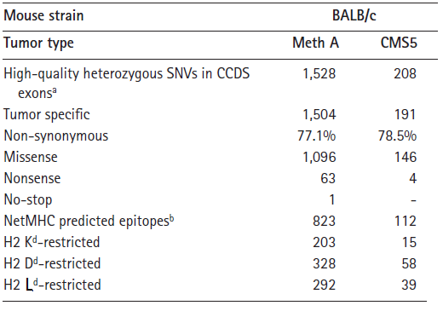
Sequencing
QC and Mapping
SNV Calling & Phasing
Epitope Prediction
Vaccine Design
Clonality Analysis
TCR Sequencing
Candidate neo-epitopes statistics for two mouse cell lines
Duan et al., JEM 2014

Slide 37
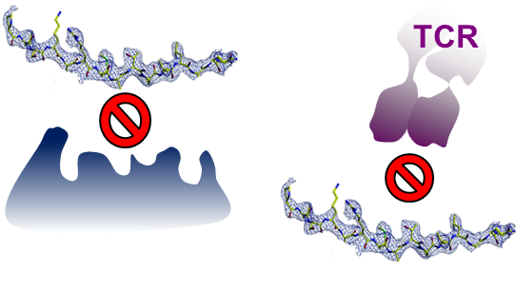
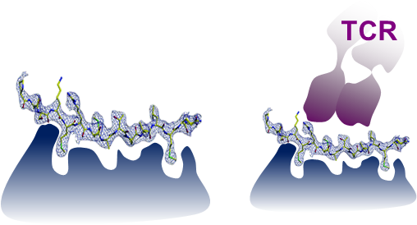
Sequencing
QC and Mapping
SNV Calling & Phasing
Epitope Prediction
Vaccine Design
Clonality Analysis
TCR Sequencing
Common dogma: higher MHC binding affinity, higher T-cell response
No MHC binding
no T-cell activation
Higher MHC binding
more T-cell activation

Slide 38
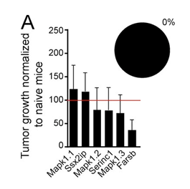
Sequencing
QC and Mapping
SNV Calling & Phasing
Epitope Prediction
Vaccine Design
Clonality Analysis
TCR Sequencing
NetMHC score is NOT a predictor of tumor immunity
Top score
Duan et al., JEM 2014

Slide 39
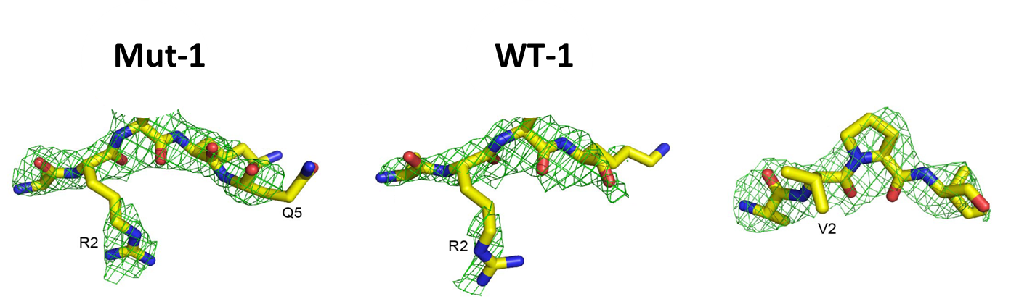
Sequencing
QC and Mapping
SNV Calling & Phasing
Epitope Prediction
Vaccine Design
Clonality Analysis
TCR Sequencing
T-cells are trained to see the difference
Low DAI score = similar peptides
High DAI score = different peptides
Mut 1
WT 1
Mut 2
WT 2
Differential Agretopic Index(DAI) = Score_{mut}-Score_{WT}
Duan et al., JEM 2014

Slide 40
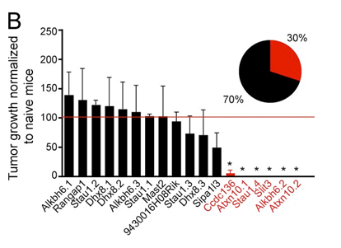
Sequencing
QC and Mapping
SNV Calling & Phasing
Epitope Prediction
Vaccine Design
Clonality Analysis
TCR Sequencing
Top score
Top DAI score
Duan et al., JEM 2014

Slide 41
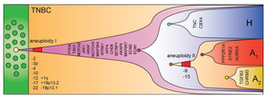
Sequencing
QC and Mapping
SNV Calling & Phasing
Epitope Prediction
Vaccine Design
Clonality Analysis
TCR Sequencing
Rational vaccine design requires info on the clonal structure of the tumor
  Not all cells harbor all candidate epitopes
Approaches to clonality analysis
  Computational inference from sequencing depth
  Targeted amplicon sequencing of selected mutations at single cell level

Slide 42
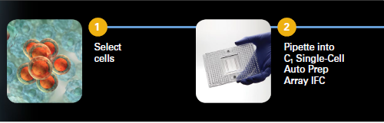
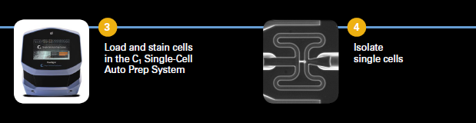
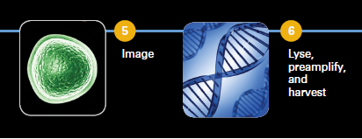
Cell capture
Sequencing
QC and Mapping
SNV Calling & Phasing
Epitope Prediction
Vaccine Design
Clonality Analysis
TCR Sequencing

Slide 43
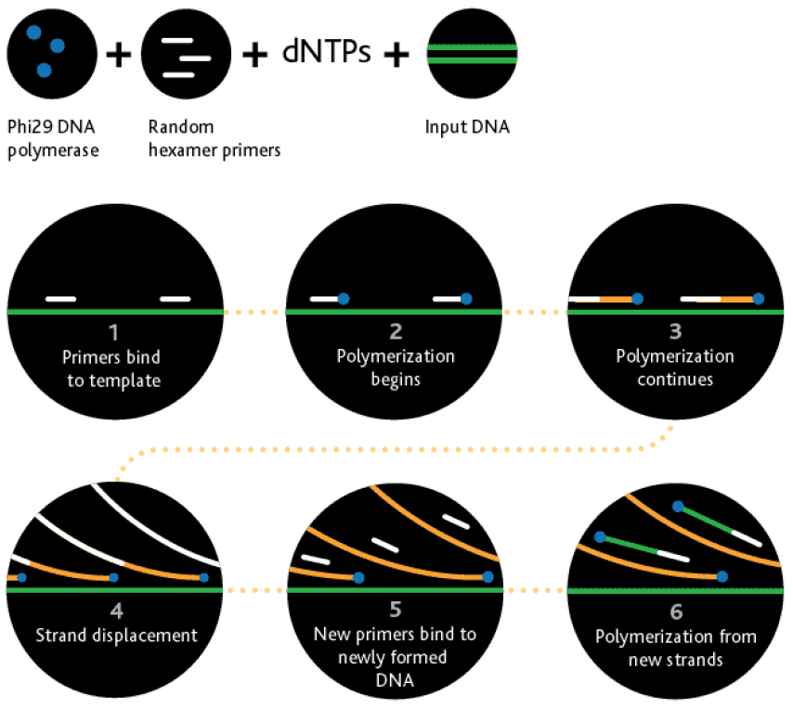
Pre-amplification
Sequencing
QC and Mapping
SNV Calling & Phasing
Epitope Prediction
Vaccine Design
Clonality Analysis
TCR Sequencing

Slide 44
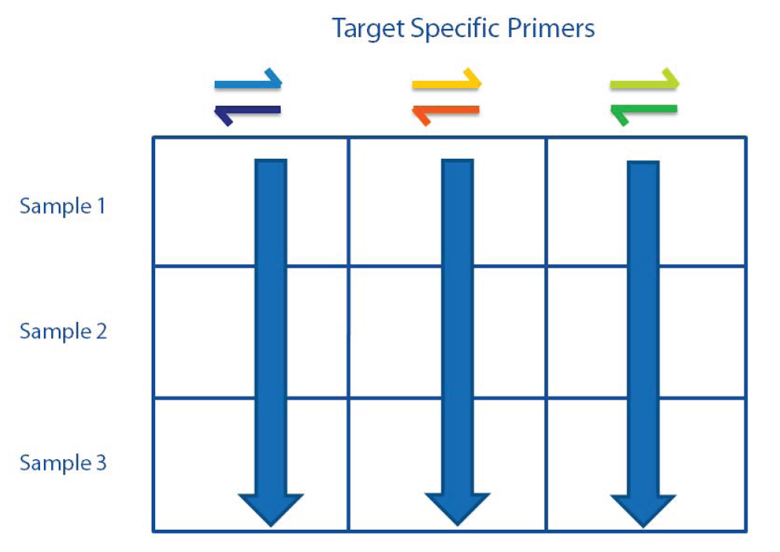
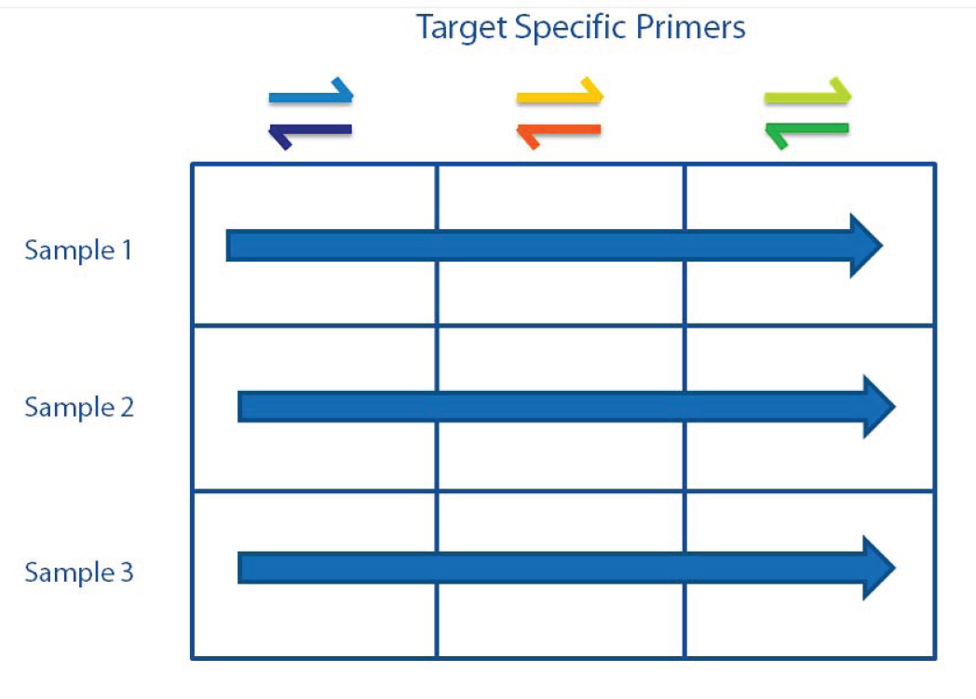
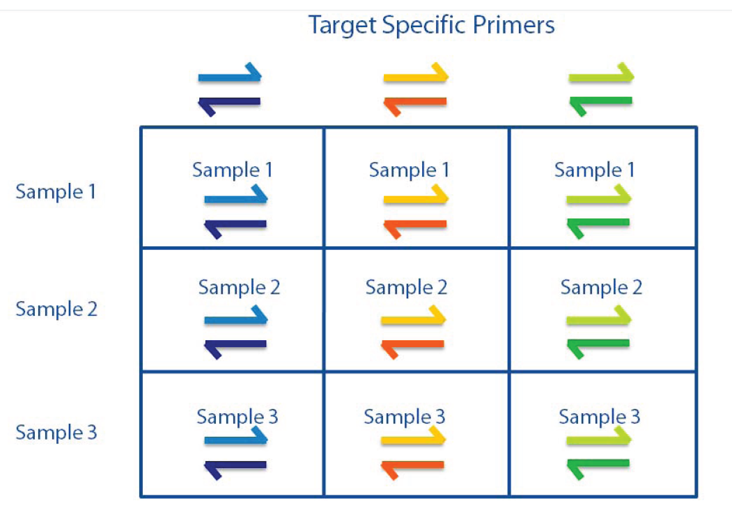
PCR on Access Array
Sequencing
QC and Mapping
SNV Calling & Phasing
Epitope Prediction
Vaccine Design
Clonality Analysis
TCR Sequencing

Slide 45
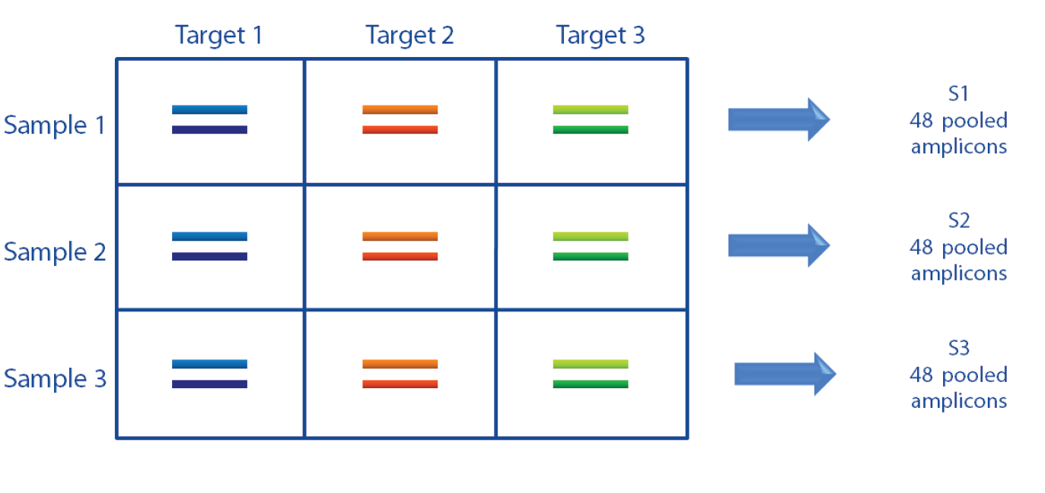
PCR on Access Array
Sequencing
QC and Mapping
SNV Calling & Phasing
Epitope Prediction
Vaccine Design
Clonality Analysis
TCR Sequencing

Slide 46
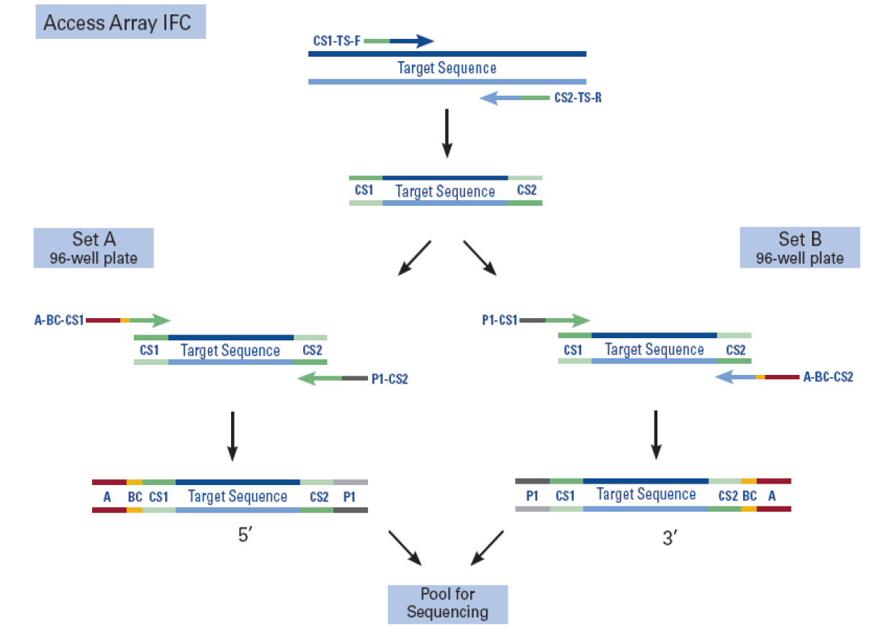
Bidirectional amplicon tagging
Sequencing
QC and Mapping
SNV Calling & Phasing
Epitope Prediction
Vaccine Design
Clonality Analysis
TCR Sequencing

Slide 47
Captured cells in pilot run
Sequencing
QC and Mapping
SNV Calling & Phasing
Epitope Prediction
Vaccine Design
Clonality Analysis
TCR Sequencing
 | 1 | 2 | 3 | 4 | 5 | 6 | 7 | 8 | 9 | 10 | 11 | 12
A | 1_C03 | 1_C02 | 1_C01 | 1_C49 | 1_C50 | 1_C51 | 1_C06 | 3_C05 | 1_C04 | 1_C52 | 1_C53 | 1_C54
B | 2_C09 | 1_C08 | 1_C07 | 1_C55 | 1_C56 | 1_C57 | 1_C12 | 1_C11 | 1_C10 | 1_C58 | 1_C59 | 1_C60
C | 1_C15 | 2_C14 | 2_C13 | 1_C61 | 1_C62 | 1_C63 | 1_C18 | 2_C17 | 1_C16 | 1_C64 | 1_C65 | 1_C66
D | 1_C21 | 2_C20 | 1_C19 | 1_C67 | 1_C68 | 1_C69 | 2_C24 | 2_C23 | 4_C22 | 1_C70 | 1_C71 | 1_C72
E | bulk | 2_C26 | 1_C27 | 1_C75 | 1_C74 | 1_C73 | 0_C28 | 0_C29 | 0_C30 | 1_C78 | 1_C77 | 2_C76
F | 1_C31 | 0_C32 | 1_C33 | 1_C81 | 1_C80 | 1_C79 | 0_C34 | 1_C35 | 0_C36 | 1_C84 | 0_C83 | 1_C82
G | 0_C37 | 1_C38 | 0_C39 | 1_C87 | 1_C86 | 1_C85 | 1_C40 | 1_C41 | 1_C42 | 1_C90 | 1_C89 | 1_C88
H | 1_C43 | 1_C44 | 1_C45 | 1_C93 | 1_C92 | 1_C91 | 1_C46 | 1_C47 | 1_C48 | 1_C96 | 1_C95 | 1_C94

Slide 48
Read processing pipeline
Sequencing
QC and Mapping
SNV Calling & Phasing
Epitope Prediction
Vaccine Design
Clonality Analysis
TCR Sequencing
Barcode list
Fastx Barcode Splitter
96 fastq files: one per well
pooled fastq file
tmap
96 sam files: one per well
mm9 BALBc genome
Generate Referece
fasta with +/- 300 bases around each SNV
List of SNV Locations
compute coverage
96x48 with total and fwd/rev variant coverage for each well/SNV

Slide 49
Target Aligned Reads
Sequencing
QC and Mapping
SNV Calling & Phasing
Epitope Prediction
Vaccine Design
Clonality Analysis
TCR Sequencing

Slide 50
Per SNV Coverage
Sequencing
QC and Mapping
SNV Calling & Phasing
Epitope Prediction
Vaccine Design
Clonality Analysis
TCR Sequencing

Slide 51
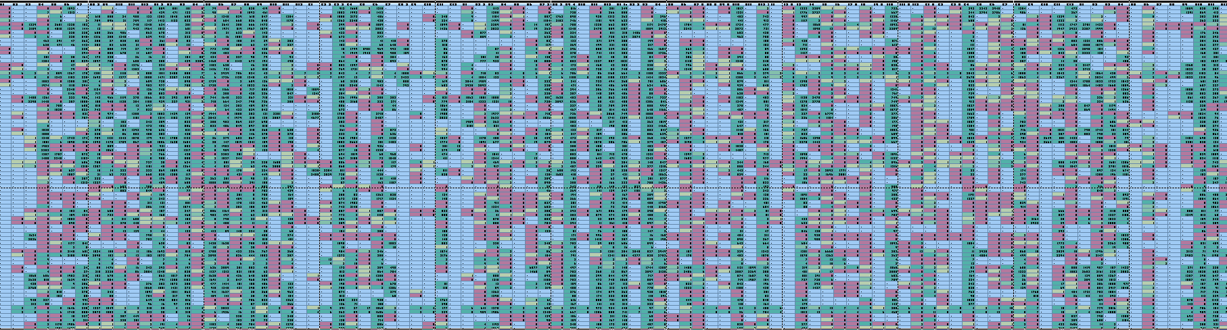
Sequencing
QC and Mapping
SNV Calling & Phasing
Epitope Prediction
Vaccine Design
Clonality Analysis
TCR Sequencing
SNV Support Matrix
Cells
SNVs

Slide 52
Sequencing
QC and Mapping
SNV Calling & Phasing
Epitope Prediction
Vaccine Design
Clonality Analysis
TCR Sequencing
Which Epitopes go into the vaccine?
  High Differential Agretopic Index (DAI)
  High expression
  High (expected) clone coverage
  Diversity across the individual’s HLA alleles
  High peptide-MHC rigidity

Slide 53
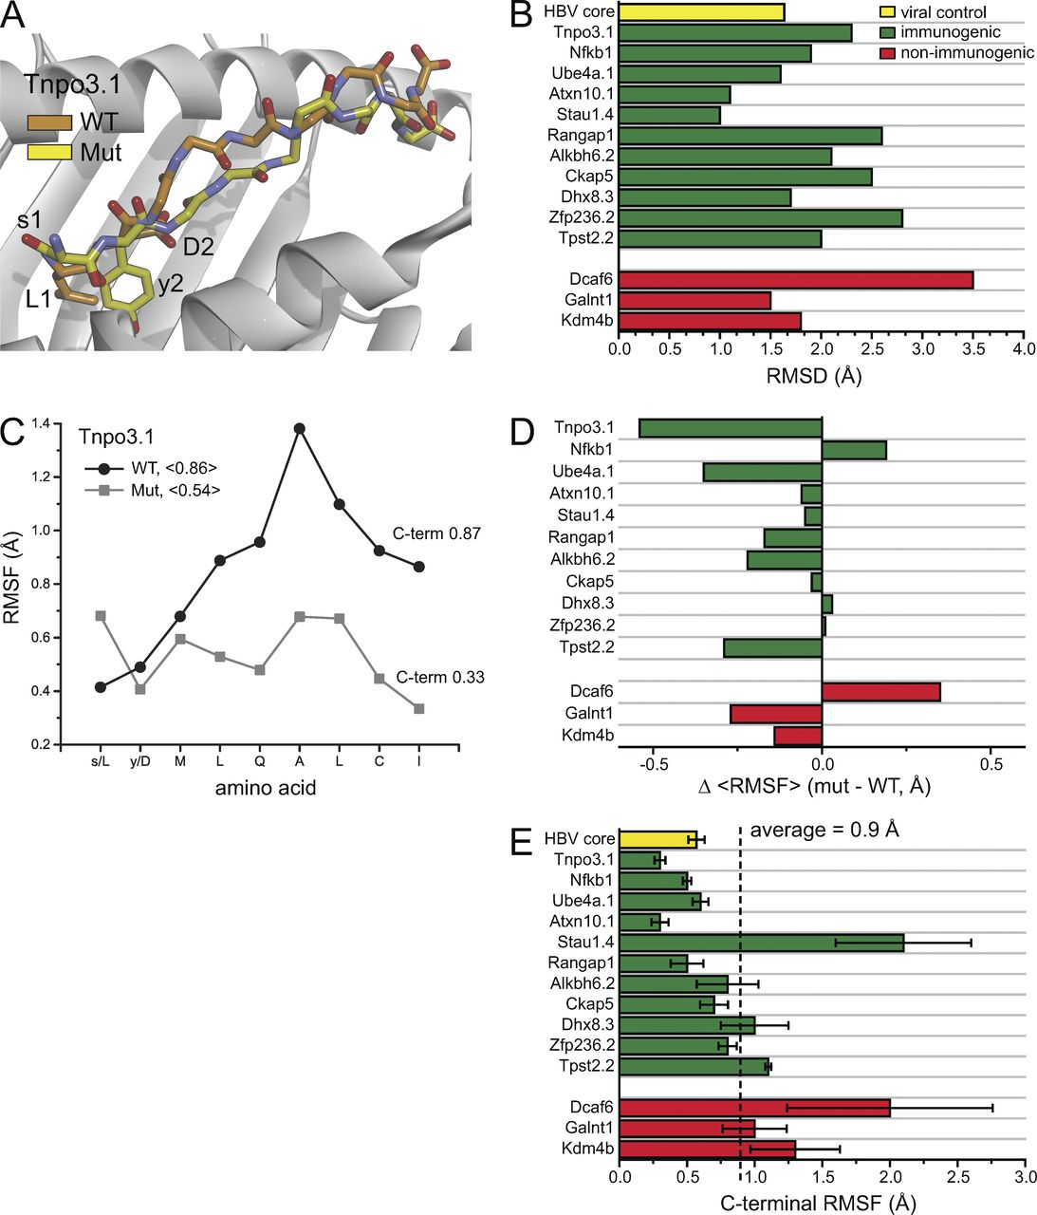
Sequencing
QC and Mapping
SNV Calling & Phasing
Epitope Prediction
Vaccine Design
Clonality Analysis
TCR Sequencing
Peptide rigidity correlates with immune response
Duan et al., JEM 2014

Slide 54
Sequencing
QC and Mapping
SNV Calling & Phasing
Epitope Prediction
Vaccine Design
Clonality Analysis
TCR Sequencing
Which Epitopes go into the vaccine?
  High Differential Agretopic Index (DAI)
  High expression
  High (expected) clone coverage
  Diversity across the individual’s HLA alleles
  High peptide-MHC rigidity
  High cognate TCR precursor frequency

Slide 55
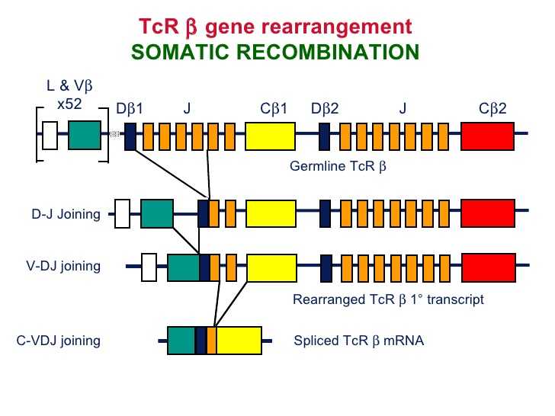
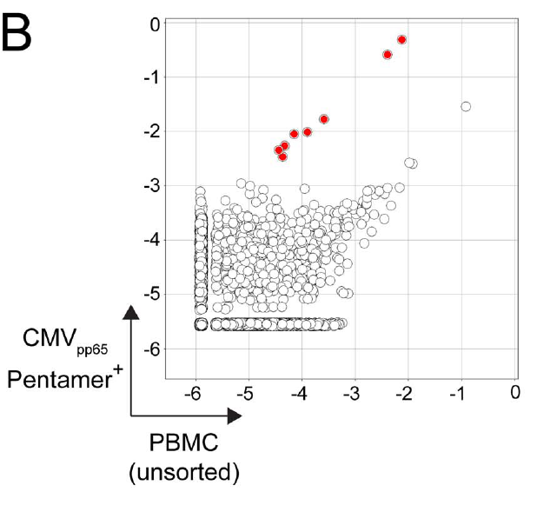
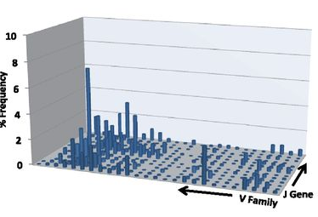
Sequencing
QC and Mapping
Calling SNVs
Epitope Prediction
Vaccine Design
Clonality Analysis
TCR Sequencing
Klinger et al. 2013

Slide 56
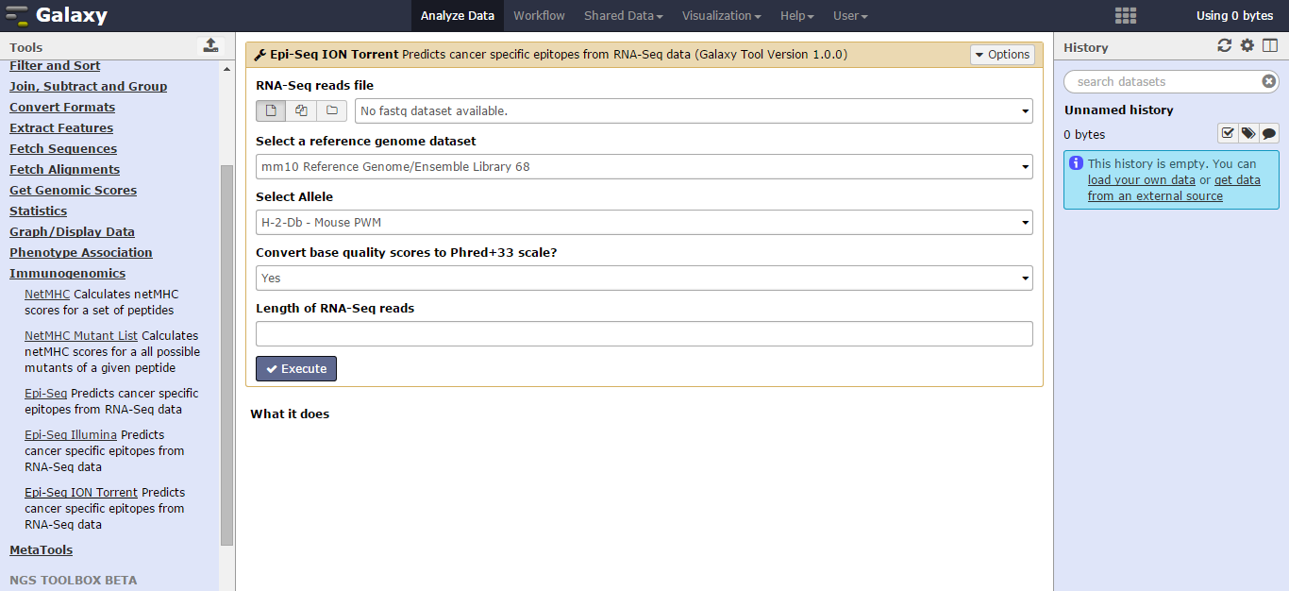
Galaxy implementation

Slide 57
Ongoing Work
Detecting other forms of variation: indels, gene fusions, novel splicing isoforms
Integration of mass-spectrometry data
Modeling TCR precursor frequencies

Slide 58








Acknowledgements
Cory Ayres
Steven Corcelli
Brian M. Baker
Jorge Duitama
Sahar Al Seesi
Anas Al-Okaily
Gabriel Ilie
Marius Nicolae
Fei Duan
Arpita Pawashe
Tatiana Blanchard
David McMahon
Pramod Srivastava
John Sidney Alessandro Sette

