Slide 1
Computational methods for genomics-guided cancer immunotherapy
Ion Mandoiu
Computer Science & Engineering Department
University of Connecticut

Slide 2
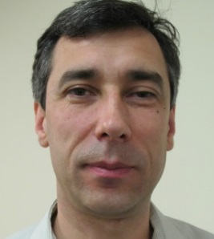
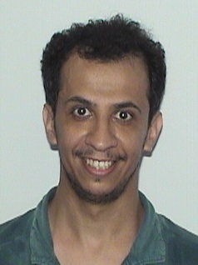
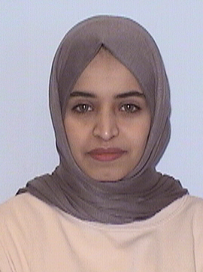
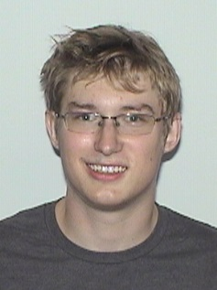
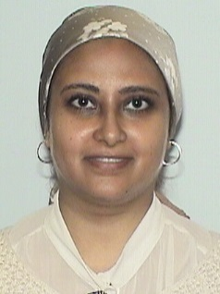
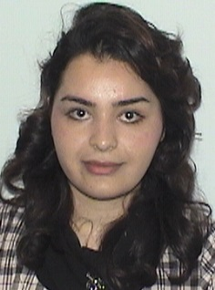

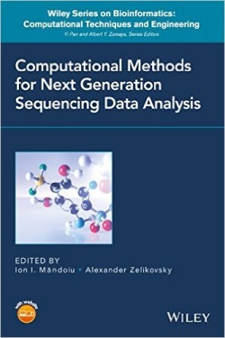



Mandoiu Lab
Principal Investigator
  Ion Mandoiu, Professor of Computer Science & Engineering
PhD Students
  Fahad Alqahtani
  Maha Asiri
  Jordan Force
  Marmar Moussa
  Elham Sherafat
Research Areas:
Bioinformatics Algorithms
Computational Methods for Next-Gen Sequencing Data Analysis
http://dna.engr.uconn.edu
ion@engr.uconn.edu, 860-486-3784

Slide 3
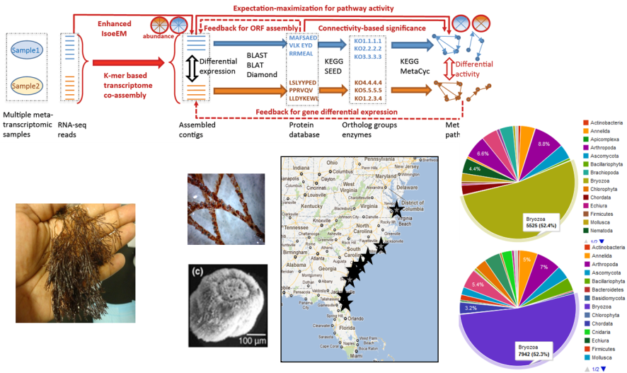
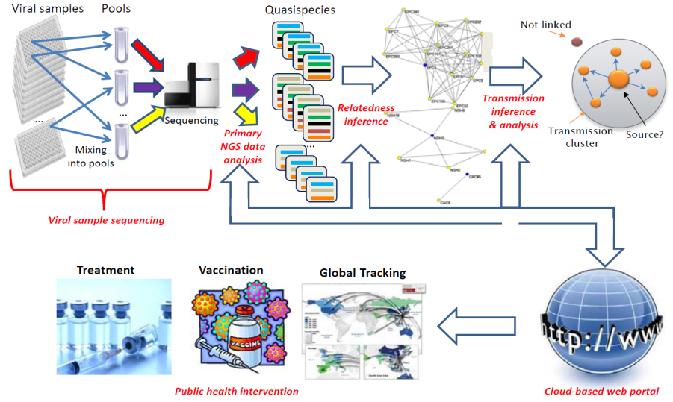
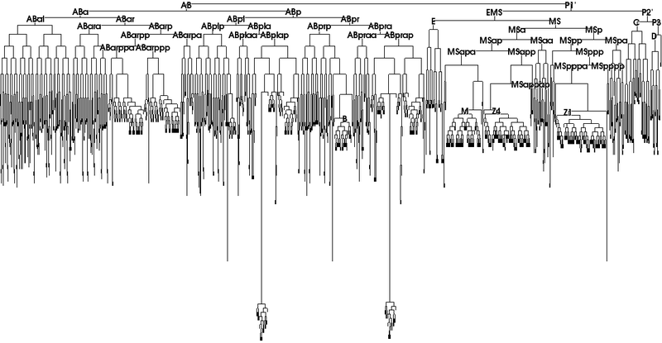
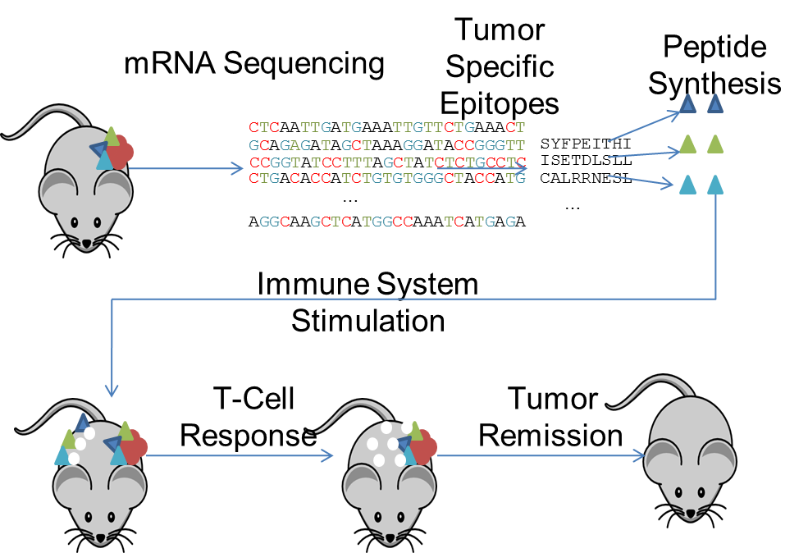
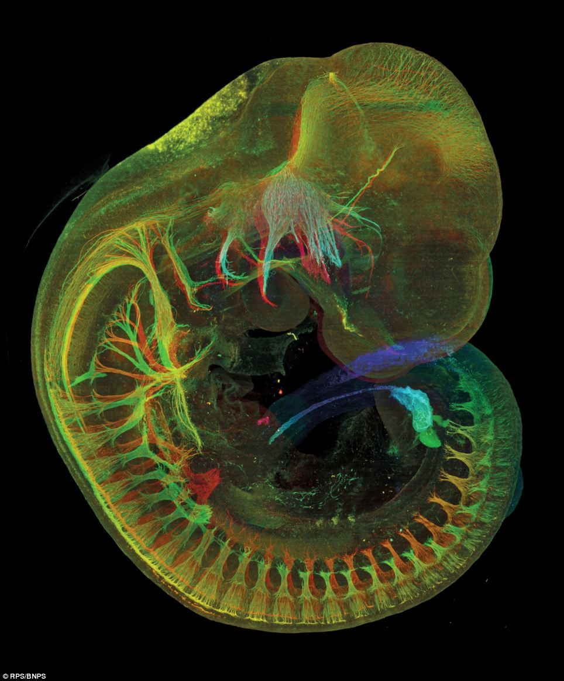
Ongoing Projects
Metatranscriptomics
Transmission Networks
Mouse Cell Lineage
Genomics-Guided Cancer Immunotherapy

Slide 4
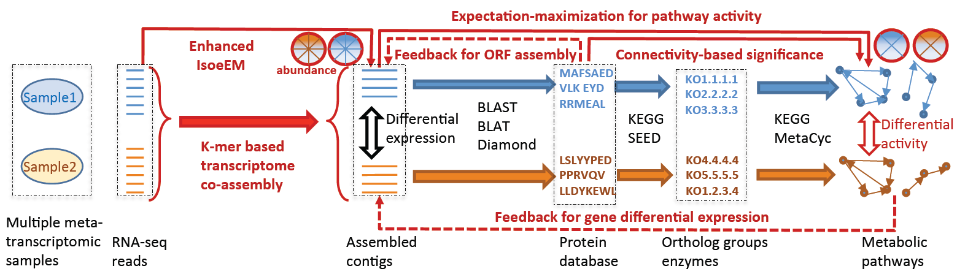
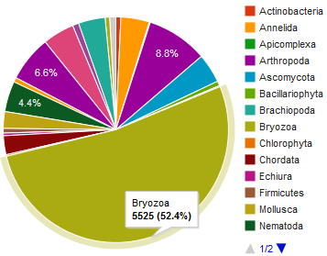
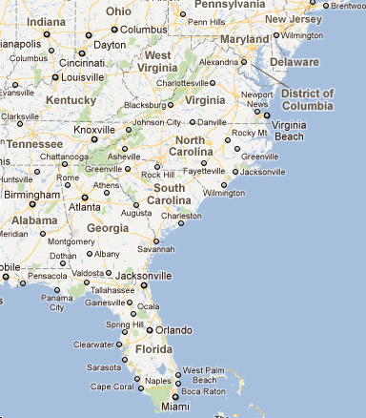
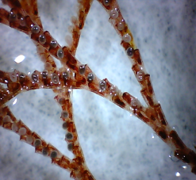
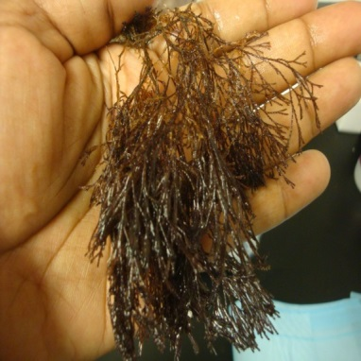
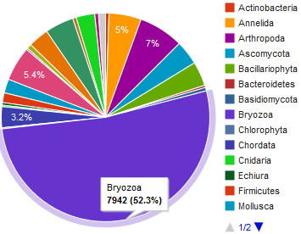
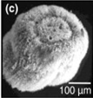
Ongoing Projects: Metatranscriptomics
Collaborators: F. Stewart and N. Lopanik (Gatech), A. Zelikovsky (GSU), M.A. Amalaradjou (Uconn)

Slide 5

Ongoing Projects: Transmission Networks
Collaborators: M. Bansal (Uconn), A. Zelikovsky and P. Skums (GSU), Y. Khudyakov (CDC)

Slide 6
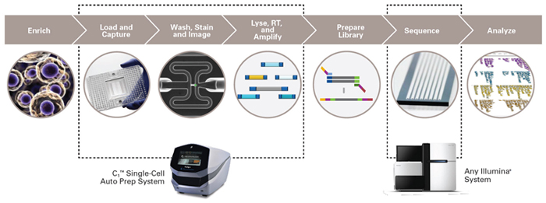
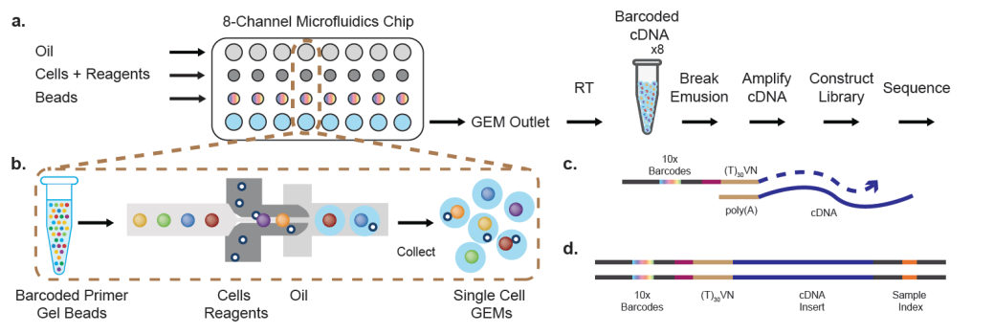
Ongoing Projects: Mouse Cell Lineage
Collaborators: C.E. Nelson, A. Jackson, A. Nishiyama, D. Goldhamer (Uconn)

Slide 7
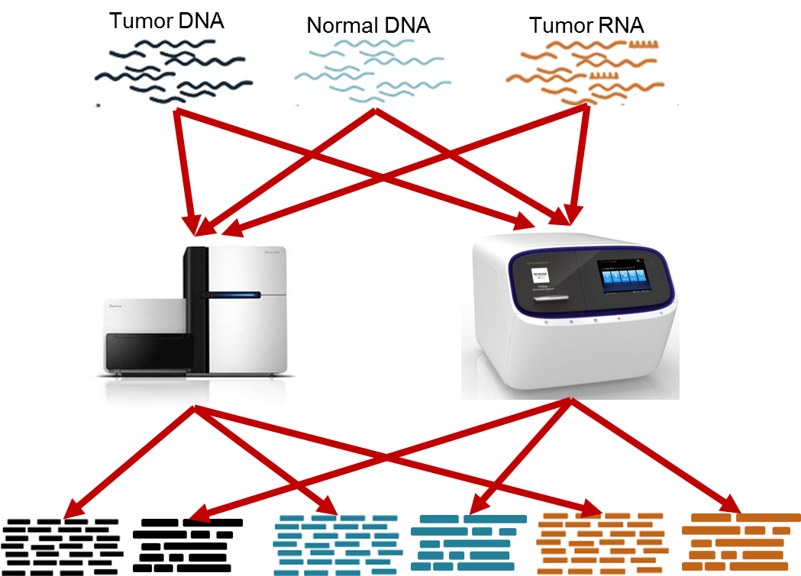



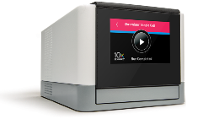
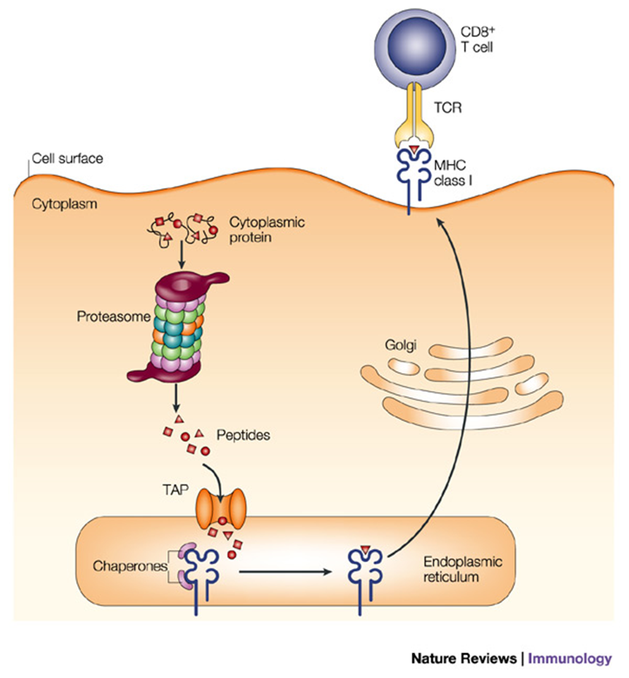
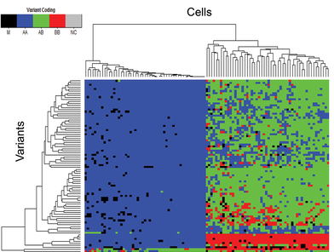
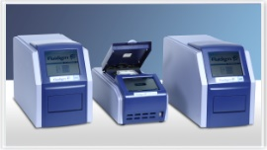
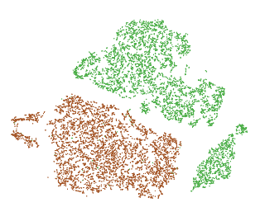

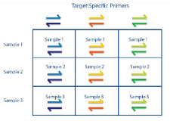
Genomics-Guided Cancer Immunotherapy
Illumina &
Ion Proton
bulk exome and RNA
sequencing
Phase I clinical trial for ovarian cancer
ongoing at the Neag Cancer Center
  GeNeo suite of Galaxy tools
TCR precursor
frequencies
Clone coverage
Expression
levels
DAI index
MHC binding affinity
Variant validation and clonal analysis by single-cell RNA-Seq and targeted DNA sequencing
Neoepitope prediction and
combinatorial vaccine design
Collaborators: P.K. Srivastava (Uconn Health), Y. Ionov (Roswell Park), A. Zelikovsky (GSU)

Slide 8

Immunology background: Class I endogenous antigen presentation

Slide 9
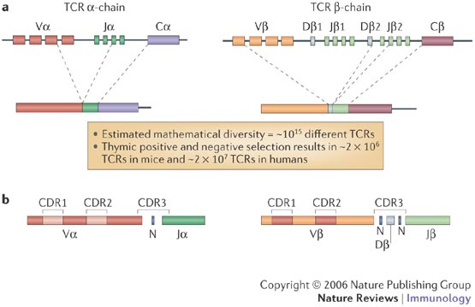
Somatic rearrangement of T-cell receptor genes
Potential TCR repertoire diversity: 10¹⁵

Slide 10
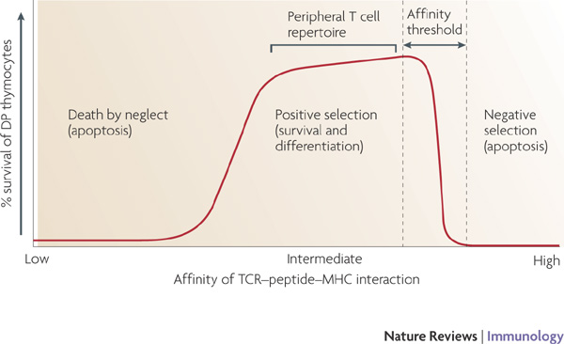
T-cell selection in thymus
Estimated TCR repertoire diversity after selection: ~2x10⁷

Slide 11
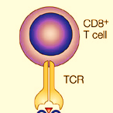
T-cell activation and proliferation

Slide 12
T-cell activation and proliferation

Slide 13

T-cell activation and proliferation

Slide 14
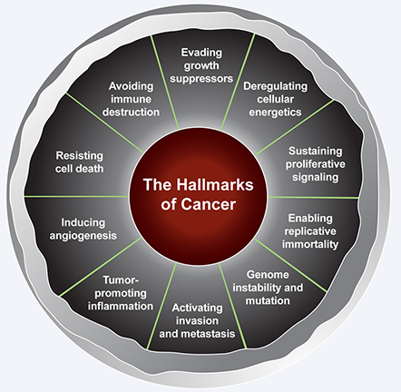
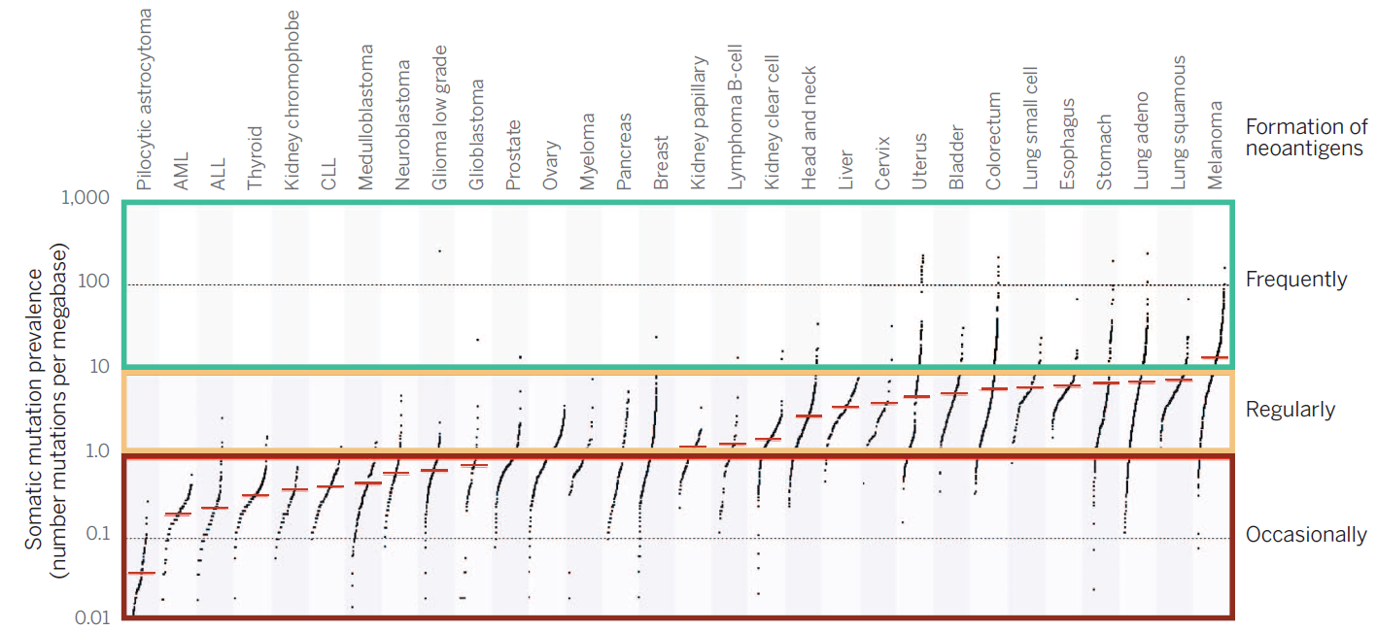
The immune system and cancer

Slide 15
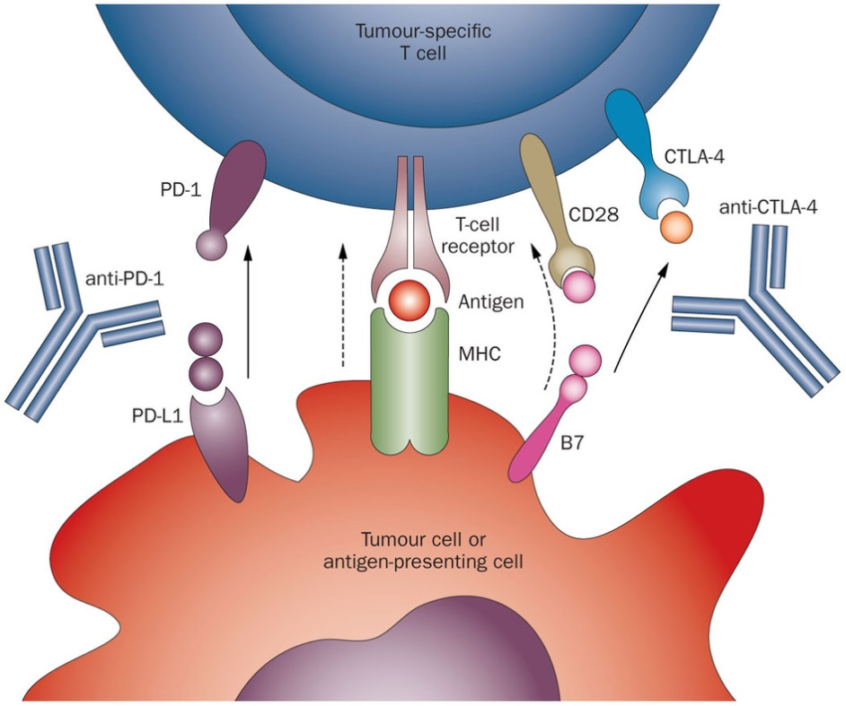
Cutting the brakes: PD1 and CTLA-4 blockade

Slide 16
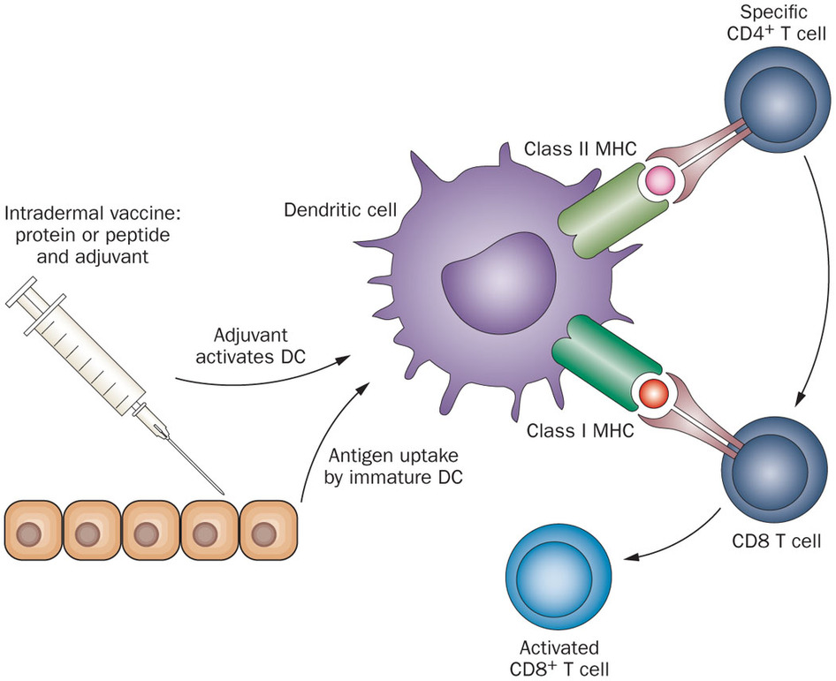
Stepping on the gas: vaccination with neoepitopes

Slide 17
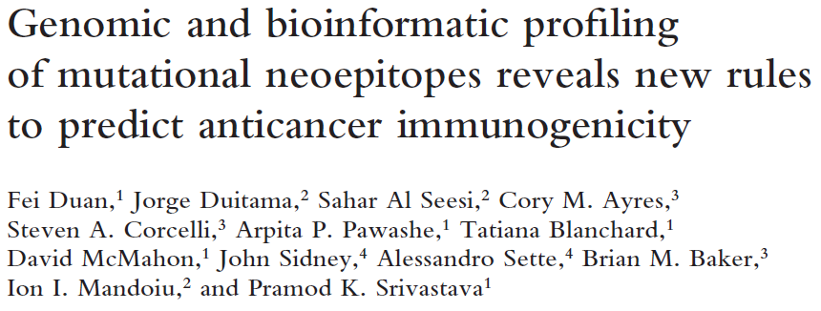
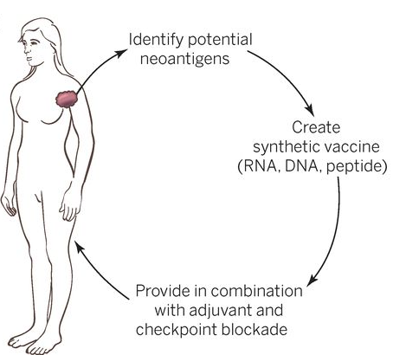
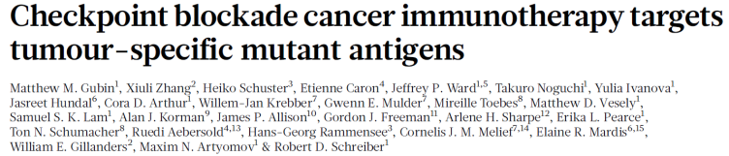
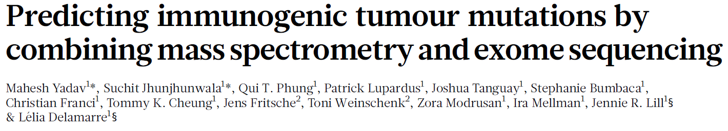
Combined approach
Ton N. Schumacher, and Robert D. Schreiber Science 2015;348:69-74

Slide 18
Sequencing
QC and Mapping
SNV Calling & Phasing
Epitope
Prediction
Vaccine Design
Clonality Analysis
TCR Sequencing

Slide 19

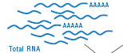
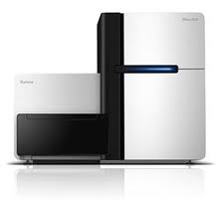

Sequencing
QC and Mapping
SNV Calling & Phasing
Epitope Prediction
Vaccine Design
Clonality Analysis
TCR Sequencing
Tumor DNA
Normal DNA
Tumor RNA
Whole Genome
Library prep
or
Nextera Rapid
Capture Exome
Whole Transcriptome
Library prep
Illumina HiSeq
Sequencing

Slide 20
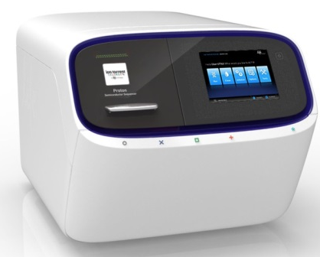
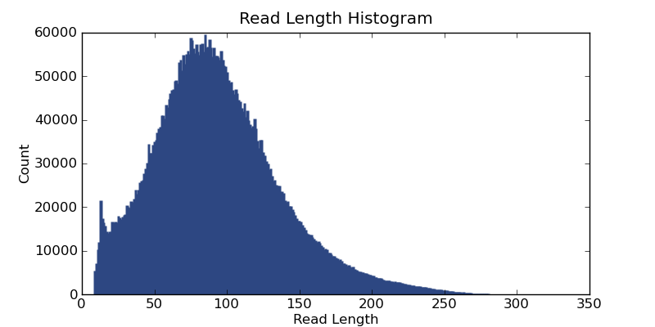
Sequencing
QC and Mapping
SNV Calling & Phasing
Epitope Prediction
Vaccine Design
Clonality Analysis
TCR Sequencing
Tumor DNA
Normal DNA
Tumor RNA
Whole Genome
Library prep
or
Exome
AmpliSeq
Whole Transcriptome
Library prep
Ion Proton
Sequencing

Slide 21
Sequencing
QC and Mapping
SNV Calling & Phasing
Epitope Prediction
Vaccine Design
Clonality Analysis
TCR Sequencing
Pre-alignment QC
  Trim reads based on base quality scores
  Filter reads below min. length

Slide 22
Sequencing
QC and Mapping
SNV Calling & Phasing
Epitope Prediction
Vaccine Design
Clonality Analysis
TCR Sequencing
Read mapping decisions
  What is the best mapper for your data?
  End-to-end vs. spliced vs local alignments
  Unique vs. non-unique alignments

Slide 23
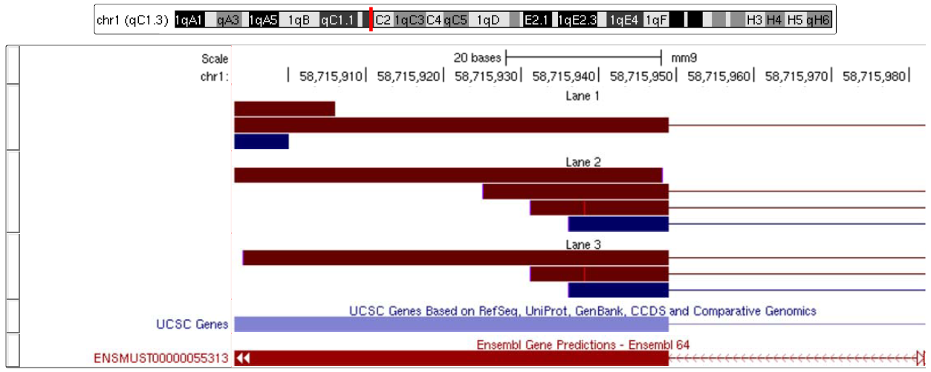
Sequencing
QC and Mapping
SNV Calling & Phasing
Epitope Prediction
Vaccine Design
Clonality Analysis
TCR Sequencing
Post-alignment QC
  Remove duplicate read sequences (likely PCR artifacts)

Slide 24

Sequencing
QC and Mapping
SNV Calling & Phasing
Epitope Prediction
Vaccine Design
Clonality Analysis
TCR Sequencing
Tumor Exome Reads
*
*
*
*
*
*
Human Reference
*
*
Normal Exome Reads

Slide 25
Sequencing
QC and Mapping
SNV Calling & Phasing
Epitope Prediction
Vaccine Design
Clonality Analysis
TCR Sequencing
Many Somatic Variant Callers
Mutect (Broad)
VarScan2 (Wash. U.)
SomaticSniper (Wash. U)
Strelka (Illumina)
SNVQ w/ subtraction (UConn)
…

Slide 26
Sequencing
QC and Mapping
SNV Calling & Phasing
Epitope Prediction
Vaccine Design
Clonality Analysis
TCR Sequencing
Comparison of Somatic Variant Callers
In silico mixtures of real Proton exome reads simulating 0.1-0.5 allelic fractions

Slide 27
Sequencing
QC and Mapping
SNV Calling & Phasing
Epitope Prediction
Vaccine Design
Clonality Analysis
TCR Sequencing
Coverage distribution of exome vs. SNV calls

Slide 28
Sequencing
QC and Mapping
SNV Calling & Phasing
Epitope Prediction
Vaccine Design
Clonality Analysis
TCR Sequencing
  For epitope prediction we need phase of nearby SNVs
    RefHap algorithm [Duitama et al. 2010]
Reduce the problem to Max-Cut
Solve Max-Cut
Build haplotypes according with the cut
Locus | 1 | 2 | 3 | 4 | 5
f₁ | * | 0 | 1 | 1 | 0
f₂ | 1 | 1 | 0 | * | 1
f₃ | 1 | * | * | 0 | *
f₄ | * | 0 | 0 | * | 1
f₄
1
-1
3
f₁
f₂
1
-1
f₃
h₁ 00110
h₂ 11001

Slide 29
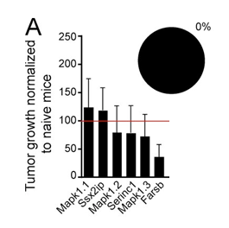
Sequencing
QC and Mapping
SNV Calling & Phasing
Epitope Prediction
Vaccine Design
Clonality Analysis
TCR Sequencing
Binding affinity is NOT a predictor of tumor immunity
Top score
Duan et al., JEM 2014

Slide 30
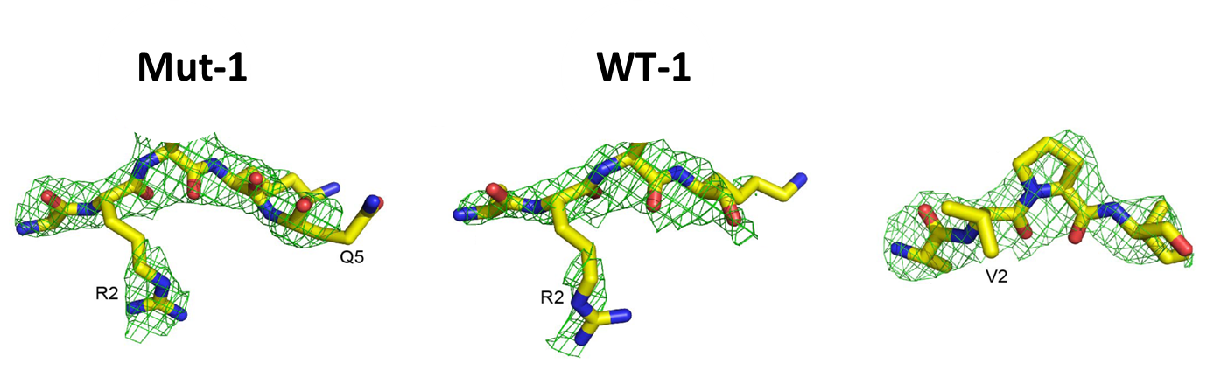
Sequencing
QC and Mapping
SNV Calling & Phasing
Epitope Prediction
Vaccine Design
Clonality Analysis
TCR Sequencing
T-cells are trained to see the difference
Low DAI score = similar peptides
High DAI score = different peptides
Mut 1
WT 1
Mut 2
WT 2
Differential Agretopic Index(DAI) = Score_{mut}-Score_{WT}
Duan et al., JEM 2014

Slide 31
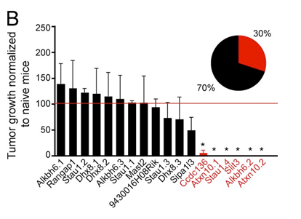
Sequencing
QC and Mapping
SNV Calling & Phasing
Epitope Prediction
Vaccine Design
Clonality Analysis
TCR Sequencing
Top score
Top DAI score
Duan et al., JEM 2014

Slide 32
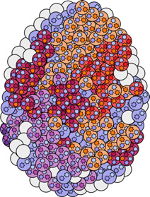
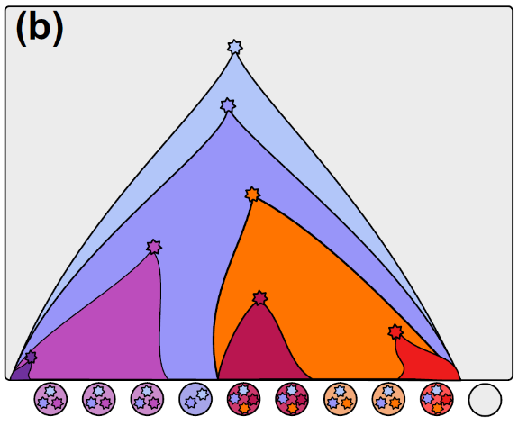
Sequencing
QC and Mapping
SNV Calling & Phasing
Epitope Prediction
Vaccine Design
Clonality Analysis
TCR Sequencing
Rational vaccine design requires info on the clonal structure of the tumor
  Not all cells harbor all candidate epitopes
Approaches to clonality analysis
  Computational inference from bulk samples
  Reconstruction from single cell DNA (targeted) and RNA sequencing data

Slide 33
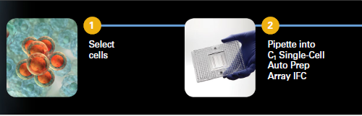


Cell capture
Sequencing
QC and Mapping
SNV Calling & Phasing
Epitope Prediction
Vaccine Design
Clonality Analysis
TCR Sequencing

Slide 34

Pre-amplification
Sequencing
QC and Mapping
SNV Calling & Phasing
Epitope Prediction
Vaccine Design
Clonality Analysis
TCR Sequencing

Slide 35



PCR on Access Array
Sequencing
QC and Mapping
SNV Calling & Phasing
Epitope Prediction
Vaccine Design
Clonality Analysis
TCR Sequencing

Slide 36

PCR on Access Array
Sequencing
QC and Mapping
SNV Calling & Phasing
Epitope Prediction
Vaccine Design
Clonality Analysis
TCR Sequencing

Slide 37

Bidirectional amplicon tagging
Sequencing
QC and Mapping
SNV Calling & Phasing
Epitope Prediction
Vaccine Design
Clonality Analysis
TCR Sequencing

Slide 38

Clonal structure inferred by unsupervised clustering of multi-locus cell genotypes
Sequencing
QC and Mapping
SNV Calling & Phasing
Epitope Prediction
Vaccine Design
Clonality Analysis
TCR Sequencing
Szulwach et al. http://journals.plos.org/plosone/article?id=10.1371/journal.pone.0135007

Slide 39


Full mutation history inferred from multi-locus cell genotypes
Sequencing
QC and Mapping
SNV Calling & Phasing
Epitope Prediction
Vaccine Design
Clonality Analysis
TCR Sequencing
Leung et al http://genome.cshlp.org/content/early/2017/06/28/gr.209973.116

Slide 40

3’-end single cell RNA-Seq w/ UMIs (10X Genomics)
Sequencing
QC and Mapping
SNV Calling & Phasing
Epitope Prediction
Vaccine Design
Clonality Analysis
TCR Sequencing
Encapsulates up to 48,000 cells in 10 minutes

Slide 41

Loss of XCI (XIST expression) in ovarian cancer
Sequencing
QC and Mapping
SNV Calling & Phasing
Epitope Prediction
Vaccine Design
Clonality Analysis
TCR Sequencing
P0 CD45+
P0 CD45-
P1 CD45+
P1 CD45-
P1c CD45+
P1c CD45-
P2 CD45+
P2 CD45-

Slide 42
XIST expression tracks putative CNV in chr 11
Sequencing
QC and Mapping
SNV Calling & Phasing
Epitope Prediction
Vaccine Design
Clonality Analysis
TCR Sequencing
XIST
X chr
Chr 11

Slide 43
Sequencing
QC and Mapping
SNV Calling & Phasing
Epitope Prediction
Vaccine Design
Clonality Analysis
TCR Sequencing
Which Epitopes go into the vaccine?
  High Differential Agretopic Index (DAI)?
  High expression?
  High clone coverage?
  Diversity across the individual’s HLA alleles?
  High cognate TCR precursor frequency?

Slide 44



Sequencing
QC and Mapping
Calling SNVs
Epitope Prediction
Vaccine Design
Clonality Analysis
TCR Sequencing
Klinger et al. 2013

Slide 45

Galaxy deployment
Sequencing
QC and Mapping
Calling SNVs
Epitope Prediction
Vaccine Design
Clonality Analysis
TCR Sequencing

Slide 46
Conclusions
Personalized cancer immunotherapy needs solutions for a wide range of computational problems
  Efficient algorithms and HPC infrastructure needed to handle the large amounts of data
    Scalability helps quantifying predicition uncertainty (bootstrapping) and parameter sensitivity
  Benchmarking needed to select best methods
    Ongoing community efforts: ICGC somatic mutation challenge, TESLA consortium
  User-friendly software tools still lacking

Slide 47
Ongoing Work
Handling other forms of variation that yield neoepitopes: indels, novel splicing isoforms, gene fusions
Enhanced models of MHC binding trained from mass-spec of eluted peptides presented in vivo
Modeling TCR precursor frequencies

Slide 48





Acknowledgements
Fei Duan
Adam Hagymasi
Anupinder Kaur
Tatiana Shcheglova
Pramod Srivastava
Cory Ayres
Steven Corcelli
Brian M. Baker
Jorge Duitama
Sahar Al Seesi
Anas Al-Okaily
Tyler Daddio
Gabriel Ilie
Marmar Moussa
Marius Nicolae
Elham Sherafat
John Sidney Alessandro Sette

