Slide 1
Challenges in
Single Cell Sequencing Data Analysis
Ion Măndoiu
Computer Science & Engineering Department
University of Connecticut
ion@engr.uconn.edu

Slide 2
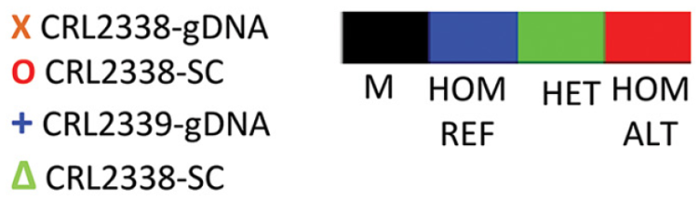
Challenges
Allelic dropouts
Szulwach et al. http://journals.plos.org/plosone/article?id=10.1371/journal.pone.0135007

Slide 3
Challenges
Allelic dropouts
Szulwach et al. http://journals.plos.org/plosone/article?id=10.1371/journal.pone.0135007

Slide 4
Challenges
Allelic dropouts
Szulwach et al. http://journals.plos.org/plosone/article?id=10.1371/journal.pone.0135007

Slide 5
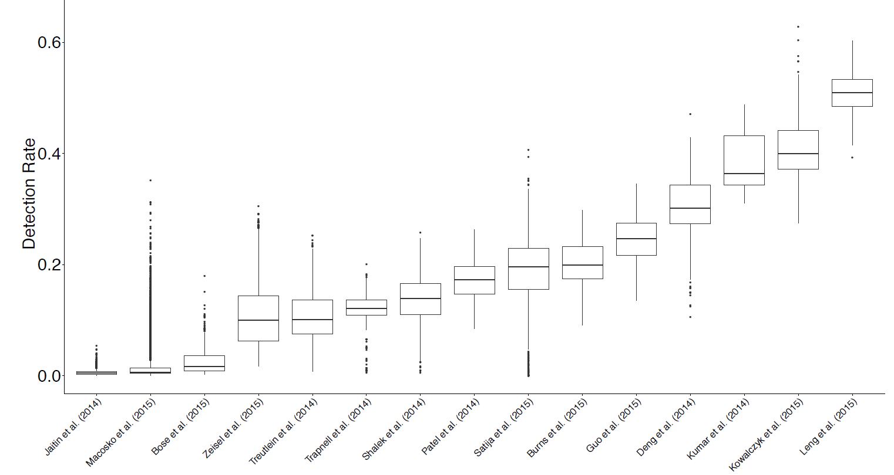
Challenges
Low RT efficiency & sequencing depth
Hicks et al. 2015, http://biorxiv.org/content/early/2017/05/08/025528
Hicks et al. 2015, http://biorxiv.org/content/early/2017/05/08/025528

Slide 6
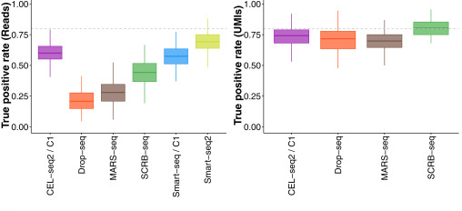
Challenges
PCR amplification bias
Ziegenhain et al. 2017, Mol. Cel. 65(4), pp. 631–643.e4
Ziegenhain et al. 2017, Mol. Cel. 65(4), pp. 631–643.e4

Slide 7
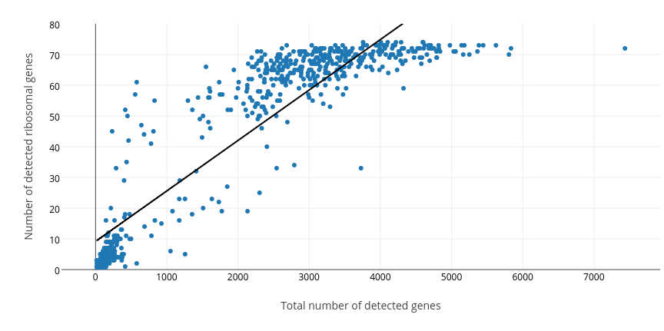
Challenges
Cell “quality”
  Live/dead
  Stress response
  Multiplets

Slide 8
Challenges
Many more:
Stochastic effects
  Cells captured in different cell cycle phases
  Transcriptional bursting hard to distinguish from technical artifacts
Cell capture bias
  Capture rates may not be representative of population frequencies
Scalability
  Million cell datasets…

Slide 9
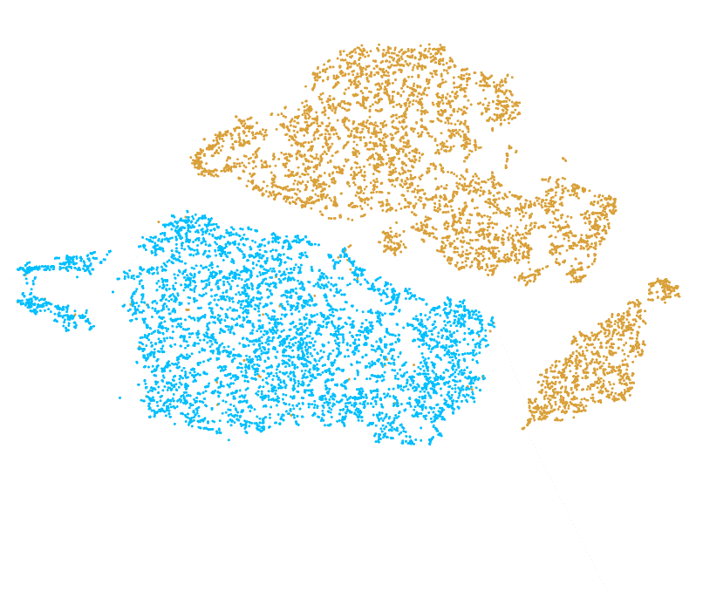
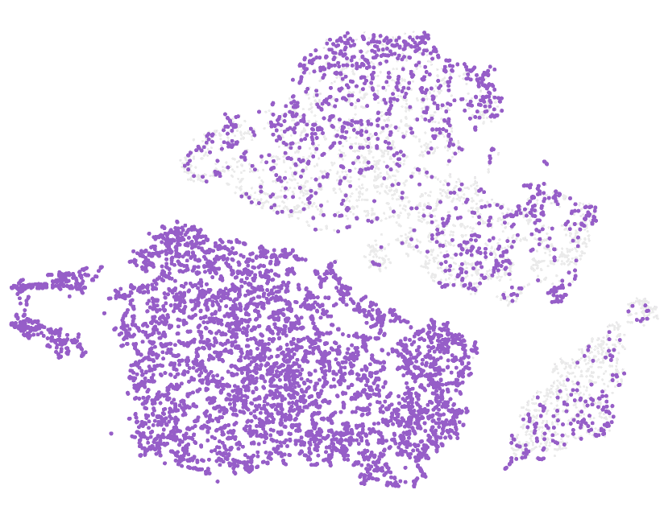
Imputation for scRNA-Seq Data
CD45- CD45+
CD45 UMI count=0
Can drop-outs be recovered by imputation?

Slide 10
Existing Imputation Methods
BISCUIT (Azizi et al., GCB 2017)
CIDR (Lin, Troup, & Ho, Genome Biol. 2017)
DRImpute (Kwak et al., bioRxiv 2017)
LSImpute (Moussa & Mandoiu, ISBRA 2018)
MAGIC (van Dijk et al. bioRxiv. 2017)
netSmooth (Ronen & Akalin, F1000Res. 2018)
scImpute (Li & Li, Nat. Comm. 2018)

Slide 11
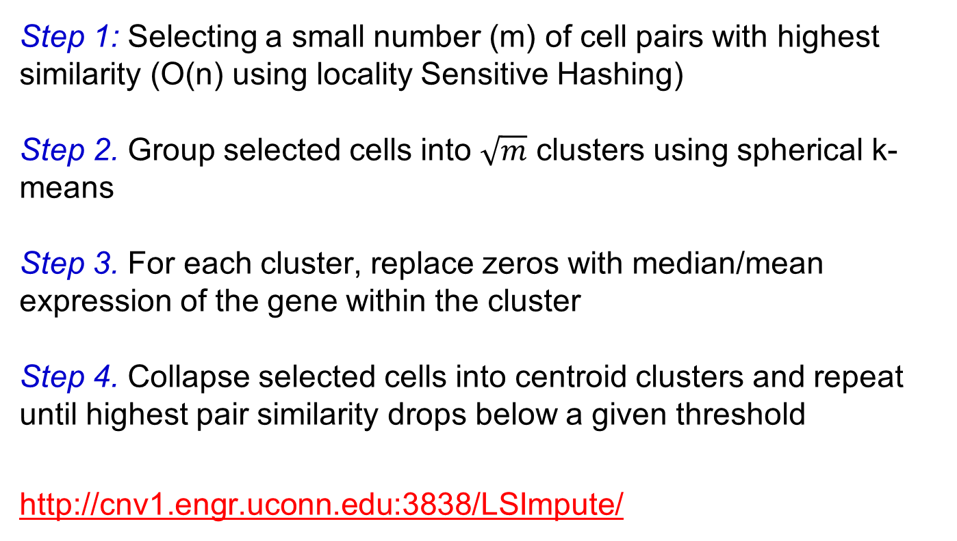
LSImpute
Step 1: Selecting a small number (m) of cell pairs with highest similarity (O(n) using locality Sensitive Hashing)
Step 2. Group selected cells into $\sqrt{m}$ clusters using spherical k-means
Step 3. For each cluster, replace zeros with median/mean expression of the gene within the cluster
Step 4. Collapse selected cells into centroid clusters and repeat until highest pair similarity drops below a given threshold
http://cnv1.engr.uconn.edu:3838/LSImpute/

Slide 12
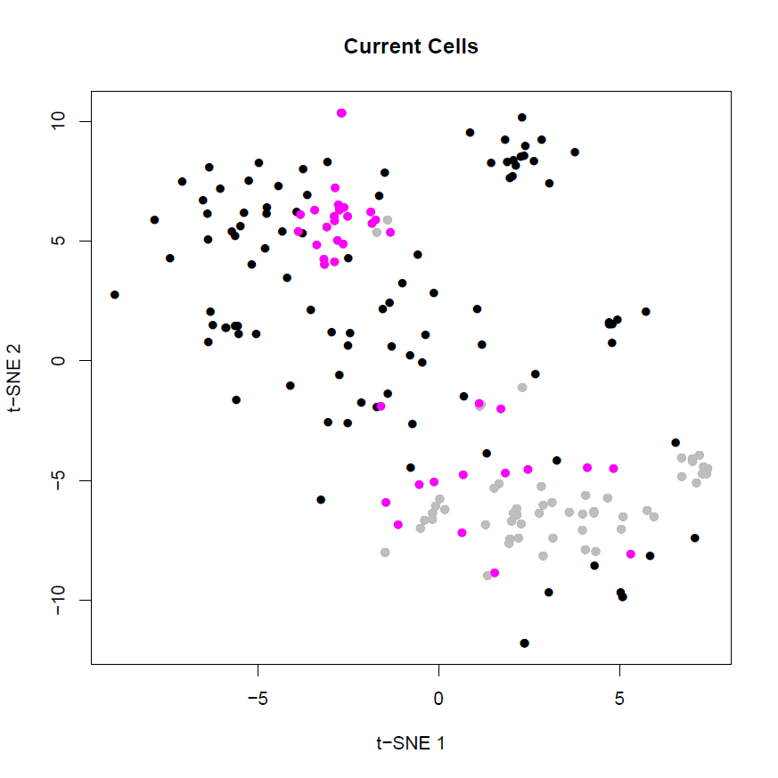
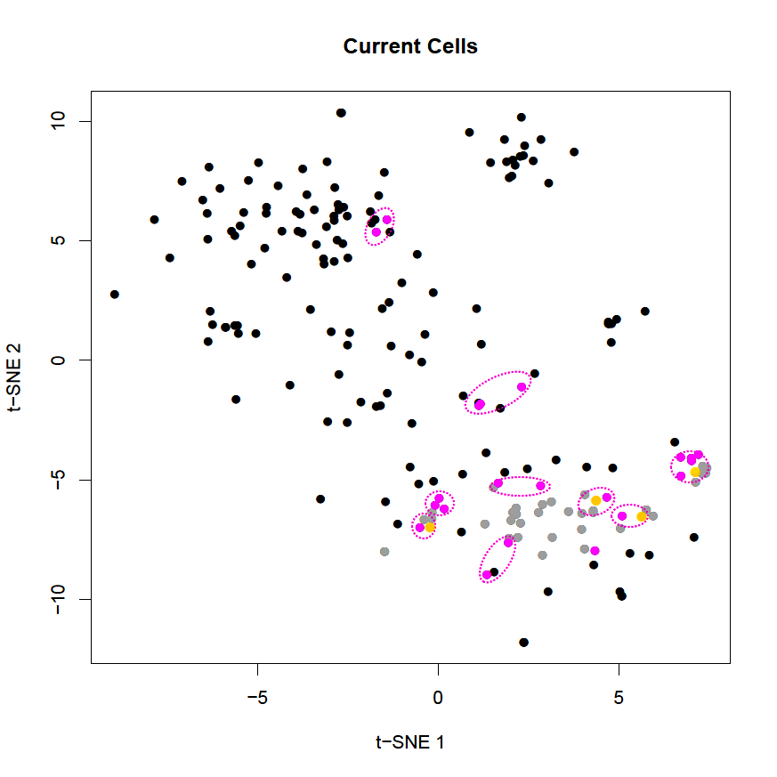
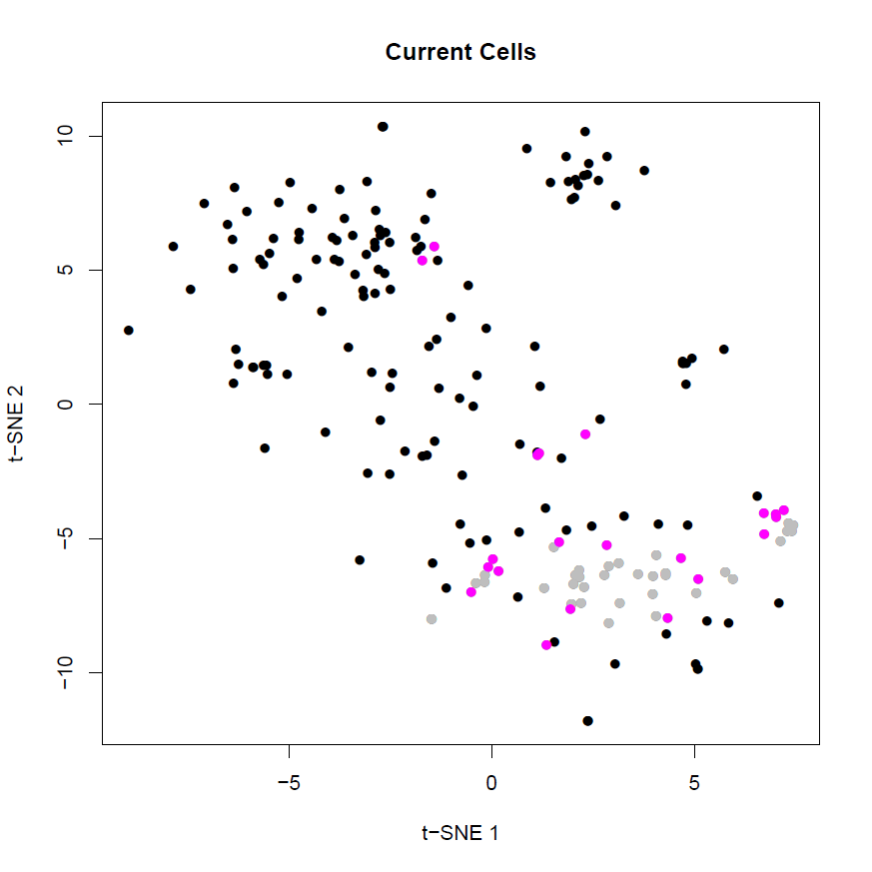
Toy example

Slide 13
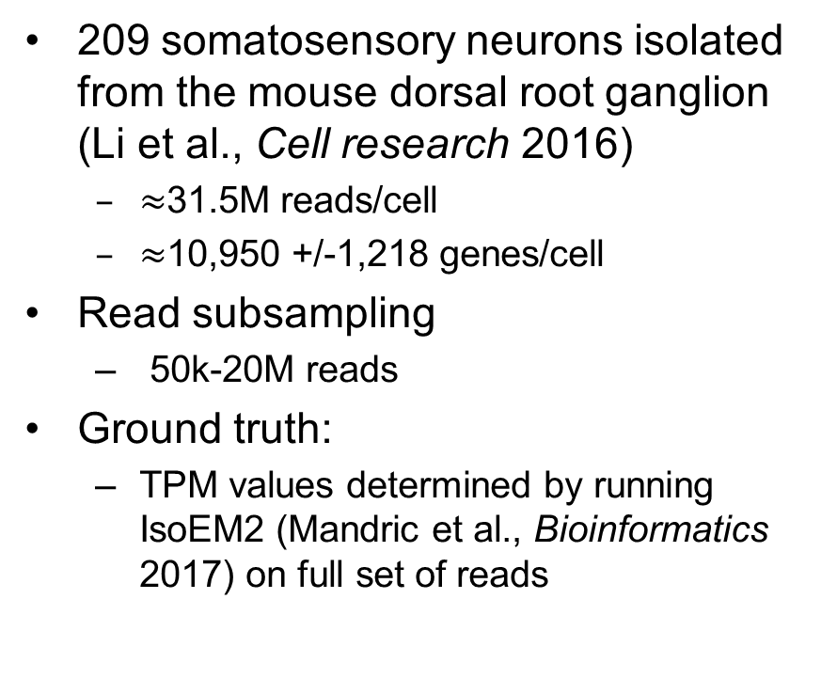
Imputation Experimental Setup
209 somatosensory neurons isolated from the mouse dorsal root ganglion (Li et al., Cell research 2016)
  $≈$31.5M reads/cell
  $≈$10,950 +/-1,218 genes/cell
Read subsampling
  50k-20M reads
Ground truth:
  TPM values determined by running IsoEM2 (Mandric et al., Bioinformatics 2017) on full set of reads

Slide 14
Gene Detection Fraction
Raw Data
DrImpute
scImpute
KNNImpute
LSImputeMed
LSImputeMean
100k 1M 10M

Slide 15
Imputation effect on Clustering
sKmeans, top TF-IDF

Slide 16
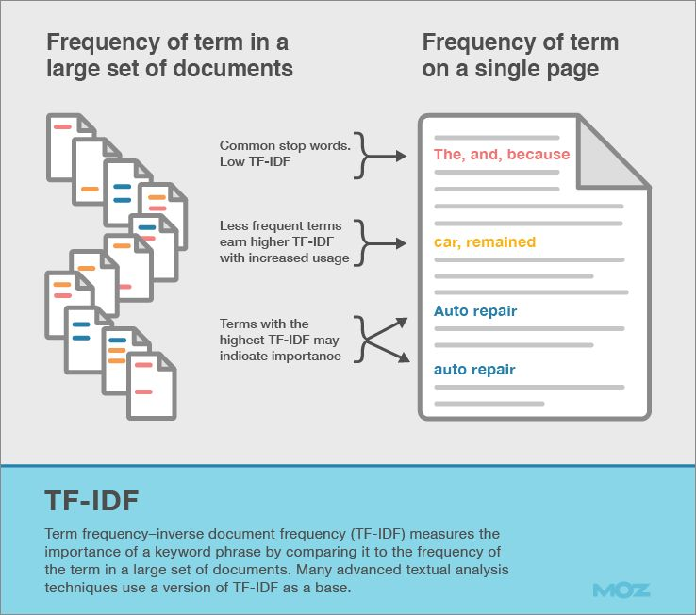

TF-IDF Transformation
Borrowed from information retrieval
Product of two factors:
  Term frequency: How frequently a term occurs in a document?
  Inverse document frequency: How uncommon the term is in the document collection?
For scRNA-Seq data:
  For gene i in cell j with count f_{ij} :
  $$TF_{ij}=f_{ij}/\max_{k}{f_{kj}}$$
  If gene i is detected in n_{i} out of N cells:
  $$IDF_{i}=\log_{2}{(N/n_{i})}$$
  TF-IDF score:
  $$TF_{ij} × IDF_{i}$$

Slide 17
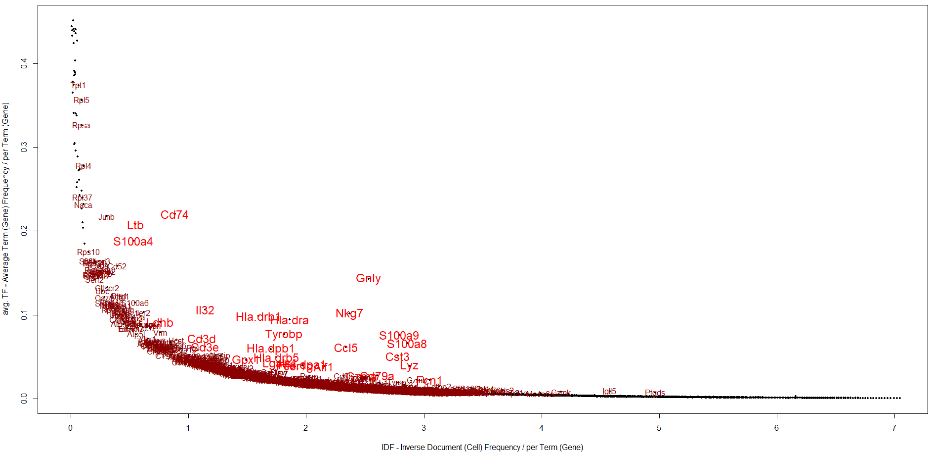
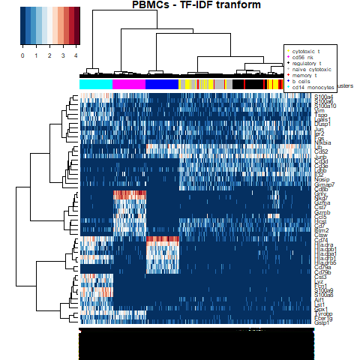
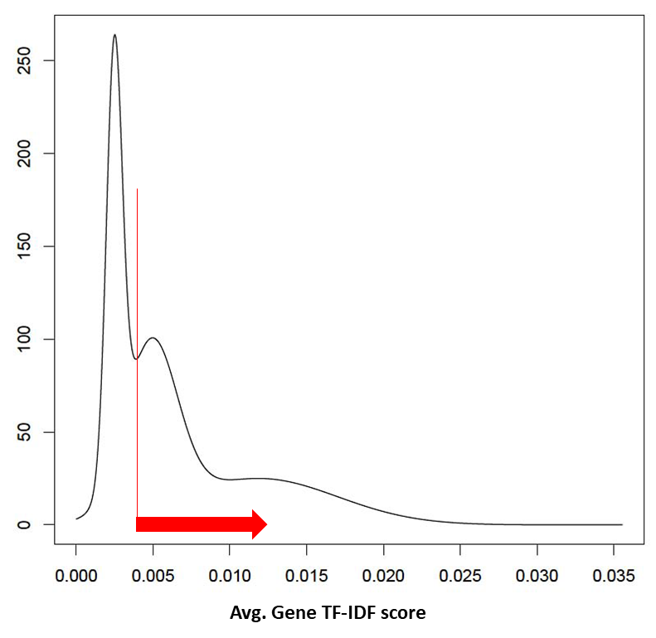
TF-IDF Based Feature Selection

Slide 18
TF-IDF Based Clustering
Seurat (K-means)*
Seurat (SNN)*
Feature Selection: PCA, tSNE, highly variable genes* or none
GMM
Data Transformation: Log2(x+1) or none
K-means
Sph. K-means
HC (E/P)
Cells QC, Genes QC, Gap-Statistics Analysis
Louvain (E)
GMM
Feature Selection: High avg. TFIDF score (Top) or Highly variable TF-IDF (Var)
K-means
Sph. K-means
Data Transformation:
TF-IDF
HC (E/P/C)
Data Binarization:
Cutoff threshold per cell based on cell avg. TF-IDF(Bin)
HC (E/P/C/J)
Greedy (E/P/C/J)
Louvain (E/P/C/J)

Slide 19
Experimental Setup: 10x PBMC
FACS sorted blood cells of 7 types [Zheng et al., Nat. Comm. 2017]
7:1, 3:1, 1:1, 1:3, and 1:7 simulated mixtures of cell type pairs of varying dissimilarity (1000 cells/pair)
7-way mixture, equal proportions (7000 cells/mix)
All datasets available at http://cnv1.engr.uconn.edu:3838/SCA/

Slide 20
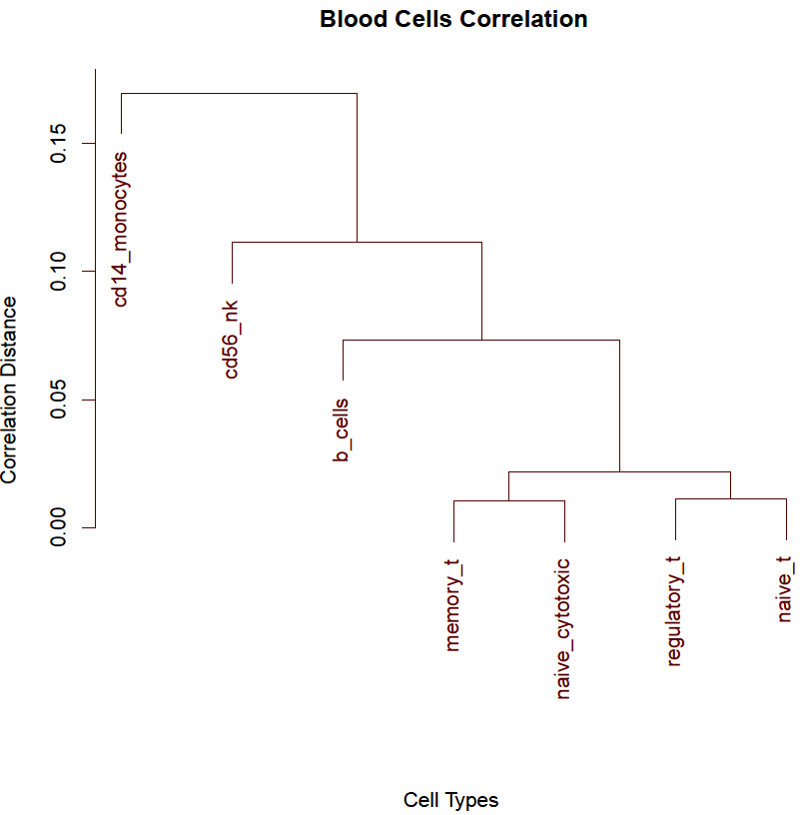
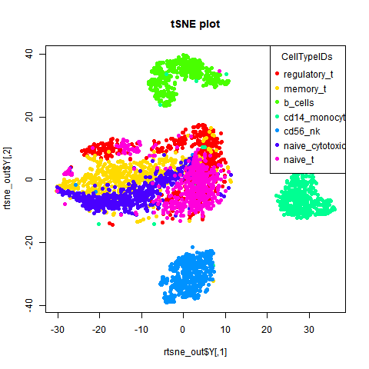
Experimental Setup: 10x PBMC

Slide 21
Experimental Setup: Pancreatic Cells
2045 Pancreatic cells of 7 types [Segerstolpe et al. 2016]
  Annotated based on known markers (removed for clustering)
  Capture proportions: 185 acinar cells, 886 alpha cells, 270 beta cells, 197 gamma cells, 114 delta cells, 386 ductal cells, and 7 epsilon cells

Slide 22
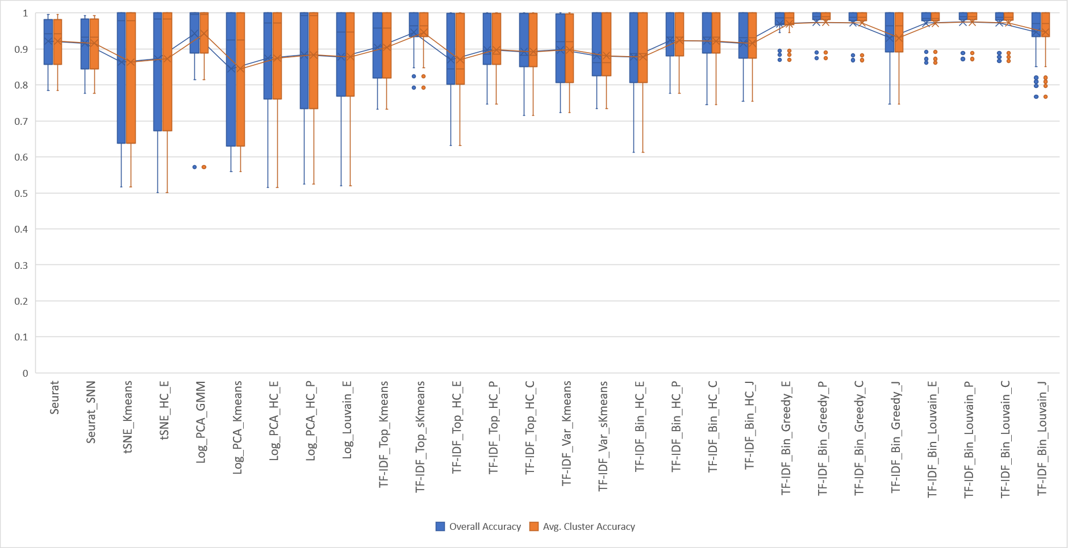
Pairs: 1:1 mixtures

Slide 23
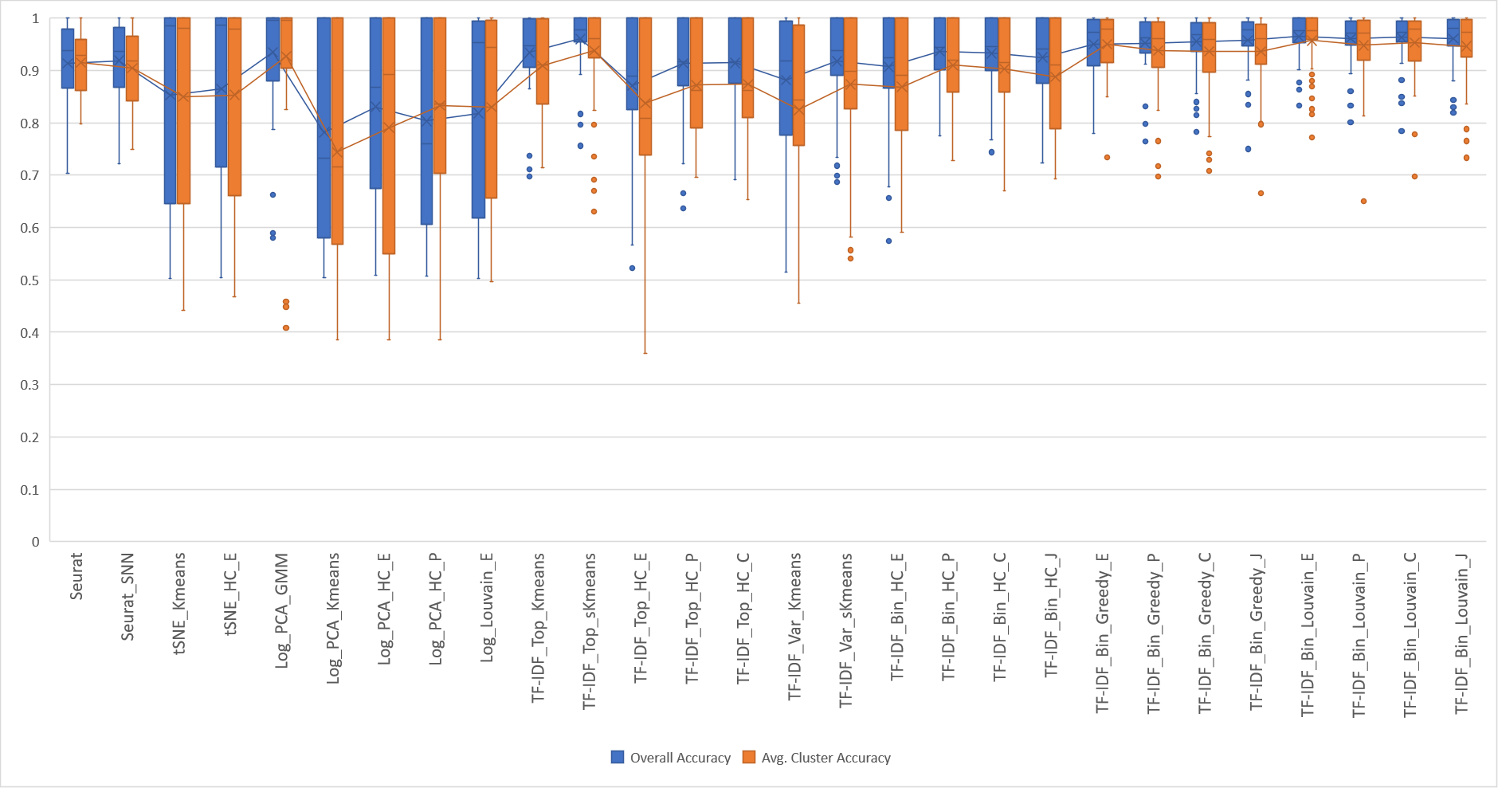
Pairs: 1:3/3:1 mixtures

Slide 24
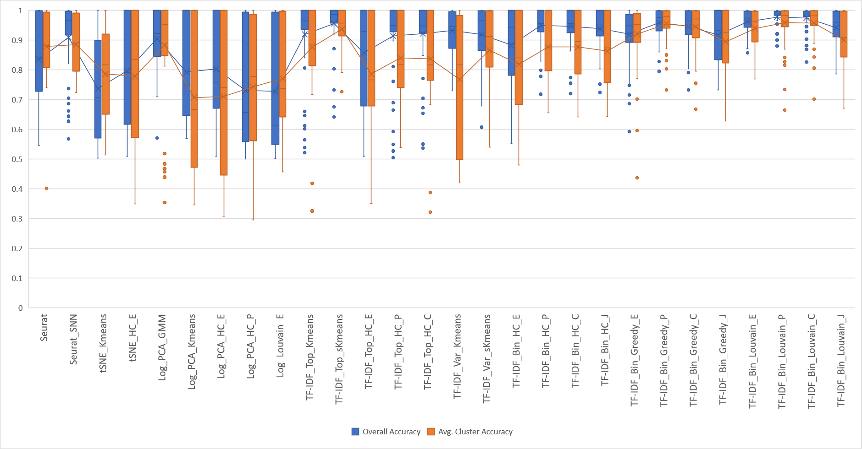
Pairs: 1:7/7:1 mixtures

Slide 25
7-Way PBMC Mixture

Slide 26
Pancreatic Cells

Slide 27
Joint analysis of bulk and scRNA-Seq
Needed to get unbiased population frequencies of cell types
  Potential to identify cell types missed by capture protocols

Slide 28













Linear model
cell type 3
cell type 2
cell type 1
gene 1
$$s_{11}$$
$$s_{13}$$
$$x_{1}$$
gene 2
$$x_{2}$$
$$c_{1}$$
$$x_{3}$$
gene 3
$$c_{2}$$
gene 4
$$x_{4}$$
$$c_{3}$$
gene 5
$$x_{5}$$
gene 6
$$s_{61}$$
$$s_{63}$$
$$x_{6}$$
Cell signatures
Cell concentrations
heterogeneous mixture

Slide 29
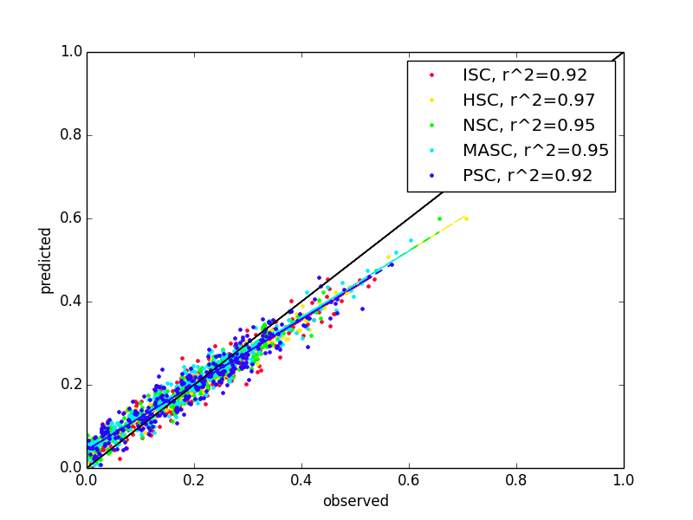
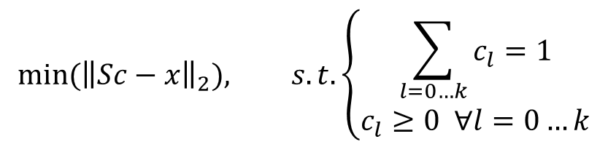
Estimation of mixture proportions
S
c
x
$$min⁡({\left\|Sc−x\right\|}_{2}), s.t. \left\{\begin{aligned}\sum_{l=0…k}{c_{l}}=1 \\ c_{l}≥0 ∀l=0…k\end{aligned}\right.$$

Slide 30
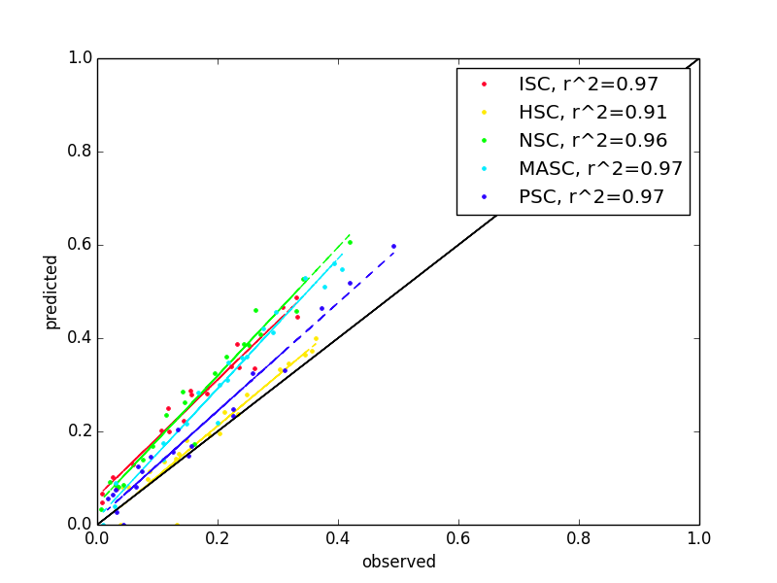
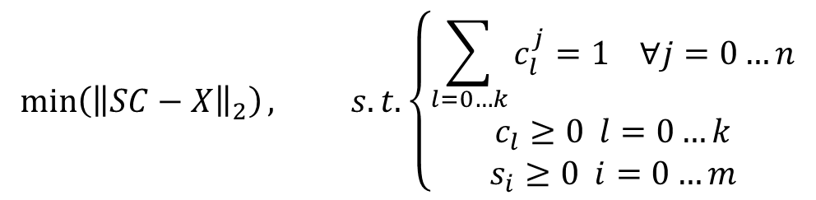
Simultaneous Estimation of Mixture Proportions and Missing Signature
S
C
X
$$\min\left({\left\|SC−X\right\|}_{2}\right), s.t. \left\{\begin{aligned}\sum_{l=0…k}{c_{l}^{j}}=1 ∀j=0…n \\ c_{l}≥0 l=0…k \\ s_{i}≥0 i=0…m\end{aligned}\right.$$

Slide 31
Conclusions
Is there a role for imputation?
scRNA-Seq clustering based on TF-IDF yields promising results
Ongoing work:
  Web-based workflow for analysis and interactive visualization
  Integration of cell-cycle phase prediction
  Clustering based on protein/pathway activity

Slide 32




Acknowledgements

