Slide 1
Single Cell RNA-Seq Data Analysis
Ion Mandoiu
Computer Science & Engineering Department
ion@engr.uconn.edu

Slide 2
Outline
Motivation and challenges
Locality sensitive imputation
TF-IDF based feature selection& clustering
Cell cycle analysis
SC1 pipeline
Conclusions and ongoing work

Slide 3
Single Cell RNA-Seq Growth

Slide 4
Rapid Technology Advances
(Svensson et al.)

Slide 5
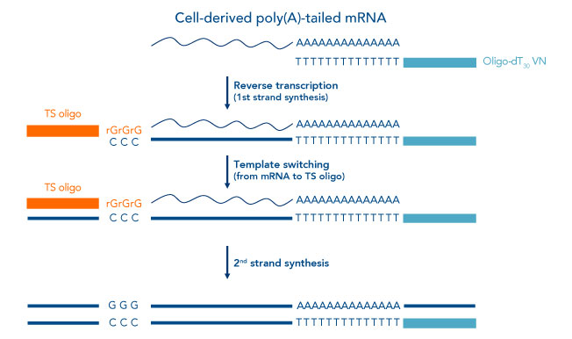
SMART Protocol
https://www.idtdna.com/pages/education/decoded/article/use-of-template-switching-oligos-(ts-oligos-tsos)-for-efficient-cdna-library-construction

Slide 6
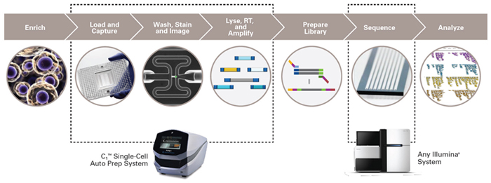
Fluidigm Workflow
Microfluidic chips with 96 (C1) or 800 (HT) capture chambers
Whole transcript (C1) or 3’-end (HT) sequencing
http://www.well.ox.ac.uk/ogc/single-cell-resources

Slide 7
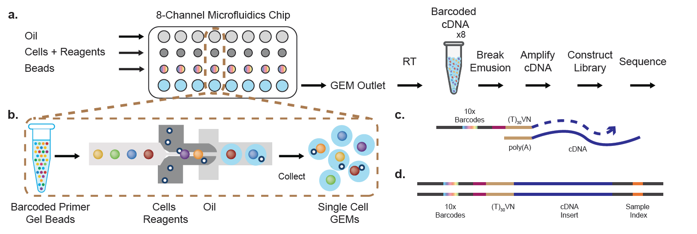
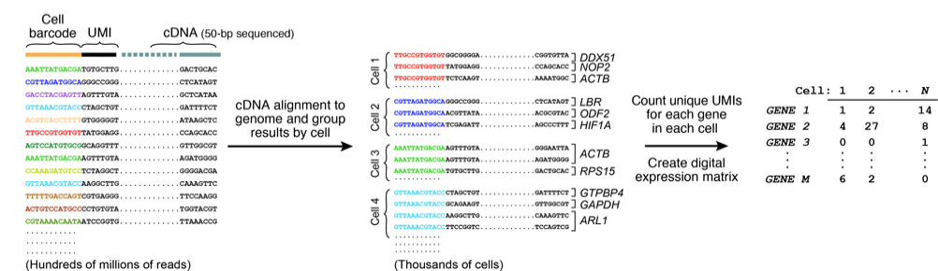
10X Genomics Workflow (3’-end w/ UMIs)

Slide 8




Bulk RNA-Seq vs. scRNA-Seq
Tissue samples are heterogeneous mixtures of cells
Bulk RNA-Seq averages expression over thousands to millions of cells
  Conflates molecular and compositional changes
Single cell data captures sample heterogeneity…
  But is very noisy!

Slide 9
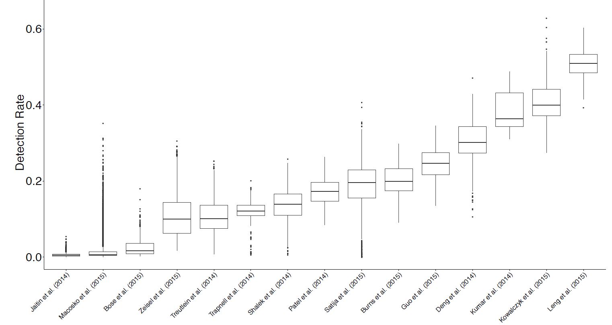
Challenges
Low RT efficiency & sequencing depth
  Results in zero-inflated data due to drop-out effects
Hicks et al. 2015, http://biorxiv.org/content/early/2017/05/08/025528

Slide 10
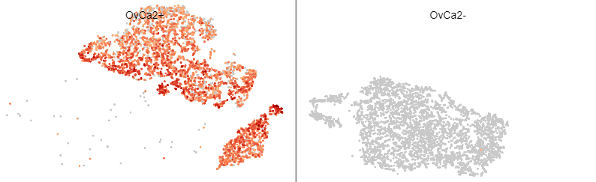
Challenges
Low RT efficiency & sequencing depth
  Results in zero-inflated data due to drop-out effects
Log Ptprc expression

Slide 11
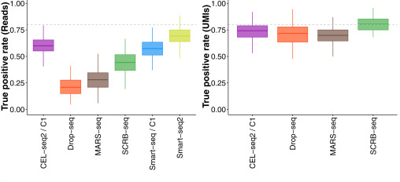
Challenges
Low RT efficiency & sequencing depth
PCR amplification bias
  UMIs help
Ziegenhain et al. 2017, Mol. Cel. 65(4), pp. 631–643.e4

Slide 12
Challenges
Low RT efficiency & sequencing depth
PCR amplification bias
Cell quality
  Live/dead
  Stress response
  Contaminant mRNA
  Empty droplets
  Multiple cells

Slide 13
Challenges
Low RT efficiency & sequencing depth
PCR amplification bias
Cell quality
Stochastic effects
  Cells captured in different cell cycle phases
  Transcriptional bursting hard to distinguish from technical artifacts

Slide 14
Challenges
Low RT efficiency & sequencing depth
PCR amplification bias
Cell quality
Stochastic effects
Cell capture bias
  Capture rates may not be representative of population frequencies

Slide 15
Challenges
Low RT efficiency & sequencing depth
PCR amplification bias
Cell quality
Stochastic effects
Cell capture bias
Analysis tools lagging behind
  Protocols still evolving rapidly
  Many analysis methods do not scale well with #cells

Slide 16
Outline
Motivation and challenges
Locality sensitive imputation
TF-IDF based feature selection & clustering
Cell cycle analysis
SC1 pipeline
Ongoing work

Slide 17
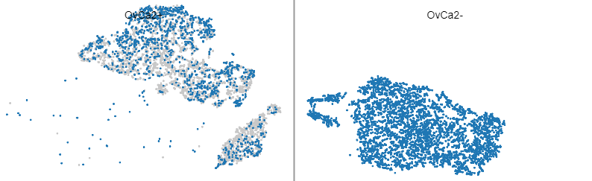
Imputation for scRNA-Seq Data
Ptprc=0
Can drop-outs be recovered by imputation?

Slide 18
Existing Imputation Methods
BISCUIT (Azizi et al., GCB 2017)
CIDR (Lin, Troup, & Ho, Genome Biol. 2017)
DRImpute (Kwak et al., bioRxiv 2017)
LSImpute (Moussa & Mandoiu, ISBRA 2018)
MAGIC (van Dijk et al. bioRxiv. 2017)
netSmooth (Ronen & Akalin, F1000Res. 2018)
scImpute (Li & Li, Nat. Comm. 2018)
…

Slide 19
LSImpute
Step 1: Select pairs of cells with highest similarity using Locality Sensitive Hashing
Step 2. Group selected cells into clusters using spherical k-means
Step 3. For each cluster, replace zeros with median/mean expression of the gene within the cluster
Step 4. Collapse selected cells into cluster centroids and repeat until highest pair similarity drops below a given threshold

Slide 20
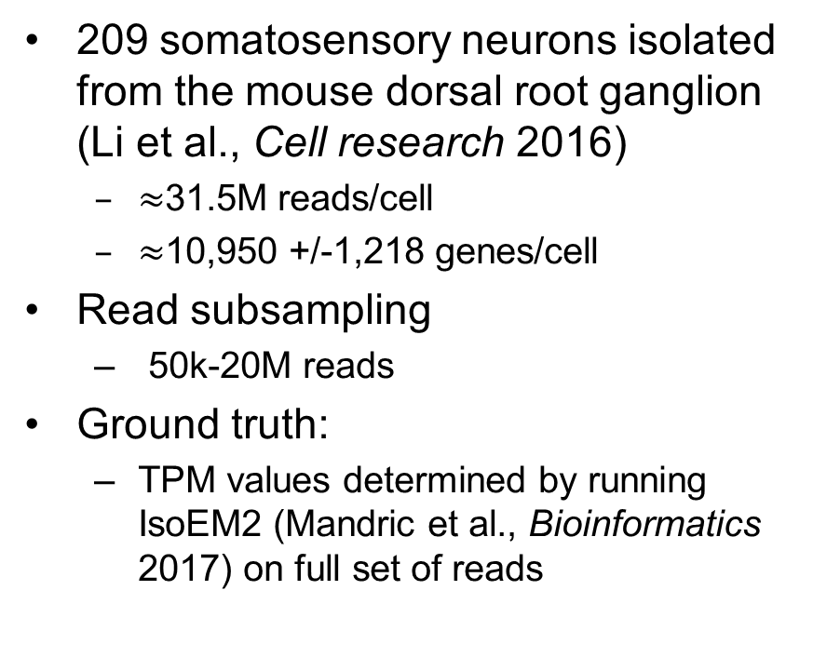
Evaluation on Subsampled Data
209 somatosensory neurons isolated from the mouse dorsal root ganglion (Li et al., Cell research 2016)
  $≈$31.5M reads/cell
  $≈$10,950 +/-1,218 genes/cell
Read subsampling
  50k-20M reads
Ground truth:
  TPM values determined by running IsoEM2 (Mandric et al., Bioinformatics 2017) on full set of reads

Slide 21
Gene Detection Fraction
Raw Data
DrImpute
scImpute
KNNImpute
LSImputeMed
LSImputeMean
100k 1M 10M

Slide 22
Accuracy on 10x Data
638 MethA cells: 500k reads/cell, down-sampled to 50k reads/cell
True vs. down-sampled
DrImpute
LSImpute

Slide 23
Outline
Motivation and challenges
Locality sensitive imputation
TF-IDF based feature selection & clustering
Cell cycle analysis
SC1 pipeline
Conclusions and ongoing work

Slide 24
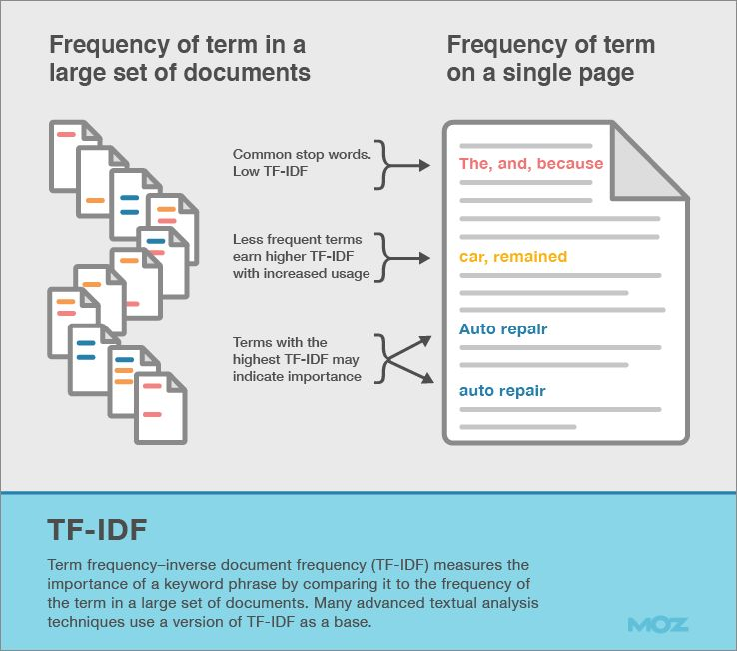

TF-IDF Transformation
Borrowed from information retrieval
Product of two factors:
  Term frequency: How frequently a term occurs in a document?
  Inverse document frequency: How uncommon the term is in the document collection?
For scRNA-Seq data:
  For gene i in cell j with count f_{ij} :
  $$TF_{ij}=f_{ij}/\max_{k}{f_{kj}}$$
  If gene i is detected in n_{i} out of N cells:
  $$IDF_{i}=\log_{2}{(N/n_{i})}$$
  TF-IDF score:
  $$TF_{ij} × IDF_{i}$$

Slide 25
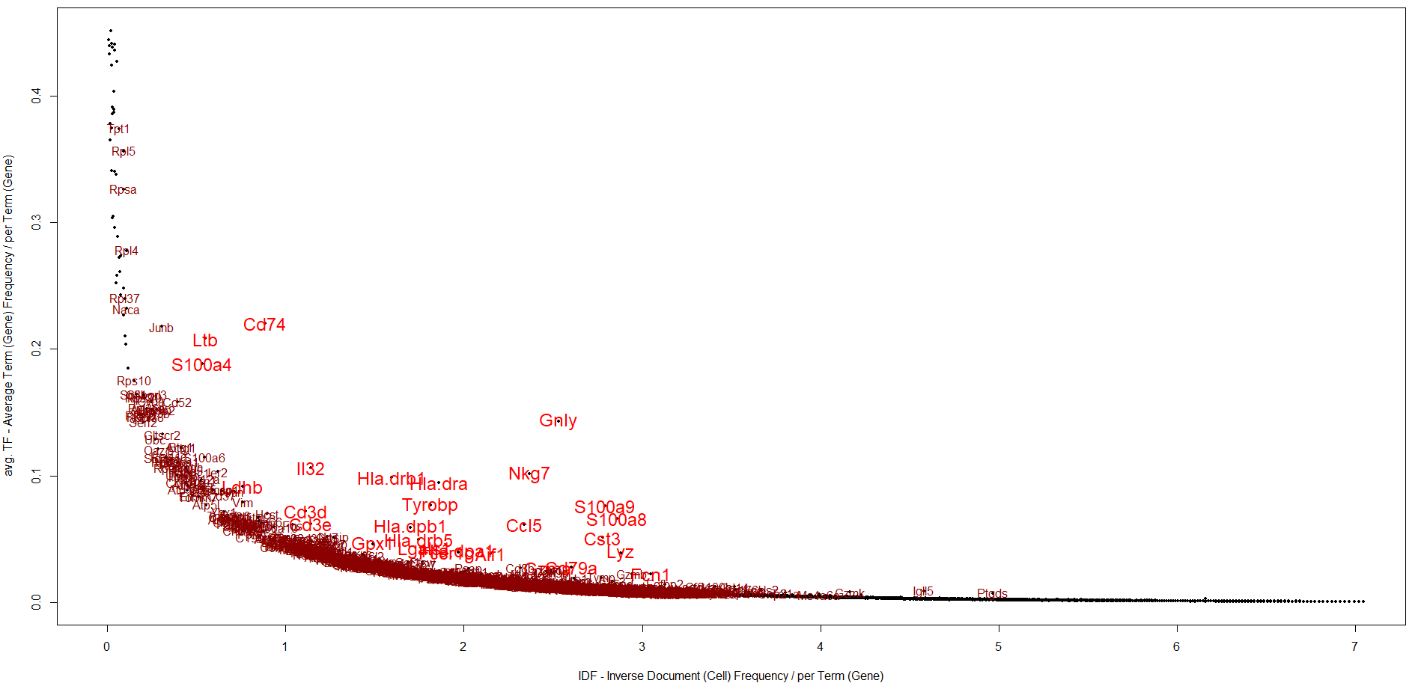
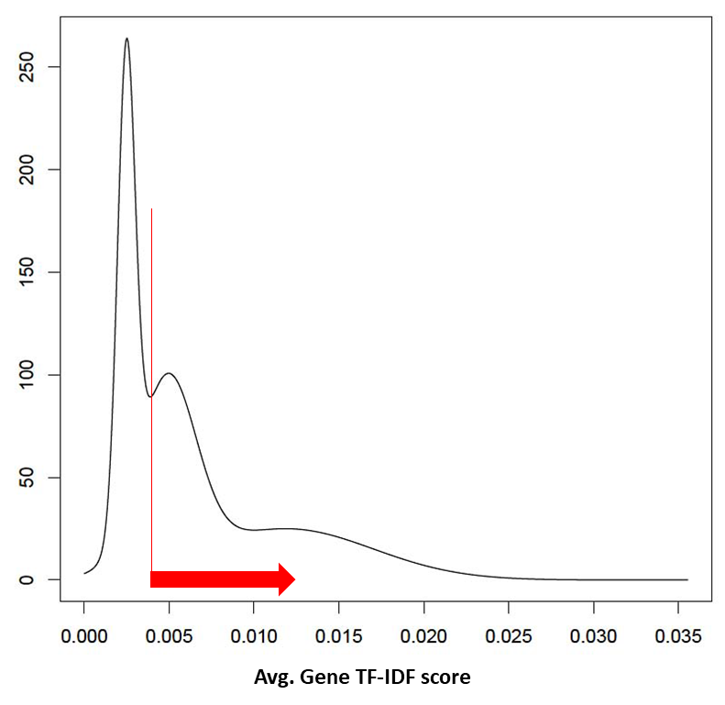
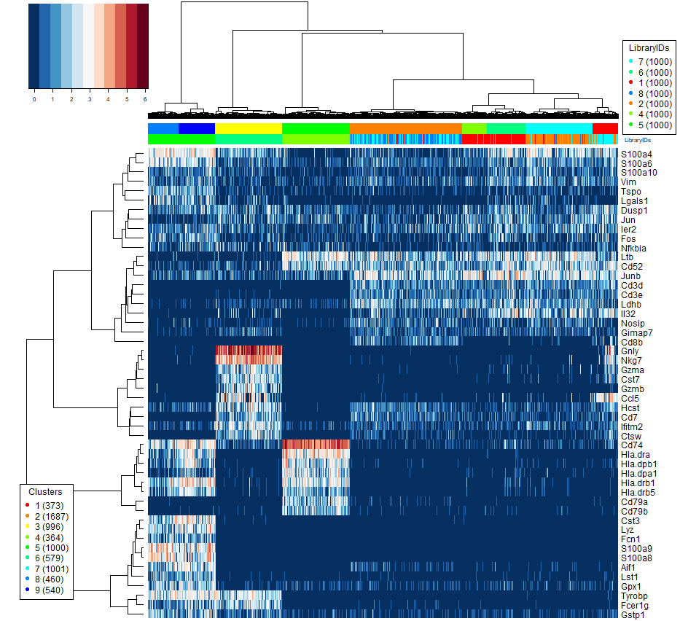
TF-IDF Based Feature Selection
PBMC, 10X
5: Monocytes,
6: Natural Killer
4: B cells
7,8: naïve cytotoxic, cytotoxic, activated cytotoxic
1: helper
2: regulatory
Genes with highest avg. TF-IDF (highest mean GMM in red)

Slide 26
TF-IDF Based Clustering
Seurat (K-means)*
Seurat (SNN)*
Feature Selection: PCA, tSNE, highly variable genes* or none
GMM
Data Transformation: Log2(x+1) or none
K-means
Sph. K-means
HC (E/P)
Cells QC, Genes QC, Gap-Statistics Analysis
Louvain (E)
GMM
Feature Selection: High avg. TFIDF score (Top) or Highly variable TF-IDF (Var)
K-means
Sph. K-means
Data Transformation:
TF-IDF
HC (E/P/C)
Data Binarization:
Cutoff threshold per cell based on cell avg. TF-IDF(Bin)
HC (E/P/C/J)
Greedy (E/P/C/J)
Louvain (E/P/C/J)

Slide 27
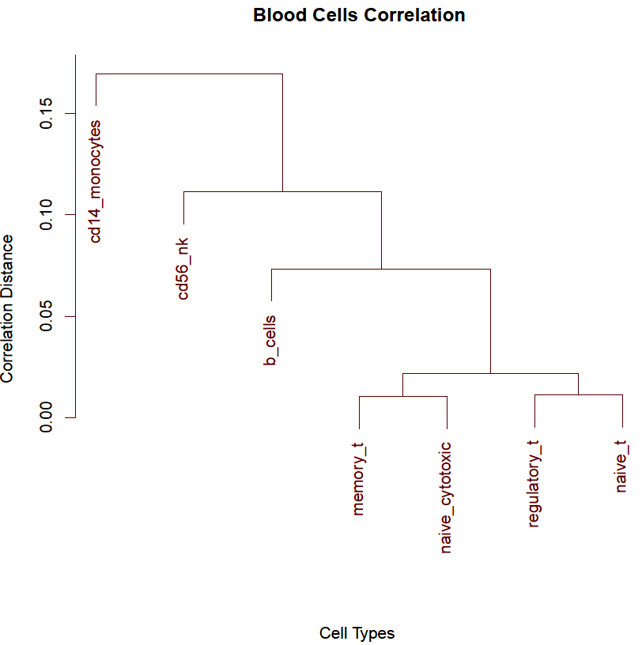
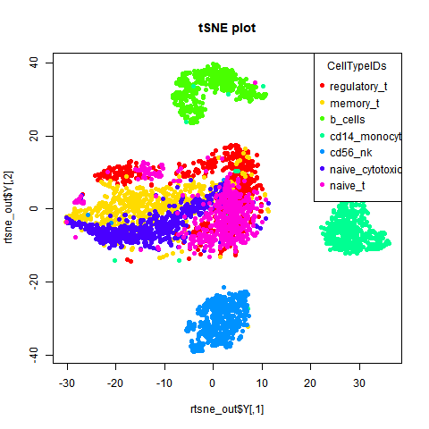
Evaluation on Synthetic PBMC Mixtures
FACS sorted blood cells of 7 types [Zheng et al., Nat. Comm. 2017]
7-way mixtures, equal proportions (7000 cells/mix)

Slide 28
Clustering Accuracy on PBMC Mixture

Slide 29
Pancreatic Cells Dataset
2045 Pancreatic cells of 7 types [Segerstolpe et al. 2016]
  Annotated based on known markers (removed for clustering)
  Capture proportions: 185 acinar cells, 886 alpha cells, 270 beta cells, 197 gamma cells, 114 delta cells, 386 ductal cells, and 7 epsilon cells

Slide 30
Clustering Accuracy on Pancreatic Cells

Slide 31
Outline
Motivation and challenges
Locality sensitive imputation
TF-IDF based feature selection & clustering
Cell cycle analysis
SC1 pipeline
Conclusions and ongoing work

Slide 32
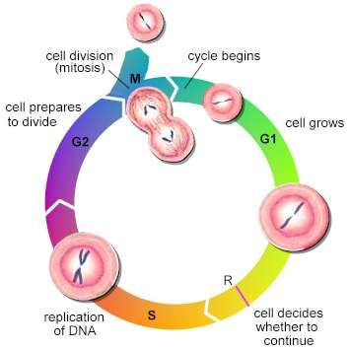
Cell Cycle Analysis
  Goal: disentangle cell type effects from cell cycle effects
  Existing Methods:
    Cyclone (classifies cells into G1, S, and G2 cycle phases)
    Oscope/reCAT: identifies oscillatory genes/orders cells based on cell cycle pseudo-time
    ccRemover: attempts to subtract cell cycle signal; fails on mix of Jurkat & 293 cells

Slide 33
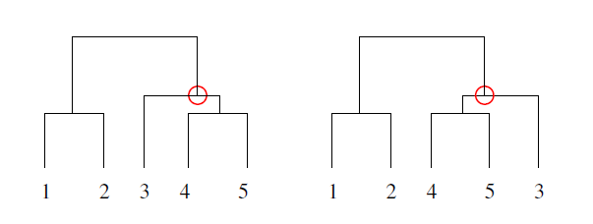
SC1CC Method
PCA of normalized RNA-Seq counts sub-matrix for cell cycle marker genes only
  Captures global variation due to cell cycle
3 component t-SNE transformation using first few PCs
  Captures local cell similarity
Hierarchical clustering
  Using average linkage, cosine similarity
Reorder leaves of HC dendrogram using the Optimal Leaf Ordering algorithm (OLO)
Notes:
Challenges: Deciding on PCs to use
CC genes based PCA vs. PC loadings analysis
Normalization
Centering (mean-based) & Scaling (sd-based) of cells (genes)
Gene Lists
Genes Correlation Filter

Slide 34
Cluster Scoring
Dividing/non-dividing clusters identified based on gene smoothness scores:
  N is the number of genes.
  SC_{ord}(g_{i}) is the serial-correlation of gene i under OLO order
  SC_{rand}(g_{i}) is the serial-correlation of gene i under a random order
Cell phase assigned based on max mean (normalized) expression of cell cycle marker genes

Slide 35
Evaluation on Labeled Data
Undifferentiated human embryonic stem cells sorted by FACS into G1, S and G2/M phases

Slide 36
Outline
Motivation and challenges
Locality sensitive imputation
TF-IDF based feature selection & clustering
Cell cycle analysis
SC1 pipeline
Conclusions and ongoing work

Slide 37
SC1 Analysis Workflow
https://sc1.engr.uconn.edu

Slide 38
Outline
Motivation and challenges
Locality sensitive imputation
TF-IDF based feature selection & clustering
Cell cycle analysis
SC1 pipeline
Conclusions and ongoing work

Slide 39
Conclusions
The range of single-cell applications continues to expand rapidly, fueled by rapid advances in technology
  Analysis tools lagging behind
Our contributions
  Scalable imputation method based on LSH
  TF-IDF based gene selection and clustering
  Robust methods for cell cycle analysis
  Web-based workflow for scRNA-Seq analysis and interactive visualization

Slide 40
Ongoing Work
Additional pipeline components in progress
  Correction for mRNA contamination
  Batch effect removal
  Lineage inference
  RNA velocity
  Cell type matching
  Integration of scTCR-Seq, scATAC-Seq, …
  …

Slide 41





Acknowledgments
Marmar Moussa

Slide 42
Questions?

