Slide 1
Computational Methods for the Analysis of Single Cell RNA-Seq Data
Marmar Moussa
Supervisor: Ion Măndoiu
Computer Science & Engineering Department
University of Connecticut

Slide 2
Outline
Background/Motivation
Part I - Clustering Single Cell RNA-Seq Data using TF-IDF based Methods
Part II – LSImpute: Locality Sensitive Imputation for Single Cell RNA-Seq Data
Part III – (WIP) Web-based Work-flow for the Analysis and Interactive Visualization of Single Cell RNA-Seq Data
Part IV – (Future Work) Cell Cycle Effect on Single Cell RNA-Seq Data Analysis.

Slide 3
Background
(Svensson et al.)
Notes:
Currently very active area of research
10x Genomics data set is comprised of 1.3 million mouse brain cells

Slide 4
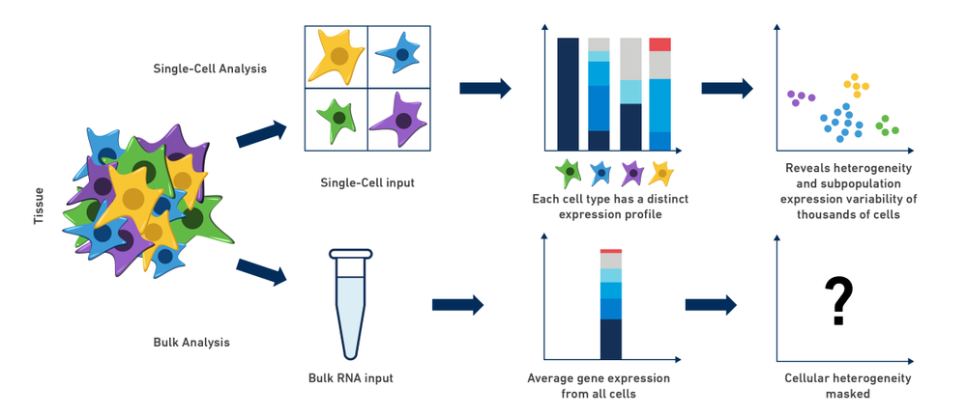
Bulk vs. Single Cell RNA-Seq
Notes:
Method of the Year for 2013.(nature methods | VOL.11 NO.1 | JANUARY 2014)
Measures distribution of expression levels for each gene across a population of cells
Bulk→ useful for comparative transcriptomics - tissue from different species or in disease studies.
SC→ Cell Differentiation, Tumor Heterogeneity, Cell Type Identification

Slide 5
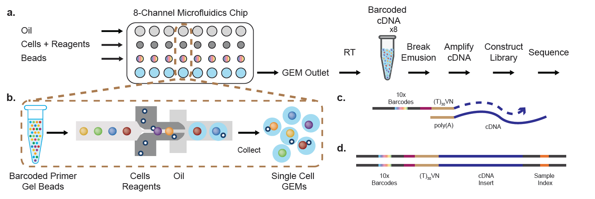
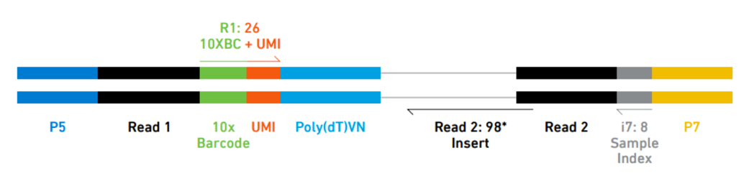
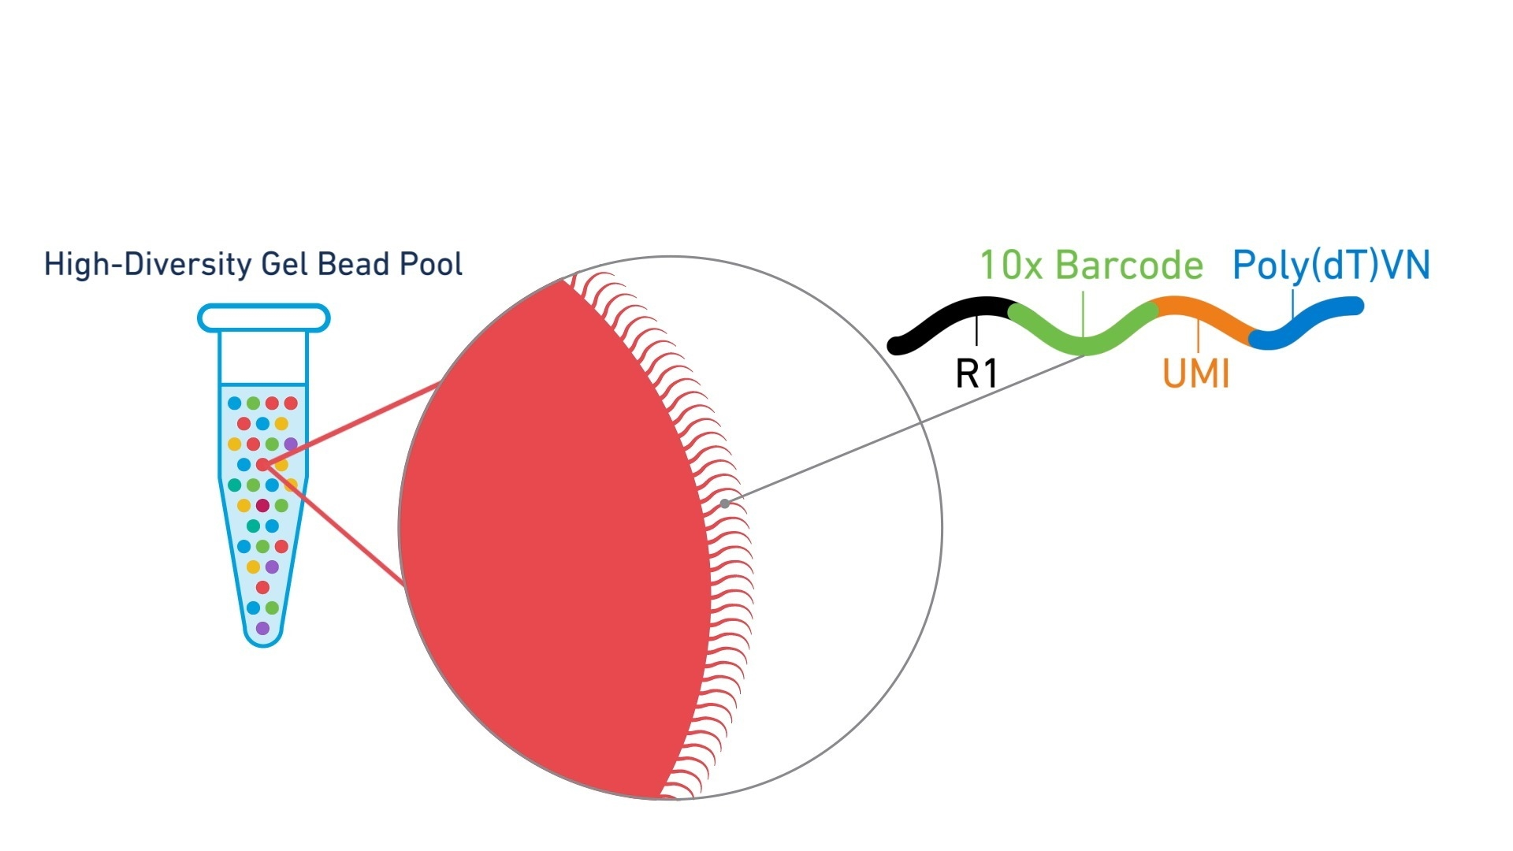
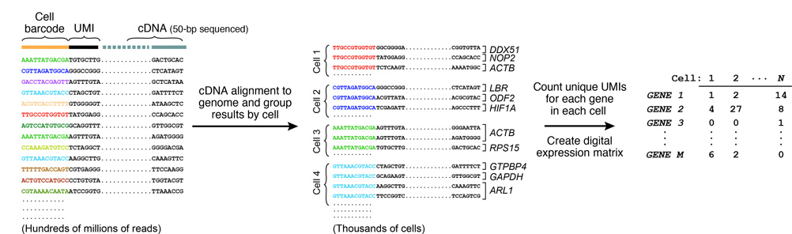
3’-end Sequencing w/ UMIs* (10X Genomics)
*unique molecular identifiers
l
Notes:
How do we get the data?
This slide shows the 3’ end sequencing workflow using UMIs in 10x
At the core : Cells combined with gel beads to form GEMs./ Droplet
(b) Gel beads loaded with primers and barcoded oligonucleotides RT takes place inside each GEM, after which cDNAs are pooled for amplification and library construction in bulk.
(c) Gel beads contain barcoded oligonucleotides consisting of Illumina adapters, 10x barcodes, UMIs and oligo dTs, which prime RT of polyadenylated RNAs.
(d) Finished library molecules consist of Illumina adapters and sample indices, allowing pooling and sequencing of multiple libraries on a next-generation short read sequencer.

Slide 6
scRNA-Seq Analysis
Applications
  Studying heterogeneous systems: Cell Differentiation, Tumor Heterogeneity, Cell Type Identification, Stochasticity of gene expression, Inference of gene regulatory networks across the cells.
Challenges
  Noisy: Low RT efficiency & sequencing depth causes ‘zero-inflated’ data ( gene ‘dropouts’), cell quality, stochastic effects, cell capture bias, phenomenon of transcriptional bursting
Analysis Pipeline
Reads QC
Read mapping
Normalization
Quantification
Clustering
Cells QC
Differential expression
Functional annotation
Notes:
Cell Type Identification (e.g. seemingly uniform populations such as immune cells that have been purified on the basis of cell-surface markers)

Slide 7
Part I - Clustering Single Cell RNA-Seq Data using TF-IDF based Methods
Notes:
Goal → clustering cells into cell types …

Slide 8
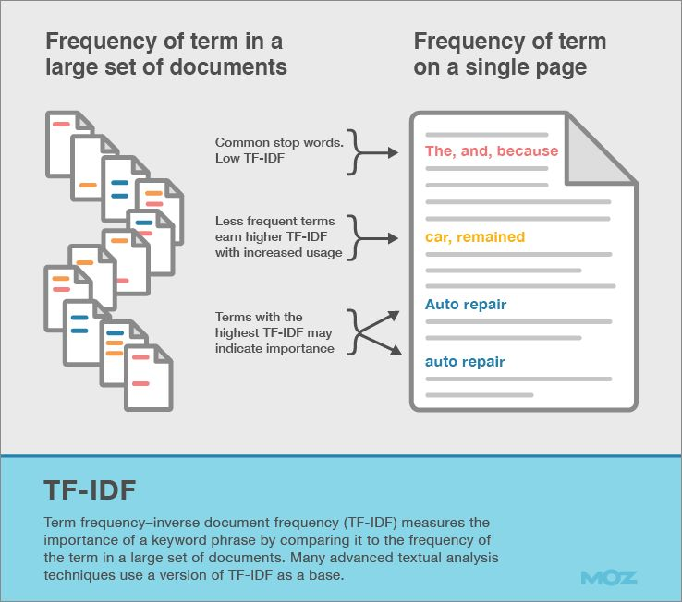
TF-IDF Transformation
Term Frequency x Inverse Document Frequency
  Successfully employed in information retrieval
Two parts:
  How many times a term occurs in a document? (Considers term frequency )
  How ‘important’ the term is?(Considers document/collection frequency )
  (Intuition: rare terms in a collection are more informative than frequent terms; Think stop-words!)
Notes:
Topics classification

Slide 9
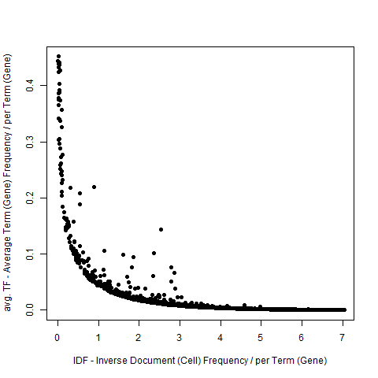
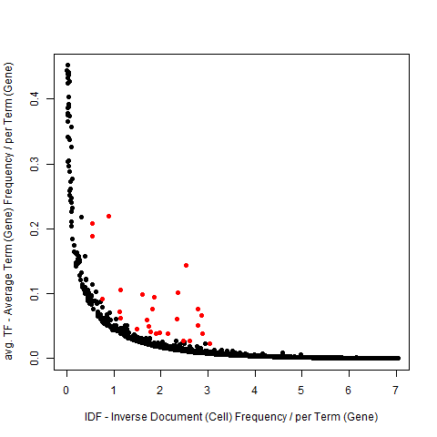
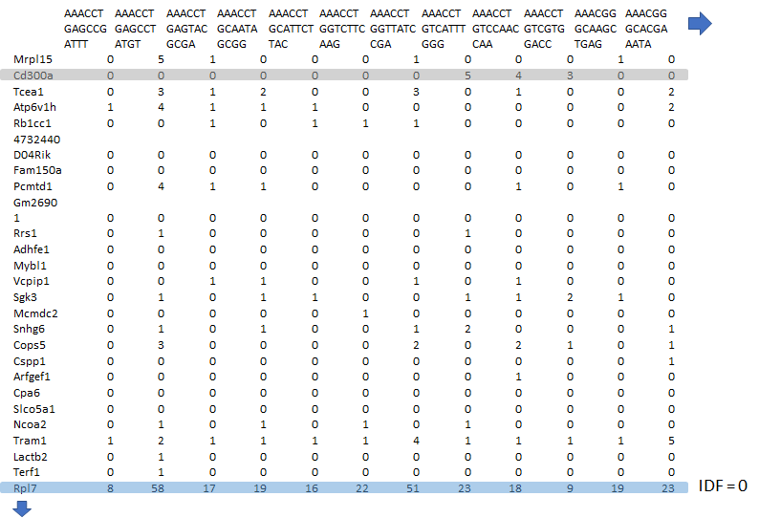
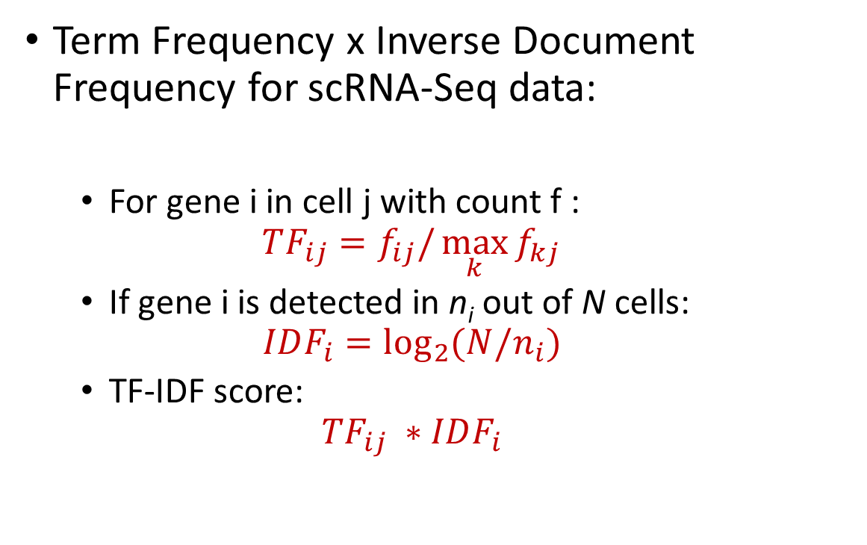
TF-IDF Transformation
Term Frequency x Inverse Document Frequency for scRNA-Seq data:
  For gene i in cell j with count f :
  $$TF_{ij}=f_{ij}/\max_{k}{f_{kj}}$$
  If gene i is detected in n_{i} out of N cells:
  $$IDF_{i}=\log_{2}{(N/n_{i})}$$
  TF-IDF score:
  $$TF_{ij} ∗IDF_{i}$$
>
Notes:
Analogy to scRNA-seq data
Library/collection/corpus of documents – sample of cells
Document – cell
Term -- Genes

Slide 10
scRNA-Seq Clustering Methods
Data Transformation:
TF-IDF
GMM
K-means
Cells QC, Genes QC, Gap-Statistics Analysis
Data Transformation: Log2(x+1) or none
Feature Selection: PCA, tSNE, highly variable genes* or none
Seurat (K-means)*
K-means
HC (E/P)
Feature Selection: High avg. TFIDF score (Top) or Highly variable TF-IDF (Var)
Louvain (E)
HC (E/P/C)
Data Binarization:
Cutoff threshold per cell based on cell avg. TF-IDF(Bin)
HC (E/P/C/J)
Greedy (E/P/C/J)
Louvain (E/P/C/J)
GMM
Seurat (SNN)*
Sph. K-means
Sph. K-means
Data Transformation:
TF-IDF
GMM
K-means
Cells QC, Genes QC, Gap-Statistics Analysis
Data Transformation: Log2(x+1) or none
Feature Selection: PCA, tSNE, highly variable genes* or none
Seurat (K-means)*
K-means
HC (E/P)
Feature Selection: High avg. TFIDF score (Top) or Highly variable TF-IDF (Var)
Louvain (E)
HC (E/P/C)
Data Binarization:
Cutoff threshold per cell based on cell avg. TF-IDF(Bin)
HC (E/P/C/J)
Greedy (E/P/C/J)
Louvain (E/P/C/J)
GMM
Seurat (SNN)*
Sph. K-means
Sph. K-means
Notes:
Designed several methods based on some aspect of TF-IDF ..

Slide 11
Existing scRNA-Seq clustering methods
Seurat: DOKMeans()
Seurat_SNN: FindClusters() shared nearest neighbor (SNN) clustering algorithm (SNN assigns objects to a cluster, which share a large number of their nearest neighbors).
Log_PCA_GMM (Gaussian Mixture Model based clustering using mclust R package).
K-means clustering variants:
  Log_Kmeans (motivated by Granatum pipeline)
  Log_PCA_Kmeans (motivated by CellRanger pipeline)
  tSNE_Kmeans (Granatum).
Log_PCA_sKmeans (Spherical K-means with log transform and PCA variants)
Hierarchical Clustering variants:
  Log_PCA_HC_E, Log_PCA_HC_P, tSNE_HC_E, tSNE_HC_P
Log_Louvain_E (Graph based Louvain modularity optimization clustering algorithm, CellRanger)

Slide 12
scRNA-Seq Clustering Methods
Data Transformation:
TF-IDF
GMM
K-means
Cells QC, Genes QC, Gap-Statistics Analysis
Data Transformation: Log2(x+1) or none
Feature Selection: PCA, tSNE, highly variable genes* or none
Seurat (K-means)*
K-means
HC (E/P)
Feature Selection: High avg. TFIDF score (Top) or Highly variable TF-IDF (Var)
Louvain (E)
HC (E/P/C)
Data Binarization:
Cutoff threshold per cell based on cell avg. TF-IDF(Bin)
HC (E/P/C/J)
Greedy (E/P/C/J)
Louvain (E/P/C/J)
GMM
Seurat (SNN)*
Sph. K-means
Sph. K-means
Data Transformation:
TF-IDF
GMM
K-means
Cells QC, Genes QC, Gap-Statistics Analysis
Data Transformation: Log2(x+1) or none
Feature Selection: PCA, tSNE, highly variable genes* or none
Seurat (K-means)*
K-means
HC (E/P)
Feature Selection: High avg. TFIDF score (Top) or Highly variable TF-IDF (Var)
Louvain (E)
HC (E/P/C)
Data Binarization:
Cutoff threshold per cell based on cell avg. TF-IDF(Bin)
HC (E/P/C/J)
Greedy (E/P/C/J)
Louvain (E/P/C/J)
GMM
Seurat (SNN)*
Sph. K-means
Sph. K-means

Slide 13
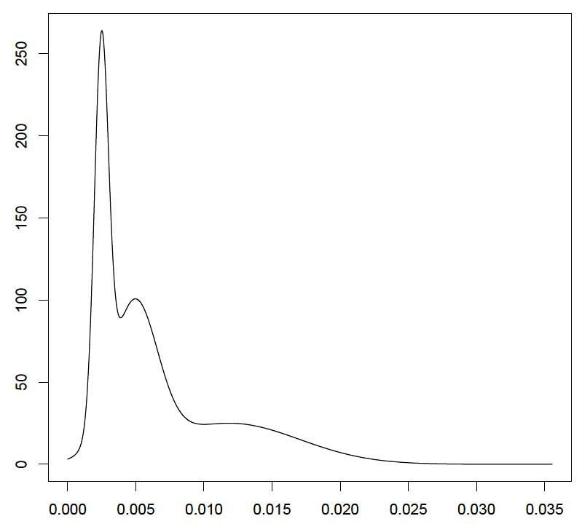
TF-IDF based gene selection
Genes with highest avg. TF-IDF, ranked (Top):
Density
fitted 2-mixture GMM model to the distribution of TF-IDF gene averages, ranked by number of detecting cells
Genes with highest avg. TF-IDF (highest mean GMM in red)
Avg. Gene TF-IDF score for regulatory, memory cells mix

Slide 14
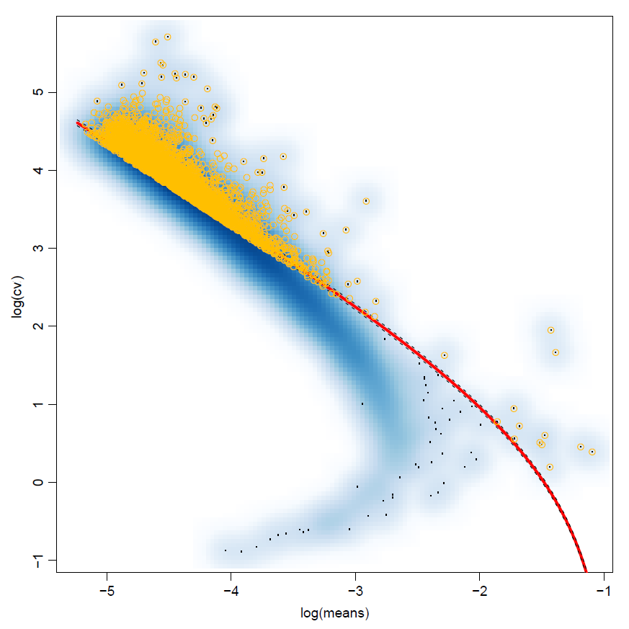
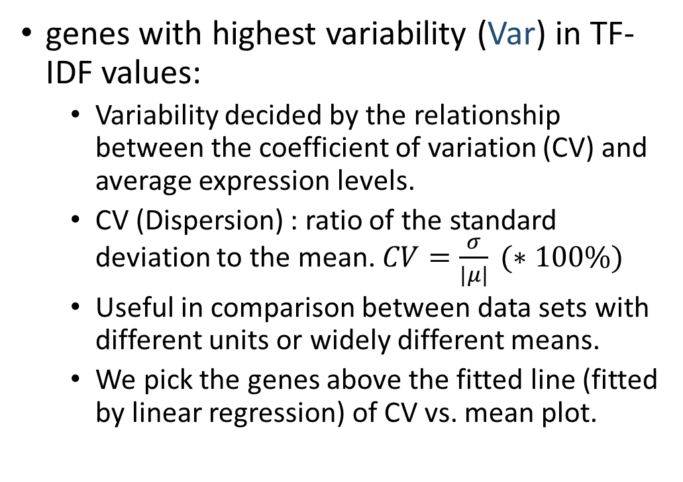
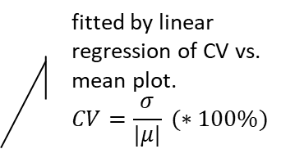
TF-IDF based gene selection
genes with highest variability (Var) in TF-IDF values:
  Variability decided by the relationship between the coefficient of variation (CV) and average expression levels.
  CV (Dispersion) : ratio of the standard deviation to the mean. $CV=\frac{σ}{|μ|} (∗100\%)$
  Useful in comparison between data sets with different units or widely different means.
  We pick the genes above the fitted line (fitted by linear regression) of CV vs. mean plot.
  fitted by linear regression of CV vs. mean plot.
  $$CV=\frac{σ}{|μ|} (∗100\%)$$

Slide 15
scRNA-Seq Clustering Methods
Data Transformation:
TF-IDF
GMM
K-means
Cells QC, Genes QC, Gap-Statistics Analysis
Data Transformation: Log2(x+1) or none
Feature Selection: PCA, tSNE, highly variable genes* or none
Seurat (K-means)*
K-means
HC (E/P)
Feature Selection: High avg. TFIDF score (Top) or Highly variable TF-IDF (Var)
Louvain (E)
HC (E/P/C)
Data Binarization:
Cutoff threshold per cell based on cell avg. TF-IDF(Bin)
HC (E/P/C/J)
Greedy (E/P/C/J)
Louvain (E/P/C/J)
GMM
Seurat (SNN)*
Sph. K-means
Sph. K-means
Data Transformation:
TF-IDF
GMM
K-means
Cells QC, Genes QC, Gap-Statistics Analysis
Data Transformation: Log2(x+1) or none
Feature Selection: PCA, tSNE, highly variable genes* or none
Seurat (K-means)*
K-means
HC (E/P)
Feature Selection: High avg. TFIDF score (Top) or Highly variable TF-IDF (Var)
Louvain (E)
HC (E/P/C)
Data Binarization:
Cutoff threshold per cell based on cell avg. TF-IDF(Bin)
HC (E/P/C/J)
Greedy (E/P/C/J)
Louvain (E/P/C/J)
GMM
Seurat (SNN)*
Sph. K-means
Sph. K-means

Slide 16
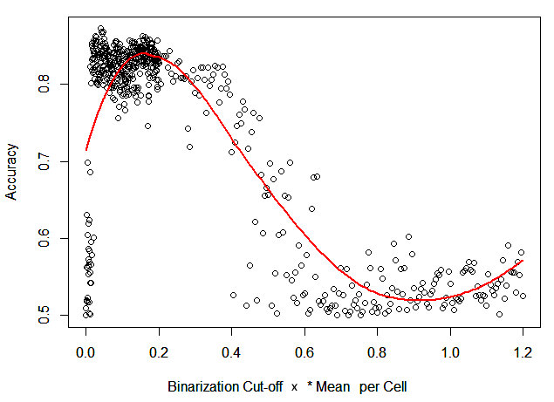
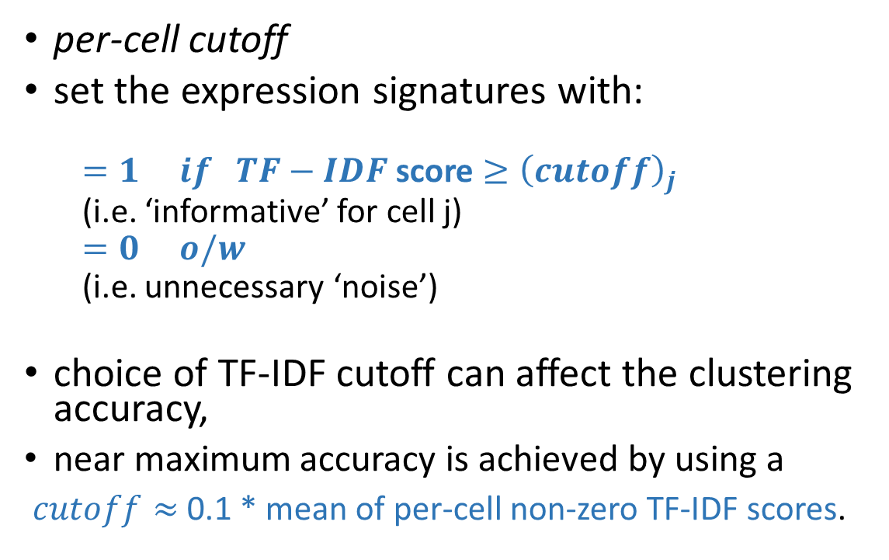
TF-IDF Binarization
per-cell cutoff
set the expression signatures with:
  $=1 if TF−IDF$ score $≥{\left(cutoff\right)}_{j}$
  (i.e. ‘informative’ for cell j)
  $=0 o/w$
  (i.e. unnecessary ‘noise’)
choice of TF-IDF cutoff can affect the clustering accuracy,
near maximum accuracy is achieved by using a
$cutoff≈$ 0.1 * mean of per-cell non-zero TF-IDF scores.
(plotted for a mix of 1,000 memory and 1,000 regulatory T cells)

Slide 17
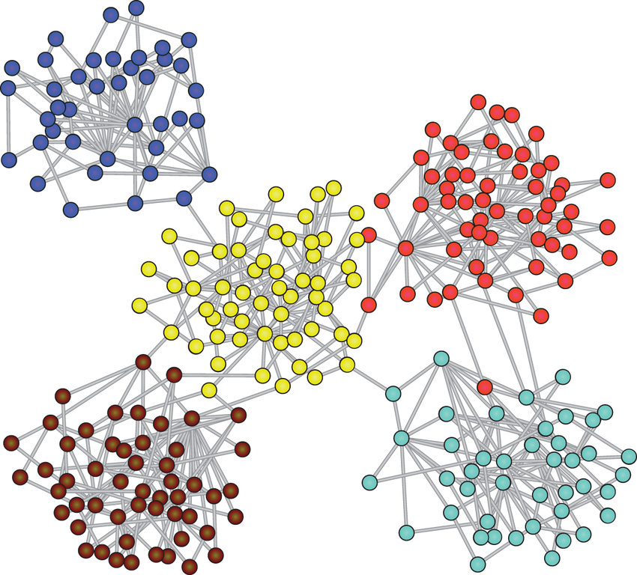
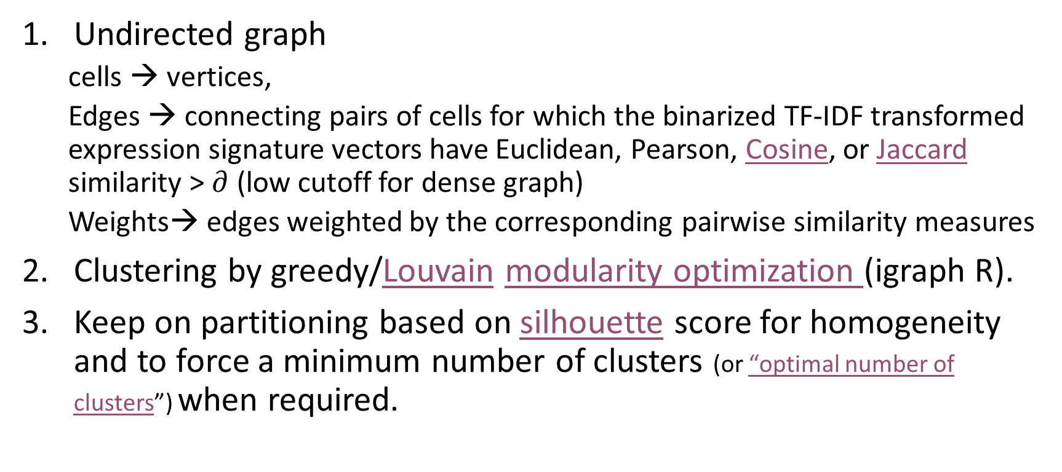
Graph based clustering
Undirected graph
  cells → vertices,
  Edges → connecting pairs of cells for which the binarized TF-IDF transformed expression signature vectors have Euclidean, Pearson, Cosine, or Jaccard similarity > $∂$ (low cutoff for dense graph)
  Weights→ edges weighted by the corresponding pairwise similarity measures
Clustering by greedy/Louvain modularity optimization (igraph R).
Keep on partitioning based on silhouette score for homogeneity and to force a minimum number of clusters (or “optimal number of clusters”) when required.

Slide 18
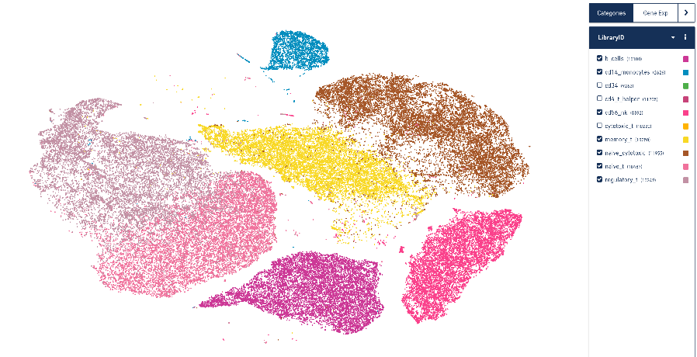
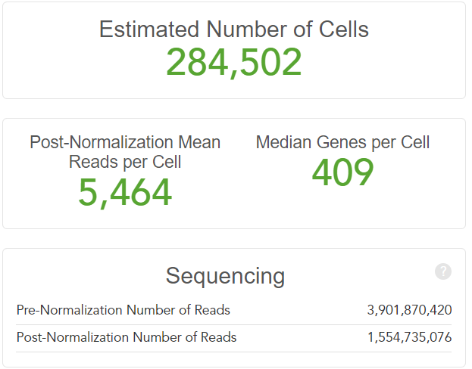
Experimental Setup: PBMC data set
FACS sorted blood cells of 7 types [Zheng et al. 2017] using the 10x Genomics platform
  CD14+ Monocytes
  CD19+ B Cells
  CD4+/CD25+ Regulatory T Cells
  CD4+/CD45RA+/CD25- Naive T cells
  CD4+/CD45RO+ Memory T Cells
  CD56+ Natural Killer Cells
  CD8+/CD45RA+ Naive Cytotoxic T Cells
7:1, 3:1, 1:1, 1:3, and 1:7 mixtures of cell type pairs of varying dissimilarity, bootstrapping (5x sampling, 1000 cells/pair)
  highly dissimilar: (b cells and cd14 monocytes) and (b cells and cd56 nk)
  highly similar : (memory t and naive cytotoxic) and (regulatory t and naive t)
  intermediate similarity: (memory t and naive t) and (regulatory t and naive cytotoxic)
7-way mixture, equal proportions (5x sampling, 7000 cells/mix)
  https://support.10xgenomics.com/single-cell-gene-expression/datasets
  http://cnv1.engr.uconn.edu:3838/SCA/

Slide 19
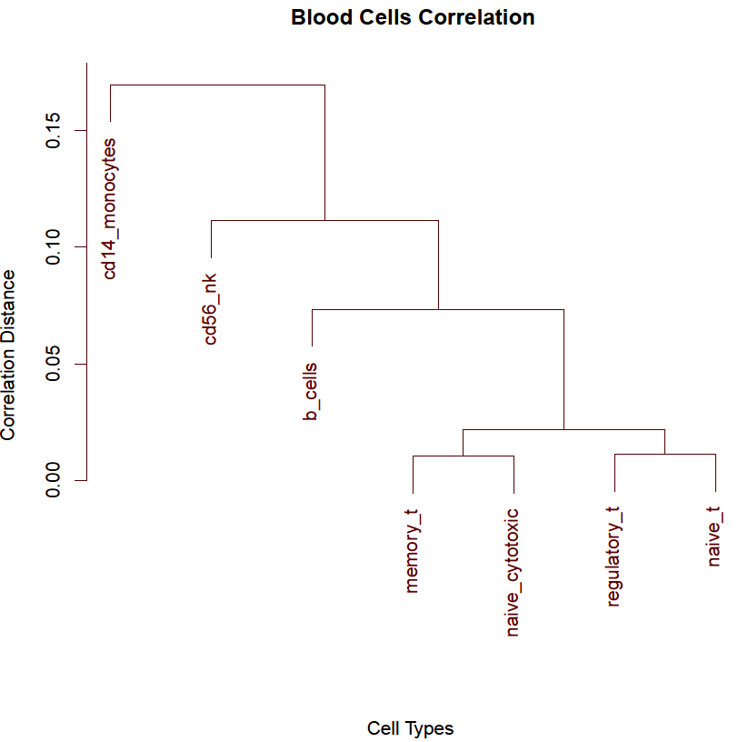
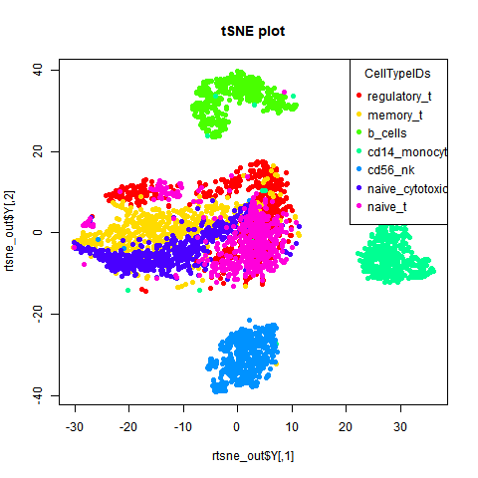
Experimental Setup: PBMC data set

Slide 20
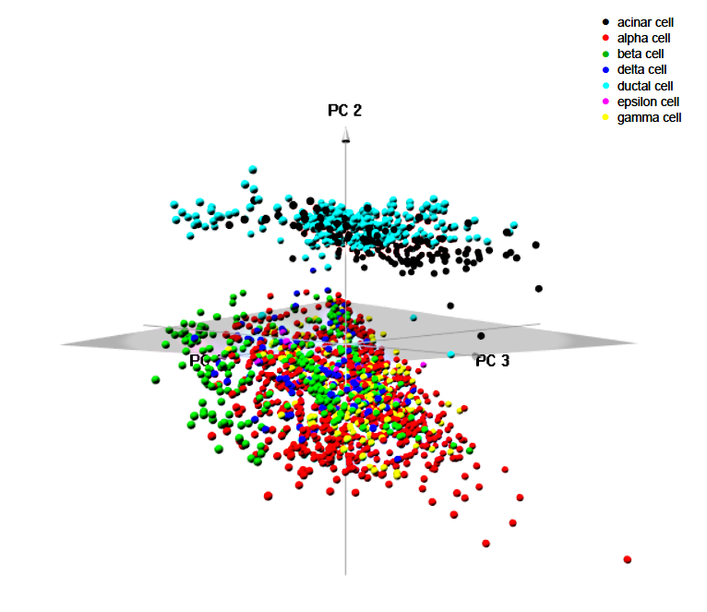
Experimental Setup: Pancreatic cells
2045 Pancreatic cells of 7 types [Segerstolpe et al. 2016]
  Annotated based on known markers
  Capture proportions: (185 acinar cells, 886 alpha cells, 270 beta cells, 197 gamma cells, 114 delta cells, 386 ductal cells, and 7 epsilon cells)

Slide 21
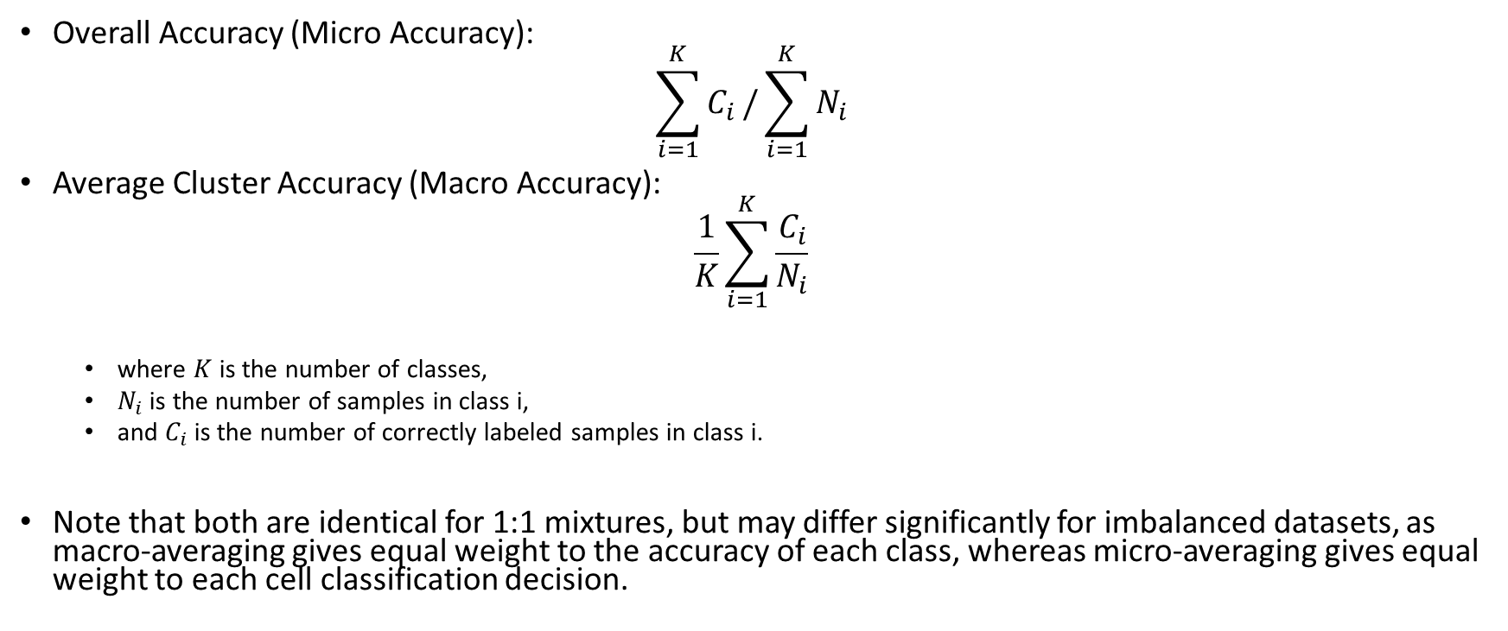
Accuracy measures
Overall Accuracy (Micro Accuracy):
$$\sum_{i=1}^{K}{C_{i}}/\sum_{i=1}^{K}{N_{i}}$$
Average Cluster Accuracy (Macro Accuracy):
$$\frac{1}{K}\sum_{i=1}^{K}{\frac{C_{i}}{N_{i}}}$$
  where $K$ is the number of classes,
  $N_{i}$ is the number of samples in class i,
  and $C_{i}$ is the number of correctly labeled samples in class i.
Note that both are identical for 1:1 mixtures, but may differ significantly for imbalanced datasets, as macro-averaging gives equal weight to the accuracy of each class, whereas micro-averaging gives equal weight to each cell classification decision.

Slide 22
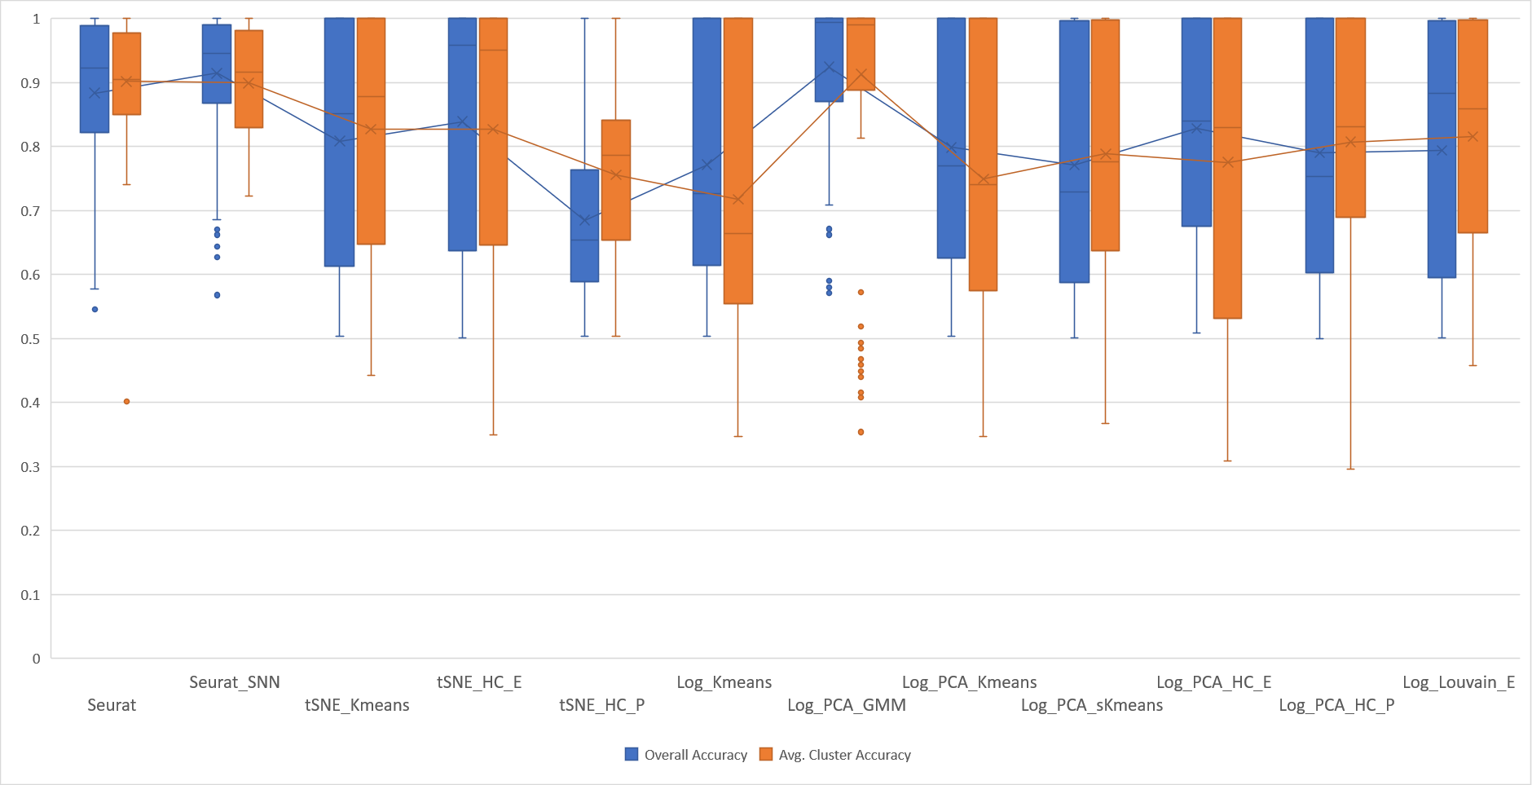
Pairs: Existing Methods
Box-and-whiskers plots for results of 150 sets/method.
Median: horizontal line; mean: connected middle points; whiskers: extreme non-outlier; outliers: data points > 1.5 interquartile

Slide 23
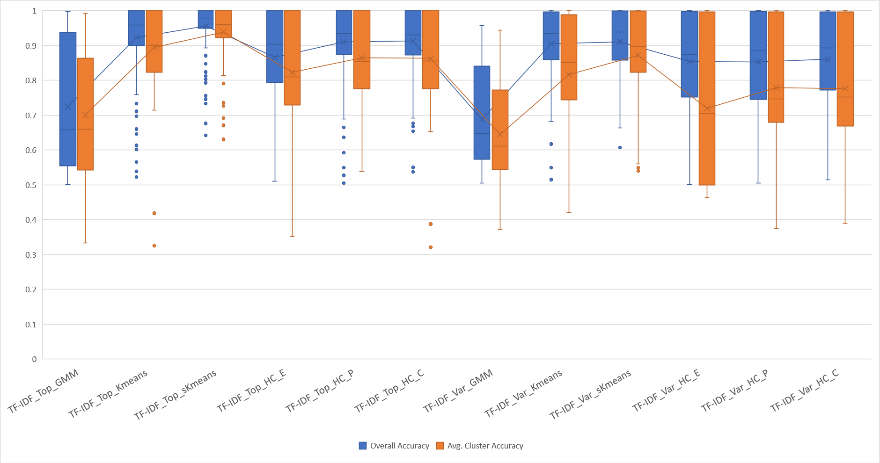
Pairs: Algorithms using TF-IDF gene selection

Slide 24
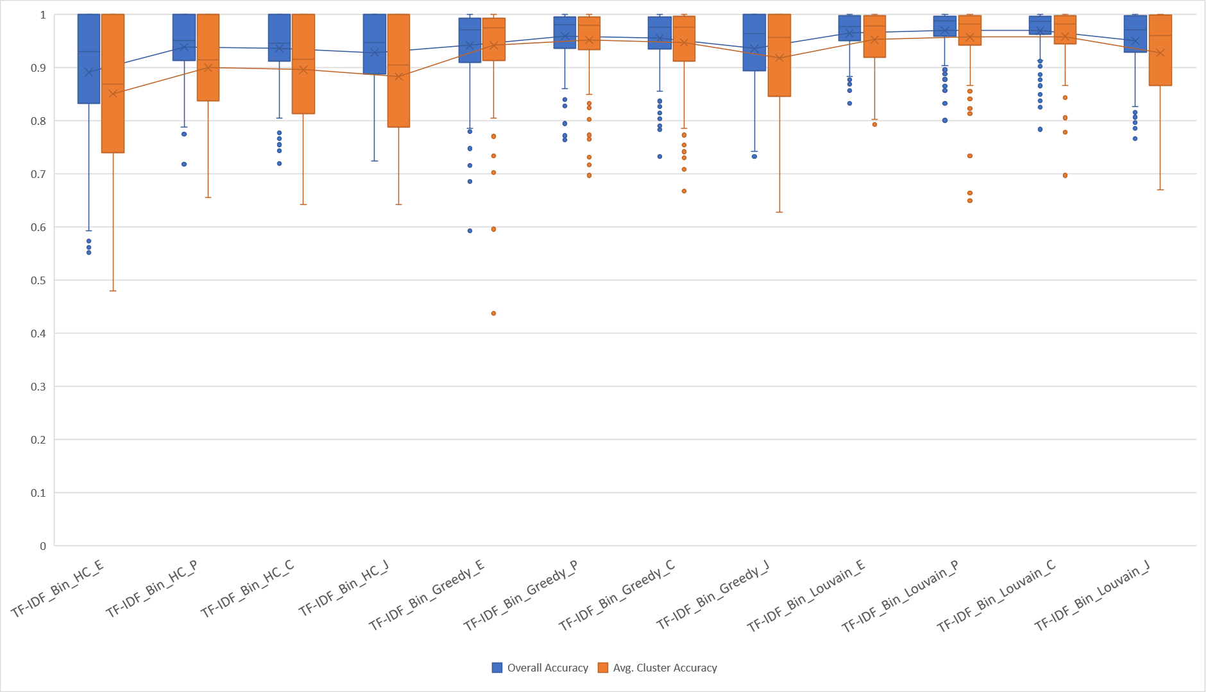
Pairs: Algorithms using TF-IDF binarization.

Slide 25
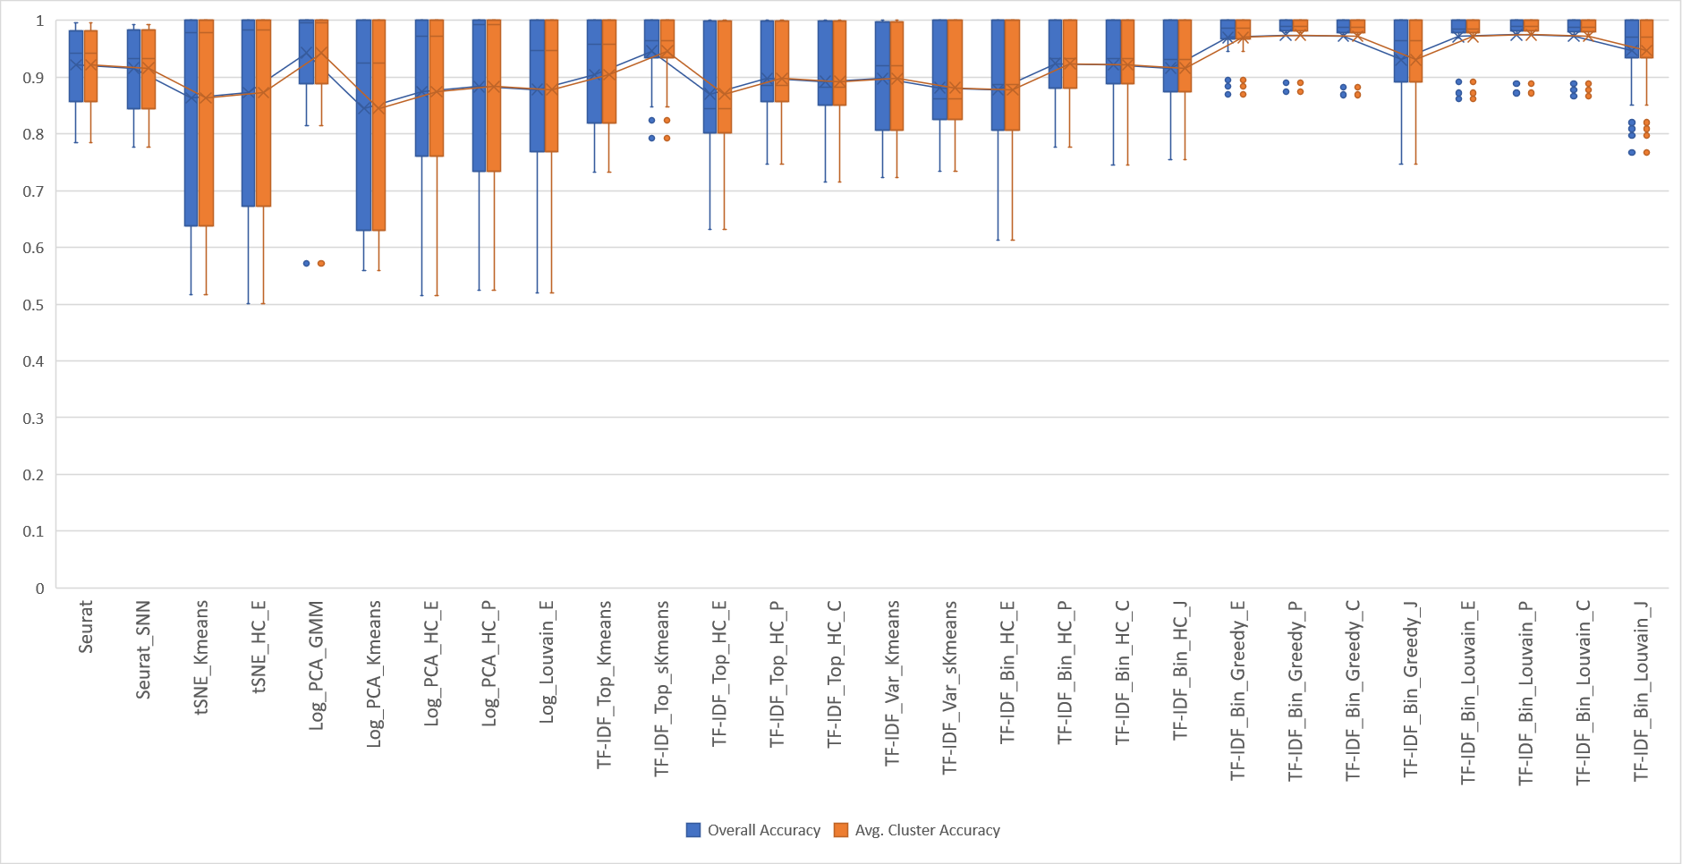
Pairs: 1:1 mixtures

Slide 26
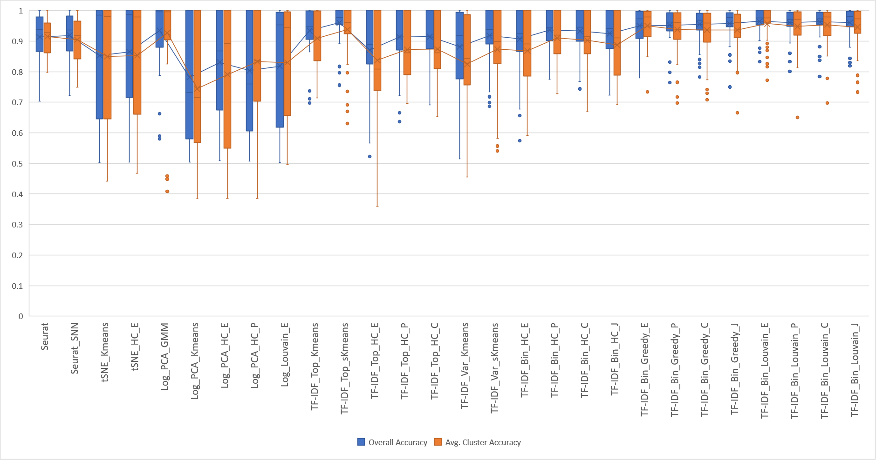
Pairs: 1:3/3:1 mixtures

Slide 27
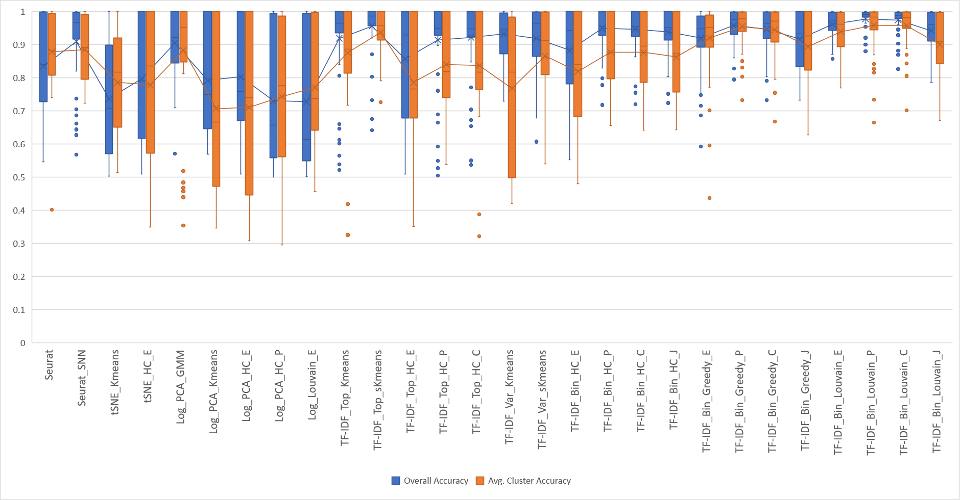
Pairs: 1:7/7:1 mixtures

Slide 28
Accuracy for PBMC Cells, 7-way mixture

Slide 29
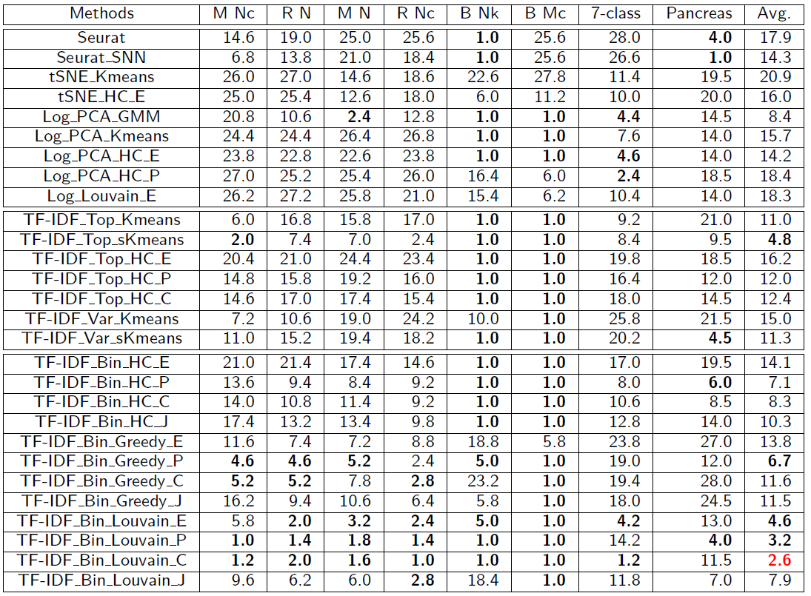
Average ranks based on overall accuracy.
The lowest five average ranks (including ties) for each dataset are typeset in bold, and the best overall average rank is shown in red.

Slide 30
Conclusion & Ongoing Work – Part I
The range of single-cell applications continues to expand, fueled by advances in technology
New algorithms for scRNA-Seq clustering still needed
  Preliminary results using TF-IDF transformation promising
  Scalable to millions of cells in conjunction with graph-based clustering
Ongoing work
  Modified TF-IDF definition
  Study effect of cell cycle analysis/removal on clustering.
  TF-IDF based feature selection.
>

Slide 31
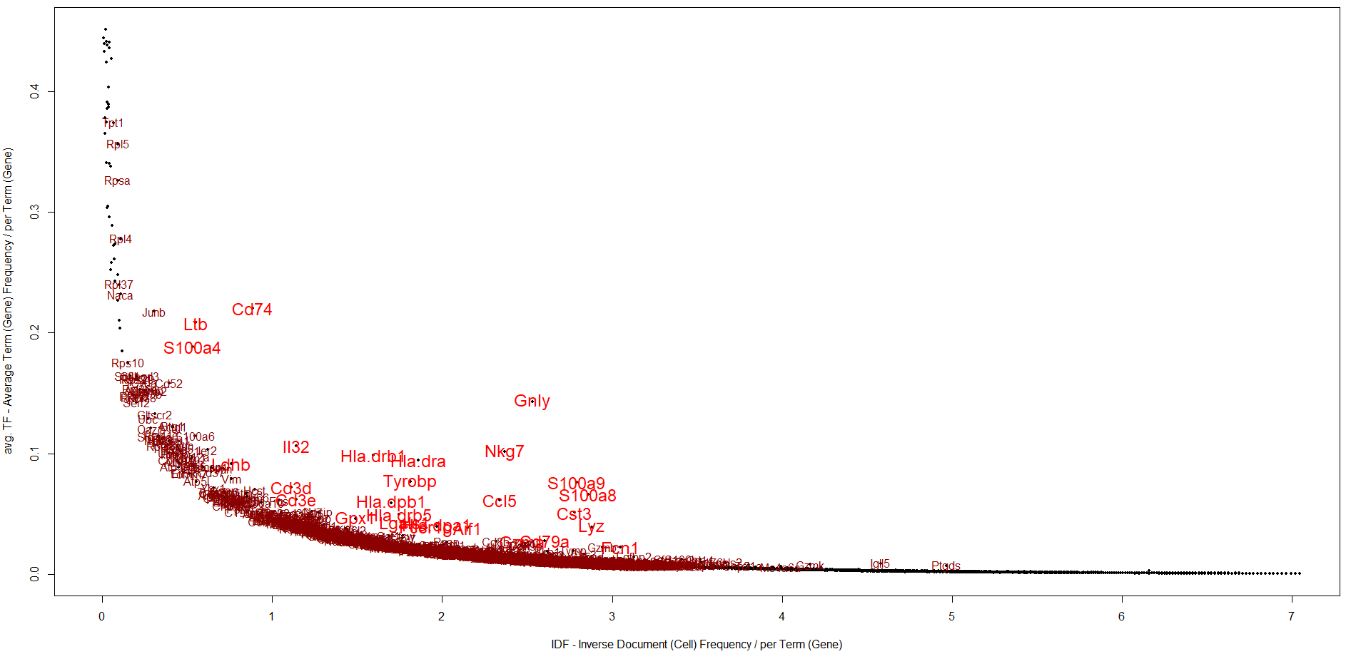
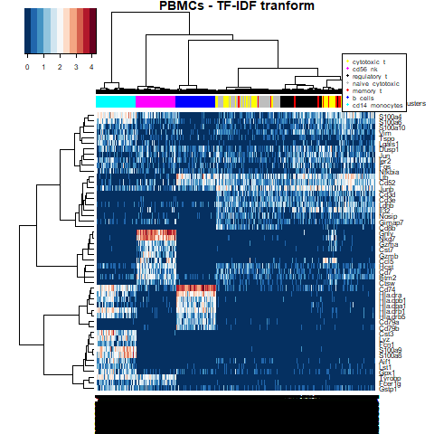
TF-IDF based Feature selection
Genes with highest avg. TF-IDF (highest mean GMM in red)
<

Slide 32
Extra Slides – Part I
>

Slide 33
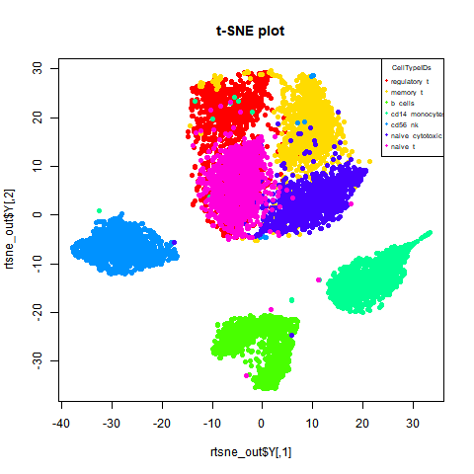
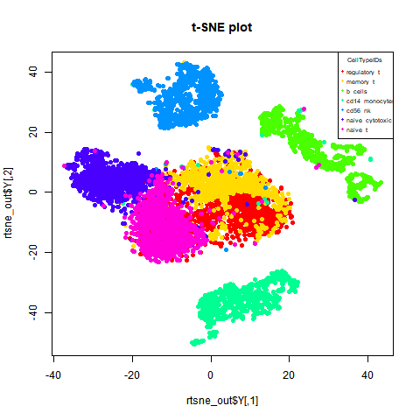
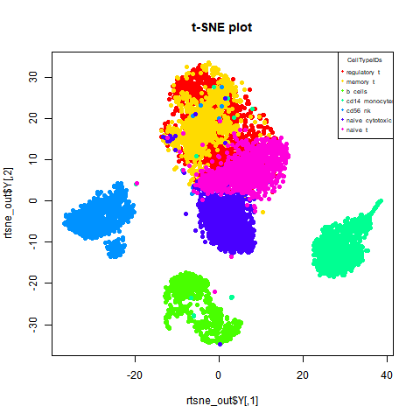
t-SNE TF-IDF transformation
Raw PBMC data t-SNE plot
TF-IDF transformed data t-SNE plot
<

Slide 34
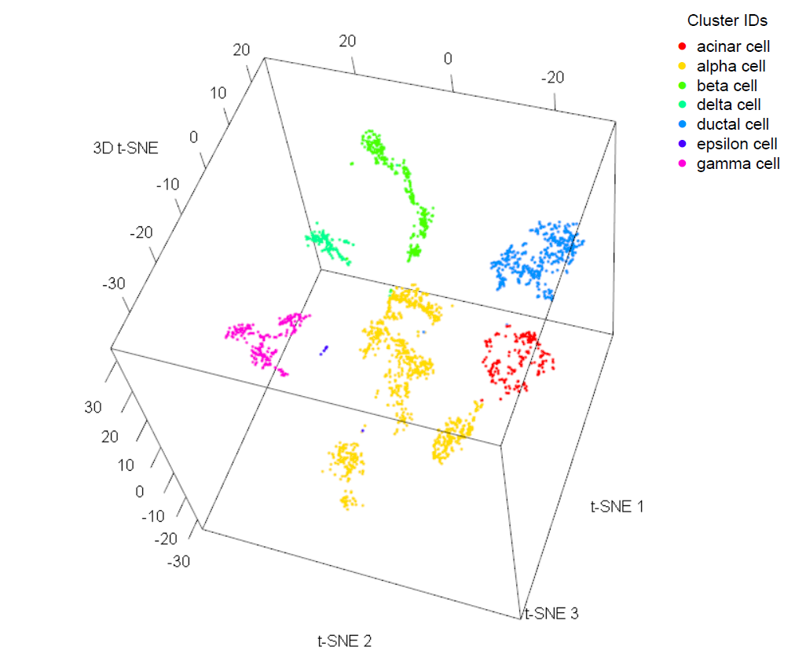
t-SNE TF-IDF transformation
Raw Pancreas data t-SNE plot
TF-IDF transformed data t-SNE plot
<

Slide 35
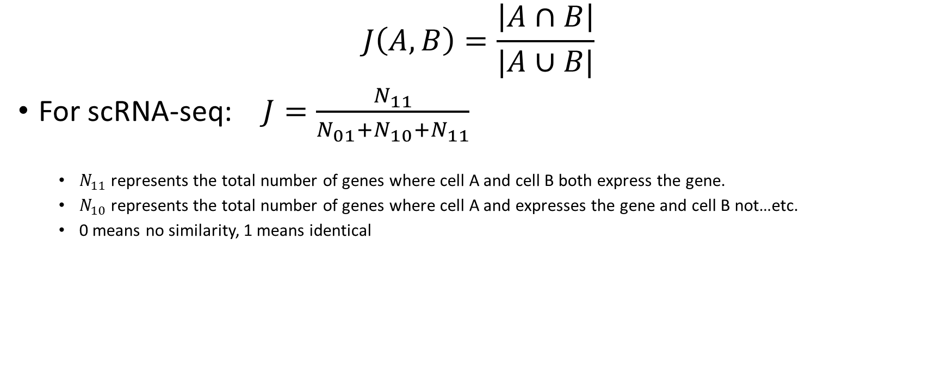
Jaccard Similarity
$$J\left(A,B\right)=\frac{\left|A∩B\right|}{|A∪B|}$$
For scRNA-seq: $J=\frac{N_{11}}{N_{01}+N_{10}+N_{11}}$
  $N_{11}$ represents the total number of genes where cell A and cell B both express the gene.
  $N_{10}$ represents the total number of genes where cell A and expresses the gene and cell B not…etc.
  0 means no similarity, 1 means identical
<

Slide 36
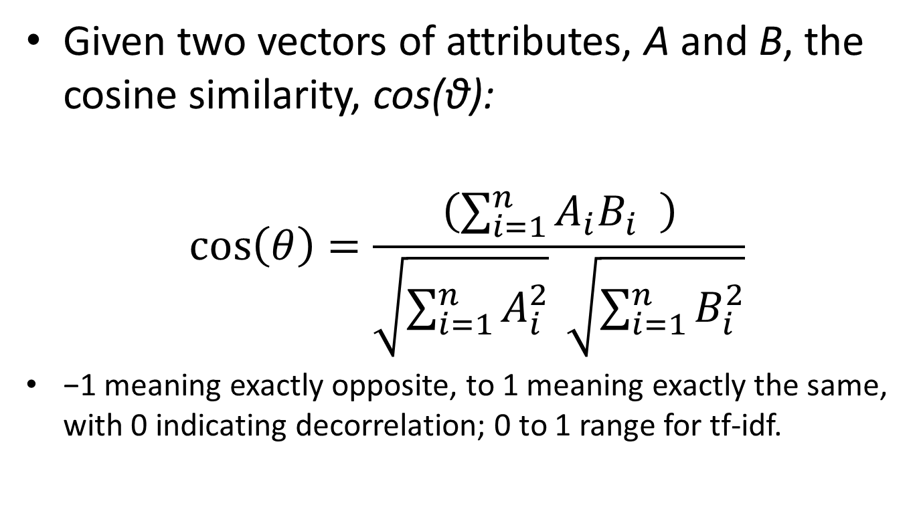
Cosine Similarity
Given two vectors of attributes, A and B, the cosine similarity, cos(θ):
$$\cos\left(θ\right)=\frac{\left(\sum_{i=1}^{n}{A_{i}B_{i} } \right)}{\sqrt{\sum_{i=1}^{n}{A_{i}^{2}}} \sqrt{\sum_{i=1}^{n}{B_{i}^{2}}}}$$
−1 meaning exactly opposite, to 1 meaning exactly the same, with 0 indicating decorrelation; 0 to 1 range for tf-idf.
<

Slide 37
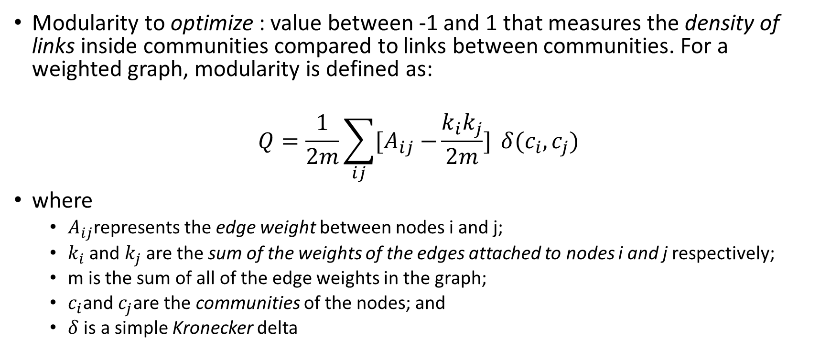
Modularity Optimization
Modularity to optimize : value between -1 and 1 that measures the density of links inside communities compared to links between communities. For a weighted graph, modularity is defined as:
$$Q=\frac{1}{2m}\sum_{ij}{{[A}_{ij} −\frac{k_{i}k_{j}}{2m}]} δ(c_{i}, c_{j})$$
where
  $A_{ij}$represents the edge weight between nodes i and j;
  $k_{i}$ and $k_{j}$ are the sum of the weights of the edges attached to nodes i and j respectively;
  m is the sum of all of the edge weights in the graph;
  $c_{i}$and $c_{j}$are the communities of the nodes; and
  $δ$ is a simple Kronecker delta
<

Slide 38
Louvain Method
first small communities are found by optimizing modularity locally on all nodes (evaluates the change of modularity by removing i from its community and then by moving it into a neighboring community),
then each small community is grouped into one node and the first step is repeated.
<

Slide 39
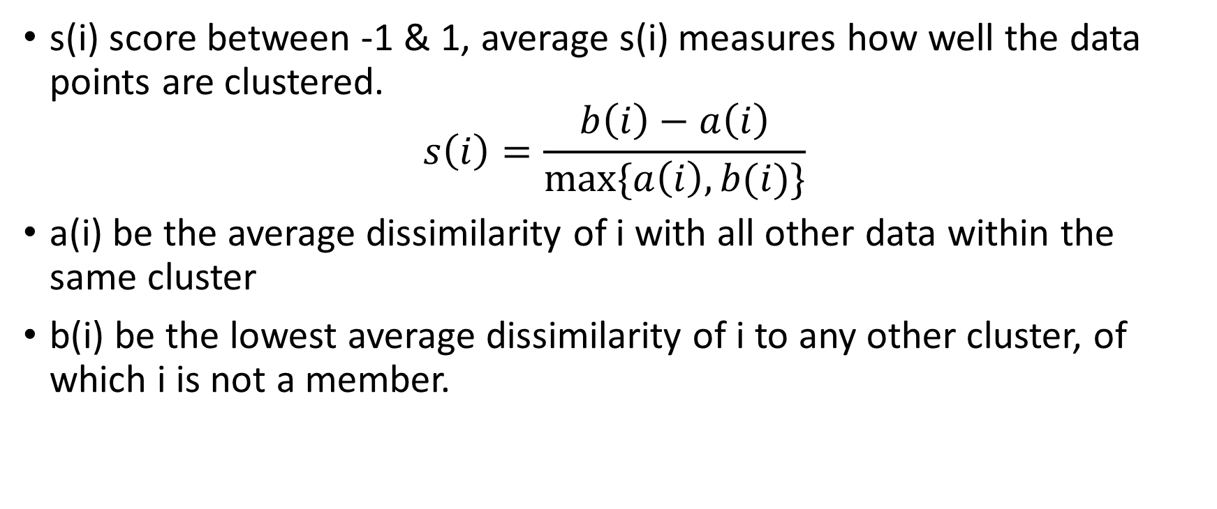
Silhouette Score
s(i) score between -1 & 1, average s(i) measures how well the data points are clustered.
$$s\left(i\right)=\frac{b\left(i\right)−a\left(i\right)}{max⁡\{a\left(i\right),b(i)\}}$$
a(i) be the average dissimilarity of i with all other data within the same cluster
b(i) be the lowest average dissimilarity of i to any other cluster, of which i is not a member.
<

Slide 40
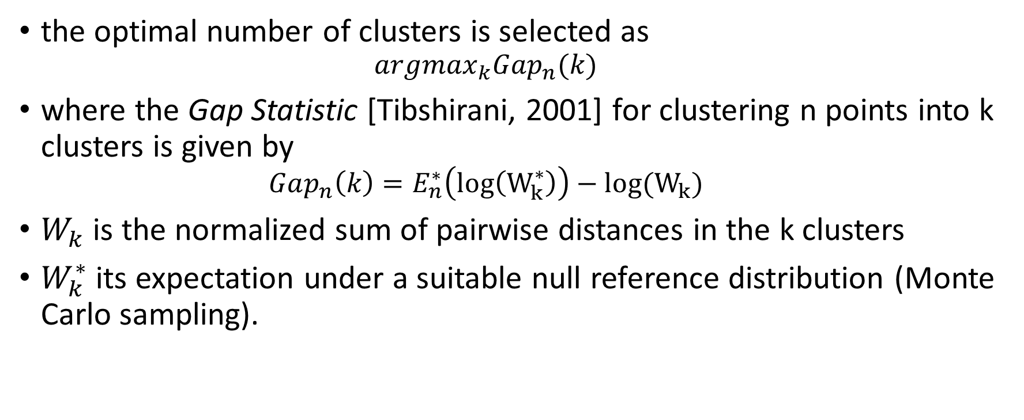
‘Optimal’ number of clusters
the optimal number of clusters is selected as
  $$argmax_{k}Gap_{n}(k)$$
where the Gap Statistic [Tibshirani, 2001] for clustering n points into k clusters is given by
  $$Gap_{n}\left(k\right)=E_{n}^{∗}\left(log\left(W_{k}^{∗}\right)\right)−log(W_{k})$$
$W_{k}$ is the normalized sum of pairwise distances in the k clusters
$W_{k}^{∗}$ its expectation under a suitable null reference distribution (Monte Carlo sampling).
<

Slide 41
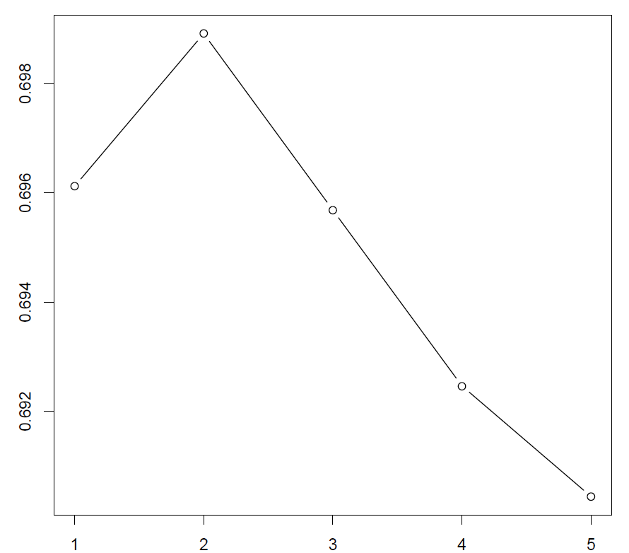
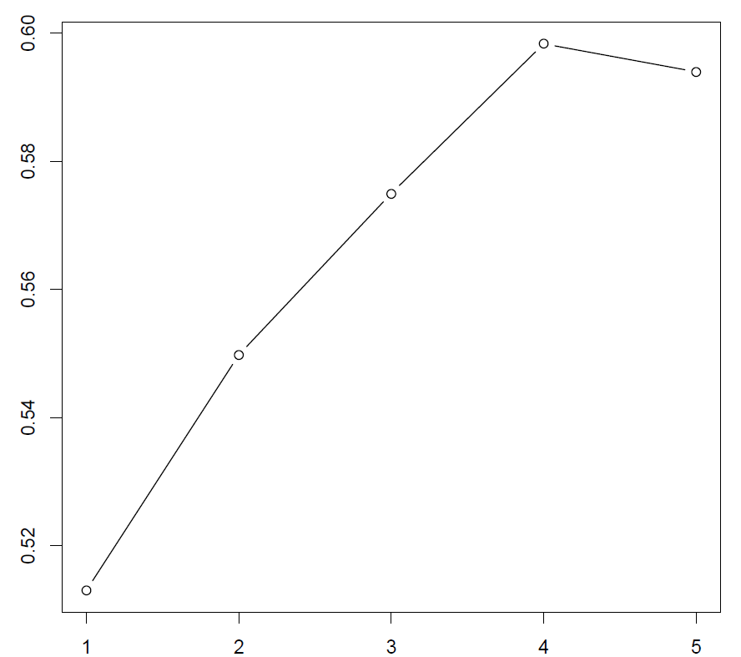
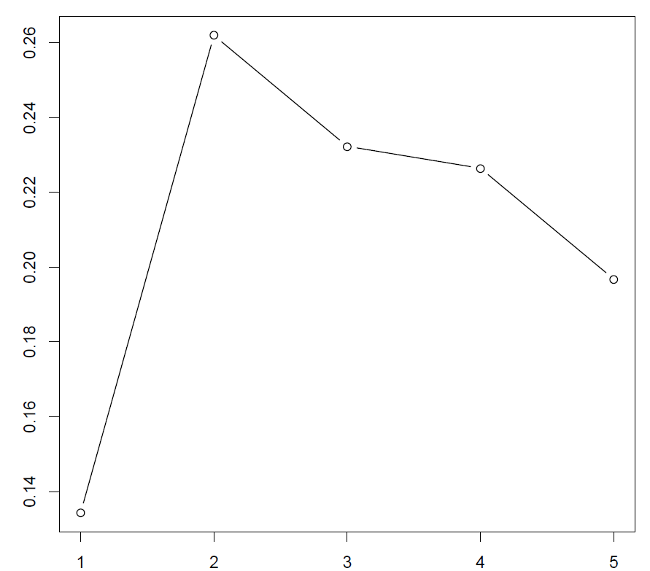
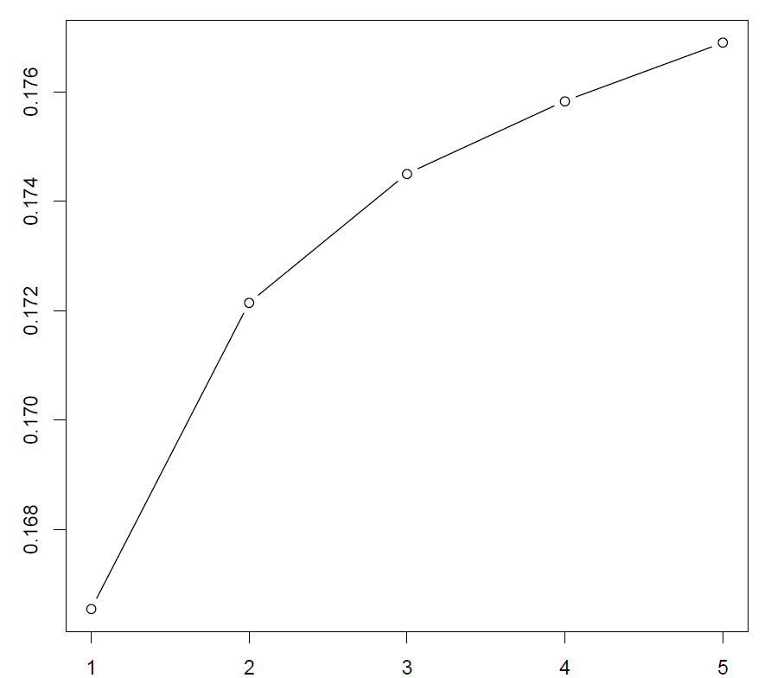
Example: Regulatory_t and naïve_t data set
Clockwise from top left:
Gap statistics for log-transformed, log-transformed PCA, tSNE,
and TF-IDF transformed and binarized expression levels of a 7:1 mixture of regulatory t and
naive t cells.
The x-axis gives the number of clusters K and the y-axis gives the gap statistic.
<

Slide 42
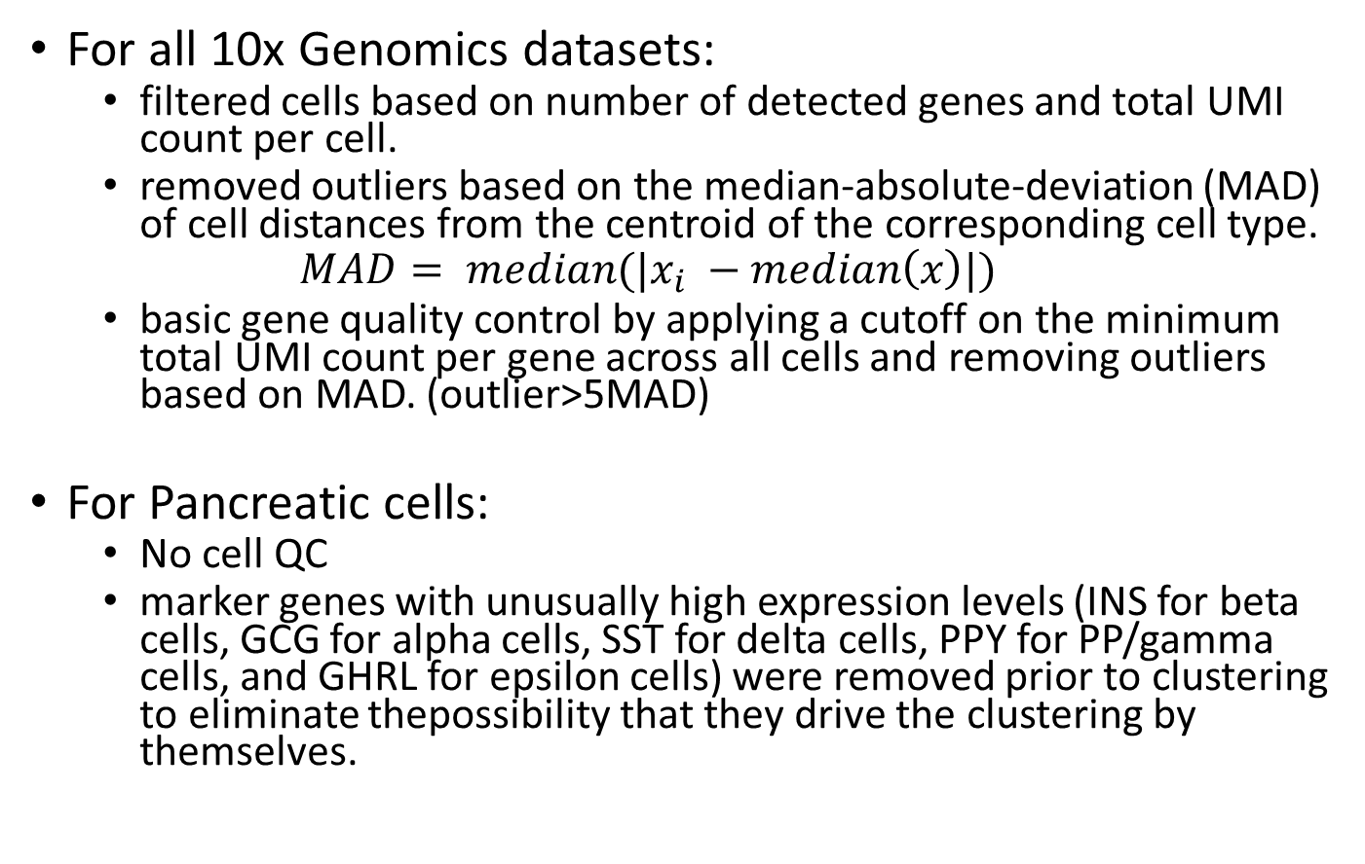
Cells’ & Genes’ QC
For all 10x Genomics datasets:
  filtered cells based on number of detected genes and total UMI count per cell.
  removed outliers based on the median-absolute-deviation (MAD) of cell distances from the centroid of the corresponding cell type.
  $$MAD= median(|x_{i} −median\left(x\right)|)$$
  basic gene quality control by applying a cutoff on the minimum total UMI count per gene across all cells and removing outliers based on MAD. (outlier>5MAD)
For Pancreatic cells:
  No cell QC
  marker genes with unusually high expression levels (INS for beta cells, GCG for alpha cells, SST for delta cells, PPY for PP/gamma cells, and GHRL for epsilon cells) were removed prior to clustering to eliminate thepossibility that they drive the clustering by themselves.
<

Slide 43
Pairs by ‘difficulty’: dissimilar → intermediate → similar
  highly dissimilar: (b cells and cd14 monocytes) and (b cells and cd56 nk)
  highly similar : (memory t and naive cytotoxic) and (regulatory t and naive t)
  intermediate similarity: (memory t and naive t) and (regulatory t and naive cytotoxic)
<

Slide 44
Accuracy for Pancreatic mixture
<

Slide 45
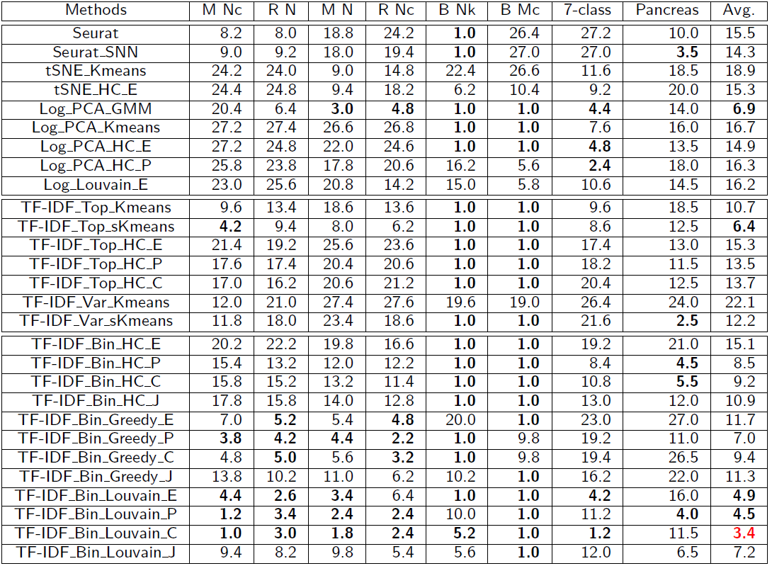
Average ranks based on average cluster accuracy.
The lowest five average ranks (including ties) for each dataset are typeset in bold, and the best overall average rank is shown in red.
<

Slide 46

Modified TF-IDF Transformation
Term Frequency x Inverse Document Frequency for scRNA-Seq data:
  $$f^{′}=log⁡(f+1)$$
  For gene i in cell j with count f:
  $$TF_{ij}=f_{ij}^{′}/\max_{k}{f_{kj}^{′}}$$
  If gene i is detected with $f_{i}≥$t in n_{i} out of N cells:
  $$IDF_{i}=\log_{2}{(N/n_{i})}$$
  Possible choice for $t=mean TF$
  TF-IDF score:
  $$TF_{ij} ∗IDF_{i}$$
<

Slide 47
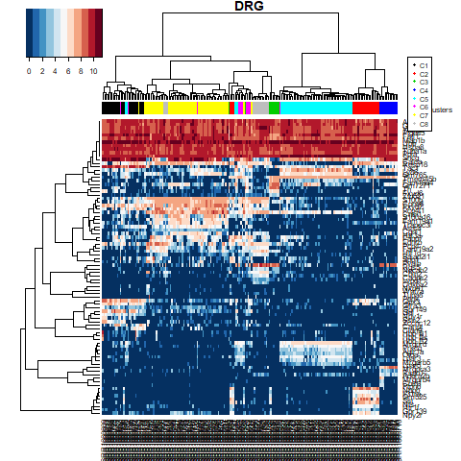
TF-IDF based Feature selection
42 Genes out of 47 hand-curated Markers List picked in top 1K TF-IDF Genes
<

Slide 48
References – Part I
Tang, F., et al. "mRNA-Seq whole-transcriptome analysis of a single cell." Nature methods 6.5 (2009): 377-382.
Macosko, E. Z., et al. "Highly parallel genome-wide expression profiling of individual cells using nanoliter droplets." Cell 161.5 (2015): 1202-1214.
Satija, R., Farrell, J.A., Gennert, D., Schier, A.F., Regev, A.: Spatial reconstruction of single-cell gene expression data. Nature biotechnology 33(5), 495{502 (2015)
Zheng, G.X.Y., Terry, J.M., Belgrader, P., Ryvkin, P., Bent, Z.W., Wilson, R., Ziraldo, S.B., Wheeler, T.D., McDermott, G.P., Zhu, J., Gregory, M.T., Shuga, J., Montesclaros, L., Underwood, J.G., Masquelier, D.A., Nishimura, S.Y., Schnall-Levin, M., Wyatt, P.W., Hindson, C.M., Bharadwaj, R., Wong, A., Ness, K.D., Beppu, L.W., Deeg, H.J., McFarland, C., Loeb, K.R., Valente, W.J., Ericson, N.G., Stevens, E.A., Radich, J.P., Mikkelsen, T.S., Hindson, B.J., Bielas, J.H.: Massively parallel digital transcriptional profiling of single cells.
Tibshirani, R., Walther, G., Hastie, T.: Estimating the number of clusters in a data set via the gap statistic. Journal of the Royal Statistical Society: Series B (Statistical Methodology) 63(2), 411{423 (2001).
Moussa, M., and Mandoiu, I.: Clustering scRNA-Seq Data using TF-IDF. Bioinformatics Research and Applications. 13th International Symposium, ISBRA 2017, Honolulu, HI, USA. Lecture Notes in Computer Science book series ( Extended Abstract in LNCS, volume 10330).
Moussa, M., and Mandoiu, I.: Single Cell RNA-seq Data Clustering using TF-IDF based Methods. (BMC Genomics, 2017).
Chung, W., et al. "Single-cell RNA-seq enables comprehensive tumour and immune cell profiling in primary breast cancer." Nature Communications 8 (2017).

Slide 49
Part II - Locality Sensitive Imputation for Single-Cell RNA-Seq Data

Slide 50
Drop-outs
Problem: overrepresentation of zeros in scRNA-seq datasets makes it difficult to distinguish technical dropout of transcripts from true biological variation between cells.
Drop outs occurring because of
  inefficient mRNA capture,
  low number of RNA transcripts and the stochastic nature of gene expression,
→ the result is capturing only a fraction of the transcriptome of each cell and hence data that has a high degree of sparsity.
Notes:
drop-outs typically do not affect the highly expressed genes as severely but may affect biologically interesting genes expressed at low levels such as transcription factors.

Slide 51
Existing single cell RNA-Seq imputation methods - DrImpute
DRImpute (clustering cells)
scImpute
KNNImpute (K nearest neighbour genes)

Slide 52
Proposed method: Locality Sensitive Imputation for scRNA-Seq Data (LSImpute)
High level summary of the novel imputation algorithm (LSImpute):
Step 1. Given a set (S) of (n) cells , start by selecting a small number (m) of cells with highest similarity level.
Step 2. Group the highly similar cells from Step 1 into clusters (“tight” ).
Step 3. For each cluster, replace zeros for each gene j with values imputed based on the expression levels of gene j in all cells within the cluster.
Step 4. The selected cells now have imputed values and the clusters they form are collapsed into their respective centroids.
The centroids are pooled together with remaining cells to form a (S’) and the process is repeated starting again at Step 1.
Notes:
unlike KNN, which uses similarity between genes, LSImpute uses similarity between cells. Also, the number of nearest cells used for imputation is not fixed but depends on the minimum similarity threshold

Slide 53



Toy Example:

Slide 54

Proposed method: Locality Sensitive Imputation for scRNA-Seq Data (LSImpute)
High level summary of the novel imputation algorithm (LSImpute):
Step 1. Given a set (S) of (n) cells , start by selecting a small number (m) of cells with highest similarity level.
Quadratic Pairwise Distance ${O(n}^{2}) each round$?? → LSH: Locality Sensitive Hashing O(n).
Step 2. Group the highly similar cells from Step 1 into clusters (“tight” ).
Step 3. For each cluster, replace zeros for each gene j with values imputed based on the expression levels of gene j in all cells within the cluster.
Mean (LSImputeMean) /Median (LSImputeMed)
Step 4. The selected cells now have imputed values and the clusters they form are collapsed into their respective centroids.
The centroids are pooled together with remaining cells to form a (S’) and the process is repeated starting again at Step 1. O(n) iterations.
Notes:
unlike KNN, which uses similarity between genes, LSImpute uses similarity between cells. Also, the number of nearest cells used for imputation is not fixed but depends on the minimum similarity threshold.
Using the median of both zero and non-zero values, first, decides implicitly whether a zero is a drop-out event or a true biological effect, and prevents large but isolated expression values from driving imputation of nearby zeros, while collapsing into centroids in each iteration limits the propagation of potential imputation errors.

Slide 55

Experimental Setup – DRG Data Sets
Ultra-deep scRNA-Seq data generated for 209 somatosensory neurons isolated from the mouse dorsal root ganglion (DRG)
  $≈$31.5M mapped reads
  $≈$10,950 +/-1,218 genes per cell.
We simulated varying levels of drop-out effects:
  50K, 100K, 200K, 300K, 400K, 500K, 1M, 5M , 10M, respectively 20M.
As ground truth we used TPM values determined by running IsoEM2 on the full set of reads.

Slide 56
Evaluation metrics
Detection fraction accuracy:
  Number of cells in which the cell is detected divided by the total number of cells. This was compared to the `true' detection ratio, defined based on ground truth TPM values.
Median percent error (MPE):
  median of the set of relative errors for the gene detection fraction. If a gene has predicted detection fraction y and a ground truth detection fraction of x, the gene's relative error is defined as |y -x| / y.
Gene detection accuracy:
  This metric views gene detection as a binary classification problem. For each imputation method, TP are the (gene,cell) pairs for which both imputed and ground truth TPM values are positive, while TN are (gene,cell) pairs for which both TPM values are zero. TP+TN / (N*M) where N and M are the # genes and # cells respectively.
Clustering micro-accuracy.

Slide 57
Detection Fraction
True (x-axis) Detection of each gene (dot) vs. Raw (y-axis) Detection Fraction.
Dot color shades are based on four quartiles.
For an ideal imputation method all dots would lie on the main diagonal

Slide 58
For 200K Raw Rounded TPMs
DrImpute
scImpute
KNNImpute
LSImpute-Med
LSImpute-Mean

Slide 59
Error curves for
100K data set.
The error curve plots, for every threshold x between 0 and 1, the percentage of genes with a relative error above x.
The abscissa of dashed vertical lines correspond to MPE of raw data.

Slide 60
Gene Detection Accuracy

Slide 61
Conclusion Part II
Two-edged sword (over-imputation)
LSImpute, especially the variant based on median imputation, tends to impute more conservatively than existing methods resulting in improved performance based on a variety of metrics.
LSImpute is more likely to reduce drop-out effects and reduce sparsity of the data without introducing false expression patterns or over-imputation.
Testing for 10x Data

Slide 62
MethA 10x Data
638 cells: 494,275 Reads/Cell, down-sampled to 52,180 Reads/Cell (Fraction of Reads Kept 11.8%)
True vs. down-sampled
DrImpute
LSImpute

Slide 63
Extra Slides – Part II
>

Slide 64

Notes on LSImpute
Using the median of both zero and non-zero values first, decides implicitly whether a zero is a drop-out event or a true biological effect, and prevents large but isolated expression values from driving imputation of nearby zeros, while collapsing into centroids in each iteration limits the propagation of potential imputation errors.
Locality Sensitive Hashing O(n) using Cosine Similarity to select $m≥m_{min}(=6)$cells with min similarity Threshold = 0.85.
Internal clustering implementation using sKmeans with $k=\sqrt{m}$
<

Slide 65

Notes on LSImpute
 | Candidate Cell 1 | Candidate Cell 2 | N-Bands/Similarity Level
1 | 25 | 27 | 40
2 | 205 | 209 | 27
3 | 207 | 209 | 27
4 | 205 | 207 | 26
5 | 208 | 209 | 24
6 | 137 | 165 | 22
7 | 206 | 208 | 22
8 | 206 | 209 | 22
9 | 207 | 208 | 22
10 | 33 | 69 | 21
11 | 62 | 68 | 21
12 | 111 | 113 | 21
13 | 132 | 170 | 21
14 | 137 | 192 | 21
15 | 153 | 171 | 21
16 | 153 | 177 | 21
17 | 18 | 20 | 20
18 | 56 | 62 | 20
19 | 56 | 68 | 20
20 | 62 | 63 | 20
21 | 68 | 79 | 20
if m_min = 6 → 6 unique cells
if m_min = 10, overshoot, >10 unique cells → resolve with Threshold Step
<

Slide 66
Toy Example for LSH
Similar items are more likely to be hashed to the same bucket than dissimilar items are.
We then consider any pair that hashed to the same bucket for any of the hashings to be a candidate pair.
<

Slide 67
Existing single cell RNA-Seq imputation methods - DrImpute
The DrImpute R package implements imputation for scRNA-Seq based on clustering the data.
  distance between cells using Spearman and Pearson correlations,
  cell clustering based on each distance matrix,
  followed by imputing zero values multiple times based on the resulting clusters, and
  finally averaging the imputation results to produce a value for the drop-outs.
<

Slide 68
Existing single cell RNA-Seq imputation methods - scImpute
The scImpute R package makes the assumption that most genes have a bimodal expression pattern that can be described by a mixture model with two components.
The parameters in the mixture model are estimated using Expectation-Maximization (EM) results to produce a value for the drop-outs.
<

Slide 69
Existing single cell RNA-Seq imputation methods - KNNimpute
Weighted K-nearest neighbors (KNNimpute), a method originally developed for microarray data, selects genes with expression profiles similar to the gene of interest to impute missing values.
For instance, consider a gene A that has a missing value in cell 1, KNN will find K other genes which have a value present in cell 1, with expression most similar to A in cells 2 to N, where N is the total number of cells.
A weighted average of values in cell 1 for the K genes closest in Euclidean distance is then used as an estimate for the missing value for gene A.
<

Slide 70
Rounded True vs. imputed detection fractions (columns, left to right: 100K, 1M, 10M read pairs per cell; rows, top to bottom: Raw Data, DrImpute, scImpute, KNNImpute, LSImputeMed, and LSImputeMean).
<

Slide 71
Median Percent Error values in log scale (y-axis) for each depth (x-axis) in each quantile (z-axis) for each method:
Raw data,
DrImpute,
scImpute,
KNNImpute,
LSImputeMed, and
LSImputeMean
<

Slide 72
<

Slide 73
References - Part II
Kwak, I.Y., Gong, W., Koyano-Nakagawa, N., Garry, D.: Drimpute: Imputing dropout events in single cell rna sequencing data. bioRxiv p. 181479 (2017)
Leskovec, J., Rajaraman, A., Ullman, J.D.: Mining of massive datasets. Cambridge University Press (2014) 20.
Li, C.L., Li, K.C., Wu, D., Chen, Y., Luo, H., Zhao, J.R., Wang, S.S., Sun, M.M., Lu, Y.J., Zhong, Y.Q.,et al.: Somatosensory neuron types identied by high-coverage single-cell rna-sequencing and functional heterogeneity. Cell research 26(1), 83 (2016)
21. Li, W.V., Li, J.J.: scimpute: accurate and robust imputation for single cell rna-seq data. bioRxiv p. 141598 (2017)
Moussa, M., Mandoiu, I.: Locality sensitive imputation for single-cell rna-seq data. ISBRA2018 Proceedings (2018) . doi: https://doi.org/10.1101/291807.

Slide 74
scRNA-Seq Data Analysis Workflow
Data Exploration, QC, Imputation
Normalization, Batch Effect, Cell Cycle Effect
Feature Selection
Data Transformation
Log Transform
TF-IDF
Markers Genes
TF-IDF Genes
Dimensionality Reduction
PCA
t-SNE
Optimal Number of Clusters, Within Cluster Homogeneity
Protein Activity?
DE Analysis, Enrichment, Annotation
Clustering Algorithm
Similarity/ Dissimilarity
Visualization
…
…
Notes:
Many methods available
K-means
Hierarchical clustering
Graph based
…
Active area of research
Reducing effect of confounders such as detection rate & cell cycle phase
Discriminative similarity metrics
Scalability to millions of cells…

Slide 75
Demo
http://cnv1.engr.uconn.edu:3838/SC1/
http://cnv1.engr.uconn.edu:3838/LSImpute/

Slide 76
Part IV – Cell Cycle Analysis & Effect on scRNA-Seq Analysis Workflow
Existing Methods:
  Oscope (identifies oscillatory genes in unsynchronized single cell RNA-seq)
  ccRemover (cell cycle effect remover)
  Cyclone (scoring for G1, S, and G2 cell cycle phases)
  reCAT (reconstructing cell cycle pseudo time-series)
References – Part IV
Leng, N., Chu, L.F., Barry, C., Li, Y., Choi, J., Li, X., Jiang, P., Stewart, R.M., Thomson, J.A., Kendziorski, C.: Oscope identies oscillatory genes in unsynchronized single-cell rna-seq experiments. Nature methods 12(10), 947 (2015)
Scialdone, A., Natarajan, K.N., Saraiva, L.R., Proserpio, V., Teichmann, S.A., Stegle, O., Marioni, J.C., Buettner, F.: Computational assignment of cell-cycle stage from single-cell transcriptome data. Methods 85, 54{61 (2015)
Liu, Zehua, et al. "Reconstructing cell cycle pseudo time-series via single-cell transcriptome data." Nature communications 8.1 (2017): 22.
Barron, Martin, and Jun Li. "Identifying and removing the cell-cycle effect from single-cell RNA-sequencing data." Scientific reports 6 (2016): 33892.

Slide 77
CC Genes-based Approach
first principal component(s) (PC) of a set of annotated cell cycle marker genes is sufficient for constructing a cell to cell covariance matrix, reflecting the cell cycle induced correlation among cells.
tested the ordering the cells based on their nearest neighbor relation when this is calculated from the first few PCAs of the cell cycle marker genes. To help capture the nearest neighbor relation, we first performed t-SNE transformation on the first 3 PCAs and then ordered the cells using single linkage algorithm.
Data: hESCs (200+ single undifferentiated human embryonic stem cells)

Slide 79
Intron Retention & Cell Cycle
IR measured for T cells sorted at different stages of the cell cycle:
~1K differentially retained introns with distinct patterns of retention for each stage of the cell cycle. These introns were retained from genes enriched for cell cycle (p = 8E-6).
Reference:
Middleton, Robert, et al. "IRFinder: assessing the impact of intron retention on mammalian gene expression." Genome biology 18.1 (2017): 51.

Slide 80
Conclusion
Clustering Single Cell RNA-Seq Data using TF-IDF based Methods
LSImpute: Locality Sensitive Imputation for Single Cell RNA-Seq Data
Ongoing work: Web-based Work-flow for the Analysis and Interactive Visualization of Single Cell RNA-Seq Data
Future Work:
  Cell Cycle Effect on scRNA-Seq Analysis.
Other potential Future Work
  Protein Activity Analysis

Slide 81
Thank You.
Questions?

