Slide 1

Cell Cycle Analysis & Effect on scRNA-Seq Analysis Workflow
Marmar Moussa
Computer Science & Engineering Department
University of Connecticut

Slide 2
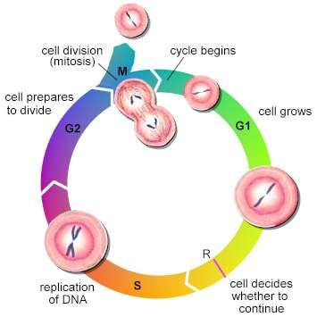
Cell Cycle Analysis
G0?

Slide 3
Motivation
Cell Type Effect vs. Cell Cycle Effect
  The variation in the gene expression profiles of single cells in different phases of the cell cycle can interfere with the functional analysis of the transcriptomic data.
When the objective is identifying functional cell type:

Slide 4
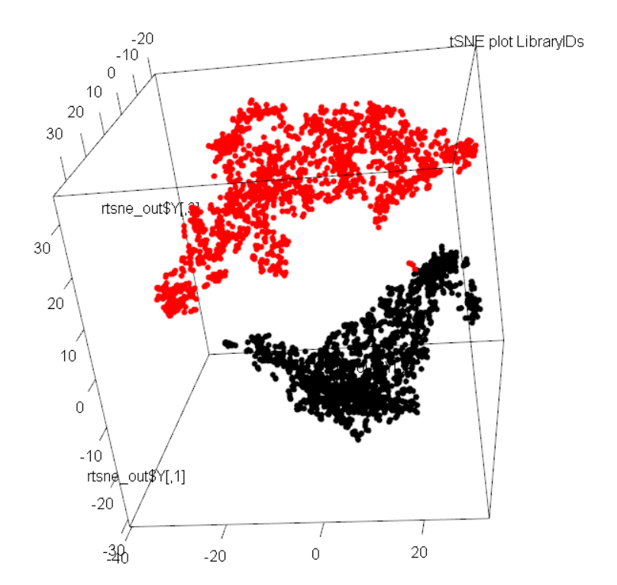
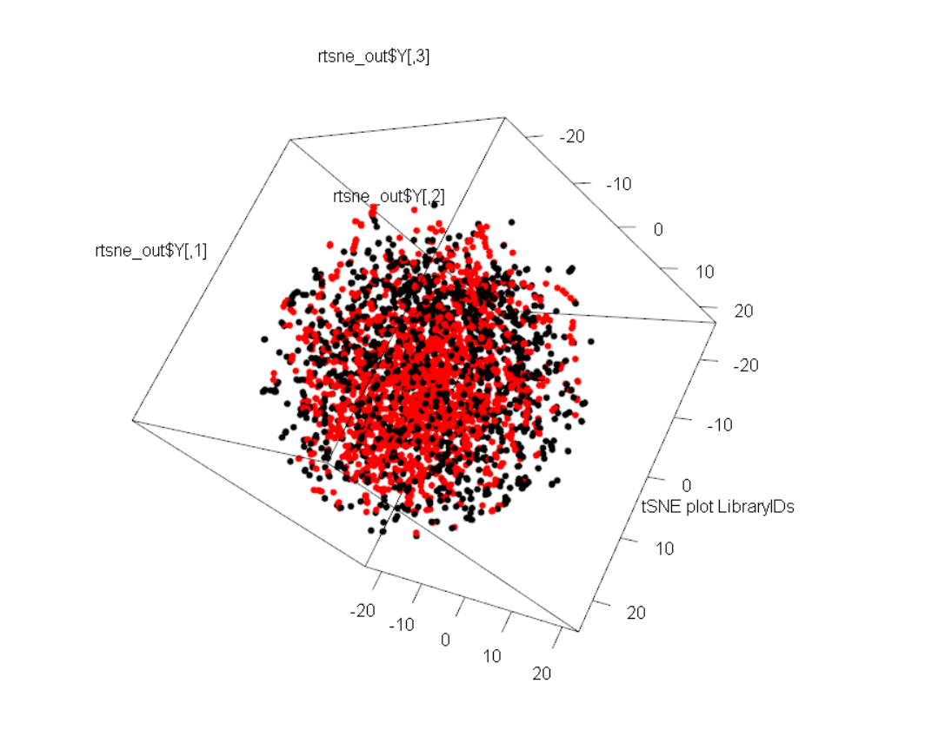
Existing Methods:
  Cyclone (classifier, scoring for G1, S, and G2 cell cycle phases)
  ccRemover (cell cycle effect remover)
    Test on jurkat & 293 cell lines →
  Oscope (identifies oscillatory genes in unsynchronized single cell RNA-seq)
  reCAT (reconstructing cell cycle pseudo time-series)

Slide 5
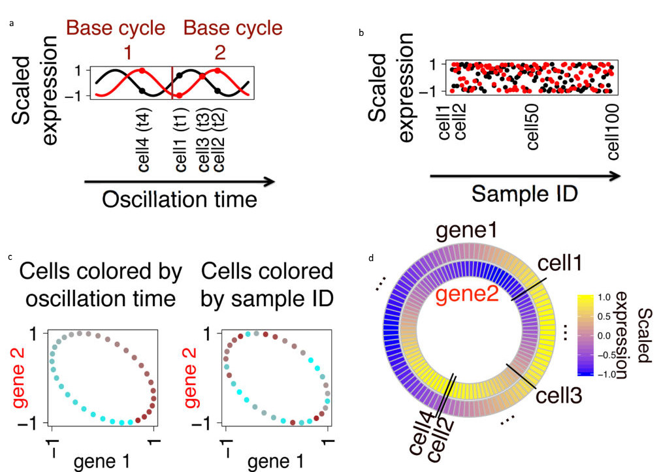
Oscope/reCAT

Slide 6
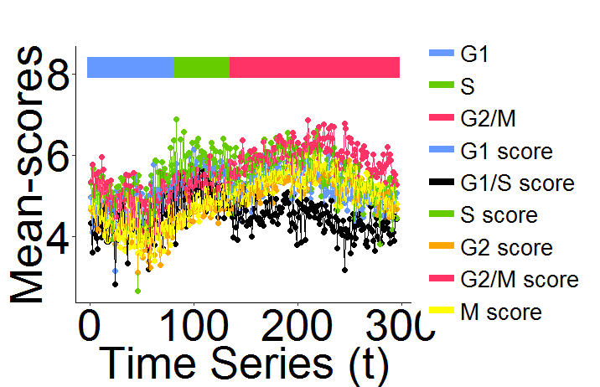
Oscope/reCAT

Slide 7
WIP : PCA-tSNE-based Approach
1st few PCs of a set of annotated cell cycle marker genes is sufficient for constructing a cell to cell covariance matrix, reflecting the cell cycle induced correlation among cells^{1,2,3,4}.
Examine the idea of ordering the cells based on :
  first few PCAs of the cell cycle marker genes as features
  3 component t-SNE transformation (capturing nearest neighbor relation)
  clustered/ordered cells using average/ward linkage algorithm.

Slide 8
Challenges
Deciding on PCs to use
  CC genes based PCA vs. PC loadings analysis
Normalization
  Centering (mean-based) & Scaling (sd-based) of cells (genes)
Gene Lists
  Genes Correlation Filter

Slide 9
Dataset(s) - Labeled
H1-Fucci hESC cell line: Fluorescent ubiquitination-based cell cycle indicator (Fucci) H1 hESCs isolated by sorting single cells by fluorescence activated cell sorting (FACS).
  G1, S or G2/M cell-cycle phases isolated by FACS into 91, 80 and 76 cells in G1, S and G2/M.
  https://www.ncbi.nlm.nih.gov/geo/query/acc.cgi?acc=GSE64016
Rex1-GFP-expressing mESC (182) stained with Hoechst 33342 and Flow cytometry sorted for G1, S and G2M stages of cell cycle.
  Sequencing by Fluidigm C1 system and Nextera XT (Illumina) kit.
  https://www.ebi.ac.uk/arrayexpress/experiments/E-MTAB-2805/

Slide 10
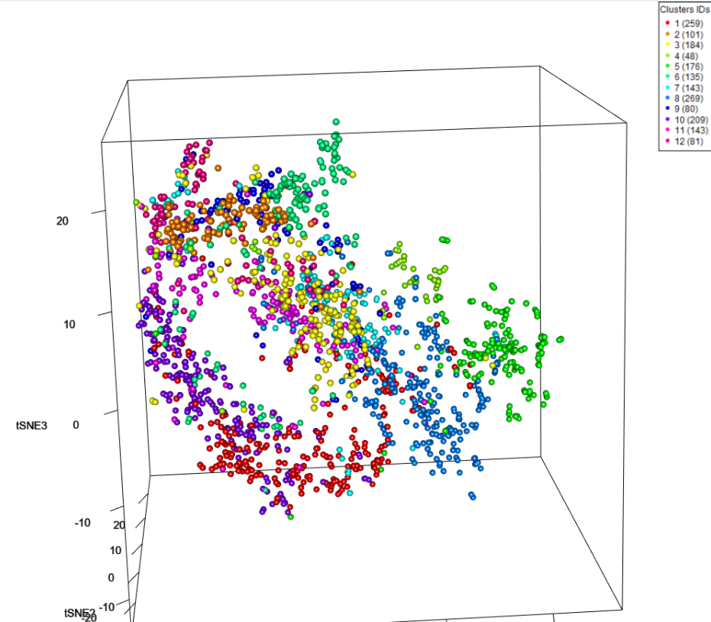
Dataset – Not Labeled
T-cells (CD3+ cells), 10x Genomics.
  Additional challenges:
    Sparser data than C1 platform
    Cycling vs. non-cycling cells

Slide 11
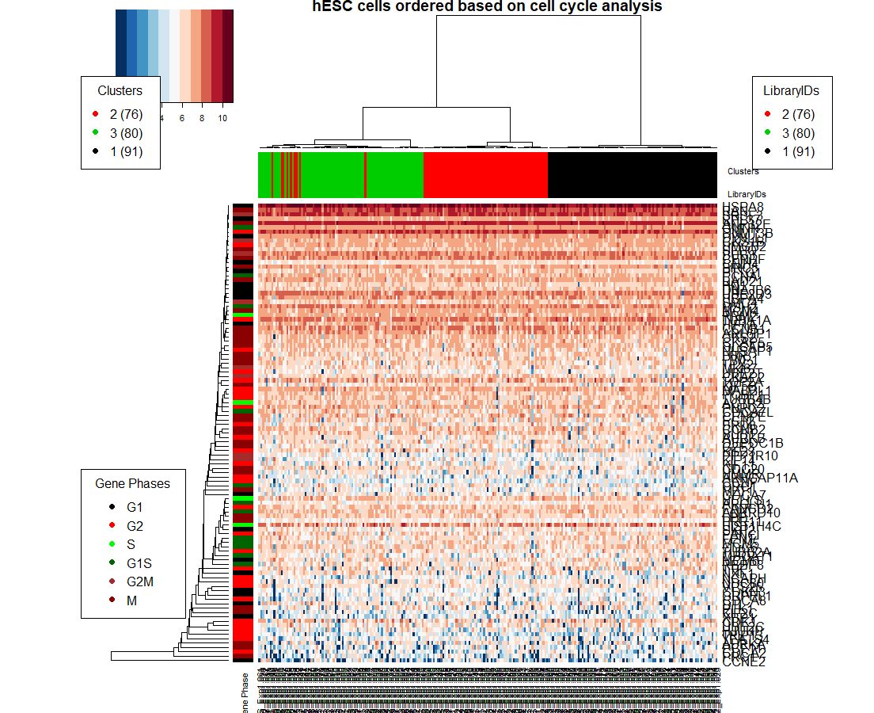

Slide 12
Gene Lists Effect - hESC
Gene Lists → | Cyclone,etc... | CycleBase* | CC Go Term
Number of Genes | 1180 | 324 | 640
Correlation Filter | 0.25 | 0.25 | 0.25
G1 | 0.857142857 | 1 | 1
G2 | 0.828947368 | 0.881578947 | 0.868421053
S | 1 | 1 | 1
Micro Accuracy | 0.894736842 | 0.963562753 | 0.95951417
Macro Accuracy | 0.895363409 | 0.960526316 | 0.956140351
*CycleBase DB genes (human) are annotated by their peak phase
(6 phases : G1, G2, S, G1/S, G2/M, M)

Slide 13
True Labels | G1-Genes | G1S-Genes | S-Genes | G2-Genes | G2M-Genes | M-Genes | All Genes Avg
G1 Phase cells | 0.1160004 | 0.001255134 | -0.01616238 | -0.02431784 | 0.01816772 | 0.1118672 | 3.45E-02
G2 Phase cells | -0.0768833 | -0.1291946 | -0.10372 | 0.1114958 | 0.1180861 | 0.04258149 | -6.27E-03
S Phase cells | -0.05891127 | 0.1213072 | 0.1169187 | -0.07825951 | -0.1328476 | -0.1677013 | -3.32E-02
All cells average | -6.60E-03 | -2.21E-03 | -9.88E-04 | 2.97E-03 | 1.14E-03 | -4.42E-03

Slide 14
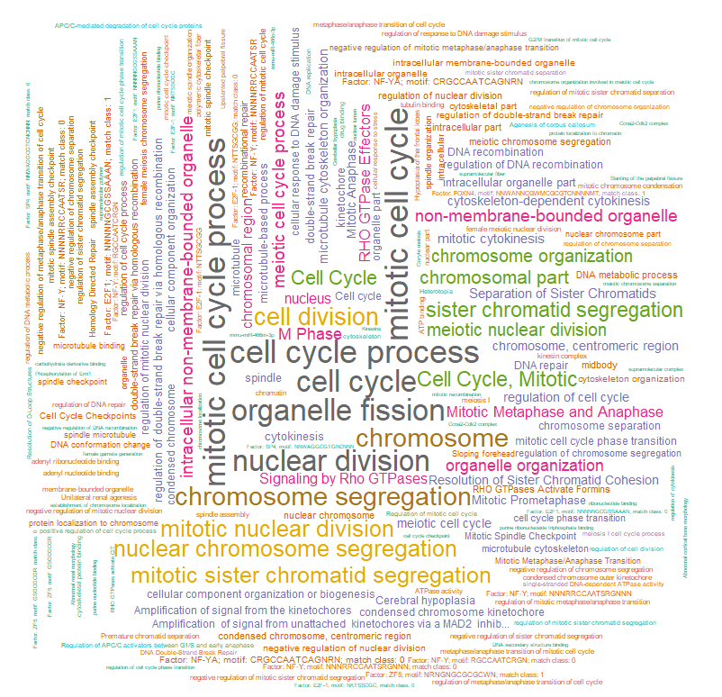
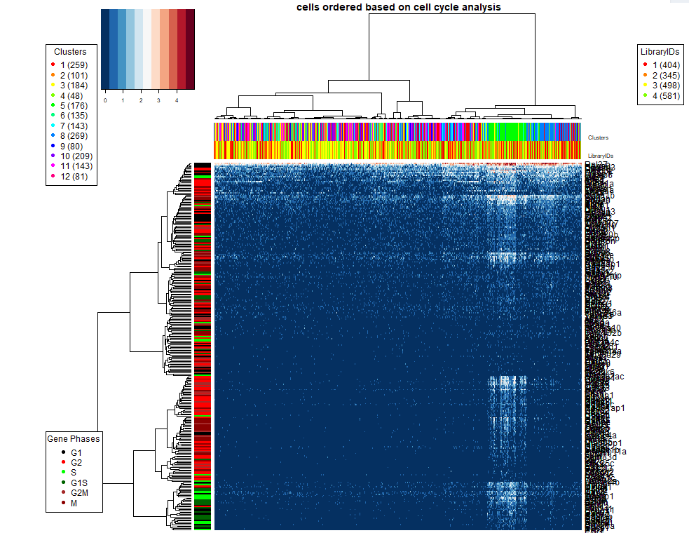

C5:
Clusters: | G1-Genes | G1S-Genes | S-Genes | G2-Genes | G2M-Genes | M-Genes
1 | -0.0908 | -0.1212 | -0.1185 | -0.1024 | -0.1304 | -0.1134
2 | -0.238 | -0.18 | -0.2014 | -0.1783 | -0.1754 | -0.1879
3 | -0.1383 | -0.1671 | -0.1568 | -0.1464 | -0.1466 | -0.1359
4 | 0.1029 | -0.0577 | -0.049 | -0.026 | -0.0432 | -0.0279
5 | 0.7584 | 1.082 | 1.0557 | 0.9449 | 1.0182 | 0.9695
6 | -0.1853 | -0.1664 | -0.171 | -0.1674 | -0.1622 | -0.165
7 | -0.0087 | -0.07 | -0.0672 | -0.0626 | -0.0385 | -0.0562
8 | 0.2174 | 0.0414 | 0.0717 | 0.0729 | 0.0615 | 0.0787
9 | -0.1758 | -0.1666 | -0.1538 | -0.1295 | -0.1482 | -0.1465
10 | -0.1993 | -0.1637 | -0.1859 | -0.1688 | -0.1793 | -0.1846
11 | -0.1664 | -0.1618 | -0.162 | -0.1523 | -0.1614 | -0.1448
12 | -0.2236 | -0.189 | -0.1954 | -0.1757 | -0.1901 | -0.1954

Slide 15
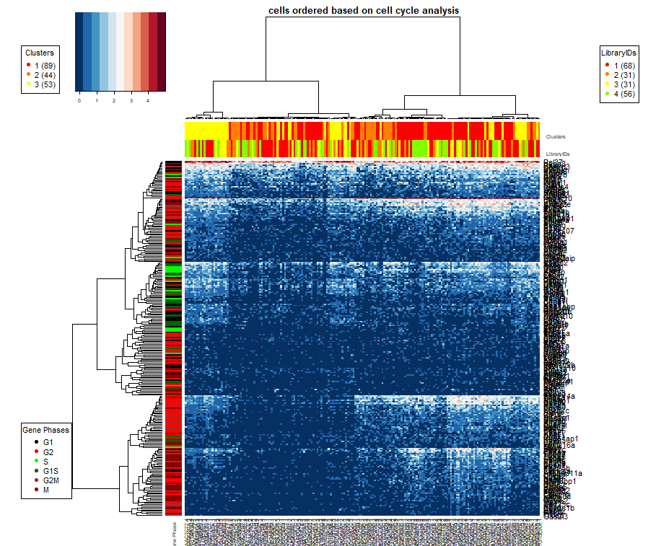
Dividing t-cells

Slide 16
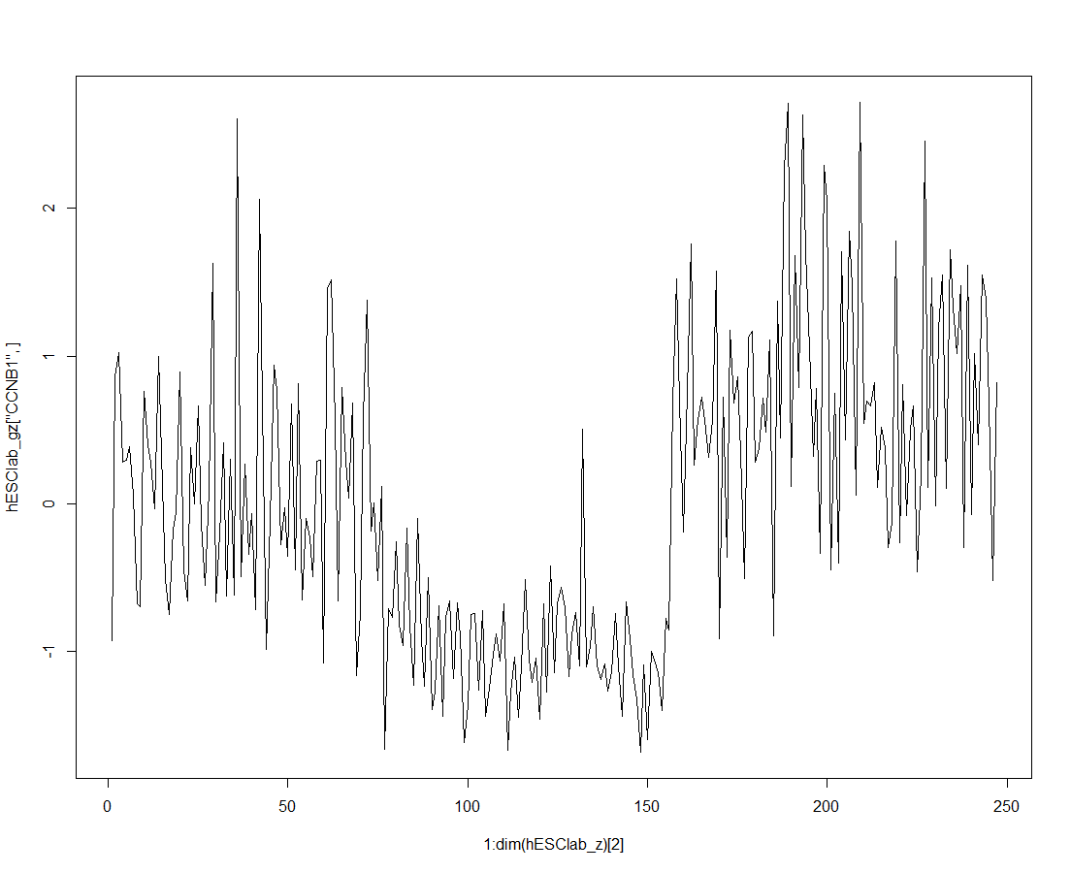
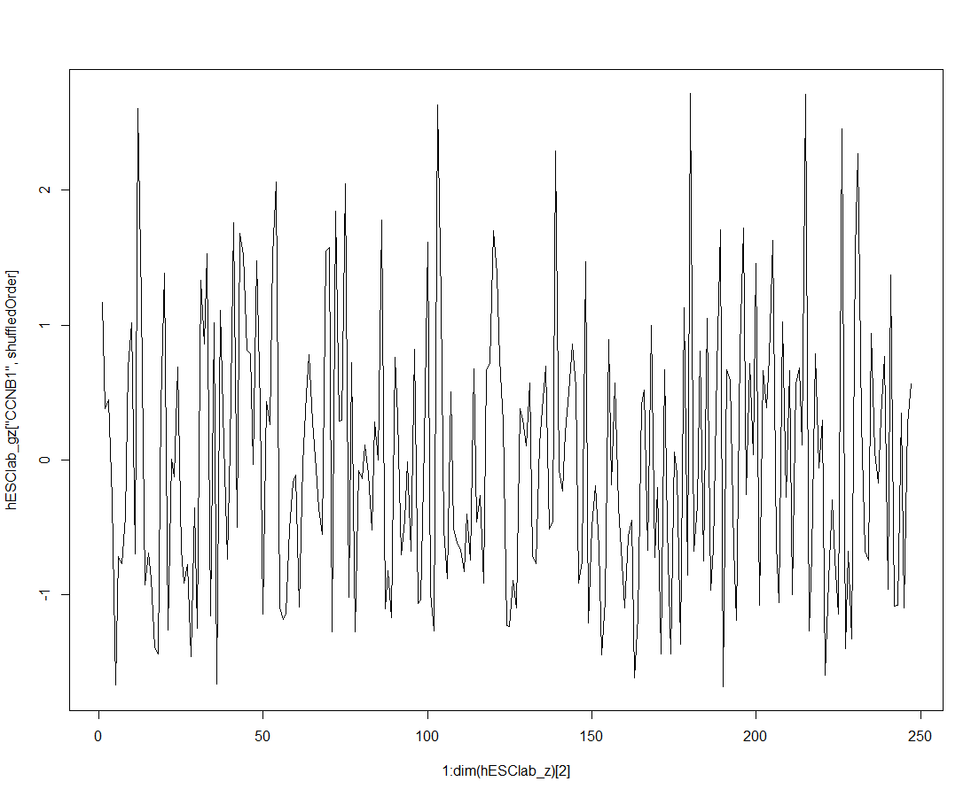
Open Question: Can we distinguish cycling vs. non-cycling cells, and/or assess cell order?
IF we could directly assess the order,
  without having to know the labels,
  without assuming a certain model for the genes (binary, bi-modal, sinusoidal etc), and
  without a 'perfect' list of the cc genes as a whole or per phase;
  → then we could use this to select the best order from potential orders.

Slide 17
Assessing cell order
Defining Gene-Smoothness:
    GeneSmoothness(x) = {sd(diff(x))/abs(mean(diff(x)))}
  x = Gene as vector of expressions in cells
Score interpretation:
  Lower scores mean less variance within the order → smoother signal

Slide 20
Assessing cell order
Autocorrelation (serial correlation): correlation of a signal with a delayed copy of itself.
  Informally, it is the similarity between observations as a function of the time lag between them.
Score interpretation:
  scores near 1 imply a smoothly varying series
  scores near 0 imply that there's no overall relationship between a data point and the following one.
  scores near -1 suggest that the series is jagged/rough in a particular way: if one point is above the mean, the next is likely to be below the mean by about the same amount, and vice versa.

Slide 22
References
Leng, N., Chu, L.F., Barry, C., Li, Y., Choi, J., Li, X., Jiang, P., Stewart, R.M., Thomson, J.A., Kendziorski, C.: Oscope identies oscillatory genes in unsynchronized single-cell rna-seq experiments. Nature methods 12(10), 947 (2015)
Scialdone, A., Natarajan, K.N., Saraiva, L.R., Proserpio, V., Teichmann, S.A., Stegle, O., Marioni, J.C., Buettner, F.: Computational assignment of cell-cycle stage from single-cell transcriptome data. Methods 85, 54{61 (2015)
Liu, Zehua, et al. "Reconstructing cell cycle pseudo time-series via single-cell transcriptome data." Nature communications 8.1 (2017): 22.
Barron, Martin, and Jun Li. "Identifying and removing the cell-cycle effect from single-cell RNA-sequencing data." Scientific reports 6 (2016): 33892.

Slide 23
Thank You!
Cell Cycle in SC1 tool : https://sc1.engr.uconn.edu/
Questions?

Slide 24
Future Work: Intron Retention & Cell Cycle
IR measured for T cells sorted at different stages of the cell cycle:
~1K differentially retained introns with distinct patterns of retention for each stage of the cell cycle. These introns were retained from genes enriched for cell cycle (p = 8E-6).
Reference:
Middleton, Robert, et al. "IRFinder: assessing the impact of intron retention on mammalian gene expression." Genome biology 18.1 (2017): 51.

Slide 25
Correlation Filter – CycleBase Gene List | 0 | 0.05 | 0.1 | 0.15 | 0.2 | 0.25 | 0.3 | 0.35 | 0.4 | 0.45 | 0.5**
G1 | 1 | 1 | 1 | 1 | 1 | 1 | 1 | 1 | 1 | 0.989011 | 1
G2 | 0.868421 | 0.868421 | 0.868421 | 0.855263 | 0.855263 | 0.88158 | 0.855263 | 0.88158 | 0.894737 | 0.947368 | 0.947368
S | 1 | 1 | 1 | 1 | 1 | 1 | 1 | 0.9875 | 0.975 | 0.9375 | 0.925
Micro Accuracy | 0.959514 | 0.959514 | 0.959514 | 0.955466 | 0.955466 | 0.9636 | 0.955466 | 0.95951 | 0.959514 | 0.959514 | 0.959514
Macro Accuracy | 0.95614 | 0.95614 | 0.95614 | 0.951754 | 0.951754 | 0.960526 | 0.951754 | 0.95636 | 0.956579 | 0.95796 | 0.957456

