Slide 1
Computational Methods for the Analysis of Single Cell RNA-Seq Data
Marmar Moussa
Supervisor: Ion Măndoiu
Computer Science & Engineering Department
University of Connecticut

Slide 2
Outline
Background/Motivation
Single Cell RNA-Seq Data Analysis Methods
  Clustering Single Cell RNA-Seq Data using TF-IDF based Methods
  LSImpute: Locality Sensitive Imputation for Single Cell RNA-Seq Data
  Cell Cycle Analysis for Single Cell RNA-Seq Data.
SC1: Web-based Interactive Pipeline for Single Cell RNA-Seq Data Analysis Methods
Conclusion & Future Work
Notes:
single cell genomics has become an important tool in studying heterogenous and complex systems

Slide 3
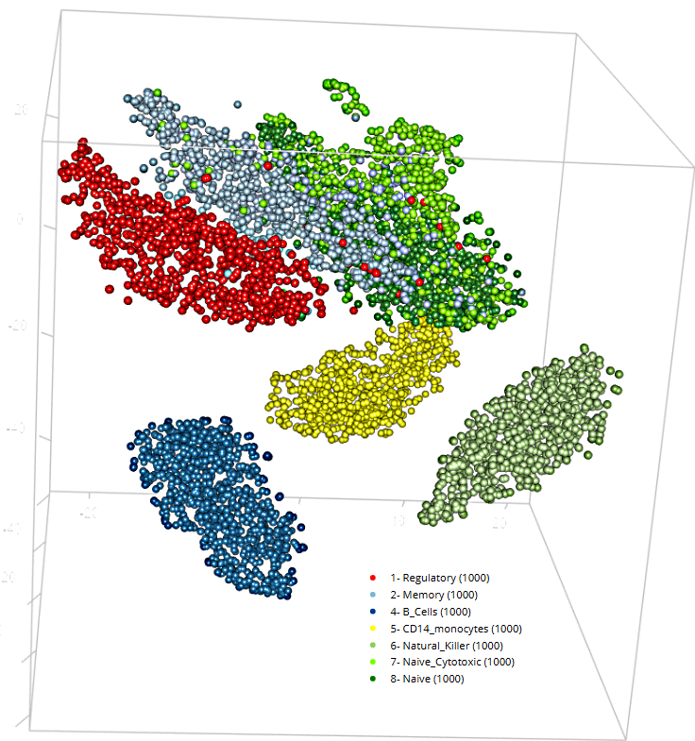
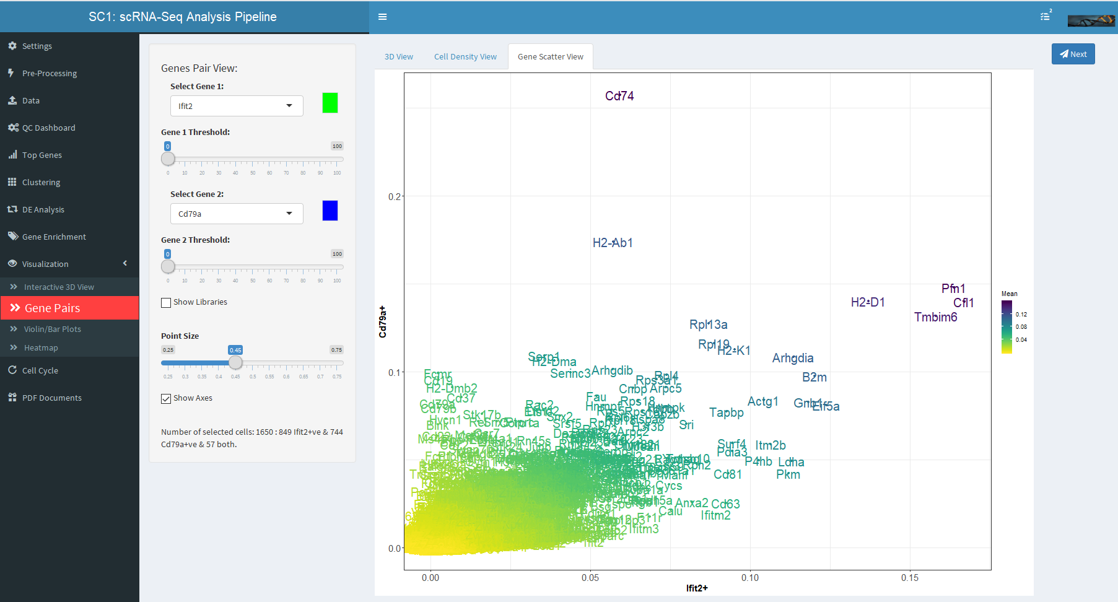
Talk Survival Guide
COLORFUL plots → interesting
HyperLinks to more slides → method details & results
Seeing RED dots? → Imputation - time to check your phone!
Screen shots → SC1 analysis pipeline

Slide 4
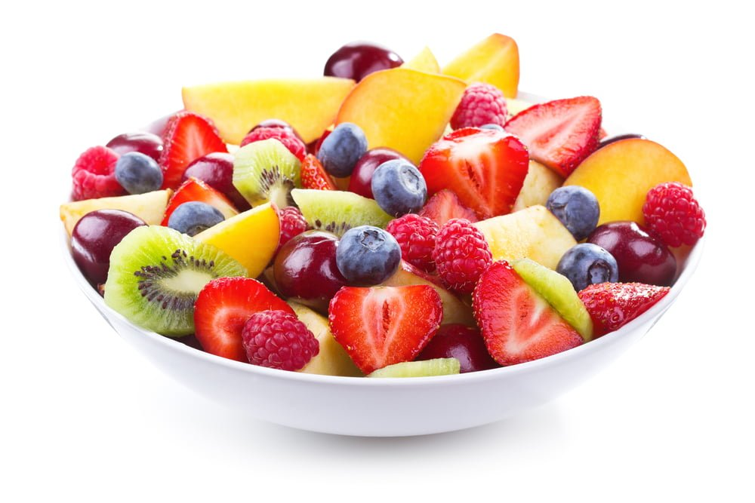
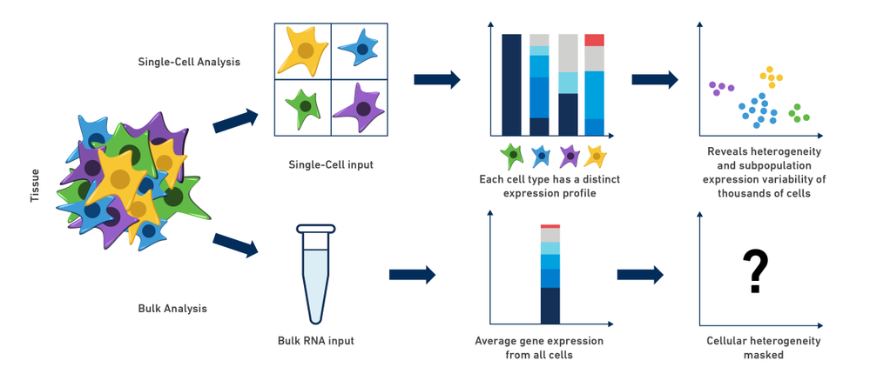

scRNA-Seq Analysis - Applications
Studying heterogeneous systems:
Cell Differentiation, Intratumor Heterogeneity, Cell Type Identification (functional / phenotypical), Stochasticity of gene expression, Inference of gene regulatory networks (e.g. in stem cells).
Notes:
Bulk: comparative transcriptomics
Cell Type Identification (e.g. seemingly uniform populations such as immune cells that have been purified on the basis of cell-surface markers)

Slide 5
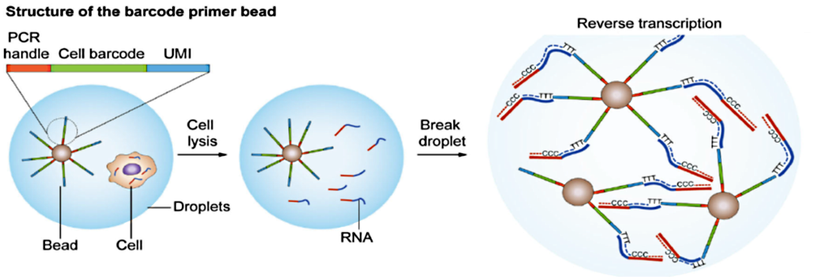
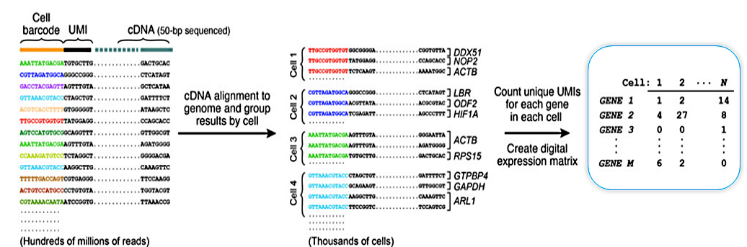
Quantification of expression in scRNA-Seq (droplet-based example)

Slide 6
scRNA-Seq Analysis - Workflow
Data Exploration& QC
Feature Selection
Data Transformation
Log transform
Dimensionality Reduction
Optimal Number of Clusters, Intra-Cluster Homogeneity
DE Analysis
Clustering
Visualization
Imputation
Normalization for Batch Effect
Enrichment
Analysis,
Annotation
Cell Cycle Analysis

Slide 7
scRNA-Seq Analysis - Workflow
Pre-Processing
  Cell/Gene Quality Control
  Dimensionality reduction
TF-IDF-based Informative Genes’ Selection
TF-IDF-based Clustering Methods
LSImpute: Locality Sensitive Imputation
Cell Cycle Analysis
Cell type identification/annotation
  Differential Expression Analysis
  Enrichment Analysis
Visualization
SC1 interactive workflow : https://sc1.engr.uconn.edu
Notes:
Our Contribution : methods in various parts of the workflow …

Slide 8
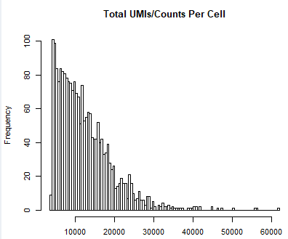
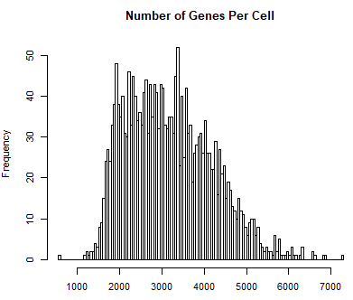
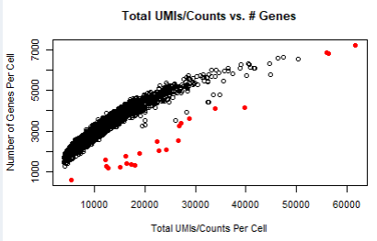
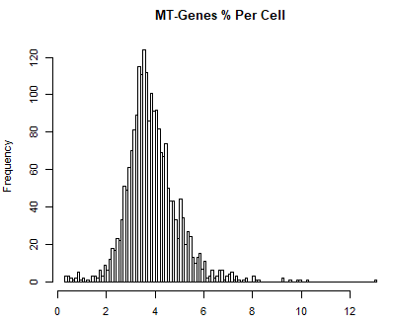
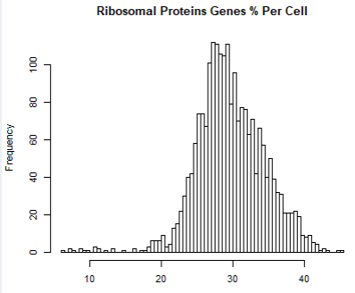
Quality Control in SC1
total UMI count/expression,
number of detected genes,
fraction of reads mapping to mitochondrial genes,
ribosomal protein genes, or
Outliers: ratio between the number of detected genes to total UMI count/expression per cell.
Notes:
To start from the beginning, we look at various metrics,
Long tails need to be excluded, too little ribosomal protein might indicate low viability, too much mitochondrial content might indicate broken cells etc.

Slide 9
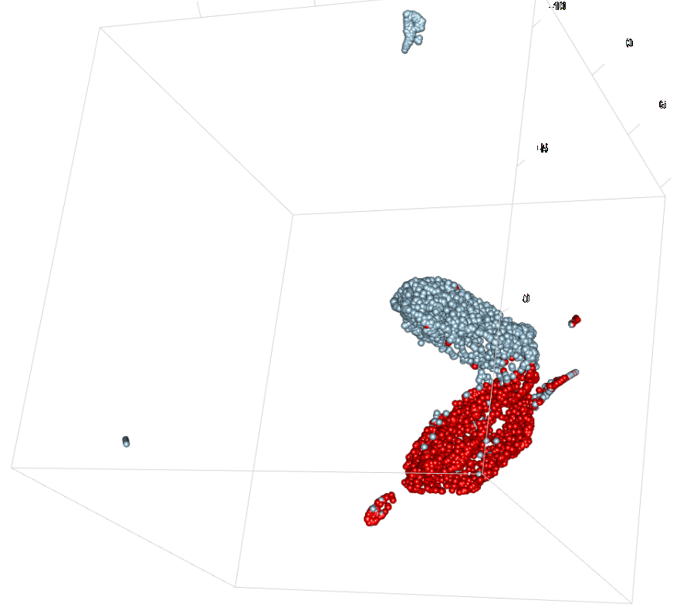
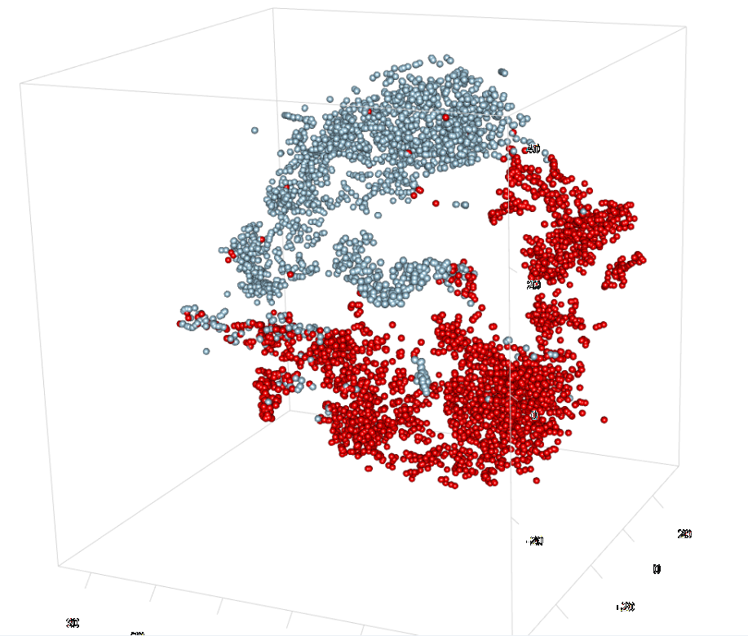
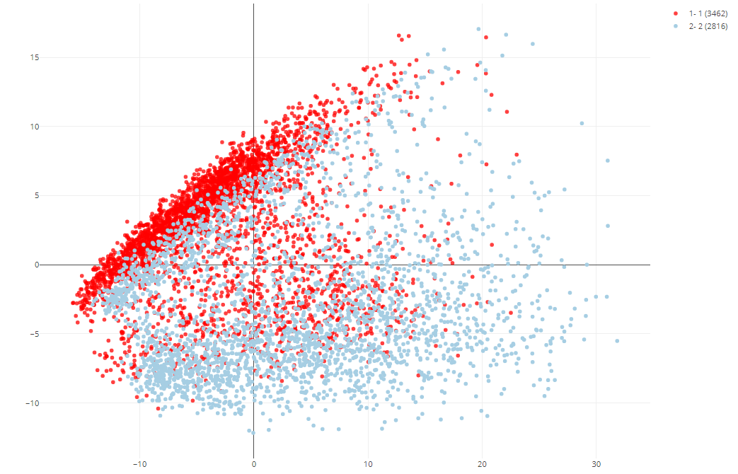
Dimensionality Reduction for Visualization
Principal component analysis (PCA)
  historically most commonly used
  captures global variability
  Randomized singular value decomposition for speed (optional)
t-distributed stochastic neighborhood embedding (t-SNE)
  currently the most common
  nonlinear dimensionality reduction
  avoids overcrowding
  efficiently reveal local data structure
Uniform manifold approximation and projection (UMAP)
  “preserve as much of the local and more of the global data structure than t-SNE”
HPV Dataset (Powell et al.): C57/BL6 vs. K14E7 mouse
Notes:
For efficiency: part of the preprocessing steps;
Tsne and umap are both neighbor graph embedding algorithms
The essential idea of probabilistic algorithms is to employ some amount of randomness in order to derive a smaller matrix from a high-dimensional data matrix. The smaller matrix is then used to compute the desired low-rank approximation. → computationally efficient

Slide 10
scRNA-Seq Analysis - Workflow
Pre-Processing
  Cell/Gene Quality Control
  Dimensionality reduction
TF-IDF-based Informative Genes’ Selection
TF-IDF-based Clustering Methods
LSImpute: Locality Sensitive Imputation
Cell Cycle Analysis
Cell type identification/annotation
  Differential Expression Analysis
  Enrichment Analysis
Visualization
SC1 interactive workflow : https://sc1.engr.uconn.edu
Notes:
This takes us to several computational methods that we proposed for various parts of the workflow …
Now that we covered preparing the data for analysis, the goal is either to identify important genes or isolate important cell groups
Confounder to clustering: drop outs and cell cycle

Slide 11
Clustering scRNA-Seq Data using TF-IDF based Methods
Notes:
Goal → clustering cells into cell types …

Slide 12
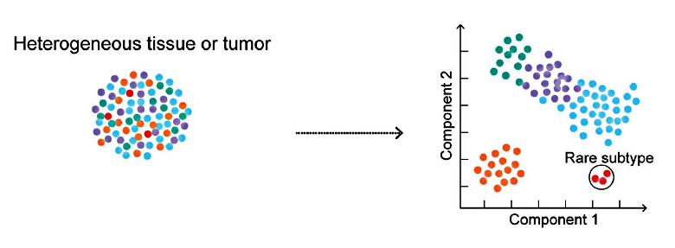
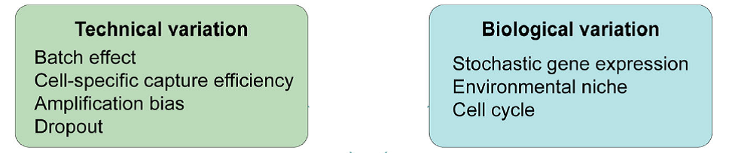
Problem: Cell Type Identification
Unsupervised multi-class unique-label learning:
Challenges for single cell clustering:
Data size
Thousands of Genes x Thousands (Millions) of cells
Notes:
Active area of research
Reducing effect of confounders such as detection rate & cell cycle phase
Discriminative similarity metrics
Scalability to millions of cells…

Slide 13
Clustering Methods
Seurat (K-means)*
Seurat (SNN)*
Feature Selection: PCA, tSNE, highly variable genes* or none
GMM
Data Transformation: Log2(x+1) or none
K-means
Sph. K-means
HC (E/P)
Cells QC, Genes QC, Gap-Statistics Analysis
Louvain (E)
GMM
Feature Selection: High avg. TFIDF score (Top) or Highly variable TF-IDF (Var)
K-means
Sph. K-means
TF-IDF
Term Frequency -
Inverse Doc Frequency
HC (E/P/C)
Binarization:
Cutoff threshold per cell based on cell avg. TF-IDF(Bin)
HC (E/P/C/J)
Greedy (E/P/C/J)
Louvain (E/P/C/J)
Notes:
Several methods we proposed to deal with sc clustering issues, most clustering methods use PCA as feature selection method

Slide 14
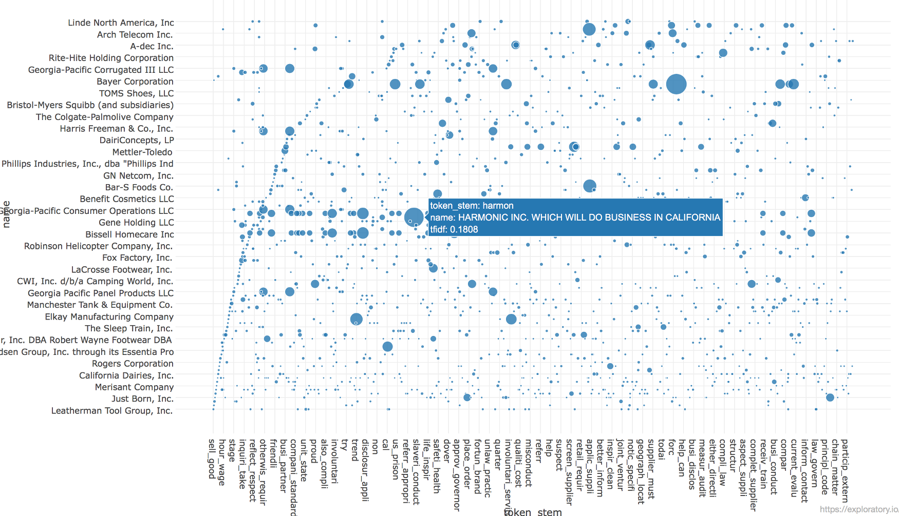
Term Frequency – Inverse Document Frequency

Slide 15

Term Frequency-Inverse Document Frequency
Term Frequency: How frequently a term occurs in a document?
Inverse Document Frequency: How uncommon the term is in the document collection?
For scRNA-Seq data TF-IDF score is defined as:
  $TF_{ij} × IDF_{i}=(x_{ij}/\max_{k}{x_{kj})}$ $×$ ($\log_{2}{(N/n_{i}))}$
  For gene i in cell j the UMI count/Expression is x_{ij}
  And gene i is detected in n_{i} out of N cells.
Modified TF-IDF definition

Slide 16
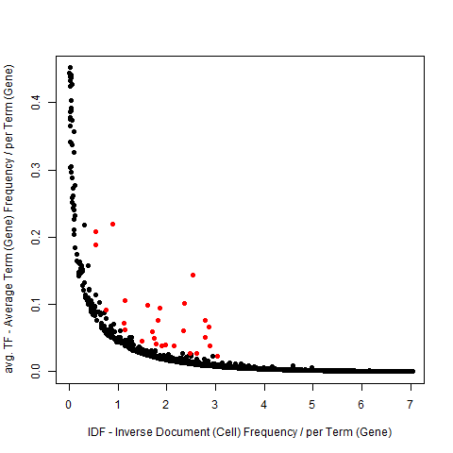
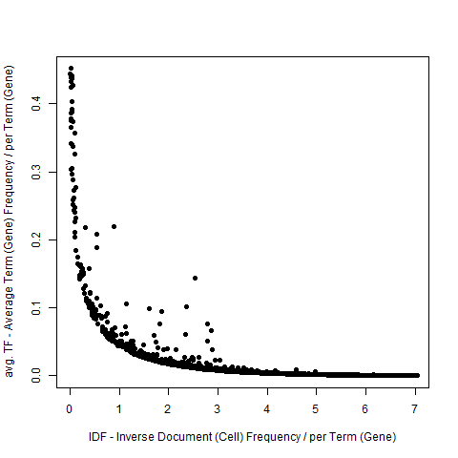
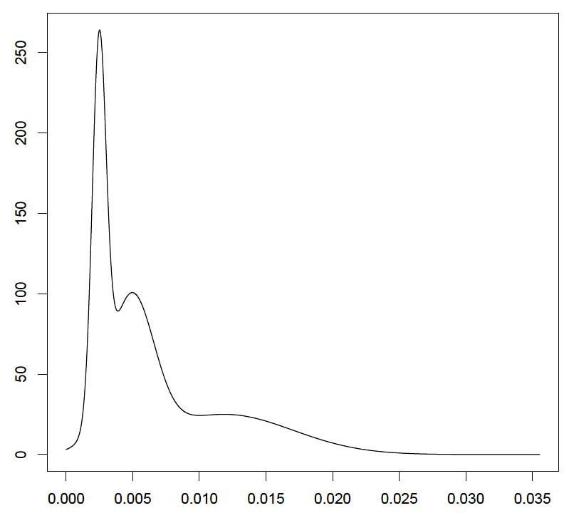
TF-IDF based gene selection (Top)
Genes with highest avg. TF-IDF, ranked (Top):
Density
Gaussian mixture models fitted to the distribution of TF-IDF gene averages, ranked by means (also, number of detecting cells)
CD74
GNLY
Genes with highest avg. TF-IDF (highest mean GMM in red)
NKG7
Avg. Gene TF-IDF score for regulatory, memory cells mix

Slide 17
Clustering Methods
Seurat (K-means)*
Seurat (SNN)*
Feature Selection: PCA, tSNE, highly variable genes* or none
GMM
Data Transformation: Log2(x+1) or none
K-means
Sph. K-means
HC (E/P)
Cells QC, Genes QC, Gap-Statistics Analysis
Louvain (E)
GMM
Feature Selection: High avg. TFIDF score (Top) or Highly variable TF-IDF (Var)
K-means
Sph. K-means
TF-IDF
Term Frequency -
Inverse Doc Frequency
HC (E/P/C)
Binarization:
Cutoff threshold per cell based on cell avg. TF-IDF(Bin)
HC (E/P/C/J)
Greedy (E/P/C/J)
Louvain (E/P/C/J)

Slide 18
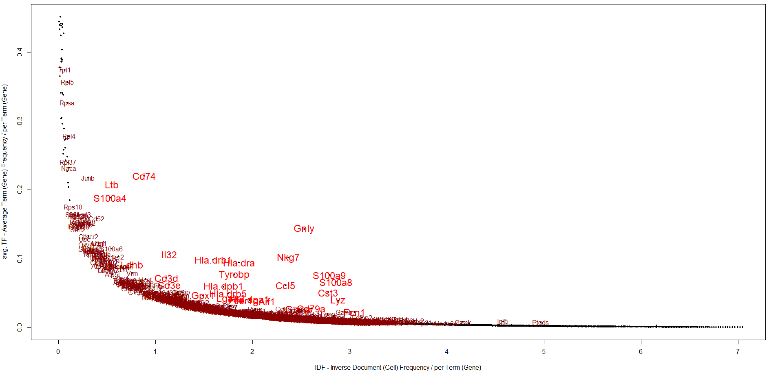
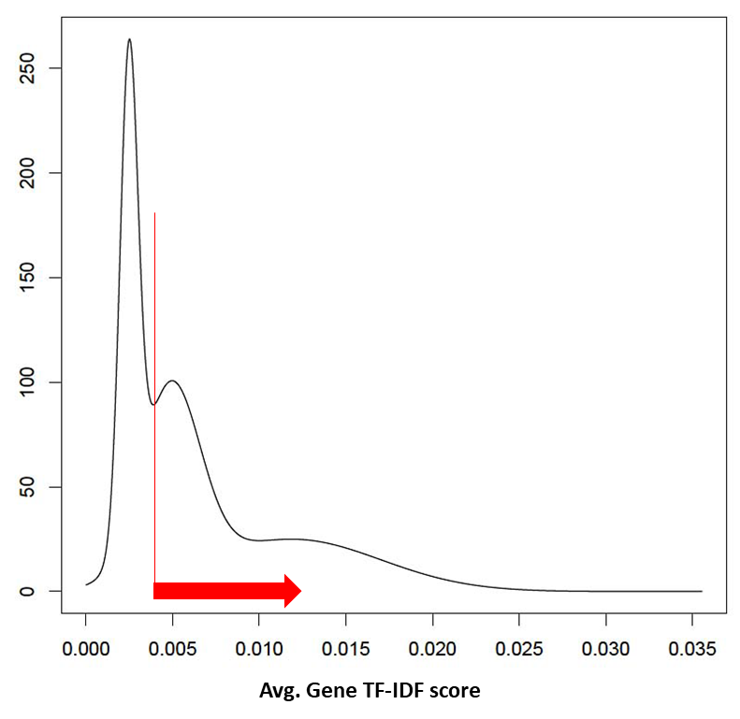
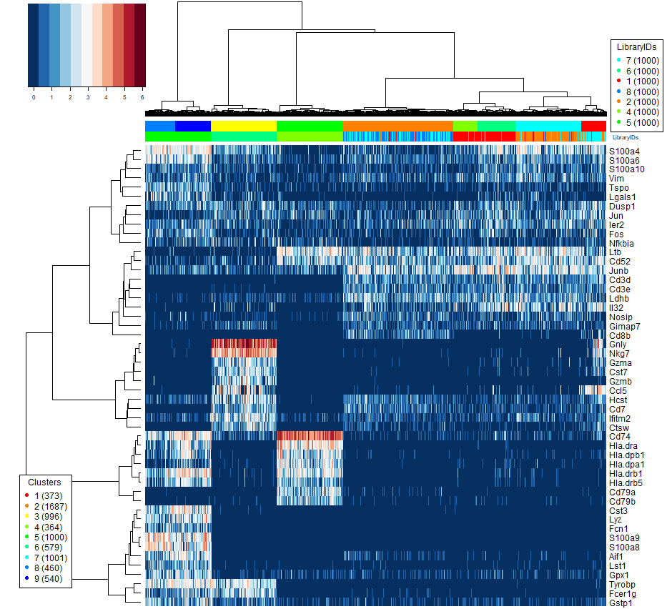
TF-IDF based gene selection (Top)
PBMC, 10x :
5: Monocytes,
6: Natural Killer
4: B cells
7,8: naïve cytotoxic, cytotoxic, activated cytotoxic
1: helper
2: regulatory
Genes with highest avg. TF-IDF (highest mean GMM in red)

Slide 19
Clustering Methods
Seurat (K-means)*
Seurat (SNN)*
Feature Selection: PCA, tSNE, highly variable genes* or none
GMM
Data Transformation: Log2(x+1) or none
K-means
Sph. K-means
HC (E/P)
Cells QC, Genes QC, Gap-Statistics Analysis
Louvain (E)
GMM
Feature Selection: High avg. TFIDF score (Top) or Highly variable TF-IDF (Var)
K-means
Sph. K-means
TF-IDF
Term Frequency -
Inverse Doc Frequency
HC (E/P/C)
Binarization:
Cutoff threshold per cell based on cell avg. TF-IDF(Bin)
HC (E/P/C/J)
Greedy (E/P/C/J)
Louvain (E/P/C/J)

Slide 20
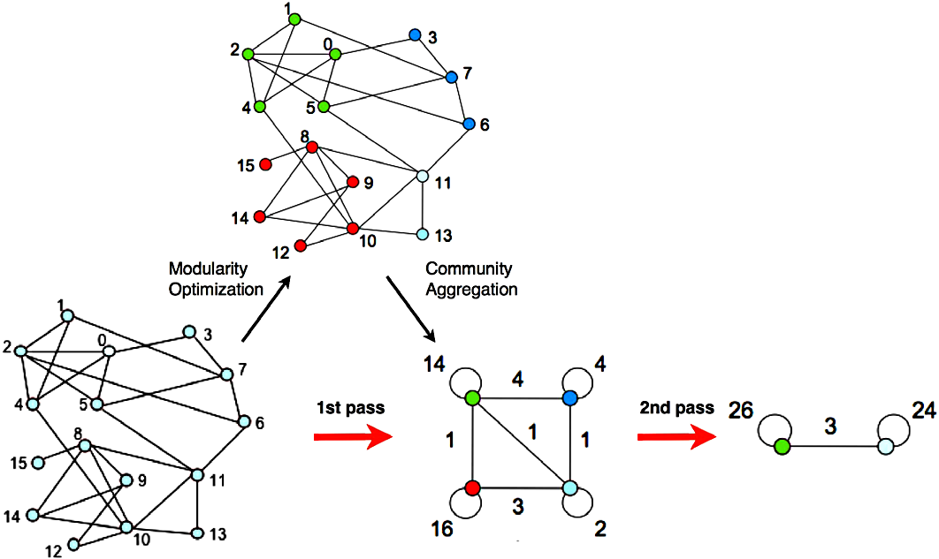
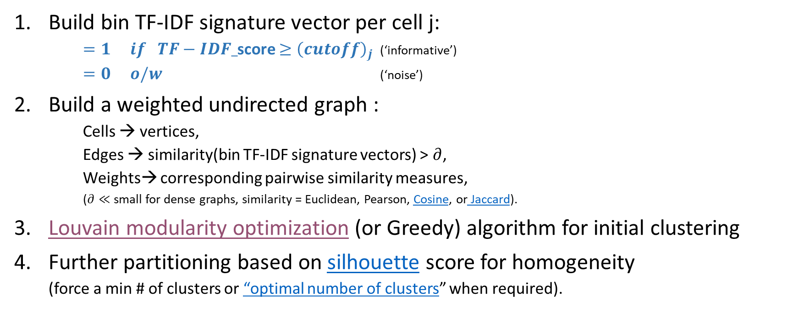
TF-IDF Graph based clustering
Build bin TF-IDF signature vector per cell j:
    $=1 if TF−IDF_$score $≥{\left(cutoff\right)}_{j}$ (‘informative’)
    $=0 o/w$ (‘noise’)
Build a weighted undirected graph :
    Cells → vertices,
    Edges → similarity(bin TF-IDF signature vectors) > $∂$,
    Weights→ corresponding pairwise similarity measures,
    ($∂≪$small for dense graphs, similarity = Euclidean, Pearson, Cosine, or Jaccard).
Louvain modularity optimization (or Greedy) algorithm for initial clustering
Further partitioning based on silhouette score for homogeneity
  (force a min # of clusters or “optimal number of clusters” when required).
Louvain Toy Example

Slide 21

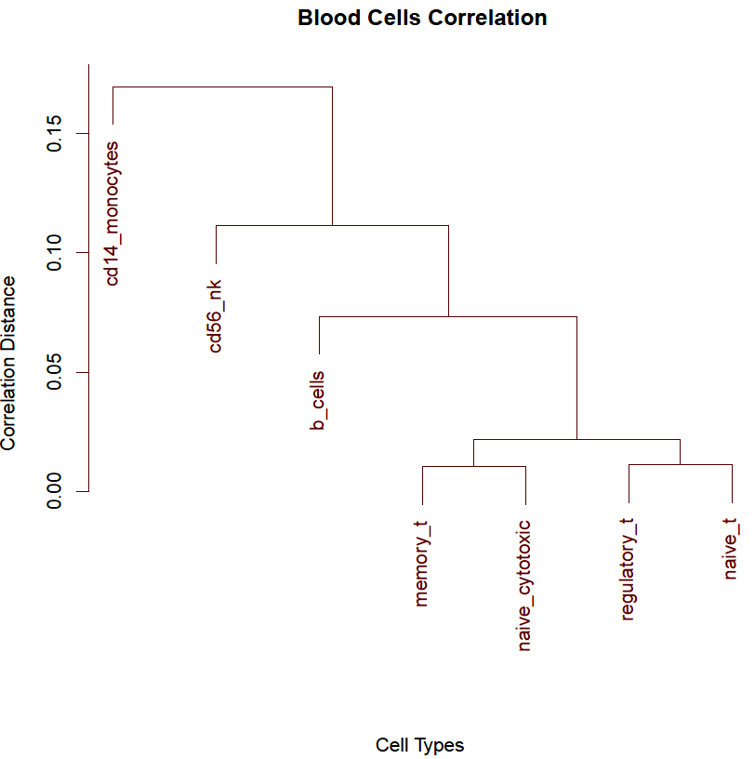
Experimental Setup:
PBMC Data set from 10x Genomics
  FACS sorted blood cells of 7 types (Zheng, 2017)
  7:1, 3:1, 1:1, 1:3, and 1:7 semi-simulated mixtures of 6 cell type pairs of varying dissimilarity (1000 cells/pair)
    highly dissimilar: (b cells and cd14 monocytes) and (b cells and cd56 nk)
    highly similar : (memory t and naive cytotoxic) and (regulatory t and naive t)
    intermediate similarity: (memory t and naive t) and (regulatory t and naive cytotoxic)
  7-way mixture,
    (7000 cells/mix)
  5 sampling replicas
2045 Pancreatic cells of
  7 types (Segerstolpe, 2016)

Slide 22
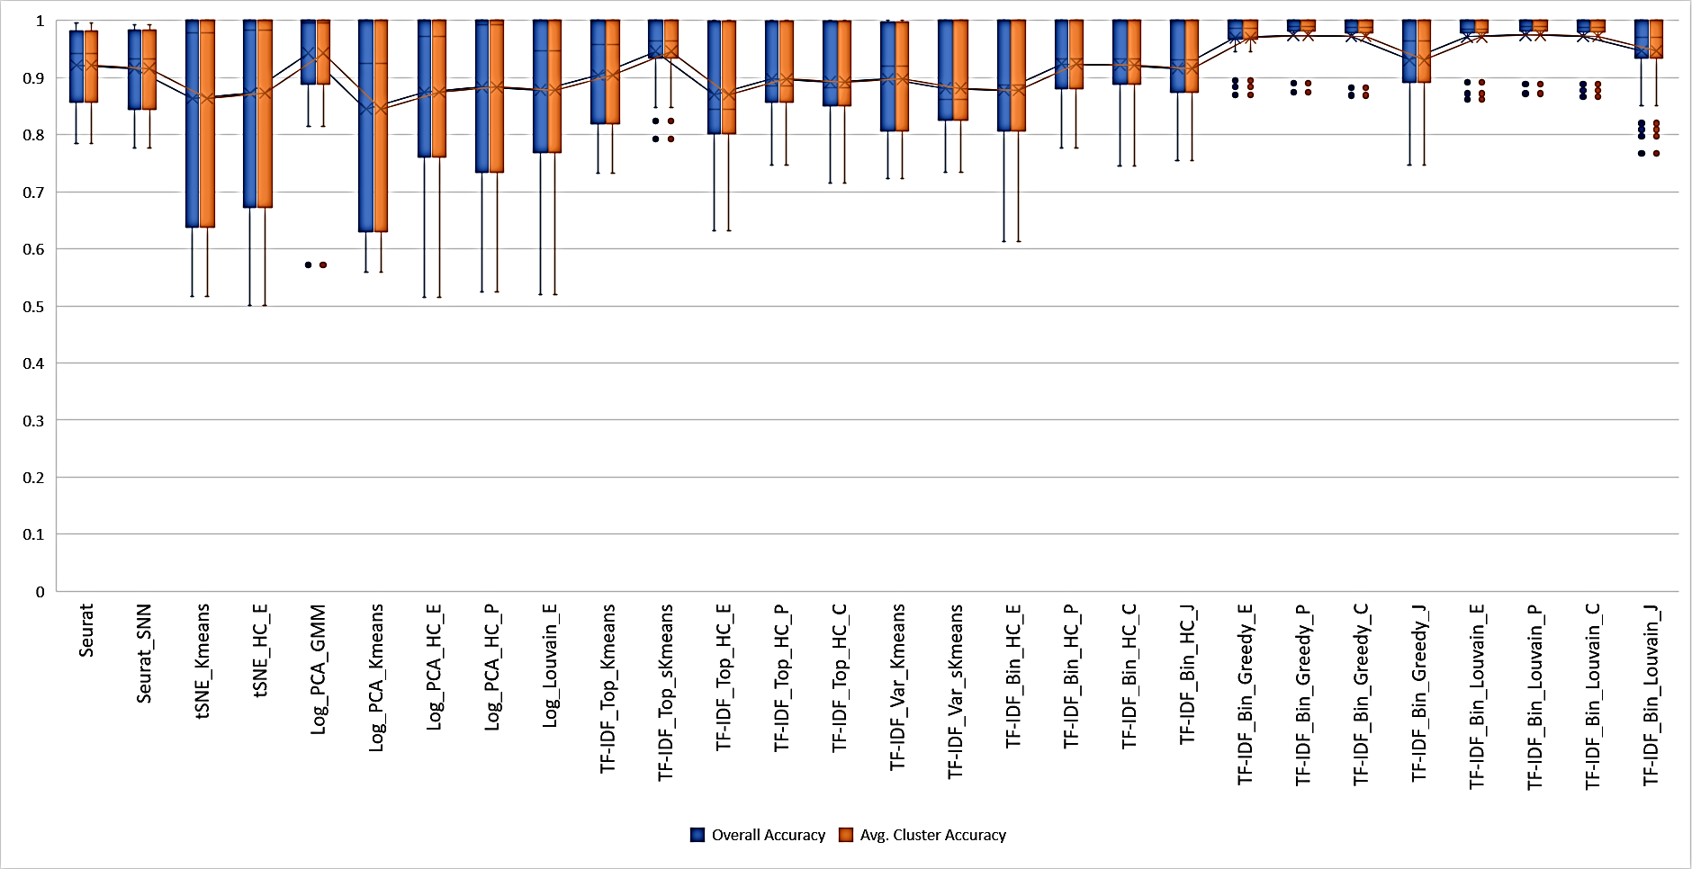
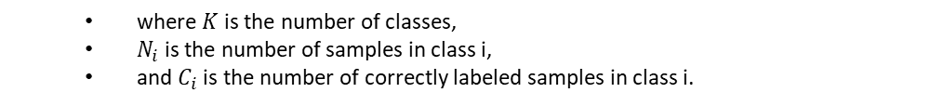
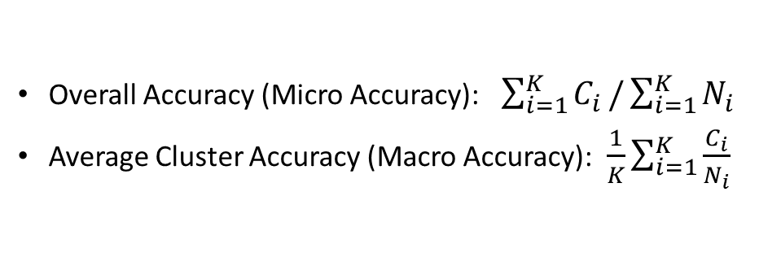
Pairs: 1:1/1:1 mixtures
Overall Accuracy (Micro Accuracy):$\sum_{i=1}^{K}{C_{i}}/\sum_{i=1}^{K}{N_{i}}$
Average Cluster Accuracy (Macro Accuracy):$\frac{1}{K}\sum_{i=1}^{K}{\frac{C_{i}}{N_{i}}}$
  where $K$ is the number of classes,
  $N_{i}$ is the number of samples in class i,
  and $C_{i}$ is the number of correctly labeled samples in class i.

Slide 23
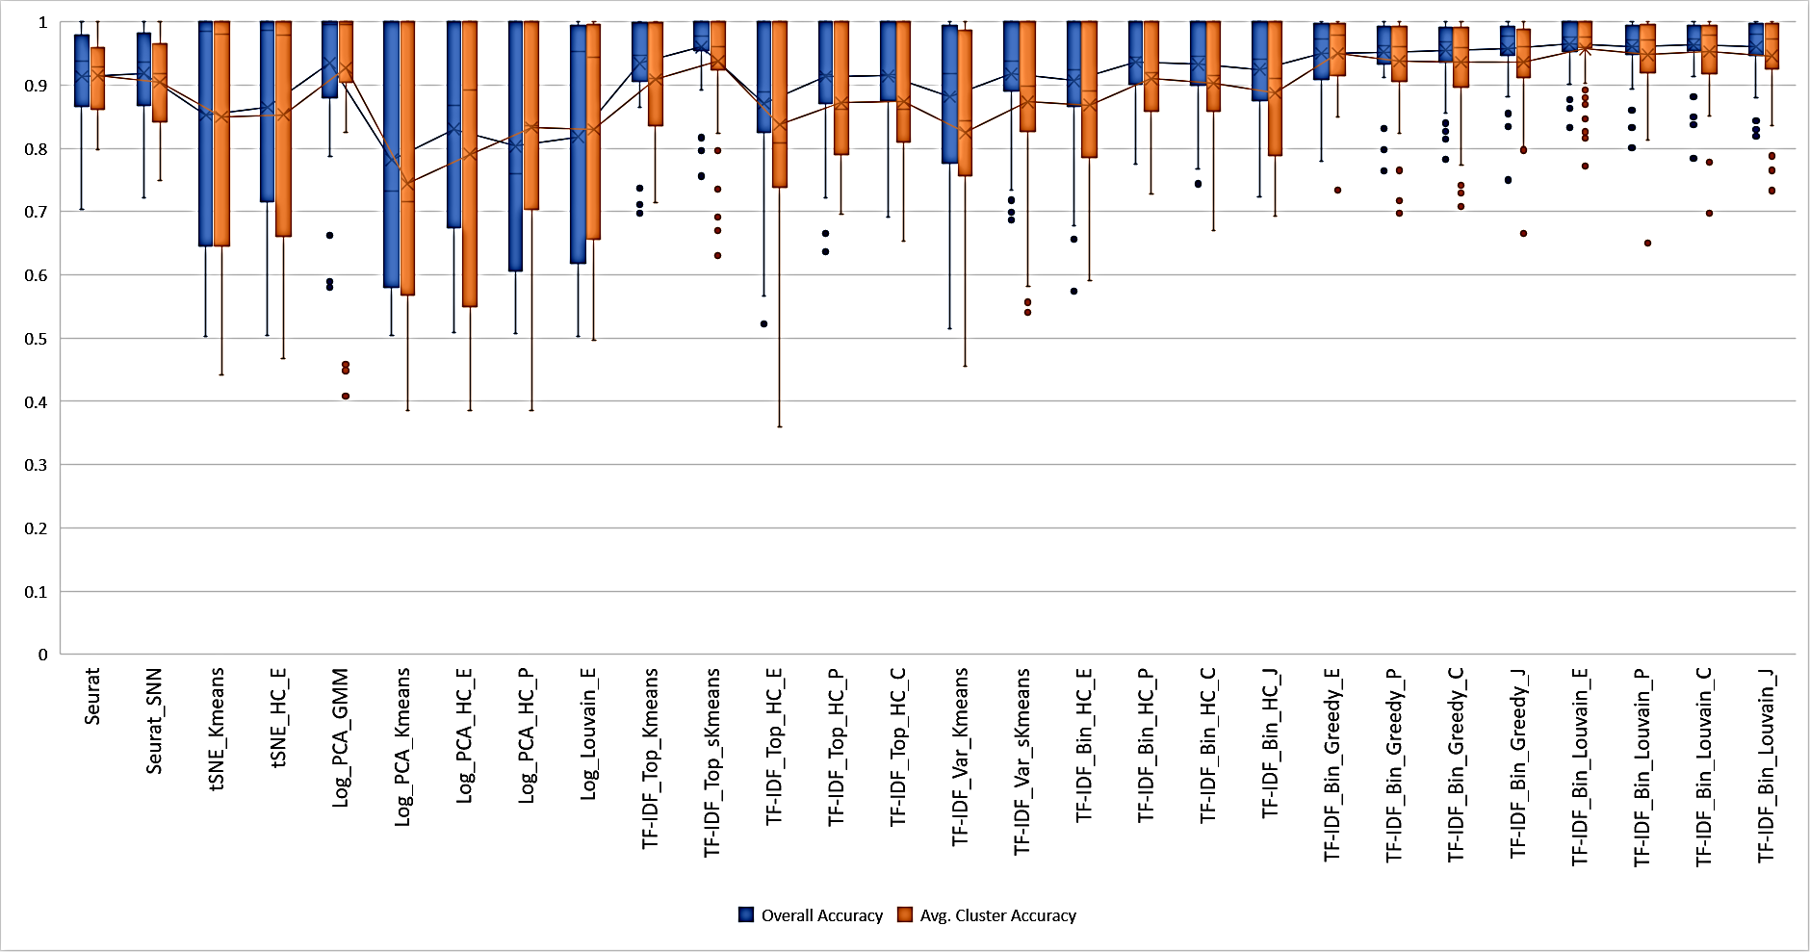
Pairs: 1:3/3:1 mixtures
Overall Accuracy (Micro Accuracy):$\sum_{i=1}^{K}{C_{i}}/\sum_{i=1}^{K}{N_{i}}$
Average Cluster Accuracy (Macro Accuracy):$\frac{1}{K}\sum_{i=1}^{K}{\frac{C_{i}}{N_{i}}}$
  where $K$ is the number of classes,
  $N_{i}$ is the number of samples in class i,
  and $C_{i}$ is the number of correctly labeled samples in class i.
More Results ->

Slide 24
LSImpute - Locality Sensitive Imputation for Single-Cell RNA-Seq Data

Slide 25
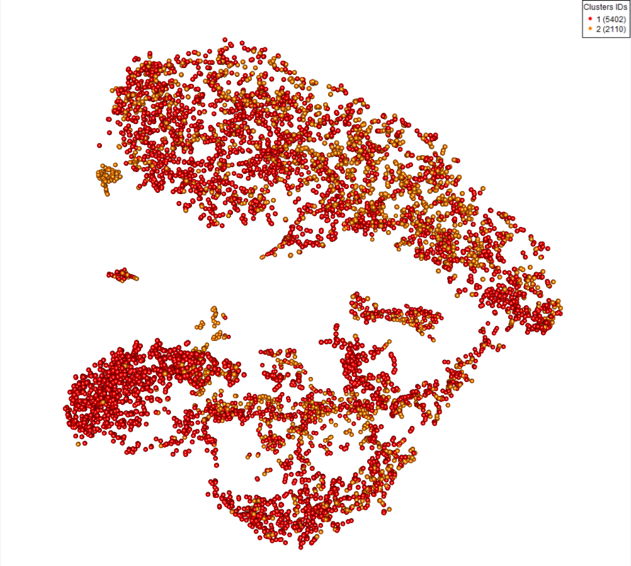
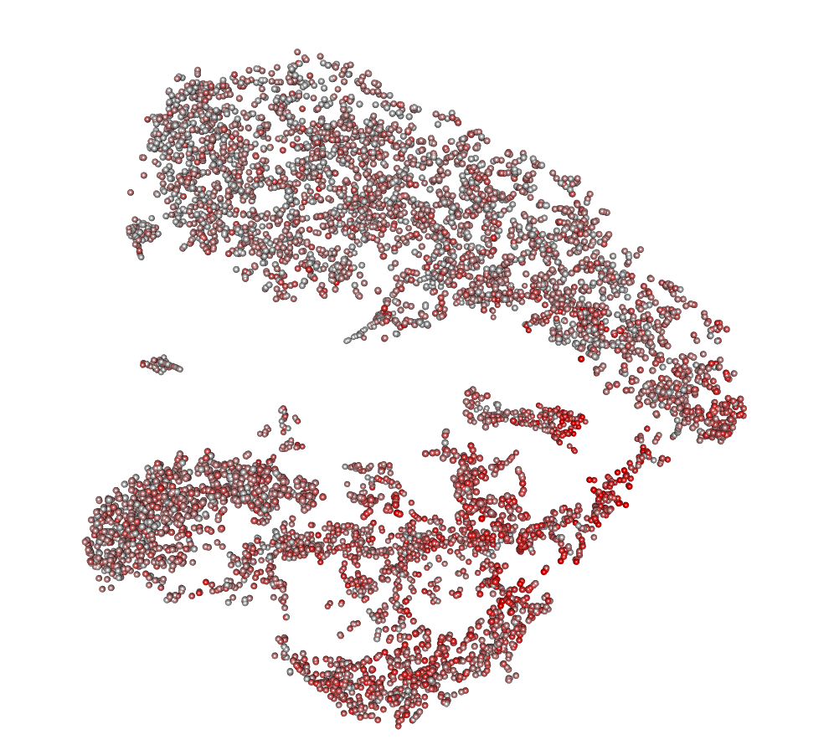
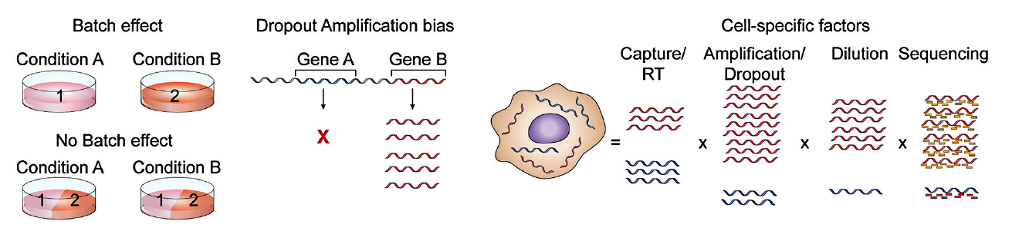
Drop-outs
Drop outs can occur due to:
  inefficient mRNA capture,
  low number of RNA transcripts and the stochastic nature of gene expression,
7512 CD45+
by FACS
5811 CD45+
Notes:
drop-outs typically do not affect the highly expressed genes as severely but may affect biologically interesting genes expressed at low levels such as transcription factors.

Slide 26
Single cell RNA-Seq imputation methods
DRImpute (Kwak, 2017)
  clustering cells in k clusters, average expression
scImpute (Li, 2018)
KNNImpute (Troyanskaya, 2001)
  Find K nearest neighbor genes, average expression
LSImpute: Locality Sensitive Imputation for scRNA-Seq Data (Moussa, 2018)
  A novel imputation algorithm selects cells with highest similarity level using LSH: Locality Sensitive Hashing in O(n) that form tight groups to be used for conservative imputation avoiding ‘over-imputation’.

Slide 27
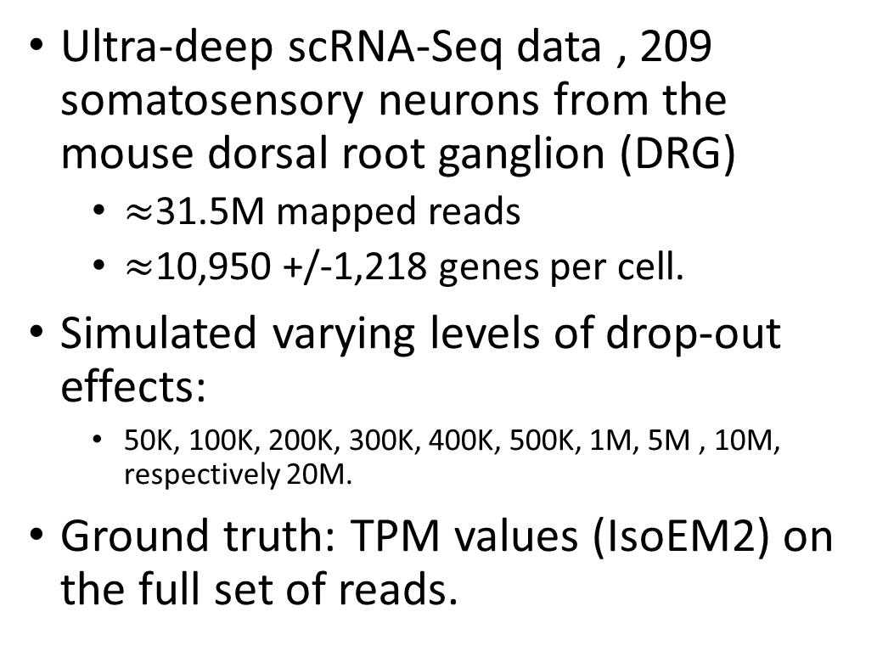
Experimental Setup – DRG Data Sets
Ultra-deep scRNA-Seq data , 209 somatosensory neurons from the mouse dorsal root ganglion (DRG)
  $≈$31.5M mapped reads
  $≈$10,950 +/-1,218 genes per cell.
Simulated varying levels of drop-out effects:
  50K, 100K, 200K, 300K, 400K, 500K, 1M, 5M , 10M, respectively 20M.
Ground truth: TPM values (IsoEM2) on the full set of reads.

Slide 28
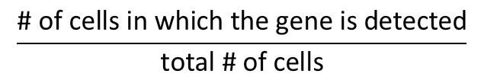
Gene Detection Fraction
$$\frac{\text{\# }\text{of} \text{cells} \text{in} \text{which} \text{the} \text{gene} \text{is} \text{detected}}{\text{total}\text{ \# }\text{of} \text{cells}}$$
True (x-axis) Detection of each gene (dot) vs. Raw (y-axis) Detection Fraction.
Dot color shades are based on four quartiles.
For an ideal imputation method all dots would lie on the main diagonal
Raw (Down-sampled) Gene Detection Fraction
Gene Detection Fraction for Ground Truth

Slide 29
For 200K Raw Rounded TPMs
DrImpute
scImpute
KNNImpute
LSImpute-Med
LSImpute-Mean

Slide 30
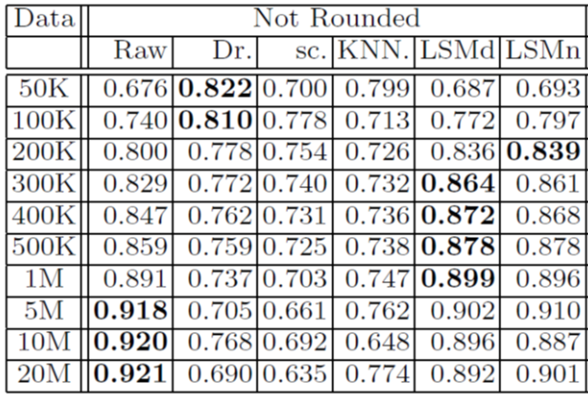
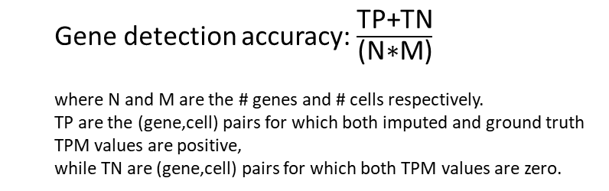
Gene Detection Accuracy
Median percent error (MPE) vs. Accuracy
  Gene detection accuracy:$\frac{\text{TP}\text{+}\text{TN}}{\text{(}\text{N}\text{∗}\text{M}\text{)}}$
  where N and M are the # genes and # cells respectively.
  TP are the (gene,cell) pairs for which both imputed and ground truth TPM values are positive,
  while TN are (gene,cell) pairs for which both TPM values are zero.
More ->

Slide 31
Raw Data 100K
DrImpute
scImpute
KNNImpute
LSImputeMed
LSImputeMean

Slide 32
MethA 10x Data
638 cells: 494,275 Reads/Cell, down-sampled to 52,180 Reads/Cell (Fraction of Reads Kept 11.8%):
Detection Accuracy : Raw 0.97; DrImpute 0.95; LSImpute 0.974
True vs. down-sampled
DrImpute
LSImpute

Slide 33
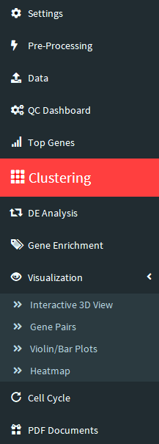
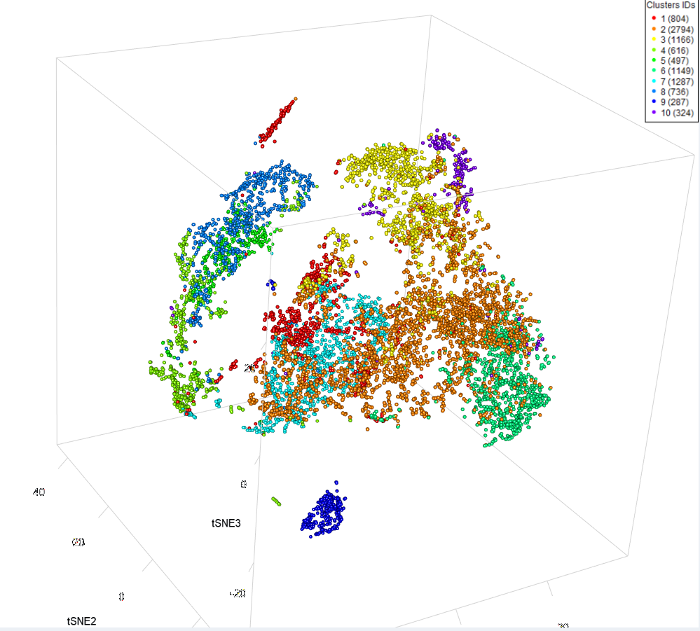
When to impute?
CD4 T-cells:
Cluster size > CD4+ve count

Slide 34
To Impute …
100k 1M 10M
Raw Data
DrImpute
scImpute
KNNImpute
LSImputeMed
LSImputeMean
… or not to impute ?
Two-edged sword (over-imputation)
LSImpute, imputes more conservatively than existing methods resulting in improved performance.
LSImpute is more likely to reduce drop-out effects without introducing false expression patterns.

Slide 35
Cell Cycle Analysis

Slide 36
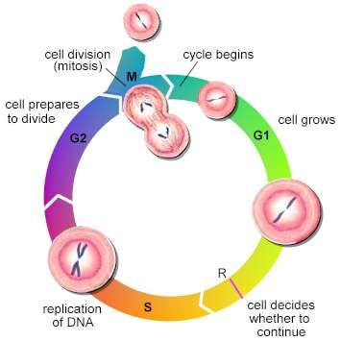
Cell Cycle Analysis
  Cell Type Effect vs. Cell Cycle Effect
  Existing Methods:
    Cyclone
      (classifier, scoring for G1, S, and G2 cell cycle phases)
    ccRemover
    jurkat & 293 cell lines:
    Oscope (identifies sinusoidal genes in unsynchronized scRNA-seq)
    reCAT (reconstructing cell cycle pseudo time-series)

Slide 37
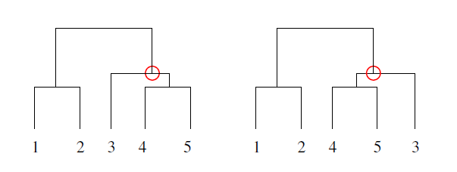
SC1CC Method
Principal Component Analysis of normalized RNA-Seq counts sub-matrix (cell cycle marker genes only) → global variation
Followed by 3 component t-SNE transformation using the first few PCs → local variation/similarity of cells
Hierarchical clustering (dendrogram).
Reconstruct the order of cells based on cell cycle by reordering the leaves of the obtained dendrogram using OLO (Optimal Leaf Ordering algorithm).
Notes:
Challenges: Deciding on PCs to use
CC genes based PCA vs. PC loadings analysis
Normalization
Centering (mean-based) & Scaling (sd-based) of cells (genes)
Gene Lists
Genes Correlation Filter

Slide 38
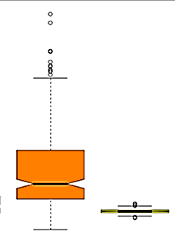
Gene-Smoothness Score
We define GSS per (ordered) cells’ group/cluster c:
  c is a given cluster/group of cells whose order is to be examined, and
  N is the number of genes.
  SC(G_i) is the serial-correlation of a given Gene i.
  Serial- (or auto-) correlation: correlation value between a given gene vector
  (gene as a vector of centered expressions in cells) and a shifted version of itself.

Slide 39
Dataset - Labeled
hESC cell line (200+ single undifferentiated human embryonic stem cells isolated by FACS into 91, 80 and 76 cells in G1, S and G2/M)

Slide 40
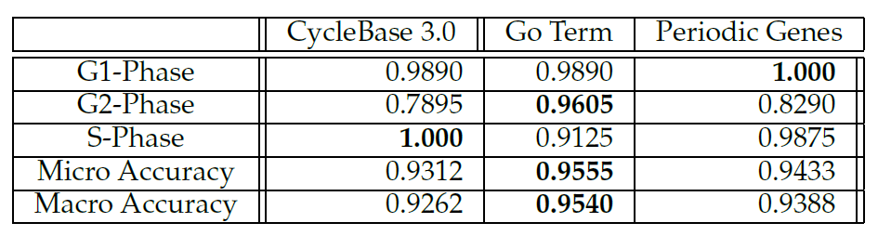
Accuracy- hESC

Slide 41
Dataset – Not Labeled
T-cells (CD3+ cells), 10x Genomics.
  Additional challenges:
    Sparser data than C1 platform
    Cycling vs. non-cycling cells

Slide 42
Dividing vs. non-dividing

Slide 43
Dividing cells

Slide 44
scRNA-Seq Analysis - Workflow
Pre-Processing
  Cell/Gene Quality Control
  Dimensionality reduction
TF-IDF-based Informative Genes’ Selection
TF-IDF-based Clustering Methods
LSImpute: Locality Sensitive Imputation
Cell Cycle Analysis
Cell type identification/annotation
  Differential Expression Analysis
  Enrichment Analysis
Visualization
SC1 interactive workflow : https://sc1.engr.uconn.edu
Notes:
Our Contribution : methods in various parts of the workflow …

Slide 45
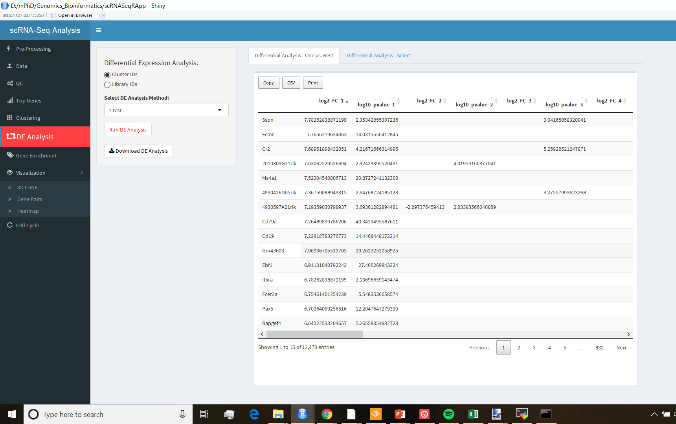
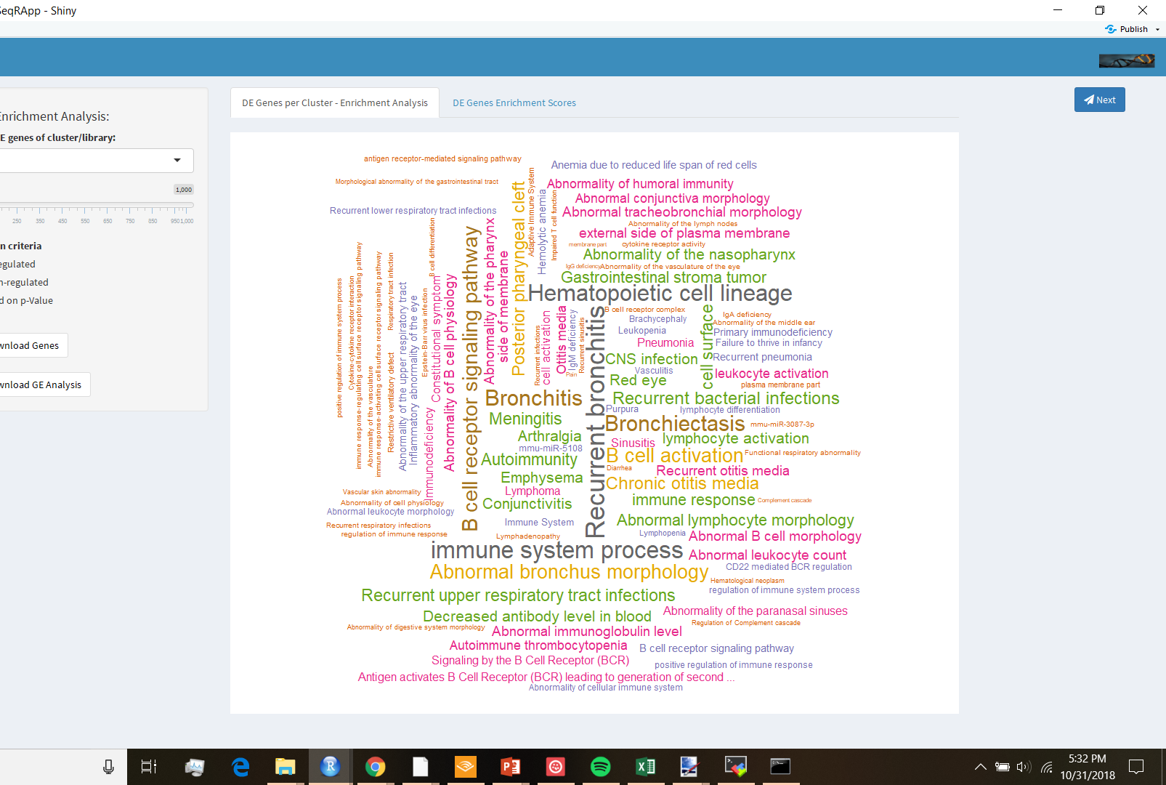
Cell Type Identification in SC1
Optimal Number of Clusters (Gap Statistics Algorithm)
Pre-Clustering heterogeneity (TF-IDF based Gene Selection)
TF-IDF based Clustering Methods: Hierarchical Clustering, Spherical K-means, Graph-based
Differential Expression Analysis
  One vs. the Rest (t-test using Welch approximation with 0.95 confidence interval)
Genes Enrichment Analysis
  functional enrichment analysis performed using gProfiler, results visualized as word clouds.
Cluster-based Gene Enrichment (Cluster Annotation)
Notes:
unequal variances t-test, is a two-sample used to test the hypothesis equal means

Slide 46
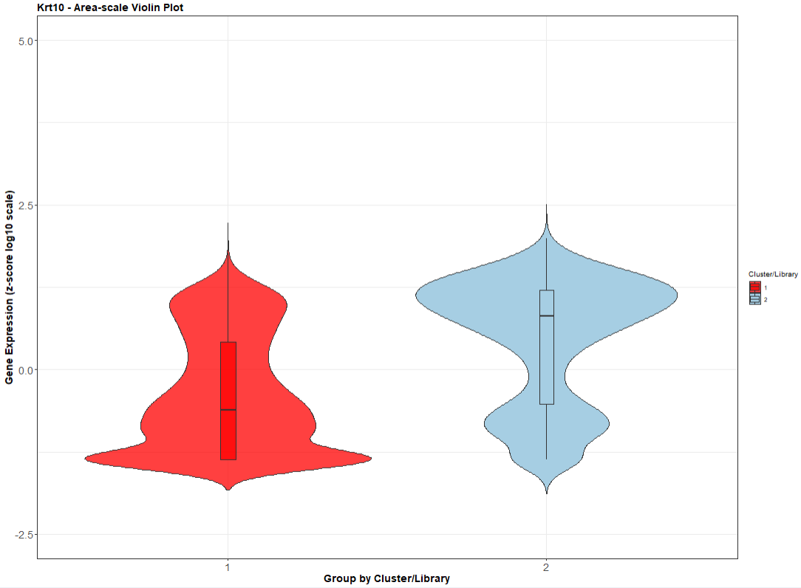
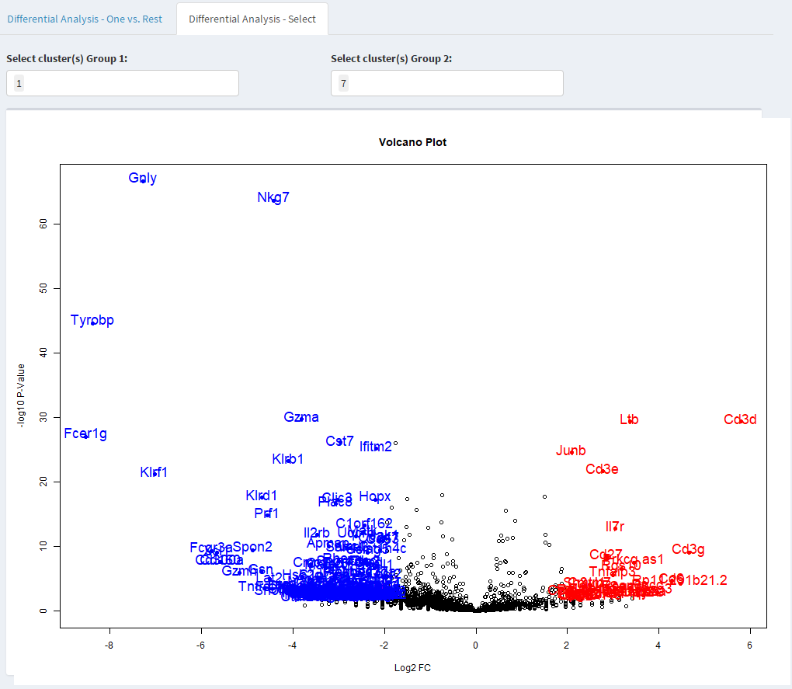
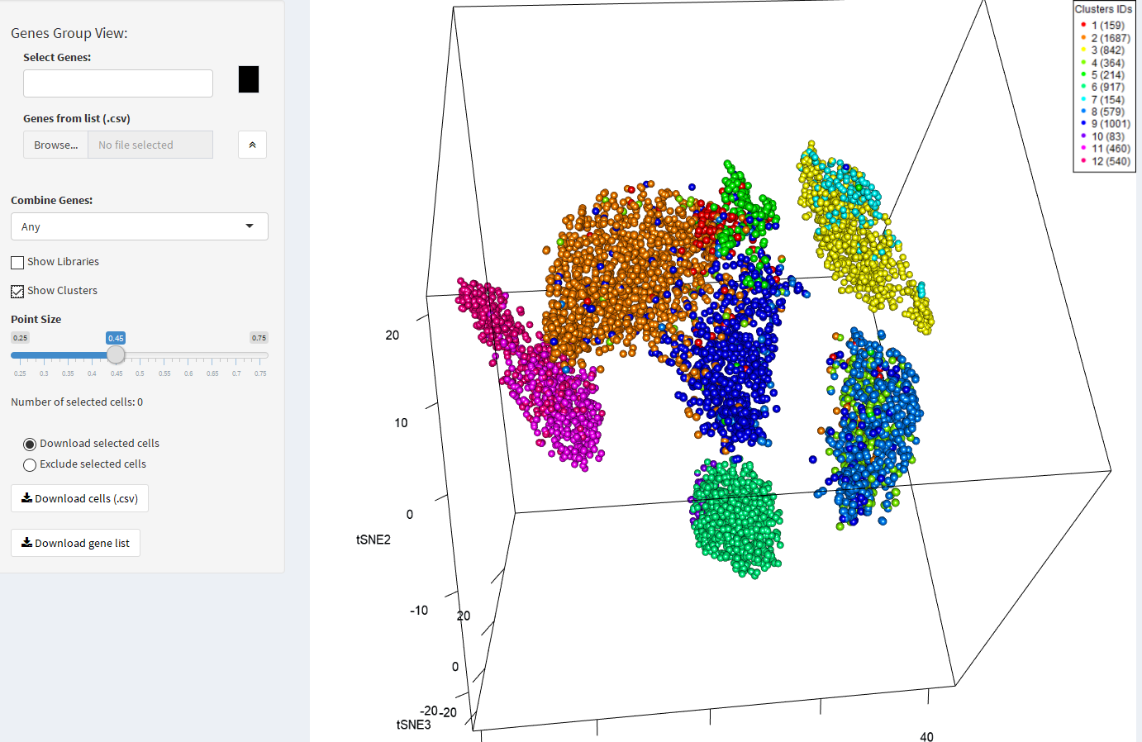
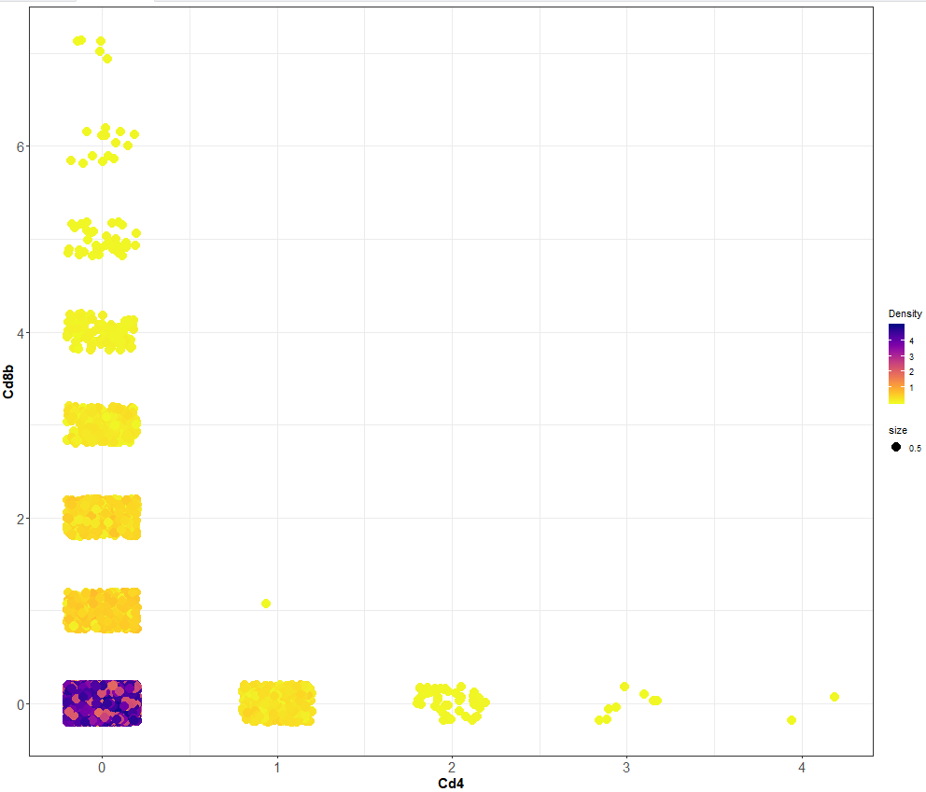

Visualization
Interactive 2D Visualization
Interactive 3D Visualization
Volcano Plot: Differential Expression
Word Cloud: Gene Enrichment
Violin Plots: Probability Density of gene expression values per cluster/library
Heatmaps: Log-transformed Gene Expression showing
  Cell Types Hierarchy
  Pseudo-Bulk (Summary Heatmap)
  Cell Cycle Order

Slide 47


Datasets analyzed in SC1
Single cell experiments of different species and technologies:
  Smart-seq2, CEL-Seq, 10x Genomics, …
Tens of datasets, hundreds of thousands of cells:
  Umbilical cord blood and bone marrow
  Human / Mouse Melanoma
  Ovarian Cancer
  Pancreas
  Immune Cells
  PBMCs
  HPV
  Human / Mouse Stem Cells
  DRG
  Mouse Brain / Embryo
  ….

Slide 48
Conclusion
The range of single-cell applications continues to expand, fueled by advances in technology
Clustering Single Cell RNA-Seq Data using TF-IDF based Methods
  TF-IDF based clustering methods outperform existing methods
  Top average TF-IDF score allows pre-clustering insights into data
  Scalable to large # of cells, especially with graph-based clustering
  Robust across technologies
  Less affected by batch effect, cell cycle effect …
LSImpute: Locality Sensitive Imputation for Single Cell RNA-Seq Data
Cell Cycle Effect on scRNA-Seq Analysis.
SC1: Web-based Work-flow for the Analysis and Interactive Visualization of Single Cell RNA-Seq Data

Slide 49
Future Work
Lineage inference
Integrative (Multi-Modal) Analysis
Additional workflow components (cell type matching, lineage inference, RNA velocity,…)

Slide 50
Publications
Single cell rna-seq data clustering using tf-idf based methods. M Moussa, II Măndoiu. BMC Genomics 19 (6), 127. 2018
Locality sensitive imputation for single-cell RNA-Seq data. M Moussa, II Măndoiu International Symposium on Bioinformatics Research and Applications, 347-360. 2018
SC1: A web-based single cell RNA-seq analysis pipeline. M Moussa, II Măndoiu. 2018 IEEE 8th International Conference on Computational Advances in Bio and Medical Sciences (ICCABS). 2018 ( accepted abstract, in preparation)
Computational cell cycle analysis of single cell RNA-seq data. M Moussa. 2018 IEEE 8th International Conference on Computational Advances in Bio and Medical Sciences (ICCABS) . 2018 ( accepted abstract, in preparation)
Clustering Single Cell RNA-Seq Data using TF-IDF based Methods. M Moussa, I Mandoiu. Bioinformatics Research and Applications. 13th International Symposium, ISBRA 2017, Honolulu, HI, USA. Lecture Notes in Computer Science book series ( extended abstract, volume 10330)
Differential Privacy Approach for Big Data Privacy in Healthcare. M Moussa, SA Demurjian. Privacy and Security Policies in Big Data, 191-213. 2017
iClass: Combining Multiple Multi-label Classification with Expert Knowledge. M Moussa, M Maynard. 2015 IEEE 14th International Conference on Machine Learning and Applications. 2015
iClass-Applying Multiple Multi-Class Machine Learning Classifiers Combined With Expert Knowledge to Roper Center Survey Data. M Moussa, M Maynard. LWA, 221-229 . 2015

Slide 51
Thank You.
Questions?
Demo: https://sc1.engr.uconn.edu/

Slide 52
Genes and Cells Selection in SC1
Identifying important genes
Identifying cell populations
Highly expressed genes
Custom gene selection
(High variability genes)
Differentially expressed genes
Top average TF-IDF genes
Pre-defined libraries/conditions
Cell populations based on gene selection
Cell Types (Clustering Results)*
Cell Cycle based :
  Dividing, non-dividing cell populations
  Cell cycle phases
*Results can be affected by drop out

Slide 53
Extra Slides – Clustering
>

Slide 54

T-SNE vs. UMAP

Slide 55



TF-IDF based gene selection (Var)
genes with highest variability (Var) in TF-IDF values:
  Variability decided by the relationship between the coefficient of variation (CV) and average expression levels.
  CV (Dispersion) : ratio of the standard deviation to the mean. $CV=\frac{σ}{|μ|} (∗100\%)$
  Useful in comparison between data sets with different units or widely different means.
  We pick the genes above the fitted line (fitted by linear regression) of CV vs. mean plot.
  fitted by linear regression of CV vs. mean plot.
  $$CV=\frac{σ}{|μ|} (∗100\%)$$

Slide 56


TF-IDF based gene selection (Top) (ft. Hierarchical Clustering)
High abundance Genes
High TF-IDF score Genes
Notes:
Clustering using only few genes in the heatmap

Slide 57


Experimental Setup: PBMC data set
FACS sorted blood cells of 7 types [Zheng et al. 2017] using the 10x Genomics platform
  CD14+ Monocytes
  CD19+ B Cells
  CD4+/CD25+ Regulatory T Cells
  CD4+/CD45RA+/CD25- Naive T cells
  CD4+/CD45RO+ Memory T Cells
  CD56+ Natural Killer Cells
  CD8+/CD45RA+ Naive Cytotoxic T Cells
7:1, 3:1, 1:1, 1:3, and 1:7 mixtures of cell type pairs of varying dissimilarity, bootstrapping (5x sampling, 1000 cells/pair)
  highly dissimilar: (b cells and cd14 monocytes) and (b cells and cd56 nk)
  highly similar : (memory t and naive cytotoxic) and (regulatory t and naive t)
  intermediate similarity: (memory t and naive t) and (regulatory t and naive cytotoxic)
7-way mixture, equal proportions (5x sampling, 7000 cells/mix)
  https://support.10xgenomics.com/single-cell-gene-expression/datasets
  http://cnv1.engr.uconn.edu:3838/SCA/

Slide 58

Experimental Setup: PBMC data set

Slide 59



t-SNE TF-IDF transformation
Raw PBMC data t-SNE plot
TF-IDF transformed data t-SNE plot
<

Slide 60
Experimental Setup: Pancreatic cells
2045 Pancreatic cells of 7 types [Segerstolpe et al. 2016]
  Capture proportions: (185 acinar cells, 886 alpha cells, 270 beta cells, 197 gamma cells, 114 delta cells, 386 ductal cells, and 7 epsilon cells)

Slide 61

t-SNE TF-IDF transformation
Raw Pancreas data t-SNE plot
TF-IDF transformed data t-SNE plot
<

Slide 62

Louvain modularity optimization algorithm
$$Q=\frac{1}{2m}\sum_{ij}{{[A}_{ij} −\frac{k_{i}k_{j}}{2m}]} δ(c_{i}, c_{j})$$
between -1 and 1, measures density of links inside vs. between communities.
$A_{ij}$is the edge weight between nodes i and j,
$k_{i}$ and $k_{j}$ is the sum of weights of edges attached to i & j,
2m is the sum of all edge weights in graph,
$c_{i}$and $c_{j}$are the communities of $i$& $j$, and
$δ$ is a simple Kronecker delta

Slide 63

Louvain modularity optimization algorithm
Find small communities by optimizing modularity locally on all nodes (~evaluate gain in $Q$by removing i from its community & moving it into a neighboring community),
Each small community is grouped into one node and the first step is repeated.

Slide 64

Jaccard Similarity
$$J\left(A,B\right)=\frac{\left|A∩B\right|}{|A∪B|}$$
For scRNA-seq: $J=\frac{N_{11}}{N_{01}+N_{10}+N_{11}}$
  $N_{11}$ represents the total number of genes where cell A and cell B both express the gene.
  $N_{10}$ represents the total number of genes where cell A and expresses the gene and cell B not…etc.
  0 means no similarity, 1 means identical
<

Slide 65

Cosine Similarity
Given two vectors of attributes, A and B, the cosine similarity, cos(θ):
$$\cos\left(θ\right)=\frac{\left(\sum_{i=1}^{n}{A_{i}B_{i} } \right)}{\sqrt{\sum_{i=1}^{n}{A_{i}^{2}}} \sqrt{\sum_{i=1}^{n}{B_{i}^{2}}}}$$
−1 meaning exactly opposite, to 1 meaning exactly the same, with 0 indicating decorrelation; 0 to 1 range for tf-idf.
<

Slide 66

Silhouette Score
s(i) score between -1 & 1, average s(i) measures how well the data points are clustered.
$$s\left(i\right)=\frac{b\left(i\right)−a\left(i\right)}{max⁡\{a\left(i\right),b(i)\}}$$
a(i) be the average dissimilarity of i with all other data within the same cluster
b(i) be the lowest average dissimilarity of i to any other cluster, of which i is not a member.
<

Slide 67

‘Optimal’ number of clusters
the optimal number of clusters is selected as
  $$argmax_{k}Gap_{n}(k)$$
where the Gap Statistic [Tibshirani, 2001] for clustering n points into k clusters is given by
  $$Gap_{n}\left(k\right)=E_{n}^{∗}\left(log\left(W_{k}^{∗}\right)\right)−log(W_{k})$$
$W_{k}$ is the normalized sum of pairwise distances in the k clusters
$W_{k}^{∗}$ its expectation under a suitable null reference distribution (Monte Carlo sampling).
<

Slide 68




Example: Regulatory_t and naïve_t data set
Clockwise from top left:
Gap statistics for log-transformed, log-transformed PCA, tSNE,
and TF-IDF transformed and binarized expression levels of a 7:1 mixture of regulatory t and
naive t cells.
The x-axis gives the number of clusters K and the y-axis gives the gap statistic.
<

Slide 69

PBMCs QC
For all 10x Genomics datasets:
  filtered cells based on number of detected genes and total UMI count per cell.
  removed outliers based on the median-absolute-deviation (MAD) of cell distances from the centroid of the corresponding cell type.
  $$MAD= median(|x_{i} −median\left(x\right)|)$$
  basic gene quality control by applying a cutoff on the minimum total UMI count per gene across all cells and removing outliers based on MAD. (outlier>5MAD)
For Pancreatic cells:
  No cell QC
  marker genes with unusually high expression levels (INS for beta cells, GCG for alpha cells, SST for delta cells, PPY for PP/gamma cells, and GHRL for epsilon cells) were removed prior to clustering to eliminate thepossibility that they drive the clustering by themselves.
<

Slide 70


Accuracy measures
Overall Accuracy (Micro Accuracy):
$$\sum_{i=1}^{K}{C_{i}}/\sum_{i=1}^{K}{N_{i}}$$
Average Cluster Accuracy (Macro Accuracy):
$$\frac{1}{K}\sum_{i=1}^{K}{\frac{C_{i}}{N_{i}}}$$
Note that both are identical for 1:1 mixtures, but may differ significantly for imbalanced datasets, as macro-averaging gives equal weight to the accuracy of each class, whereas micro-averaging gives equal weight to each cell classification decision.
  where $K$ is the number of classes,
  $N_{i}$ is the number of samples in class i,
  and $C_{i}$ is the number of correctly labeled samples in class i.

Slide 71

Pairs: Existing Methods
Box-and-whiskers plots for results of 150 sets/method.
Median: horizontal line; mean: connected middle points; whiskers: extreme non-outlier; outliers: data points > 1.5 interquartile

Slide 72

Pairs: Algorithms using TF-IDF gene selection

Slide 73

Pairs: Algorithms using TF-IDF binarization.

Slide 74

Pairs: 1:7/7:1 mixtures
Overall Accuracy (Micro Accuracy):$\sum_{i=1}^{K}{C_{i}}/\sum_{i=1}^{K}{N_{i}}$
Average Cluster Accuracy (Macro Accuracy):$\frac{1}{K}\sum_{i=1}^{K}{\frac{C_{i}}{N_{i}}}$
  where $K$ is the number of classes,
  $N_{i}$ is the number of samples in class i,
  and $C_{i}$ is the number of correctly labeled samples in class i.

Slide 75
Pairs by ‘difficulty’: dissimilar → intermediate → similar
  highly dissimilar: (b cells and cd14 monocytes) and (b cells and cd56 nk)
  highly similar : (memory t and naive cytotoxic) and (regulatory t and naive t)
  intermediate similarity: (memory t and naive t) and (regulatory t and naive cytotoxic)
<

Slide 76
Accuracy for PBMC Cells, 7-way mixture

Slide 77
Accuracy for Pancreatic mixture
<

Slide 78

Average ranks based on overall accuracy.
The lowest five average ranks (including ties) for each dataset are typeset in bold, and the best overall average rank is shown in red.

Slide 79

Average ranks based on average cluster accuracy.
The lowest five average ranks (including ties) for each dataset are typeset in bold, and the best overall average rank is shown in red.
<

Slide 80

Modified TF-IDF Transformation
Term Frequency x Inverse Document Frequency for scRNA-Seq data:
  $$f^{′}=log⁡(f+1)$$
  For gene i in cell j with count f:
  $$TF_{ij}=f_{ij}^{′}/\max_{k}{f_{kj}^{′}}$$
  If gene i is detected with $f_{i}≥$t in n_{i} out of N cells:
  $$IDF_{i}=\log_{2}{(N/n_{i})}$$
  Possible choice for $t=mean TF$
  TF-IDF score:
  $$TF_{ij} ∗IDF_{i}$$
<

Slide 81


DRG - TF-IDF based Feature selection
42 Genes out of 47 hand-curated Markers List picked in top 1K TF-IDF Genes
<

Slide 82
Extra Slides – Imputation
>

Slide 83
scRNA-Seq Analysis- Challenges

Slide 84
Proposed method: Locality Sensitive Imputation for scRNA-Seq Data (LSImpute)
High level summary of the novel imputation algorithm (LSImpute):
Step 1. Given a set (S) of (n) cells , start by selecting a small number (m) of cells with highest similarity level using LSH: Locality Sensitive Hashing in O(n).
Step 2. Group the highly similar cells from Step 1 into “tight” clusters.
Step 3. For each cluster, replace zeros for each gene j with values imputed based on the expression levels of gene j in all cells within the cluster using either Mean (LSImputeMean) or Median (LSImputeMed) modes.
Step 4. The selected cells now have imputed values and the clusters they form are collapsed into their respective centroids.
The centroids are pooled together with remaining cells to form a new set (S’) and the process is repeated starting again at Step 1.
Notes:
unlike KNN, which uses similarity between genes, LSImpute uses similarity between cells. Also, the number of nearest cells used for imputation is not fixed but depends on the minimum similarity threshold

Slide 85



Toy Example:

Slide 86

Evaluation metrics
Gene detection fraction
  $$\frac{\text{\# }\text{of} \text{cells} \text{in} \text{which} \text{the} \text{gene} \text{is} \text{detected}}{\text{total}\text{ \# }\text{of} \text{cells}}$$
  (Compared to detection ratio from ground truth in scatter plots)
Median percent error (MPE)
  Median of the set of relative errors for the gene detection fraction
Gene detection accuracy
  $$\frac{\text{TP}\text{+}\text{TN}}{\text{(}\text{N}\text{∗}\text{M}\text{)}}$$
  where N and M are the # genes and # cells respectively. TP are the (gene,cell) pairs for which both imputed and ground truth TPM values are positive, while TN are (gene,cell) pairs for which both TPM values are zero.
Clustering micro-accuracy

Slide 87
Error curves for
100K data set.
The error curve plots, for every threshold x between 0 and 1, the percentage of genes with a relative error above x.
The abscissa of dashed vertical lines correspond to MPE of raw data.
% of Genes with Relative Error > x
Relative Error Threshold x

Slide 88
Median Percent Error values in log scale (y-axis) for each depth (x-axis) in each quantile (z-axis) for each method:
Raw data,
DrImpute,
scImpute,
KNNImpute,
LSImputeMed, and
LSImputeMean
<

Slide 89

Notes on LSImpute
Using the median of both zero and non-zero values first, decides implicitly whether a zero is a drop-out event or a true biological effect, and prevents large but isolated expression values from driving imputation of nearby zeros, while collapsing into centroids in each iteration limits the propagation of potential imputation errors.
Locality Sensitive Hashing O(n) using Cosine Similarity to select $m≥m_{min}(=6)$cells with min similarity Threshold = 0.85.
Internal clustering implementation using sKmeans with $k=\sqrt{m}$
<

Slide 90

Toy Example for LSH
Similar items are more likely to be hashed to the same bucket than dissimilar items are.
We then consider any pair that hashed to the same bucket for any of the hashings to be a candidate pair.
<

Slide 91

Notes on LSImpute
 | Candidate Cell 1 | Candidate Cell 2 | N-Bands/Similarity Level
1 | 25 | 27 | 40
2 | 205 | 209 | 27
3 | 207 | 209 | 27
4 | 205 | 207 | 26
5 | 208 | 209 | 24
6 | 137 | 165 | 22
7 | 206 | 208 | 22
8 | 206 | 209 | 22
9 | 207 | 208 | 22
10 | 33 | 69 | 21
11 | 62 | 68 | 21
12 | 111 | 113 | 21
13 | 132 | 170 | 21
14 | 137 | 192 | 21
15 | 153 | 171 | 21
16 | 153 | 177 | 21
17 | 18 | 20 | 20
18 | 56 | 62 | 20
19 | 56 | 68 | 20
20 | 62 | 63 | 20
21 | 68 | 79 | 20
if m_min = 6 → 6 unique cells
if m_min = 10, overshoot, >10 unique cells → resolve with Threshold Step
<

Slide 92
Existing single cell RNA-Seq imputation methods - DrImpute
The DrImpute R package implements imputation for scRNA-Seq based on clustering the data.
  distance between cells using Spearman and Pearson correlations,
  cell clustering based on each distance matrix,
  followed by imputing zero values multiple times based on the resulting clusters, and
  finally averaging the imputation results to produce a value for the drop-outs.
<

Slide 93
Existing single cell RNA-Seq imputation methods - scImpute
The scImpute R package makes the assumption that most genes have a bimodal expression pattern that can be described by a mixture model with two components.
The parameters in the mixture model are estimated using Expectation-Maximization (EM) results to produce a value for the drop-outs.
<

Slide 94
Existing single cell RNA-Seq imputation methods - KNNimpute
Weighted K-nearest neighbors (KNNimpute), a method originally developed for microarray data, selects genes with expression profiles similar to the gene of interest to impute missing values.
For instance, consider a gene A that has a missing value in cell 1, KNN will find K other genes which have a value present in cell 1, with expression most similar to A in cells 2 to N, where N is the total number of cells.
A weighted average of values in cell 1 for the K genes closest in Euclidean distance is then used as an estimate for the missing value for gene A.
<

Slide 95
Extra Slides – Cell Cycle

Slide 96
Dataset - Labeled
hESC cell line (200+ single undifferentiated human embryonic stem cells):
  Fluorescent ubiquitination-based cell cycle indicator (Fucci) H1 hESCs isolated by sorting single cells by fluorescence activated cell sorting (FACS).
  https://www.ncbi.nlm.nih.gov/geo/query/acc.cgi?acc=GSE64016
  G1, S or G2/M cell-cycle phases isolated by FACS into 91, 80 and 76 cells in G1, S and G2/M.

Slide 97
Results - hESC

Slide 98
Cell Cycle Genes
hESC
normalized expressions ordered by SC1CC (red) vs. a random order of cells (blue)

Slide 99
Mean-scores (hESC)

Slide 100
References
Satija, R., Farrell, J.A., Gennert, D., Schier, A.F., Regev, A.: Spatial reconstruction of single-cell gene expression data. Nature biotechnology 33(5), 495{502 (2015)
Zheng, G.X.Y., Terry, J.M., Belgrader, P., Ryvkin, P., Bent, Z.W., Wilson, R., Ziraldo, S.B., Wheeler, T.D., McDermott, G.P., Zhu, J., Gregory, M.T., Shuga, J., Montesclaros, L., Underwood, J.G., Masquelier, D.A., Nishimura, S.Y., Schnall-Levin, M., Wyatt, P.W., Hindson, C.M., Bharadwaj, R., Wong, A., Ness, K.D., Beppu, L.W., Deeg, H.J., McFarland, C., Loeb, K.R., Valente, W.J., Ericson, N.G., Stevens, E.A., Radich, J.P., Mikkelsen, T.S., Hindson, B.J., Bielas, J.H.: Massively parallel digital transcriptional profiling of single cells.
Tibshirani, R., Walther, G., Hastie, T.: Estimating the number of clusters in a data set via the gap statistic. Journal of the Royal Statistical Society: Series B (Statistical Methodology) 63(2), 411{423 (2001).
Moussa, M., and Mandoiu, I.: Clustering scRNA-Seq Data using TF-IDF. Bioinformatics Research and Applications. 13th International Symposium, ISBRA 2017, Honolulu, HI, USA. Lecture Notes in Computer Science book series ( Extended Abstract in LNCS, volume 10330).
Moussa, M., and Mandoiu, I.: Single Cell RNA-seq Data Clustering using TF-IDF based Methods. (BMC Genomics, 2018).
Kwak, I.Y., Gong, W., Koyano-Nakagawa, N., Garry, D.: Drimpute: Imputing dropout events in single cell rna sequencing data. bioRxiv p. 181479 (2017)
Leskovec, J., Rajaraman, A., Ullman, J.D.: Mining of massive datasets. Cambridge University Press (2014) 20.
Li, C.L., Li, K.C., Wu, D., Chen, Y., Luo, H., Zhao, J.R., Wang, S.S., Sun, M.M., Lu, Y.J., Zhong, Y.Q.,et al.: Somatosensory neuron types identied by high-coverage single-cell rna-sequencing and functional heterogeneity. Cell research 26(1), 83 (2016)
21. Li, W.V., Li, J.J.: scimpute: accurate and robust imputation for single cell rna-seq data. bioRxiv p. 141598 (2017)
Moussa, M., Mandoiu, I.: LSImpute: Locality sensitive imputation for single-cell RNA-seq data. (Journal of Computational Biology, 2018).
Leng, N., Chu, L.F., Barry, C., Li, Y., Choi, J., Li, X., Jiang, P., Stewart, R.M., Thomson, J.A., Kendziorski, C.: Oscope identies oscillatory genes in unsynchronized single-cell rna-seq experiments. Nature methods 12(10), 947 (2015)
Scialdone, A., Natarajan, K.N., Saraiva, L.R., Proserpio, V., Teichmann, S.A., Stegle, O., Marioni, J.C., Buettner, F.: Computational assignment of cell-cycle stage from single-cell transcriptome data. Methods 85, 54{61 (2015)
Liu, Zehua, et al. "Reconstructing cell cycle pseudo time-series via single-cell transcriptome data." Nature communications 8.1 (2017): 22.
Barron, Martin, and Jun Li. "Identifying and removing the cell-cycle effect from single-cell RNA-sequencing data." Scientific reports 6 (2016): 33892.
Moussa, M. Computational cell cycle analysis of single cell RNA-seq data. 2018 IEEE 8th International Conference on Computational Advances in Bio and Medical Sciences (ICCABS). (2018) (preprint)

