Slide 1
Computational methods for genomics-guided immunotherapy
Sahar Al Seesi and Ion Măndoiu
Computer Science & Engineering Department
University of Connecticut

Slide 2
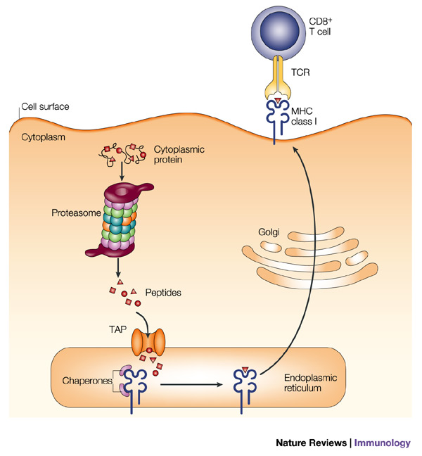
Class I endogenous antigen presentation

Slide 3
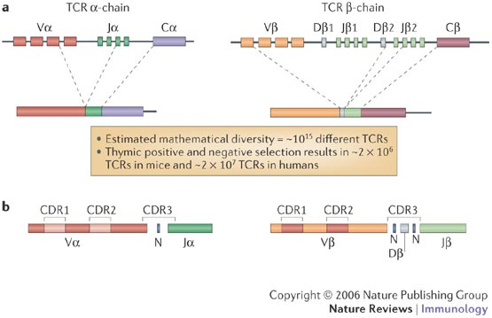
Somatic rearrangement of T-cell receptor genes
Potential TCR repertoire diversity: 10¹⁵

Slide 4
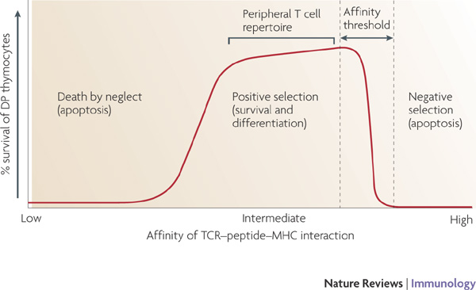
T-cell selection in thymus
Estimated TCR repertoire diversity after selection: ~2x10⁷

Slide 5
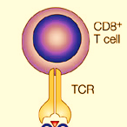
T-cell activation and proliferation

Slide 6
T-cell activation and proliferation

Slide 7

T-cell activation and proliferation

Slide 8
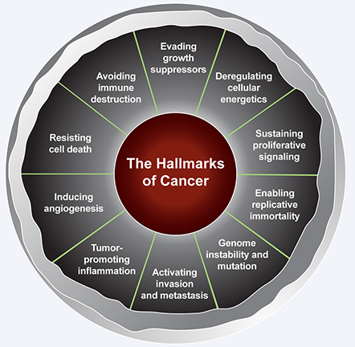
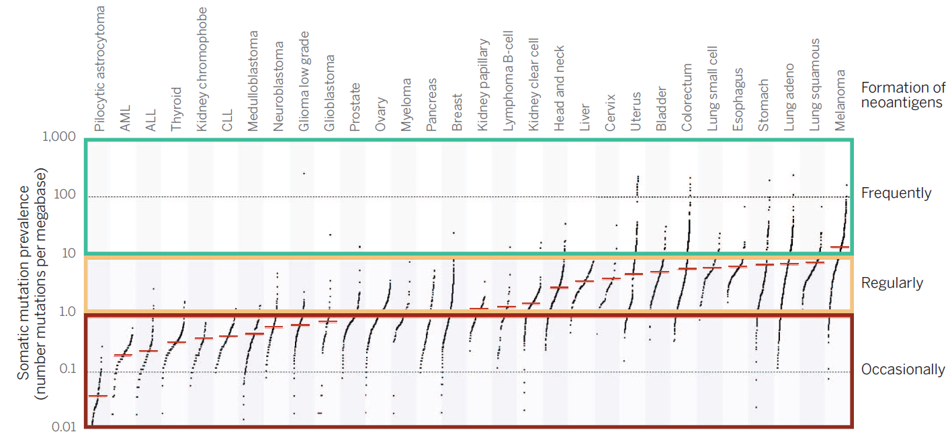
The immune system and cancer

Slide 9

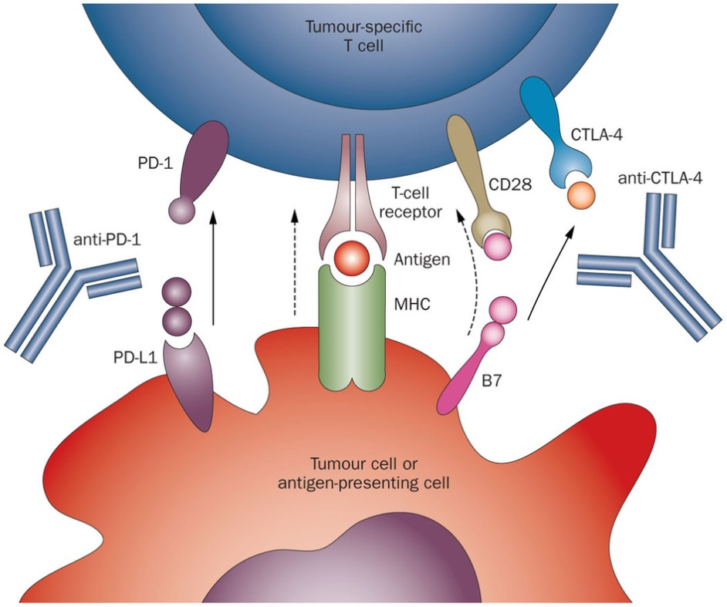
Cutting the brakes: PD1 and CTLA-4 blockade

Slide 10
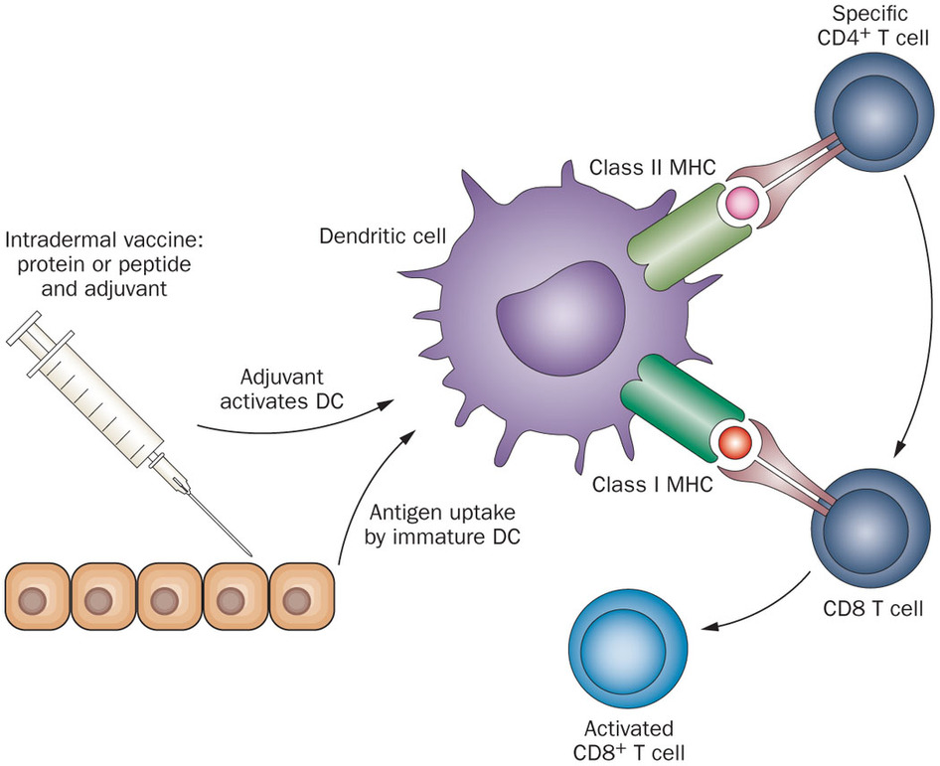
Stepping on the gas: vaccination with neoepitopes

Slide 11
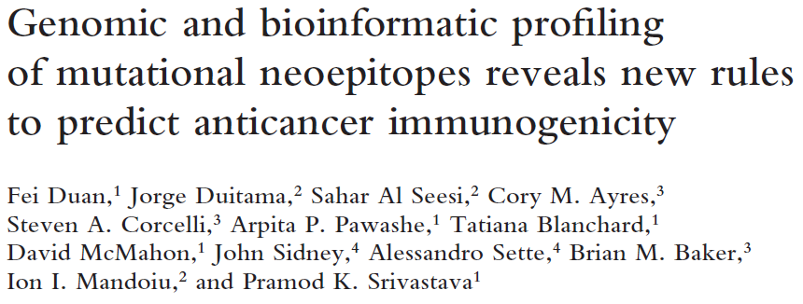
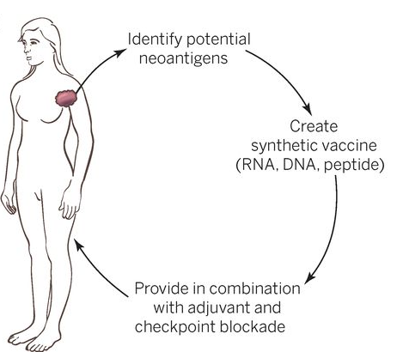
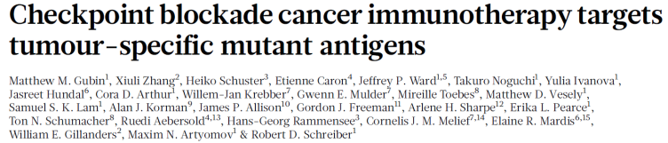
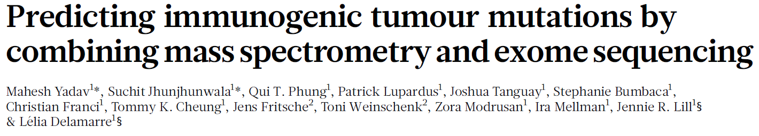
Combined approach
Ton N. Schumacher, and Robert D. Schreiber Science 2015;348:69-74

Slide 12
Sequencing
QC and Mapping
Calling SNVs
Epitope
Prediction
Vaccine Design
Clonality Analysis
TCR Sequencing

Slide 13

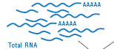
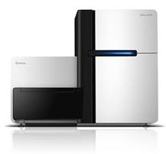

Sequencing
QC and Mapping
Calling SNVs
Epitope Prediction
Vaccine Design
Clonality Analysis
TCR Sequencing
Tumor DNA
Normal DNA
Tumor RNA
Whole Genome
Library prep
or
Nextera Rapid
Capture Exome
Whole Transcriptome
Library prep
Illumina HiSeq
Sequencing

Slide 14
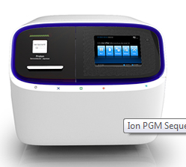
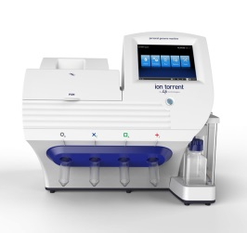
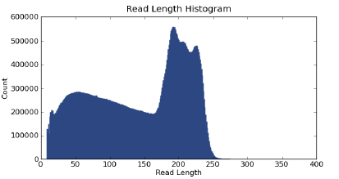
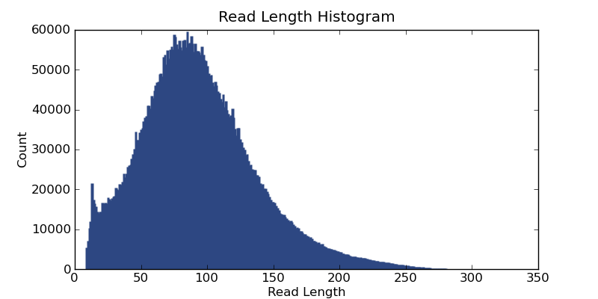
Sequencing
QC and Mapping
Calling SNVs
Epitope Prediction
Vaccine Design
Clonality Analysis
TCR Sequencing
Tumor DNA
Normal DNA
Tumor RNA
Whole Genome
Library prep
or
Exome
AmpliSeq
Whole Transcriptome
Library prep
Ion Proton
Ion PGM
Sequencing
Sequencing

Slide 15
Sequencing
QC and Mapping
Calling SNVs
Epitope Prediction
Vaccine Design
Clonality Analysis
TCR Sequencing
ION-Torrent Proton Runs: read statistics
 |  | # of reads | # of bases | Mean of reads lengths | std of reads lengths
Melanoma Patient | PB | 25,031,340 | 3,272,787,408 | 130.74 | 66.88
 | 1T | 19,252,932 | 2,589,624,915 | 134.5 | 68.67
 | 2T | 28,400,728 | 4,147,914,801 | 146.04 | 66.91
 | 3T | 26,039,006 | 3,800,446,471 | 145.95 | 67.02
Synthetic Tumor | Normal | 20,726,352 | 3,353,732,704 | 161.81 | 63.35
 | TumorAF10 | 20,726,352 | 3,360,840,809 | 162.15 | 63.14
 | TumorAF20 | 20,726,352 | 3,367,827,877 | 162.49 | 62.92

Slide 16


Sequencing
QC and Mapping
Calling SNVs
Epitope Prediction
Vaccine Design
Clonality Analysis
TCR Sequencing
Tumor Exome Reads
Human reference
Normal Exome Reads
Human reference
Tumor RNA-Seq Reads

Slide 17
Sequencing
QC and Mapping
Calling SNVs
Epitope Prediction
Vaccine Design
Clonality Analysis
TCR Sequencing
fastq QC Tools
  Tools to analyze and preprocess fastq files
  FASTX (http://hannonlab.cshl.edu/fastx_toolkit/)
    Charts quality statistics
    Filters sequences based on quality
    Trims sequences based on quality
    Collapses identical sequences into a single sequence

Slide 18
Sequencing
QC and Mapping
Calling SNVs
Epitope Prediction
Vaccine Design
Clonality Analysis
TCR Sequencing
fastq QC Tools
  Tools to analyze and preprocess fastq files
  PRINSEQ (http://prinseq.sourceforge.net/)
    Generates read length and quality statistics
    Filters reads based on length, quality, GC content and other criteria
    Trims reads based on length/position or quality scores

Slide 19
Sequencing
QC and Mapping
Calling SNVs
Epitope Prediction
Vaccine Design
Clonality Analysis
TCR Sequencing
Mapping decisions
  What is the best mapper for your data?
  End-to-end unspliced alignments vs. spliced or local alignments
  Unique vs. non-unique alignments
Tumor Exome Reads
Human reference
Normal Exome Reads
Human reference
Tumor RNA-Seq Reads

Slide 20
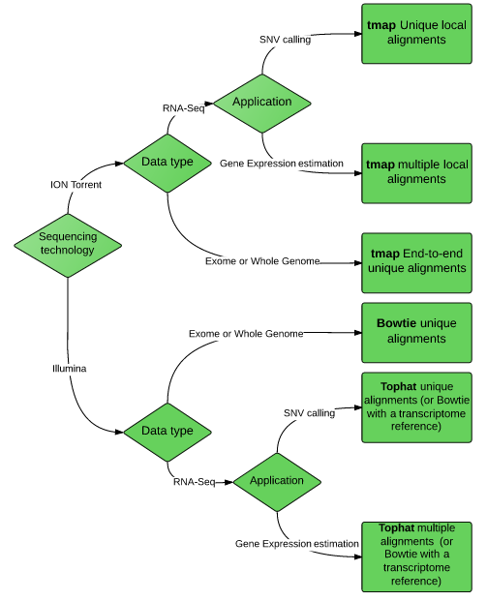

Slide 21
Sequencing
QC and Mapping
Calling SNVs
Epitope Prediction
Vaccine Design
Clonality Analysis
TCR Sequencing
ION-Torrent Proton read mapping comparison
 |  | Bowtie2 |  | TMAP |  | Segemehl
 |  | % of aligned bases | Aligned reads length mean | % of aligned bases | Aligned reads length mean | % of aligned bases 2 | Aligned reads length mean2
Melanoma Patient | PB | 89% | 138.8 | 100% | 130.7 | 99% | 135.4
 | 1T | 90% | 143.3 | 100% | 134.5 | 99% | 140.4
 | 2T | 90% | 153.3 | 100% | 146 | 99% | 150.3
 | 3T | 91% | 153.4 | 100% | 146 | 99% | 150.4
Synthetic Tumor | Normal | 89% | 172.89 | 100% | 161.81 | 98% | 167.66
 | Tumor_AF10 | 89% | 173.03 | 100% | 162.15 | 99% | 167.87
 | Tumor_AF20 | 89% | 173.17 | 100% | 162.49 | 99% | 168.08

Slide 22
Sequencing
QC and Mapping
Calling SNVs
Epitope Prediction
Vaccine Design
Clonality Analysis
TCR Sequencing
Tumor Exome Reads
*
*
*
*
Human reference
*
*
*
*
*
*
Normal Exome Reads

Slide 23
Sequencing
QC and Mapping
Calling SNVs
Epitope Prediction
Vaccine Design
Clonality Analysis
TCR Sequencing
Tumor Exome Reads
Somatic Variant Callers
Mutect (Broad Inst.)
VarScan2 (Wash. U.)
SomaticSniper (Wash. U)
Strelka (Illumina)
SNVQ w/ subtraction (UConn)
*
*
*
*
Human reference
*
*
*
*
*
*
Normal Exome Reads

Slide 24
Sequencing
QC and Mapping
Calling SNVs
Epitope Prediction
Vaccine Design
Clonality Analysis
TCR Sequencing
Coverage distribution of exome vs. SNV calls

Slide 25
Sequencing
QC and Mapping
Calling SNVs
Epitope Prediction
Vaccine Design
Clonality Analysis
TCR Sequencing
Comparing Somatic Variant Callers
Synthetic Tumors
  ION Torrent Proton exome sequencing of two 1K Genomes individual (mutations known)
  Downloaded from the public Torrent server
  Both exomes were sequenced on the same Proton chip
  Subset of the NA19240 sample was used as the normal sample
  Mixtures of NA19240 and NA12878 samples were used as the tumor samples
  Reads were mixed in different proportions to simulate allelic fractions, 0.1, 0.2, 0.3, 0.4 and 0.5.

Slide 26
Sequencing
QC and Mapping
Calling SNVs
Epitope Prediction
Vaccine Design
Clonality Analysis
TCR Sequencing
Comparing Somatic Variant Callers

Slide 27
Sequencing
QC and Mapping
Calling SNVs
Epitope Prediction
Vaccine Design
Clonality Analysis
TCR Sequencing
Comparing Somatic Variant Callers

Slide 28


Sequencing
QC and Mapping
Calling SNVs
Epitope Prediction
Vaccine Design
Clonality Analysis
TCR Sequencing
The ICGC-TCGA DREAM Somatic Mutation Calling Challenge
Initial Goal: Find the Best WGS Analysis Methods
Challenge 1 Data: 10 Real Tumor/Normal pairs
  5 from pancreatic tumors and 5 from prostate tumors
  Sequenced to ~50x/30x
Up to 10K candidates will be validated
re-sequencing to ~300x coverage using AmpliSeq primers on an IonTorrent

Slide 29

Sequencing
QC and Mapping
Calling SNVs
Epitope Prediction
Vaccine Design
Clonality Analysis
TCR Sequencing
Criteria for selecting candidate epitopes
  Gene harboring the SNV must be expressed (FPKM estimation)
    IsoEM (Nicolae et. al., Algorithms for Molecular Biology, 2011)
    http://dna.engr.uconn.edu/?page_id=105
    RSEM (Li et. al., BMC Bioinformatics, 2011)
    http://deweylab.biostat.wisc.edu/rsem/
Not Expressed X

Slide 30
Sequencing
QC and Mapping
Calling SNVs
Epitope Prediction
Vaccine Design
Clonality Analysis
TCR Sequencing
Criteria for selecting candidate epitopes
  Gene harboring the SNV must be expressed
  Peptide will be generated inside the cell upon protein being cleaved by the proteasome
  Peptide will bind to an MHC molecule that will chaperon it to the cell surface
    NetChop
    Predicts cleavage sites of the human proteasome
    http://www.cbs.dtu.dk/services/NetChop/
    SYFPEITHI
    Predicts MHC I, MHC II binding
    http://www.syfpeithi.de/
    NETMHC
    Predicts MHC I binding
    http://www.cbs.dtu.dk/services/NetMHC/
    NetCTL
    Combined cleavage and MHC biding predictions
    http://www.cbs.dtu.dk/services/NetCTL/
Notes:
>example
KYMDQLHRYTKLSYlVVFPLELRLFNTSG

Slide 31
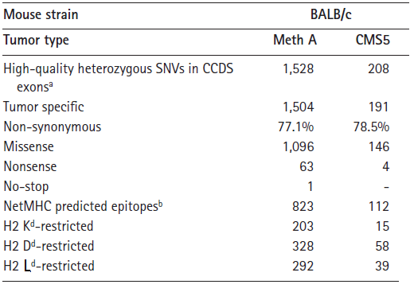
Sequencing
QC and Mapping
Calling SNVs
Epitope Prediction
Vaccine Design
Clonality Analysis
TCR Sequencing
Candidate neo-epitopes statistics for two mouse cell lines
Duan et. al., JEM 2014

Slide 32
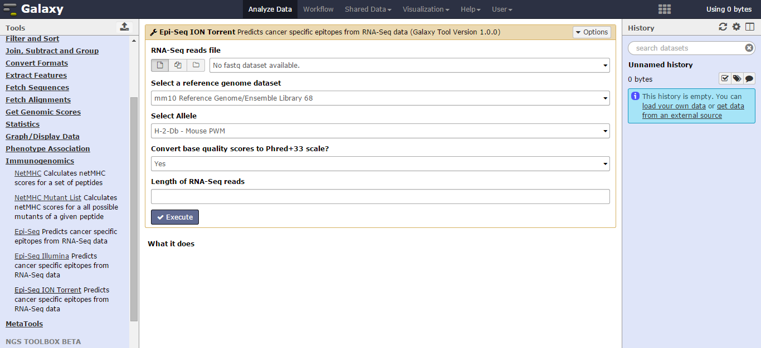
Sequencing
QC and Mapping
Calling SNVs
Epitope Prediction
Vaccine Design
Clonality Analysis
TCR Sequencing
Epi-Seq pipeline for neo-epitope prediction on local Galaxy server

Slide 33
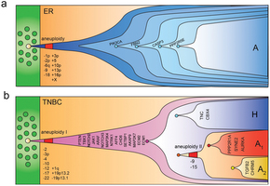
Sequencing
QC and Mapping
Calling SNVs
Epitope Prediction
Vaccine Design
Clonality Analysis
TCR Sequencing
Rational vaccine design requires info on the clonal structure of the tumor
  Not all cells harbor all candidate epitopes
Approaches to clonality analysis
  Computational inference from sequencing depth
    SNV allelic fractions only
  Targeted amplicon sequencing of selected mutations at single cell level
    More noisy data, potentially biased by capture protocols

Slide 34
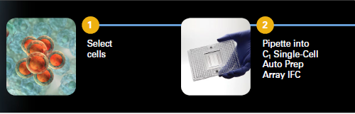
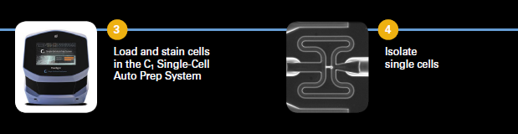
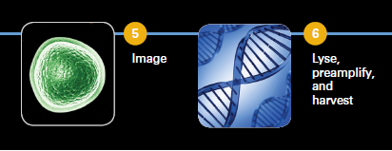
Cell capture & pre-amp
Sequencing
QC and Mapping
Calling SNVs
Epitope Prediction
Vaccine Design
Clonality Analysis
TCR Sequencing

Slide 35
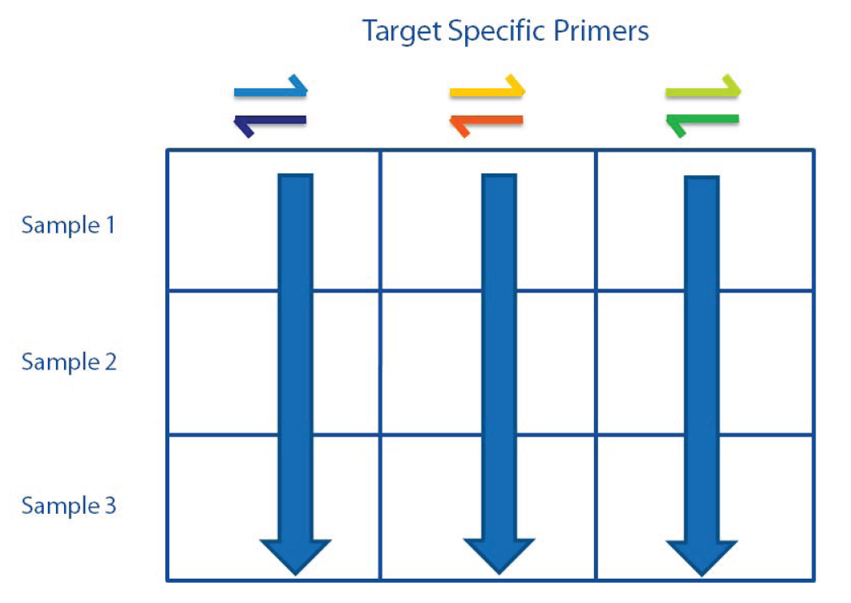
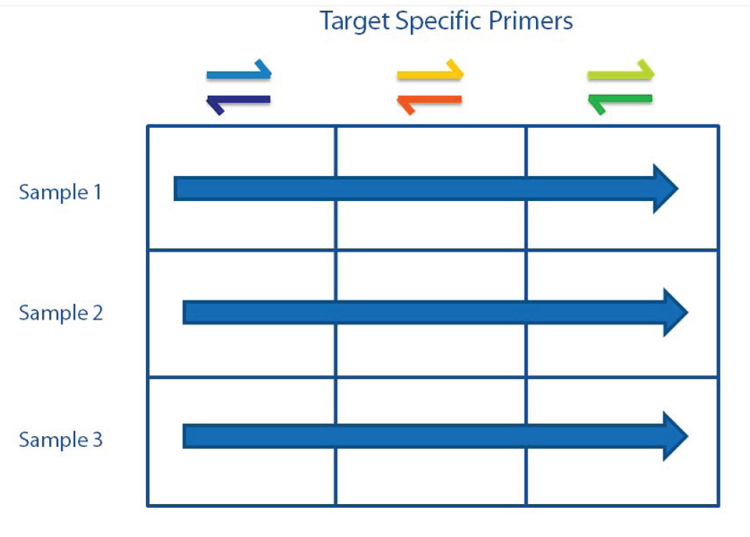
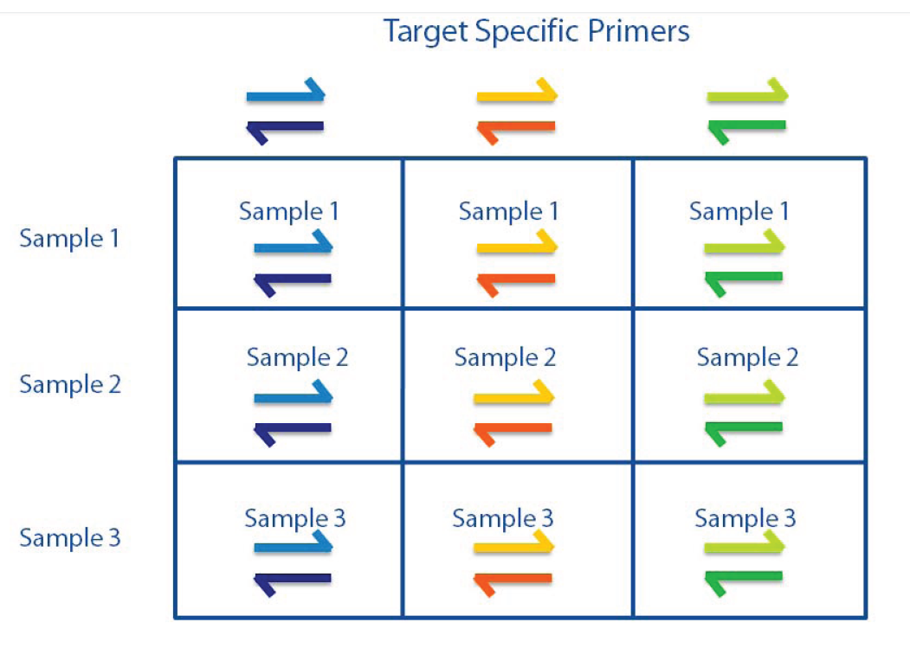
PCR on Access Array
Sequencing
QC and Mapping
Calling SNVs
Epitope Prediction
Vaccine Design
Clonality Analysis
TCR Sequencing

Slide 36
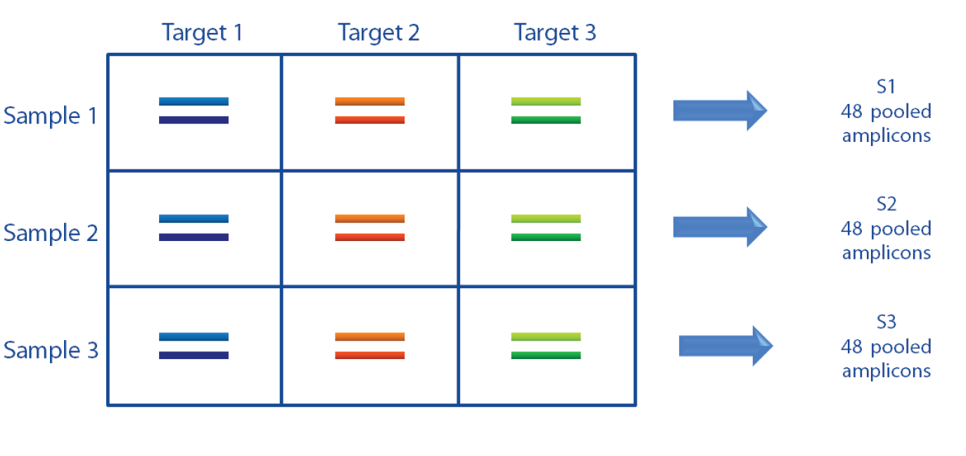
PCR on Access Array
Sequencing
QC and Mapping
Calling SNVs
Epitope Prediction
Vaccine Design
Clonality Analysis
TCR Sequencing

Slide 37
Captured cells in pilot run
Sequencing
QC and Mapping
Calling SNVs
Epitope Prediction
Vaccine Design
Clonality Analysis
TCR Sequencing
 | 1 | 2 | 3 | 4 | 5 | 6 | 7 | 8 | 9 | 10 | 11 | 12
A | 1_C03 | 1_C02 | 1_C01 | 1_C49 | 1_C50 | 1_C51 | 1_C06 | 3_C05 | 1_C04 | 1_C52 | 1_C53 | 1_C54
B | 2_C09 | 1_C08 | 1_C07 | 1_C55 | 1_C56 | 1_C57 | 1_C12 | 1_C11 | 1_C10 | 1_C58 | 1_C59 | 1_C60
C | 1_C15 | 2_C14 | 2_C13 | 1_C61 | 1_C62 | 1_C63 | 1_C18 | 2_C17 | 1_C16 | 1_C64 | 1_C65 | 1_C66
D | 1_C21 | 2_C20 | 1_C19 | 1_C67 | 1_C68 | 1_C69 | 2_C24 | 2_C23 | 4_C22 | 1_C70 | 1_C71 | 1_C72
E | bulk | 2_C26 | 1_C27 | 1_C75 | 1_C74 | 1_C73 | 0_C28 | 0_C29 | 0_C30 | 1_C78 | 1_C77 | 2_C76
F | 1_C31 | 0_C32 | 1_C33 | 1_C81 | 1_C80 | 1_C79 | 0_C34 | 1_C35 | 0_C36 | 1_C84 | 0_C83 | 1_C82
G | 0_C37 | 1_C38 | 0_C39 | 1_C87 | 1_C86 | 1_C85 | 1_C40 | 1_C41 | 1_C42 | 1_C90 | 1_C89 | 1_C88
H | 1_C43 | 1_C44 | 1_C45 | 1_C93 | 1_C92 | 1_C91 | 1_C46 | 1_C47 | 1_C48 | 1_C96 | 1_C95 | 1_C94

Slide 38
Analysis Pipeline
Sequencing
QC and Mapping
Calling SNVs
Epitope Prediction
Vaccine Design
Clonality Analysis
TCR Sequencing
Barcode list
Fastx Barcode Splitter
96 fastq files: one per well
pooled fastq file
tmap
96 sam files: one per well
mm9 BALBc genome
Generate Referece
fasta with +/- 300 bases around each SNV
List of SNV Locations
compute coverage
96x48 with total and fwd/rev variant coverage for each well/SNV

Slide 39
Target Aligned Reads
Sequencing
QC and Mapping
Calling SNVs
Epitope Prediction
Vaccine Design
Clonality Analysis
TCR Sequencing

Slide 40
Per SNV Coverage
Sequencing
QC and Mapping
Calling SNVs
Epitope Prediction
Vaccine Design
Clonality Analysis
TCR Sequencing

Slide 41
Sequencing
QC and Mapping
Calling SNVs
Epitope Prediction
Vaccine Design
Clonality Analysis
TCR Sequencing
SNV Support Matrix
Cells
SNVs
Low High

Slide 42
Sequencing
QC and Mapping
Calling SNVs
Epitope Prediction
Vaccine Design
Clonality Analysis
TCR Sequencing
Which Epitopes go into the vaccine?
  Diversify across HLA alleles
  Select mutations with balanced allele specific expression
  Maximize (expected) clone coverage
  Include epitopes with high MHC binding affinity
  Include epitopes with high Differential Agretopic Index (DAI): difference in MHC affinity between mutant epitope and its wild type counter part

Slide 43
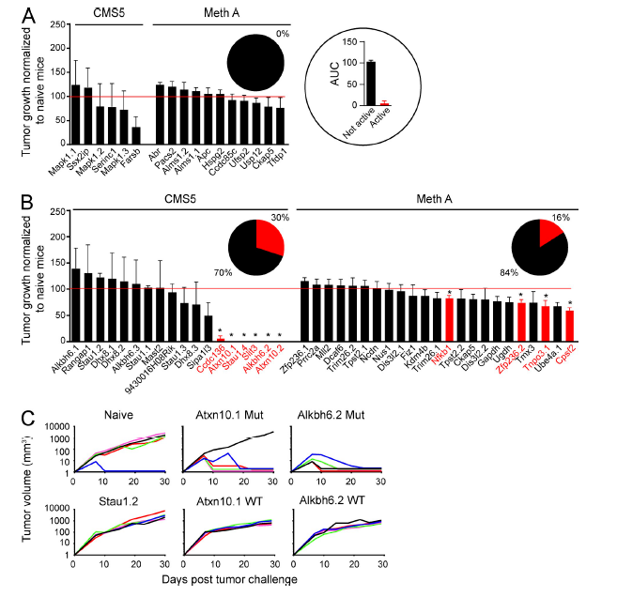
Sequencing
QC and Mapping
Calling SNVs
Epitope Prediction
Vaccine Design
Clonality Analysis
TCR Sequencing
Duan et. al., JEM 2014

Slide 44
Sequencing
QC and Mapping
Calling SNVs
Epitope Prediction
Vaccine Design
Clonality Analysis
TCR Sequencing
Expitope (Haase et. al., Bioinformatics 2014)
  Checks for cross-reactivity based on ENCODE RNA-Seq from normal tissues
  http://webclu.bio.wzw.tum.de/expitope/
OptiTope (Toussaint and Kohlbacher, Nucleic Acid Research 2009)
  Optimizes allele coverage
  http://etk.informatik.uni-tuebingen.de/optitope

Slide 45
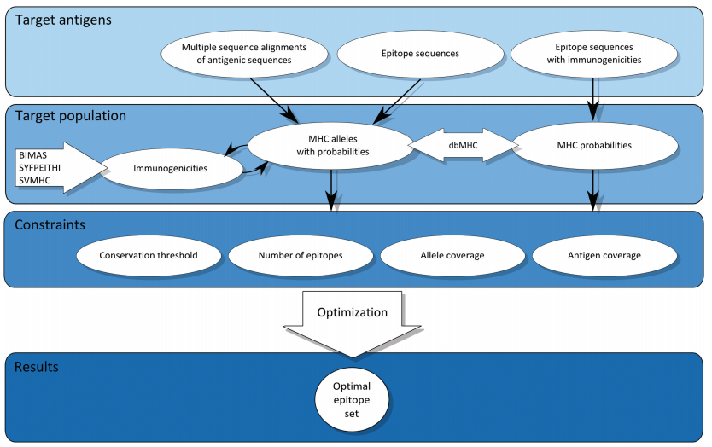
Sequencing
QC and Mapping
Calling SNVs
Epitope Prediction
Vaccine Design
Clonality Analysis
TCR Sequencing
Toussaint and Kohlbacher, Nucleic Acid Research 2009

Slide 46
Sequencing
QC and Mapping
Calling SNVs
Epitope Prediction
Vaccine Design
Clonality Analysis
TCR Sequencing
T Cell Receptor sequencing
  Compare the TCR repertoire before and after immunization to determine response against used epitope(s)
Primary analysis of TCR sequencing data
  IMSEQ (Kuchenbecker et. al., Bioinformatics 2015)
  http://www.imtools.org/
  HTJoinSolver (Russ et. al., BMC Bioinformatics 2015)
  https://dcb.cit.nih.gov/HTJoinSolver/

Slide 47
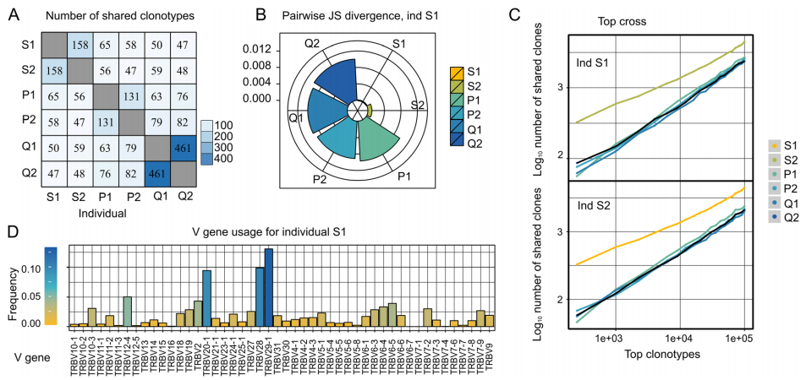
Sequencing
QC and Mapping
Calling SNVs
Epitope Prediction
Vaccine Design
Clonality Analysis
TCR Sequencing
tcR (Nazarov et. al., BMC Bioinformatics, 2015)
  R package for downstream analysis, including diversity measures, shared T cell receptor sequences identification http://imminfo.github.io/tcr/

Slide 48
THANK YOU!
QC
    FASTX: http://hannonlab.cshl.edu/fastx_toolkit/)
    PRINSEQ: http://prinseq.sourceforge.net/)
  Epitope prediction
    NetChop: http://www.cbs.dtu.dk/services/NetChop/
    SYFPEITHI: http://www.syfpeithi.de/
    NETMHC: http://www.cbs.dtu.dk/services/NetMHC/
    NetCTL: http://www.cbs.dtu.dk/services/NetCTL/
Tumor Specific epitope predicton pipeline
    Epi-Seq: http://dna.engr.uconn.edu/?page_id=470
    Also available on out galaxy server: http://mhc1.engr.uconn.edu:8080/
Vaccine design
    Expitope: http://webclu.bio.wzw.tum.de/expitope/
    OptiTope: http://etk.informatik.uni-tuebingen.de/optitope
TCR sequencing analysis
    Epi-Seq: http://imminfo.github.io/tcr/

