Slide 1
Accurate differential gene expression analysis for RNA-Seq data without replicates
Sahar Al Seesi
University of Connecticut
ISBRA 2013

Slide 2
Outline
Introduction/motivation
Bootstrapping method
Normalization methods for Fisher’s exact test
Experimental setup
Results
Ongoing work

Slide 3
Gene/Isoform Expression Estimation
Make cDNA & shatter into fragments
Sequence fragment ends
Introduction – Bootstrapping - Fisher’s - Experimental setup - Results - Ongoing work
Map reads
A
B
C
D
E
Gene Expression (GE)
Isoform Expression (IE)

Slide 4
Differential Isoform Expression
DE
*
*
Introduction – Bootstrapping - Fisher’s - Experimental setup - Results - Ongoing work
FC = 2 FC = 2 FC = 1.5

Slide 5
Differential Isoform Expression
DE
p-val < 0.05
*
p-val < 0.05
*
Introduction – Bootstrapping - Fisher’s - Experimental setup - Results - Ongoing work
p-val > 0.05
FC = 2 FC = 2 FC = 1.5

Slide 6
Motivation
Fold change does not account for the uncertainty in the gene expression estimation.
Reliable DE methods for data with replicates
edgeR [Robinson et al., 2010]
DESeq[Anders et al., 2010]
State of the art method for data w/o replicates: GFOLD [Feng, et al.]
Introduction – Bootstrapping - Fisher’s - Experimental setup - Results - Ongoing work

Slide 7
Bootstrapping
Condition 1 Condition2
A
B
C
D
E
A
B
C
D
E
(1) Sample with replacement
n reads
(2) Run IsoEM to estimate
FPKMs
(3) Calculate Fold changed
2 2 1.5
Repeat 1 through 3, m times

Slide 8
Calling DE Genes
2.2 1.9 2.5 2 1.7 2.1 1.1 2.1 2
70% FC > 2
1.5 1.8 2.1 2.5 1.7 1.2 1.1 1.9 1.5
30% FC > 2
Introduction – Bootstrapping - Fisher’s - Experimental setup - Results - Ongoing work
1.5 1.2 1.8 1.3 1.7 1.5 1.8 1.6 1.5 1.5
0% FC > 2

Slide 9
Calling DE Genes
DE
Introduction – Bootstrapping - Fisher’s - Experimental setup - Results - Ongoing work
FC = 2 FC = 2 FC = 1.5

Slide 10
Calling DE Genes
2 2.2 1.9 2.5 2 1.7 2.1 1.1 2.1 2
2 1.5 1.8 2.1 2.5 1.7 1.2 1.1 1.9 1.5

Slide 11
Fisher’s Exact Test
Statistical significance test for categorical data which measures the association between two variables.
a = estimated number of reads mapped to gene of interest per kilobase of gene length in condition a
b = estimated number of reads mapped to gene of interest per kilobase of gene length in condition a
c and d depends on the normalization method
p-value = hypergeometric probability of the numbers given in the contingency table or more extreme differences, while keeping the marginal sums in the contingency table unchanged
Total Aligned Reads
Housekeeping Gene
ERCCs
Introduction – Bootstrapping - Fisher’s - Experimental setup - Results - Ongoing work

Slide 12
Experimental Setup
Compared Bootstrapping and Fisher’s Exact Test (different normalization methods) to GFOLD and cuffdiff [Trapnell et al., 2010]
Tested on Illumina and ION-Torrent MAQC data
Number of mapped reads in millions
Introduction – Bootstrapping - Fisher’s - Experimental setup - Results - Ongoing work

Slide 13
Prediction Classification
Truth Prediction
DE DE
DE DE
DE DE
DE DE
DE NonDE
NonDE NonDE
NonDE DE
NonDE DE
→ TPOE
→ TPUE
→ TPND
Introduction – Bootstrapping - Fisher’s - Experimental setup - Ongoing work

Slide 14
Methods Evaluation
Genes are classified as follows
Evaluation Criteria
Introduction – Bootstrapping - Fisher’s - Experimental setup - Results - Ongoing work

Slide 15
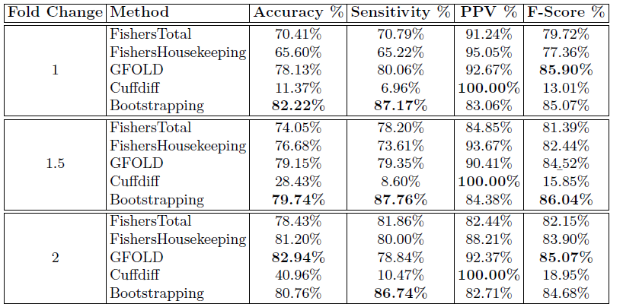
Results for Illumina Dataset
Introduction – Bootstrapping - Fisher’s - Experimental setup - Results - Ongoing work

Slide 16
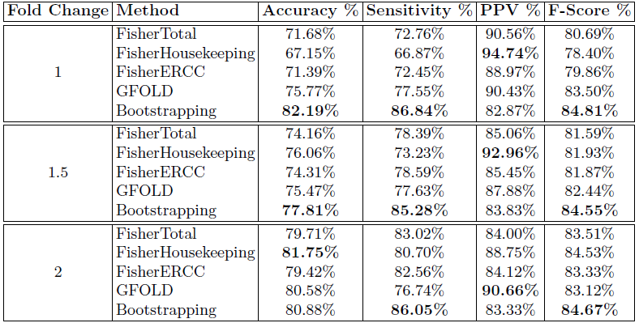
Results for ION Torrent Dataset
Introduction – Bootstrapping - Fisher’s - Experimental setup - Results - Ongoing work

Slide 17
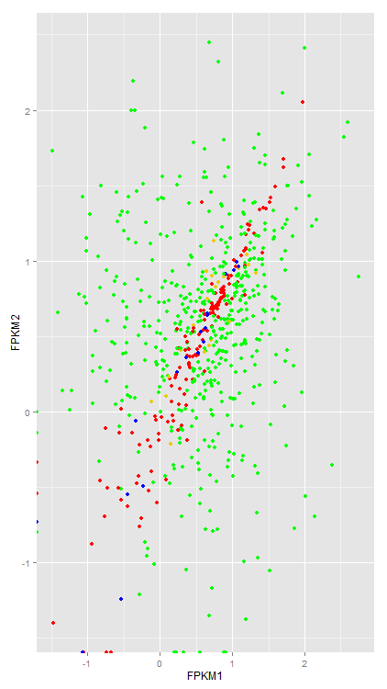
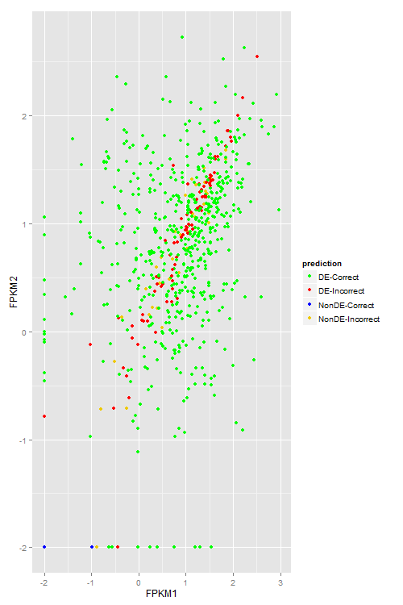
Effect of Expression Level on DE Calls
Introduction – Bootstrapping - Fisher’s - Experimental setup - Results - Ongoing work
FC = 1
GFOLD Bootstrapping

Slide 18
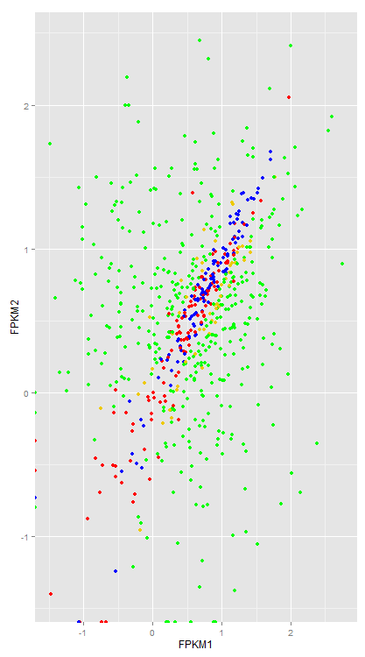
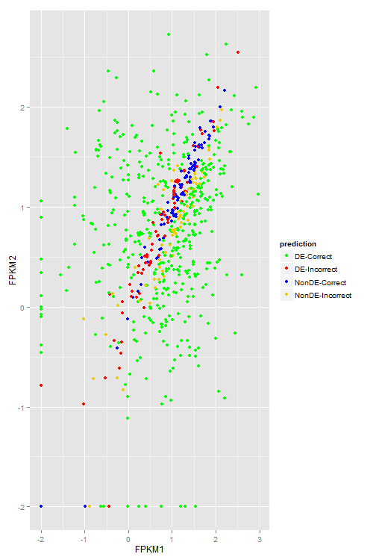
Effect of Expression Level on DE Calls
Introduction – Bootstrapping - Fisher’s - Experimental setup - Results - Ongoing work
FC = 1.5
GFOLD Bootstrapping

Slide 19
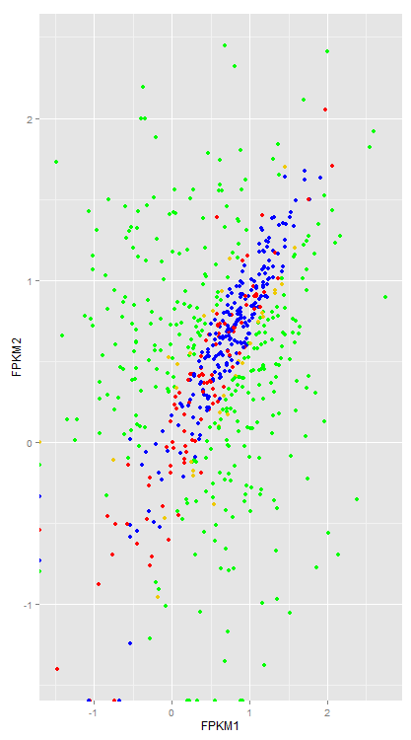
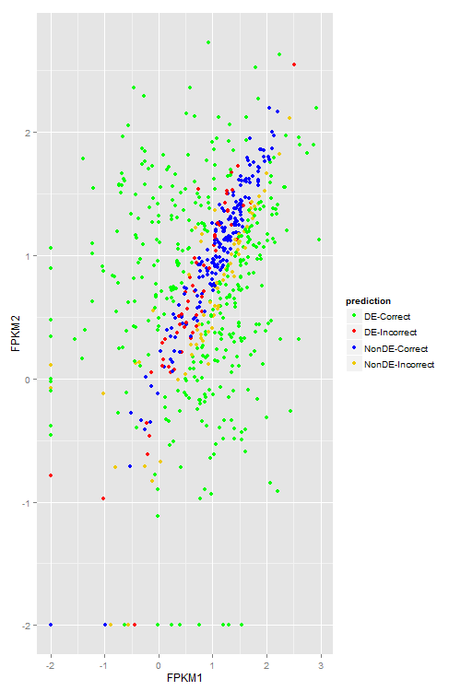
Effect of Expression Level on DE Calls
Introduction – Bootstrapping - Fisher’s - Experimental setup - Results - Ongoing work
FC = 2
GFOLD Bootstrapping

Slide 20
What next?
Test bootstrapping parameters
Number of bootstrapping samples (currently 200)
Sample pairing strategies (currently random matching)
Bootstrapping support threshold (currently 50%)
Try Trimmed Mean of M (TMM) [] values normalization for Fisher’s exact test
Test on more datasets/more technologies
Introduction – Bootstrapping - Fisher’s - Experimental setup - Results - Ongoing work

Slide 21
Acknowledgements
Yvette Temate Tiagueu (GSU)
Alex Zelikovsky (GSU)
Ion Mandoiu (Uconn)

