Slide 1
Reconstruction of Infectious Bronchitis Virus Quasispecies from NGS Data
Bassam Tork
Georgia State University
Atlanta, GA 30303, USA

Slide 2
Outline
Introduction
Reconstruction of Quasispecies from Shotgun Reads
different methods with different parameter settings
Experiment Results and Validation
validation of 454 IBV reads
validation of correction methods
validation of reconstructed quasispecies
Future Work.

Slide 3
How Are Quasispecies Contributing to Virus Persistence and Evolution?
Variants differ in
Virulence
escape immune response
Resistance to antiviral therapies
Lauring & Andino, PLoS Pathogens 2011
Notes:
RNA viruses are unable to detect and repair mistakes during replication due to the lack of DNA polymerase.
Mutations are passed down to descendants, producing a family/set of closely related variants of the ancestral genome referred as a quasispecies.
Qsps differ in virulence, ability to escape the immune system, resistance to therapies.
Knowing particular qsps sequences in patient can help
develop more efficient therapy or drug targeting particular qsps.
estimate outcome of treatment for the infected host and minimize side effects.

Slide 4
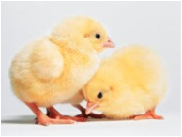
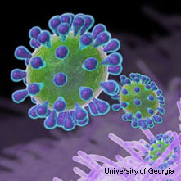
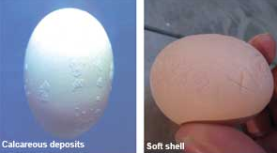
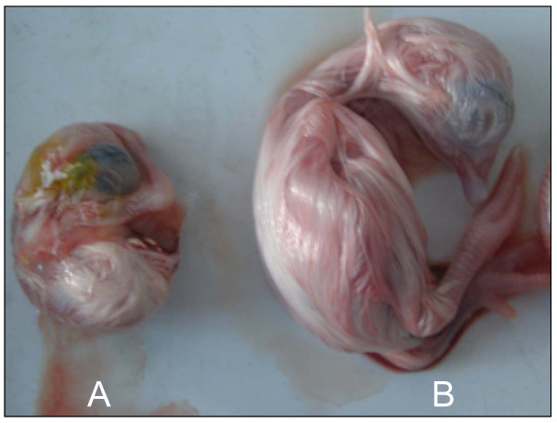
Infectious Bronchitis Virus (IBV)
Group 3 coronavirus
Main cause of economic loss in US poultry farms
Young chickens
Broiler chickens
Layers
healthy chicks
IBV-infected
embryo
normal
embryo
IBV-infected egg defect
Notes:
Signs occur after an incubation period of 18-48 hr. Spread to other birds is rapid, and morbidity may be nearly 100%. The nature and severity of the disease are influenced by the age and immune status of the flock and virulence of the causal strain. Young chickens cough, sneeze, and have tracheal rales for 10-14 days. Wet eyes and dyspnea may be seen, and facial swelling may also occur ccasionally, particularly with concurrent bacterial infection of the sinuses. In broiler chickens, IBV infection is a major cause of poor feed conversion, reduced growth rate, and condemnation of meat at processing. Nephropathogenic strains can produce interstitial nephritis with high mortality (up to 60%) in young chickens. In most outbreaks, however, mortality is 5%, although secondary bacterial infections may cause higher losses.
In layers, egg production may drop 5-50%, and eggs are often misshapen, thin-shelled, and contain watery albumen. Egg production and egg quality generally return to near normal levels in most birds on recovery.

Slide 5
IBV Vaccination
Broadly used; attenuated live vaccine
Short lived protection
Layers need to be re-vaccinated multiple times during their lifespan
Vaccines might undergo selection in vivo and regain virulence [Hilt, Jackwood, and McKinley 2008]

Slide 6
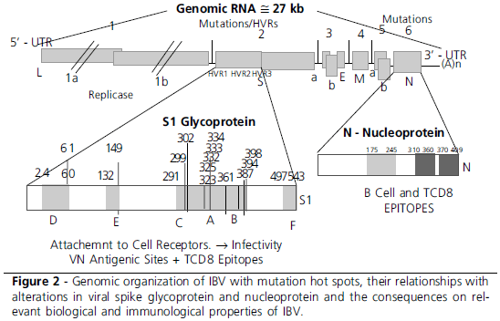
IBV Genome Organization
Taken from Rev. Bras. Cienc. Avic. vol.12 no.2 Campinas Apr./June 2010

Slide 7
Reconstructed Quasispecies Variability
*IonSample42RL1.fas_KEC_corrected_I_2_20_CNTGS_DIST0_EM20.txt
Sequencing primer ATGGTTTGTGGTTTAATTCACTTTC
Notes:
Amt of variability in quasispecies on a window basis – window of 300bp, placed at shifts of 10 bp
Sequences – different ones may agree within this window
2,20parameters = less aggressive many collapsed by highly variable regions up to 60 different alleles in a 300bp window
Matches well with the mutations in highly variable region from IBV pusblished figure

Slide 8
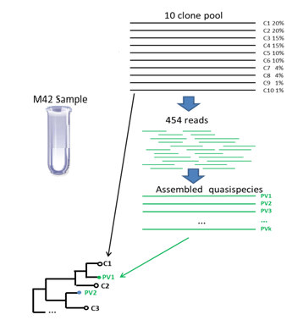
Experiment Design
Notes:
Sample42 was collected from infected chicken long time ago, we don't know if they were vaccinated or not.
Sample Vaccine is the vaccine itself -- not from chicken.
Samples 1-4 were collected from chicken after vaccination at different times (but they are not a time series, since they don't come from the same chicken farm).

Slide 9
Pairwise Edit Distance Between 10 Clones
C1 | C2 | C3 | C4 | C5 | C6 | C7 | C8 | C9 | C10
0 | 0 | 2 | 2 | 1 | 3 | 4 | 42 | 7 | 3 | C1
 | 0 | 2 | 2 | 1 | 2 | 3 | 41 | 6 | 2 | C2
 |  | 0 | 4 | 3 | 5 | 6 | 44 | 9 | 5 | C3
 |  |  | 0 | 1 | 5 | 4 | 42 | 9 | 3 | C4
 |  |  |  | 0 | 4 | 3 | 41 | 8 | 2 | C5
 |  |  |  |  | 0 | 6 | 40 | 6 | 4 | C6
 |  |  |  |  |  | 0 | 45 | 11 | 4 | C7
 |  |  |  |  |  |  | 0 | 41 | 41 | C8
 |  |  |  |  |  |  |  | 0 | 8 | C9

Slide 10
Add vispa flow jan 2013
Delete first 4 steps from 1st to reads pre-alignment.
Add
n: number of mismatches between superreads and subreads
m: number of mismatches in the overlap between two reads
t: mutation rate
Delete slide 12 with vispa parameters

Slide 11
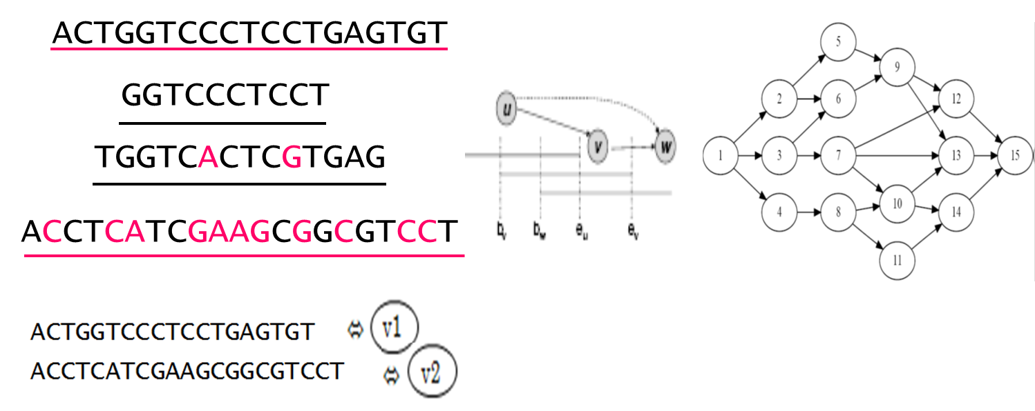
Reconstruction from Shotgun Reads: ViSpA
Read Graph Construction
Contig Assembly
Frequency Estimation
Shotgun reads
Quasispecies sequences w/ frequencies
User Specified Parameters:
n: number of mismatches between superreads and subreads
m: number of mismatches in the overlap between two reads
t: mutation rate

Slide 12
Evaluated Reconstruction Flows

Slide 13
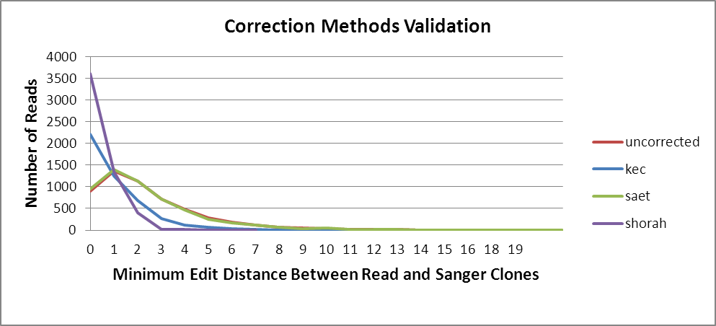
Correction Method Validation
Notes:
Reads validation Method:
1-Get sanger clones
2-for each clone in data,map reads to this single clone.
3-if reads edit distance = threshold ==> add it to that mismatch class
4-report avg.coverage
5-repeat step 2-4 for all clones in the data set
Algorithm:
For each correction method reads:
for each clone:
get all reads categories to that clone(0,1,...,15 mismatches classes)
for each reads category:
compute the average coverage
plot (reads_category,average coverage)
--------------------
Validation of Correction Method
-We measured the closest editing distance between each read to closest sanger clone(take the minimum) we don't care about sanger clones themselves
-Then we count the number of reads for each editing distance (how many reads per min. edit distance)
Algorithm:#better than above explanation
for each correction method:
get all reads categories(minimum edit distance for some clone(for all clones))
for each read category:
count number of reads
plot(read_category,number of reads)

Slide 14
Comparison Measures for Reconstructed Quasispecies
c$i$: $\text{sanger} \text{clone} \text{i}\text{, 1 ≤ }\text{i}\text{ ≤ 10,}$ $$\text{q}j\text{: }\text{reconstructed} \text{quasispecies} \text{j}\text{ ;} \\ \text{f}ci\text{: }\text{frequency} \text{of} \text{sanger} \text{clone} \text{i}\text{;} \\ fq\text{j}:\text{frequency} \text{of} \text{reconstructed} \text{quasispecies} \text{j}\text{;} \\ mi:\text{how} \text{far} \text{is} \text{clone} \text{i} \text{from} \text{closest} \text{quasispecies}\text{;} \\ mj:\text{how} \text{far} \text{is} \text{q}\text{uasispecies} \text{j} \text{from} \text{closest} \text{clone}\text{ ;}$$
$$mi\underset{j}{=min}{(ci,qj)}$$
$$mj\underset{i}{=min}{(ci,qj)}$$
$$Average Ditance to Clones\left(ADC\right)=\sum_{ci}{mi}.fci$$
$$Average Prediction Error\left(APE\right)=\sum_{qj}{mj}.fqj$$

Slide 15
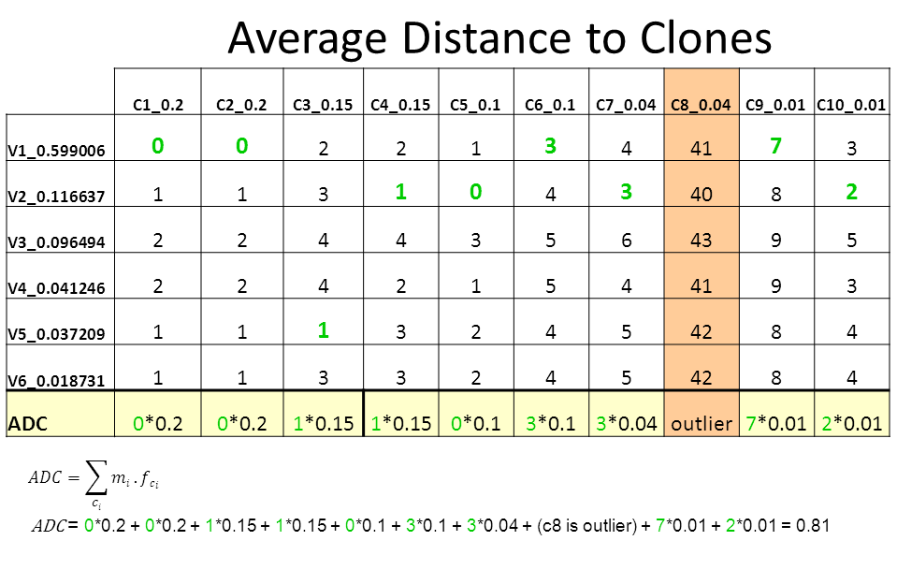
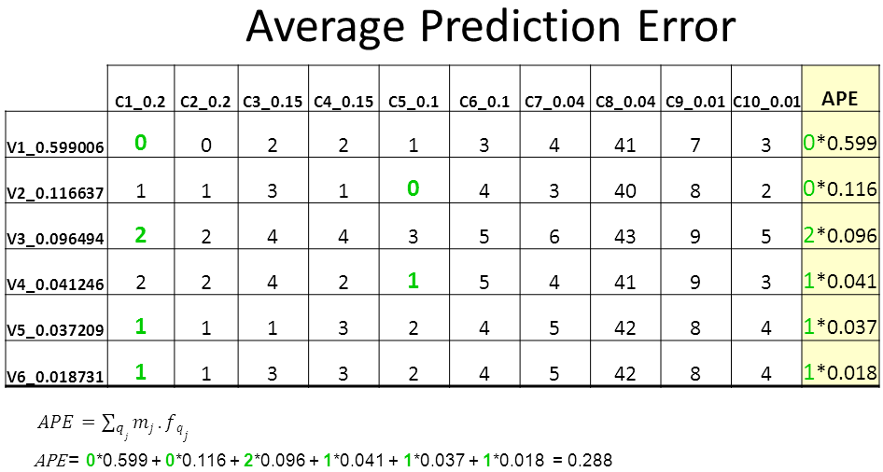
How well we predicted sanger clones
How well our
prediction is
Notes:
Distance to True Quasispecies(sensitivity):
How well we predicted sanger clones
DTQ=sum(min(column)*clone_freq) over all columns$DTQ=\sum_{i=1}^{n}{\left(minimum distance in columni ∗clone frequency in coumni\right)}$
where n: number of clones
------------------------------------
Average Prediction Error:
How good our prediction is (similar to ppv)
APE=sum(min(row)*qsps_freq) over all rows $APE=\sum_{i=1}^{m}{\left(minimum distance in rowi ∗qsps frequency in rowi\right)}$
where m: number of clones

Slide 16
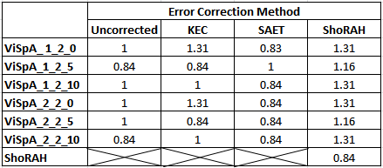
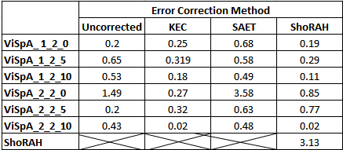
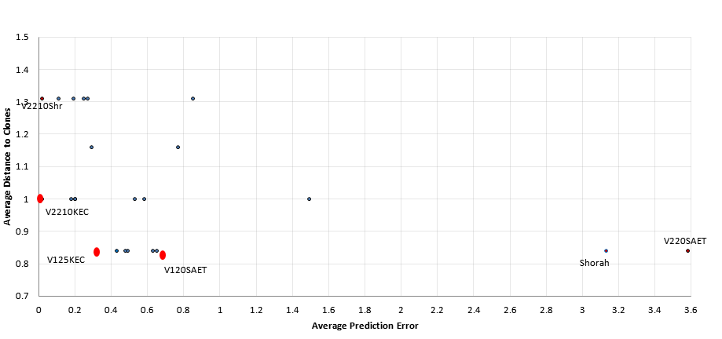
ADC
APE

Slide 17
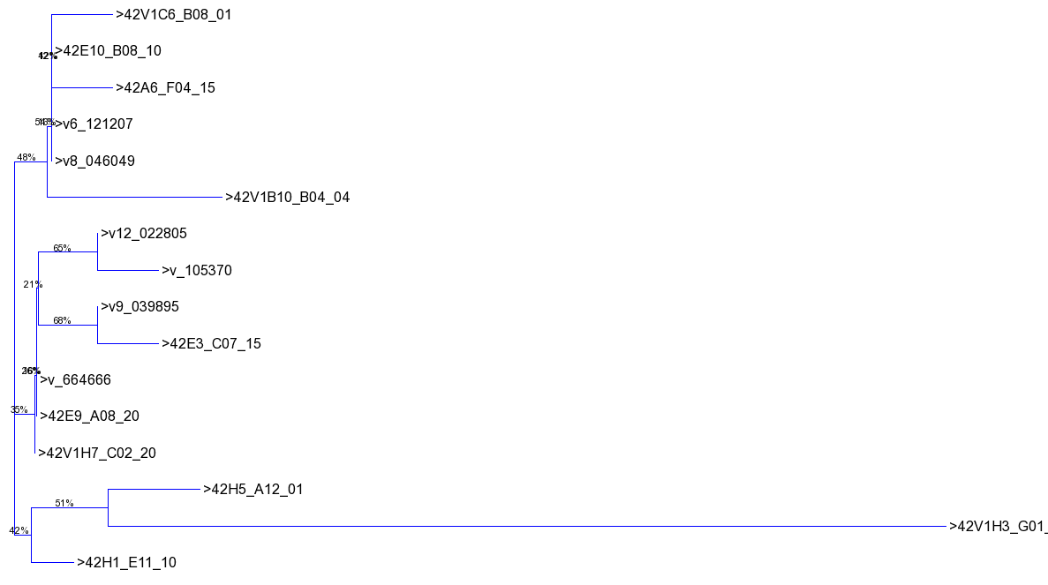
Phylogenetic tree over collapsed Sanger clones and collapsed quasispecies inferred from the method V125KEC

Slide 18
Future Work
modify ViSpA to make it applicable for Ion Torrent reads
for example we are exploring speeding up the step of assembly in a naive way, by restricting the overhang distance less than a threshold to create an edge between two overlapping reads.
Possible combining of shotgun and amplicon data, as well as incorporation of paired reads.
Combining long and short read technologies.
Optimization of vaccination strategies for IBV.

Slide 19
Contributors
Bassam Tork
Ekaterina Nenastyeva
Alex Artyomenko
Nicholas Mancuso
Alexander Zelikovsky
University of Connecticut:
Ion Mandiou, PhD.
Mazhar I. Kahn, Ph.D.
Rachel O’Neal, PhD.

Slide 20
Fundings
University of Connecticut:
Georgia State University:
Molecular Basis of Disease Program

Slide 21
Thanks

