Slide 1
Software for Robust Transcript Discovery and Quantification from RNA-Seq
Ion Mandoiu, Alex Zelikovsky, Serghei Mangul

Slide 2
Outline
Background
Existing approaches
Proposed Flow
Datasets

Slide 3
Alternative Splicing

Slide 4
RNA-Seq
Make cDNA & shatter into fragments
Sequence fragment ends
Map reads
A
B
C
D
E
Gene Expression (GE)
Isoform Discovery (ID)
Isoform Expression (IE)
A
B
C
A
C
D
E

Slide 5
Existing approaches
Genome-guided reconstruction
Exon identification
Genome-guided assembly
Genome independent reconstruction
Genome-independent assembly
Annotation-guided reconstruction
Explicitly use existing annotation during assembly

Slide 6
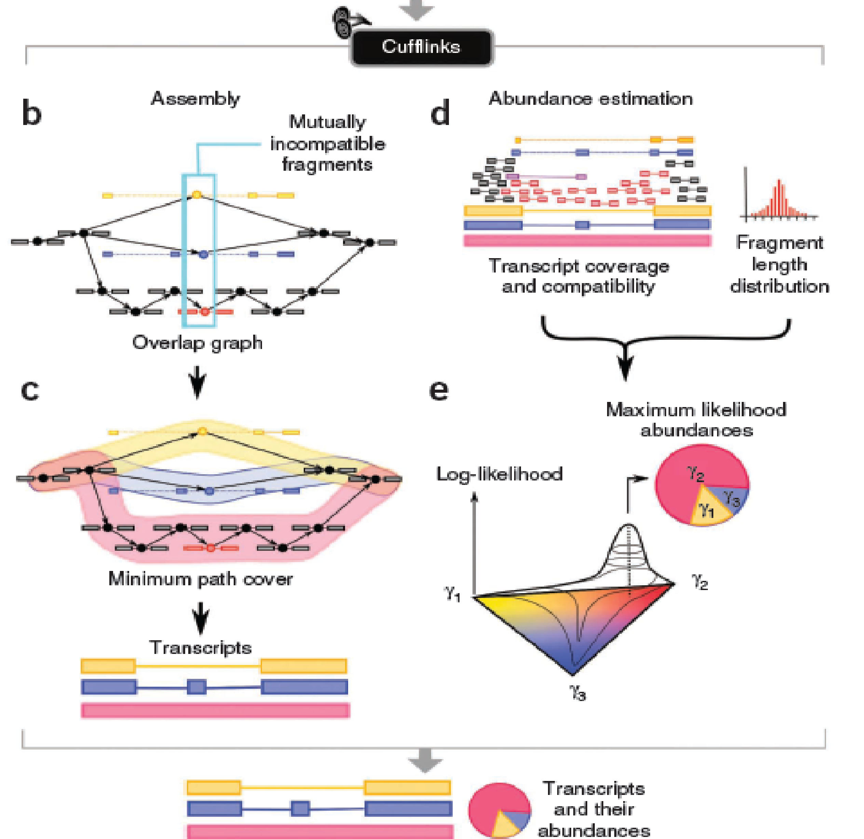
Genome-guided reconstruction (GGR)
Scripture(2010)
Reports all isoforms
Cufflinks(2010)
Reports a minimal set of isoforms
Trapnell, M. et al MAY 2010, Guttman, M. et al MAY 2010

Slide 7
Genome independent reconstruction (GIR)
Trinity(2011),Velvet(2008), TransABySS(2008)
de Brujin k-mer graph
Efficiently construct graph from large amount of raw data
Scoring algorithm to recover all plausible splice form
Robustness to the noise steaming from sequencing errors
Grabherr, M. et al. Nat. Biotechnol. JULY 2011

Slide 8
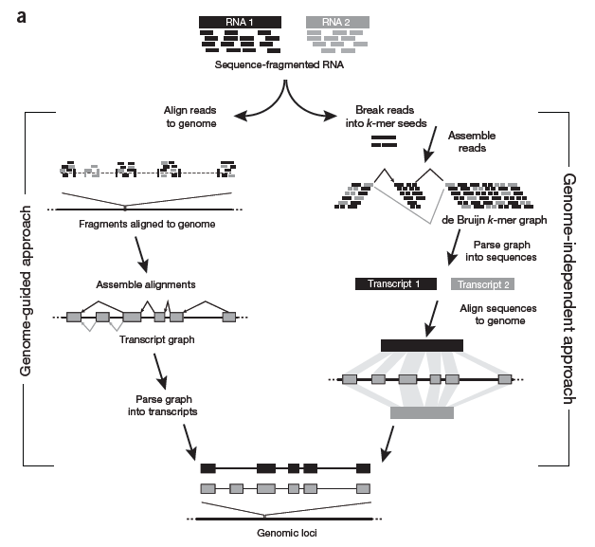
GGR vs GIR
Garber, M. et al. Nat. Biotechnol. JUNE 2011
Notes:
(a) Reads originating from two different isoforms of the
same genes are colored black and gray. In genome-guided assembly, reads are first mapped to a reference
genome, and spliced reads are used to build a transcript graph, which is then parsed into gene annotations.
In the genome-independent approach, reads are broken into k-mer seeds and arranged into a de Bruijn
graph structure. The graph is parsed to identify transcript sequences, which are aligned to the genome to
produce gene annotations.

Slide 9
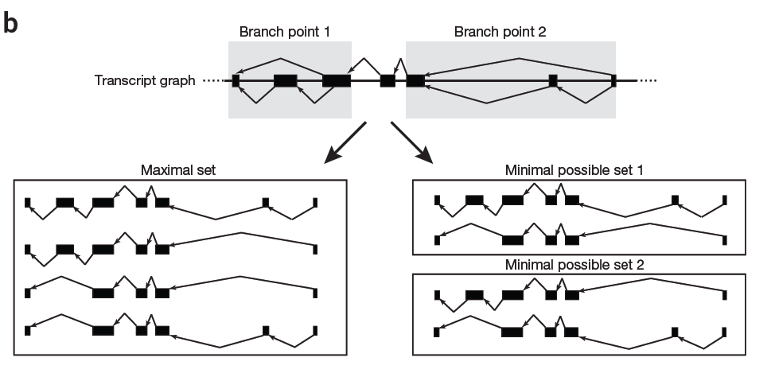
Max Set vs Min Set
Garber, M. et al. Nat. Biotechnol. JUNE 2011
Notes:
Spliced reads give rise to four possible transcripts, but only two transcripts
are needed to explain all reads; the two possible sets of minimal isoforms are depicted.

Slide 10
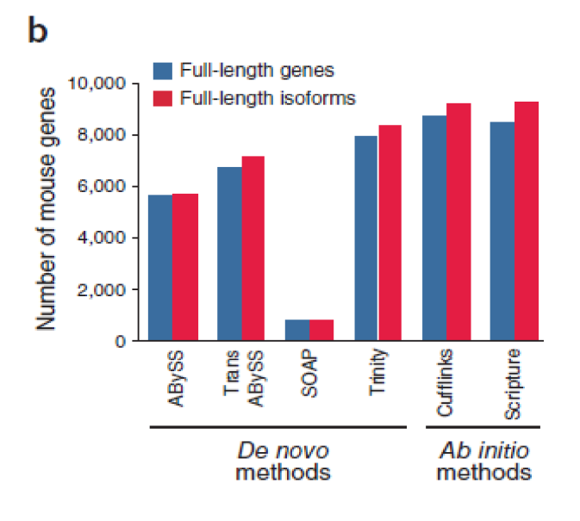
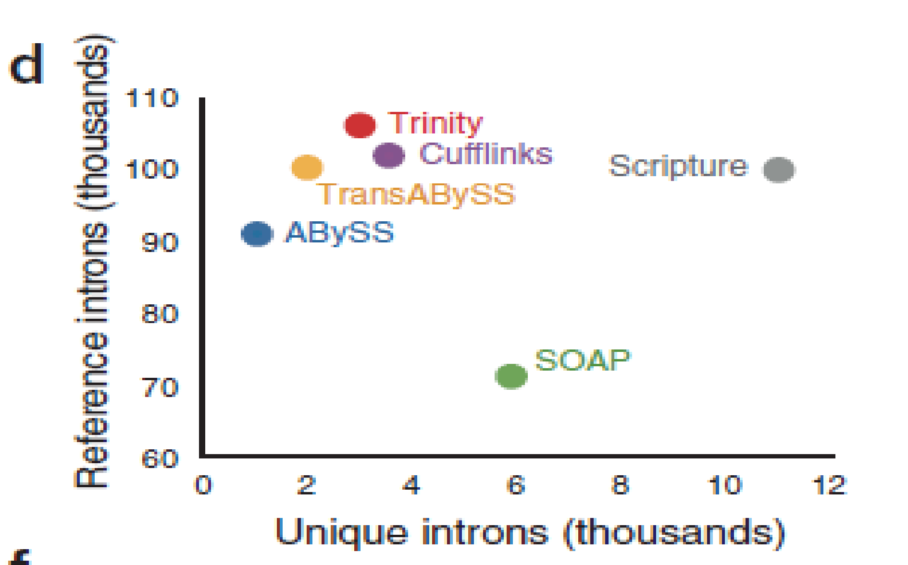
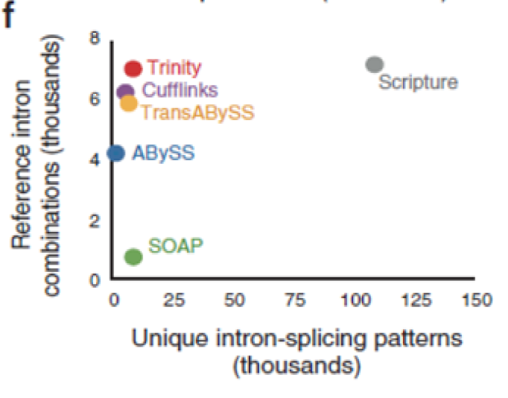
Reconstruction Strategies Comparison
Grabherr, M. et al. Nat. Biotechnol. MAY 2011

Slide 11
IsoEM
EM Algorithm for IE
Single and/or paired reads
Fragment length distribution
Strand information
Base quality scores
Nicolae, M. et al.

Slide 12
IsoEM Validation on MAQC Samples
RNA-Seq: 6 MAQC libraries, 47-92M 35bp reads each [Bullard et al. 10]
qPCR: Quadruplicate measurements for 832 Ensembl genes [MAQC Consortium 06]

Slide 13
VSEM : Virtual String EM
Estimate total frequency of missing transcripts
Identify read spectrum sequenced from missing transcripts
(Incomplete) Panel
+ Virtual String
with 0-weights
in virtual string
ML estimates
of string
frequencies
Update weights
of reads in
virtual string
EM
EM
Output string
frequencies
Virtual String frequencychange>ε?
Compute
expected read
frequencies
NO
YES
Mangul, S. et al.

Slide 14
Proposed Flow
Step 1: Read error correction
Step 2: Maximum likelihood estimation of isoform frequencies and identification of unexplained reads
Step 3: Read clustering
Step 4: Read graph construction and candidate transcript generation. Continue Step 2

Slide 15
SOLiD RNA-Seq Datasets
 | MCF7-SOLiD4 (April 2010) Paired End | MCF7-SOLiD5500 (December 2010) Paired End | MCF7-SOLiD5500 (December 2010) Frag Color | MCF7-SOLiD5500 (December 2010) Frag ECC Base
Total BAM records processed (valid records): | 540,187,060 | 964,677,956 | 447,491,122 | 442,406,834
Total unmapped records: | 135,285,131 | 249,120,112 | 0 | 0
Total not primary records: | 0 | 0 | 0 | 0
Total low mapQV(<10) records: | 125,776,254 | 302,827,913 | 116,983,995 | 149,380,139
Not in any chromosome in the dictionary: | 12,483,859 | 26,731,194 | 18,800,675 | 9,338,242
Total reads passing filters: | 266,641,816 | 385,998,737 | 311,706,452 | 283,688,453
Counted on exons: | 202,347,590 | 282,998,093 | 232,539,004 | 209,808,863
Counted on introns: | 32,366,424 | 53,218,659 | 44,321,422 | 42,017,833
Counted intergenic: | 31,927,802 | 49,781,985 | 34,846,026 | 31,861,757

Slide 16
Validation Datasets
MAQC Sample : 1K transcripts
HBR (brain sample)
UHR (universal human reference)

Slide 17
Available Annotations
NCBI
UCSC
Ensembl
AceView
Less conservative

Slide 18
Q/A

