Slide 1
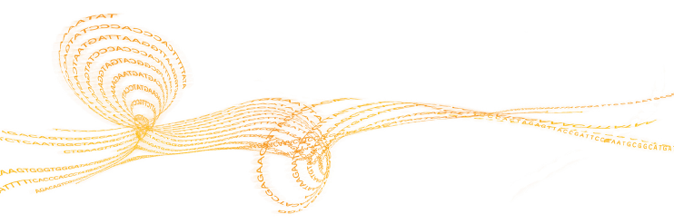


Novel transcript reconstruction from ION Torrent sequencing reads and
Viral Meta-genome Reconstruction from AmpliSeq Ion Torrent data
University of Connecticut
Ion Mandoiu
Sahar Al Seesi
Georgia State University
Alex Zelikovsky
Serghei Mangul
Adrian Caciula
Nick Mancuso

Slide 2
Outline
Plugins developed and available on the Torrent Browser Plugin Store
  IsoEM plugin
  SNVQ plugin
Ongoing work on transcriptome analysis
  RNA-PhASE
  Transcriptome reconstruction
Ongoing work on quasispecies reconstruction
  Reconstruction from shotgun reads
  Amplicon error correction
  Reconstruction from amplicons

Slide 3
Outline
Plugins developed and available on the Torrent Browser Plugin Store
  IsoEM plugin
  SNVQ plugin
Ongoing work on transcriptome analysis
  RNA-PhASE
  Transcriptome reconstruction
Ongoing work on quasispecies reconstruction
  Reconstruction from shotgun reads
  Amplicon error correction
  Reconstruction from amplicons

Slide 4

IsoEM: Isoform Expression Level Estimation
Expectation-Maximization algorithm
Unified probabilistic model incorporating
  Single and/or paired reads
  Fragment length distribution
  Strand information
  Base quality scores

Slide 5
Fragment length distribution
Paired reads
Single reads
F_{a}(i)
i
A
A
A
B
B
B
C
C
C
j
F_{a} (j)
A
A
A
C
C
C
i
A
A
A
B
B
B
C
C
C
j
A
A
A
C
C
C
F_{a}(i)
F_{a} (j)

Slide 6
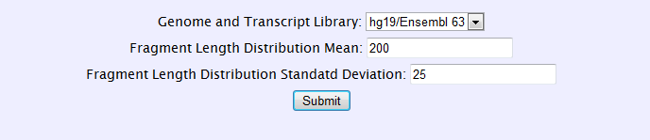
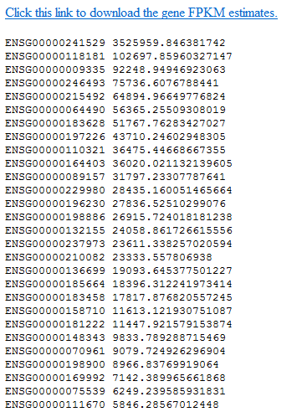
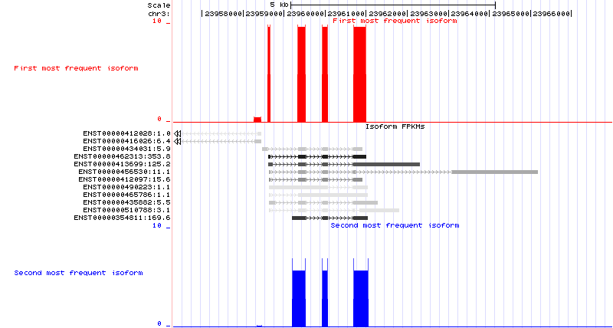
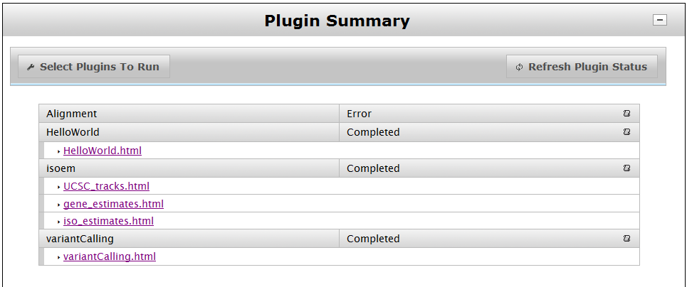
IsoEM Plugin Interface & Output

Slide 7
IsoEM vs. Cufflinks 1.0.3 on ION reads
Note: Experiment was done in Sept 2011

Slide 8
Outline
Plugins developed and available on the Torrent Browser Plugin Store
  IsoEM plugin
  SNVQ plugin
Ongoing work on transcriptome analysis
  RNA-PhASE
  Transcriptome reconstruction
Ongoing work on quasispecies reconstruction
  Reconstruction from shotgun reads
  Amplicon error correction
  Reconstruction from amplicons

Slide 9

SNVQ: Calling SNVs from RNA-Seq Reads
Beysian model for SNV detection based on quality scores
Method tuned for RNA-Seq data
Less expensive, for cases when expressed SNVs are of interest
Uses a hybrid mapping method that results in high confidence SNV calls

Slide 10

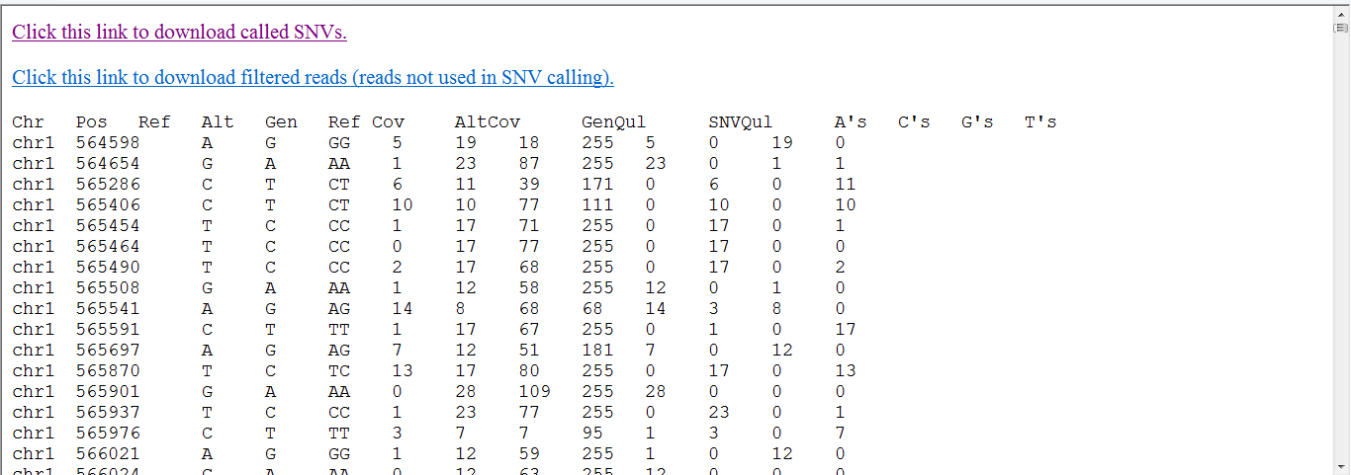
SNVQ Plugin Interface & Output

Slide 12
Outline
Plugins developed and available on the Torrent Browser Plugin Store
  IsoEM plugin
  SNVQ plugin
Ongoing work on transcriptome analysis
  RNA-PhASE
  Transcriptome reconstruction
Ongoing work on quasispecies reconstruction
  Reconstruction from shotgun reads
  Amplicon error correction
  Reconstruction from amplicons

Slide 13
Allele Specific Gene/Isoform Expression Estimation
H0
H1
Make cDNA &
shatter into fragments
Sequence fragment ends
H0
H1
Map reads
A
B
C
D
E
A
B
C
D
E
Allele Specific Gene Expression (GE)
Allele Specific Isoform Expression (IE)

Slide 14
Current Approaches
Gregg et al., 2010 : parent-of-origin effect in hybrids of inbred mouse strains with known diploid genome
McManus et al., 2010 : cis- and trans-regulatory effects in hybrids of drosophila species with known diploid genome
Heap et al., 2010 : allelic expression imbalance in human by simple alleles coverage analysis for heterozygous SNP sites within transcripts
Turro et al., 2011 : allele specific isoform expression through SNP calling and diploid transcriptome construction

Slide 15
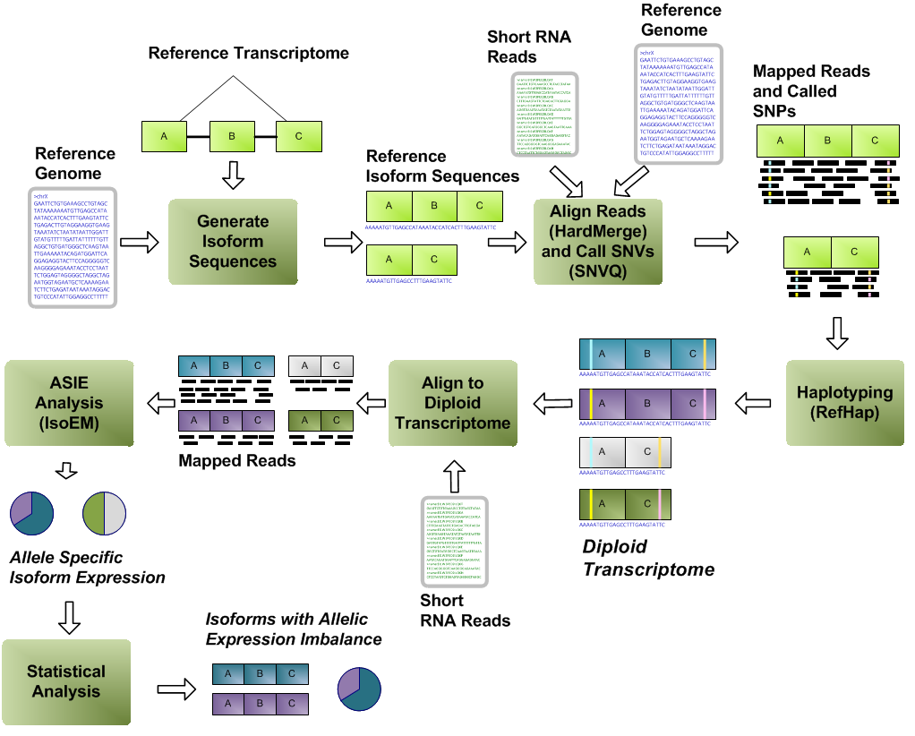


RNA-PhASE: ASIE from RNA-Seq Reads

Slide 16
Phasing SNVs
RefHap
  Assigns a score to each pair of reads based on their common allele calls
  Build a graph where reads are nodes and scores are edges
  Finds a cut that maximizes an objective function and use to build haplotypes
Coverage Based Phasing
  Phases SNVs not phased by RefHap (no read evidence) and connects blocks of phased SNVs
  For two successive heterozygous SNVs i and j, the i's allele with highest coverage is paired with j's allele with highest coverage in the same haplotype

Slide 17
Experimental Setup
Whole brain RNA-Seq Data - Sanger Institute Mouse Genomes Project
Synthetic hybrids with different levels of heterozygosity generated by pooling reads from C57/BL6 and four other strains

Slide 18
Synthetic hybrids read statistics

Slide 19
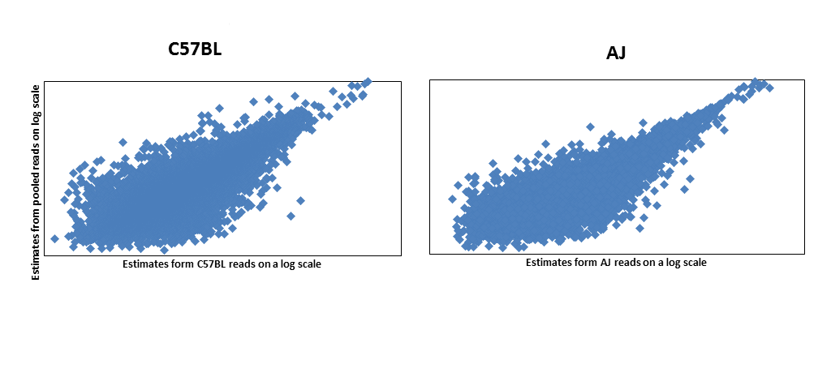
Results
R² = 0.73
R² = 0.81
Correlation between FPKM values, for alleles in C57BLxAJ synthetic hybrid vs corresponding separate strains

Slide 20
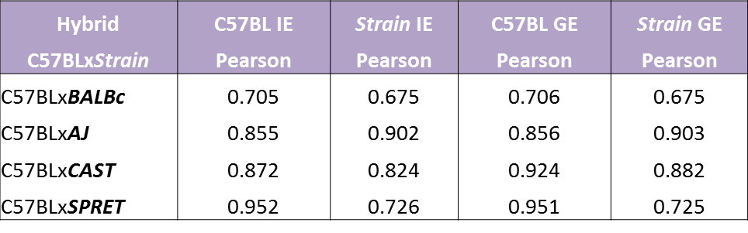
Results
Correlation between FPKM values, for each strain, inferred from the separate strain RNA-Seq reads vs. the pooled reads of the two strains (synthetic hybrid)

Slide 21
Results
Error Fractions at different threshold values for expression levels estimated for strains in synthetic hybrids vs. corresponding
separate strain

Slide 22
RNA-PhASE Strengths
RNA-PhASE addresses limitations of existing ASE methods
  Does not require availability of diploid genome/transcriptome
  Mapping the reads against the diploid transcriptome reconstructed on-the-fly resolves bias towards reference alleles
  EM model improves inference accuracy by using all reads, including those that map to more than one isoform

Slide 23
Torrent Browser Plugin for RNA-PhASE
Option 1: Incorporate all modules (SNVQ, IsoEM, RefHap) inside one plugin
Option2: Incorporate existing plugins into a pipeline.
  Would this be possible in the future?

Slide 24
Outline
Plugins developed and available on the Torrent Browser Plugin Store
  IsoEM plugin
  SNVQ plugin
Ongoing work on transcriptome analysis
  RNA-PhASE
  Transcriptome reconstruction
Ongoing work on quasispecies reconstruction
  Reconstruction from shotgun reads
  Amplicon error correction
  Reconstruction from amplicons

Slide 25

Transcriptome Reconstruction
Given partial or incomplete information about something, use that information to make an informed guess about the missing or unknown data.
Notes:
We can view as follow

Slide 26
Transcriptome Reconstruction Types
GIR : Genome-independent reconstruction (de novo)
  k-mer graph
GGR : Genome-guided reconstruction (ab initio)
  Spliced read mapping
  Exon identification
AGR : Annotation-guided reconstruction
  Use existing annotation (known transcripts)
  Focus on discovering novel transcripts

Slide 27
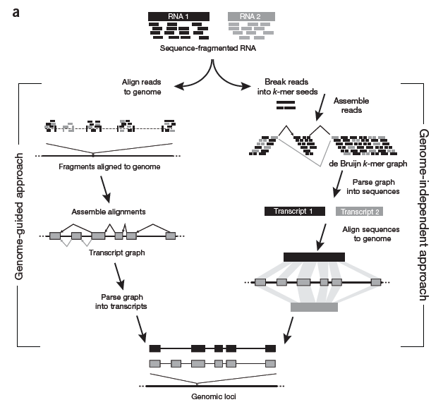
GGR vs GIR
Garber, M. et al. Nat. Biotechnol. June 2011
Notes:
Are together in unknown transcript

Slide 28
Previous approaches
GIR
  Trinity(2011), Velvet(2008), TransABySS(2008)
    de Brujin k-mer graph
GGR
  Scripture(2010)
    Reports “all” transcripts
  Cufflinks(2010), IsoLasso(2011), SLIDE(2012)
    Minimizes set of transcripts explaining reads
AGR
  RABT(2011)
    Simulate reads from annotated transcripts
Notes:
Scientific community spending effort

Slide 29
Our contribution
Annotation-guided reconstruction
  DRUT
Genome-guided reconstruction
  TRIP(in progress)

Slide 30
Our contribution
Annotation-guided reconstruction
  DRUT
Genome-guided reconstruction
  TRIP(in progress)

Slide 31
DRUT : Discovery and Reconstruction of Unannotated Transcripts
a) Map reads to annotated
transcripts (using Bowtie)
b) eVTEM: Identify overexpressed
exons (possibly from unannotated
transcripts)
c) Assemble Transcripts (e.g., Cufflinks)
using reads from “overexpressed” exons
and unmapped reads
d) Output: annotated transcripts + novel
transcripts

Slide 32
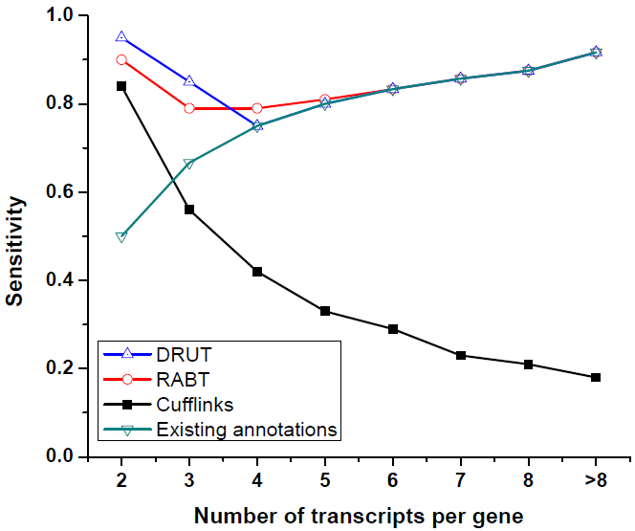
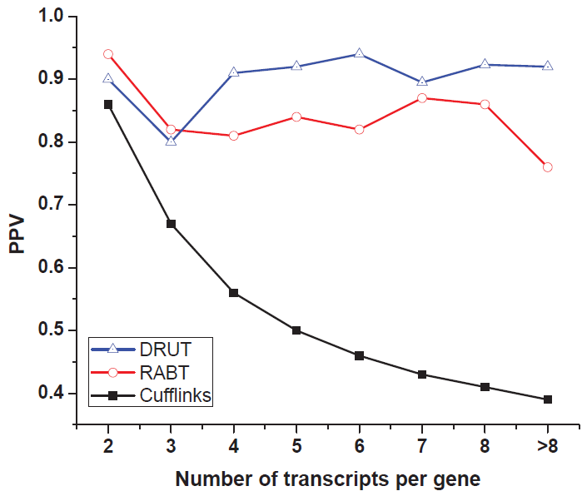
DRUT : PPV and Sensitivity
  in every gene 1 transcript is not annotated; 100bp single reads; 100x coverage

Slide 33
Our contribution
Annotation-guided reconstruction
  DRUT
Genome-guided reconstruction
  TRIP(in progress)

Slide 34
Our contribution
Annotation-guided reconstruction
  DRUT
Genome-guided reconstruction
  TRIP(in progress)

Slide 35


Challenges and Solutions
Read length is currently much shorter then transcripts length
Statistical reconstruction method
  fragment length distribution

Slide 36
1
2
3
4
5
6
7
t₁ :
1
2
3
4
5
6
7
t₂ :
1
3
4
5
6
7
t₃ :
1
2
3
4
5
7
t₄ :
1
3
4
5
7
Exon 2 and 6 are “distant” exons : how to phase them?

Slide 37

TRIP
Transciptome Reconstruction using Integer Programming
Map the RNA-Seq reads to genome
Construct Splice Graph - G(V,E)
  V : exons
  E: splicing events
Candidate transcripts
  depth-first-search (DFS)
Filter candidate transcripts
  fragment length distribution (FLD)
  integer programming
Genome
Notes:
the highest support from the RNA-Seq reads
Add splitting pe ->se

Slide 38
Gene representation
Tr₁:
e₁
e₅
Tr₂:
e₁
e₃
e₅
Tr₃:
e₂
e₄
e₆
Pseudo-exons:
pse₁
pse₂
pse₃
pse₄
pse₅
pse₆
pse₇
S_{pse1}
E_{pse1}
S_{pse2}
E_{pse2}
S_{pse3}
E_{pse3}
S_{pse4}
E_{pse4}
S_{pse5}
E_{pse5}
S_{pse6}
E_{pse6}
S_{pse7}
E_{pse7}
Pseudo-exons - regions of a gene between consecutive transcriptional or splicing events
Gene - set of non-overlapping pseudo-exons

Slide 39
Splice Graph
exons
pseudo-exons
Genome
1
2
3
4
5
6
7
8
9

Slide 40
How to filter?
t1
t2
t3
Select the smallest set of putative transcripts that yields a good statistical fit between
  empirically determined during library preparation
  implied by “mapping” read pairs
500
1
2
3
200
200
200
Mean : 500; Std. dev. 50
300
1
3
Mean : 500; Std. dev. 50
200
200
Notes:
fragment length distribution
empirically determined during library preparation
implied by mapping read pairs to selected transcripts.

Slide 41
Simplified IP Formulation
Objective
Constraints
T(p) - set of candidate transcripts on which paired-end read p can be mapped
y(t) - 1 if a candidate transcript t is selected, 0 otherwise
x(p) - 1 if the pe read p is selected to be mapped
for each pe read at least one transcript is selected

Slide 42
IP Formulation
Fragment length distribution
  Estimate number of reads to be mapped within different std. dev.
Require every splice junction to be covered

Slide 43
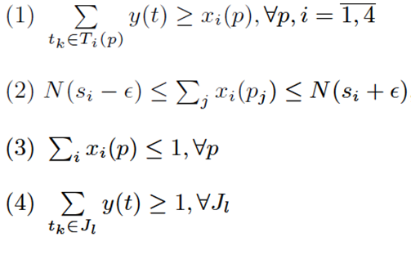
IP Formulation
Objective
Constraints
1,2,3,4 std. dev.
for each pe read from every category of std.dev. at least one transcript is selected
restricts the number of pe reads mapped within different std. dev.
each pe read is mapped no more
then with one category of std. dev.
every splice junction to be covered

Slide 44
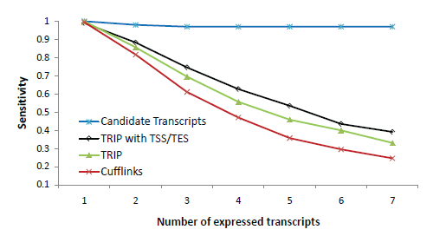
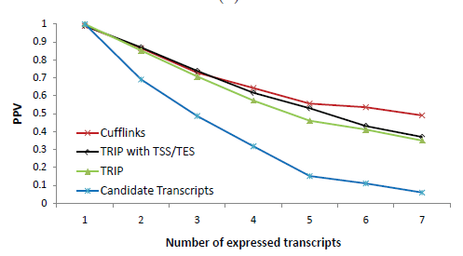
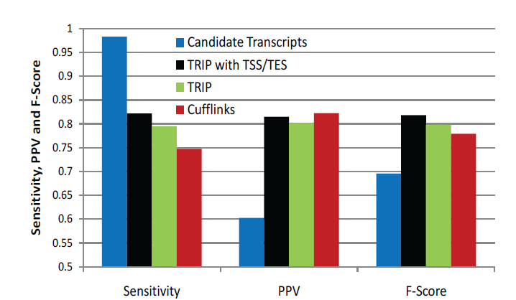
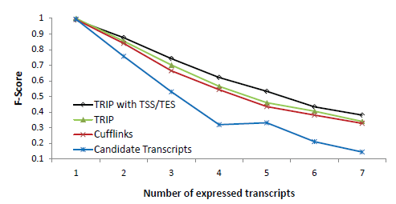
TRIP : Preliminary results
100x coverage, 2x100bp pe reads; annotations for genes

Slide 45
Outline
Plugins developed and available on the Torrent Browser Plugin Store
  IsoEM plugin
  SNVQ plugin
Ongoing work on transcriptome analysis
  RNA-PhASE
  Transcriptome reconstruction
Ongoing work on quasispecies reconstruction
  Reconstruction from shotgun reads
  Amplicon error correction
  Reconstruction from amplicons

Slide 46
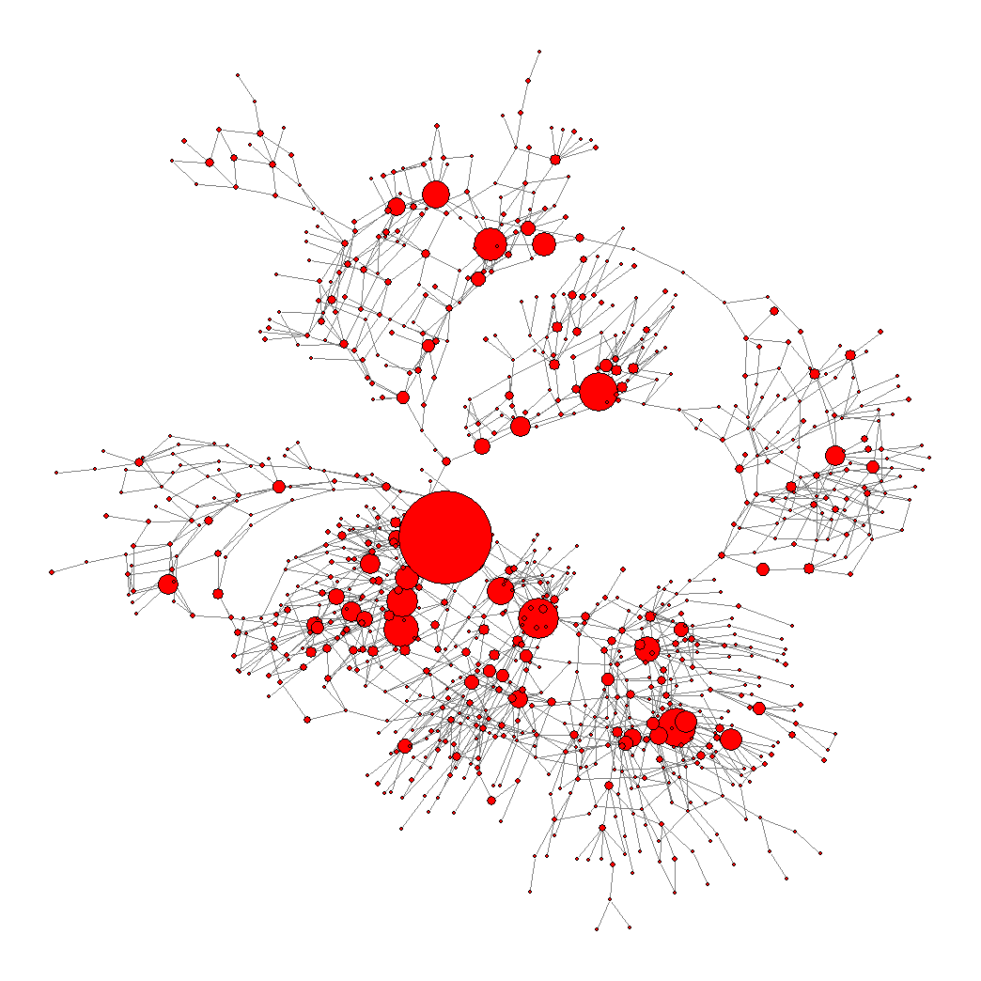
Viral Quasispecies
RNA virus replication relies on
RNA polymerase
High mutation rate (≈ 10⁻⁴ )
Recombination events occur
HIV, HCV

Slide 47
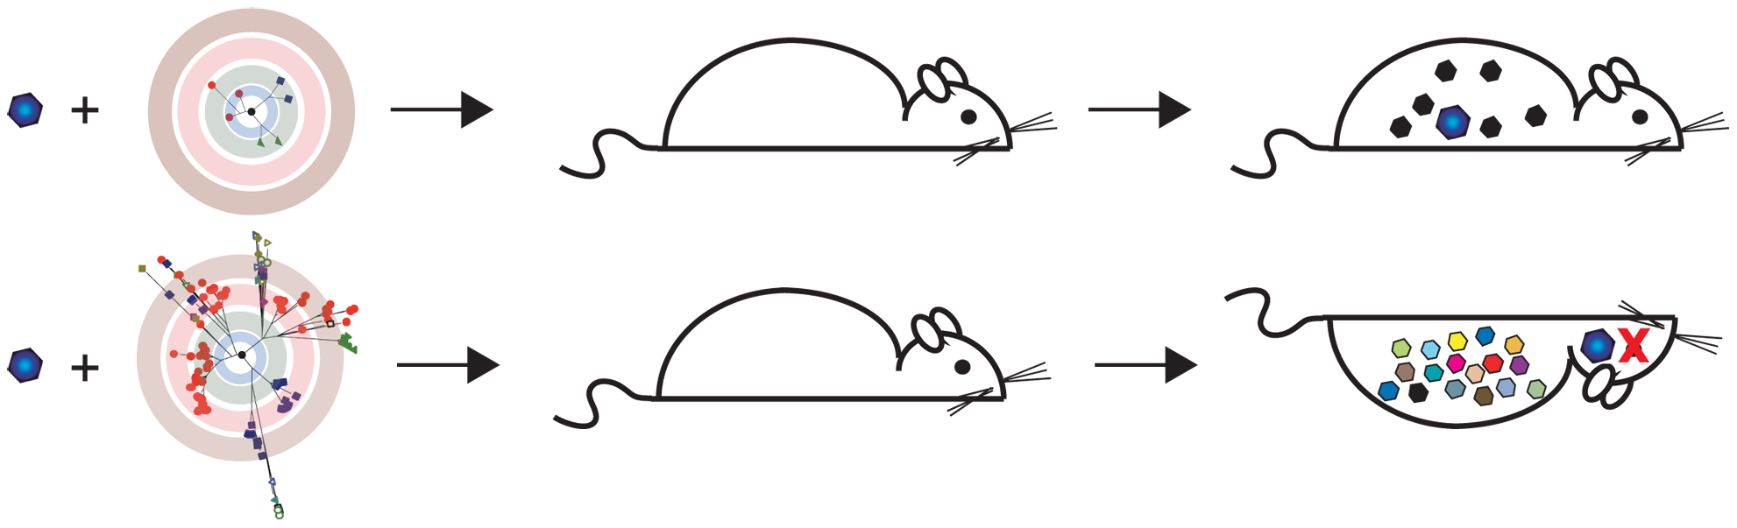
How Are Quasispecies Contributing to Virus Persistence and Evolution?
Variants differ in
  Virulence
  Ability to escape immune response
  Resistance to antiviral therapies
Lauring & Andino, PLoS Pathogens 2011
Notes:
47

Slide 48
Hepatitis C
HCV infects 2.2% of the world’s population
  No vaccine
  Current interferon and ribavirin therapy effective in 50%-60% of patients
  Therapy is expensive and uncomfortable
Skums et al., 2011
  Prediction method for interferon outcome
  Highly dependent on accuracy of quasispecies estimated frequencies

Slide 49
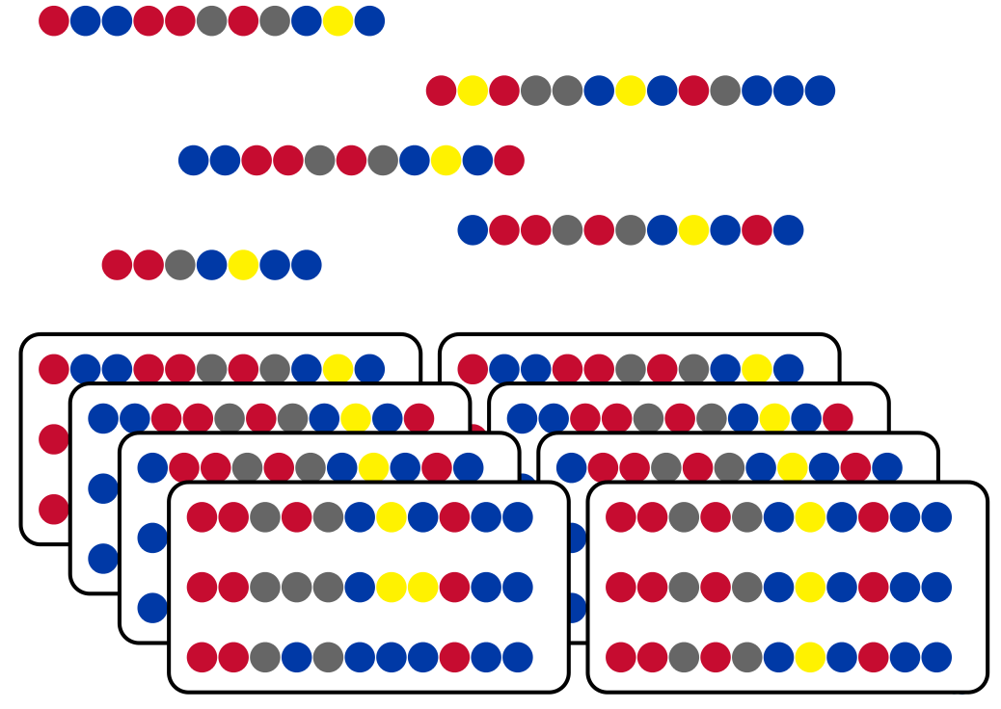
Shotgun vs. Amplicon Reads
Shotgun reads starting
positions distributed
~uniformly
Amplicon reads
have predefined
start/end positions
covering fixed
overlapping windows
Notes:
49
49

Slide 50
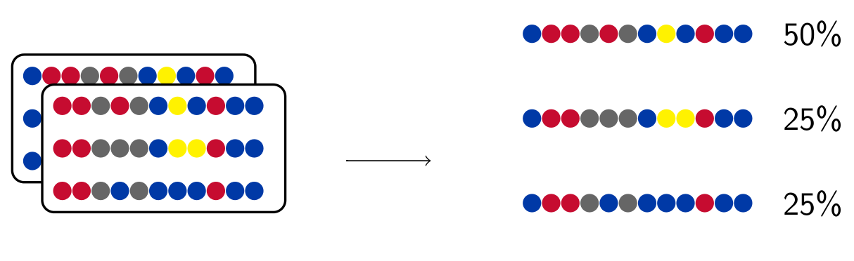
Quasispecies Spectrum
Reconstruction (QSR) Problem
Given a collection of next-generation sequencing reads generated from a viral sample, reconstruct the quasispecies spectrum, i.e., the set of sequences and respective frequencies of the sample population.

Slide 51
Viral Reconstruction Challenges
Conserved Regions
  Relatively few mutations in long regions obfuscate true population
Genotyping Errors
  Homopolymer errors
    Insertion errors
    Deletion errors
  Substitution errors

Slide 52

ViSpA: Viral Spectrum Assembler
Key features
  Error correction both pre-alignment (based on k-mers) and post-alignment
  Quasispecies assembly based on maximum-bandwidth paths in weighted read graphs
  Frequency estimation via EM on all reads
  Freely available at http://alla.cs.gsu.edu/software/VISPA/vispa.html

Slide 53
Read Graph: Edges
Edge b/w two vertices if there is an overlap between super-reads and they
agree on their overlap with ≤ m mismatches
Transitive reduction graph
Notes:
53

Slide 54
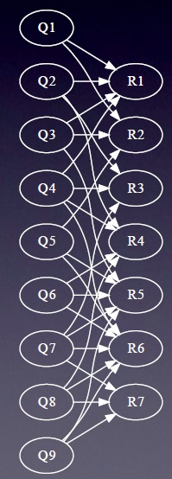
Frequency Estimation – EM Algorithm
Bipartite graph:
  Q is a candidate with frequency f_{q}
  R is a read with observed frequency o_{r}
  Weight h_{q,r} = probability that read r is produced by quasispecies q with j mismatches
E step:
M step:

Slide 55
Simulations: Error-Free Reads
44 real qsps (1739 bp long) from the E1E2 region of Hepatitis C virus (von Hahn et al. (2006))
Simulated reads:
  4 populations sizes: 10, 20, 30, 40 sequences
  Geometric distribution
  The quasispecies population:
  Number of reads between 20K and 100K
  Read length distribution N(μ,400); μ varied from 200 to 500

Slide 56
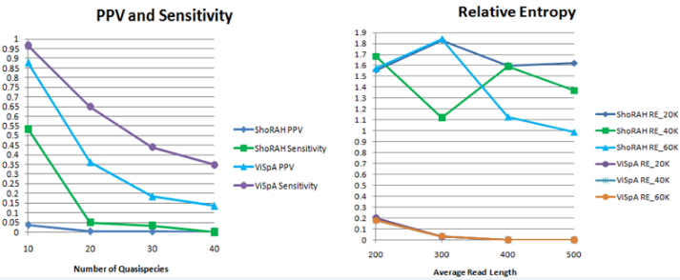



Results

Slide 57
454 Reads of HIV Qsps
55,611 reads (average read length 345bp) from ten 1.5Kbp long region of HIV-1 (Zagordi et al.2010)
  No removal of low-quality reads
  ~99% of reads has at least one indel
  ~11.6 % of reads with at least one N
ShoRAH correctly infers only 2 qsps sequences with <=4 mismatches
ViSpA correctly infers 5 qsps with <=2 mismatches , 2 qsps are inferred exactly

Slide 58
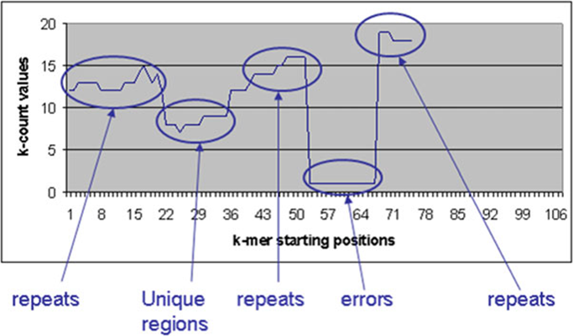

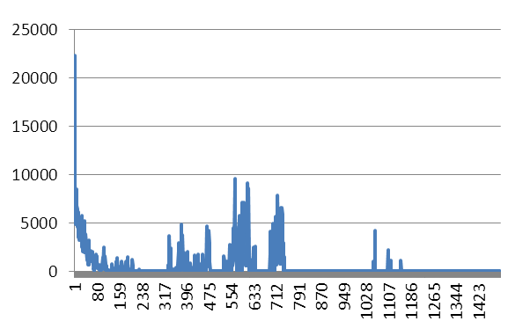
k-mer Error Correction [Skums et al.]
Zhao X et al 2010
Calculate k-mers and their frequencies (k-counts)
Assume that k-mers with high k-counts (“solid” k-mers) are correct, while k-mers with low k-counts (“weak” k-mers) contain errors
Determine the threshold k-count (error threshold), which distinguishes solid k-mers from weak k-mers.
Find error regions.
Correct the errors in error regions
Notes:
58

Slide 59
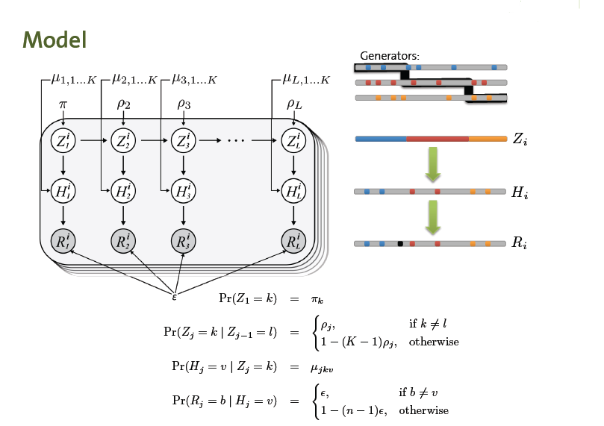
Hidden Markov Model for NGS and Quasispecies [Zagordi et al.]
Explicitly take recombination into account
Parametric method with K “generator” sequences
“Jumping” HMM that may switch from generator to generator

Slide 60
Combinatorial approach of Prosperi et al. 2011
First published approach for amplicon data
Based on the idea of guide distribution
  Choose amplicon by Chi-Squared test
  Extend to right/left with matching reads, breaking ties by rank
220 | 200 | 140 | 160 | 150
200 | 140 | 130 | 150 | 140
70 | 130 | 120 | 140 | 130
10 | 20 | 110 | 130 | 120
0 | 10 | 100 | 20 | 60
Notes:
60
60

Slide 61
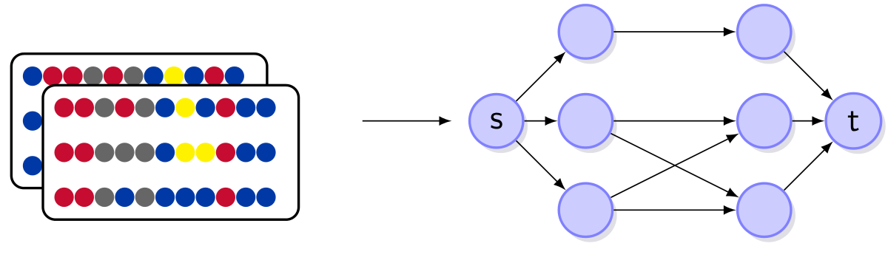
Amplicon Read Graph
K amplicons represented by K -staged read graph
Vertices ⇔ distinct reads
Edges ⇔ reads with consistent overlap
Vertices have count function c(v)
Notes:
61
61

Slide 62
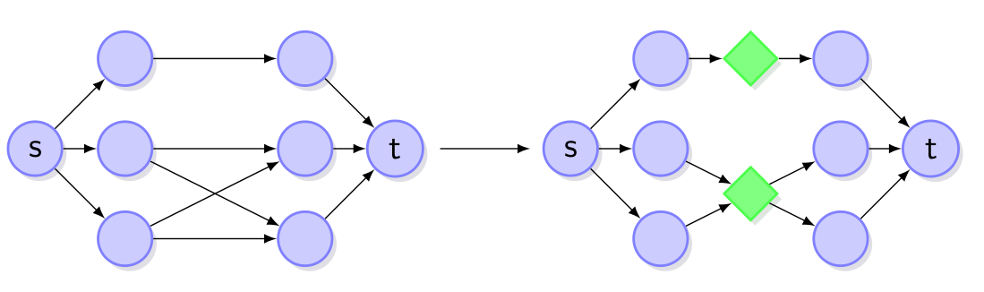
Read Graph Transformation
Heuristic to reduce edges in dense graphs
Replace bipartite cliques with star subgraphs

Slide 63
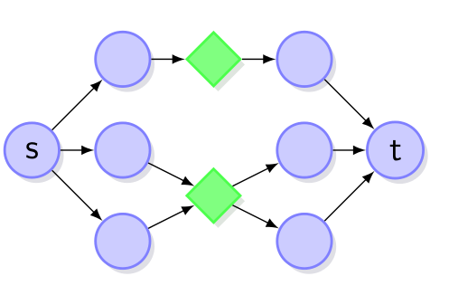
Observed vs Ideal Read Frequencies
Ideal frequency
  consistent frequency across forks
Observed frequency (count)
  inconsistent frequency across forks
Notes:
63
63

Slide 64
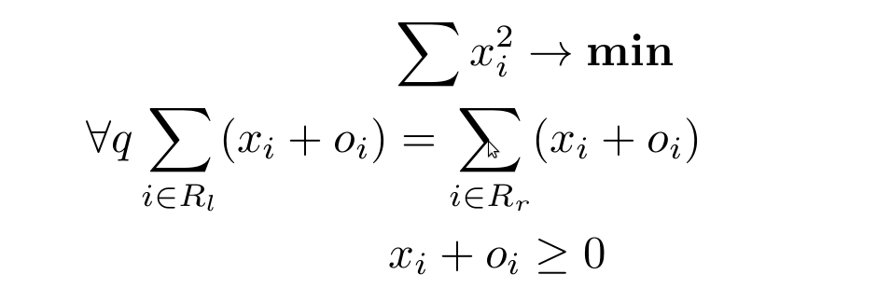
Fork Balancing Problem
Given
  Set of reads and respective frequencies
Find
Minimal frequency offsets balancing all forks
Notes:
64
64

Slide 65
Maximum Bandwidth Paths
Find simple path containing most possible flow
Repeat until graph is saturated
Can be solved by modified Dijkstra’s algorithm

Slide 66
Experimental Setup
Error free reads simulated from the E1E2 region of 44 HCV
strains from [von Hahn et al. 2006]
Frequency distributions: uniform, geometric, skewed
5k, 20k, 100k reads
Amplicon width = 300bp
Shift (= width – overlap, i.e., how much to slide the next
amplicon) between 50 and 250
Notes:
66
66
Ask

Slide 67
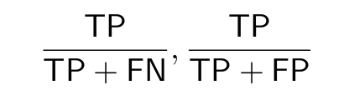
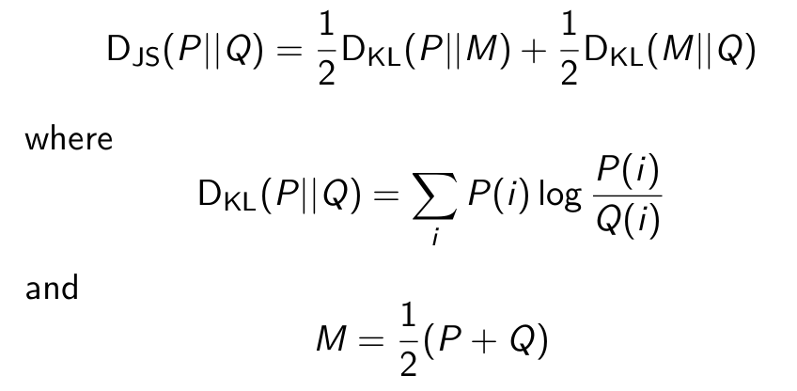
Experimental Validation
Sensitivity and Positive Predicted Value (PPV)
Jensen-Shannon Divergence
Notes:
67
67
Sensitivity : measures the correctly assembled quasispecies out of the population.
PPV: measures the correctly assembled quasispecies out of the assembled population.

Slide 68
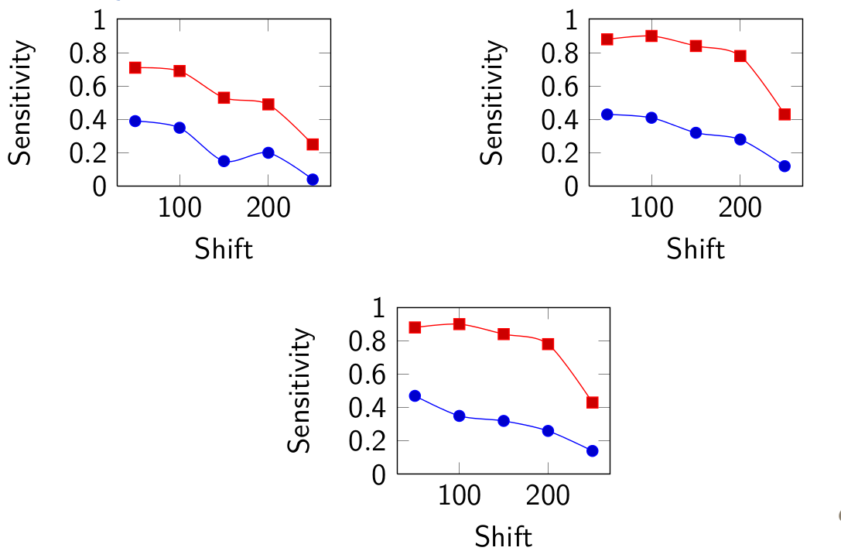
Sensitivity
Notes:
68
68

Slide 69
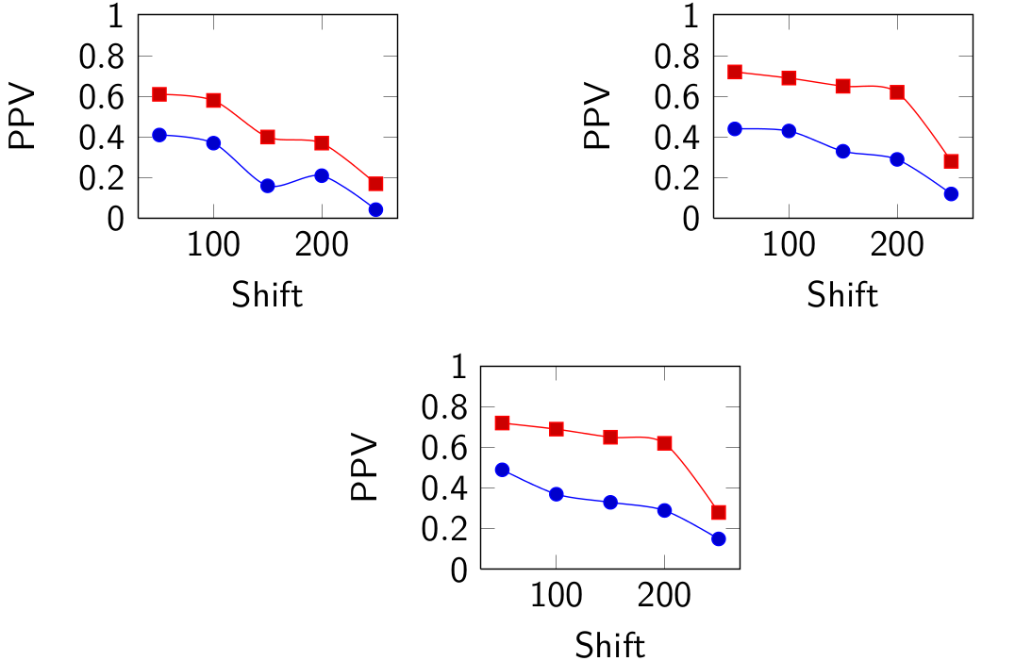
Positive Predictive Value
Notes:
69
69

Slide 70
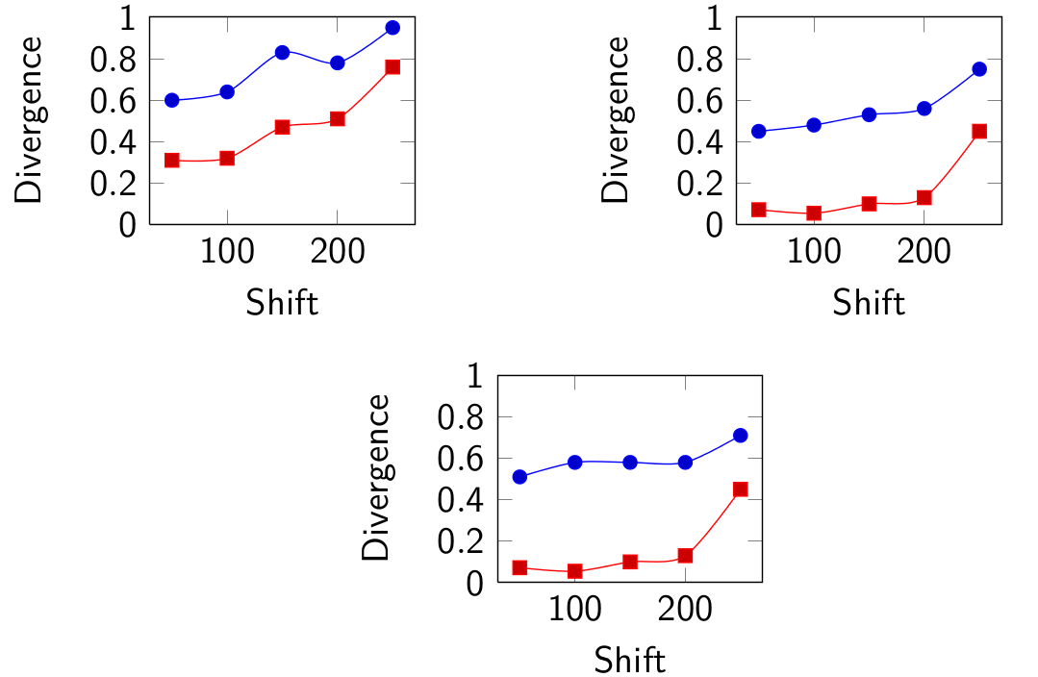
Jensen-Shannon Divergence
Notes:
70
70

Slide 71
Multi-commodity Flow Formulation
Max-Bandwidth is still not really “global” search
How can we find K paths at the same time?
Multi-commodity flows!

Slide 72
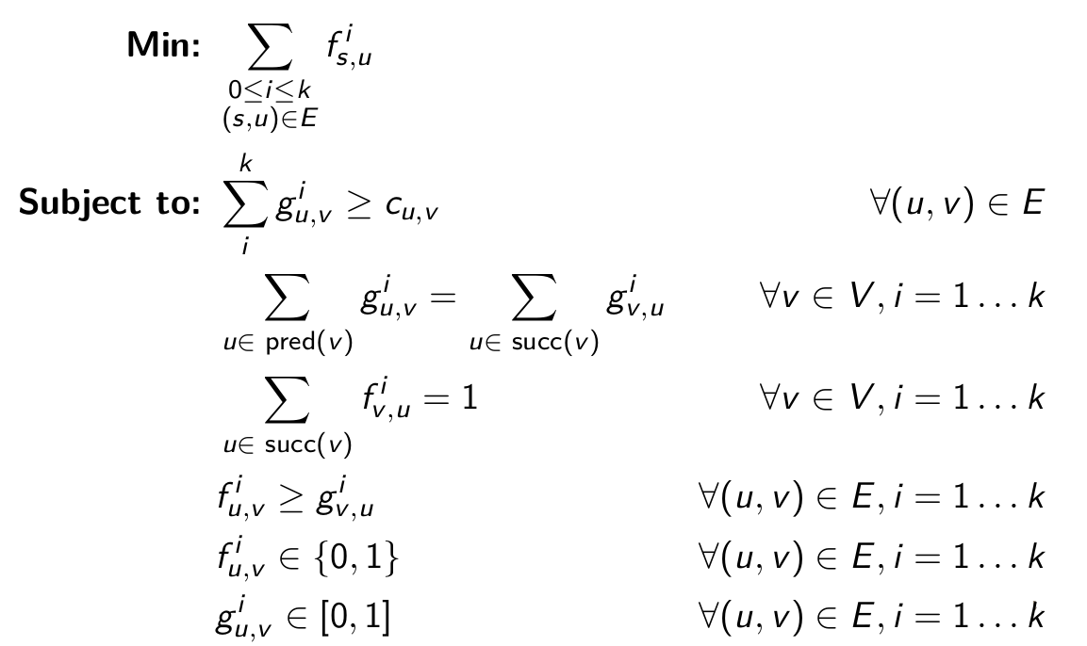
Multi-commodity Flow Formulation

Slide 73
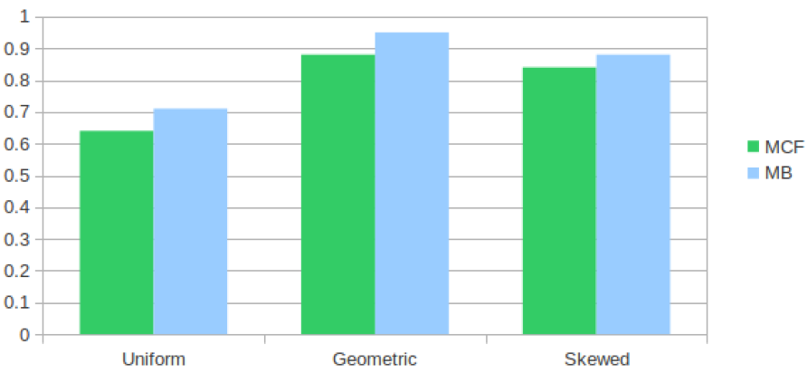
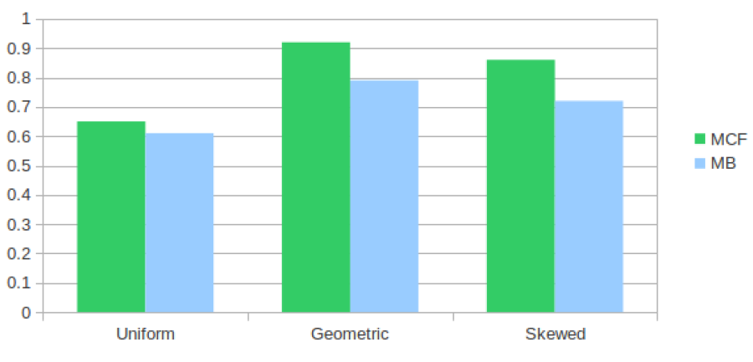
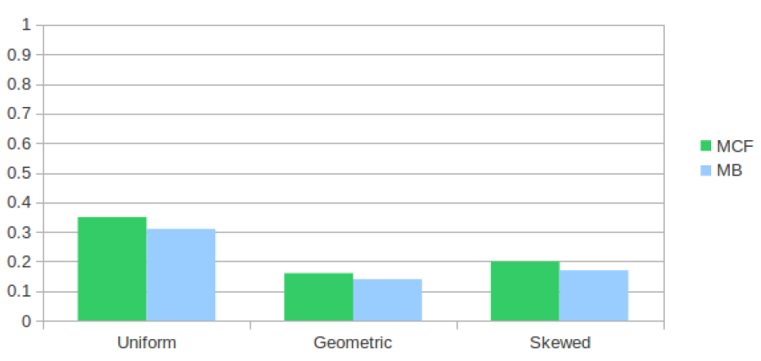
Preliminary Results
Notes:
73
73

Slide 74
Project Deliverables
  RNA-PhASE
  Sept: first plugin prototype
  Oct: livecall presentation
  Quasispecies reconstruction
  Oct: first plugin prototype
  Nov: livecall presentation
  Transcriptome reconstruction
  Nov: first plugin prototype
  Dec: livecall presentation

