Slide 1
CRC Project on Robust Transcript Discovery and Quantification from Sequencing Data
Dec. 22, 2011 live call
UCONN: Ion Mandoiu, Sahar Al Seesi
GSU: Alex Zelikovsky, Serghei Mangul, Adrian Caciula
Lifetech PI: Dumitru Brinza

Slide 2
Outline
SNV calling from RNA-Seq reads
Transcriptome reconstruction update

Slide 3
SNV Calling from RNA-Seq Reads
RNA-Seq typically used for gene expression analysis
SNV calling from RNA-Seq data?
Much less expensive than genome sequencing
Motivated by project in personalized genomic-guided immunotherapy, where we only need expressed variants
Notes:
3

Slide 4
Hybrid Approach Based on Merging Alignments
Transcript Library
Mapping
Transcript mapped reads
mRNA reads
Read Merging
Mapped reads
Genome Mapping
Genome mapped reads

Slide 5
Converting Transcriptome Alignments to Genome Coordinates
Transcriptome alignments
A
C
Convert to genome coordinates

Slide 6
Merging Rules for Short Reads
Genome | Transcripts | Agree? | Hard Merge
Unique | Unique | Yes | Keep
Unique | Unique | No | Throw
Unique | Multiple | No | Throw
Unique | Not Mapped | No | Keep
Multiple | Unique | No | Throw
Multiple | Multiple | No | Throw
Multiple | Not Mapped | No | Throw
Not mapped | Unique | No | Keep
Not mapped | Multiple | No | Throw
Not mapped | Not Mapped | Yes | Throw

Slide 7
Merging Local Alignments of ION Reads: HardMerge at Base-Level
Input: SAM files with alignments from genome and transcriptome mapping
The following alignments are filtered out
Any local alignments of length <= 15 bases
All alignments of read that has alignments on different chromosomes or different strands
Key idea: a read base mapped to multiple locations is discarded
Output alignments are generated from contiguous stretches of non-ambiguously mapped bases, based on the unique genomic location of these bases
Subject to the above filtering criteria

Slide 8
HardMerge Example
Input alignments in genome coordinates:
Filter multiple local alignments/sub-alignments
Output alignment:

Slide 9
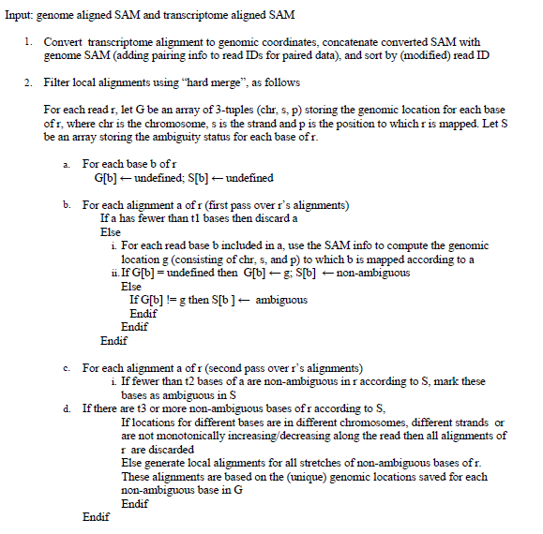
HardMerge

Slide 10
SNV Detection and Genotyping
Locus i
Reference
AACGCGGCCAGCCGGCTTCTGTCGGCCAGCAGCCAGGAATCTGGAAACAATGGCTACAGCGTGC
AACGCGGCCAGCCGGCTTCTGTCGGCCAGCCGGCAG
CGCGGCCAGCCGGCTTCTGTCGGCCAGCAGCCCGGA
GCGGCCAGCCGGCTTCTGTCGGCCAGCCGGCAGGGA
GCCAGCCGGCTTCTGTCGGCCAGCAGCCAGGAATCT
GCCGGCTTCTGTCGGCCAGCAGCCAGGAATCTGGAA
CTTCTGTCGGCCAGCCGGCAGGAATCTGGAAACAAT
CGGCCAGCAGCCAGGAATCTGGAAACAATGGCTACA
CCAGCAGCCAGGAATCTGGAAACAATGGCTACAGCG
CAAGCAGCCAGGAATCTGGAAACAATGGCTACAGCG
GCAGCCAGGAATCTGGAAACAATGGCTACAGCGTGC
R_{i}
r(i) : Base call of read r at locus i
ε_{r(i)} : Probability of error reading base call r(i)
G_{i} : Genotype at locus i

Slide 11
SNV Detection and Genotyping
Use Bayes rule to calculate posterior probabilities and pick the genotype with the largest one

Slide 12
SNVQ Model
Calculate conditional probabilities by multiplying contributions of individual reads

Slide 13
ERCC SNV Simulation
Random SNVs were inserted to the ERCC reference with probability 0.005
The modified ERCC sequences were appended to the reference genome
For each ERCC, one exon transcript annotation where added to the Ensembl64 transcript library (GTF).
tmap indices where for the reference genome and transcriptome including the ERCCs with the simluated SNVs

Slide 14
HBR Sample Statistics

Slide 15
UHR Sample Statistics

Slide 20
Comparing SNVQ & Samtools on HardMerge Alignments

Slide 21
Comparing SNVQ & Samtools on HardMerge Alignments

Slide 22
Whole Transcriptome Comparison on NA12878 Illumina Reads

Slide 23
Plugin Interface

Slide 24
Plugin Output

Slide 25
Outline
SNV calling from RNA-Seq reads
Transcriptome reconstruction update

Slide 26
Challenges and Solutions
Challenge: Read lengths are currently much shorter then transcripts length
Phasing “free” exons(no direct evidence from reads) during assembly is challenging
Solutions : Statistical reconstruction method
fragment length distribution

Slide 27
1
2
3
4
5
6
7
Candidate Transcripts:
t₁ :
1
2
3
4
5
6
7
t₂ :
1
3
4
5
6
7
t₃ :
1
2
3
4
5
7
t₄ :
1
3
4
5
7
Exon 2 and 6 are “free” exons : no direct evidence from reads

Slide 28
ILP based Transcriptome Reconstruction from PE reads
SE(from PE)
Splicing Graph : candidate transcripts
PE
ILP based filtering of candidate transcripts

Slide 29
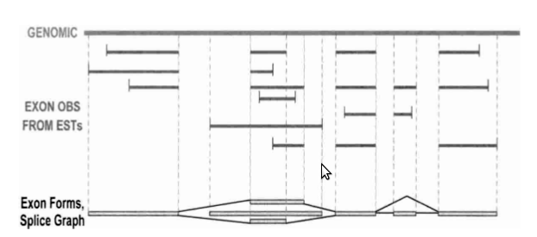
Splicing Graph
Genome Research(2004) : The Multiassembly Problem: Reconstructing Multiple Transcript Isoforms From EST

Slide 30
Naive ILP formulation
Variables:
y(t) = 1 iff candidate transcript t is selected, 0 otherwise
x(p) = 1 iff the pe read p is mapped within 1 std. dev.
Objective:
Constraints:
(1)
(2)
for each read p_{j} at least one transcript is selected
number of reads mapped within 1 std. dev. ~68%

Slide 31
Sophisticated ILP Formulation
Consider reads mapped within >1 std.dev.
Integrate reads with different fragment length
Prepare libraries with different insert sizes
reduce number of “free” exons

Slide 32
Preliminary results
 | Spec | PPV
2 | 0.73 | 0.95
3 | 0.66 | 0.92
Note : results are on ~20% of UCSC genes

