Slide 1
CRC Project on Robust Transcript Discovery and Quantification from Sequencing Data
Oct. 7, 2011 live call
UCONN: Ion Mandoiu, Sahar Elsisi
GSU: Alex Zelikovsky, Serghei Mangul, Adrian Caciula
Lifetech PI: Dumitru Brinza

Slide 2
Outline
IsoEM plugin for accurate prediction of transcription level
Results on ION data
Comparison to other tools and platforms
Progress on transcript reconstruction
Feedback on plugin development and deployment on VM

Slide 3
Outline
IsoEM plugin for accurate prediction of transcription level
Results on ION data
Comparison to other tools and platforms
Progress on transcript reconstruction
Feedback on plugin development and deployment on VM

Slide 4
IsoEM: Isoform Expression Level Estimation
Expectation-Maximization algorithm
Unified probabilistic model incorporating
Single and/or paired reads
Fragment length distribution
Strand information
Base quality scores
Repeat and hexamer bias correction

Slide 5
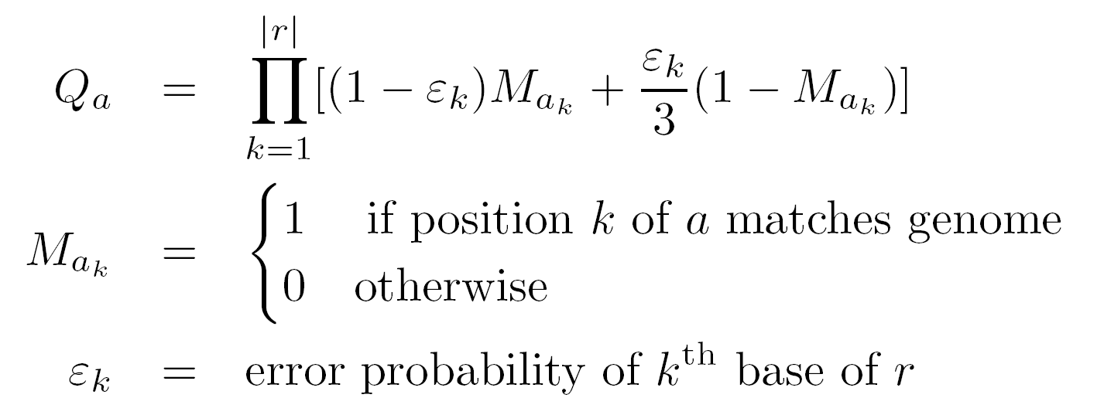
Read-isoform compatibility graph

Slide 6
Fragment length distribution
Paired reads
F_{a}(i)
i
A
A
A
B
B
B
C
C
C
j
A
A
A
C
C
C
F_{a} (j)

Slide 7
Fragment length distribution
Single reads
i
A
A
A
B
B
B
C
C
C
j
A
A
A
C
C
C
F_{a}(i)
F_{a} (j)

Slide 8
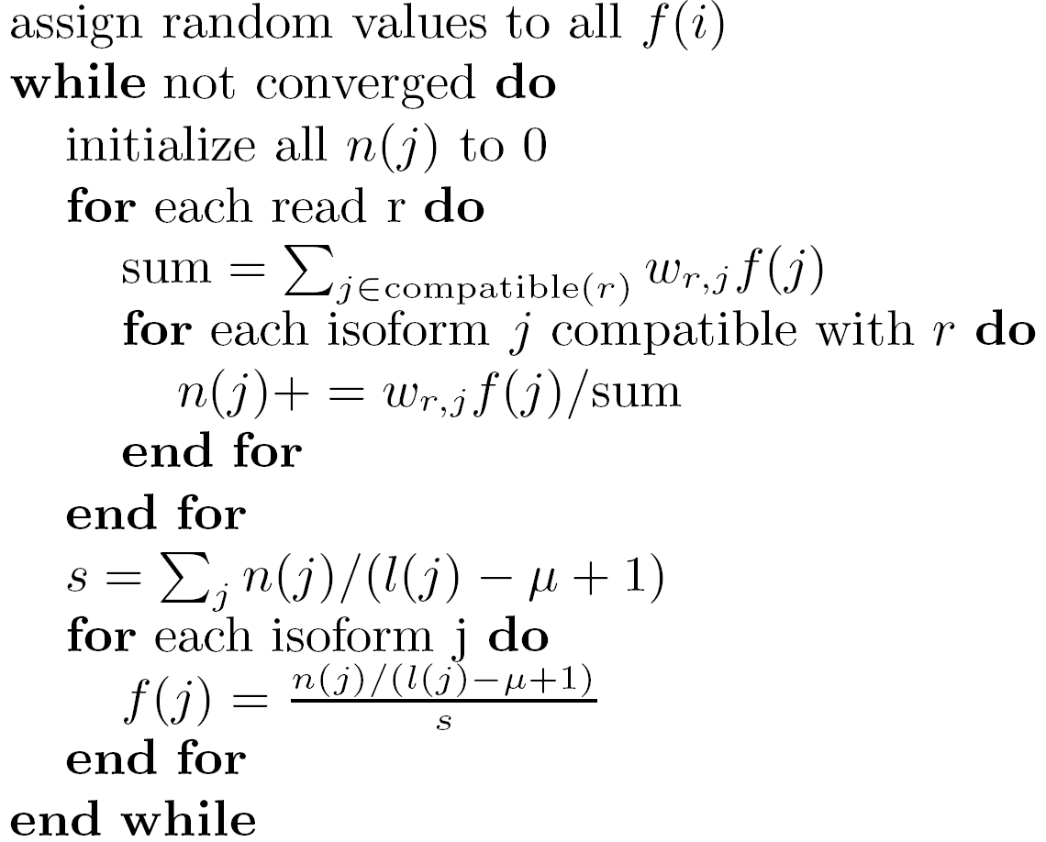
IsoEM pseudocode
E-step
M-step

Slide 9
IsoEM Plugin

Slide 10
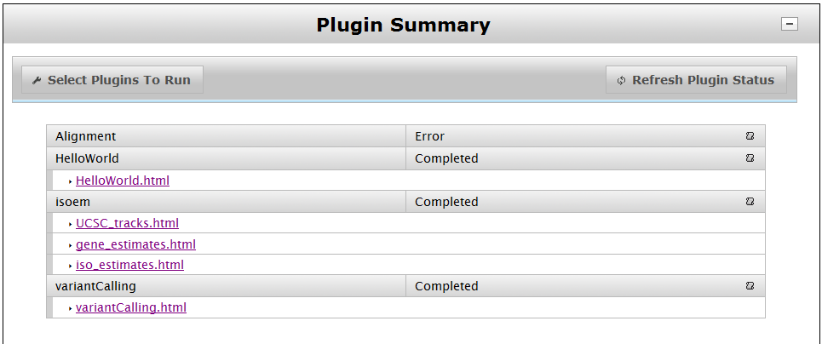
IsoEM Plugin Outputs

Slide 11
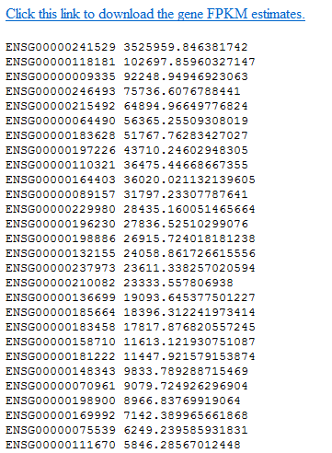
IsoEM Plugin Outputs: FPKM estimates

Slide 12
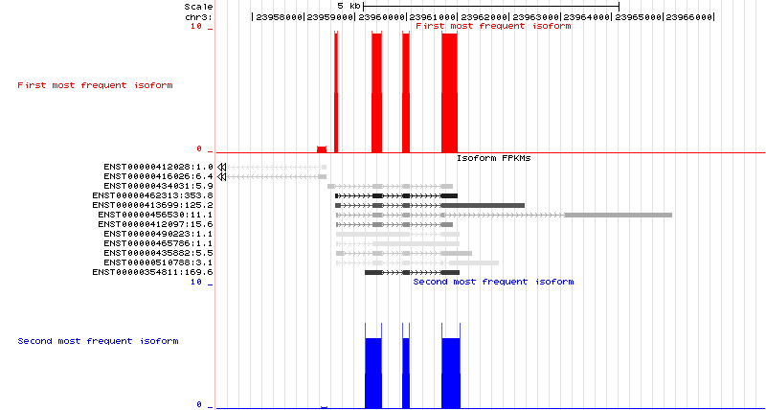
IsoEM Plugin Outputs: UCSC tracks

Slide 13
Outline
IsoEM plugin for accurate prediction of transcription level
Results on ION data
Comparison to other tools and platforms
Progress on transcript reconstruction
Feedback on plugin development and deployment on VM

Slide 14
MAQC data
2 RNA samples: UHRR, HBRR
5 ION runs each
Gold standard
Gene expression levels measured in quadruplicate by qPCR for 832 Ensembl genes [MAQC Consortium 06]

Slide 15
IsoEM results on ION HBR runs

Slide 16
IsoEM results on ION UHR runs

Slide 17
Outline
IsoEM plugin for accurate prediction of transcription level
Results on ION data
Comparison to other tools and platforms
Progress on transcript reconstruction
Feedback on plugin development and deployment on VM

Slide 18
IsoEM vs. Cufflinks 1.0.3 on ION reads

Slide 19
HBR GOG-139_281

Slide 20
HBR DID-143_282

Slide 21
UHR POZ-127_270

Slide 22
UHR DID-144_283

Slide 23
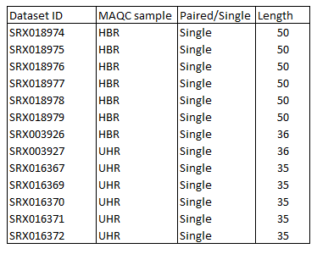
MAQC Illumina datasets

Slide 24
R² of IsoEM estimates from ION & Illumina HBR reads
Average R² for 5 ION Torrent MAQC HBR Runs (avg. 1,559,842 reads)
R² for combined reads from 5 ION Torrent MAQC HBR Runs (7,799,210 reads)

Slide 25
R² of IsoEM estimates from ION & Illumina UHR reads
Average R² for 5 ION Torrent MAQC UHR Runs (average 1,941,663 reads)
R² for combined reads from 5 ION Torrent MAQC UHR Runs (9,708,315 reads)

Slide 26
Outline
IsoEM plugin for accurate prediction of transcription level
Results on ION data
Comparison to other tools and platforms
Progress on transcript reconstruction
Feedback on plugin development and deployment on VM

Slide 27
Virtual Transcript Expectation Maximization (VTEM)
(Partially) Annotated
Genome
+ Virtual Transcript
with 0-weights
in virtual transcript
ML estimates
of transcript
frequencies
Update weights
of reads in
virtual transcript
EM
EM
Virtual Transcript frequencychange>ε?
Output
overexpressed
exons
Compute
expected exons
frequencies
NO
YES
*

Slide 28
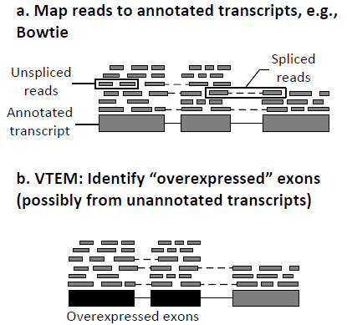
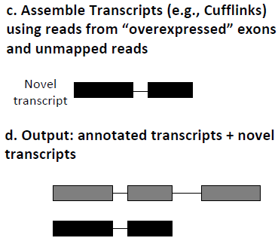
Discovery and Reconstruction of Unannotated Transcripts (DRUT)

Slide 29
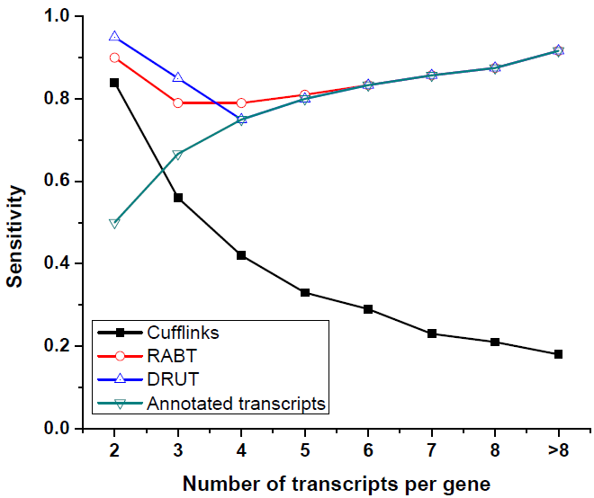
Experimental results

Slide 30
Outline
IsoEM plugin for accurate prediction of transcription level
Results on ION data
Comparison to other tools and platforms
Progress on transcript reconstruction
Feedback on plugin development and deployment on VM

Slide 31
What we would have liked…
Available RNA-Seq runs on the demo VM
Documentation for XML tag sets used in instance.html
Installed plugins that run without errors on demo data
Remote access to production Torrent server dedicated to plugin developers
Running tests on VM is very slow

Slide 32
Work in progress for IsoEM plugin v.2
More genomes/transcript libraries
Expose more options to the user
Read mapping algorithm
Filtering of local alignments
Hexamer bias correction
Quality scores
Inference of fragment length distribution (for PE data)
Bias correction using ERCC
Inference of allele specific isoform expression (requires RNA-Seq SNP calling plugin)

